Slide 1
Laser
Subtitle of Presentation
Ingmar Hartl, Dec 7, 2017

Slide 2
Requirements
Peak power: > 10²⁰ W/cm²
Pulse duration: Matched to electron beam (10 -100 fs ? FWHM) Q: How is the interaction geometry (head on?)
Wavelength: not critical, NIR (800nm or 1µm) is OK.
Beam size: ? 30µm
Repetition rate: 1 Hz ? (this is the cost driver !)

Slide 3
NAS Petawatt report is out since yesterday..

Slide 4
The Mourou plot (Moor’s law for lasers)

Slide 5
Back of the envelope calculations
With the 200TW Angus laser at DESY
http://lux.cfel.de/angus-laser-system/
we can get with a 2m focusing optics 10ˆ19 W/cmˆ2 in 30um focus with 5 Hz repetition This is a very solid number confirmed by the current performance of the laser.
So you need 2 orders of magnitude more. I would suggest to get x10 laser energy (2PW) and a 10x smaller focus area (this corresponds roughly your 10um spot size) and reduce the repetition rate to 1Hz (higher is too expensive).
For example LBNL has a 1 PW, 1Hz laser based on the same technology as ours from the same vendor (Thales).
http://bella.lbl.gov/facilities/bella-center-facilities-bella-laser/

Slide 6
Available Laser Technology

Slide 7
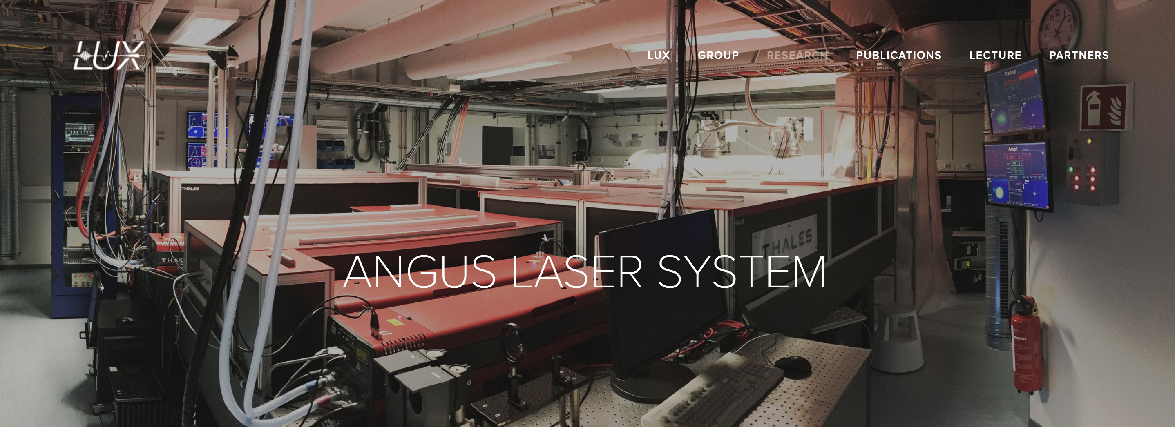
DESY’s ANGUS laser
http://lux.cfel.de/angus-laser-system/

Slide 8
10 PW system for ELI

Slide 9
PW lasers worldwide

Slide 10
PW lasers worldwide (Ti:sapphire)

Slide 11
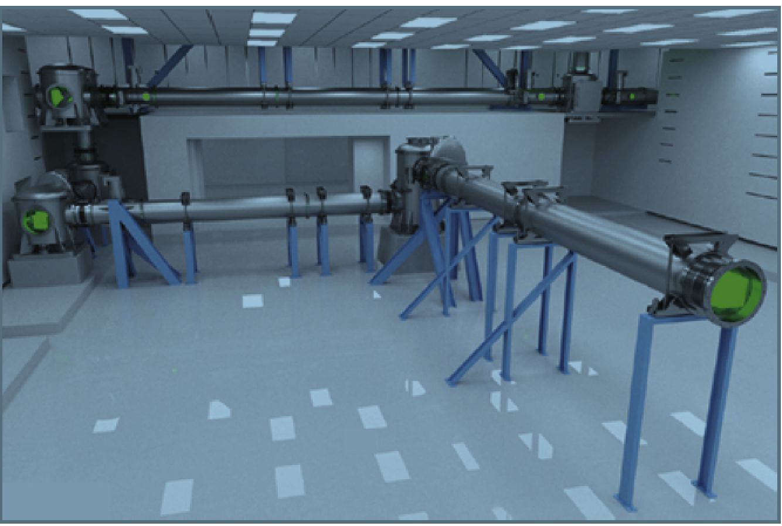
Beam transport

Slide 12
Cost
This is at the edge of current commercially available technology, but should work. Remember: even if you purchase a commercial system you need a lot of effort (e.g. several people) to get this up to specs, and daily operating.
The cost for the Angus 200kW laser is about 3.5 MEuro for the laser system + 1MEuro for lab + beamline (assuming the building is already there and the beamline is reasonable short).
For a 2PW system you are looking at significant more money I guess in the order of 10MEuro. We could ask some people we know who are currently pursuing to purchase such systems - please let me know if this is what you would like us to do.

