Slide 1
Detecting things to measure stuff
Moritz Guthoff
FH Fellow Day
1st Feb 2019

Slide 2




Journeyman years I
Internship at Philips Research
Diploma thesis
at KIT Karlsruhe
PhD at CERN & KIT
Positron Emission Tomography
Characterization of SiPM
Performance analysis of LYSO+SiPM detectors
Time resolution in coincidence measurements.
Fast X-ray detection for stroke volume measurements in mouse hearts.
  Fast X-ray shutter.
  Measurement control and data acquisition.
  Picture processing and pattern recognition
  X-ray spectroscopy
  Geant4 simulations.
Radiation damage to diamond based beam monitoring
  Beam Loss Monitoring detector data analysis
  Radiation damage in diamond detectors in high rate environments.

Slide 3


Journeyman years II
Fellowship at CERN
Fellowship at DESY
FLUKA radiation simulation
  CMS upgrade, for the phase-2 Technical Proposal
  Beam induced background and damage to CMS tracker
  Simulation toolkit for CMS opening scenarios.
Understanding and mitigating HV stability issues of the BCM1F
  Construction of replacement detector
  CMS BRIL Detector Performance Group convener
    Luminosity calibration
  BCM1F detector operations
  BCM1F for Run-3 development
  CMS phase-2 Tracker upgrade.
    Assembly and integration
BCM1F: Fast Beam Condition Monitor

Slide 4
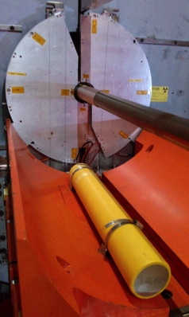
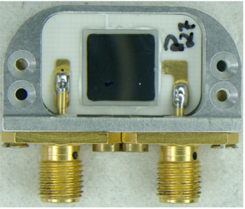
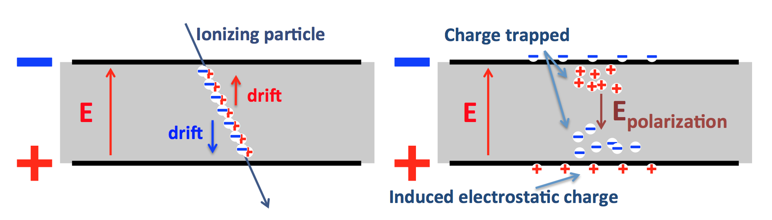
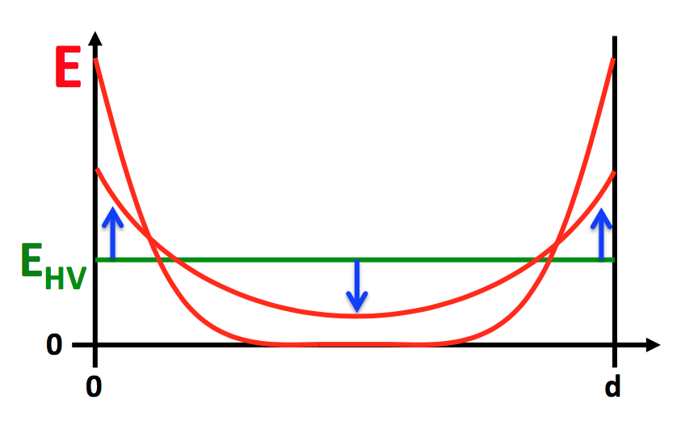
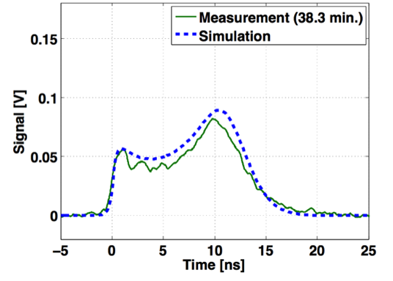
Diamond radiation damage
BCML for Tracker protection
Radiation degradation more severe in operation compared to lab tests
Expected
Relative efficiency [%]
Measured
24 GeV proton equivalent fluence
TCT measurements reveal electric field deformation.
TCT measurement
Radiation defects create space charge
  Polarization of the detector bulk

Slide 5
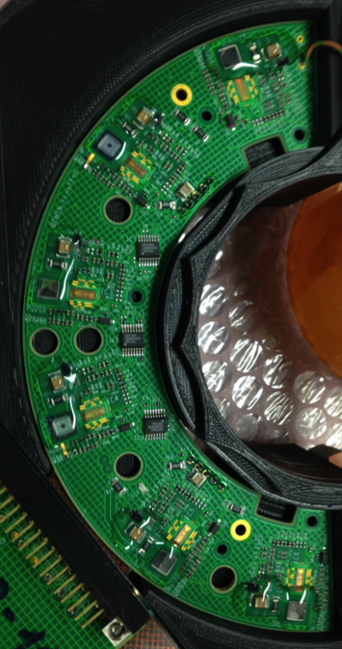
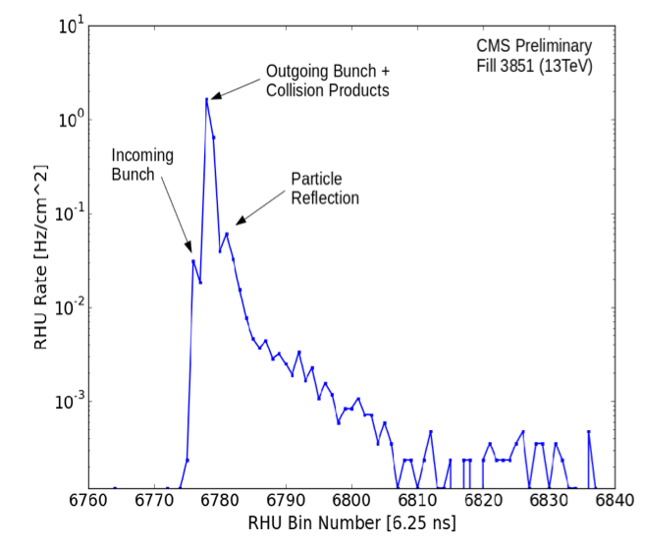
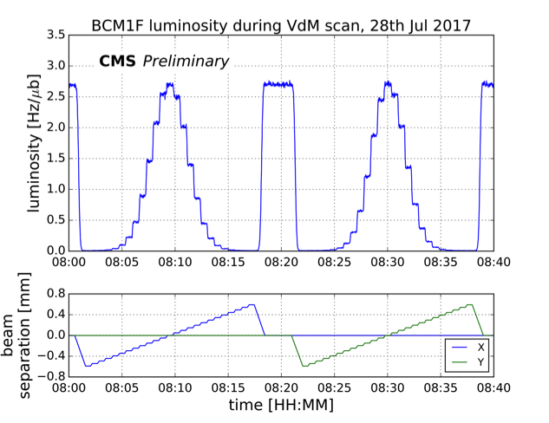
Luminosity measurement
Detect it … → BCM1F detector system
Calibrate it … → Van der Meer scans
Lumi
~ 100 m
BIB
Metallization
Optical signal output
afterglow
Diamond
Analog to optical signal conversion
Fast front end amplifier
High Voltage
Ionizing particle
Optical receiver
Discriminator
Realtime Histogramming Unit
6.25 ns time resolution
LHC parameters & measurement
VdM measurement of beam overlap

Slide 6
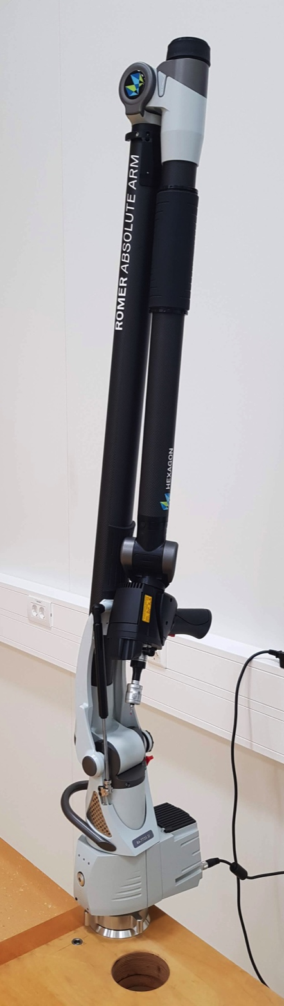
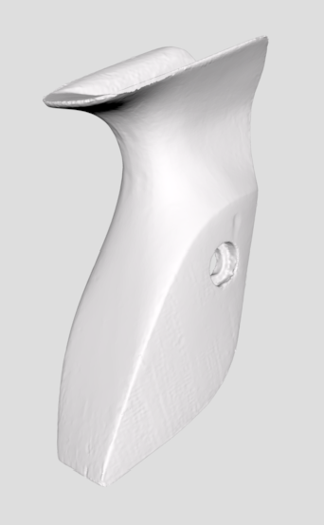
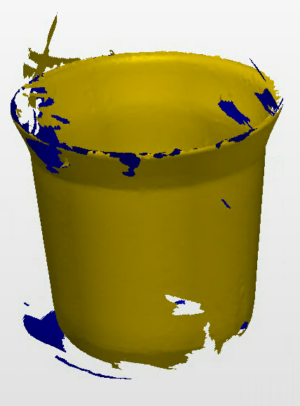
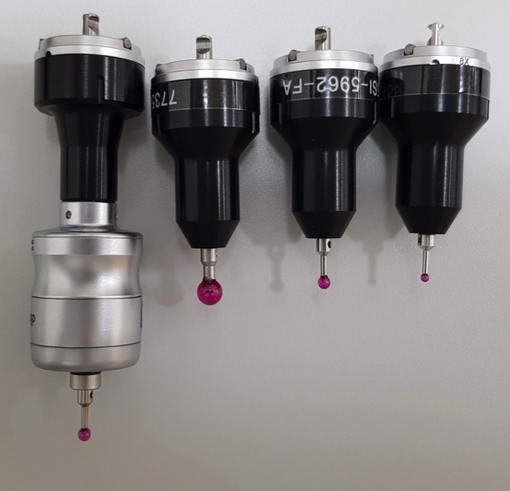
Work related to Tracker upgrade
Mostly involved in designing concepts for the assembly and integration of the CMS phase-2 Tracker endcap.
My currently favorite instrument: Metrology arm.
  Precise measurement of positions and dimensions.
  3D laser scanner
6mm 3mm 2mm
Auto trigger

Slide 7
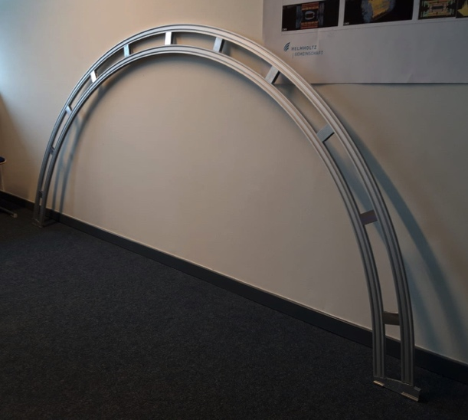
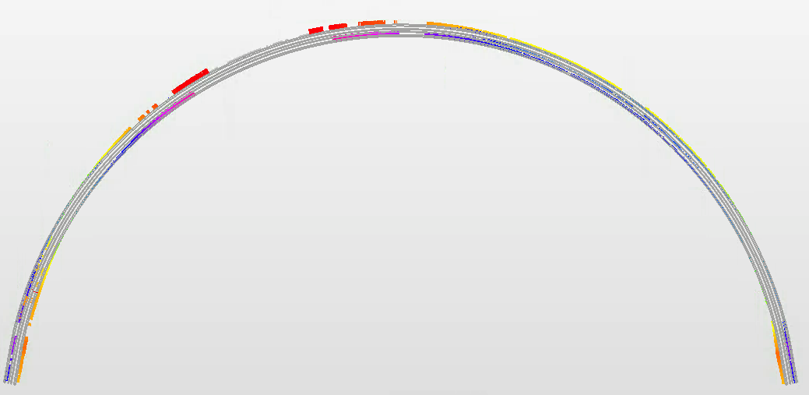
An actually useful measurement
ARC frame to hold TEDD Dees:
3D fit of point cloud to CAD model
Deviation of actual shape from ideal curve.
  Maximum about 4 mm.
~ 2.6 m

Slide 8
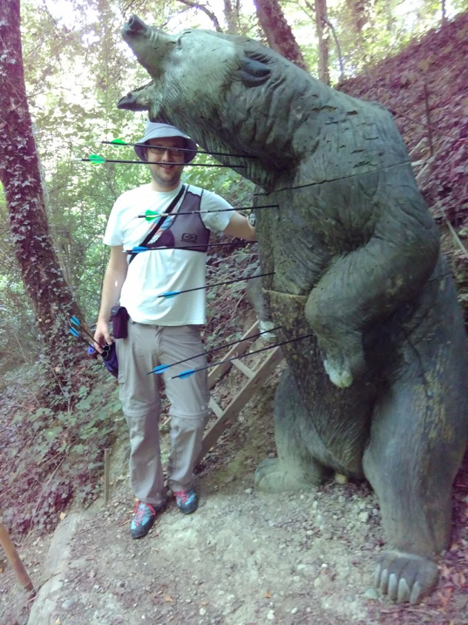
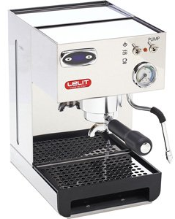
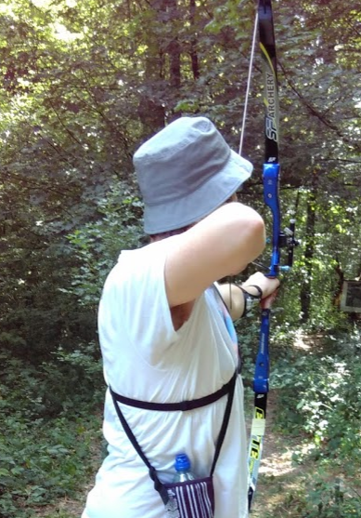
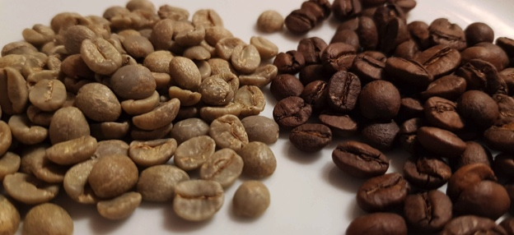
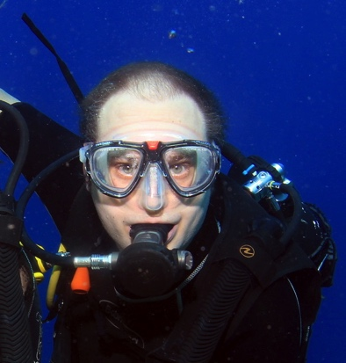
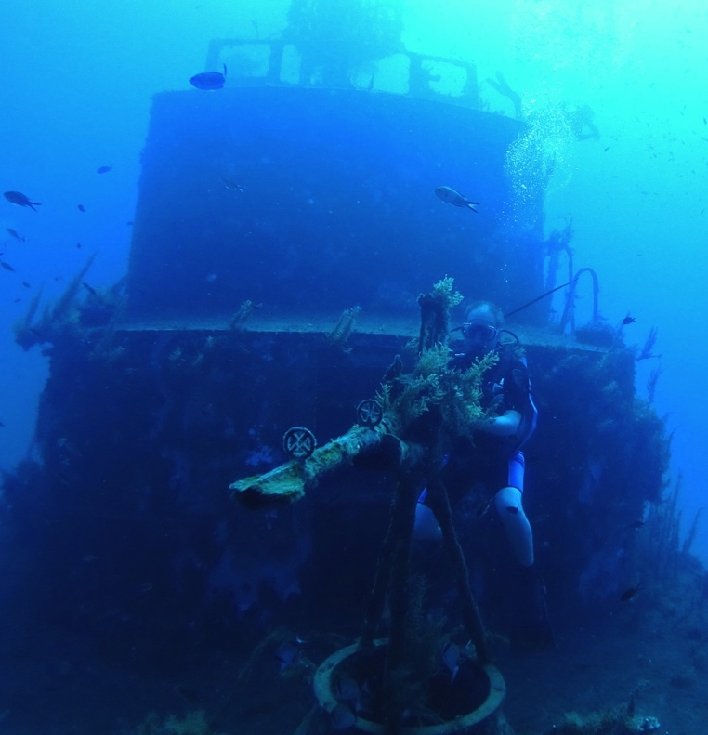
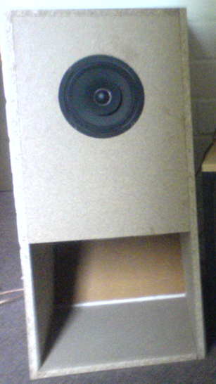
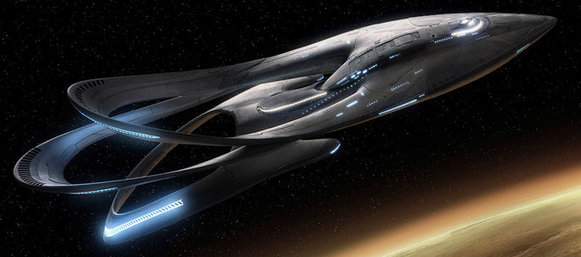
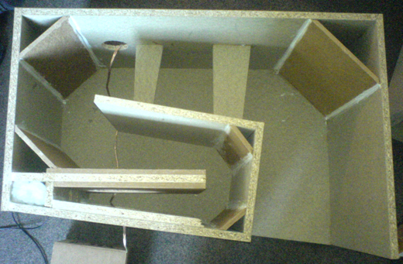
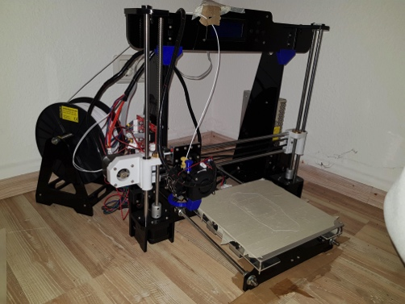
What else do I enjoy?

