Slide 1
ALPS IIc Vacuum system
ALPS collaboration meeting
Jan 22th 2020
S. Lederer, A. de Zubiaurre Wagner

Slide 2
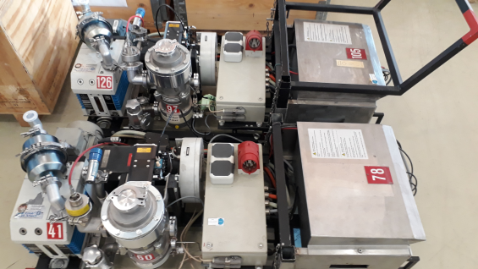
Isolation vacuum
Transfer line between HERA-W and HERA-NL (1.5 km)
Dipoles
Dipoles
8 pump isolation vacuum pump carts for the transfer line and the experiment
Transfer line separated by vacuum barriers
Shortened by bridge valves
Permission from cryogenics group to operate the whole isolation vacuum system as one sector, so NO control of the valves required

Slide 3
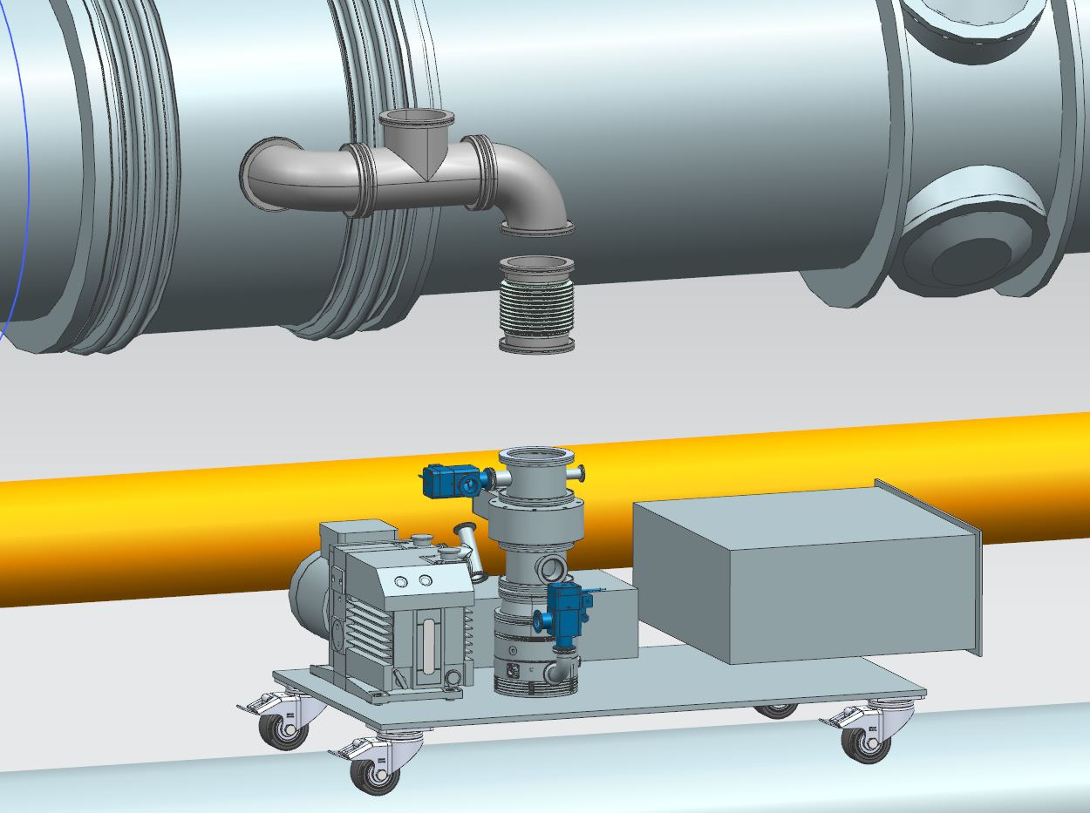
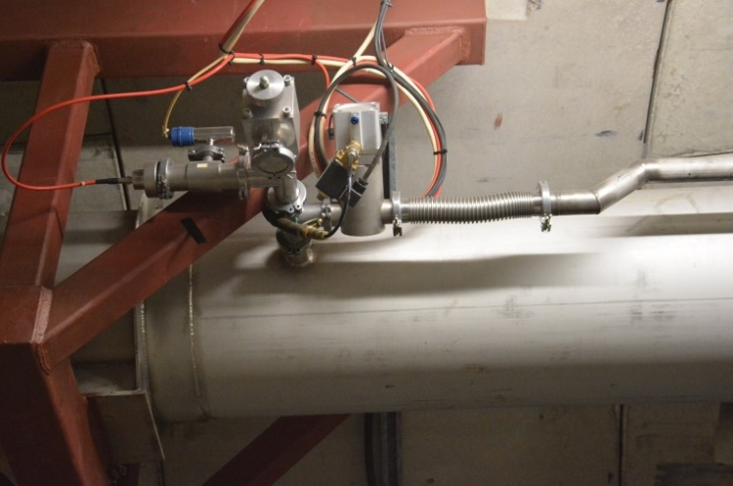
Isolation vacuum
Transfer line between HERA-W and HERA-NL (1.5 km)
Start refurbishment February 2020
Dipoles
Dipoles

Slide 4
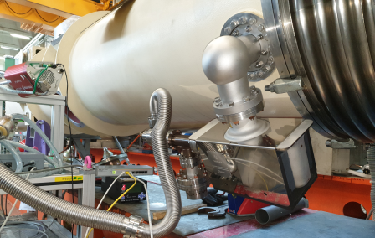
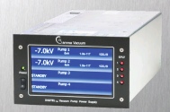
Pumping
Initial pump down by UHV pump cart
Normal pumping by means of sputter ion pumps ( ) with 55 – 75 l/s pumping speed
High voltage cable length of about 100 m no problem
Max. 4 pumps planned – only one controller necessary, e.g. QPC from gamma vacuum
Remote control via Ethernet
Integration into doocs-controls easy since already available at DESY
Test installation of an SIP on a BRP dipole at the test stand
Picture from Gamma vacuum, document 900031, Rev G

Slide 5
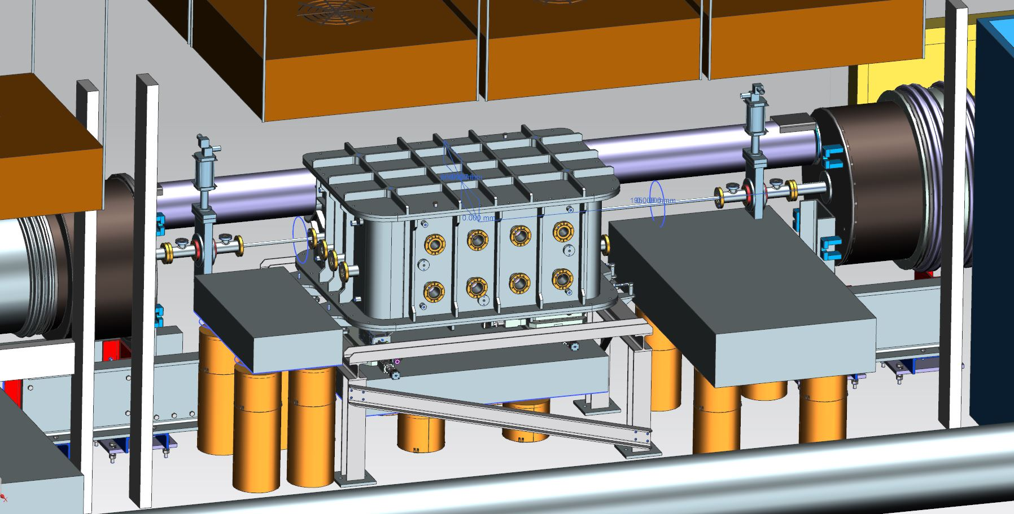
Central Chamber

Slide 6
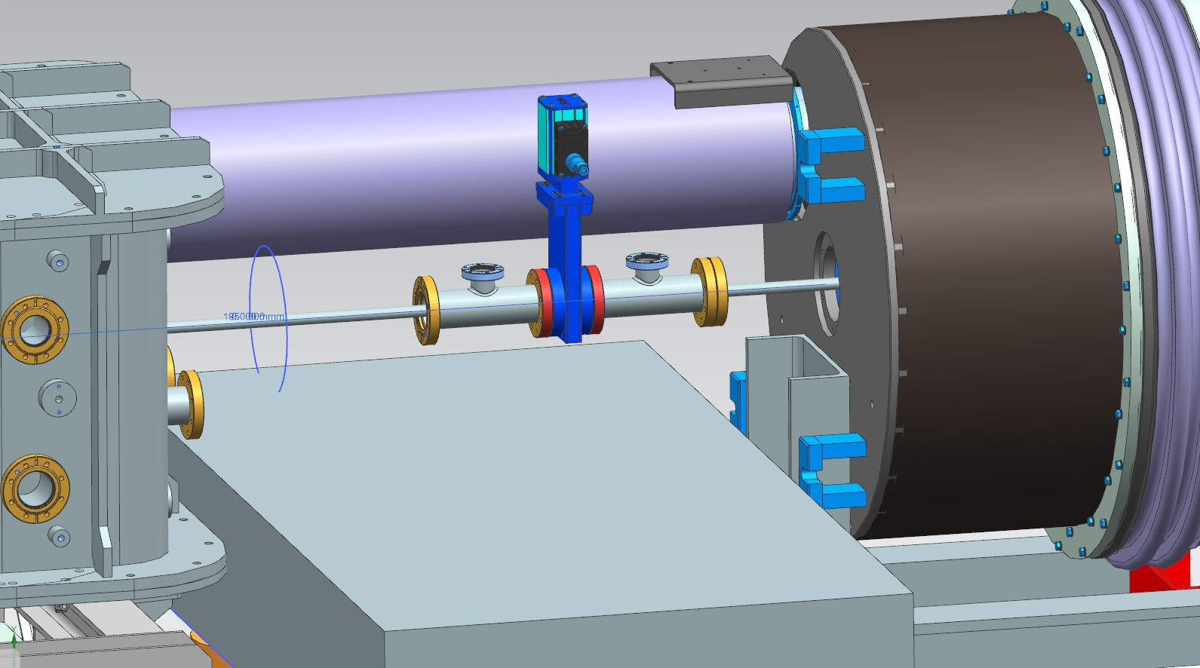
Central Chamber

Slide 7
Pumping
Regeneration side
During the experiment the cold dipoles are utilized as cryo pumps
One permanent, remote controllable UHV pump cart for initial pump down and as back-up

Slide 8
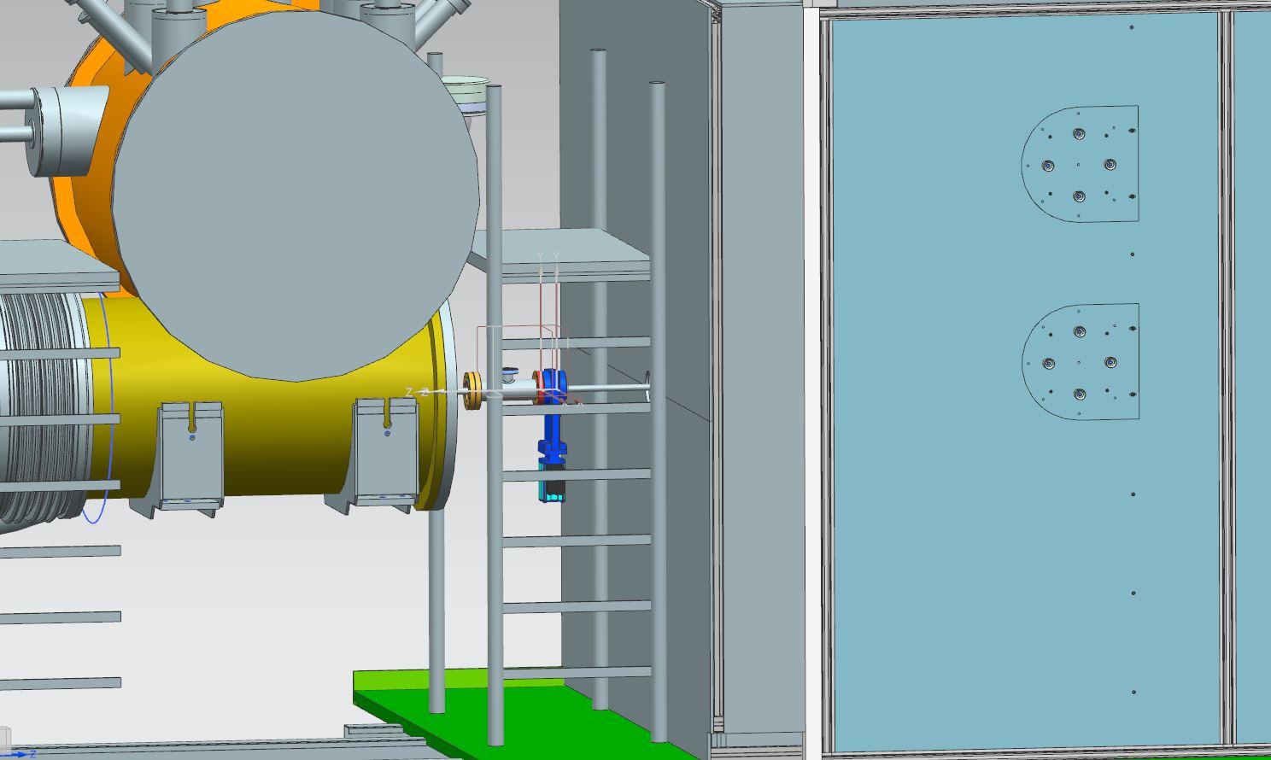
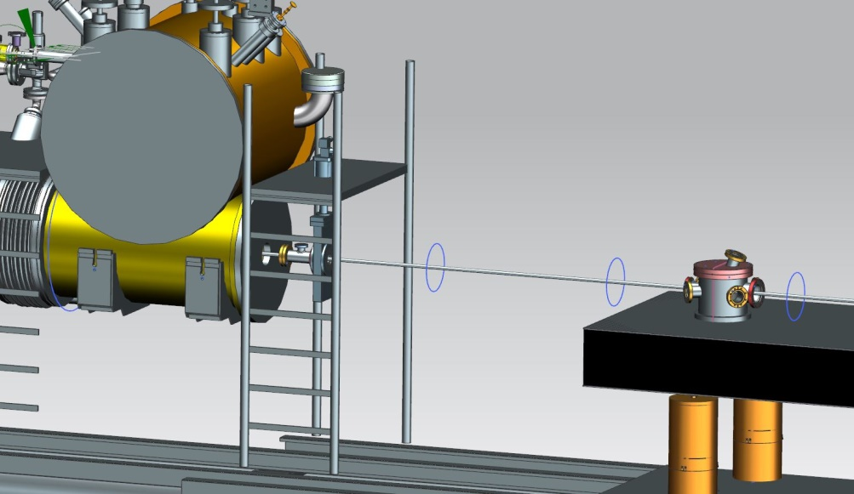
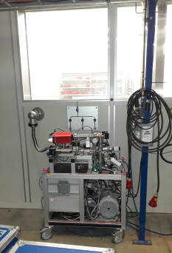
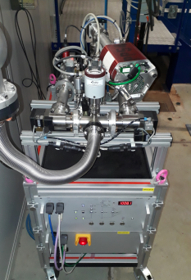
Regeneration side
Pump cart + slow venting / pumping unit at the DESY clean room for SRF cavities

