Slide 1
1.3 GHz Phase Averaging Reference Line
Ed Cullerton, Brian Chase
Fermilab, Batavia, IL
10/18/2001

Slide 2
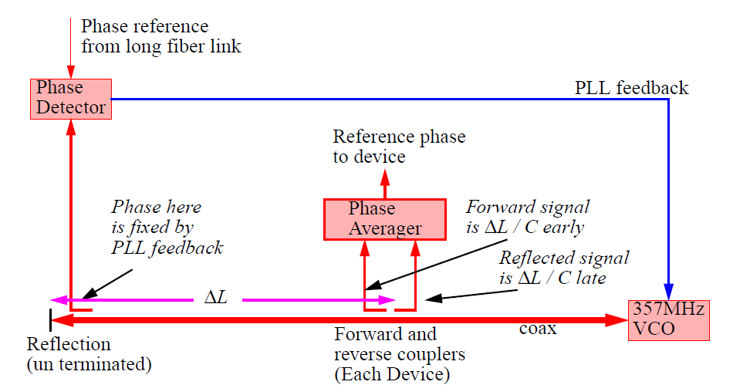
Design Concept
Original design concept from J. Frisch, D. Brown, and E. Cisneros in their paper titled, “Performance of the Prototype NLC RF Distribution System”

Slide 3
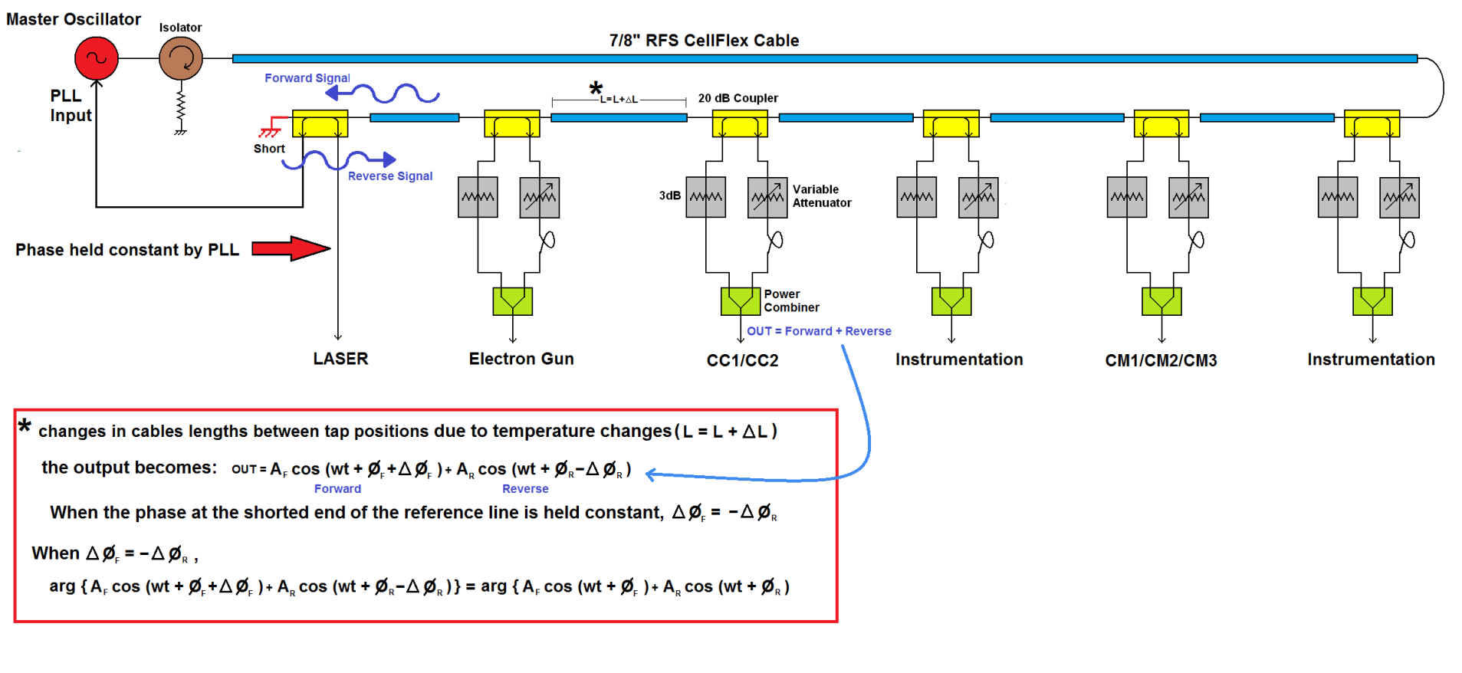
1.3 GHz Phase Averaging Reference Line for Fermilab SRF Beam Test Facility
Notes:
Lab measurements done with a scaled version of the reference line. (long 7/8” inch RFS cable replaced with short 0.141 cable with similar temperature characteristics)

Slide 4
Design Limitations
The performance of the reference line will be limited by two key factors:
Impedance mismatches between the directional coupler and the coaxial line.
Phase drifts in the combiner circuit.
*Careful selection of each part must be made!

Slide 5
Design Goals and Procedure
The design goal is to minimize phase drift between taps vs temperature.
A design procedure has been developed that minimizes the phase drift between taps of the reference line by adjusting the cable length between directional couplers so that the averaged signals are on a peak of the phase ripple caused by reflections and impedance mismatches.
The phase drift due to the combiner circuit can be minimized by good part selection and proper arrangement of each component.

Slide 6
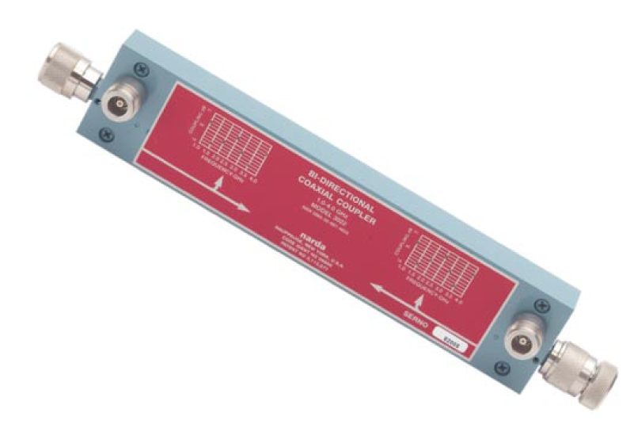
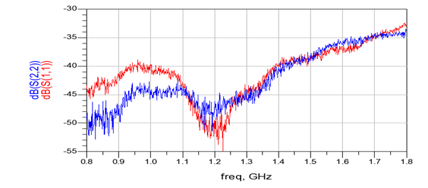
Directional Coupler Selection
Narda 3022 20 dB directional coupler
VSWR < 1.05
Directivity > 35 dB
Typical Narda 3022 Return Loss

Slide 7
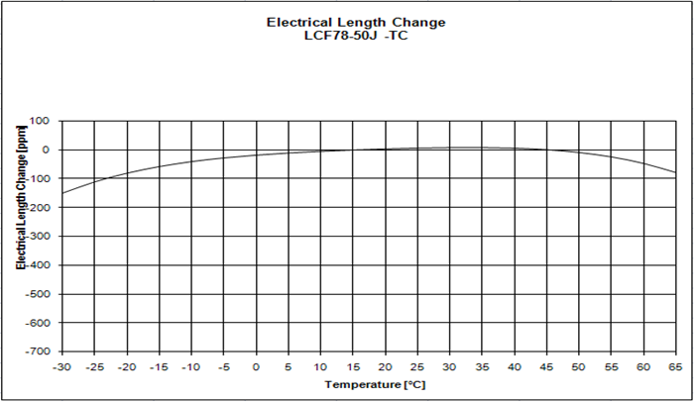
Cable Selection
RFS LCF78-50J 7/8” Coaxial cable

Slide 8
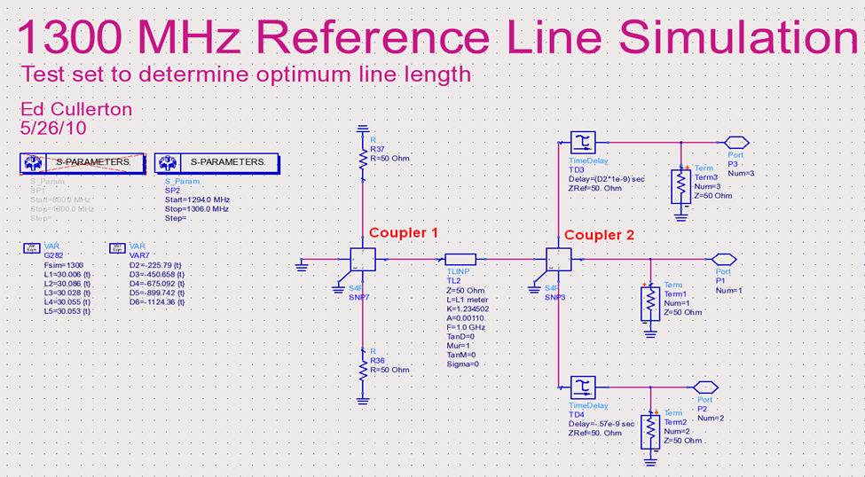
Design Procedure Simulation

Slide 9
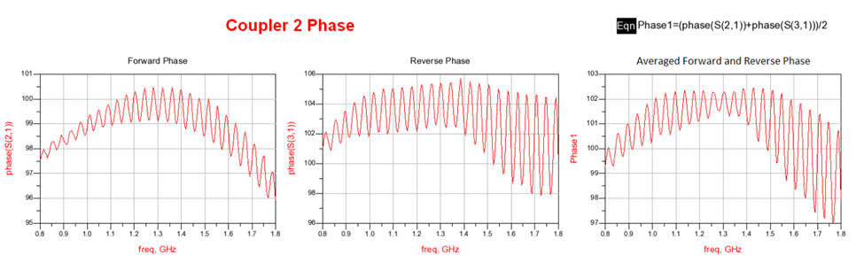
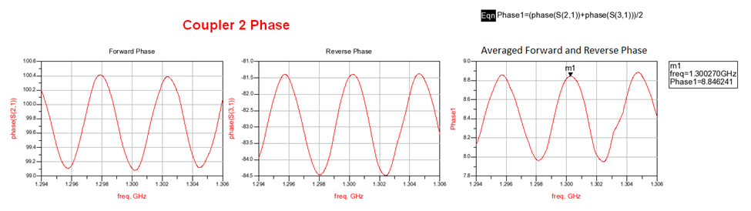
S-parameter Results of Simulation
Broadband phase – the phase is flattened at 1.3 GHz by adjusting the time delay on the forward and reverse measurement ports.
Narrow band phase – observe that the peak of the averaged phase ripple is not at 1.3 GHz.

Slide 10
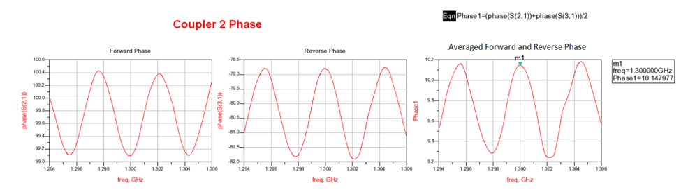
Cable Adjustment Result
The averaged phase is on the peak at 1.3 GHz. This will minimize the phase error for small changes in length of the cable.

Slide 11
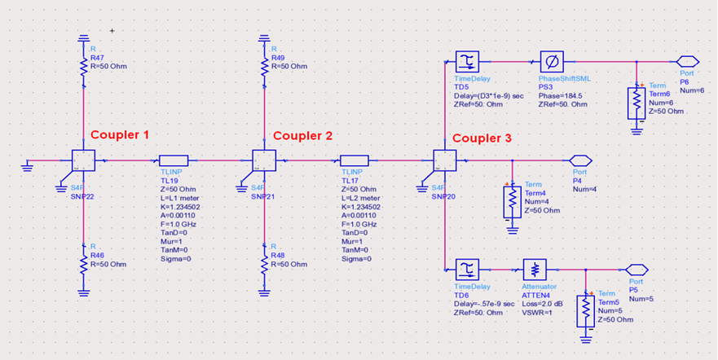
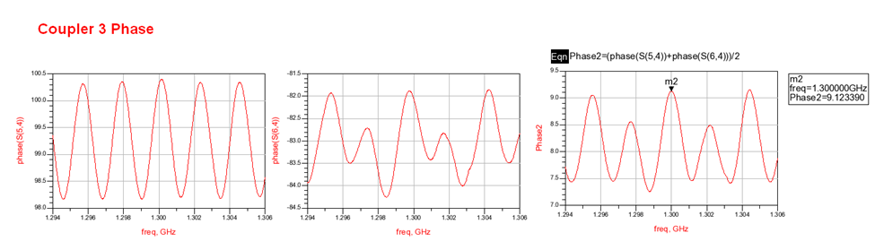
Design Procedure Continued
Adjust the cable length between coupler 2 and 3

Slide 12
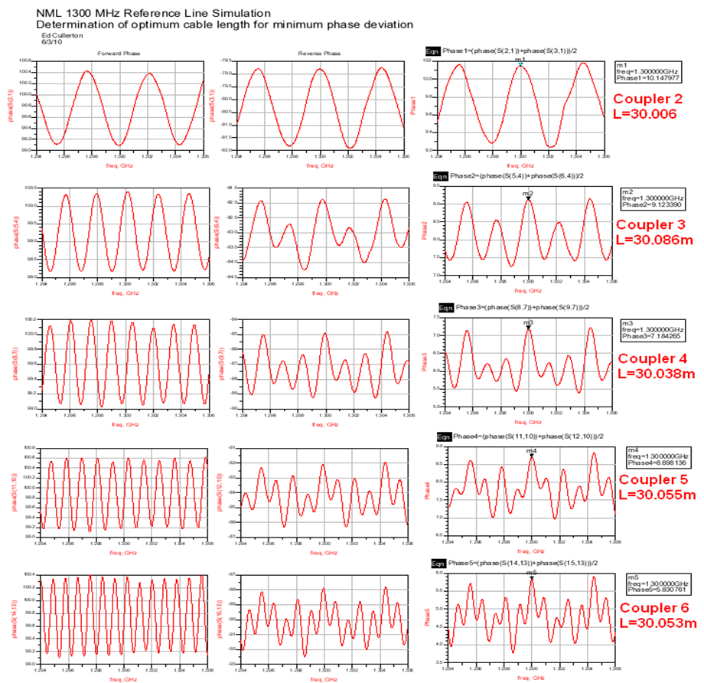
Design Procedure Simulation
The procedure is continued for each coupler in the reference line.

Slide 13
Complete Reference Line Simulation with Adjusted Cables

Slide 14
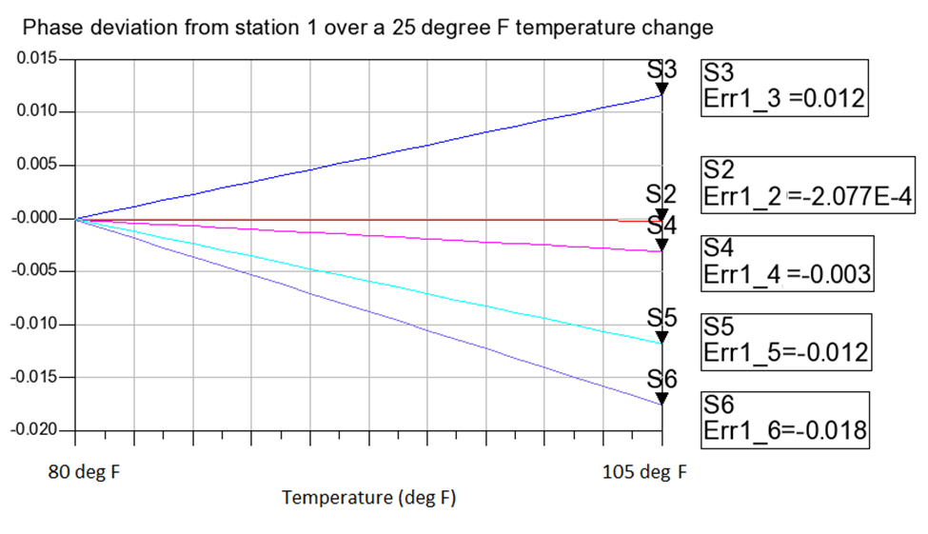
Simulation Results
Phase (degrees)

Slide 15
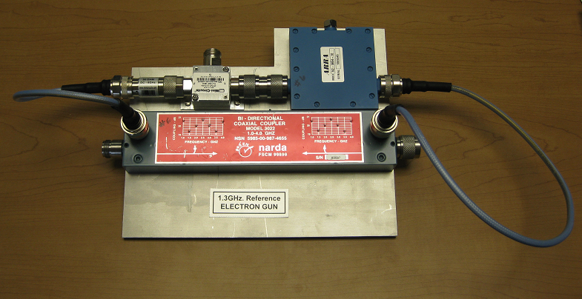
Combiner Circuit

Slide 16
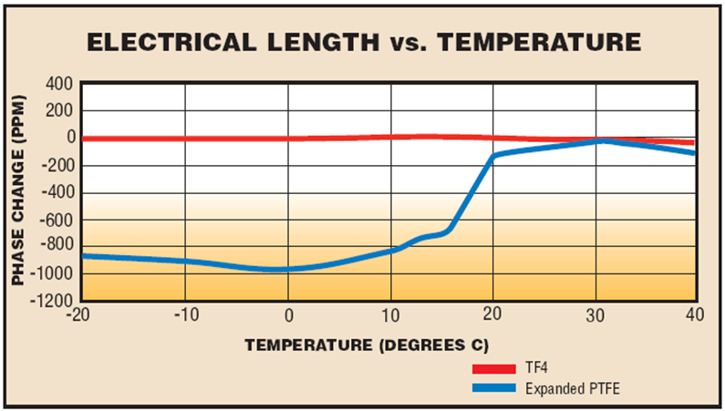
Combiner Circuit Coax Cable Selection
Times Microwave Phasetrack 210 coax cable

Slide 17
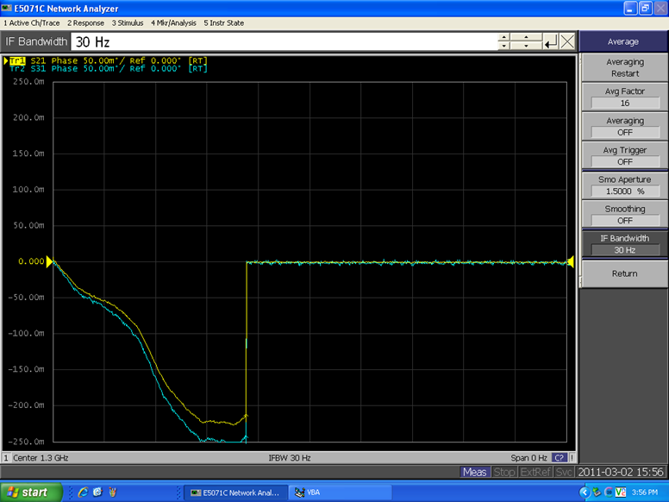
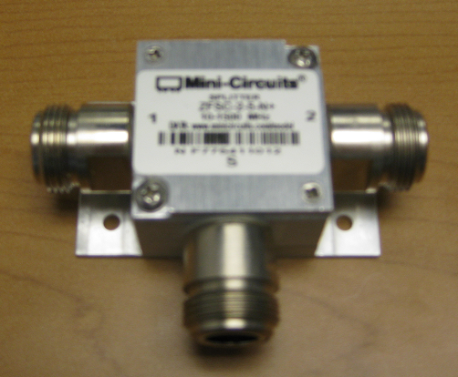
Mini-Circuits ZFSC-2-5-N Power Combiner Measurements
Network Analyzer phase measurement of the two outputs of the combiner over a 25 degrees C change.
~30 mDeg Separation

Slide 18
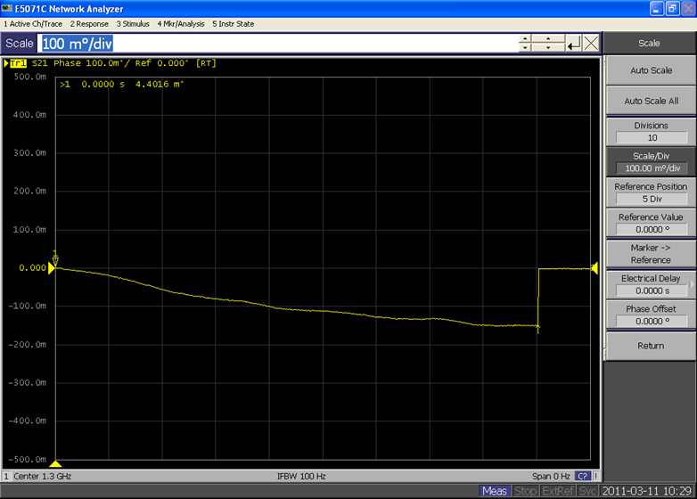
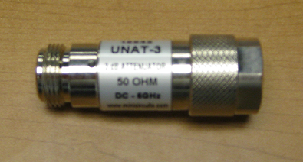
Mini-Circuits UNAT-3 Attenuator Measurement
Network Analyzer phase measurement of the fixed attenuator over a 25 degrees C change.
150 mDeg drift

Slide 19
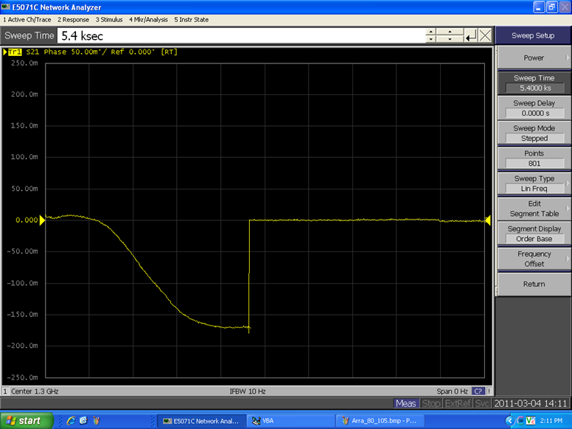
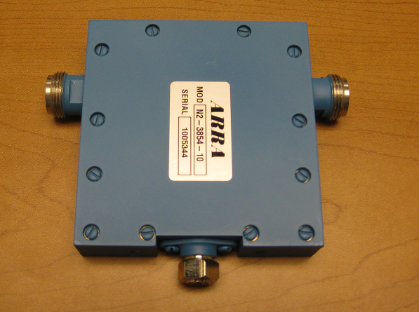
ARRA N2-3854-10 Variable Attenuator Measurement
Network Analyzer phase measurement of variable attenuator over a 25 degrees C change. Attenuator set to 0.5 dB.
~170 mDeg drift

Slide 20
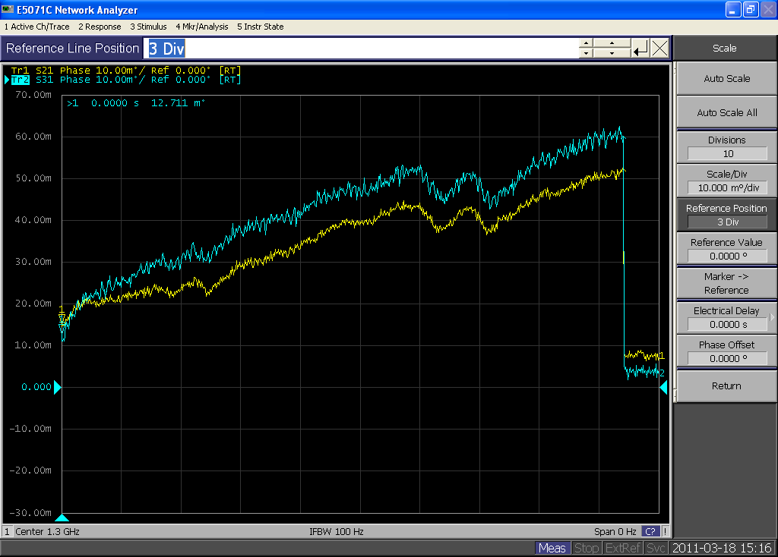
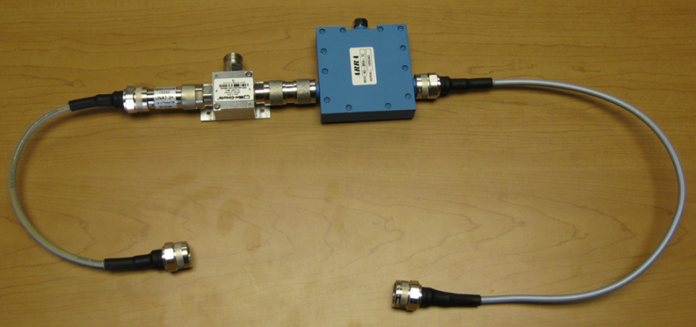
Complete Combiner Circuit Measurement
Network Analyzer phase measurement of combiner circuit over a 25 degrees C change.
10 mDeg of separation

Slide 21
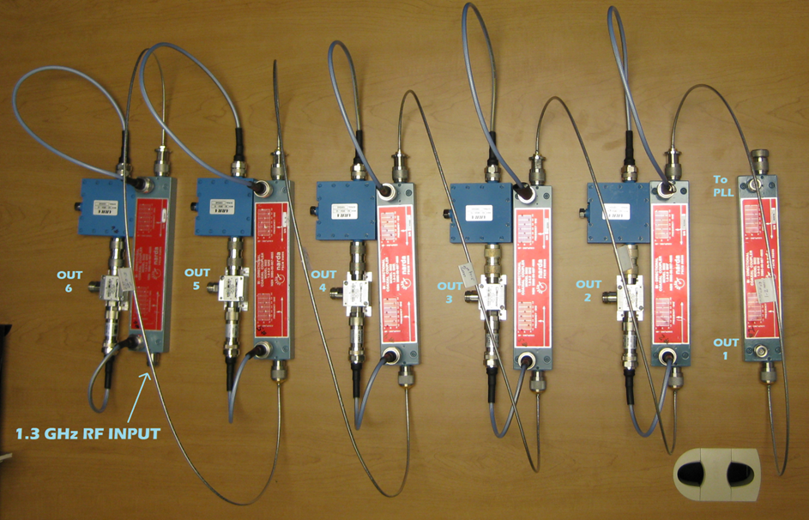
Lab Scaled Reference Line
The 7/8” RFS cable is replaced by Belden 0.141 tin coated coax. The electrical length change for 1 meter of the 0.141 cable is similar to that of 30 m of 7/8’ RFS cable.

Slide 22
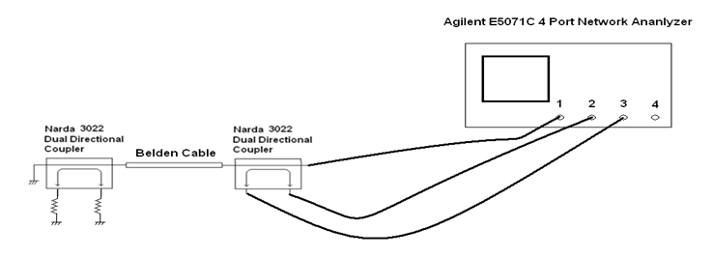
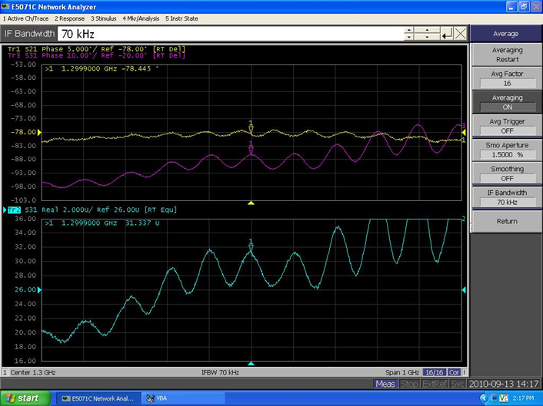
Lab Scaled Reference Line Cable Length Measurement and Adjustments
Forward and reverse phase
Averaged phase

Slide 23
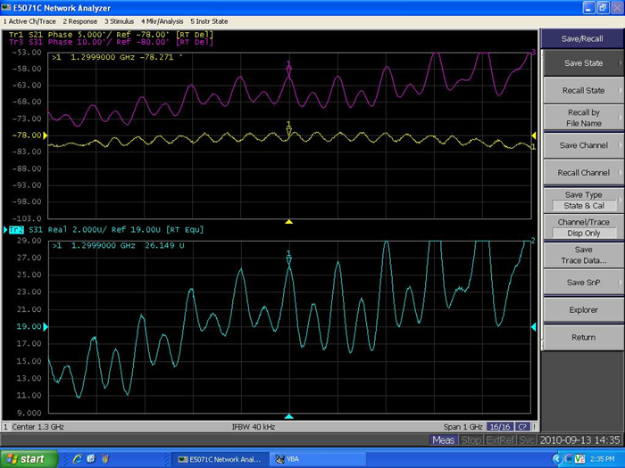
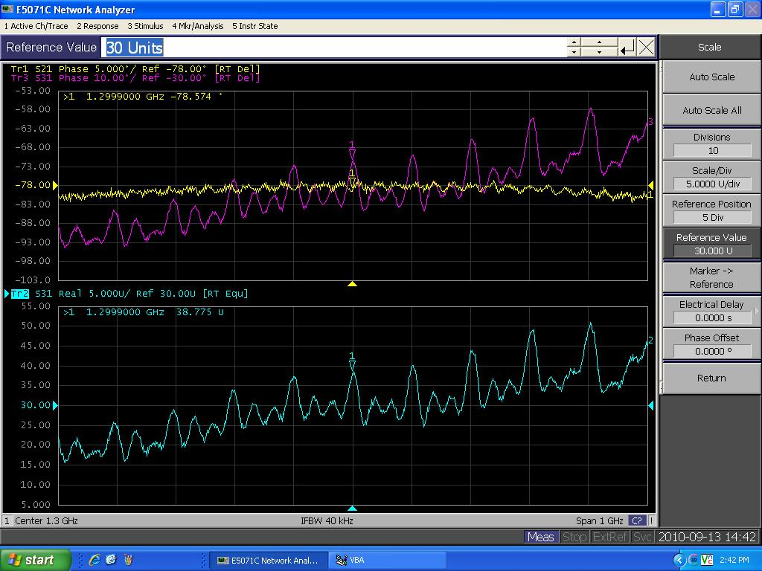
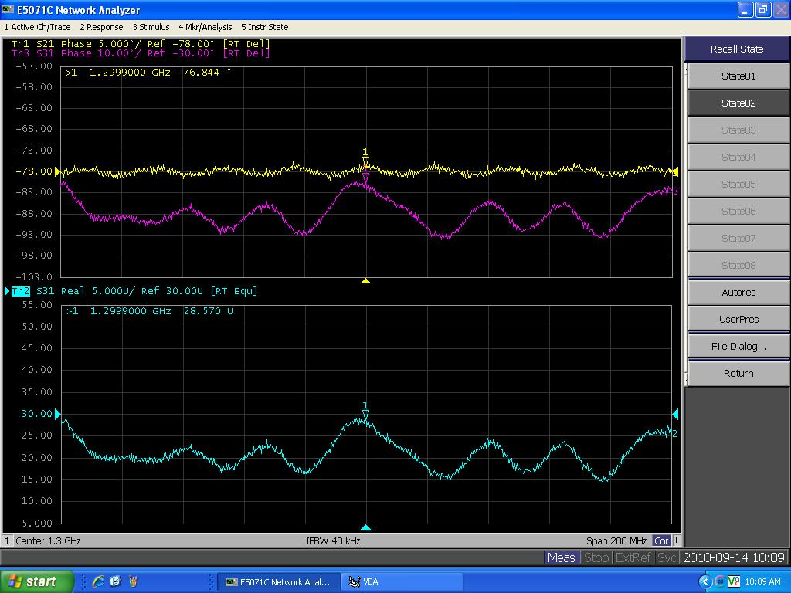
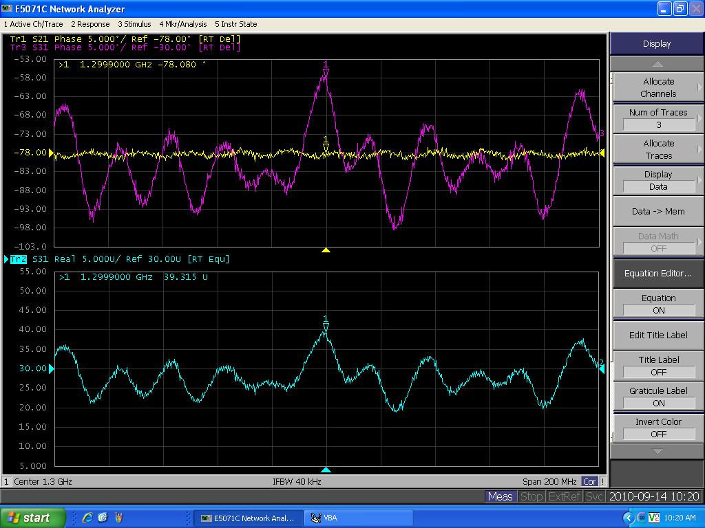
Remaining Cable Length Measurements
Coupler 3 cable measurement
Coupler 4 cable measurement
Coupler 5 cable measurement
Coupler 6 cable measurement

Slide 24
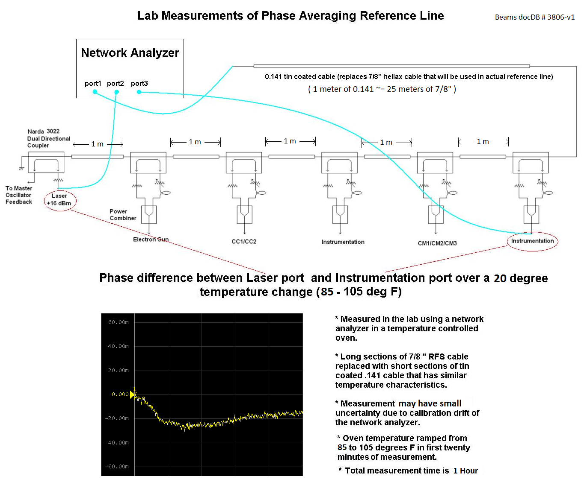
Scaled Reference Line Lab Results
~30 mDeg of phase drift between tap 1 and tap 6

Slide 25
Conclusions
A promising design has been proposed and analyzed for the 1.3 GHz reference line for the Fermilab SRF Beam Test Facility.
Simulations and the scaled lab model have been shown to have good phase stability over a broad temperature range.

