Slide 1
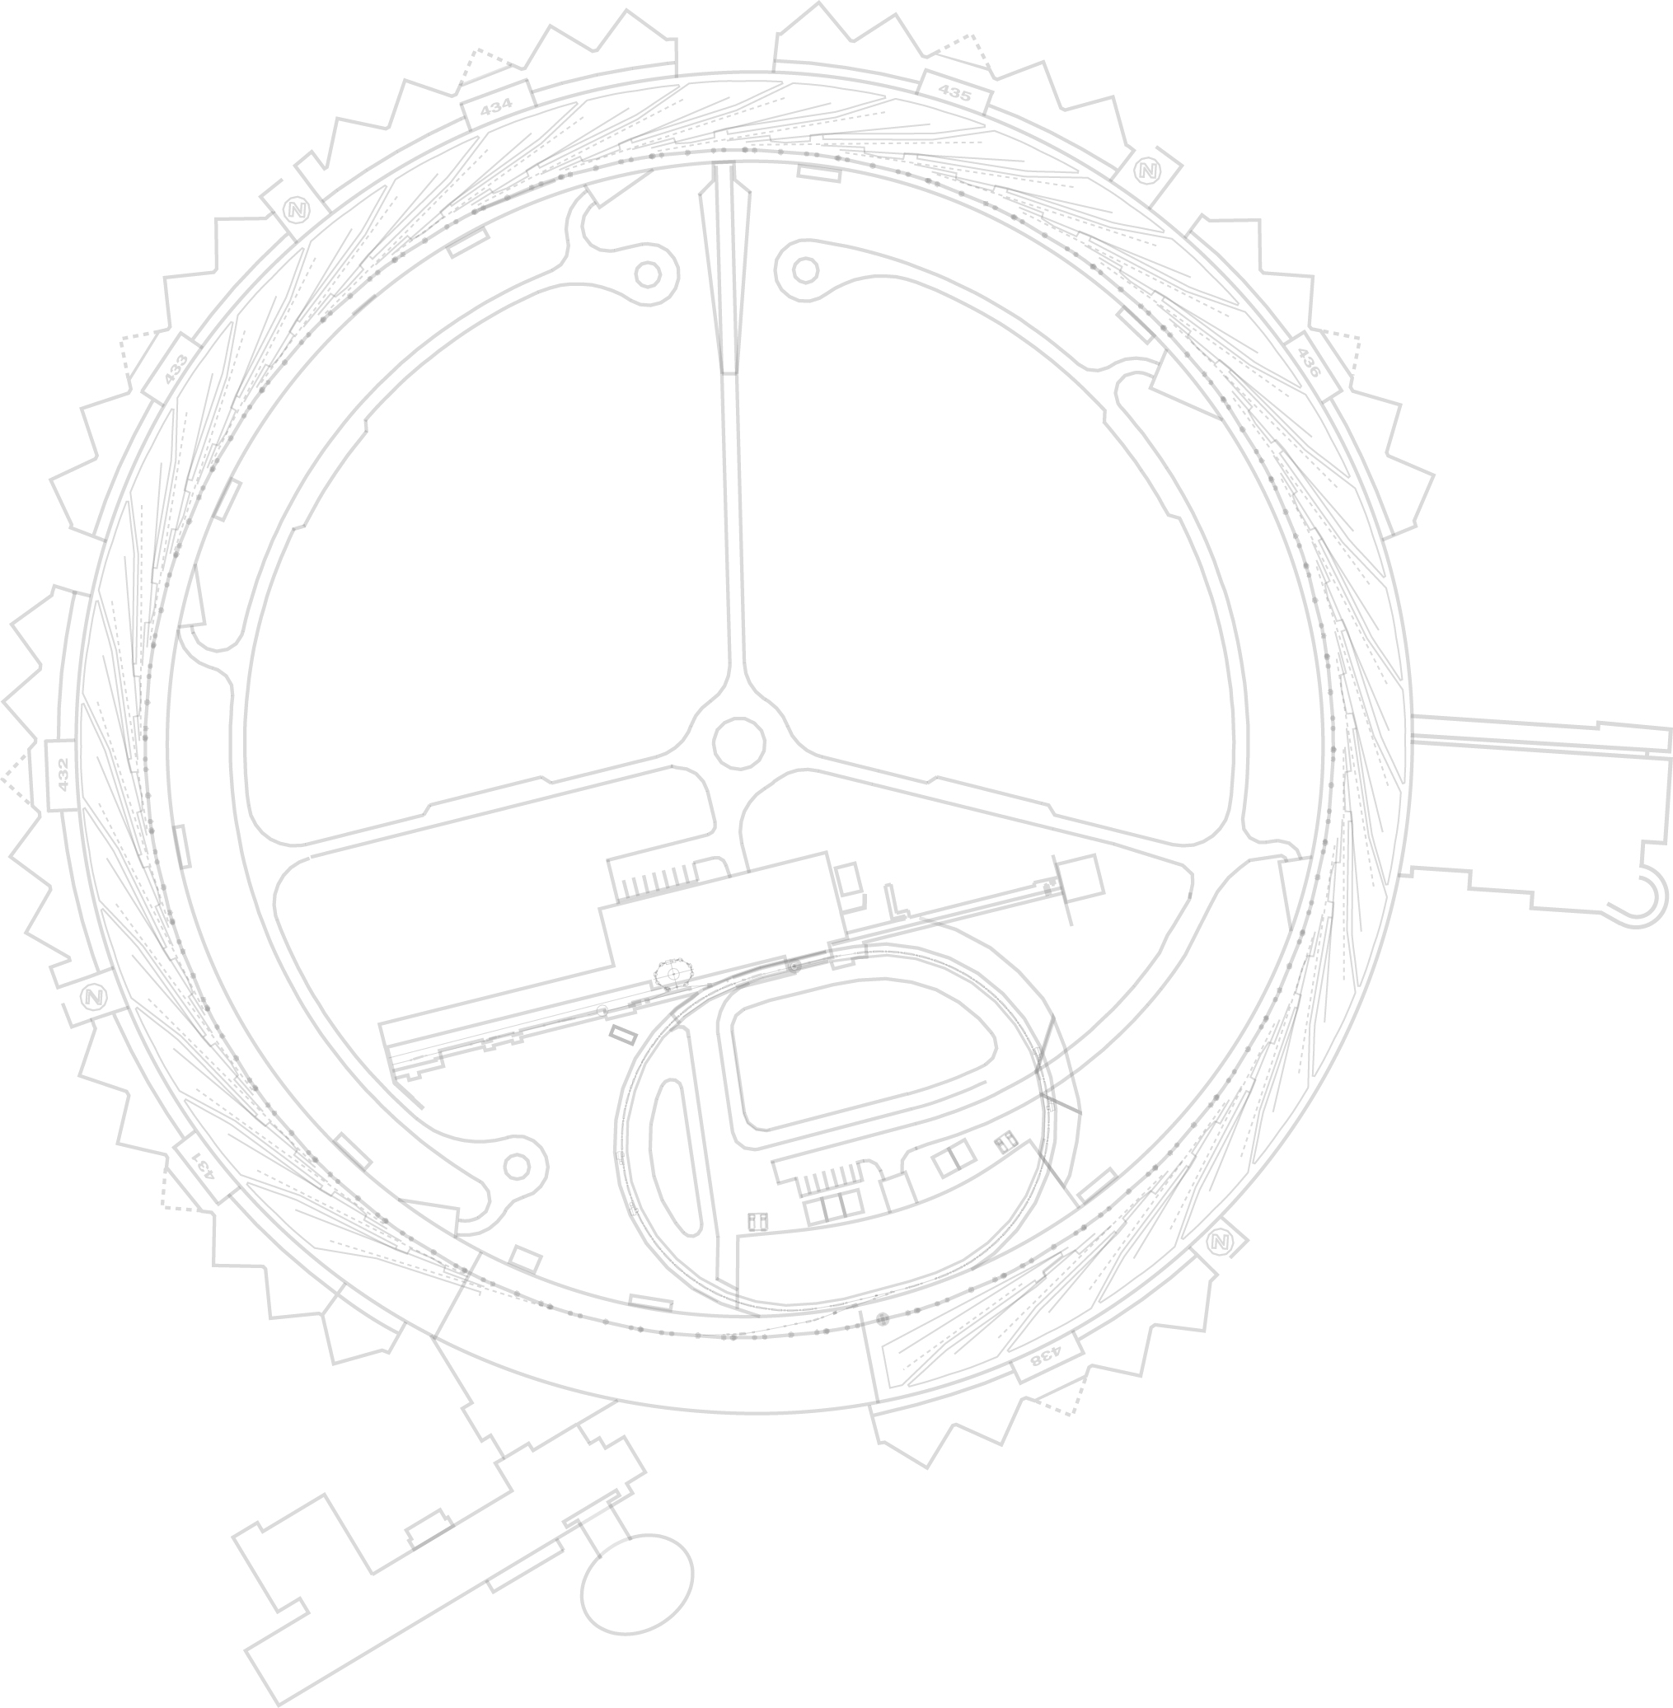
ANL APS-Upgrade Short Pulse X-ray (SPX) LLRF System
ANL*: Tim Berenc, Hengjie Ma, Ned Arnold, Frank Lenkszus
LBNL**: Larry Doolittle, Gang Huang, John Byrd
LLRF 2011 Workshop
Oct. 20, 2011
*Work at Argonne supported by U.S. Department of Energy, Office of Science, Office of Basic Energy Sciences, under Contract No. DE-AC02-06CH11357.
** Work supported by U.S. Department of Energy, Office of Science, Office of Basic Energy Sciences, under Contract No. DE-AC02-06CH11354.

Slide 2
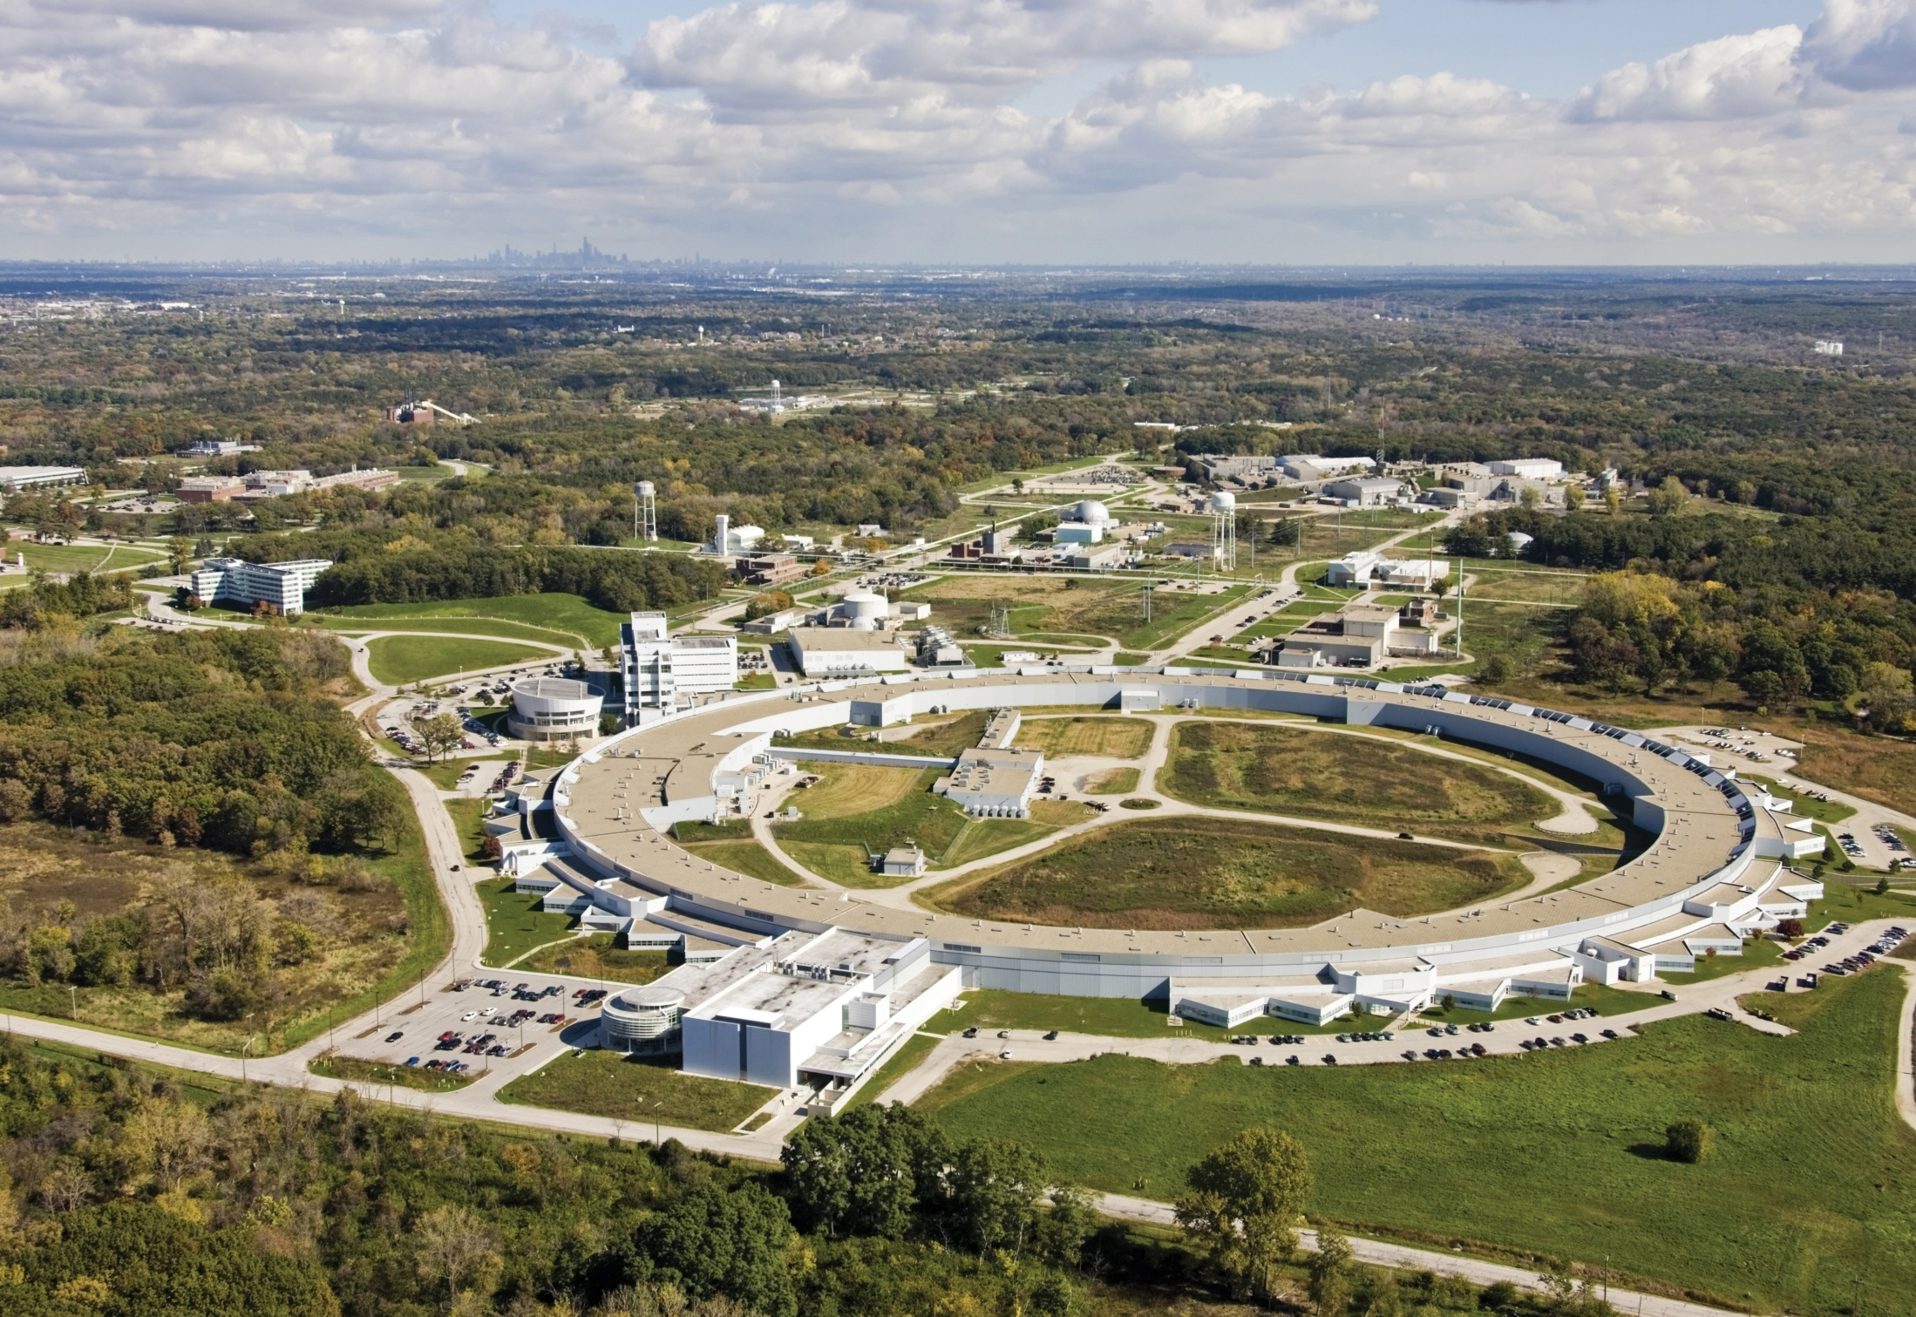
Advanced Photon Source (APS) @ Argonne National Laboratory
Planned
SPX Location

Slide 3
APS-U SPX System – Zholents’ Transverse RF Chirp Concept¹
Goal: provide ~2 psec (presently 50-100 psec) X-ray pulses at 6.5 MHz rep. rate for time-resolved studies
RF at ~2815 MHz
(8th harmonic of Storage Ring RF)
Ideally, second cavity exactly cancels effect of first cavity
Correlation between vertical distribution of x-rays and time-distribution of electrons that generated them. Pulse can be sliced or compressed with an asymmetric cut crystal.
¹ A. Zholents et al., NIM A 425, 385 (1999)

Slide 4
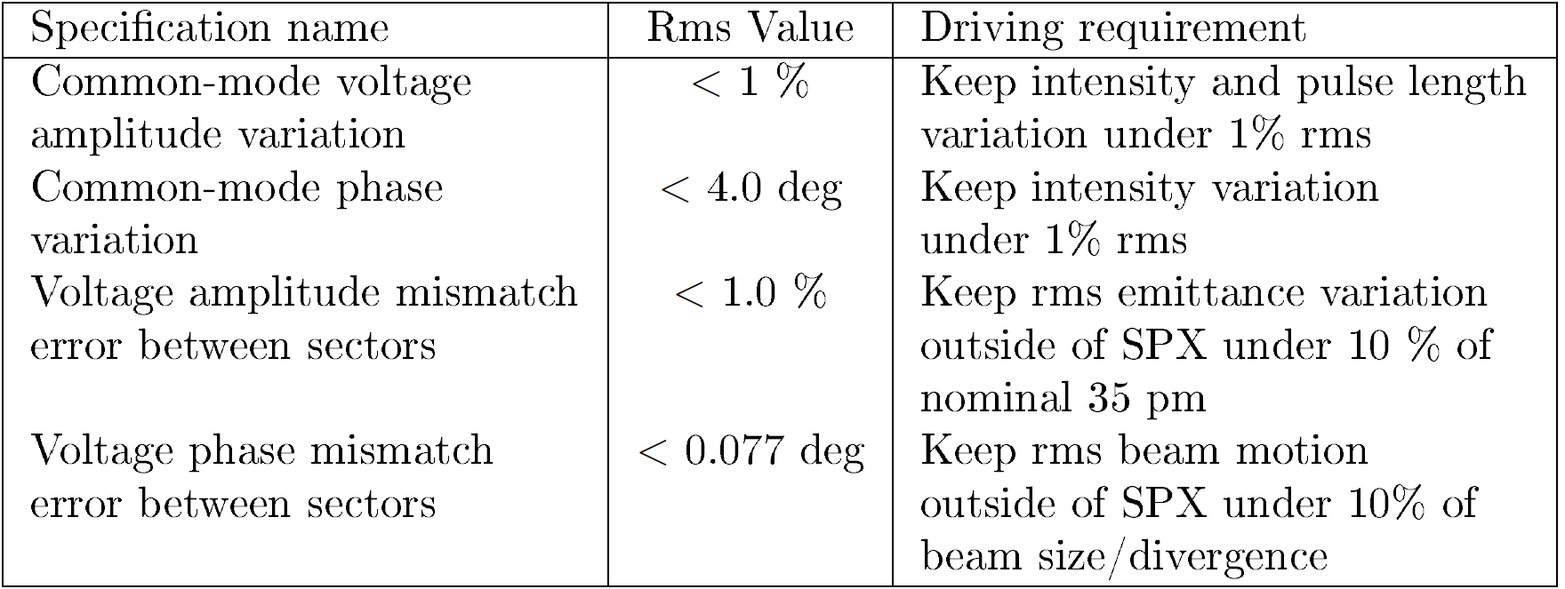
Performance Requirements
Common
Mode
Differential
Mode
Residual tilt
Residual kick

Slide 5
SPX System - Conceptual Design Strategy
Orbit Feedback System provides long-term stability … < 100 Hz
LLRF System on its own > 10 Hz [10 Hz – 100 Hz overlap with Orbit Feedback]
Beam Arrival Time feedback to main Storage Ring RF to address common mode phase
LBNL-based phase stable references² to synchronize RF (x-ray pulse) and user lasers
Single Klystron per cavity
LLRF drift compensation via CW calibration tone
² J. Byrd et al., Optics Letters Vol. 34, No. 20 (2009)

Slide 6
R&D System Proof of Principle (1 Sector, 2 cavities)
Cavities counter-phased (180deg) to demonstrate tolerance requirements
Cavities run in-phase to create a chirped beam around entire ring to have a look at short pulse x-rays

Slide 7
RF Strategy #1 – Regulate to Designated Phase Reference
Don’t let the LO assume the role of the phase reference
Phase is a Differential Measurement
Mixers preserve phase information, x’s and ÷’s preserve timing
In theory, common mode LO and clock noise cancels

Slide 8
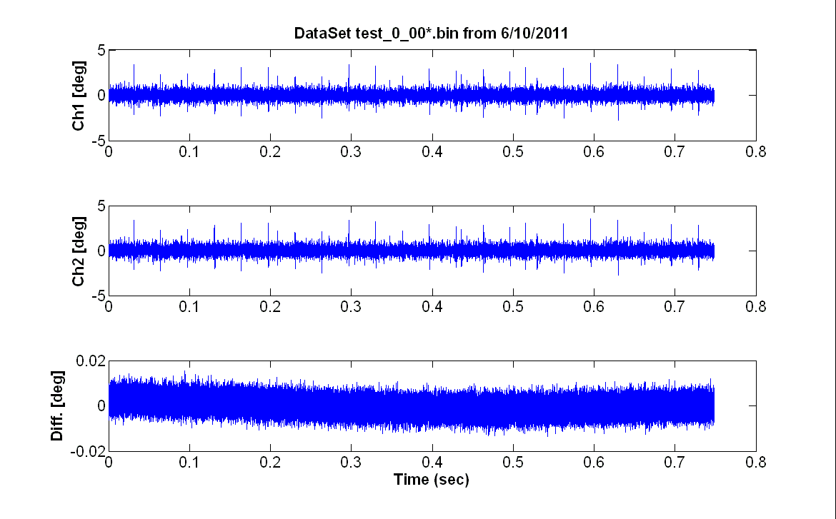
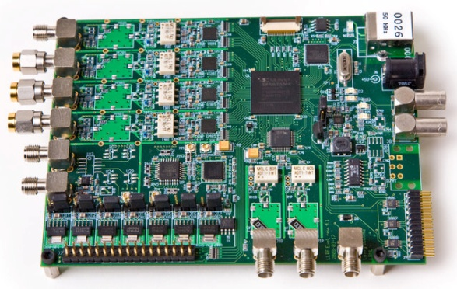
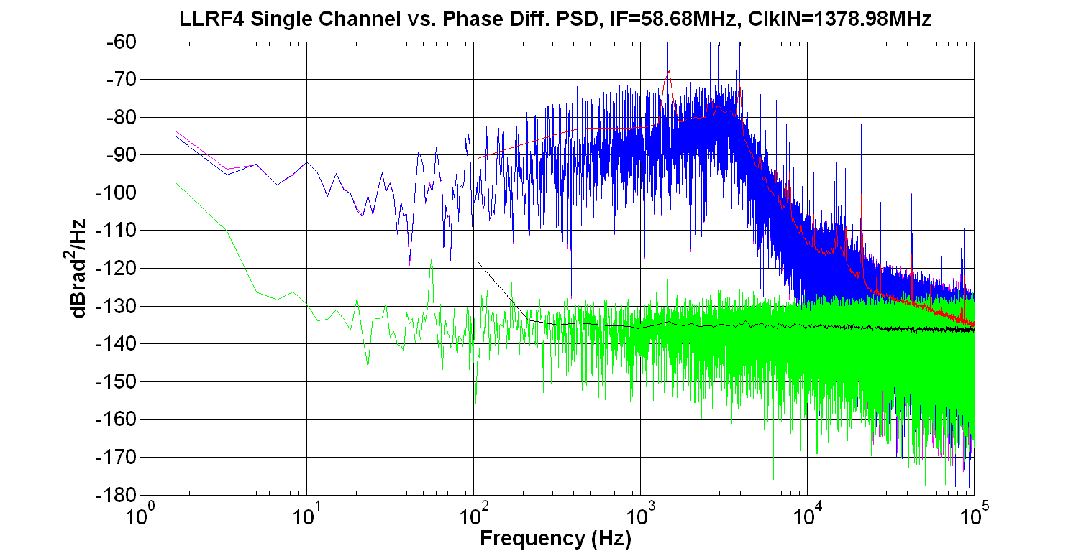
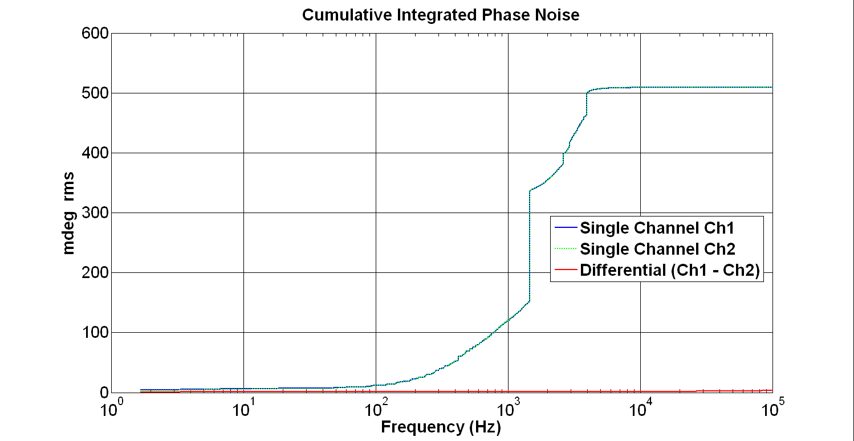
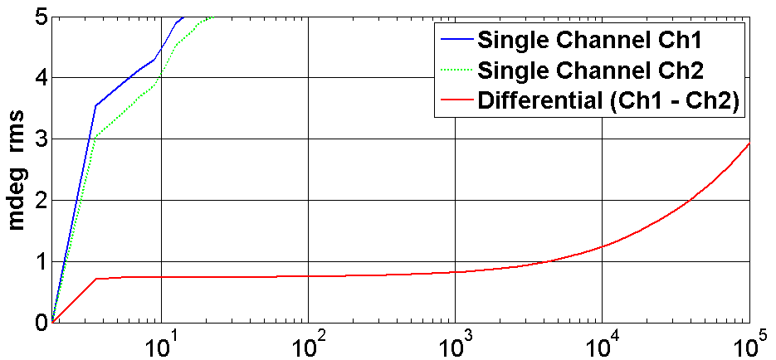
LLRF4 Board – Input Differential Phase Noise
IF
CLK

Slide 9
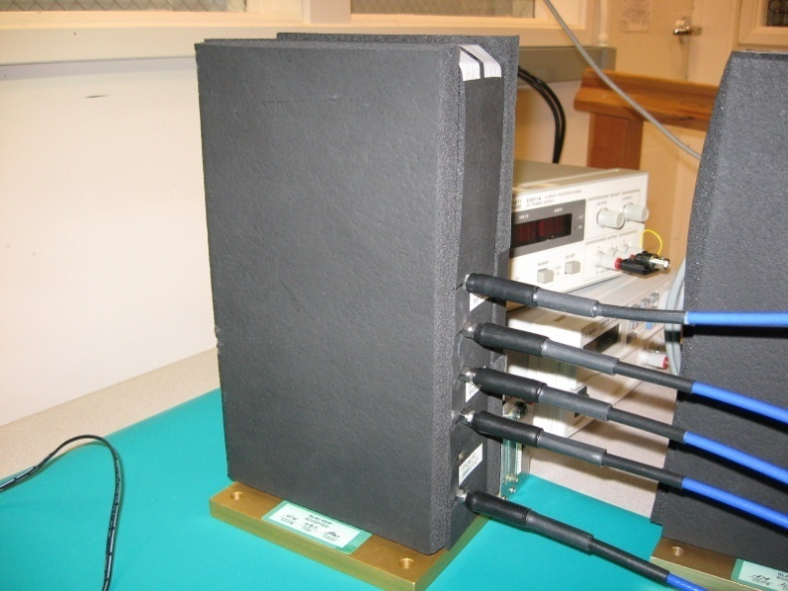
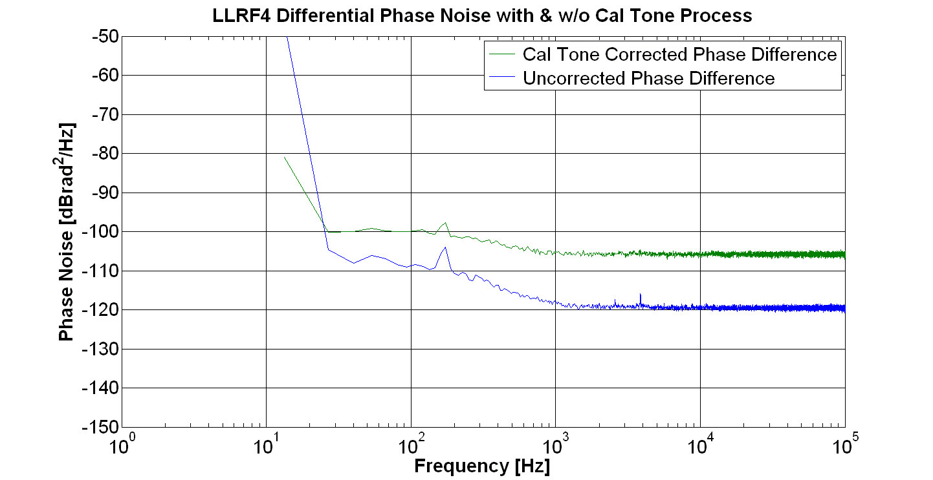
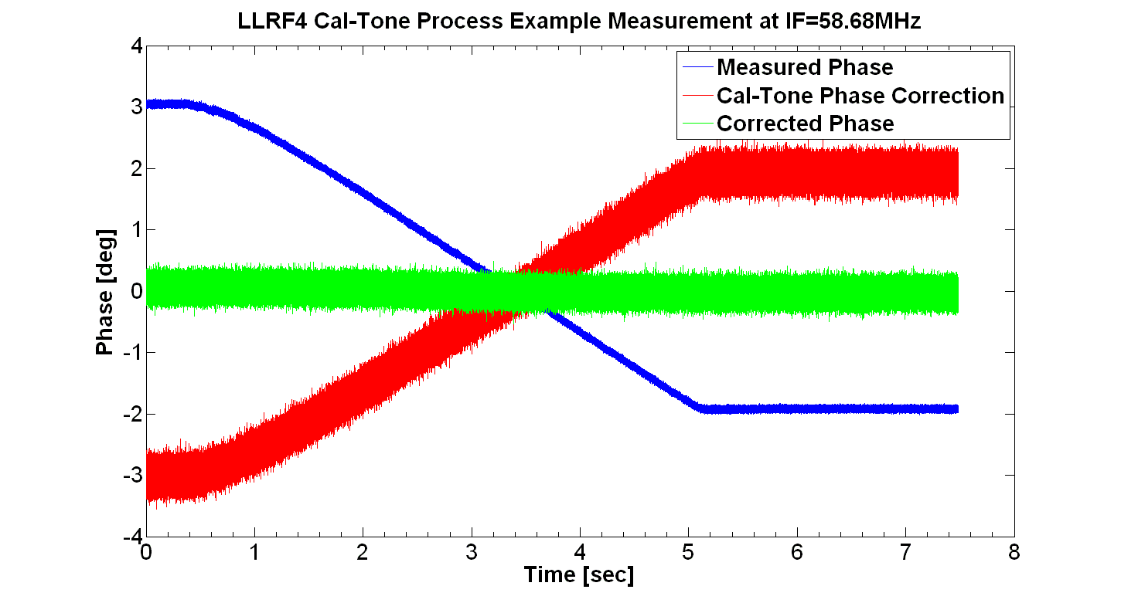
RF Strategy #2 - CW Drift Compensation³
5°
~ 0.118° rms
~ 0.023° rms
0.09°
~ 35 dB
³ “Signal Processing for High Precision Phase Measurements”, G. Huang, L. Doolittle, J. Staples, R. Wilcox, J. Byrd , Proceedings of BIW10

Slide 10
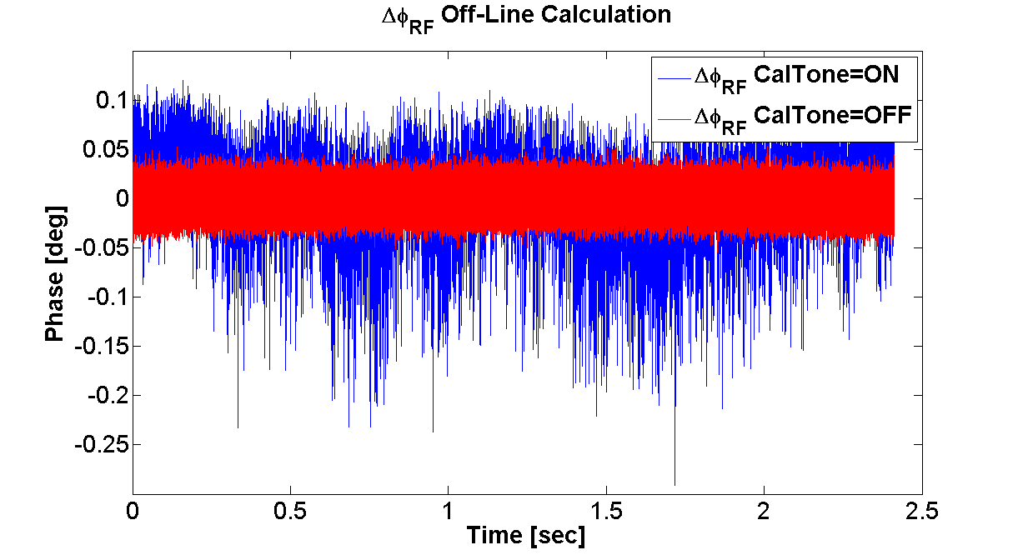
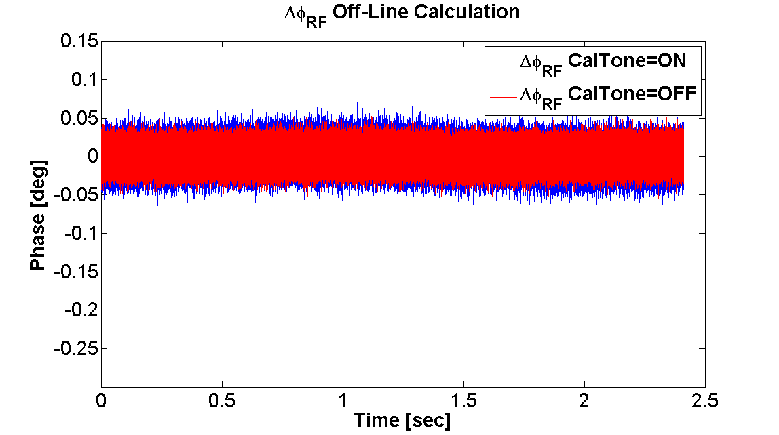
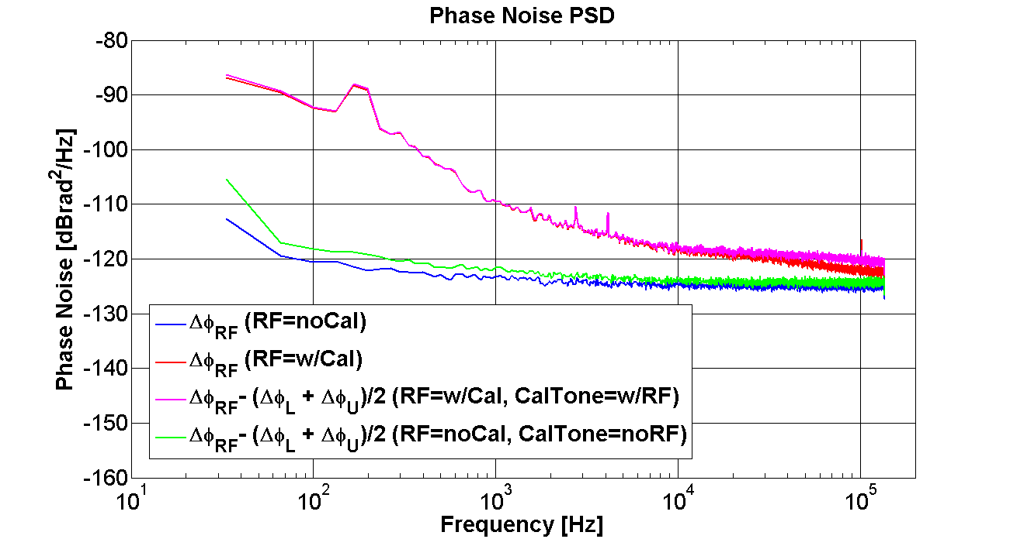
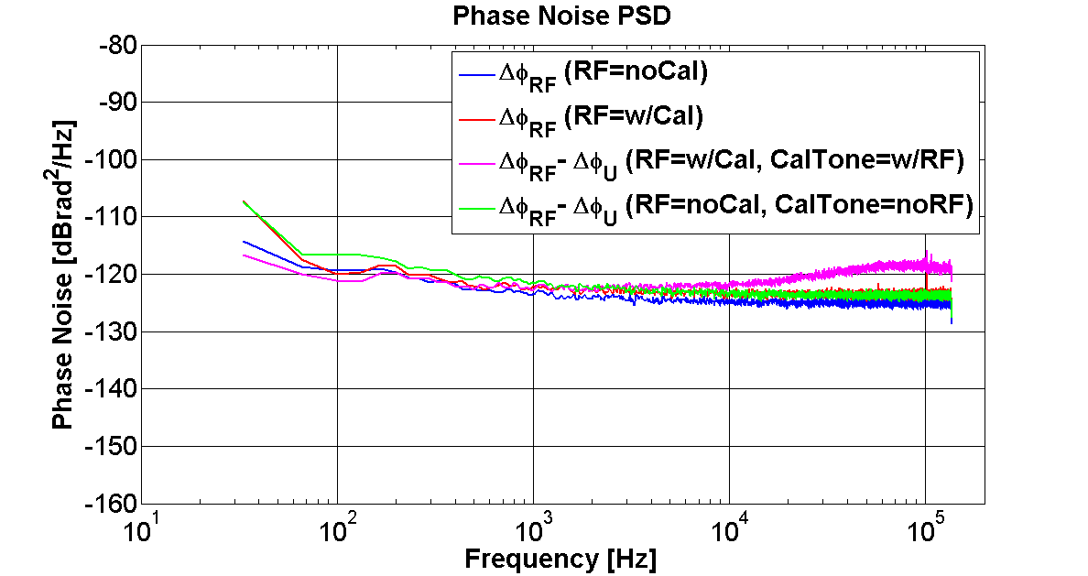
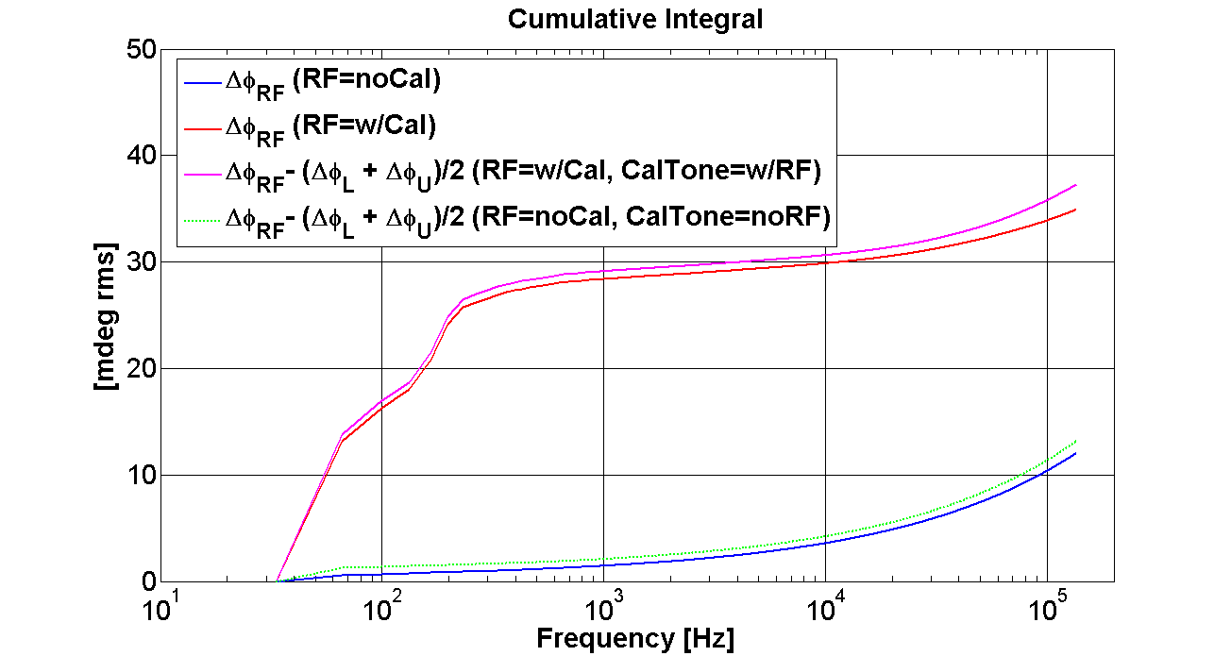
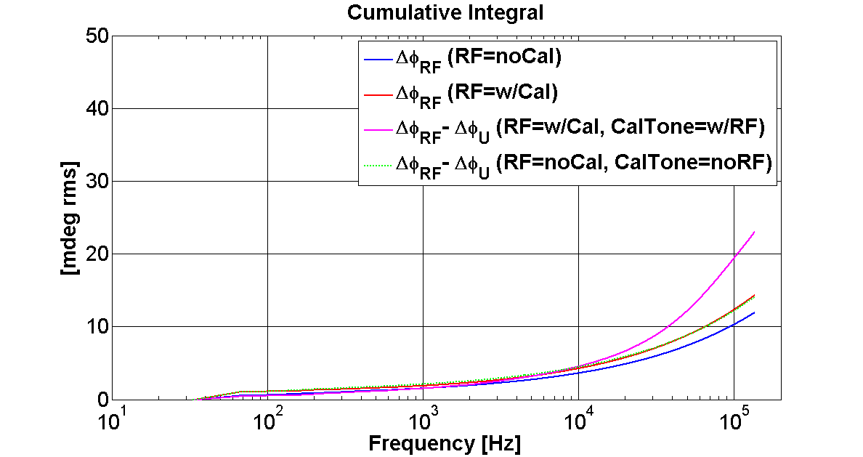
CW Drift Compensation – Intermodulation Distortion
Double Sideband Cal-Tone
Single Sideband Cal-Tone

Slide 11
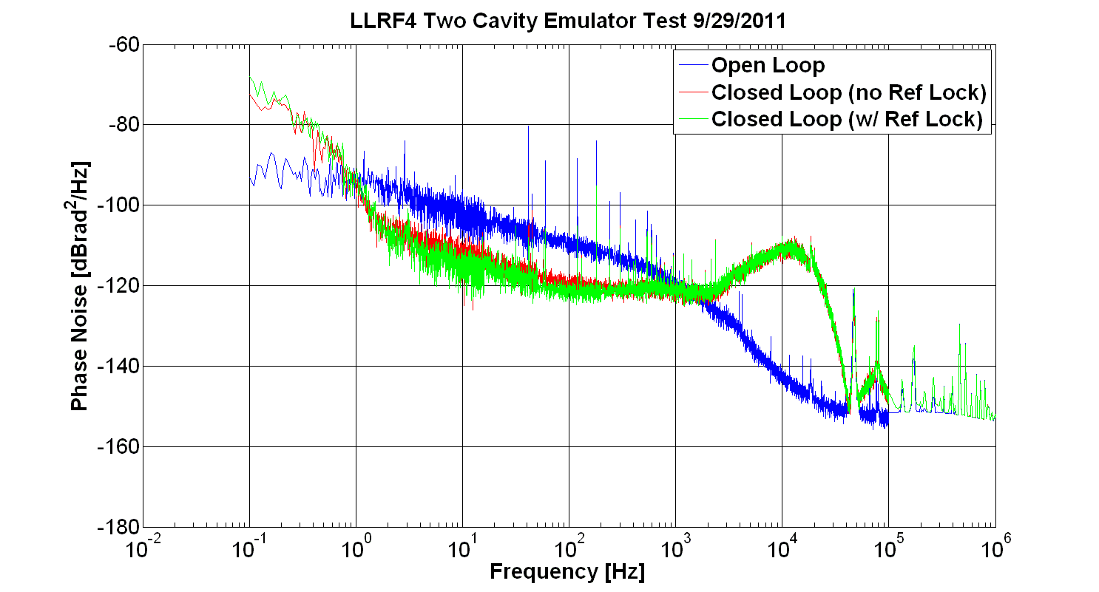
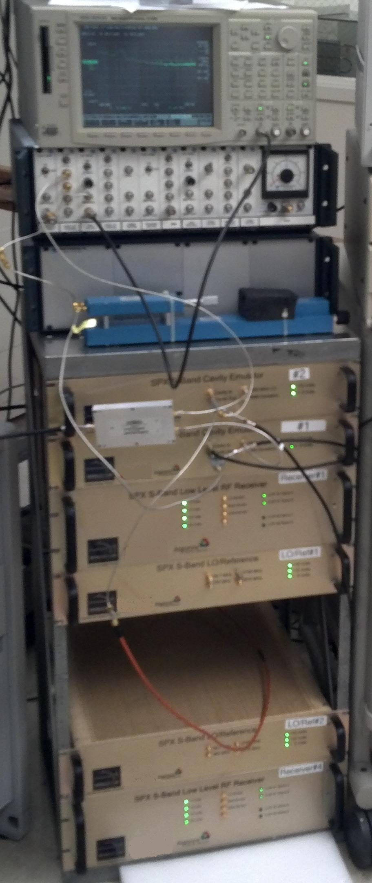
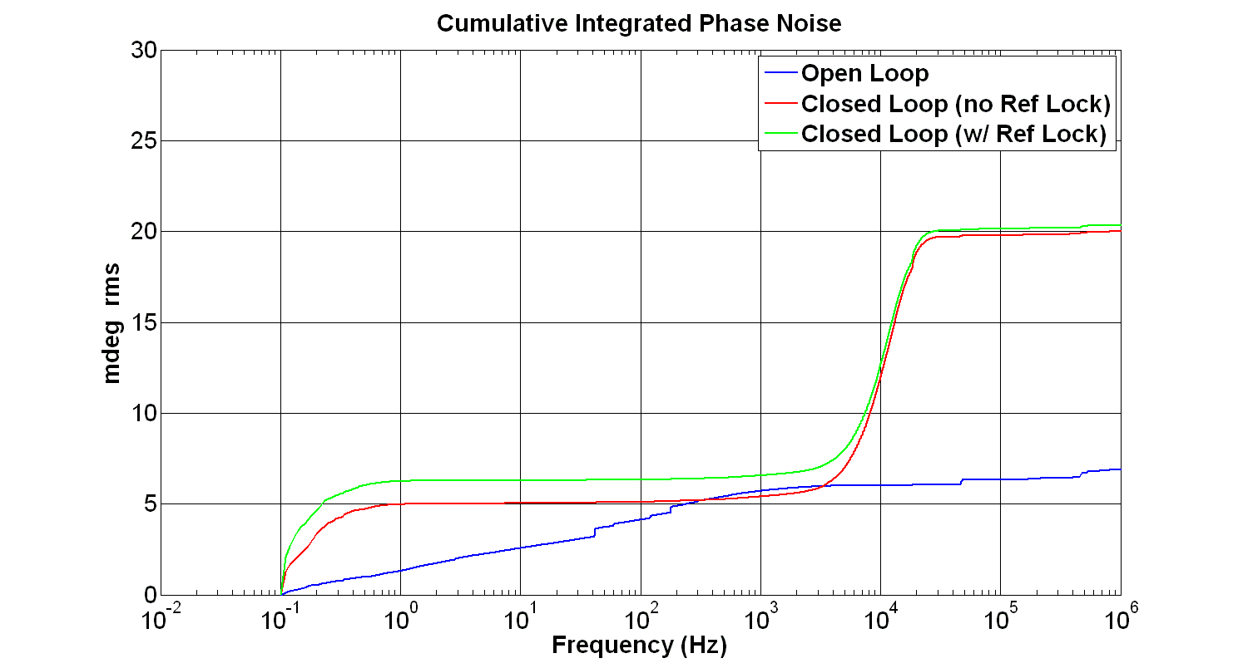
LLRF Benchtop Demonstration:
Differential Phase Noise between 2 LLRF controlled cavity emulators
Residual
Phase Noise Test Set
(measure noise between cavity emulators)
Cavity Emulators
#1 and #2
LLRF Receiver #1
Freq. Generation Chassis
LLRF System contribution
~ 20 fsec rms [0.1 Hz – 1MHz]
Price paid to suppress low freq. noise
(i.e., beam loading & microphonics)
LLRF Receiver #2

Slide 12
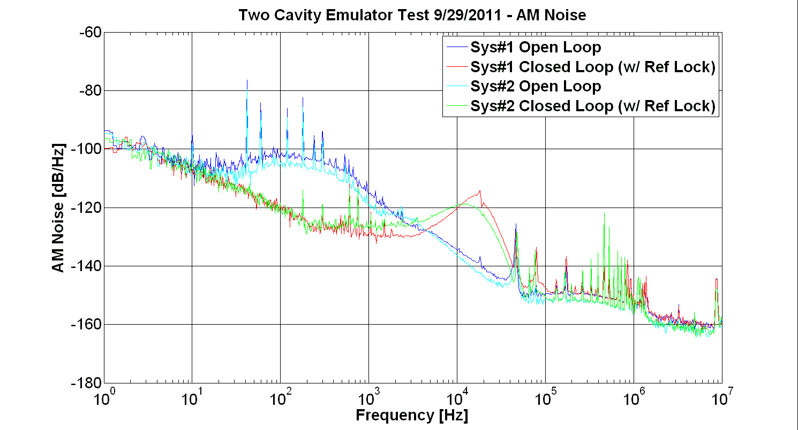
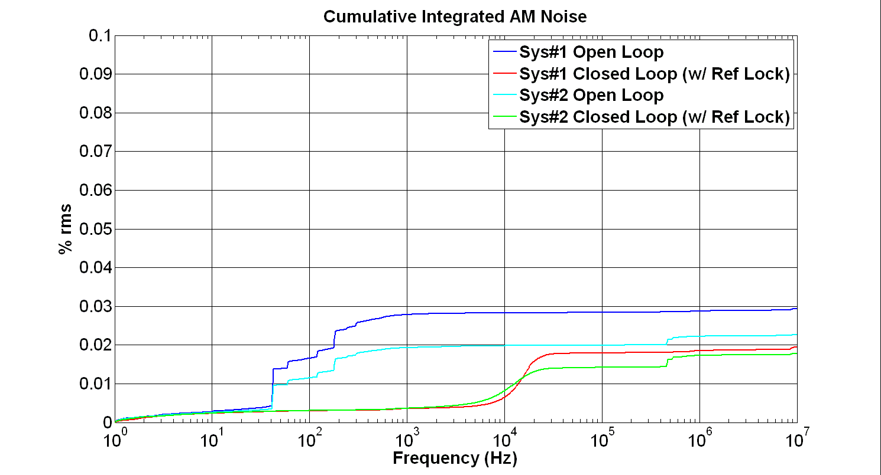
LLRF Benchtop Demonstration:
Amplitude Noise
Residual
Phase Noise Test Set
(replaced with E5052B for AM)
Cavity Emulators
#1 and #2
LLRF Receiver #1
Freq. Generation Chassis
LLRF Receiver #2

Slide 13
Some Lessons Learned about Deflecting Cavities

Slide 14
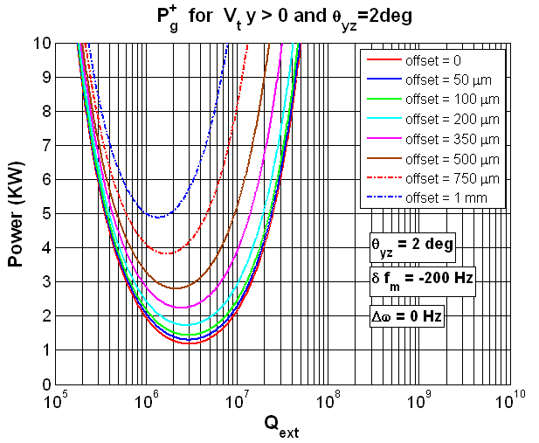
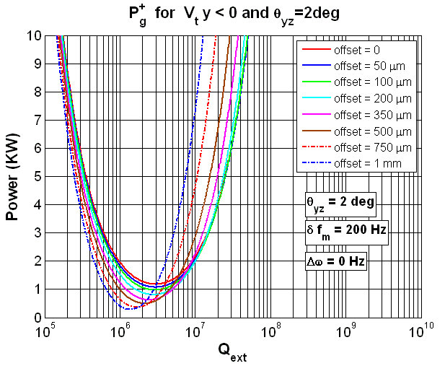
Deflecting Cavity Beam Loading
function of both: Offset and Tilt

Slide 15
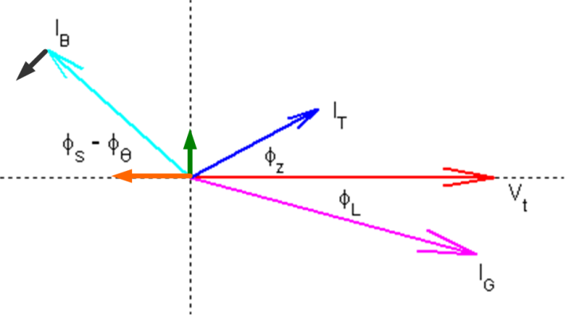
Deflecting Cavity Dynamic Model
CW small signal model will help track system noise & error budgets
Caution:
Pedersen/Boussard transfer functions are normalized for amp/phase. Beam loading factor, Y, can be negative for deflecting cavities. Amp/Phase control can be lost when beam offset drives the cavities to full field (there is no drive carrier). This isn’t true for I/Q control.
Proper normalization for I/Q transfer functions is to rotate into the cavity voltage frame, but not to normalize with respect to the various carrier terms.
LLRF 2011 Workshop

Slide 16
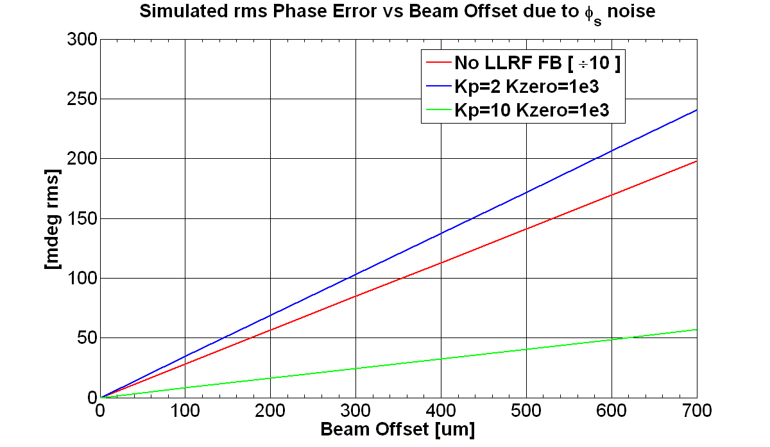
Deflecting Cavity – Motivation for Electrical Alignment
Example of Differential Phase Noise induced by Common Beam Jitter
Sector A
Sector B
Cavity-to-cavity vertical alignment errors cause differential beam-loading which leads to differential phase noise.
when
Uncontrolled Beam Arrival Time Error
Q_{L} = 2e6
200mA
Residual Kick
LLRF 2011 Workshop

Slide 17
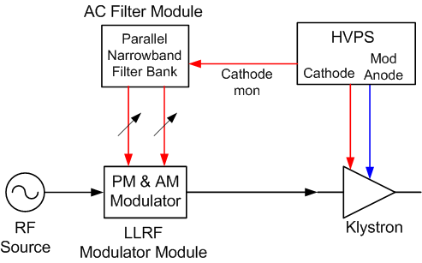
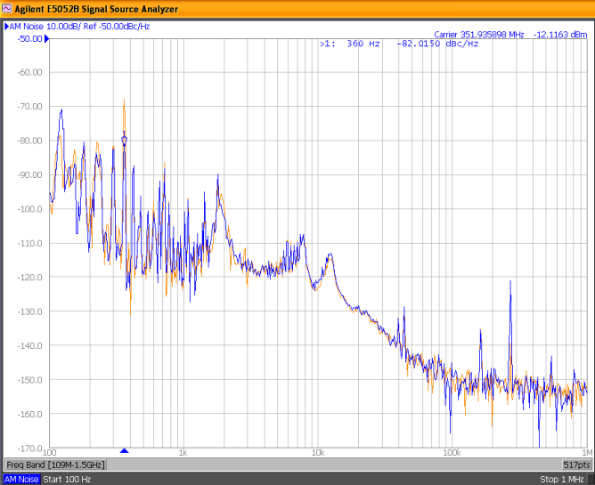
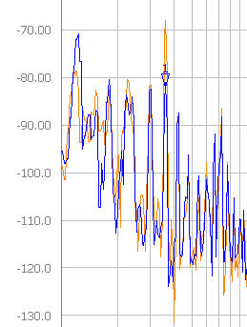
Deflecting Cavity – Motivation for Electrical Alignment
= Motivation to Reduce Storage Ring Beam Jitter
360Hz Feed-Forward correction of Klystron High-Voltage Power Supply (HVPS) induced noise
AM & PM suppression
Horizontal BPM Data
via dispersion, beam phase noise shows up as horizontal beam motion
Feed Forward OFF
Feed Forward ON

Slide 18
Summary
Digital LLRF systems are capable of femto-second level synchronization [0.1 Hz – 1MHz] with proper attention to common source distribution
Modern optical fiber link systems promise long-term femto-second level synchronization between RF systems, diagnostics, and user lasers
Deflecting cavities present new intellectually stimulating & challenging system design

