Slide 1
Jefferson Lab Low Level RF Controls
LLRF 2011 DESY, Hamburg, Germany October 2011
Rama Bachimanchi, Trent Allison, Curt Hovater, George Lahti, Mike Wilson, Tomasz Plawski, Chad Seaton and Dave Seidman

Slide 2
What’s New
Two upgrade zones have been installed and are undergoing commissioning for beam operations in November
100 MeV Cryomodule: Eight 7 cell high gradient cavities ~ 20 MV/m CW
New tuner: Piezo control range 0-2kHz
Interlocks: 8 additional window IR sensors
More RF Power: 13 kW CW Klystrons
All new digital field controls
field control
cavity interlocks
resonance control
high power amplifier

Slide 3
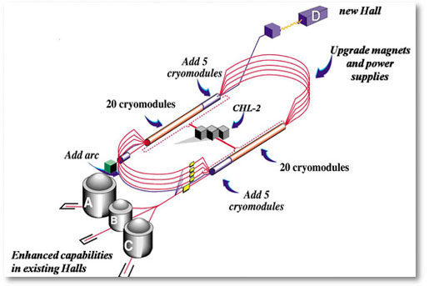
CEBAF Energy Upgrade

Slide 4
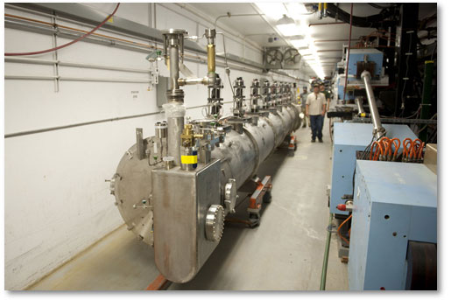
New 100 MeV Cryomodule Being Installed

Slide 5
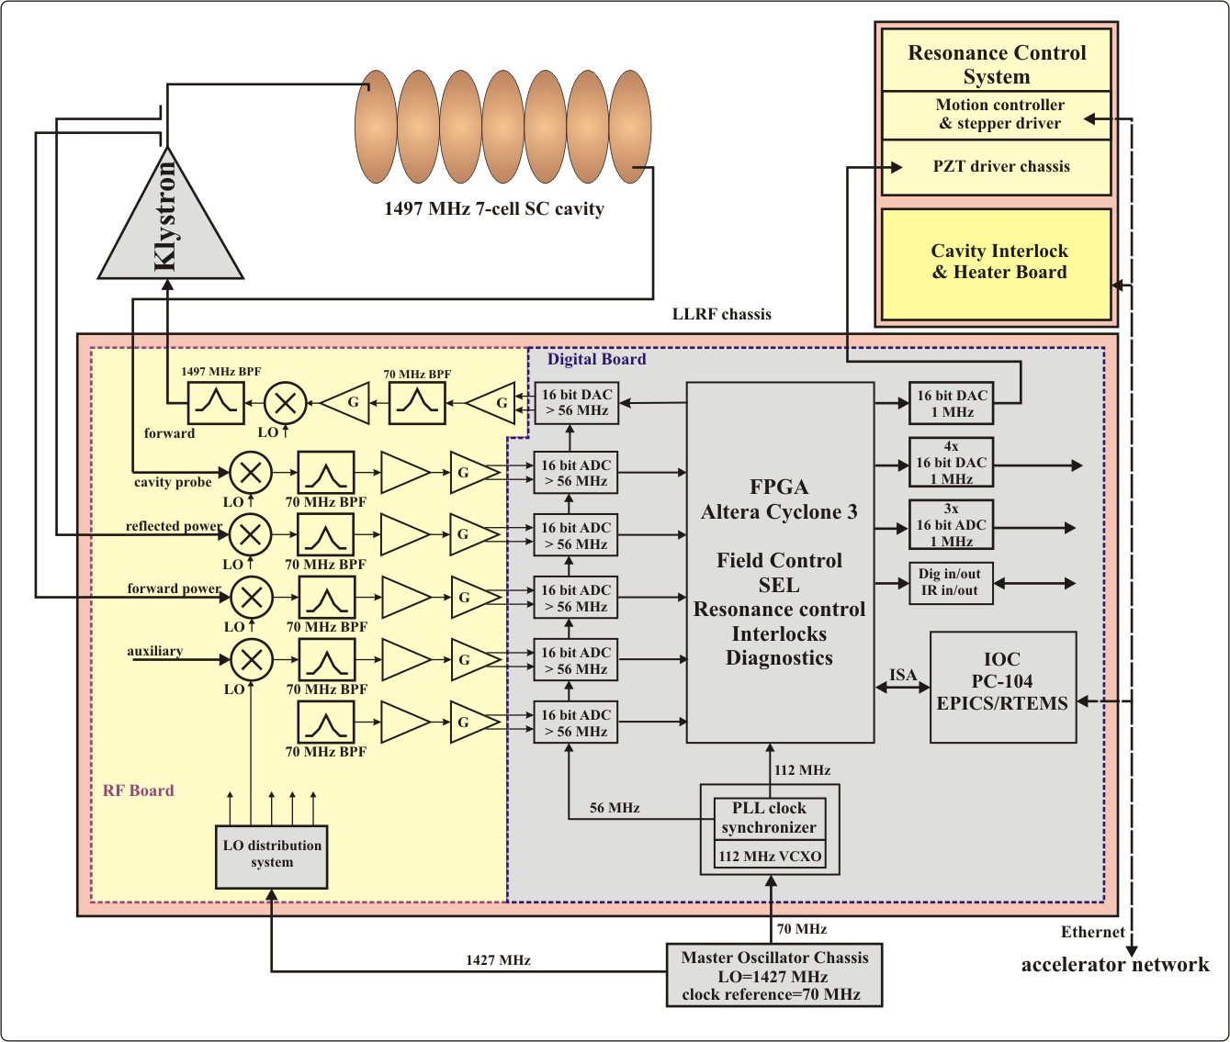
CEBAF Upgrade RF System
Notes:
Canonical LLRF system: large FPGA with 4 channels, cavity, fwd, refl, aux
Interface to operating system.

Slide 6
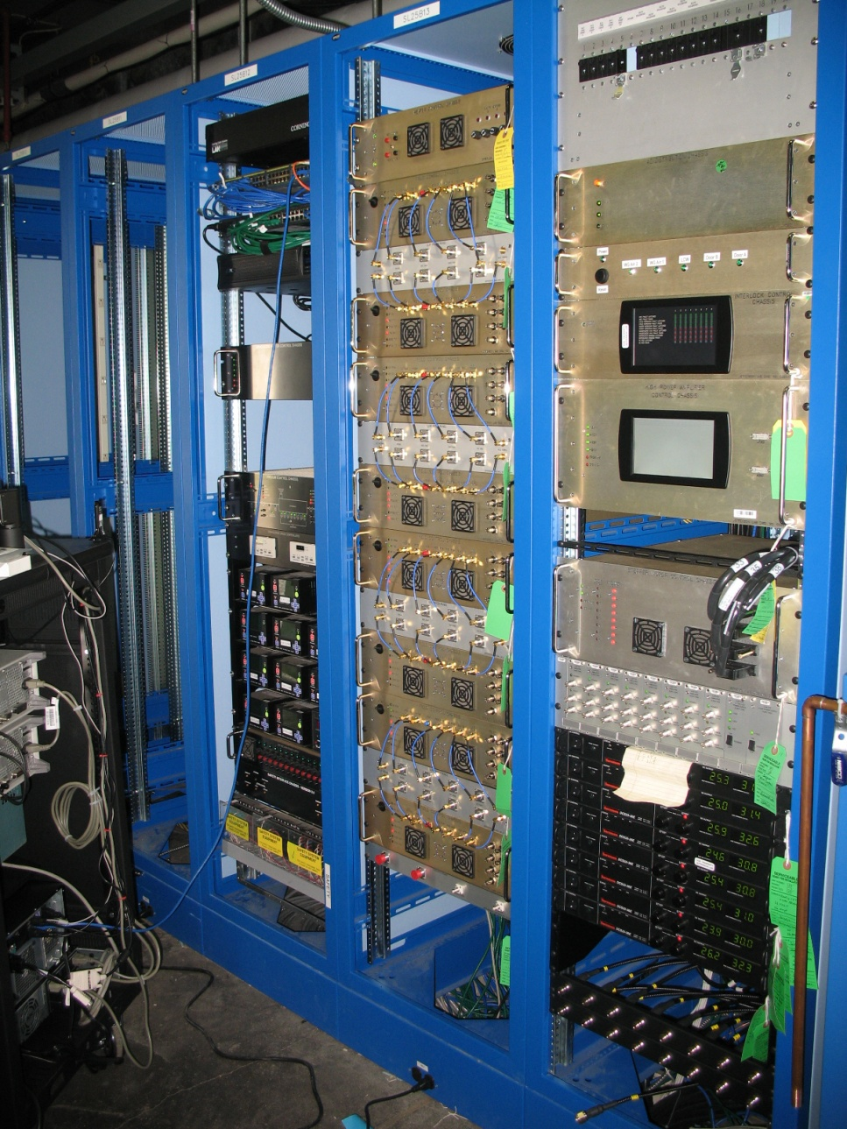
CEBAF Upgrade RF System
Cryomodule Interlocks
Field Control Chassis
High Power Amplifier Control
Stepper Tuner Control
Piezo Tuner Amplifier

Slide 7
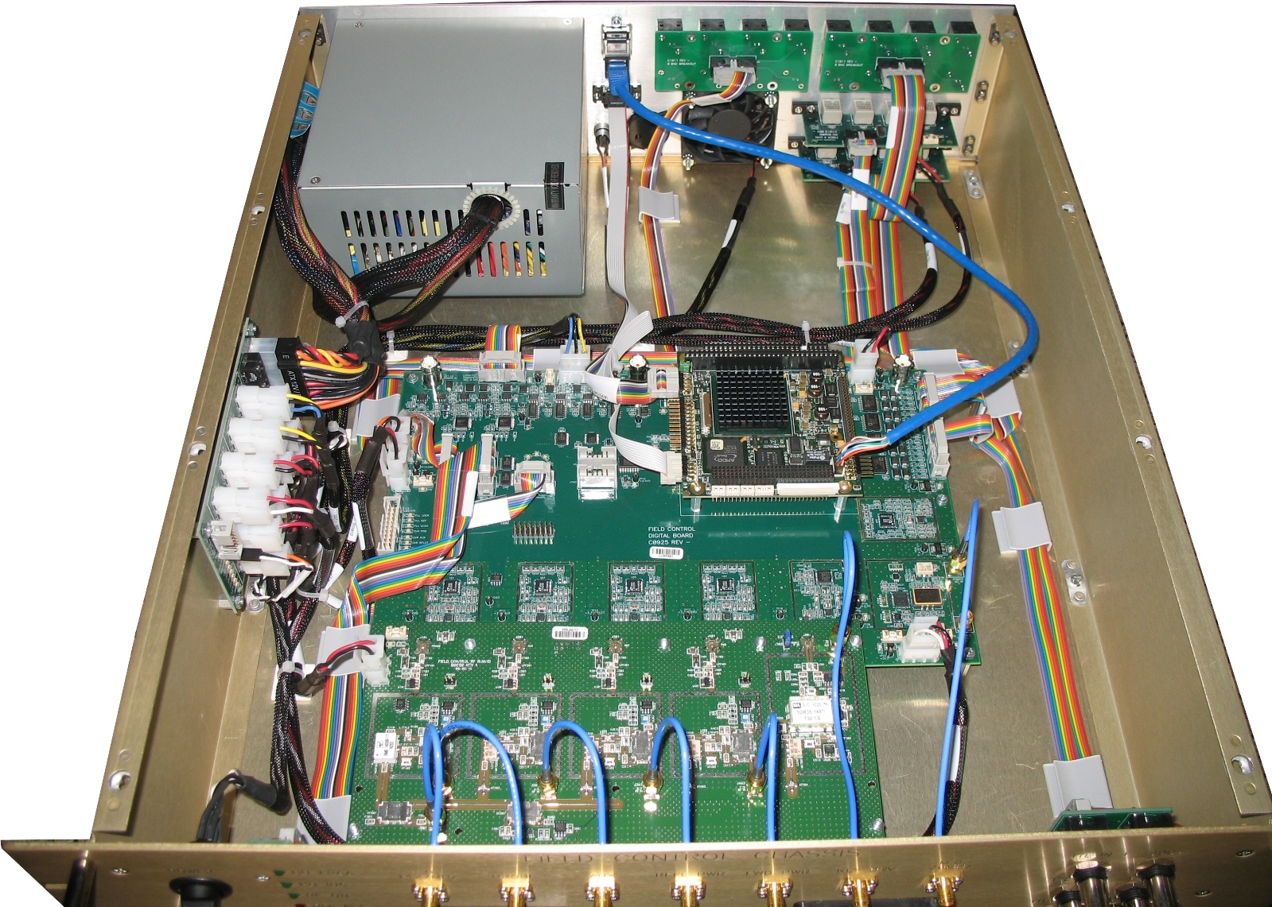
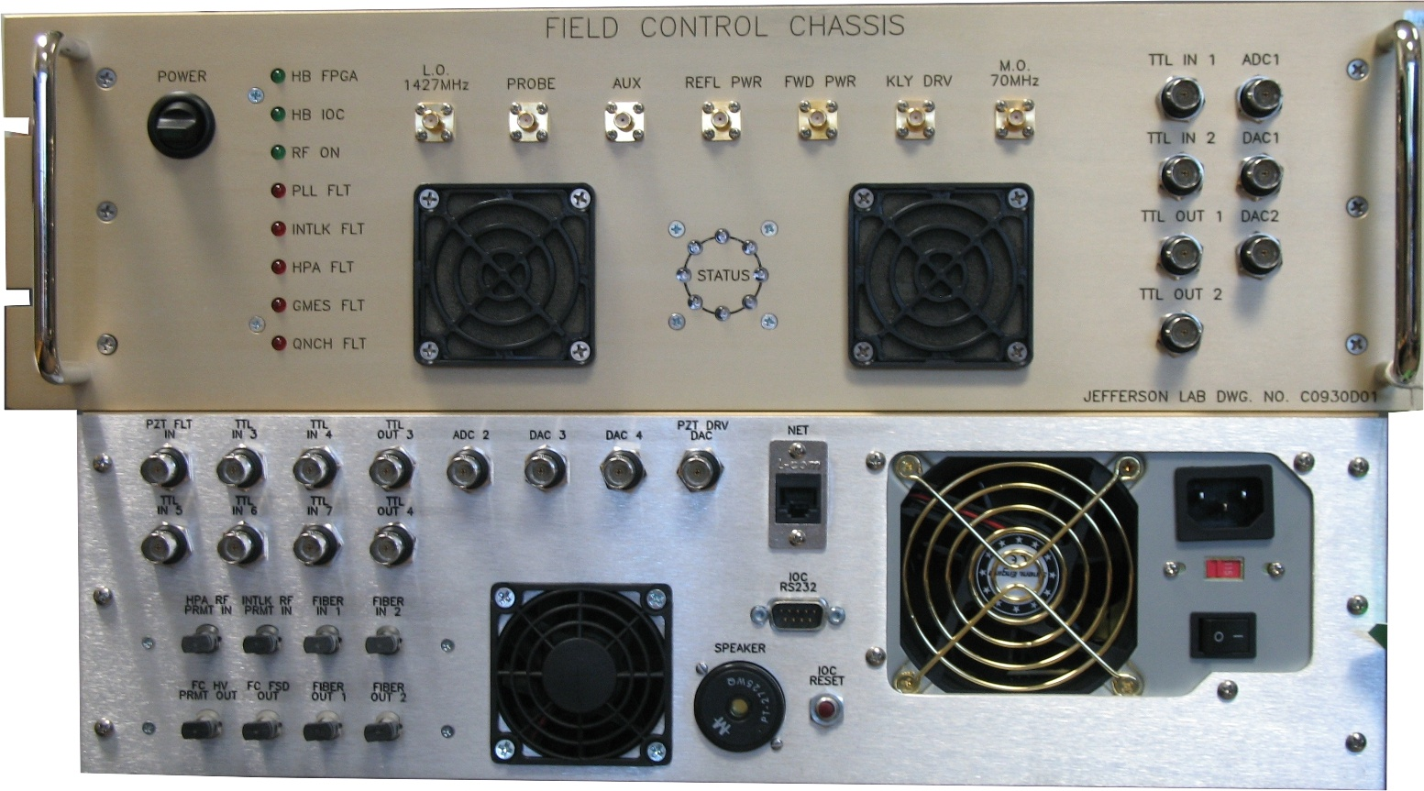
Field Control Chassis
Typical foot print
Large Altera FPGA
Four Receivers
On transmitter
Separate RF and Digital board
Features
Numerous I/O: ADC, DAC, TTL, Fiber
Ring Buffers
Hot Swappable
EPICs IOC = PC104
Installed and operating in Pohang, CEBAF and shortly at U.Wisc

Slide 8
Control Modes
Self Excited Loop (SEL): Used for finding or recovering a cavity.
Acts like an oscillator using the cavity as the “Tank” circuit.
Frequency Discriminator: Range +/- 200 kHz
Works with stepper motor to bring the cavity back to the master oscillator frequency.
Mode “free running” so can not run beam
Generator Driven Resonator (GDR): Locks the cavity to the master oscillator.
Stepper motor runs in the background keeping the cavity tuned
Stepper controls resonance from detuning angle
PZT still being tested

Slide 9
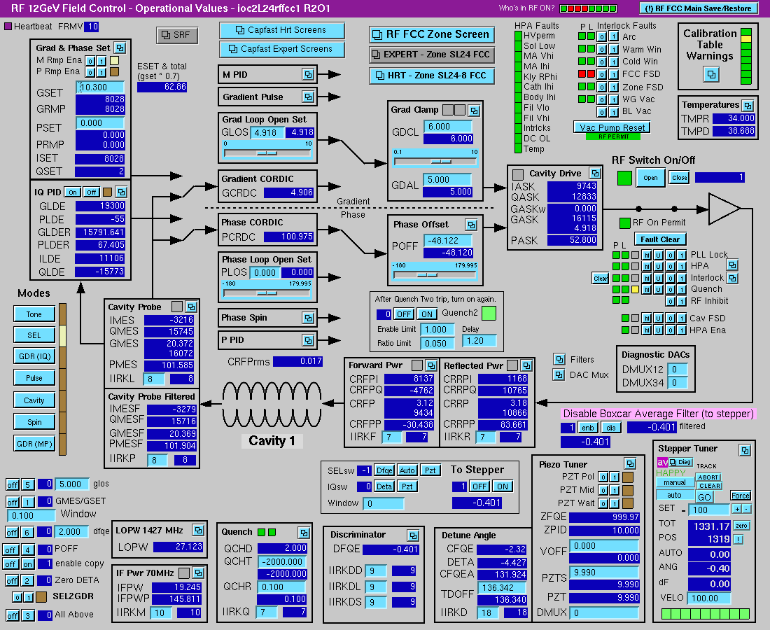
Field Control Screen

Slide 10
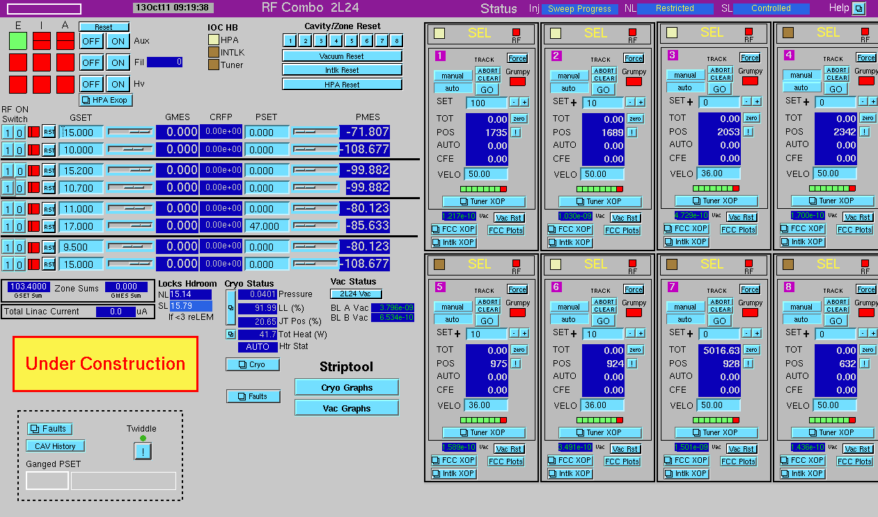
Zone RF Screen

Slide 11
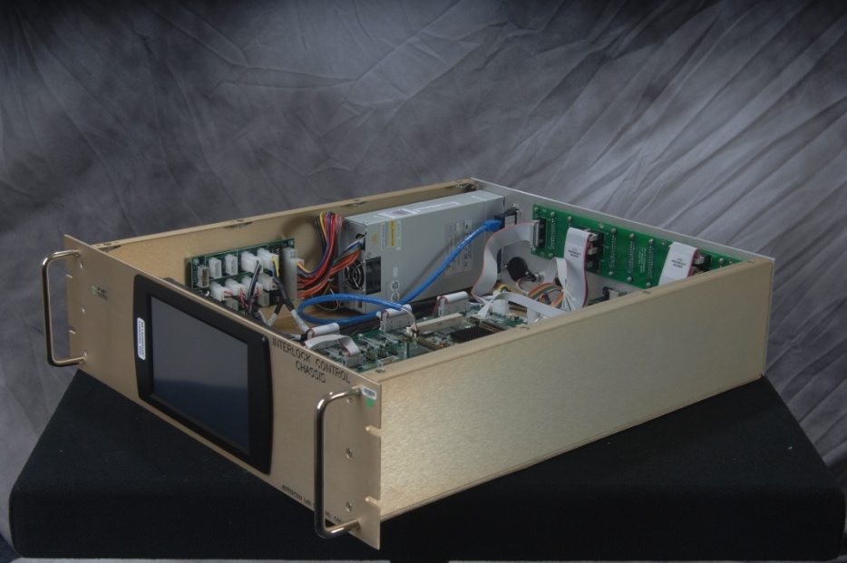
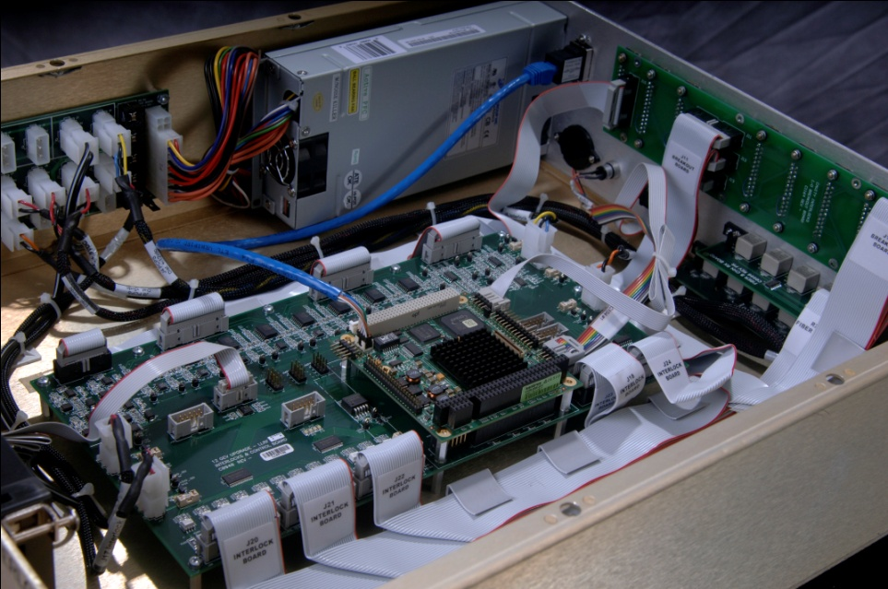
Cryomodule Interlocks
Single chassis for eight cavities
PC104/EPICs IOC
Front Panel touch/display screen
Interlocks
8 Window Arc detector (PMT)
16 IR Detector (Thermopile)
8 Waveguide Vacuum (Ion pump)
Beam Line Vacuum (Ion Pump)
Other Interlocks
Quench Detector (Rate of change)
Gradient vs. Forward Power (EPICs)
He Level (EPICs)

Slide 12
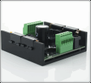
Stepper Motor Chassis
Eight stepper motor channels
PC104 Interface similar to FC chassis
Tuner much tighter than C20 can tune down to 1 Hz.
Very small backlash
US Digital MD2S

Slide 13
JLAB Piezo Tuner
Features
Commercial APEX piezo driver amplifier.
0 to 150 V at 50 mA.
Bandwidth (FS): 10 Hz
Packaging: 3U Eurocard x 8 channels
PZT will work together with the
Stepper to control small detuning
~ +/- 200 Hz
Notes:
Measured with identical PZT

Slide 14
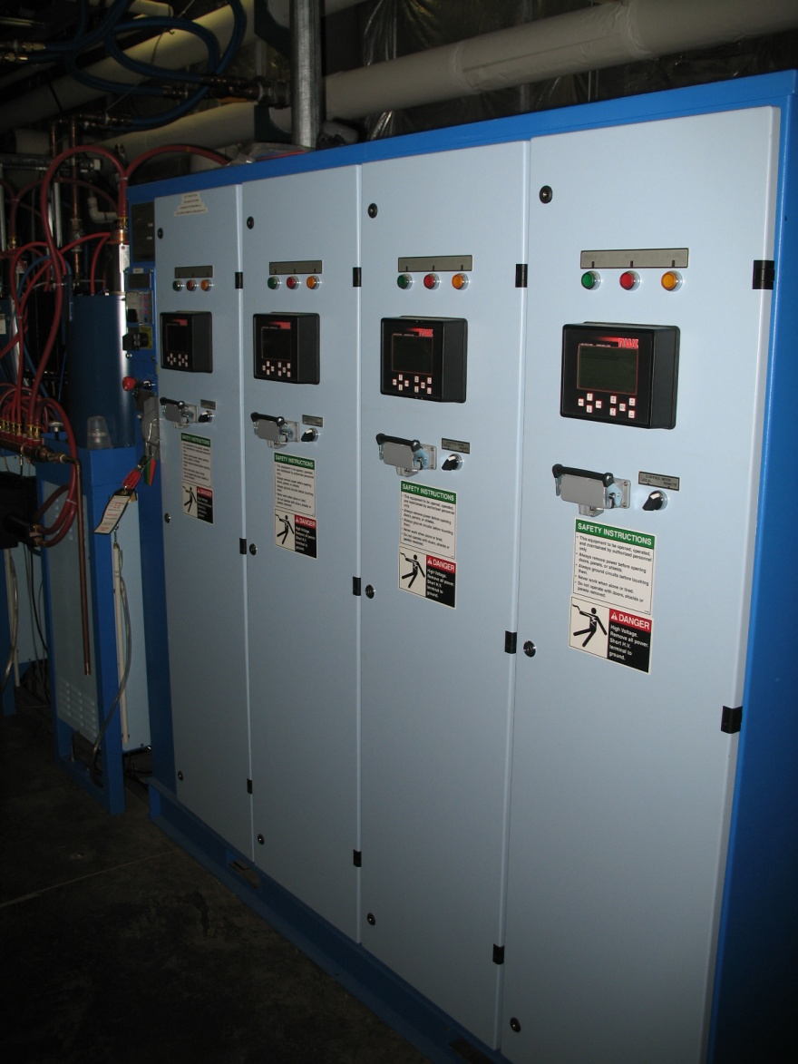
High Power Amplifier (HPA) Control
New system more forgiving when maintaining it.
Separate from RF controls (unlike older CEBAF systems)
Features and functions HV, Filament, mod anode etc.
Klystrons have solenoid instead of permanent magnet.

Slide 15
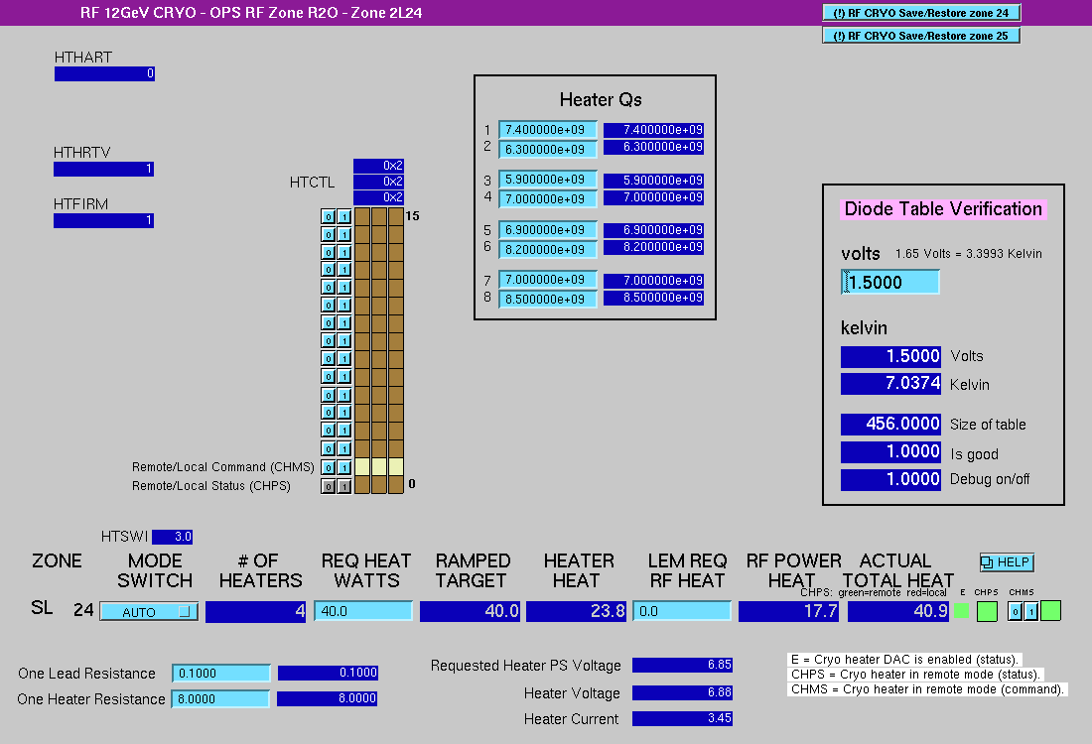
Cryomodule Diode & Heaters
Heaters are used to balance heat load in the cryogenic system
System operates in Parallel across four 8 ohm resistors inside the cryomodule
Uses the Cavity Qo’s to calculate the cryo-heat load from the gradient.
System also monitors cryo-diodes during cool down.
Cavity Qo’s

Slide 16
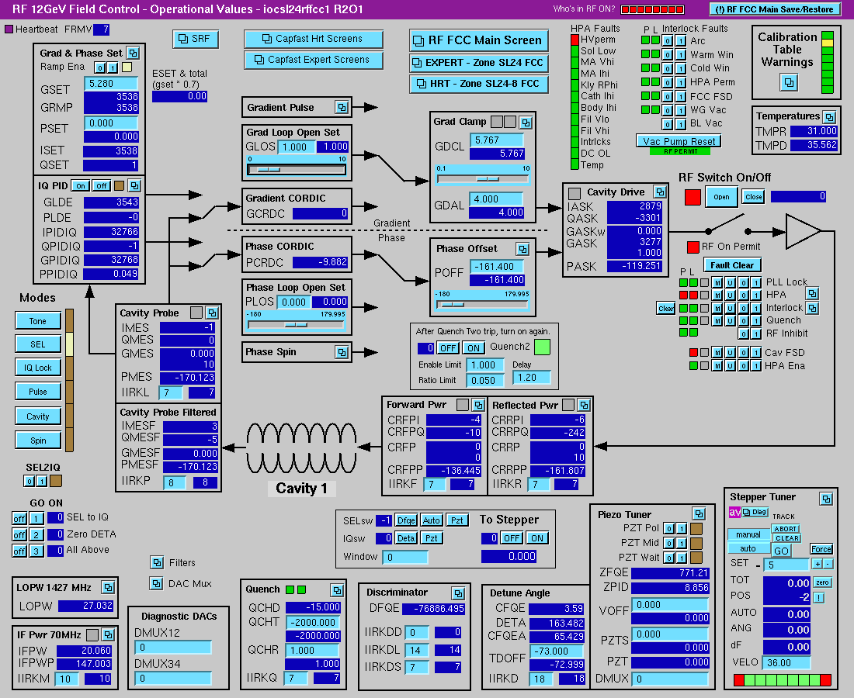
Summary
32 LLRF systems have been installed out of 80
Two 100 MeV cryomodules installed in the accelerator
The first cryomodule has been commissioned with LLRF
The 2nd is finishing up SRF commissioning
Firmware/Software continues to be modified to support beam operations.
Complete installation of the eight cryomodules beginning summer of 2012

