Slide 1
SESAME
Successes and Challenges
R-D Heuer SESAME-Germany Info day, April 21, 2023

Slide 2
Successes

Slide 3
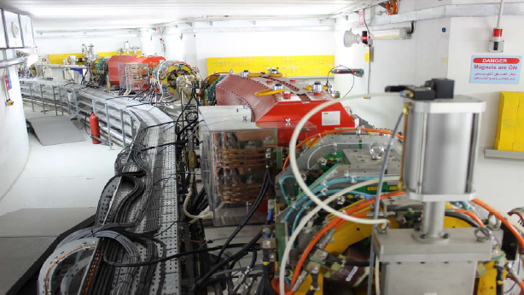
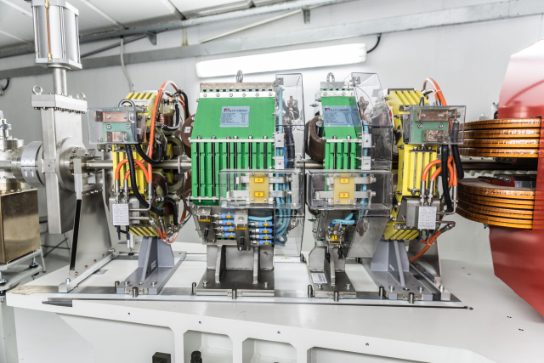
SESAME is the first Synchrotronradiation source in the Middle East
1995: First ideas
10 Februar 2016: Begin Installation of the Synchrotron
16 Mai 2017: official Opening
17 Juli 2018: Start of the
Scientific Program
2.5 GeV, 400mA
SESAME
from dream (1995) to reality (2017)
I) SESAME exists

Slide 4
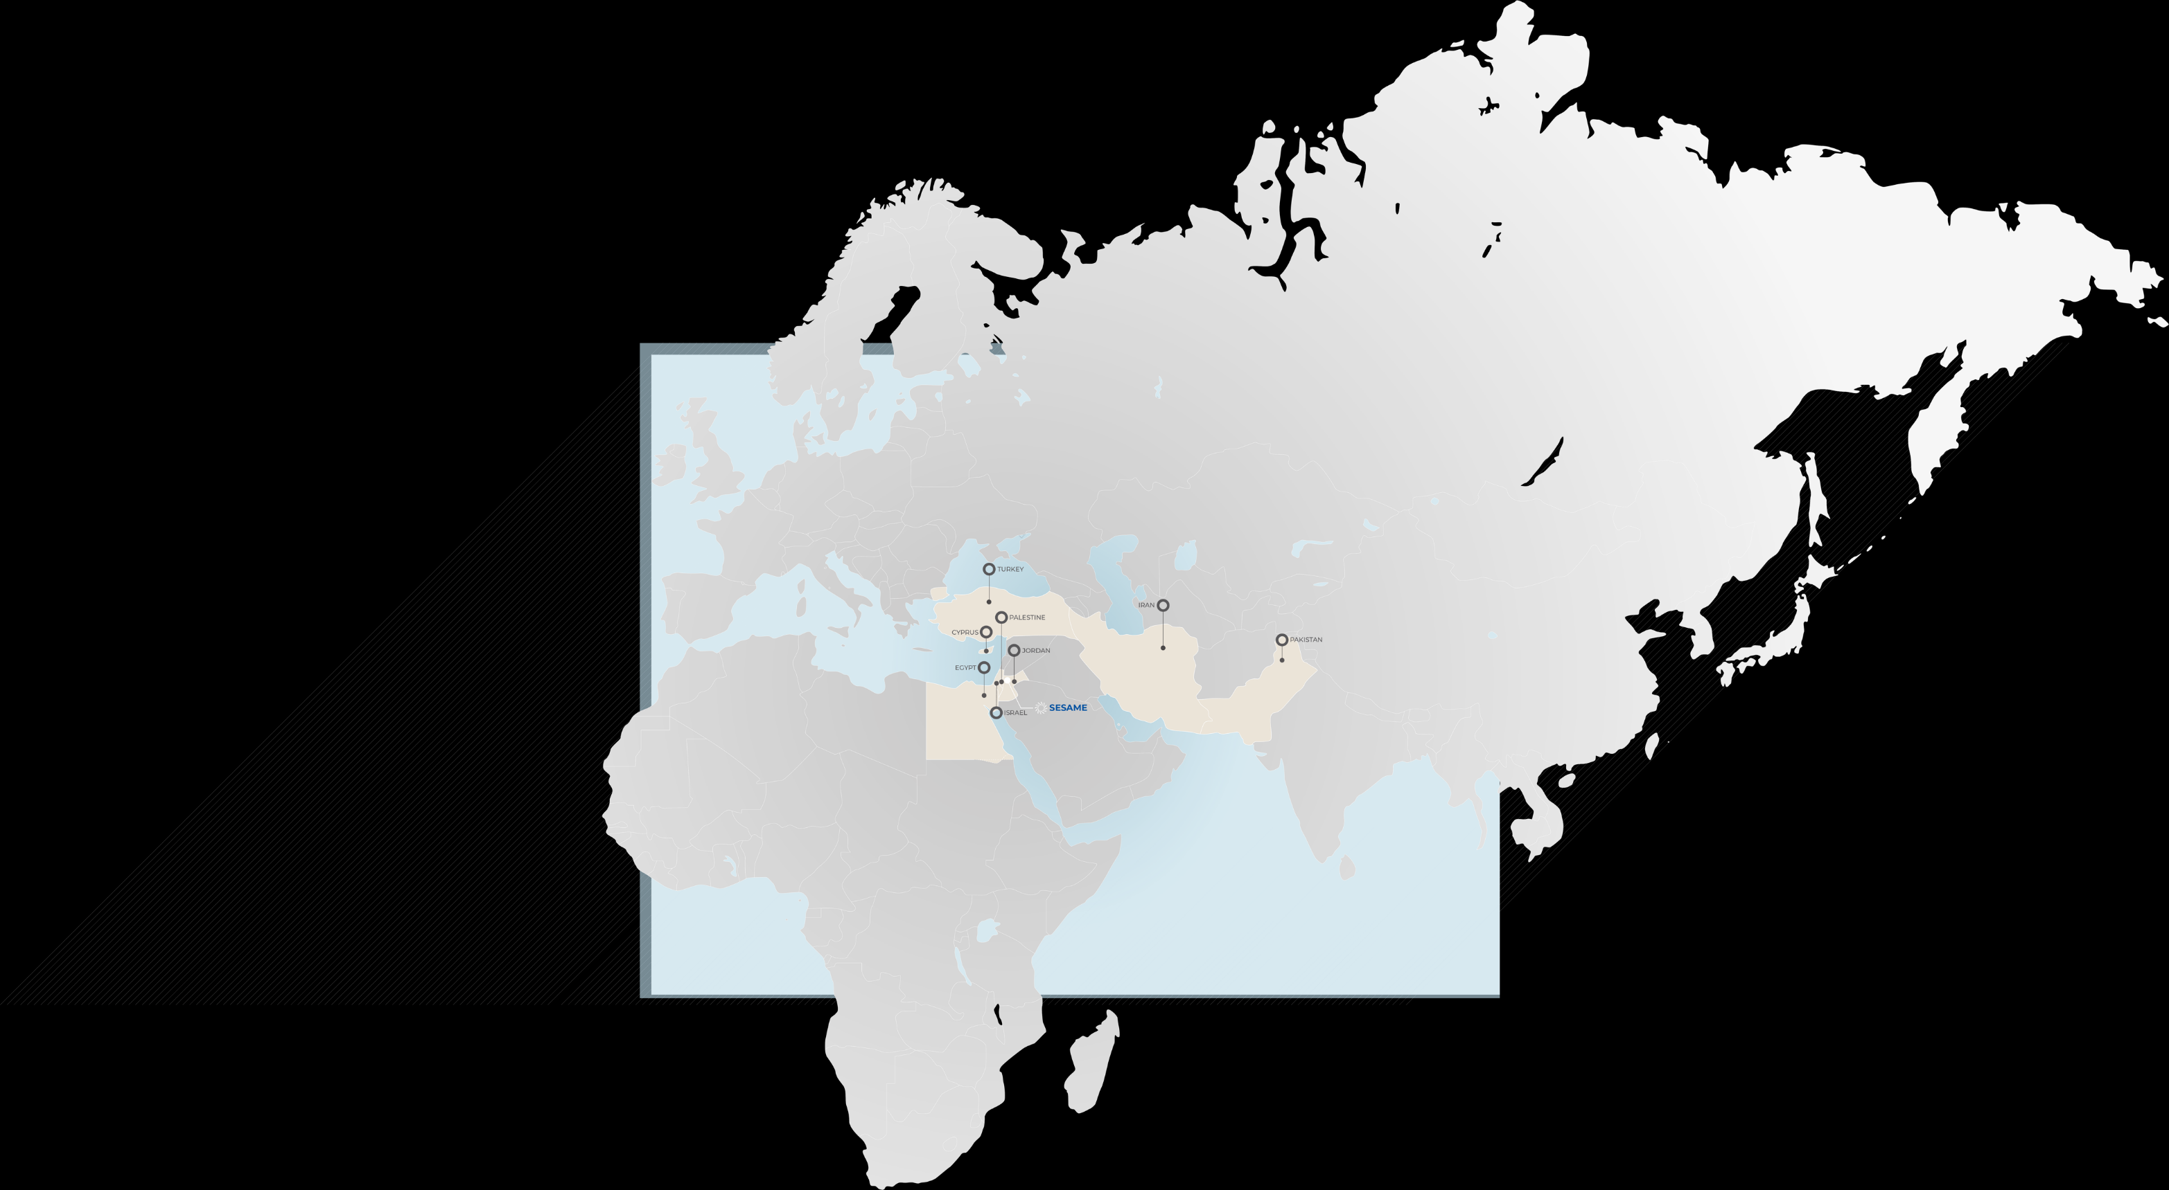
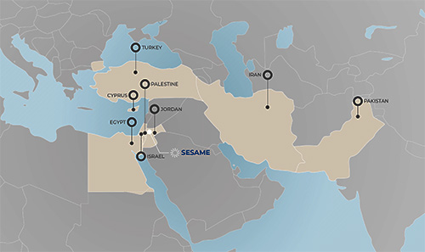
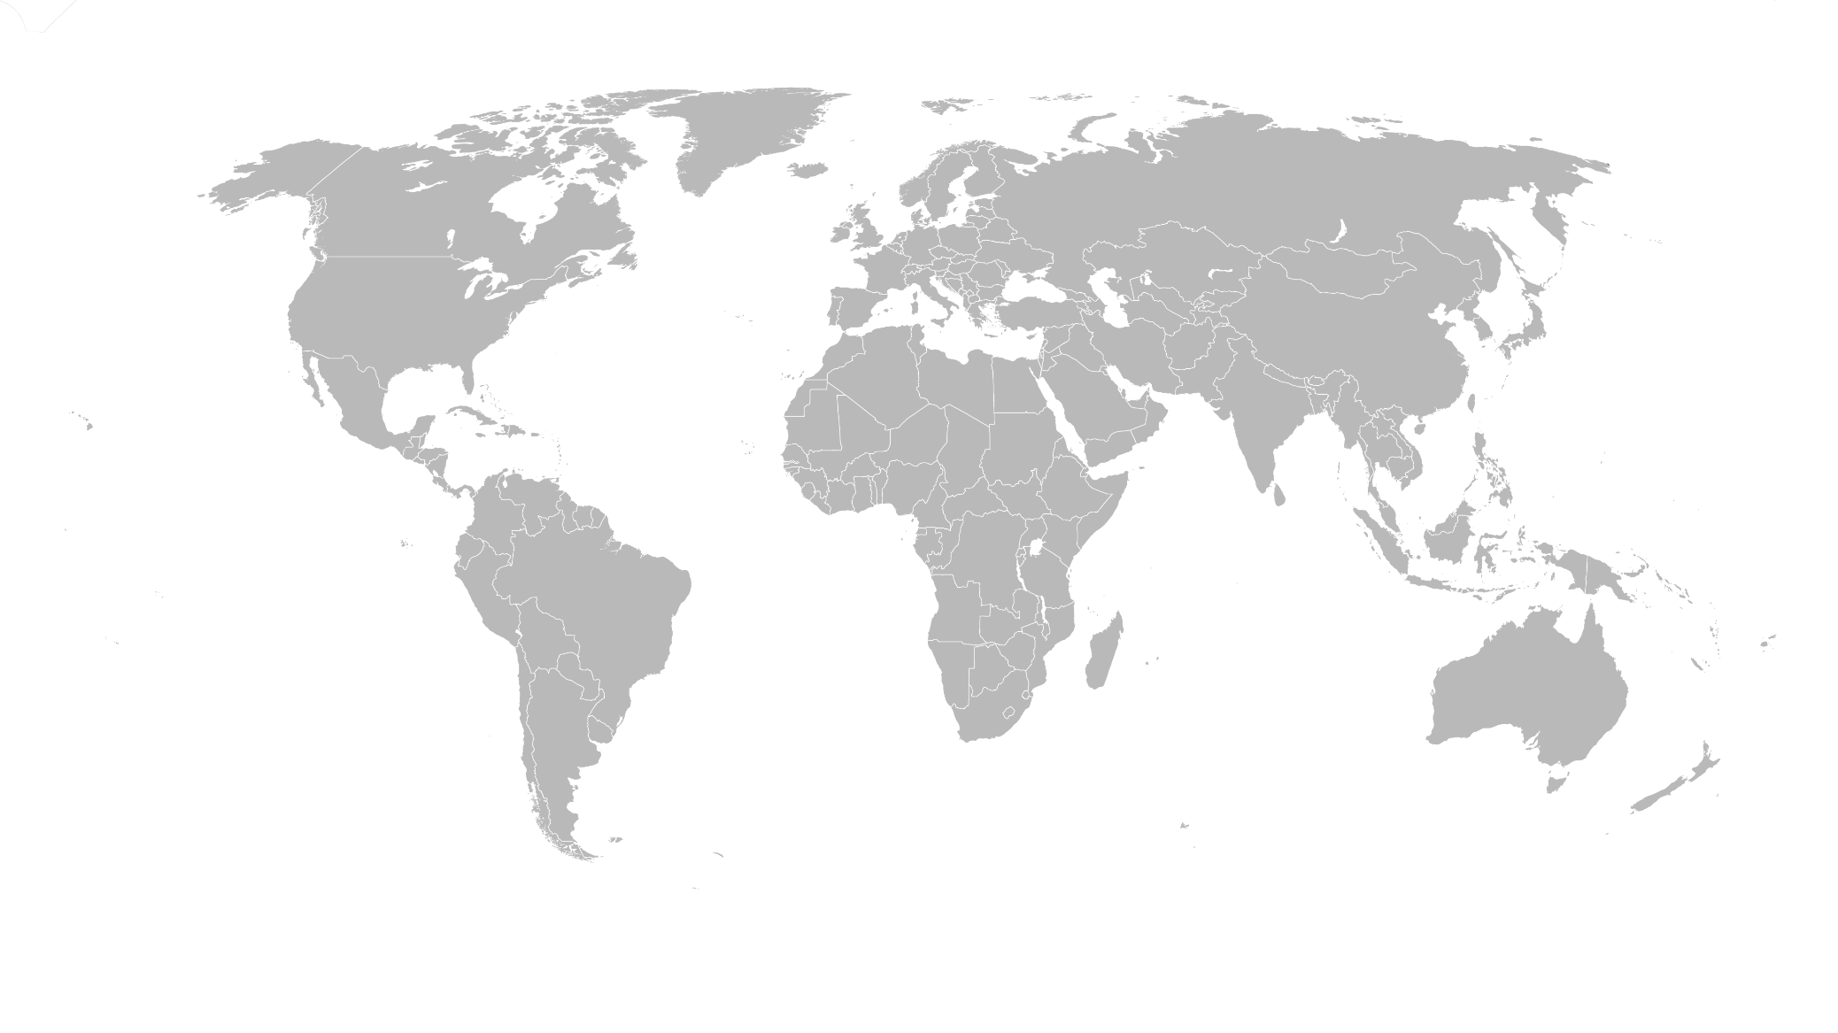
SESAME’s Members
Cyprus
Egypt
Iran
Israel
Jordan
Palestine
Pakistan
Türkiye
International Cooperation as example of
Peaceful Cooperation

Slide 5
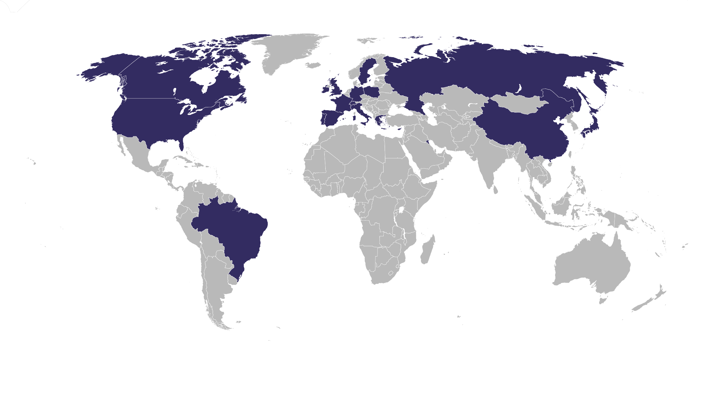
Beyond the members
there is world wide support:
SESAME’s Observers
Brazil, Canada, CERN, China, the European Union, France, Germany, Greece, Italy, Japan, Kuwait, Portugal, Russian Federation, Spain, Sweden, Switzerland, UAE, UK, and the USA.
International Cooperation as example of
Peaceful Cooperation

Slide 6
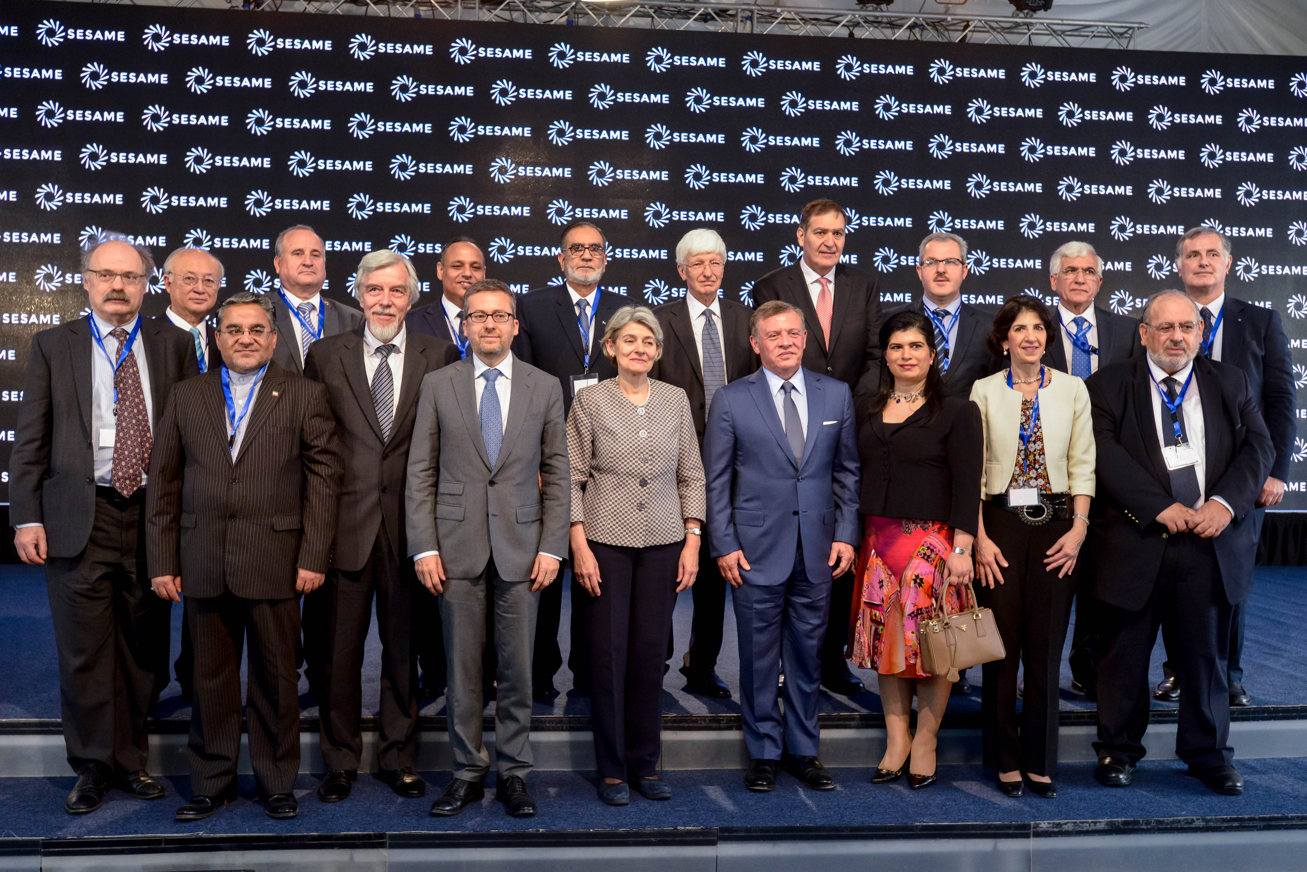
Inauguration 2017

Slide 7
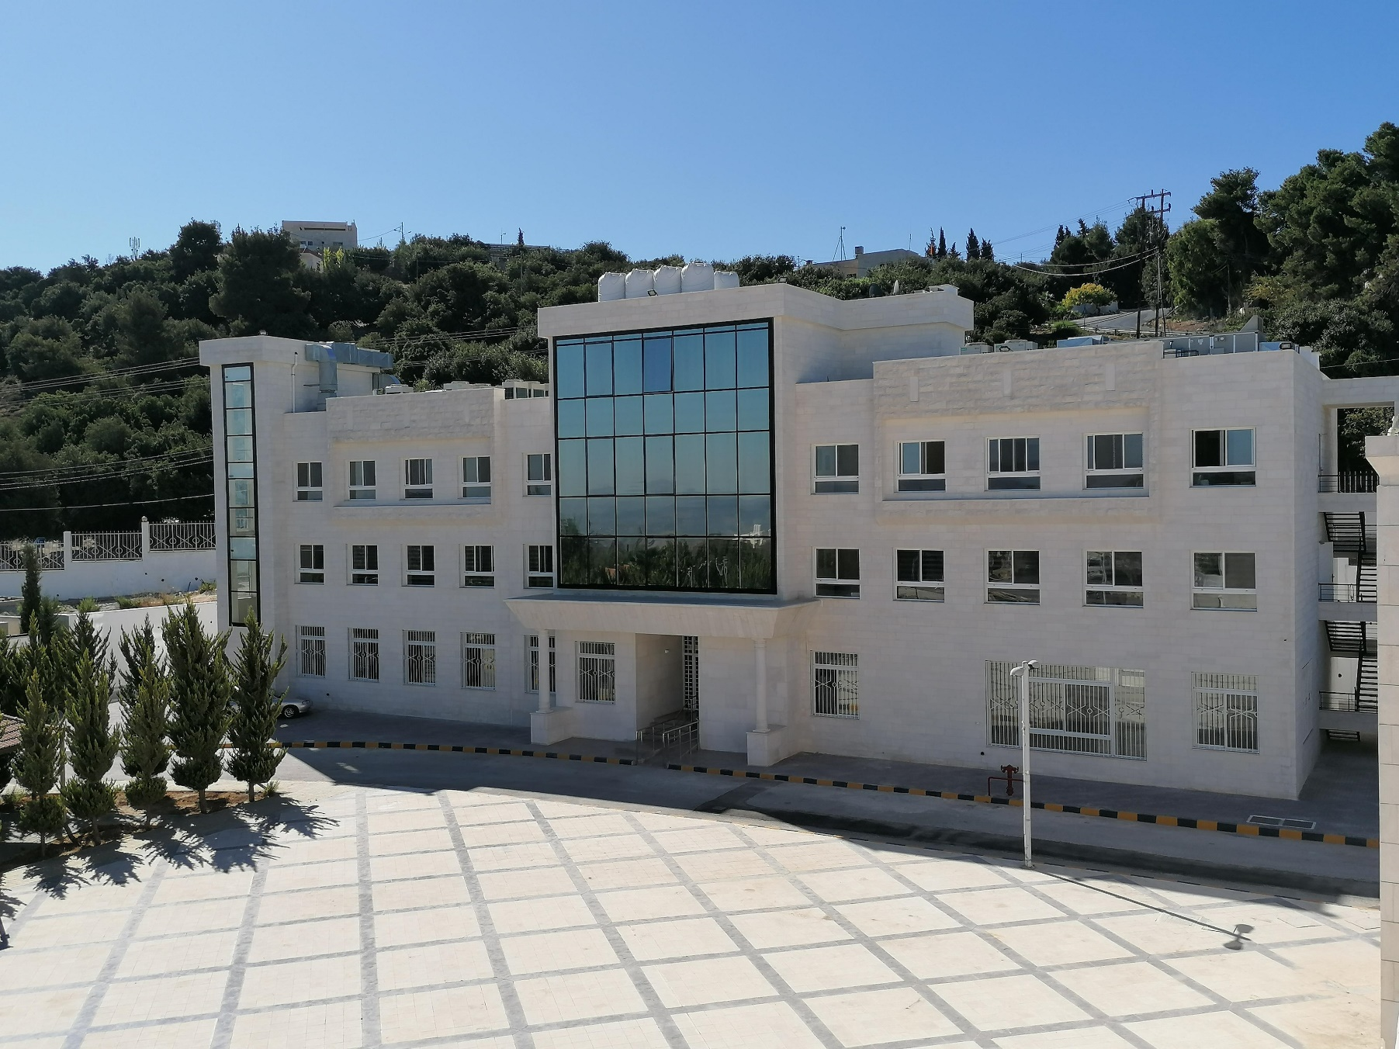
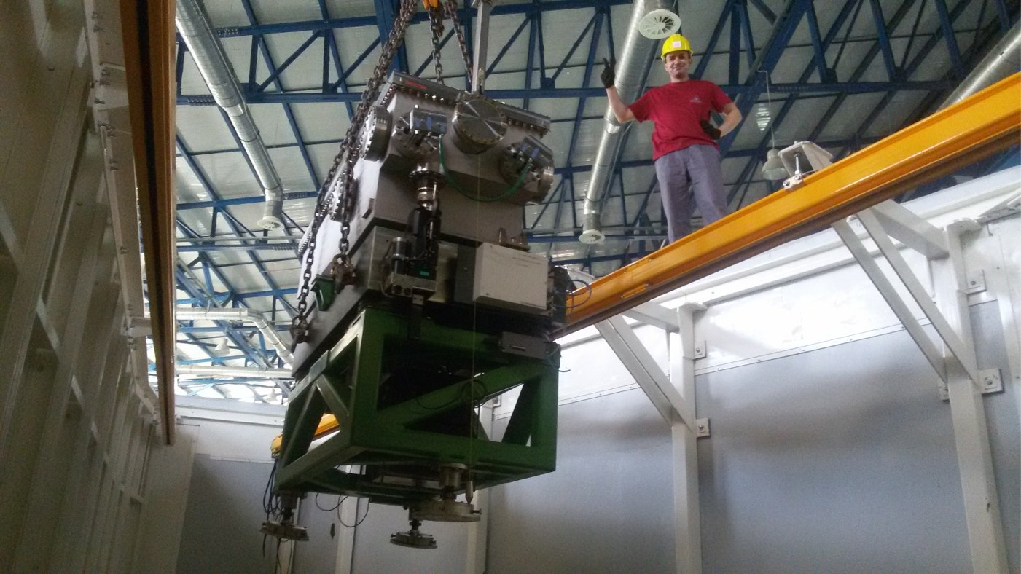
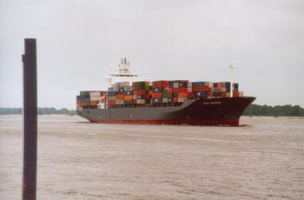
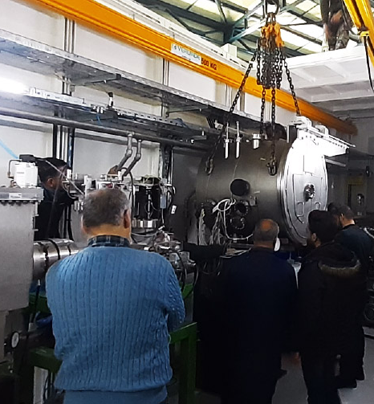
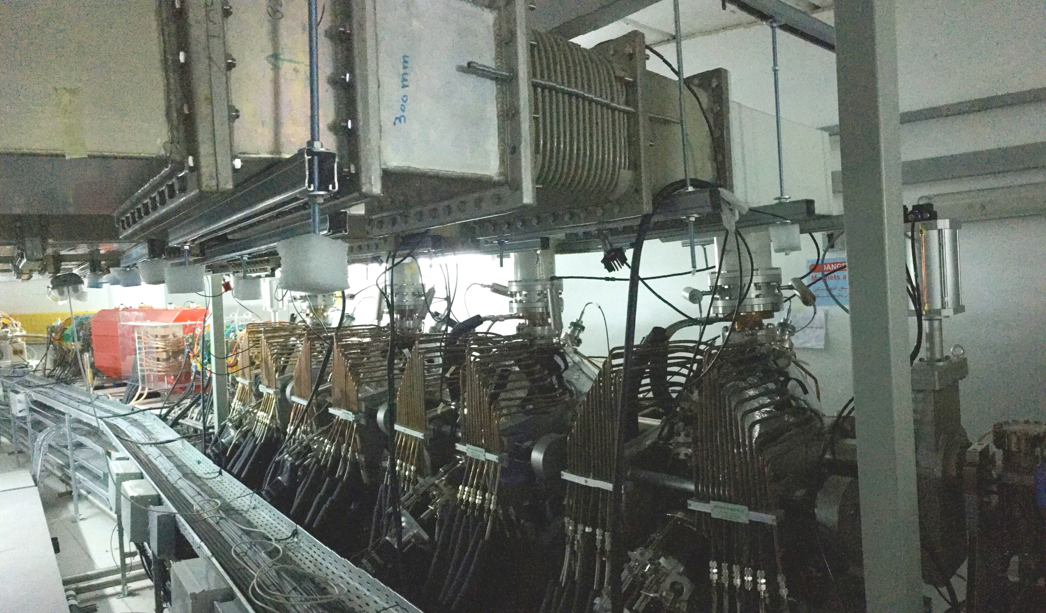
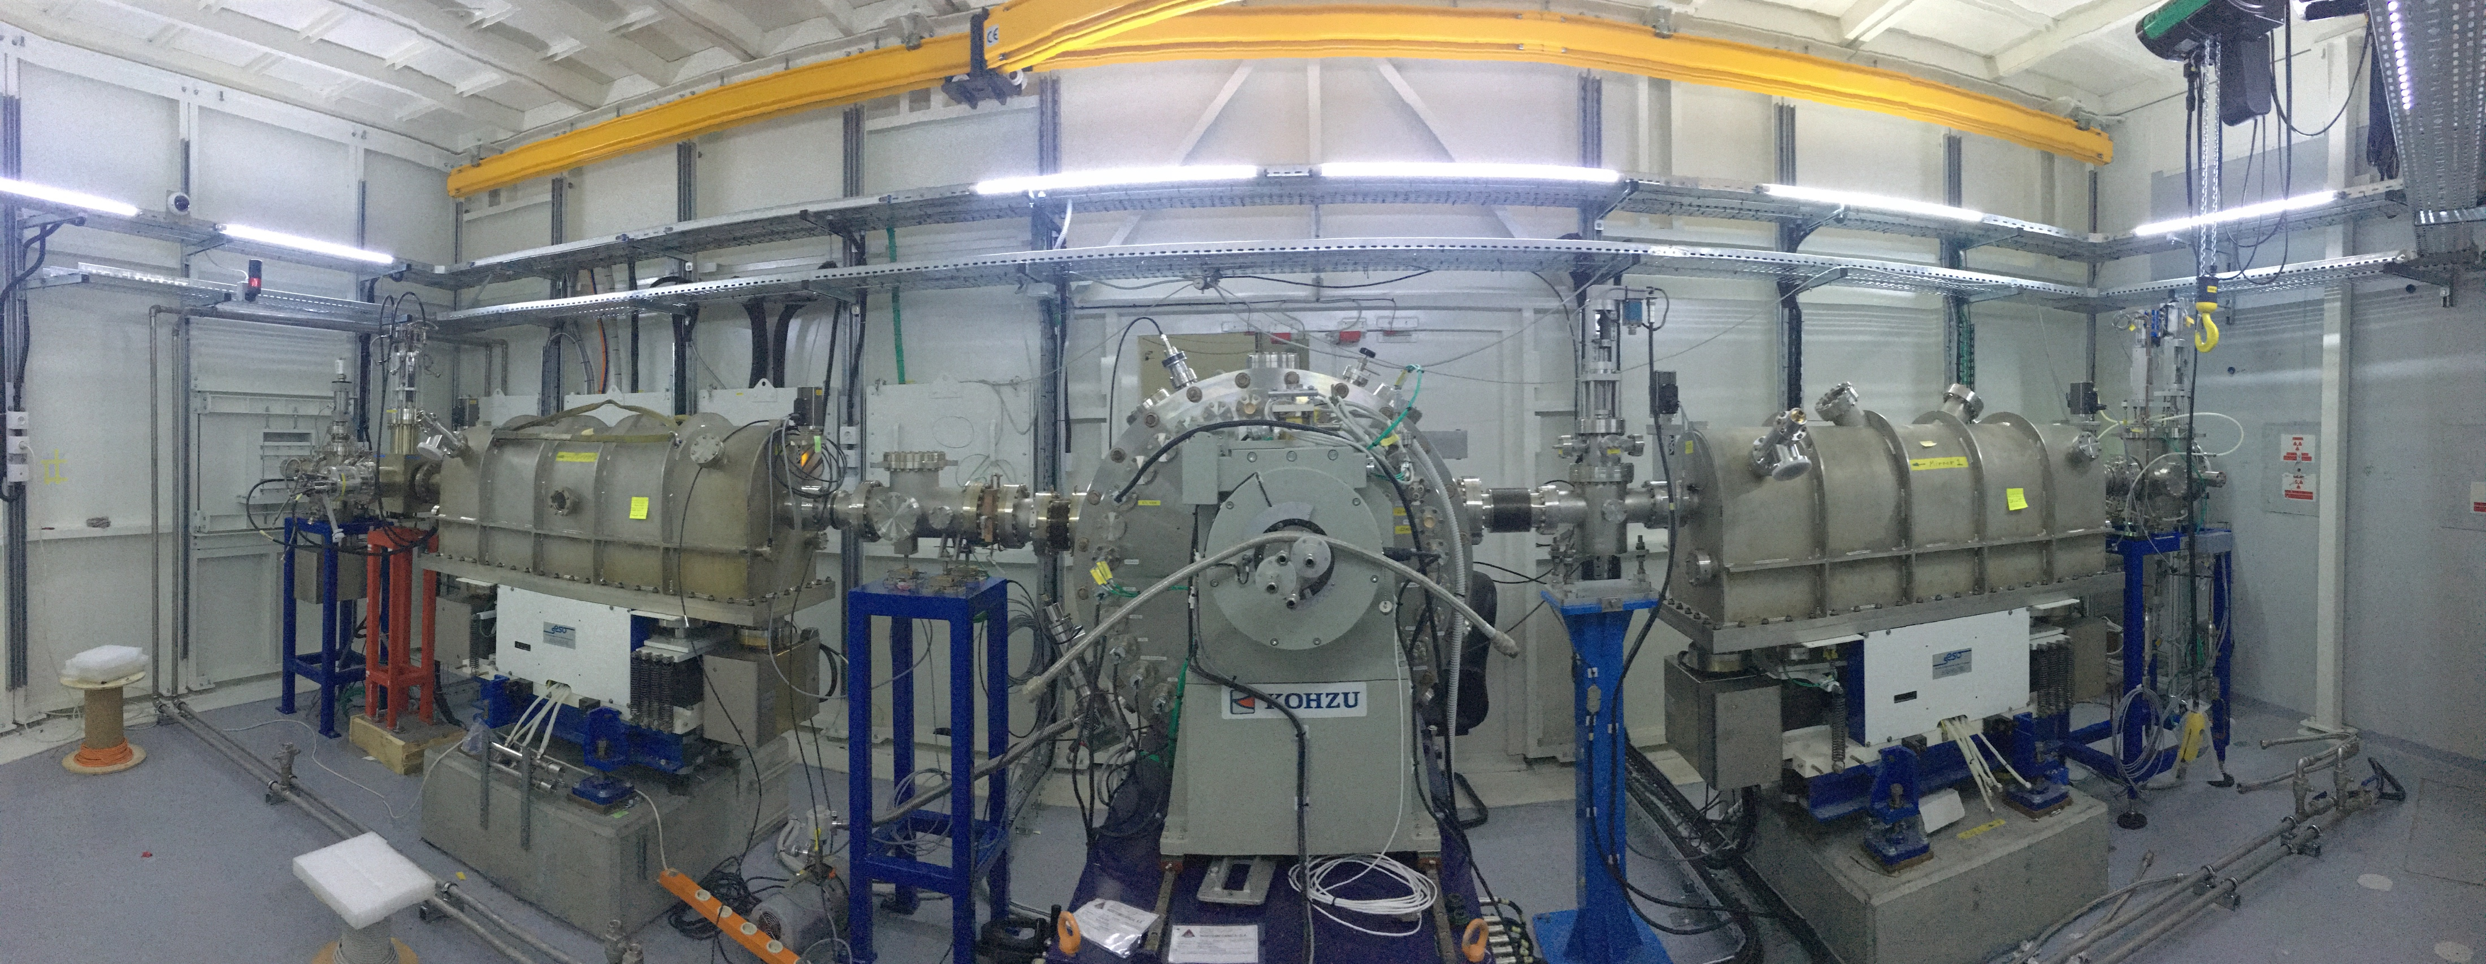
II) SESAME receives
much support from
Observers
Sergio Fubini Guest-House (I)
The boat at Hamburg harbor on its way to Aqaba, Jordan with BESSY I on board; June 7, 2002
XAFS/XRF Monochromator (UK)
Rossendorf Beamline (D)
Material Science Beamline (CH)
The 4 RF Cavities (I)

Slide 8
Important milestone 2019
III) Thanks to EU support, SESAME became the World's FIRST large accelerator complex to be fully powered by renewable energy

Slide 9
Publications
IV) 61 peer-review publications
Average impact factor 5.2
30% of publications IF > 7
BLs open to users
(Nov 22)
Common projects? Yes, starting

Slide 10
V) Performance of SESAME
Staff

Slide 11
Challenges

Slide 12
Budget: size
stability
Members: number
geogr. location
Associate Members: none yet

Slide 13
Proposals
Call #4
proposals
distributions
IR | 58
XAFS/XRF | 52
MS | 26
Total | 136
Total accepted | 59
closed March 8

Slide 14
More Proposals
from non-Members
Where are German researchers?

Slide 15
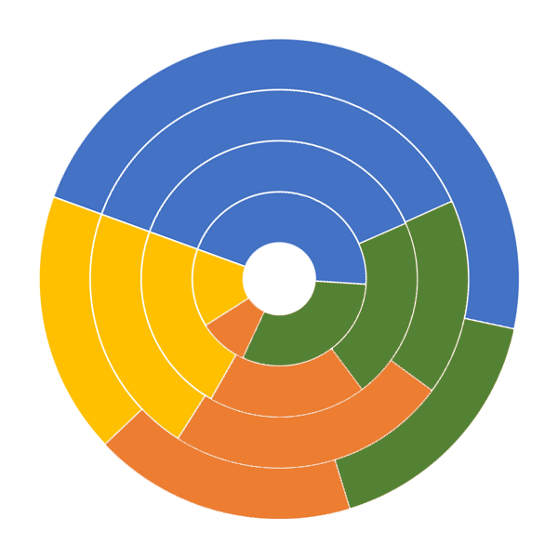
2022
Proposals distribution by
Research fields
2020
2019
2018
Materials and Physical Sciences
Life Sciences
Archeological and Heritage Sciences
Chemical Sciences

Slide 16
Opportunities

Slide 17
Collaborative Projects
Members/non-Members
Internships
Exchange of Staff
Upgrade/Maintenance of other facilities presents an opportunity to try out SESAME……..

Slide 18
SESAME
Fantastic Project
Deserves all Possible Support

