Slide 1
Characterisation of the Medipix3: A single-photon-counting hybrid detector
DESY Summer Students Programme 2011

Slide 2
Contents
Introduction
Detector structure
Pixel electronics
Normal pixel behaviour
Faulty pixels
Temperature influence
Conclusion

Slide 3
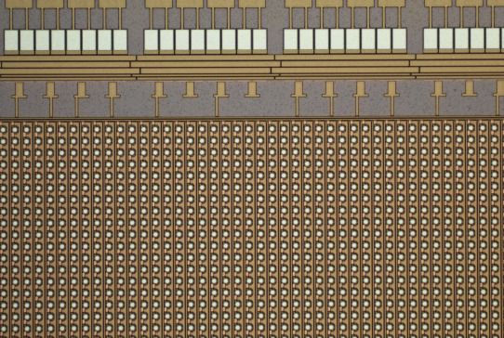
Introduction
Semiconductor photon detectors:
Huge advances in micro-electronics industry (Moore’s law)
Very fine structures => high spatial resolution
Popular design: the CCD (in your digital camera)
Hybrid detectors:
Developed at CERN for particle physics
Also very useful in photon science (X-ray research) because of the single photon counting nature
Advantages over CCD: e.g. energy threshold
Medipix3

Slide 4
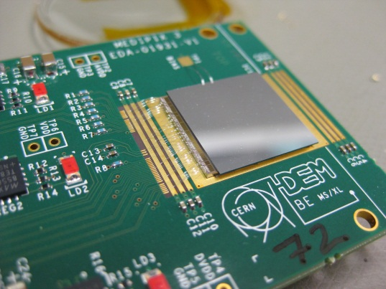
Detector structure
Hybrid design: two layers
Top layer:
Actual detector medium; converts photons to electrical current
N-type semiconductor (e.g. Si) with array of P-type implants
Reverse bias: normally no current (except leakage)
Photo-electric effect: electron-hole pairs
Connection:
Bump bonds (solder)
Bottom layer:
Signal processing electronics (actual Medipix3 chip)

Slide 5
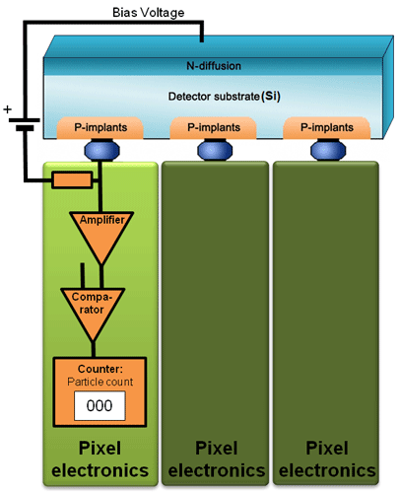
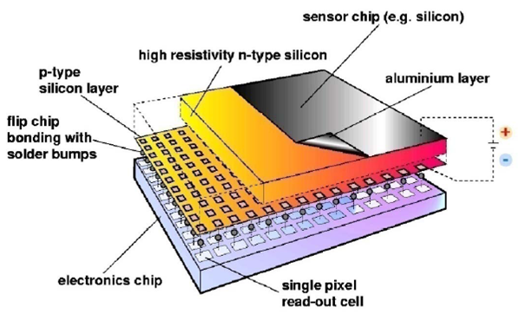
Detector structure
Top layer
Bump bonds
Bottom layer
One pixel
Pixel array

Slide 6
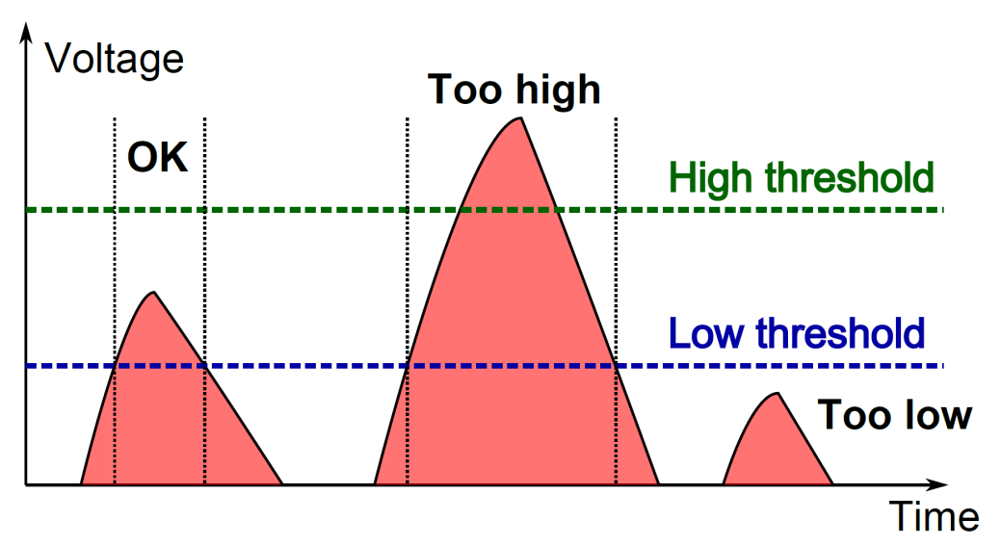
Pixel electronics
Count photons, i.e. pulses of electric current induced in PN-junction of the top layer
Amplify & “shape” each pulse
Then compare it to a threshold (~ minimum photon energy)

Slide 7
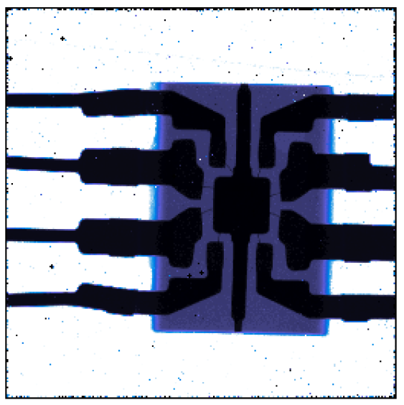
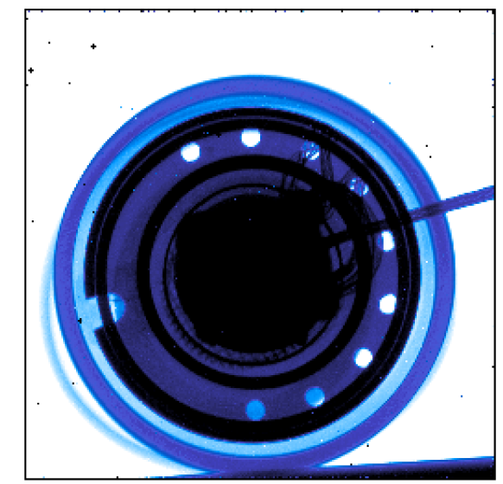
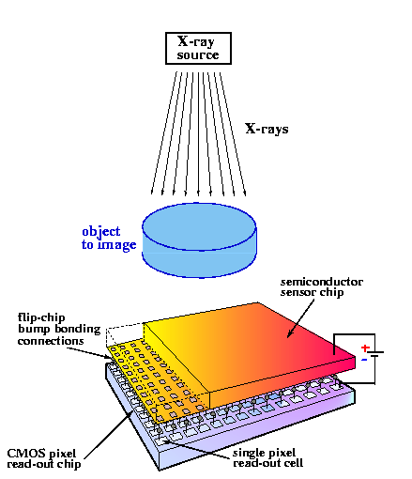
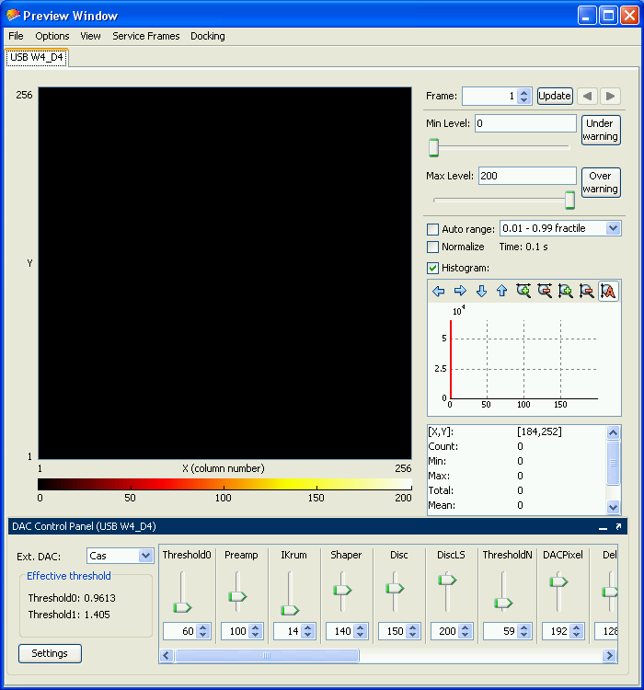
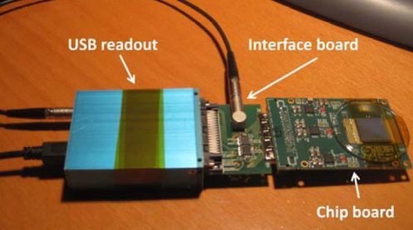
Setup: Hardware/software
Detector: single Medipix3 chip 256x256 pixels, 55 μm pitch
Software: Pixelman v2.1.0, July 4th 2011
IDL 8
USB interface
(Test pulses)

Slide 8
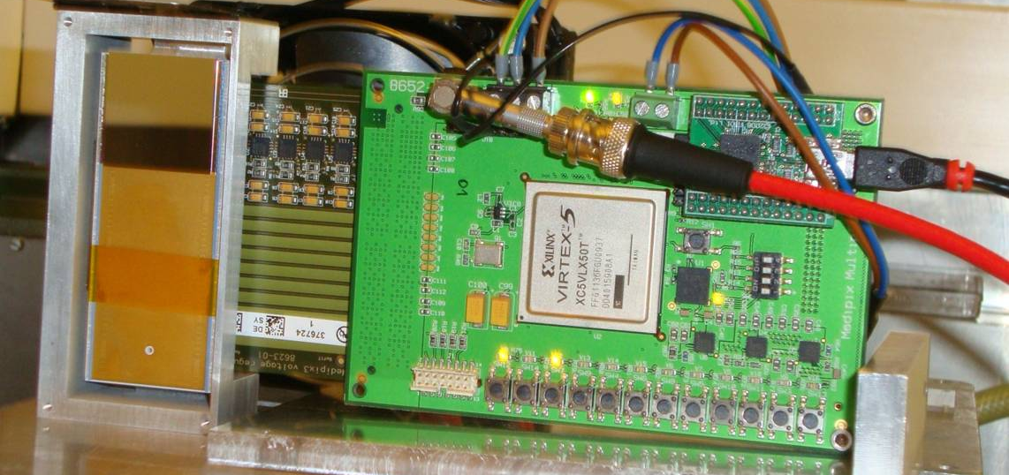
New developments
Tile several chips together => increase resolution
Chip mounting & cooling: design consideration

Slide 9
Central question
How is the performance of the Medipix3 influenced by various conditions?
DAC settings
Temperature
Accurate comparison: use test pulses instead of actual photons

Slide 10
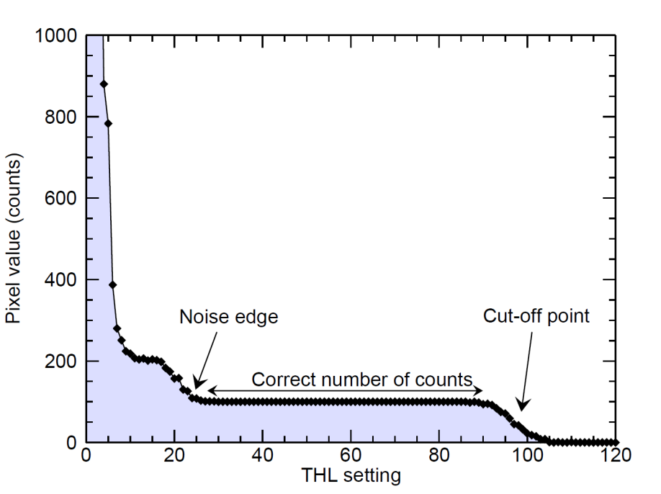
Normal pixel behaviour
Global threshold DAC (digital-to-analog converter)
Threshold very low: noise
Threshold very high: no counts
In between: correct number of counts
100 test pulses (5 ke⁻ charge)

Slide 11
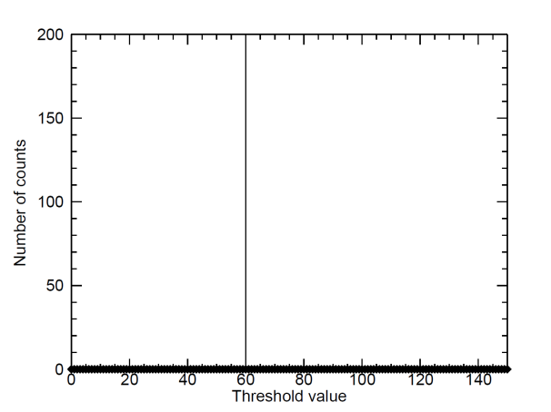
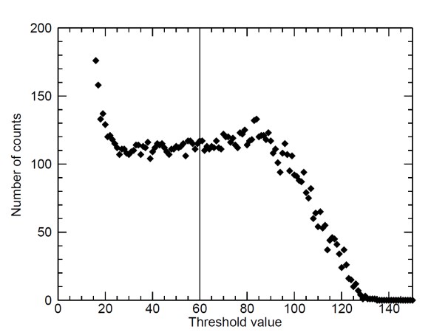
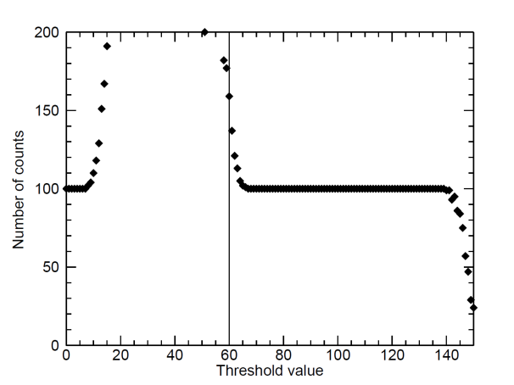
Faulty pixels
Some pixels don’t work this nicely…
No counts (dead pixel)
Wrong count (noise)
Wrong count (misadjusted pixel)
a
b
c

Slide 12
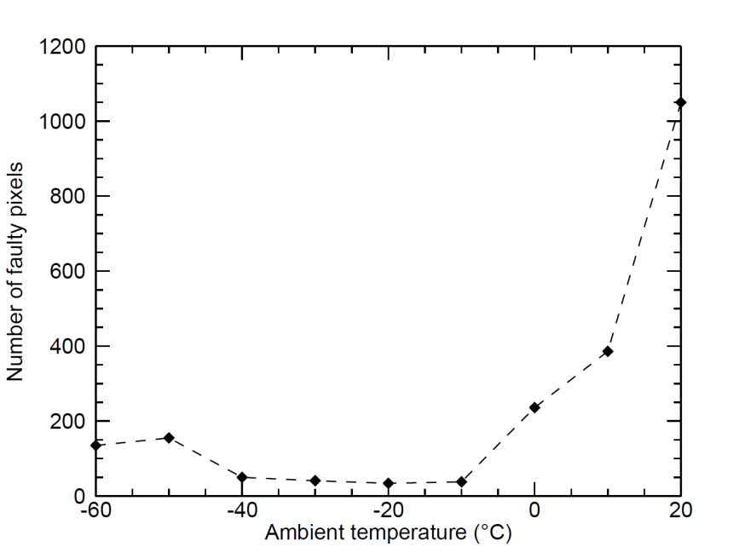
Temperature influence
Faulty pixel count
Border pixels dead
THL = 60
Optimal THL for each temperature

Slide 13
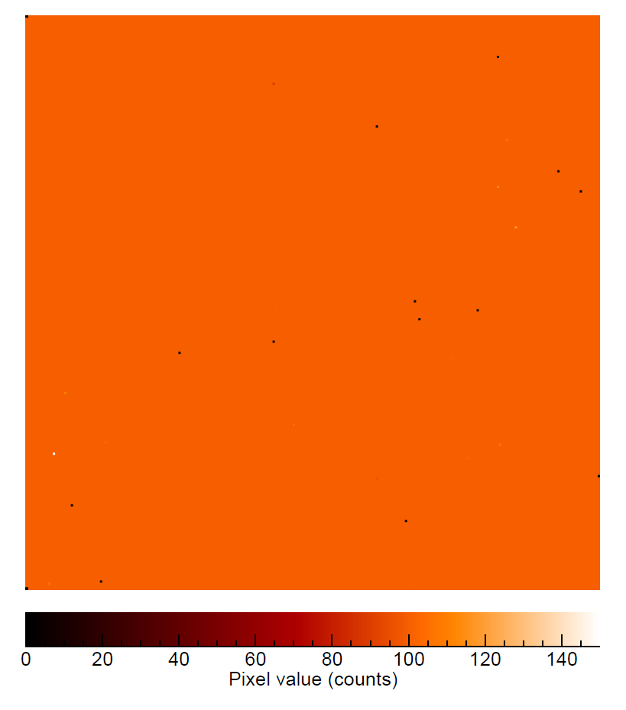
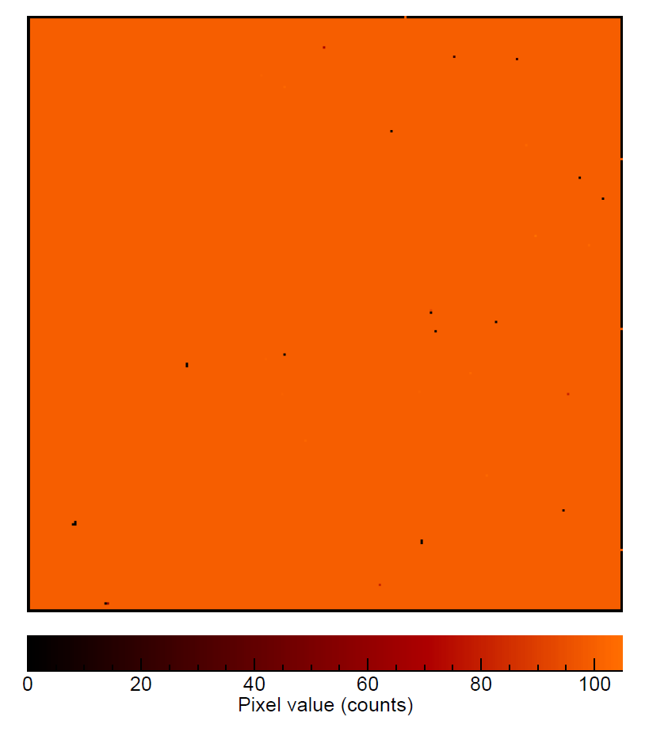
Temperature influence
Example images (THL = 60)
-20 °C
+20 °C

Slide 14
Why?
Temperature dependency of the DAC voltages
Default code + 20 steps @ -20 °C
Default code + 10 steps @ -20 °C
Default code @ -20 °C
Default code - 10 steps @ -20 °C
Default code - 20 steps @ -20 °C

Slide 15
Why?
Leakage current increases with temperature
Higher near the border (crystal defects)

Slide 16
Conclusion
Ideal: -20 °C ambient temperature (actual chip temp. ≈ +40 °C)
Even then, still some malfunctioning pixels

