Slide 1
Coherent X-Ray Diffractive Imaging: Modeling and Reconstruction
DESY Summer Student Session
Oleg Gorobtsov, MIPT, Russia
Supervisor:
Dr. Adrian Mancuso, Leading Scientist, European XFEL GmbH
September 2011
Notes:
How to edit the title slide
Upper area: Title of your talk, max. 2 rows of the defined size (55 pt)
Lower area (subtitle): Conference/meeting/workshop, location, date, your name and affiliation, max. 4 rows of the defined size (32 pt)
Change the partner logos or add others in the last row.

Slide 2
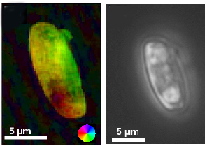
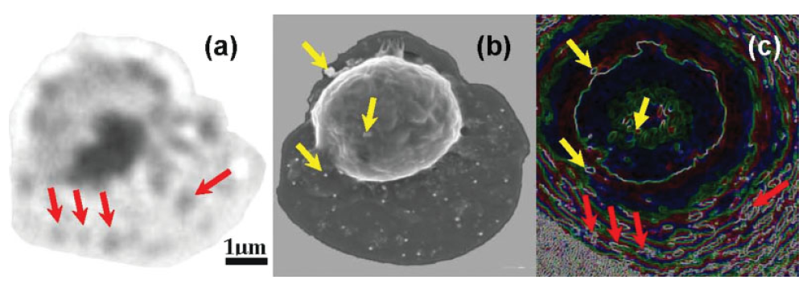
CXDI: What is it used for?
Examples of use:
Imaging of individual biological cells and viruses (biotechnology, medicine, etc) – not only 2D, but also volume structure.
Potentially – imaging of macromolecules, particularly in non-crystallized form.
Left: CXDI-reconstructed image of Navicula Perminuta, with both absorption and phase (colour) data.
Right: optical micrograph of the same cell.
Figure from Mancuso, A. P. et al., 2010. New Journal of Physics 12 035003
Comparison of different methods for imaging malaria-infected red blood cell.
a – optical image, b – scanning electron microscopy, c - FCDI
Figure from Williams, G. J. et al., 2008. Cytometry 73A: 949-957

Slide 3
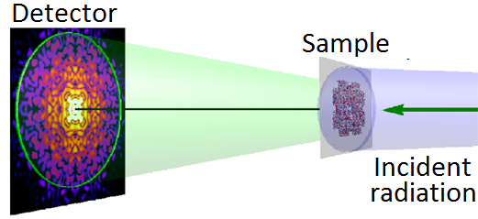
CXDI in Short
Schematic of CXDI experiment. The sample is a macromolecule, on the detector is a diffraction pattern.
Figure from Mancuso, A. P, et al., 2010. Journal of Biotechnology, 149 229-237
Isolated sample is illuminated by a coherent radiation
The incident wave interacts with the sample
Resulting Exit-Surface Wave (ESW) propagates to the 2D detector in the far-field from the sample
ESW (containing information about the sample) is reconstructed, using measured far-field diffraction pattern
Notes:
Before you start editing the slides of your talk change to the Master Slide view: Menu button “View”, Master, Slide Master:
Edit the following 2 items in the 1st slide: 1) 1st row in the violet header: Delete the existent text and write the title of your talk into this text field 2) The 2 rows in the footer area: Delete the text and write the information regarding your talk (same as on the Title Slide) into this text field.
If you want to use more partner logos position them left beside the DESY logo in the footer area Close Master View

Slide 4
CXDI: Capabilities
Advantages:
No optics between sample and detector => no resolution limitations (from optics). Resolutions of <10nm at synchrotrons; potentially atomic at FELs
X-Ray penetrative ability: permits to study objects that would be too thick for transmission electron microscopy. It also allows volume structure imaging
Limitations:
Diffracted intensities alone do not allow to simply propagate wave back to the sample plane and get ESW, sophisticated procedures needed – the focus of this work
Radiation damage to the sample limits resolution
Requirement: high coherence

Slide 5
CXDI: Why FELs?
Up to 90% and more coherent photons in a beam – compared to ~5% on synchrotrons
Ultrashort, ultrabright pulses
Pulse duration is <100 fs, at certain conditions <10 fs => pulse can scatter before it destroys the sample
However, for 3D-imaging techniques one needs to make multiple measurements

Slide 6
Reproducible and Non-Reproducible Samples
Reproducible samples:
Non-organic samples, macromolecules, some viruses
Volume structure can be reconstructed by imaging different samples, destroyed in the process. One can classify and orient 2D patterns and reconstruct 3D image
Non-reproducible samples (our case):
Cells, cell organelles etc.
Volume structure cannot be reconstructed using the same method. Radiation damage in each measurement should be limited without signal-to-noise ratio falling too low. They should NOT be destroyed in one shot

Slide 7
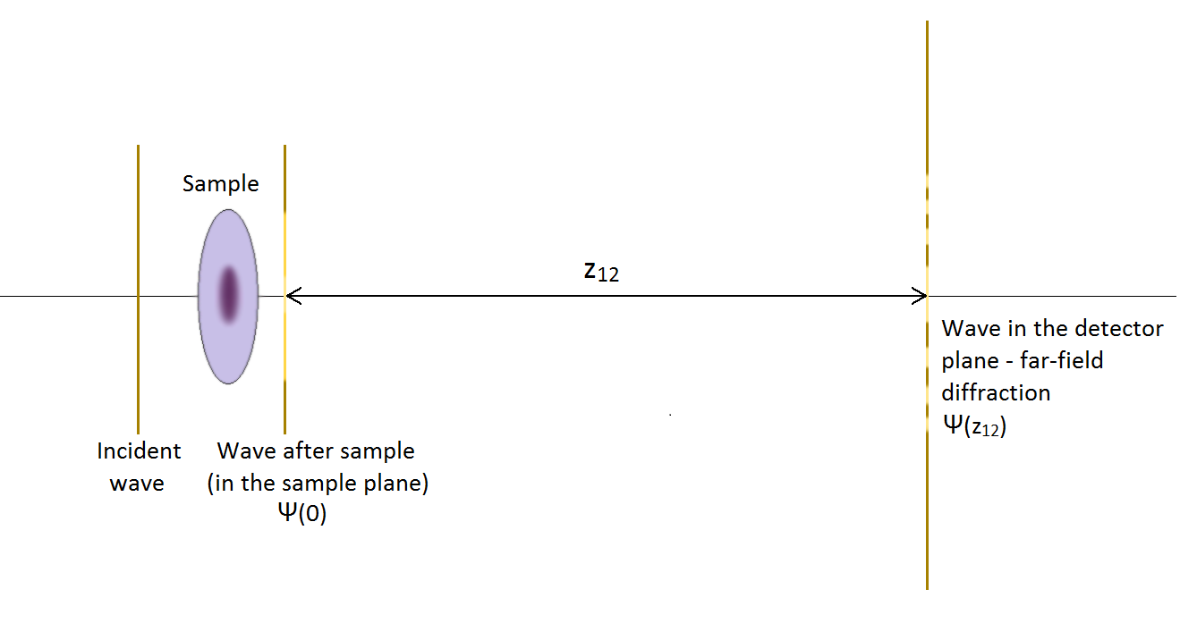
2D Plane Wave Imaging: Scheme
Schematic of 2D plane wave imaging experiment.
Far-field: distance between sample and detector planes $z_{12}≫\frac{d^{2}}{λ}$, where $d$ is sample diameter, $λ$ is wavelength
Wave is characterized by 2D field of complex numbers. Change of amplitude – absorption, phase – refraction
Propagation between planes:
$$Ψ\left(x^{′′}, y^{′′}, z_{12}\right)=\frac{i}{λz_{12}}e^{\frac{2πi}{λ}z_{12}}e^{iπλz_{12}({x^{′′}}^{2}+{y^{′′}}^{2})}F\left\{Ψ\left(x^{′}, y^{′}, 0\right)e^{−\frac{iπ}{λz_{12}}\left({x^{′}}^{2}+{y^{′}}^{2}\right)}\right\}$$

Slide 8
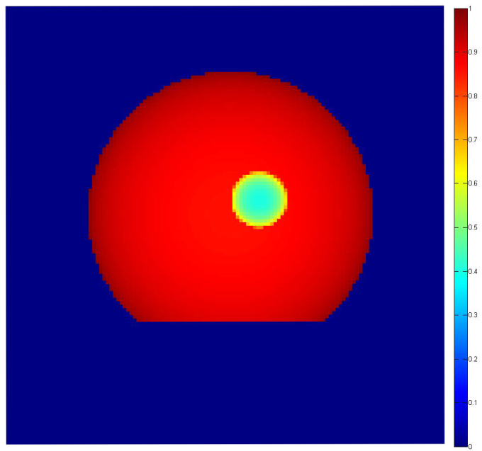
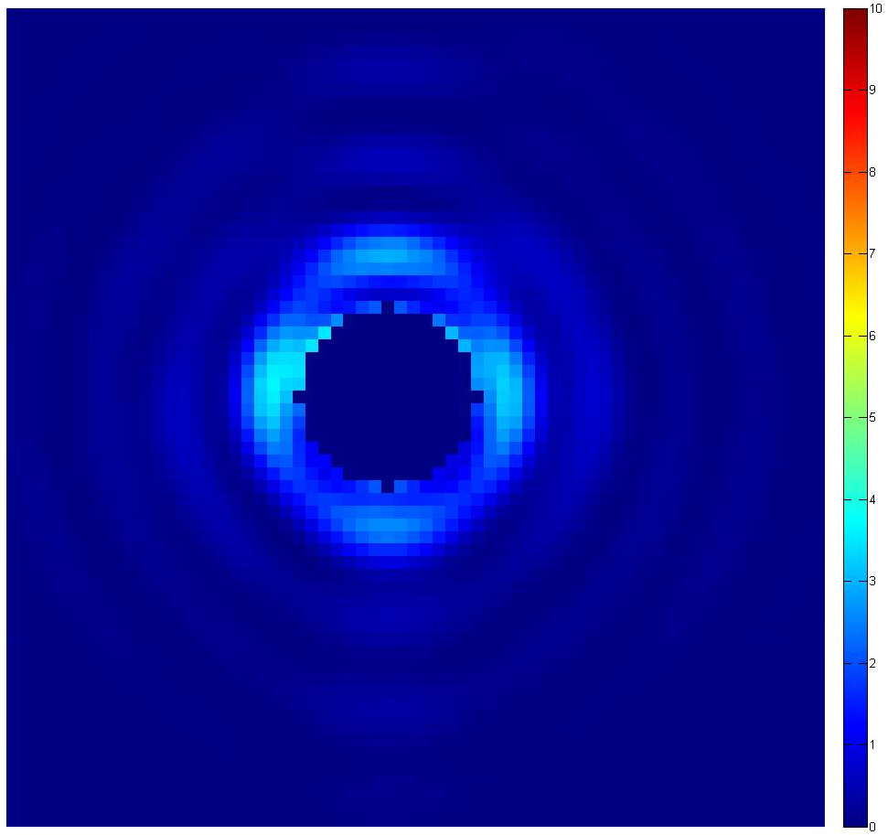
2D Plane Wave Imaging: Modeling
Modeling steps:
Construct the sample transmission function from known properties and distribution of material
Multiply the incident wavefunction by it and propagate the result to the detector plane (thin object)
Calculate the diffracted intensity – far-field wavefunction squared
Sample model:
Left: simulated ESW intensity for simplified cell nucleus model, 1µm protein sphere with 0.2 µm selenium inclusion. Pixel size 24 nm. $λ=7 A.$
Right: far-field diffraction pattern, with central stop and Poissonian noise simulated. $z_{12}=70 cm.$

Slide 9
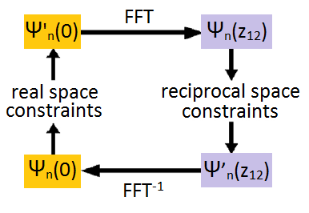
2D Plane Wave Imaging: Reconstruction
Diffracted intensities are insufficient to calculate ESW. But with some information about the sample one can use iterative algorithms for reconstruction.
Block diagram for such an algorithm:
Reciprocal space constraint:
$$\left|Ψ_{n}(z_{12})\right|→\sqrt{I_{measured}}$$
Real space constraints:
finite support of the sample
positivity (if applicable)
…
Modified figure from Mancuso, A. P, et al. 2010 Journal of Biotechnology, 149 229-237
Algorithms vary in the way these constraints are implemented. For example, Error-Reduction algorithm is just direct implementation, e. g. amplitude of the wave outside the support is just set to zero, etc.

Slide 10
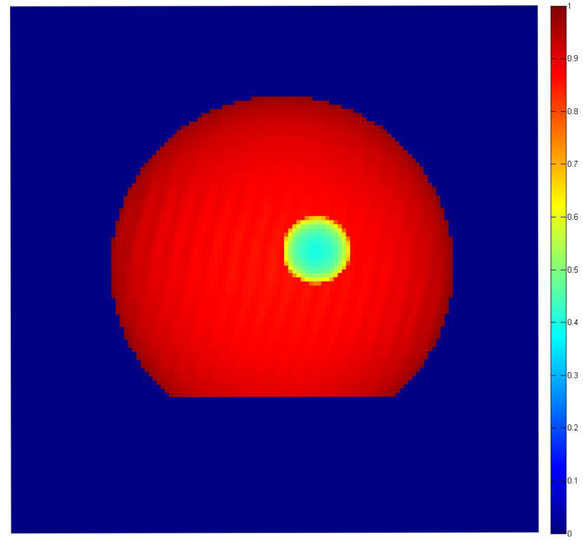
2D Plane Wave Imaging: Reconstruction
ER often converges to local minima.
In the beginning of iteration procedure, so-called Hybrid Input-Output algorithm is used. It does not strictly limit intensity in the sample plane to the support.
Reconstruction for model sample. 500 iterations of HIO and 50 iterations of ER. Left: reconstructed ESW intensity. Right: original ESW.

Slide 11
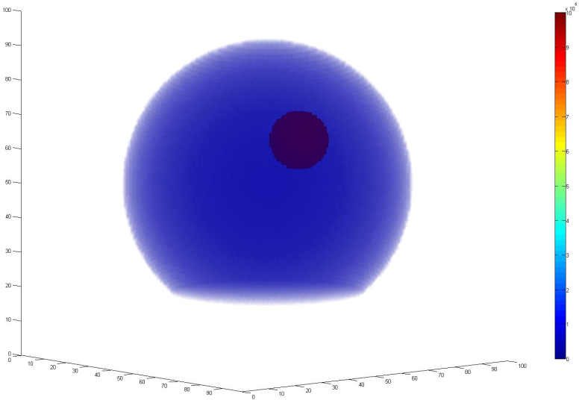
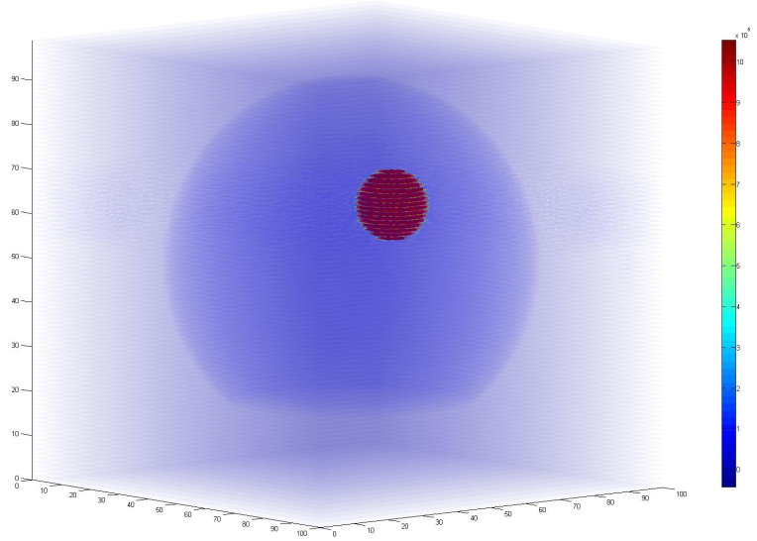
Tomography: Filtered Backprojection
If one can acquire multiple projections of the sample, rotated about one axis, it is possible to reconstruct the volume structure of the sample.
General steps:
Measure 2D far-field diffraction patterns for the rotated sample. Number should be greater than the diameter of the sample (in pixels);
Corresponding 2D projections of the sample are reconstructed;
3D image of the sample is acquired from projections.
Volume structure reconstructed through filtered backprojection.
Left: original structure. Right: volume structure reconstructed through filtered backprojection.

Slide 12
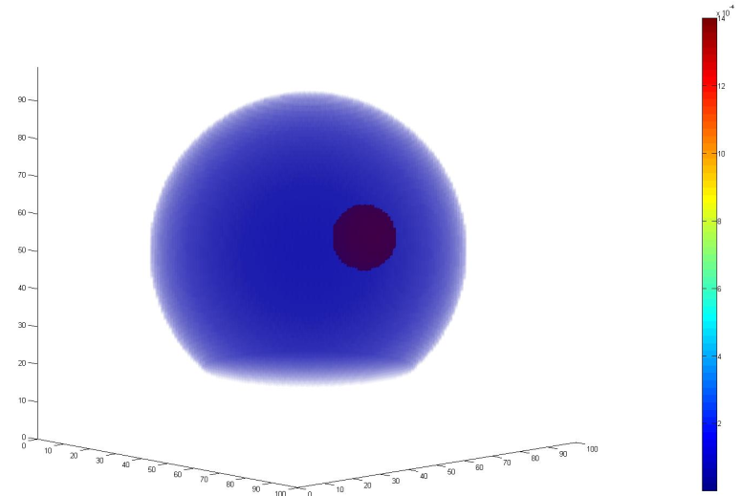
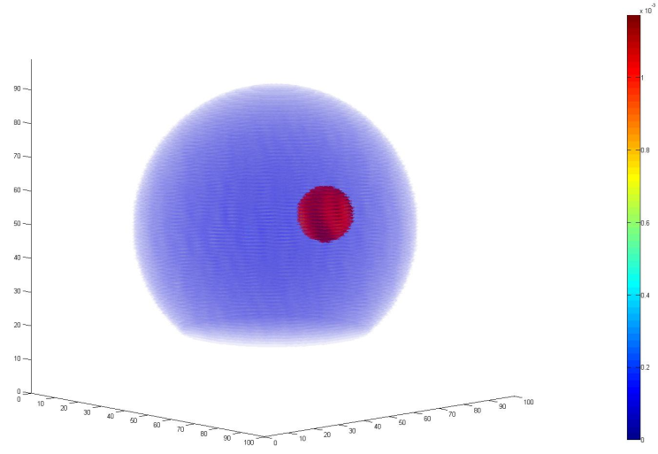
3D CXDI
Difference from tomography:
3D conjugate to the volume structure sample in the Fourier space is constructed, using its “projections” – far-field diffraction patterns. Fourier slice theorem: if sample is rotated by angle $θ,$ the result of its projection propagation is rotated by the same angle in Fourier space.
Oversampling is needed to make 3D intensity distribution more accurate: at least 1-2 propagated projection planes should pass through any given pixel in Fourier space.
Algorithms for reconstruction (ER and HIO) remain the same as in 2D case, but arrays are generalized to the 3D case.
Left: original structure. Right: volume structure reconstructed through 3D reconstruction.

Slide 13
Conclusion and Future Work
Modeling of the diffraction pattern for a known sample in plane wave and Fresnel case is implemented
HIO & ER iteration algorithm reconstruction in 2D and 3D plane wave case implemented
Tomography filtered backprojection reconstruction in plane wave case are implemented
Future Work:
Optimal working point to manage noise and radiation damage
Fresnel reconstruction

Slide 14
Acknowledgements
Adrian Mancuso for supervision
XFEL personnel
All those who made Summer Student possible and comfortable
Summer Students

Slide 15
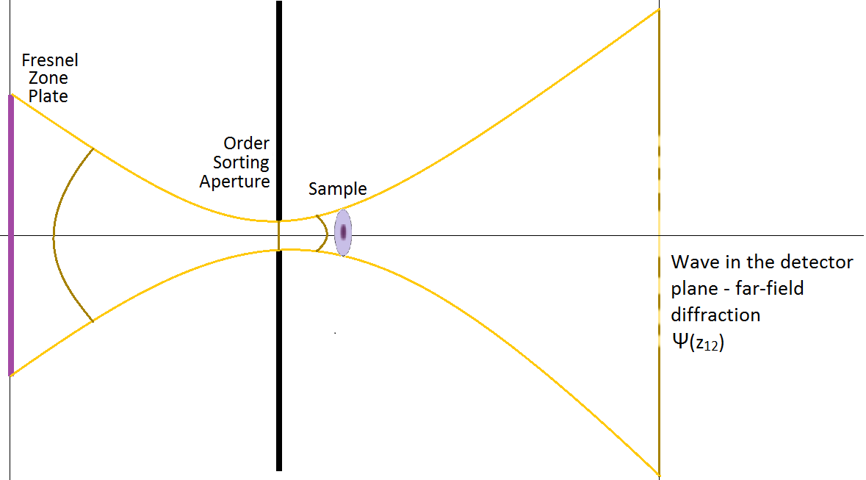
2D Fresnel Imaging: Scheme
Schematic of 2D Fresnel imaging experiment.
In all the aforementioned cases, the wave was plane. However, one can also focus the wave on the sample – using zone plate, for example.
The additional plane – “source” plane - is needed to deal with this case. The model wave is now spherical, focusing before the sample – to have a beam with significant curvature incident on the sample.

Slide 16
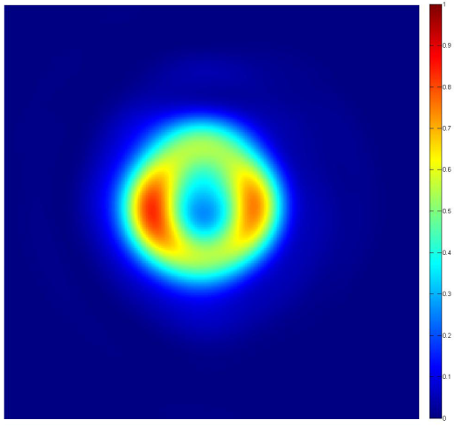
2D Fresnel Imaging: Difference in Methods
Wave has significant curvature, and phase oscillate rapidly. FFT does not work well with fast oscillations. So, instead of dealing with wavefunctions in source and detector planes, we deal with functions derived from them.
We work in 3 planes now, so to reconstruct the ESW, we need to have diffraction data with a sample and without it. From the latter we reconstruct the wave in the source plane and the “basic” wave in the sample plane. Then we reconstruct actual ESW using this information.
Sample diffraction pattern modeled. Focal distance is 12 mm, distance from source plane to the sample plane is 13 mm, distance from sample plane to the detector plane is 700 mm, wavelength is 7 A.

