Slide 1
Lessons learned in Calorimetry at CMS
Performance of the CMS Calorimeters in the past LHC running.
Kerstin Borras
5th Terascale Alliance Detector Workshop
16th March 2012

Slide 2
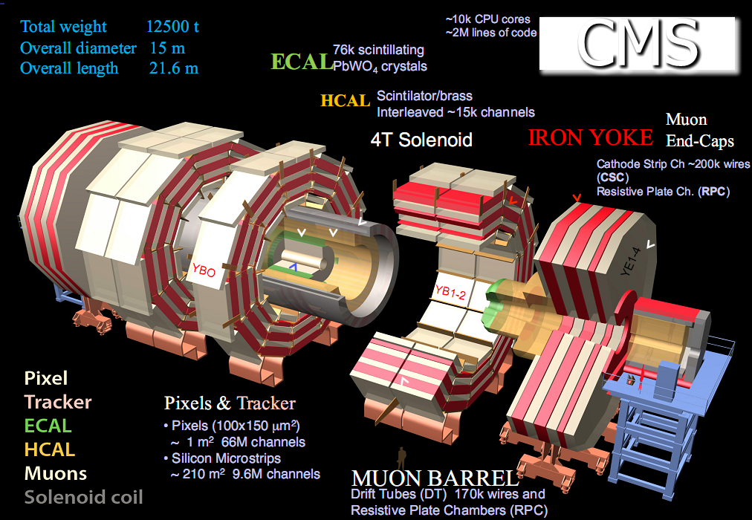
Contents
  LHC Performance
  The CMS Detector
  Performance and future plans for ECAL Barrel and Endcap, Pre-Shower
  Performance and future plans for HCAL: Barrel and Endcal, Hadronic Forward, CASTOR, Zero Degree Calorimeter
  Conclusion

Slide 3
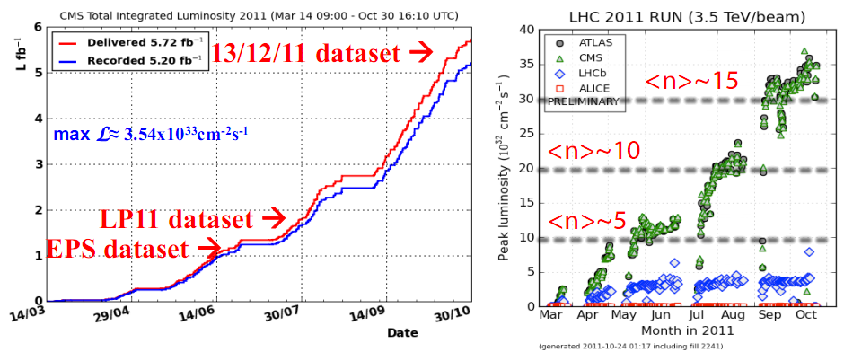
LHC and CMS Performance
LHC delivered 5.72 fb⁻¹, CMS recorded 5.20 fb⁻¹ (~91% overall eﬃciency).
Certified golden dataset: 4.745 fb⁻¹, muon dataset: 4.965 fb⁻¹.
Rapid increase in instantaneous luminosity:
from 2×10³² cm⁻²s⁻¹ in April to 3.5×10³³ cm⁻²s⁻¹ in October 2011.

Slide 4

CMS Detector
ECAL Barrel
ECAL Endcap
CASTOR

Slide 5
  ECAL

Slide 6
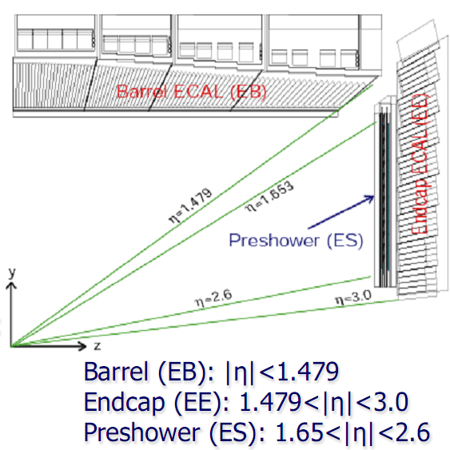
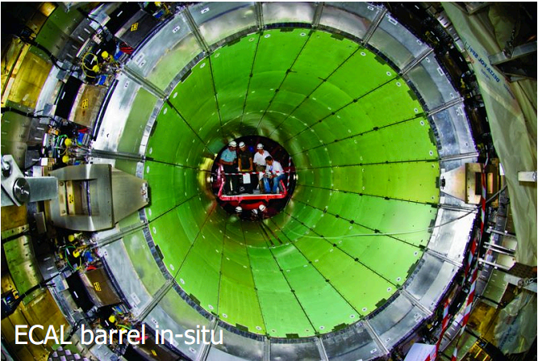
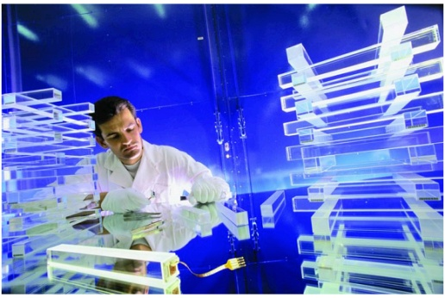
ECAL Characteristics
  ECAL: PbWO₄ Crystal Calorimeter
  Barrel:
  36 Supermodules
  61200 Crystals, APD (Avalanche Photo-Diodes)
  Total weight: 67.4t
  Endcap:
  4 Dees (2 per endcap)
  14648 Crystals, VPT (Vacuum Photo-Triodes)
  Total weight: 22.9t
  Preshower:
  Two planes of silicon strip detectors
  Behind lead layer at 2X₀ and 3X₀

Slide 7
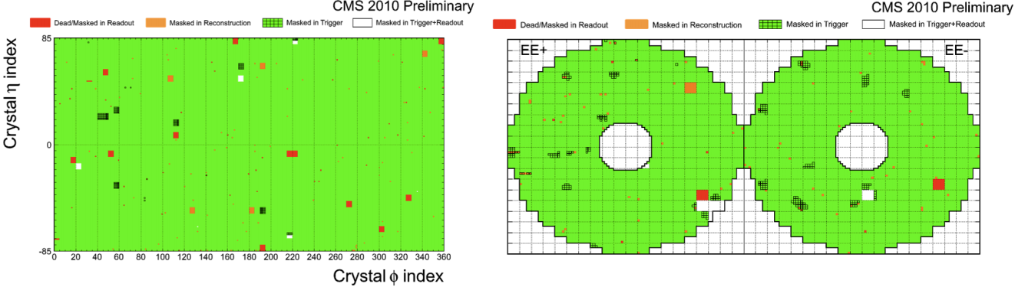
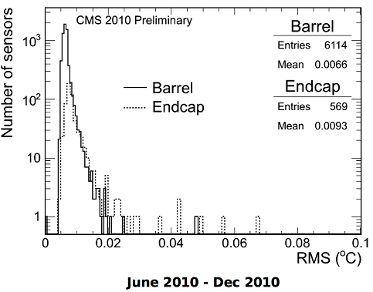
ECAL Active Channels / Temperature stability
• Barrel: 99.2%
• Endcap: 98.7%
• Preshower: 95.1%
PbWO₄ crystal light-yield and APD gain are temperature dependent (-2.2%/ºC and -2.4%/ºC, resp.), the temperature must be kept very stable
Measured temperature stability during Jul 2010-Dec 2010 well within allowed design limits:
• less than 0.05 ºC for the Barrel
• less than 0.1 ºC for the Endcaps

Slide 8
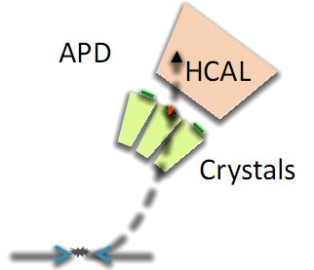
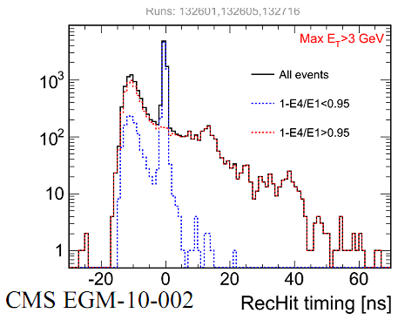
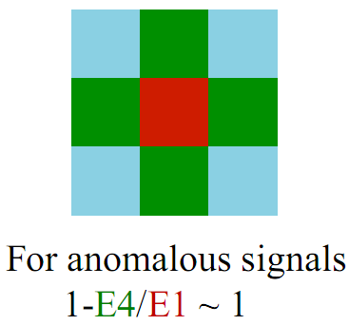
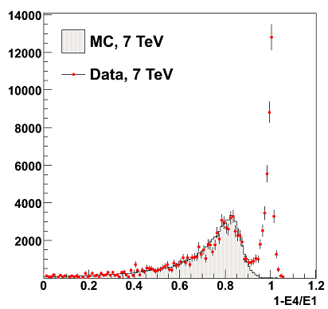
ECAL Anomalous Signals
Anomalous high energy signal in single isolated channels have been observed during the collisions.
This is due to direct energy deposition in the depleted
bulk of an APD.
They can be identified with:
• topological selection → isolated channels
• different timing
• differences in the pulse shape

Slide 9
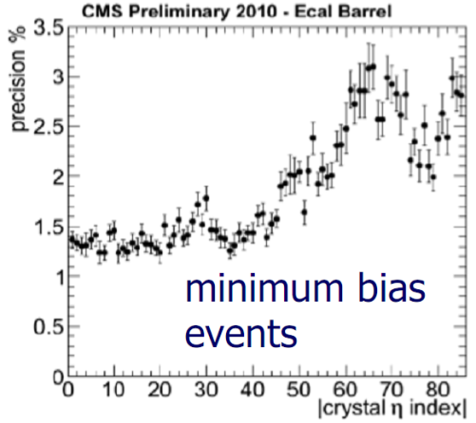
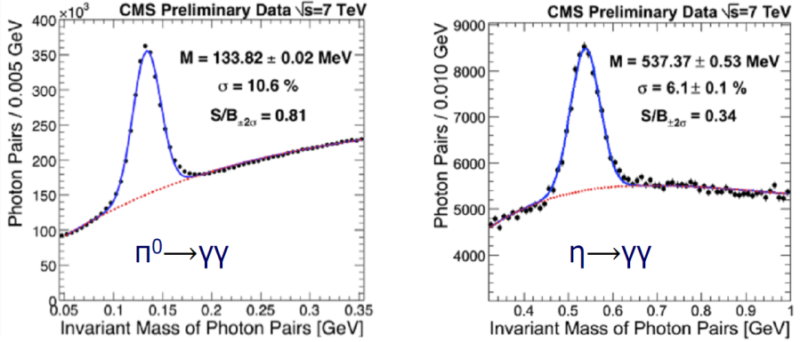
ECAL Energy Calibration
Several calibration & monitoring strategies :
φ-symmetry calibration: exploiting the energy-flow invariance around the beam axis in minimum bias events (for crystals at the same pseudo-rapidity)
π⁰/η calibration: mass constraint on di-photon events (inter-calibration and monitoring of energy scale)
laser monitoring: correction for radiation-induced crystal transparency loss
isolated, high energy electrons: using E/p in W⟶eν decays and invariant mass in Z⟶ee decays (high luminosity is required for inter-calibration)
radiative Z decays: using Z⟶µµγ, assuming correct muon scale

Slide 10
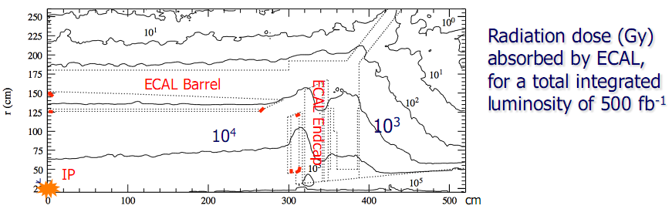
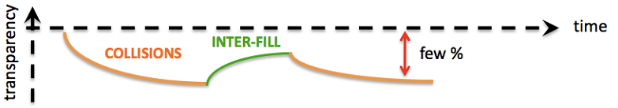
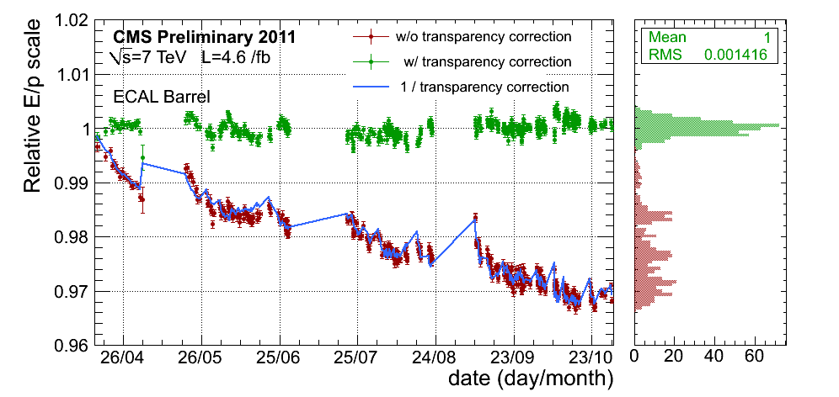
ECAL Radiation Damage
Single electron energy scale (E/p) stability in the ECAL Barrel for 2011 CMS data measured using W →eν events

Slide 11
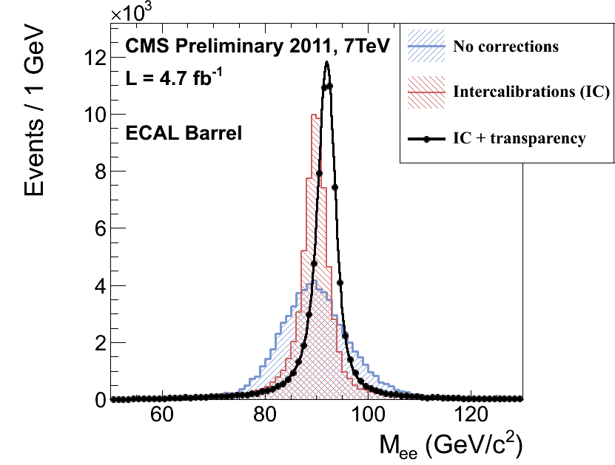
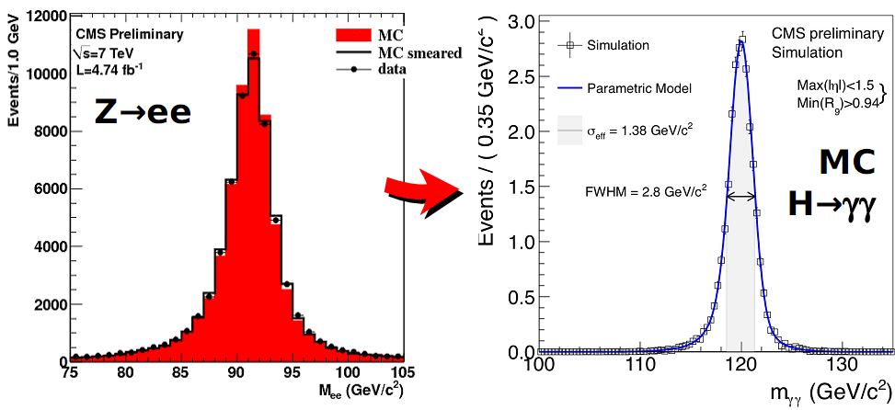
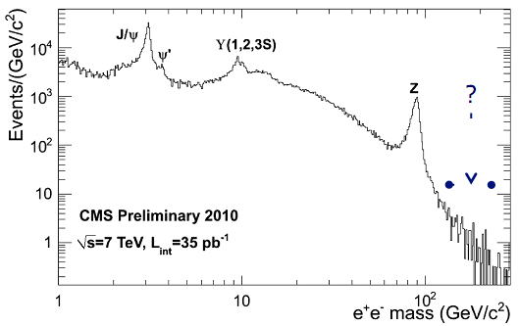
ECAL Resolution
Overall effect of single channel inter-calibration and transparency corrections on the Z→ee invariant mass in the ECAL Barrel
More corrections: shower containment, shower shape, global+local cluster coordinates
Still room for improvement: e.g. material effects
Conclusions:
the CMS ECAL detector is performing beautifully
first results match extremely well the expectations (thanks to impressive preparatory work) and are close to the design goals (further improvements will come with increased luminosity)
in the coming months ECAL will play a crucial role …
→ the fun has just started !

Slide 12
  HCAL

Slide 13
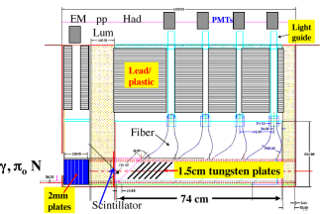
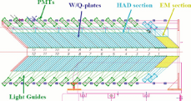
CMS Hadronic Calorimeters
HB, HE, HO: brass with scintillators, read out with HPDs
HF: steel with quartz-fibers + PMTs → more radiation hard & compact showers
99% of HCAL channels live
ZDC & CASTOR: W / Quartz- fibres / -plates
~~~~~~
ZDC
CASTOR
Closer to the beam pipe in the forward region:
high particle fluxes → high occupancy → high radiation and strong activation
→ difficult to readout and to maintain

Slide 14
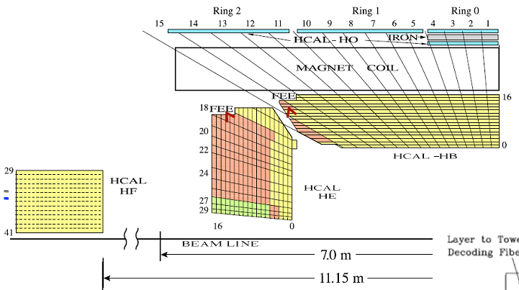
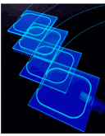
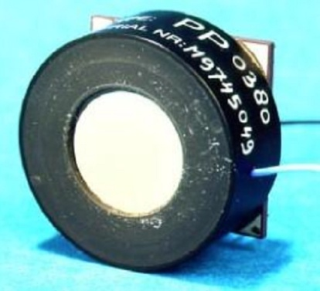
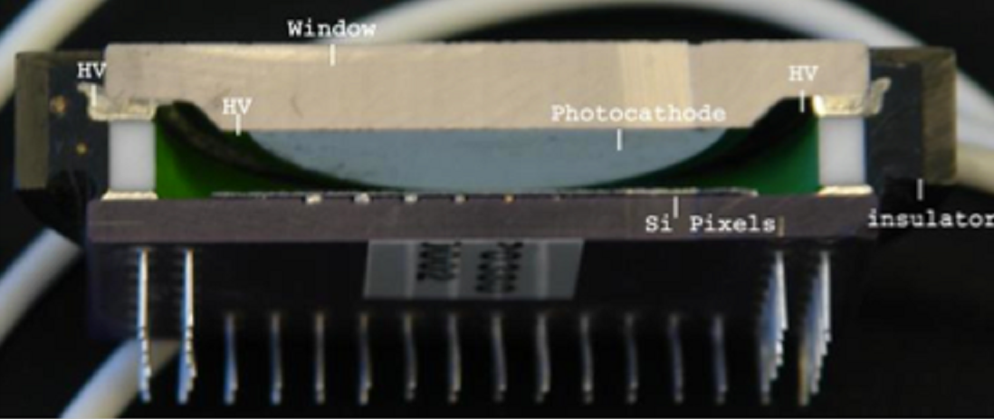
HCAL Segmentation & Readout
HB, HE, sampling calorimeter with plastic scintillator tiles and wave-length shifting (WLS) fiber in brass absorbers.
Tail catcher outside the magnet (HO)
  Hybrid Photo-detectors
  designed to operate in high magnetic fields, up to 4 Tesla
  Proximity-focusing with 3.5mm gap, with E field parallel to B field
  HV of 8kV with 18 pixels (20mm² each)
  Gain of ~ 2k, linear response over large dynamic
  Range from min-ionizing particles (muons) up to 3 TeV hadron showers

Slide 15
HCAL – Calibration Methods
  Prior to LHC start-up, initial calibration of HCAL:
    Charge injection calibration (fC/ADC) as part of incoming QC only on-the-bench measurements)
    Co60 radio-active sources (after assembly in the surface hall, 2006/07) and cosmic ray muons in the underground hall
    Absolute energy scale determined with pion and electrons test beams (on selected wedges) and carried over using radioactive sources
  At the start-up of LHC: additional calibration with Splash events (proton bunches hitting collimators upstream of CMS resulting in large horizontal flux of muons traversing CMS detectors)
  Monitoring of HPD and PMT response (at the hardware level):
    Stability of photo-detector gains is monitored using LED system, data is recorded during calibration sessions (periods between LHC fills)
    Pedestals and signal synchronization (timing) is monitored using Laser data, data is recorded using triggers generated during LHC orbit abort gap (no proton bunches)
  Collisions data (2010 and 2011): Phi-symmetry and isolated hadrons methods

Slide 16
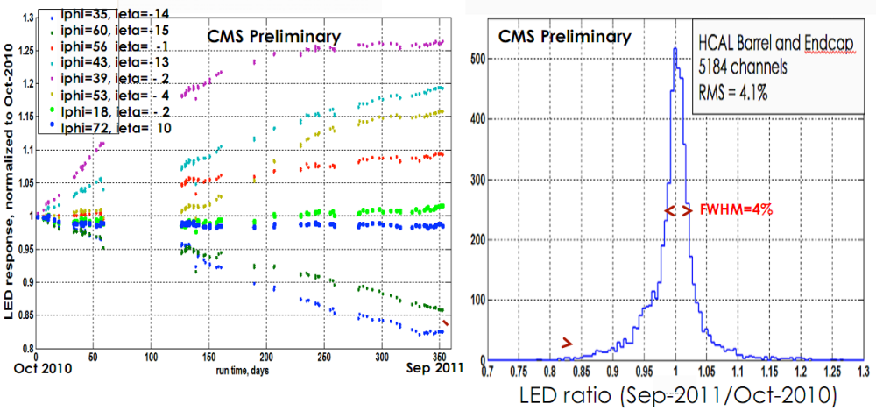
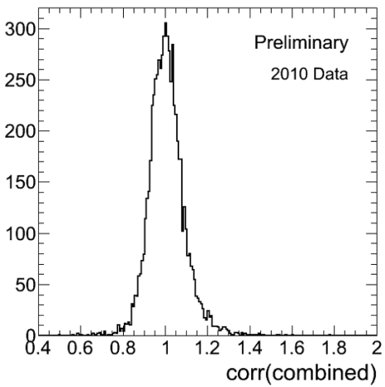
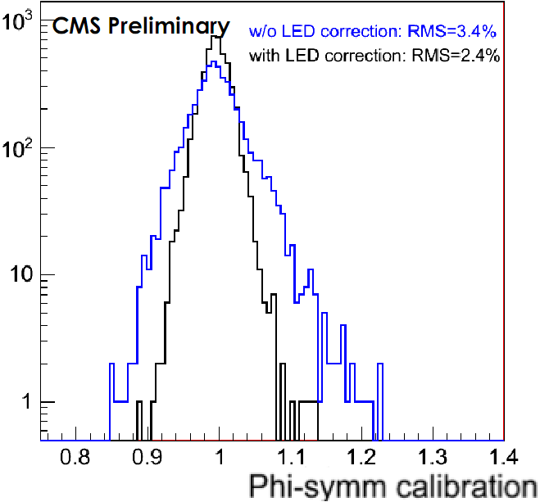
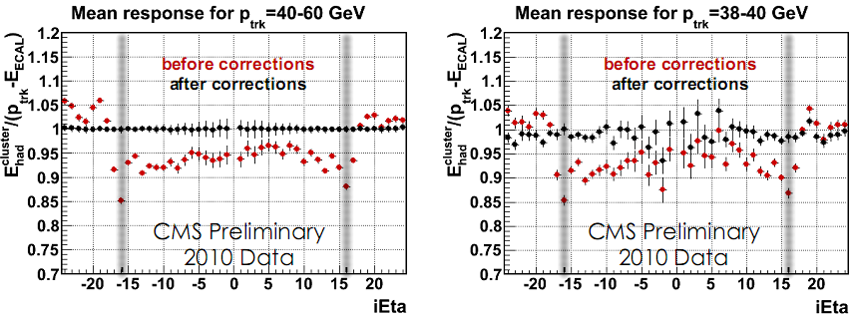
HCAL – Calibration with pp Data
Phi-Correction 2010
Phi-Correction 2011
LED Correction in 2011
Most channels stable at the level of 2-3%
~ 4% of channels exhibit gain drifts ~ 10% (Oct-2010 to Sep-2011).
Isolated Hadron Response
Precision better than 3% in HB and HE,
better than 5% in the forward calorimeter

Slide 17
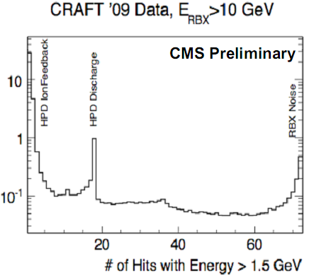
HCAL – Noise in HB / HE
  HPD Ion Feedback (~1 HPD channel)
  Photoelectron induced liberation of ions from the silicon diode which accelerate across the HV gap and interact with the photocathode freeing additional photoelectrons
  HPD Discharge (up to 18 HPD channels)
  With the HPD operating at ~8kV in the CMS magnetic field, dielectric flashover from the wall can produce large signals in many channels
  RBX Noise (up to 72 channels)
  Source unknown, possibly due to external noise coupling to HV of many channels across the whole RBX
Noise Filter on trigger levels and in off-line analysis using topological, timing and puls shape information remove these noise events with high efficiency.

Slide 18
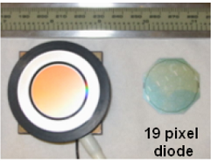
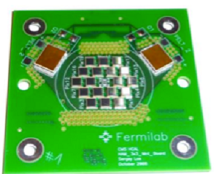
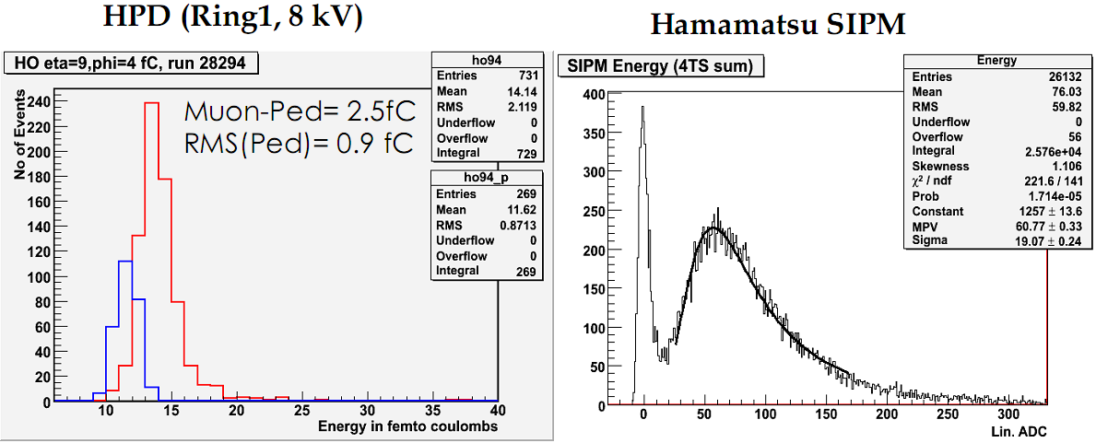
HCAL – Upgrade: HPDs → SiPMs
Muon signal to noise ratio for HPDs ~ 2, for SiPMs ~ 50
Finer granularity possible → New readout electronics (µ-TCA)

Slide 19
  HCAL
  HF, CASTOR, ZDC

Slide 20
CMS Hadronic Calorimeters
HB, HE, HO: brass with scintillators, read out with HPDs
HF: steel with quartz-fibers + PMTs → more radiation hard & compact showers
99% of HCAL channels live
ZDC & CASTOR: W / Quartz- fibres / -plates
~~~~~~
ZDC
CASTOR
Closer to the beam pipe in the forward region:
high particle fluxes → high occupancy → high radiation and strong activation
→ difficult to readout and to maintain

Slide 21
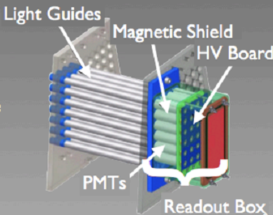
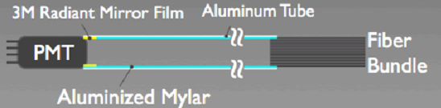
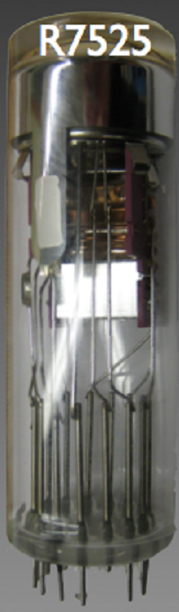
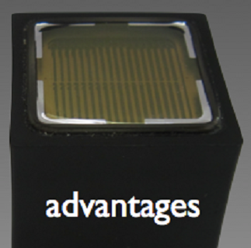

HCAL – HF Noise (anomalous events)
  Three types of noises have been identified in HF:
  Scintillation light produced in the light guides that carry the light from the quartz fibers to the photomultipliers
  Cherenkov light generated by particles passing through photomultiplier (PMT) windows
  Hadronic punch-through of particles hitting the PMTs behind HF
  Solution:
  Removal by filter on trigger and off-line level
  Installation of non-scintillating tyvek sleeves
  Change of PMT to multi-anode PMTs → thinner window, metal envelope reduces window hitting event rate, high Q.E. and gain improves HF resoltion, mesh-type structure less sensitive to magnetic field

Slide 22
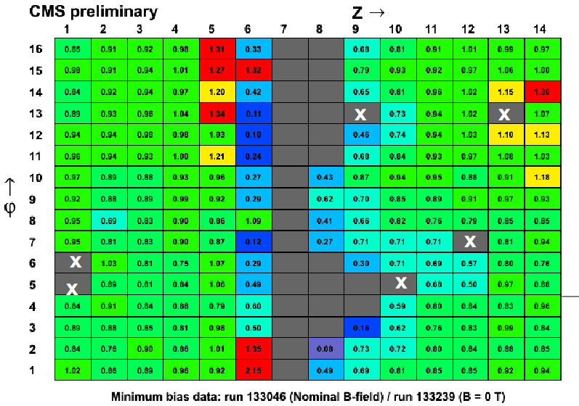
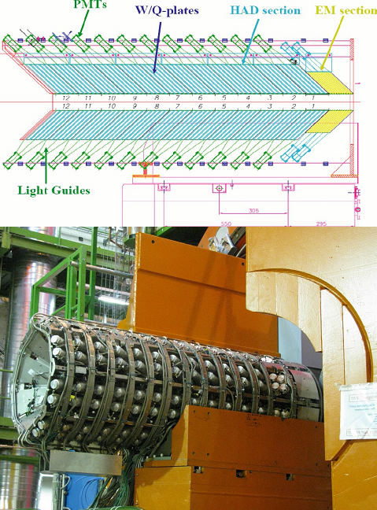
HCAL – CASTOR
  W / Quartz Cerenkov calorimeter
  Longitudinal: 2 EM + 12 HAD
  Strong stray magnetic field → needs mesh-type PMTs
  Recycled PMTs from H1 SPACAL → not radiation hard
  Replace PMTs in the front part by radiation hard version

Slide 23
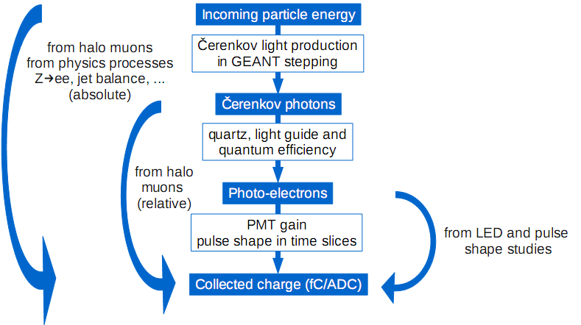
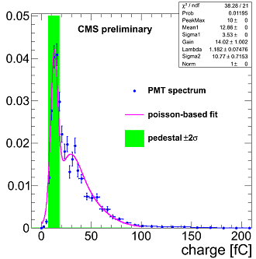
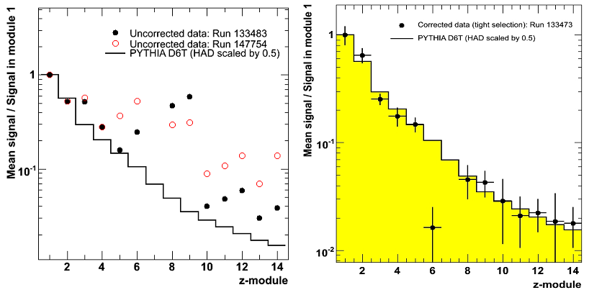
HCAL – CASTOR Calibration
Fine mesh PMTs: difficult to identify muons → a lot of time spent for:
  identifying muons
  optimizing the cuts
  establishing the trigger
  determining the muon signal
→ use mean signal and two time slices
Splashes are a very good source, otherwise use halo muons from injection/ramping/physics
Before After
Intercalibration with halo muons for all sectors
Works fine for different HV (gain) settings, cross check with different minimum bias runs and splash events successful.
Deviations found in few rear sections → tilt of CASTOR versus beam pipe identified, to be implemented in the MC
First physics results on the forward energy flow underway.

Slide 24
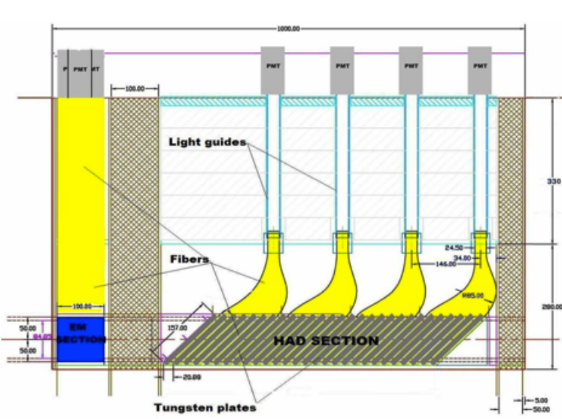
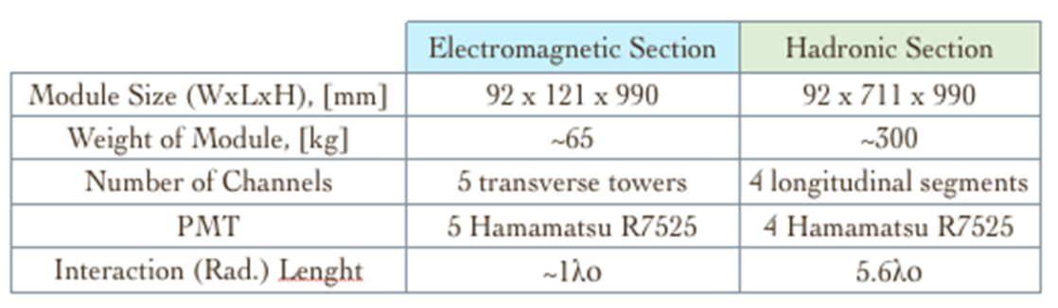
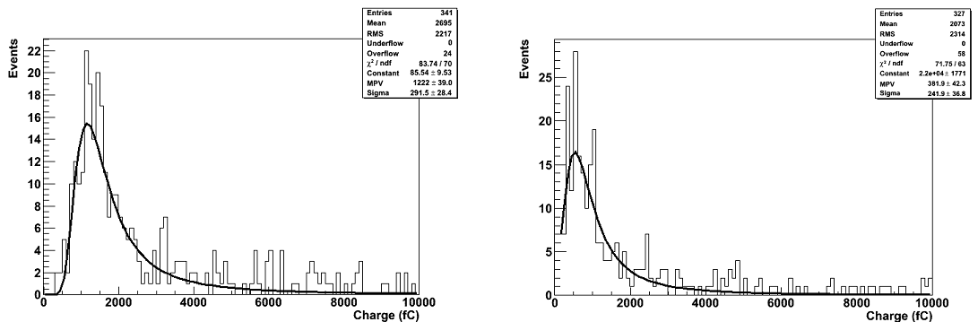
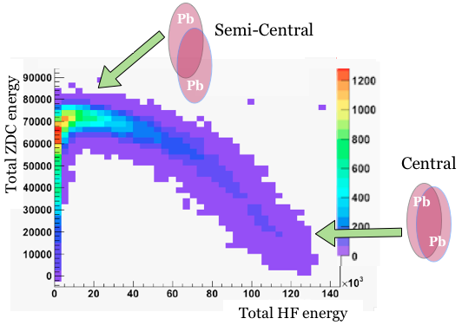
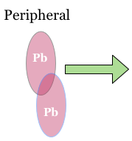
HCAL – Zero Degree Calorimeter
Pulse height distributions in HAD and in EM
Measure neutral particles
Improve the centrality determination for peripheral events by a correlation of the HF transverse energy with the total neutral energy deposited in the ZDCs

Slide 25
Summary
  The CMS Calorimeters have performed very well during the past LHC data taking periods
  Appearing problems are addressed and solved or in the process of being solved by replacements during the planned shut downs
  The fun is on both sides: physics and hardware upgrade ☺
  References:
  CMS Calorimeter:
    A. Ghezzi, 13th ICATPP Conference
  ECAL:
    Giuseppe Della Ricca, IEEE2011
    Martina Malberti, Lake Louise 2012, CMS Results on H->gg
  HCAL:
    Pawel de Barbaro, 13th ICATPP Conference
    Ekaterina Kuznetsova, TIPP 2011, CASTOR Performance
    Sercan Sen, QM 2011, ZDC Performance Poster

