Slide 1
CF Materials
K.W. Glitza

Slide 2
Requirements of Pixel Detectors
Pixel detectors are vertex detectors. All particles of a collision goes through. Therefore the requirements are clear defined:
Stability
Light weight
CTE tuning
Long radiation length
No activation
Radiation Hardness

Slide 3
Current Pixeldetector and IBL
All these requirements are full filled by Carbon based Materials
All components should be consist out of the same material to avoid inner stress and corrosion.
For the Current detector we used CC-Material and Al- pipes (which had problems with corrosion).
For the IBL we used the much lighter Carbon Foam and small Ti-pipes.
For the HL-LHC we plan to use our CF- pipe which are developed in Wuppertal

Slide 4
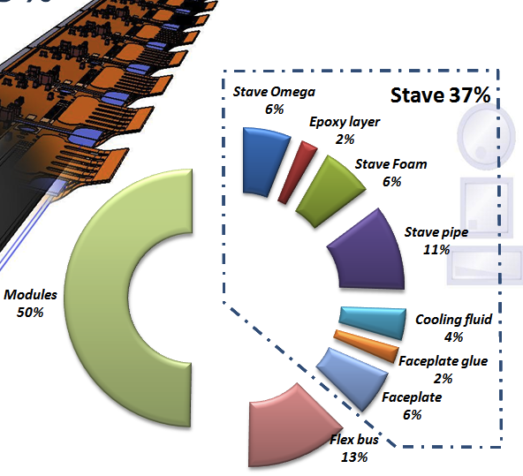
Example: Mass distribution of the IBL Stave

Slide 5
Design Requirements for Cooling and mechanical Stability
The reduction of the CTE mismatch is an important design guideline because it increase the geometrical stability of the structure for different operation states.
By using of carbon based material you can tune this mismatch and the stave stiffness by arrangement of the Carbon Fibers.

Slide 6
Properties of the main Material Components
Properties | Unit | CC | POCO | KFOAM | Al | TI | CF
Density | g/cm³ | 1.69 | 0.55 | .245 | 2.7 | 4.5 | 1.76
Thermal Conductivity | W/m K | 143 /19 | 135/35 | 30 | 235 | 22 | 250/30
CTE | ppm/K | 6.5/0.5 | -7/+0.6 | 2 | 23 | 8.6 | 0.9

Slide 7
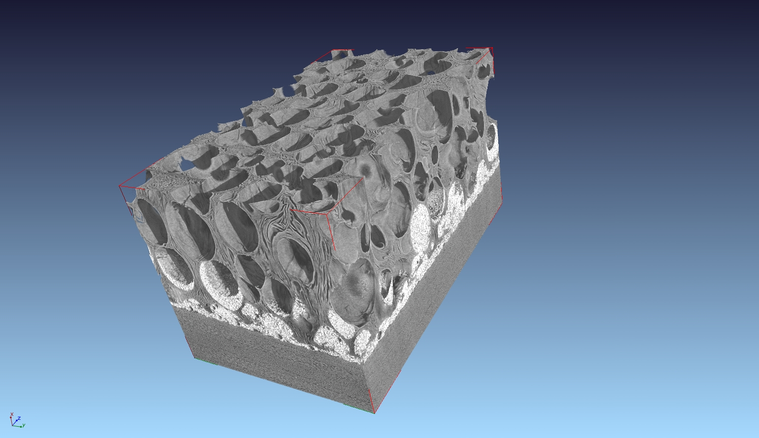
X- Ray Tomography of Carbonfoam with glued face plate
Pros:
Very light
High TC
machinable
Cons:
Dusty surface
Need shielding with face plates

Slide 8
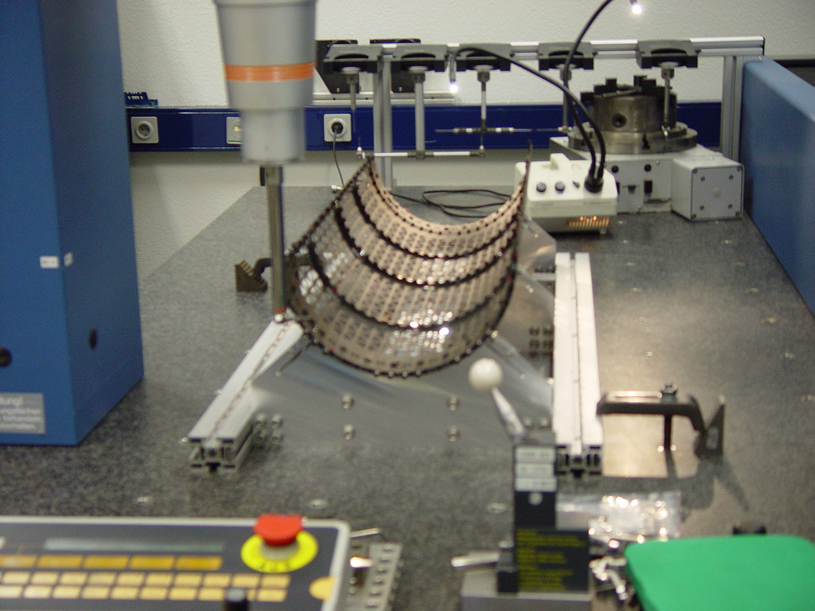
Examples of CF 3D- Assemblies
Picture of one halfshell of the current pixel detector
Layer 2 for 26 staves

Slide 9
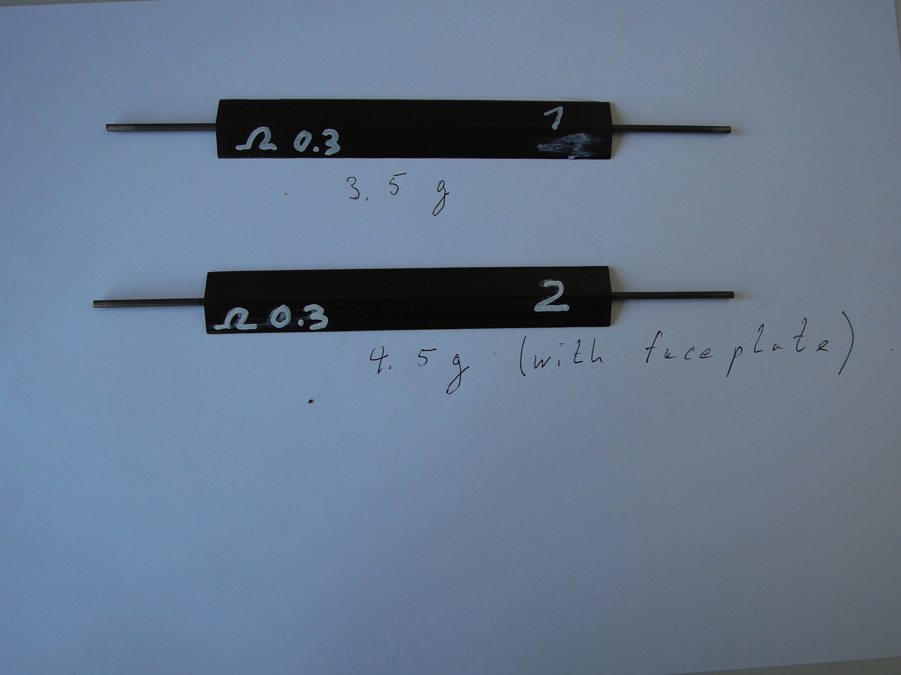
Assembly groups
You can also combine CF components with conventional assemblies
The picture shows a short prototype stave with a Ti cooling pipe

Slide 10
Further activities at Wuppertal
Ongoing of the development of Carbon Fiber Pipes
Study of new geometries
Study new materials
CF material with integrated services

Slide 11
Summary
I gave a short overview about carbon based materials used to assemble pixel vertex detectors
We saw clearly the improvement in the different generations by using new materials
We saw also the big potential of this material for future detectors

