Slide 1
Helmholtz Alliance Detector Workshop 2012
Notes:
The last speaker always has the task to prevent you from going home …
It is always the most boring talk of a conference as it summarizes what you have already heard. That is my job now.
I try to give it my personal view … and I ask for your indulgence since I am not an expert presenting YOUR results.

Slide 2
all these workshops ...
Tutorial on tools for modern detector development
here: FPGA tutorial “intro“ and “hands-on“
A focus
denser integration, low mass, speedy links ... i.e. „new directions“
lessons learned
Overview of interesting current activities (with a focus)
last time: SiPMs
this time: calorimetry

Slide 3
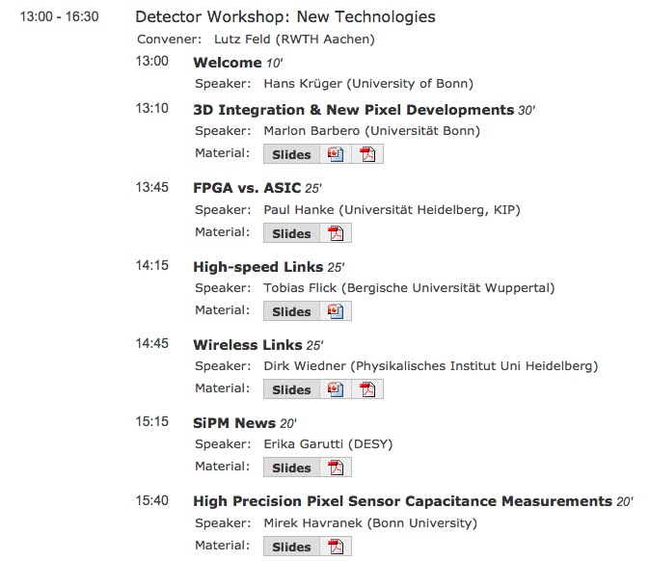
new directions

Slide 4
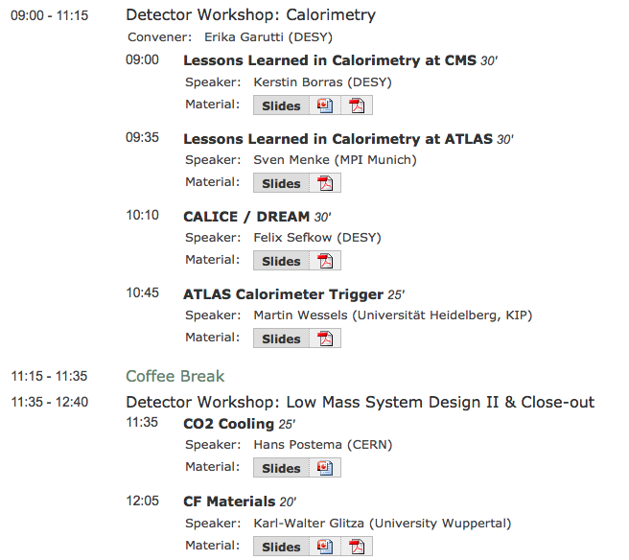
Calorimetry
Low Mass

Slide 5
Thanks to
Organization: Detector Board
Local:
Hans Krüger, Udo Idschok, Valja GebhardJochen Kaminski, Helmuth Kortmann,Tobias Kleinohl
FPGA tutorial
Victor Andrei (HD), Tobias Haring (HD), Tomasz Hemperek, Hans Krüger, Michael Schnell

