Slide 1

A TPC for the Linear Collider
ECFA Detector Panel Review – 4 Nov 2013
Introduction
Jan Timmermans (NIKHEF)

Slide 2
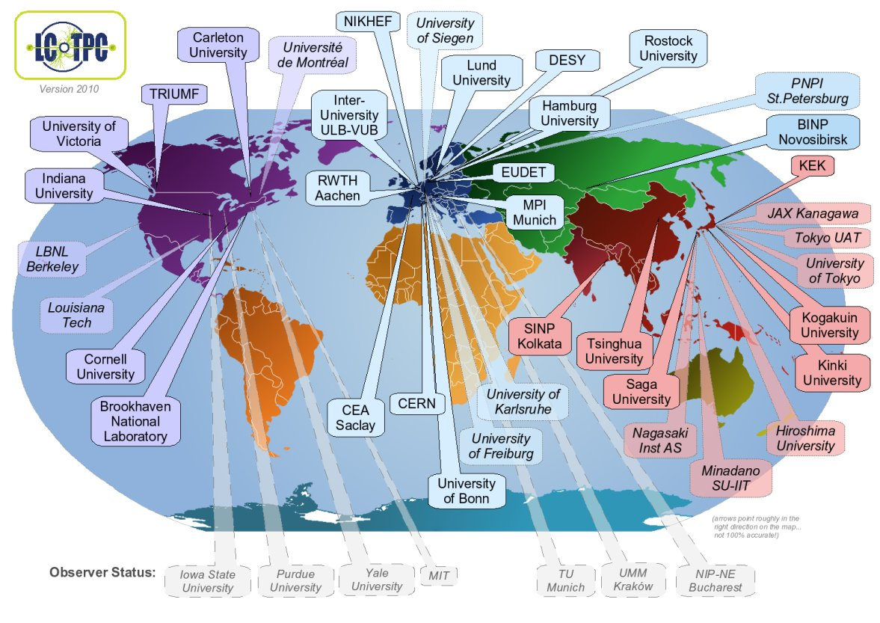
LCTPC Collaboration (1)
27 signatories; 5 pending; 13 groups ‘observer’ status

Slide 3
LCTPC Collaboration (2)
TPC as central tracker already in TESLA LC (2001)
October 2001: TPC R&D proposal to DESY PRC
  ~bi-yearly reviews by PRC; last one Oct 2010
2007/08: formal start global LCTPC collaboration
  Memorandum of Agreement (MOA); defining Work Packages
  Yearly Addendum, updating (general) information
  Work Package (#5) overseeing the R&D after the ILD DBD
Organisation:
  Collaboration Board, one member/institute; chair Leif Jonssen
  3 Regional Coordinators (Americas, Asia, Europe): one is chosen as Spokesperson, currently Jochen Kaminski
  Speakersbureau, Editorial Board
Cooperation with other TPC & MPGD groups: T2K, RD51, …

Slide 4
LCTPC Collaboration (3)
Workpackage(5):
  Advanced endcap: mechanics/alignment
  Advanced endcap: electronics development
  Advanced endcap: cooling
  Advanced endcap: power pulsing
  Gating device
  Fieldcage
  ILD TPC integration/machine-detector interface
  LCTPC software/correction methods

Slide 5
LCTPC and Linear Collider
TPC as central tracker in ILD concept detector for ILC
High occupancy in inner part of a TPC at CLIC @ 3 TeV; would need very small pads (1 x 1 mm²) or pixelised readout.
ILC possibly (hopefully likely) to be built in Japan. Preferred site has recently been selected.
First stage of ILC @ 250 GeV (Higgs “factory”)
2nd stage extension to 500 GeV (top, Higgs self coupling and other precision/new physics studies)
Possible final upgrade to 1 TeV
Both ILC and CLIC incorporated in new global Linear Collider Collaboration

Slide 6
Extra challenges at CLIC
Beam structure: 50 bunch trains per second; length of train is ~180 ns (ILC: 5 Hz, 1 ms train length)
Separation between bunches in train: 0.5 ns. Time stamping becomes issue (but still seems possible). At ILC time between bunches ~300 ns
At high energy occupancy too high in inner part of TPC, due to:
  High cross-section of hadronic 2-photon process
  High pair background due to beam strahlung
  Would need pixelised readout
High occupancy also implies high primary ion density

Slide 7
In relation to ILD detector
Based particle flow concept; topological reconstruction of events:
  Efficient separation of charged and neutral particles
  High granularity/high spatial resolution subdetectors
  High redundancy and efficiency
  Strong magnetic field 3.5 T
Efficient reconstruction of
secondary vertices
Very good momentum
resolution charged particles
Very good jet energy resolution

Slide 8
TPC performance/design parms
Continuous tracking is key to reconstruction of non-pointing tracks
(signature in several new physics scenarios

Slide 9
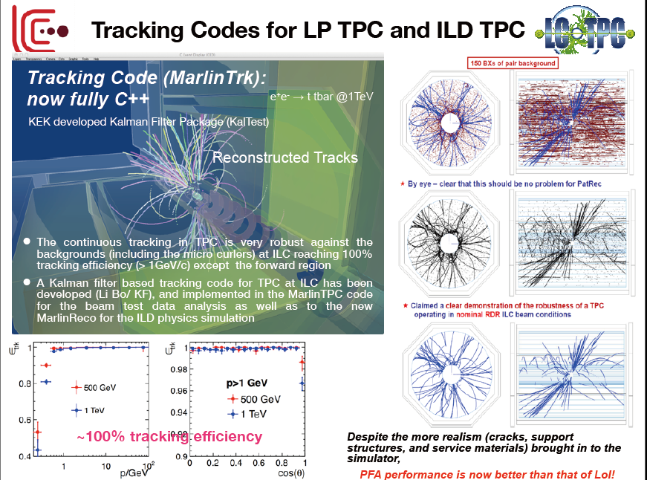

Slide 10
Example: Higgs recoil measurement
e⁺e⁻ ➝ HZ ➝ Xμ⁺μ⁻
Recoil mass opposite the μ-pair;
Requires excellent momentum resolution

Slide 11
Another example in SUSY
Minimum and maximum energies provide accurate determination of the masses of primary slepton and secondary neutralino

Slide 12
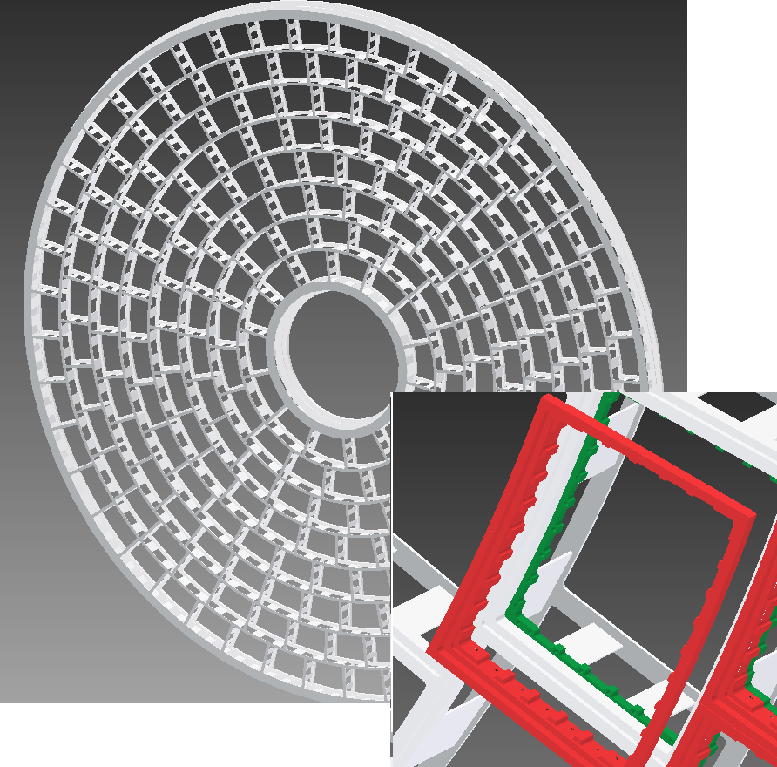
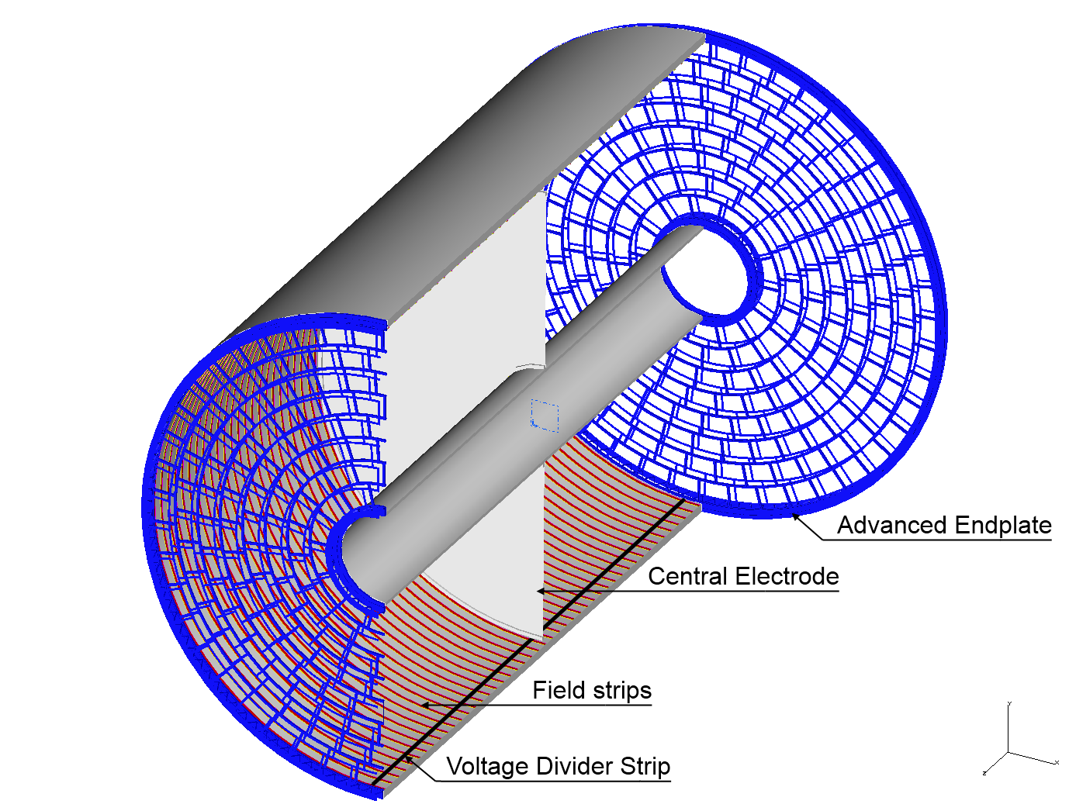
TPC in ILD
Current design: 240 modules per endplate,
size approx. 17 x 21 cm²

Slide 13
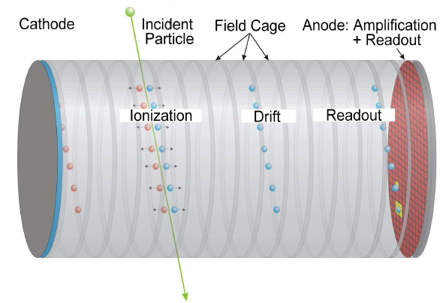
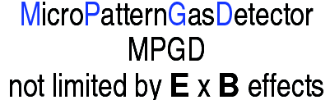
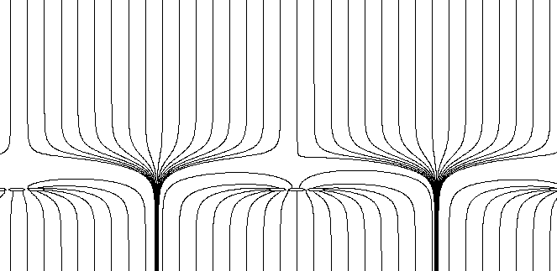
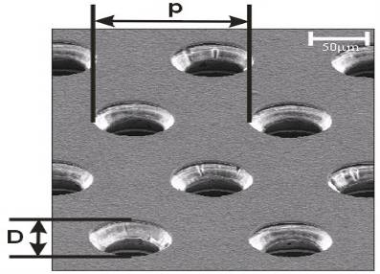
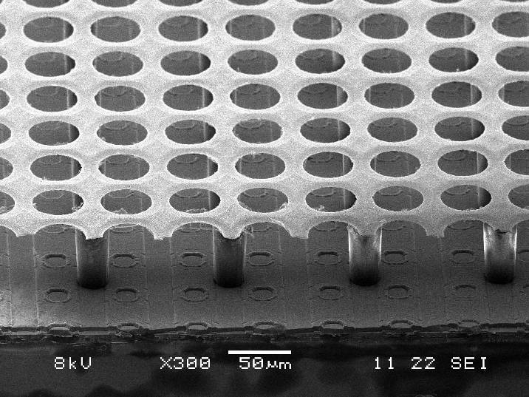
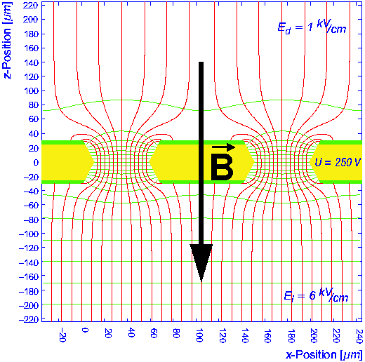
TPC with MPGD
MicroMegas
GEM
Two gas amplifications:
Analog TPC
with standard pad readout
(need signal broadening)
Digital TPC
with CMOS pixel readout

Slide 14
Drift gas choice
T2K gas: Ar/CF4/iC4H10 in ratio 95/3/2 %
Fast gas, with large value ωτ
→ Drift is along B-fieldline

Slide 15
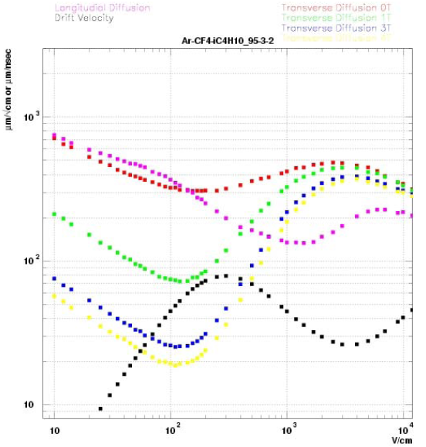
0 Tesla
Long. Diff.
1 Tesla
3 Tesla
Transv. Diff.
Drift vel.
4 Tesla

Slide 16


LCTPC testbeam infrastructure
DESY II testbeam area T24/1
PCMAG ~1T solenoid (KEK)
Fieldcage (DESY/EUDET)
Endplate(s) (Cornell, NSF)
3D lifting stage (DESY, EUDET, AIDA)
Upgrade PCMAG (KEK, DESY, AIDA)
HV, gas, slow control (DESY, EUDET)
Beam/cosmic trigger (NIKHEF, Saclay)
Laser calibration (Victoria, DESY)
DAQ (Lund, Brussels, Saclay, Medipix Coll.)
CO2 cooling system (KEK, NIKHEF)
Laser beams (under development) (BNL)
Software (MANY groups)

Slide 17
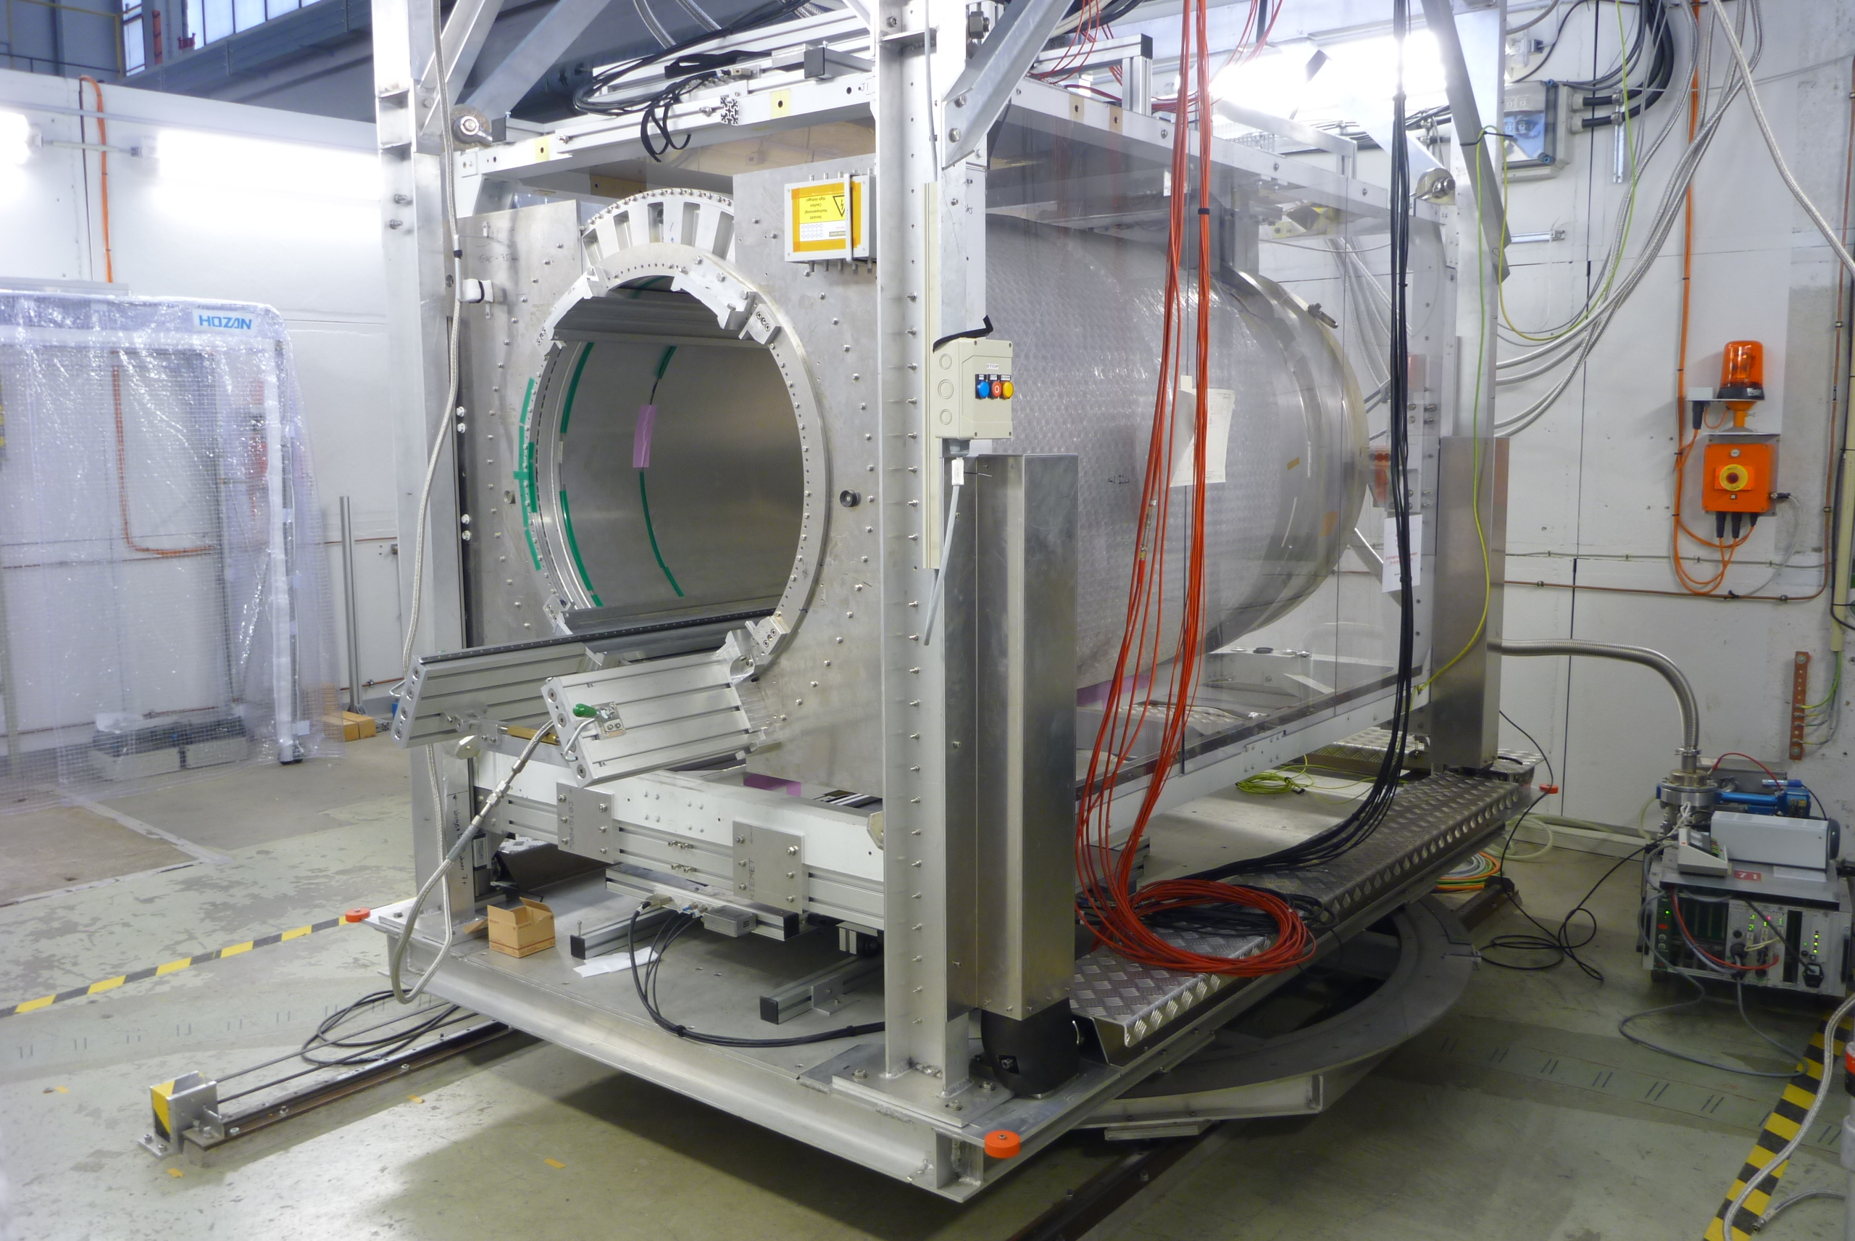
Test beam area
Usually e⁻ beam 1-5 GeV
PCMAG ~1T solenoid. Initially manual filling of liq.He from dewar. From 6/2012 closed system with 2 cryo coolers and 2 He gas compressors
3D lifting stage

Slide 18
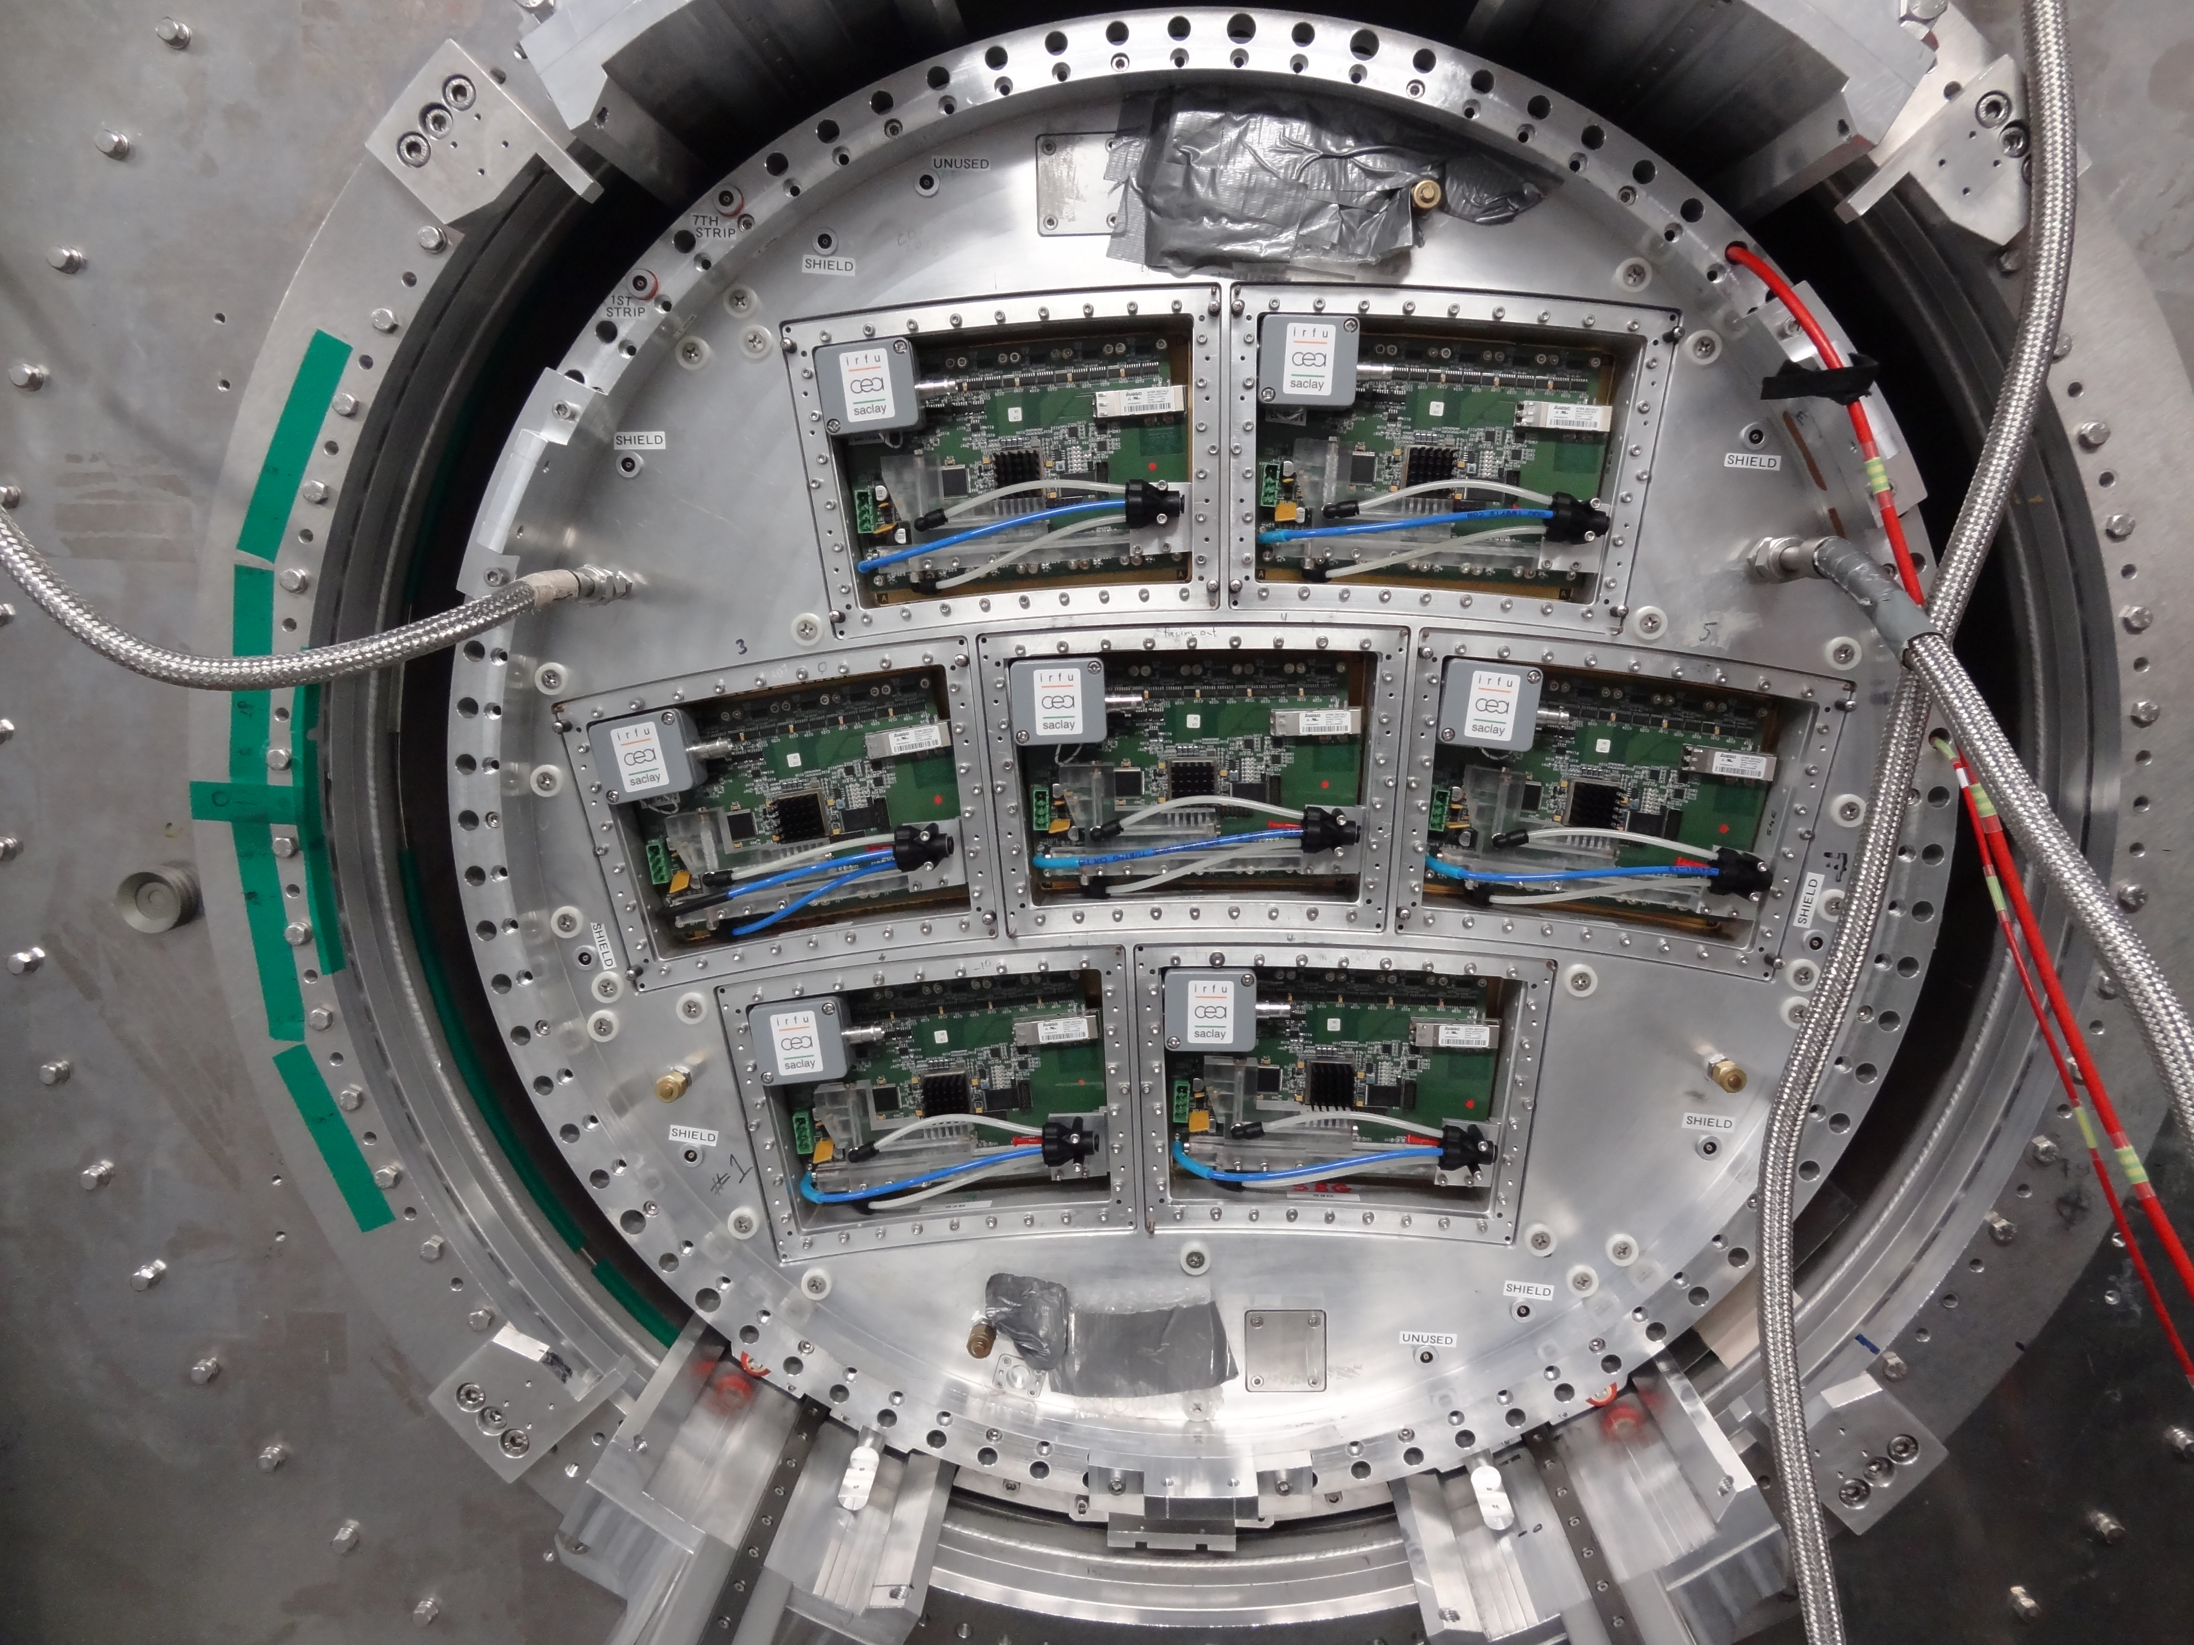
TPC in PCMAG
Lightweight fieldcage, cathode, endplate anode structure:
  7 modules ~17x22 cm²
Diameter 72 cm, maximum drift distance ~57 cm
Dummy modules + endplate guard structure
(External) Si layers in between TPC and inner wall of PCMAG under consideration; 4 cm space radially

Slide 19
2PCO2 cooling system in preparation
Purchased by KEK
Tuning tests at NIKHEF almost
finished
Module test foreseen at NIKHEF
in December
Transport to DESY early 2014

Slide 21
Next talks
Technologies – Jochen Kaminski
Ion feed back – Philippe Gros
Electronics – Paul Colas
Mechanics – Jochen Kaminski
Software/simulations – Astrid Muennich
Outlook – Takeshi Matsuda

Slide 22
Backup slides

