Slide 1
Recent Developments on ILC
77th DESY PRC
Brian Foster
(Uni Hamburg/DESY)
24/4/14

Slide 2
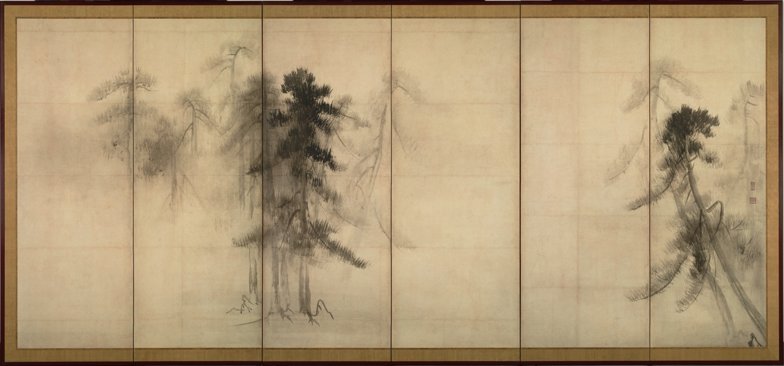
Recent Developments on ILC

Slide 3
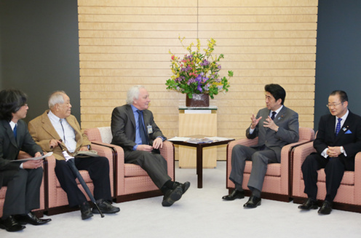
Recent Developments on ILC
Lyn Evans meets Prime Minister Abe one year ago

Slide 4
LCC Directorate
LCB
Chair: S. Komamiya
Lyn Evans
Director
Hitoshi Murayama
Deputy Director
Mike Harrison
Ass. Director, ILC
Hitoshi Yamamoto
Ass. Director, Physics & Detectors
Harry Weerts
Regional Director
Americas
Steinar Stapnes
Ass. Director, CLIC
Brian Foster
Regional Director
Europe
ILC
Technical
Board
CLIC Steering
Comm & Collaboration
Council
LCCPD
eb
Akira Yamamoto
Regional Director
Asia

Slide 5
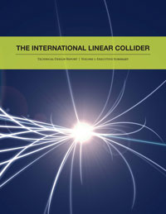
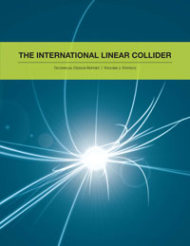
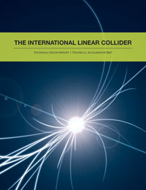
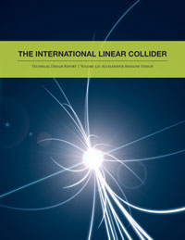
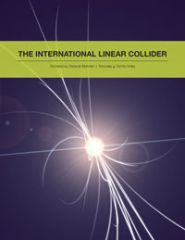
Introduction
On June 12th, ILC TDR was published in Worldwide Event.

Slide 6
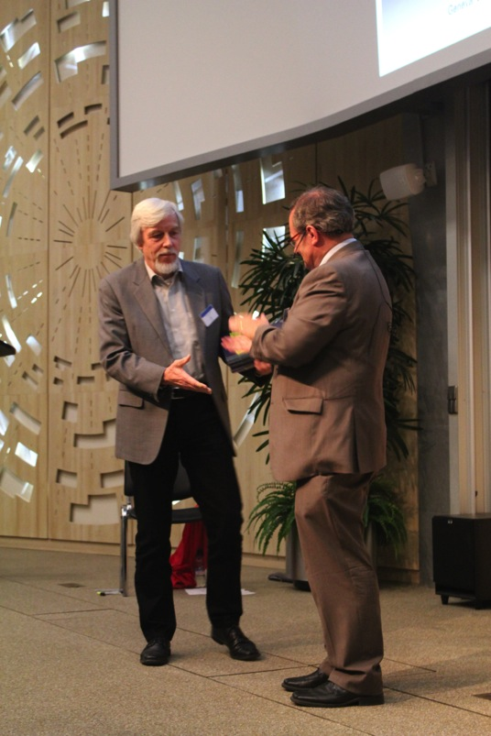
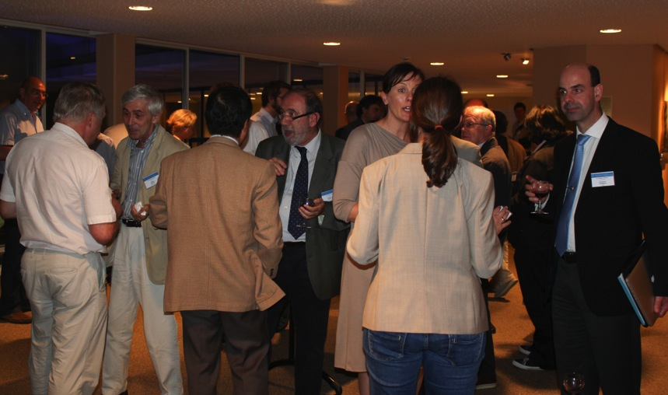
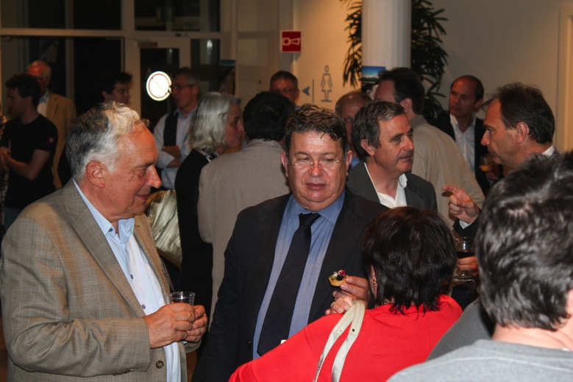
World-wide Event
On June 12th, ILC TDR was published in Worldwide Event.
End of major phase in ILC development – now what?

Slide 7
Summary and Outlook

Slide 8
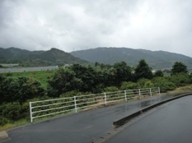
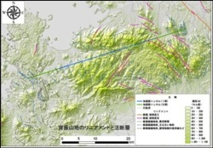
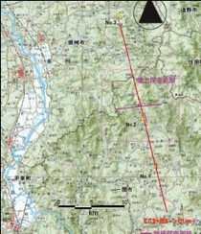
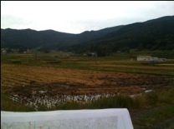
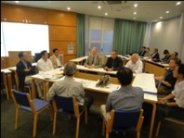
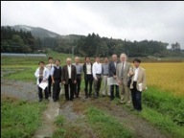
Japanese Sites for ILC
GDE-CFS group visited two sites, Oct., 2011.
GDE EC visit in Jan. 2012.

Slide 9
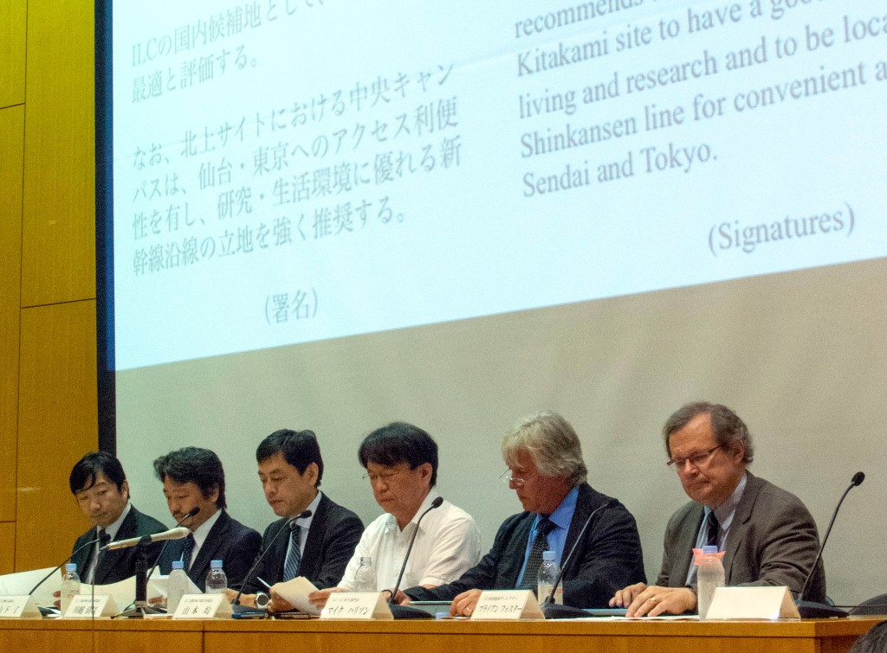
Japanese Sites for ILC

Slide 10
Japanese Sites for ILC
LCC Directorate/CF&S official site visits taken place.

Slide 11
Japanese Site

Slide 12
Japanese Site

Slide 13
SCJ Statement
There is now an official English translation, which is Delphic – the original Japanese no doubt more so.
Generally it as as expected – it supports the ILC in principle without being particularly enthusiastic.
The Committee lists issues to be addressed as follows:
A more precise research strategy for the ILC in view of the LHC upgrade path;
The funding framework that does not affect the broader field of science or other critical national priorities;
Detailed plan of international cost-sharing;
A domestic organization to implement the project consisting of KEK and universities;
Human resources required during construction and operation, in particular, for leadership positions.

Slide 14
SCJ Statement
A few years further work required during which the government should discuss possible overseas contributions with
“research institutes and the responsible funding authorities of key countries and regions involved outside of Japan.”
Important step was the addition of ILC explicitly in the MEXT budget – at level of $0.5M to fund exploration as above. Although this is a small amount it is symbolically very important; the appearance of a project in a government budget has always in the past indicated that it would be funded.
One of the SC requests already acted on on Jan 1st when the KEK ILC project preparation office came into existence, headed by Atsuto Suzuki.

Slide 15
Political Developments
Talk of Chair of Diet ILC Federation, ex-MEXT Minister
Mr Kawamura, @ LCWS in Tokyo, 12.13
While not a member of the government, he is a very senior figure in LDP and is known to have the ear of the Prime Minister Mr Abe:
“We are aware that people are usually worried that an increase of academic budget in one field may mean a decrease in other fields. … We shall arrange a dedicated budget to accommodate its much wider implications. It is the responsibility of the government to carry this out.”
2) “The Department of Education has requested the Department of Finance to provide an ILC investigation fund of 50 million yen in next year's budget. … once it has been approved, we members of the house will have achieved one of the most important milestones of recent years.”

Slide 16
Political Developments
Talk of Chair of Diet ILC Federation, Mr Kawamura
3)“The Technical Design Report of ILC was issued in December 2012 (sic)…I would again like to express my appreciation of this effort. I understand that it is now the turn of politicians to respond to this effort, and to construct a worldwide partnership to realize this project.
4) “I think that most Diet members' knowledge of physics is at high school students’ level. If you allow me, let me take the liberty of pointing out that the understanding of political dynamics by most particle physicists is also at high school students’ level. If physicists and politicians collaborate by using each other's area of expertise, it is certain that we can accelerate the realization of the ILC project.”

Slide 17
Political Developments
The MEXT Minister has visited the US Secretary of Energy in January; ILC was discussed at the meeting. In February he sent the Secretary of Energy a letter following up that discussion in which he proposes inter-governmental discussion of the ILC project. It is clear that nothing can happen in the US until the report of P5, which is due in mid May.
The MEXT Deputy Minister was in Europe in February and had
a dinner meeting with the DG of CERN and Robert-Jan Smits, the Director of the EC Department of Research and Technology. The purpose of the meeting was to discuss ILC and the next steps.
Further meetings are scheduled to follow.
Lyn Evans visited the Indian Chief Science Advisor and the Head of the AEA in January. Lyn + some LCC members will visit China in June.

Slide 18
European activities
In last 9 months, BF has visited European funding agencies – France Italy, Germany, UK – to discuss ILC and involvement over the next few years.
BF attended annual CERN/EU meeting at CERN on 25.9. Attended by R-J Smit, DG of Directorate Research at EC.
ILC was explicit item on Agenda, given priority even though R-JS was 1 hour delayed. He and colleagues had been briefed after 13.9.
BF described current situation and R-JS responded at length. Discussion was animated. EC is clearly interested in ILC and wishes to follow closely. Agreement to set up “contact group” to maintain close contact over ILC. Met in February and maintaining regular interchange.

Slide 19
Most Recent Developments
There was a site-specific Conventional Facilities and Instrumentation meeting in Tokyo two weeks ago. Here we began to get down to the details of how the TDR must be adapted to the Japanese candidate site.
A delegation from the LCC (Lyn, BF and Harry Weerts; Hitoshi Murayama translated) met the leadership of the Diet Federation for the ILC – contains > 1/5 of all Diet members, independent of party. Kawamura-san, (chair), Shionoya-san, director general of the federation, Kosaka-san and Hori-san all attended. Each of these is very influential; all are ex-senior Ministers.
It was an unusually frank & constructive meeting; much of the discussion centered on Europe. Several important initiatives were agreed, including a letter from the Diet members to CERN DG (who is the designated contact person for Europe).

Slide 20
Summary and Outlook
There is a great deal of activity, although much of it is necessarily behind the scenes.
A single site has now been selected and the political process
has momentum.
The SCJ report has been published and is more or less as expected.
Ministerial meetings have begun, starting with the USA.
In Europe we are discussing way forward with national funding authorities and EU.
Lots to do – a very exciting time.

