Slide 1
XTL Installation of Personnel Interlock components
22.04.2014
Andreas Rathjen WP38

Slide 2
XTL- Personnel Interlock Components
warning lamps (every 50 meters? Round about 40 pieces)
loud speaker (every 7 meters, 269 pieces)
emergency power-off switches (on both sides, every ~25m, 164 pieces)
illuminated magnet warning tableaus (every 50 meters, 40 pieces)
emergency power-off terminal boxes (on both sides, every 200 meters, 20 pieces)
emergency power-off interface boxes (every 200 meters, 10 pieces)
terminal boxes for miscellaneous signals
(magnet enable, magnet-, beam shutter-position,
RF-switch, shortcut plates…) (every 200 meters, 10 pieces)
interlock door (in the middle, 1 piece)

Slide 3
involved persons
technical specifications: WP38-leader Brunhilde Racky (MPS)
cable planning and material ordering: Kai Jensen (MPS), Martin Schmidt (MPS)
infrastructure planning and coordination: Andreas Rathjen (MPS)
power supply for 230V~-devices, planning and installation: Jörn Widhalm (MKK1) (contractor Cegelec)
installation and cabling: Jürgen Liebing (MDI) (contractor IMD and Wille)

Slide 4
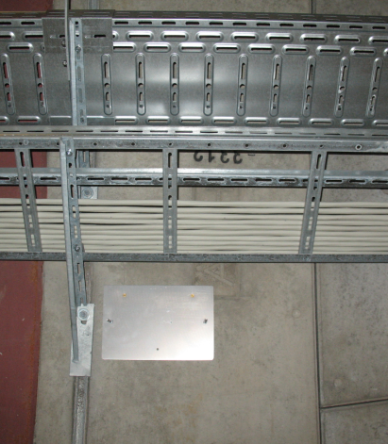
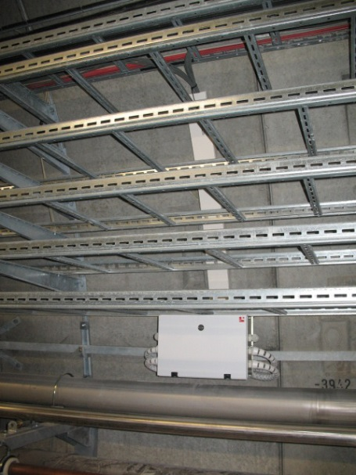
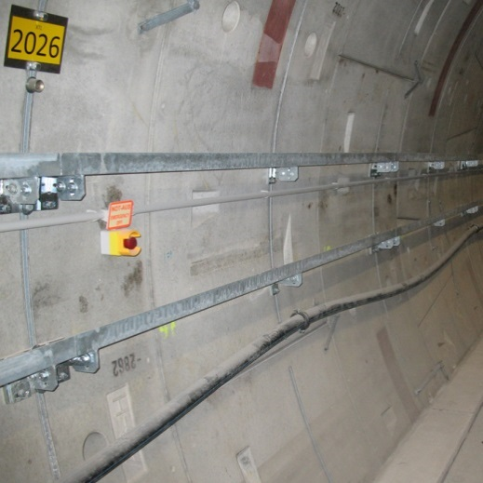
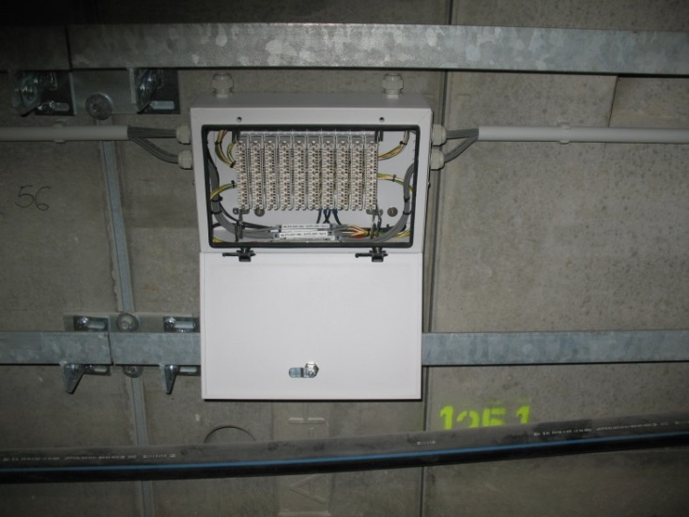
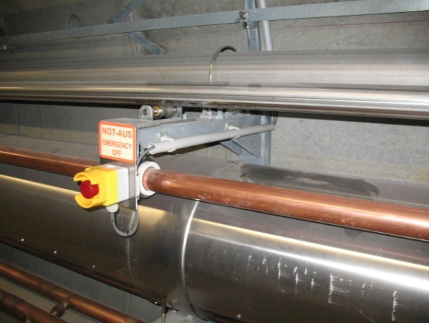
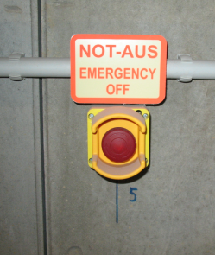
Done
installation of the loud speaker mounting plate
installation of the emergency power-off terminal boxes (on both sides)
installation of the emergency power-off switches (on both sides)
local cabling of the emergency power-off switches

Slide 5
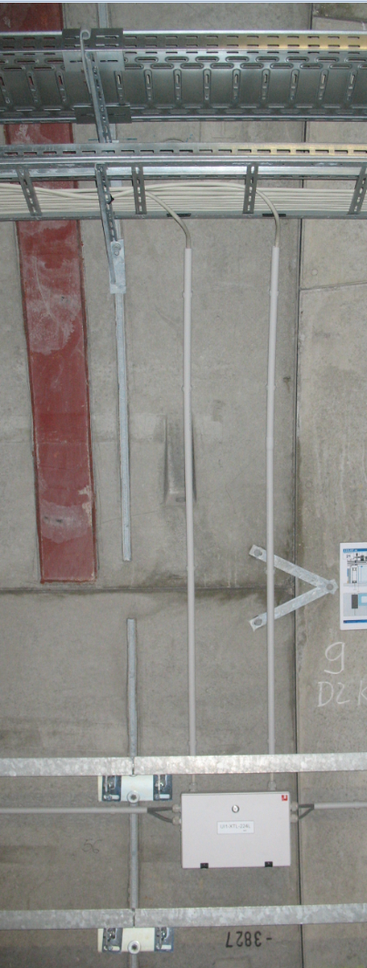
Under progress
connecting the trunk cable with the emergency power-off terminal boxes
Trunk cable
to electronic room XSE or XS1 (depends on the position)

Slide 6
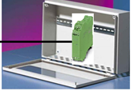
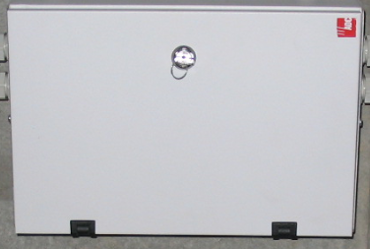
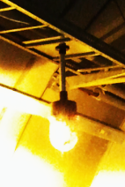
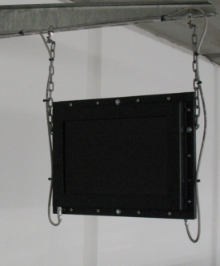
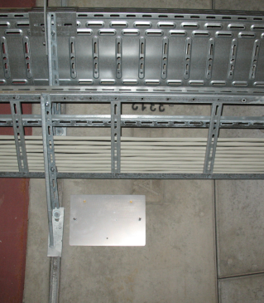
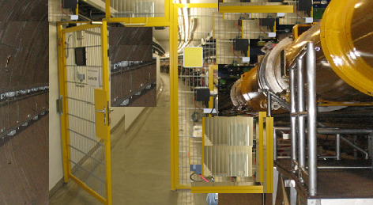
To do
Installation and cabling:
emergency power-off interface boxes
terminal boxes for miscellaneous signals
warning lamps
illuminated magnet warning tableaus
interlock door in the middle of the XTL
Only cabling:
loud speaker

Slide 7
Outlook
Projects and dates:
XFEL-Injector Jul 2014
XFEL-XTL
Linac2 – Desy2 Aug 2014
PETRA Dec 2014
Lux 2014
XFEL-SASE1 (XTD2, XTD4, XTD9, XTD10, XHEXP) Dec 2015
Flash Forward
…
Risk:
To much work in too little time for the same staff

