Slide 1
XFEL LLRF installation
Julien Branlard, for the LLRF team
Phase 1: Pre-commissioning of components
Phase 2: Rack preparation and installation
Phase 3: XTL installation
Notes:
How to edit the title slide
Upper area: Title of your talk, max. 2 rows of the defined size (55 pt)
Lower area (subtitle): Conference/meeting/workshop, location, date, your name and affiliation, max. 4 rows of the defined size (32 pt)
Change the partner logos or add others in the last row.

Slide 2
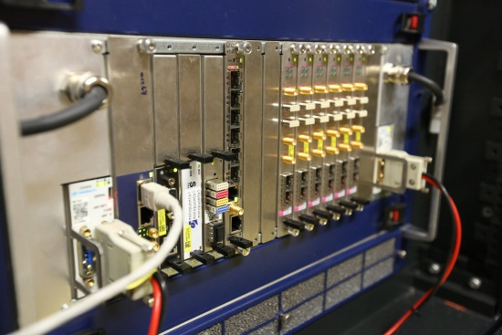
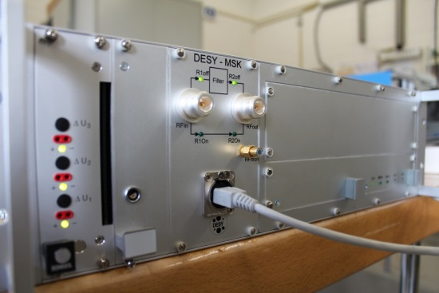
PHASE 1: PRE-COMMISSIONING
Quality control
Individual component tests (boards, modules)
Integration tests (crate-level, rack-level)
MTCA crate and boards
Drivers are installed
Boards are programmed with correct firmware
Servers are installed
Board communication + basic functionality is tested
External modules
i.e. piezo driver, power supplies
Power-up , redundancy checks
Diagnostics / sensor information can be read out

Slide 3
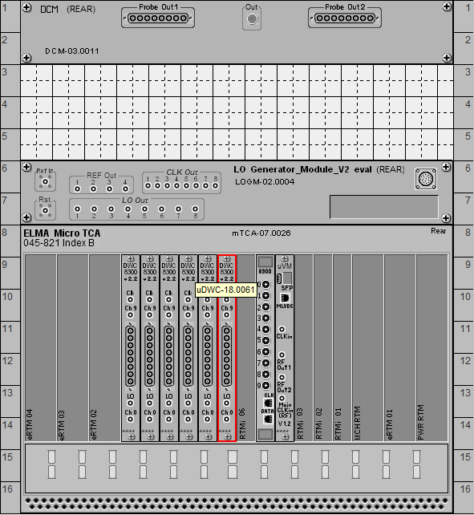
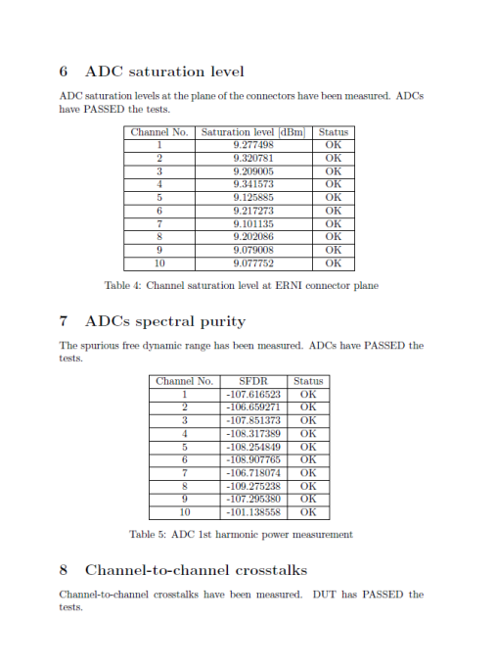
PHASE 1: PRE-COMMISSIONING
Device test stands
Device tracking
Labelling
e-identification
KDS database entry
Example :
15 minutes / uDWC
x 300
= 2 weeks

Slide 4
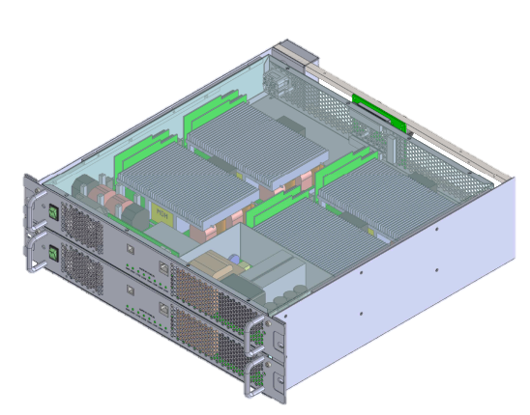
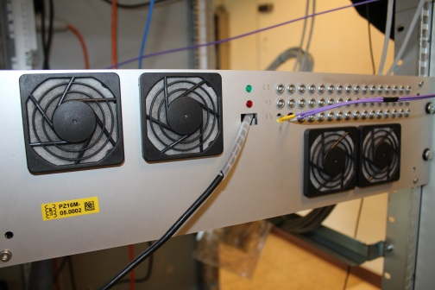
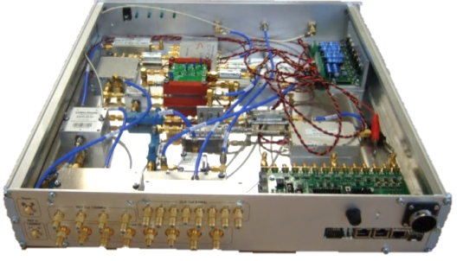
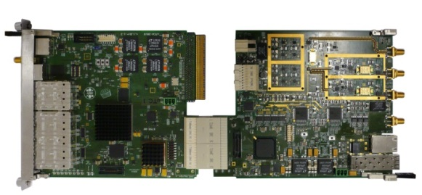
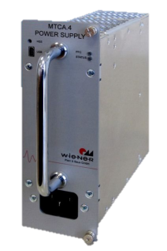
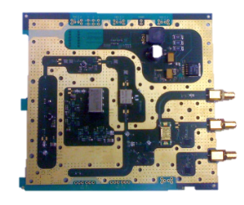
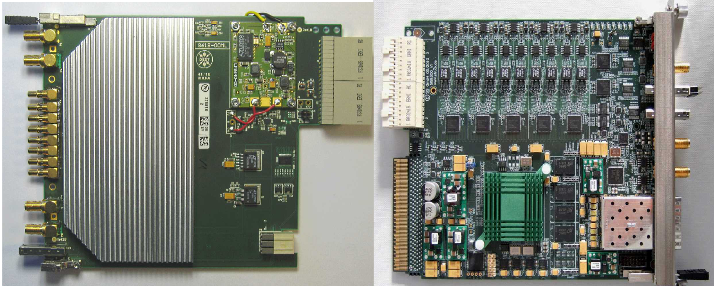
PHASE 1: PRE-COMMISSIONING
All modules tested, ready to be installed in rack
MTCA crate fully equipped and tested
PSM
PZ16M
LOGM
CPIM
MTCA

Slide 5
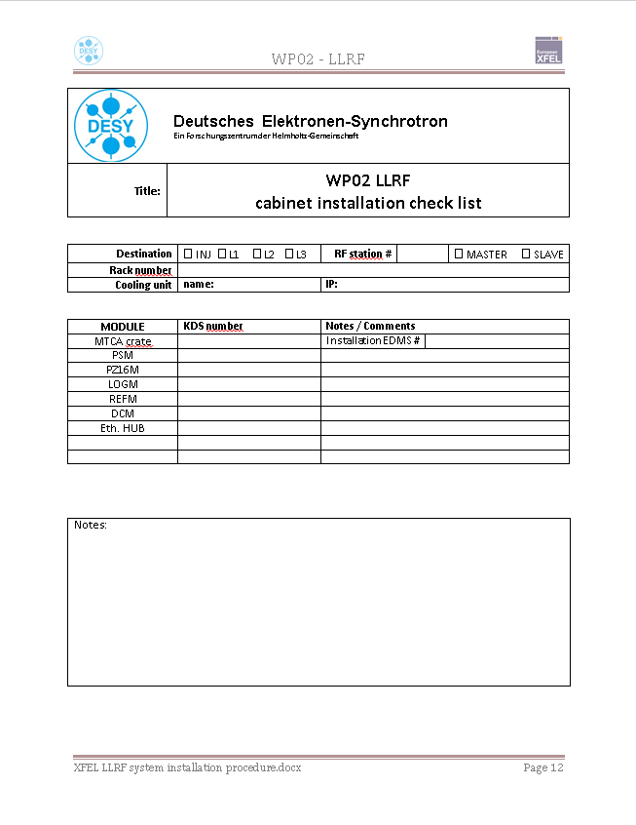
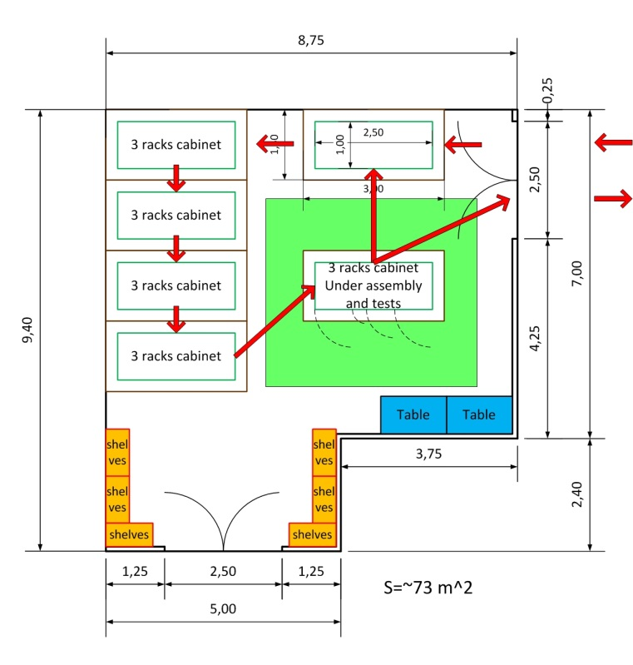
PHASE 2: RACK PREPARATION & INSTALL.
Rack assembly and pre-commissioning
Rack assembly and testing area
Cooling water
Ethernet
Mains
XTIN, UG5

Slide 6
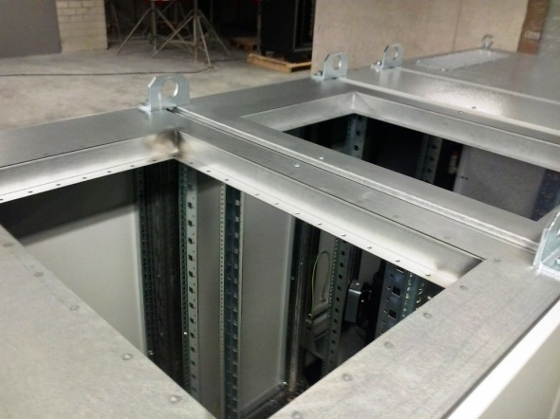
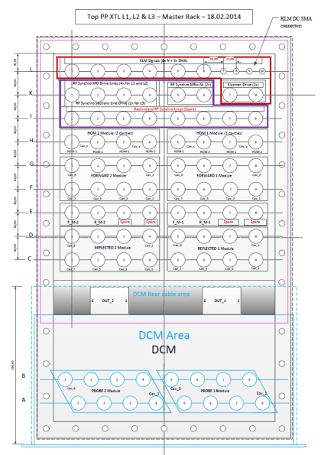
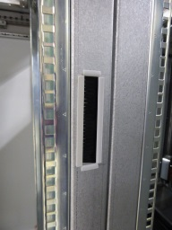
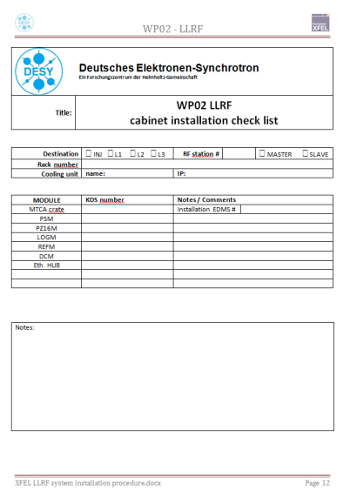
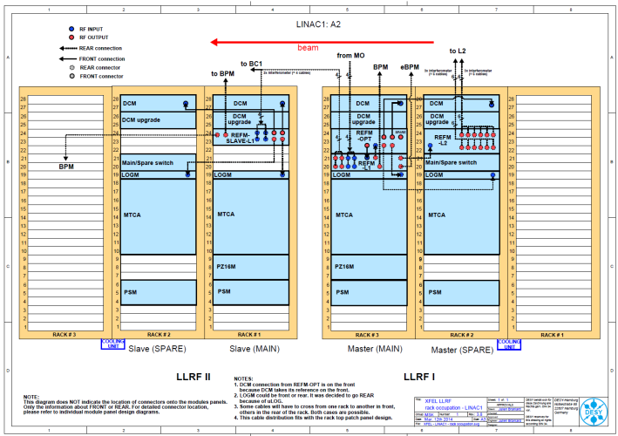
PHASE 2: RACK PREPARATION & INSTALL.
Modify racks
Top patch panels
Side patch panels
Install power outlets (3 phases) (Clarified power distribution with MKK)
Front-rear openings
etc…
Installation of hardware
19” modules
Equipped MTCA crate

Slide 7
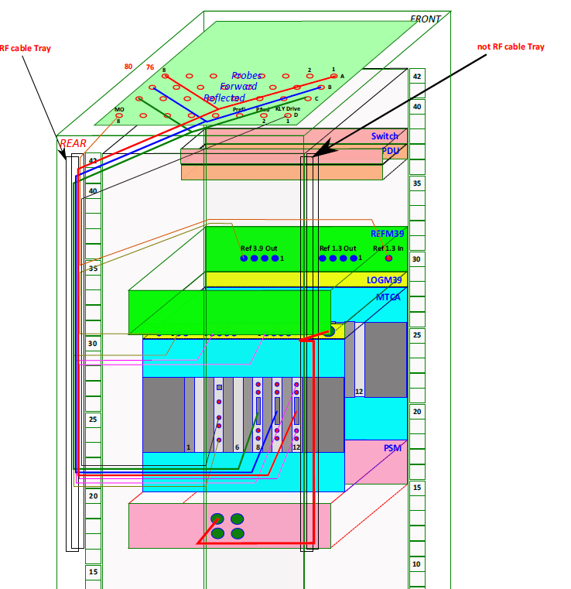
PHASE 2: RACK PREPARATION & INSTALL.
Inner rack cabling
RF cables
Ethernet cables to switch
Power cables
No optical fiber yet
At this stage
All LLRF modules are installed and tested
Inner-rack cabling done
Cooling unit check
Functional tests are done
Redundancy tests are done
➔ Ready for tunnel installation

Slide 8
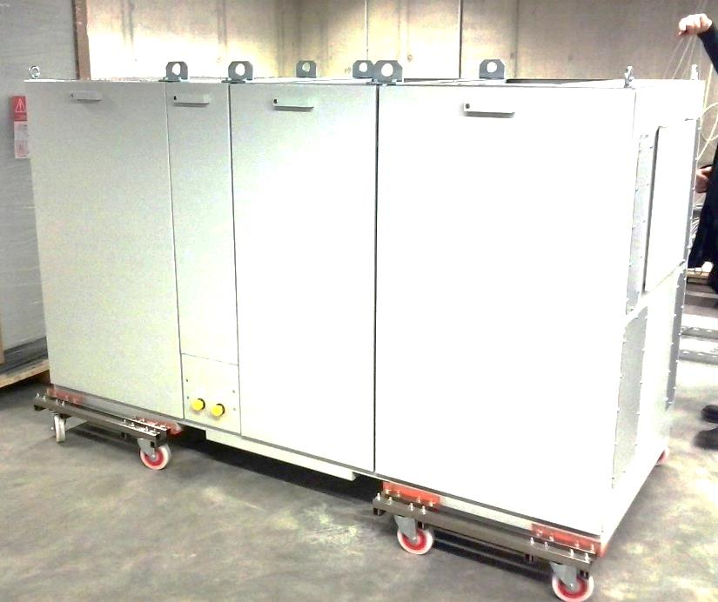
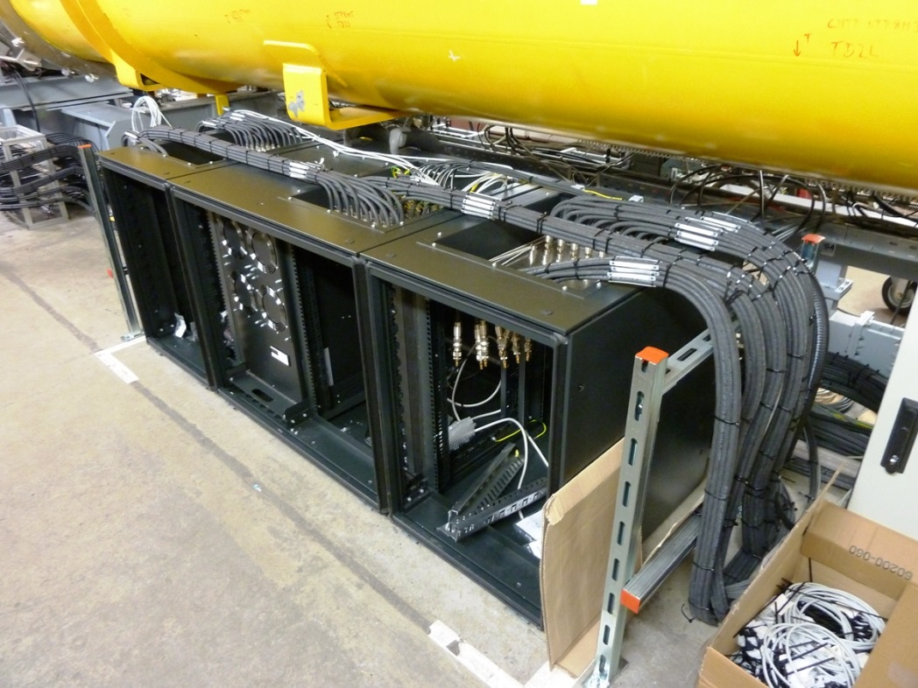
PHASE 3: XTL INSTALLATION
Moving racks into tunnel
Outer rack cabling

Slide 9
PHASE 3: XTL INSTALLATION
Connection to mains/ water/ Ethernet
Optical fibers (splicing + patch panel)
Other WP installation (if not done)
➔ ready for system-level commissioning
Proceed one RF station at a time (following cryomodule installation schedule)
i.e. 2x LLRF racks at a time

Slide 10
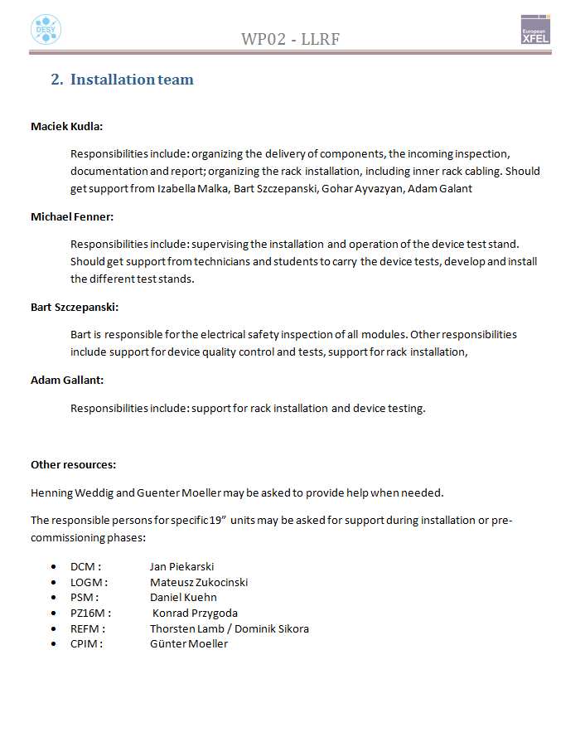
SUMMARY
Installation team:
Maciek Kudla: organization, inner-rack cabling, incoming inspection, documentation, etc…
Michael Fenner: Device incoming tests and quality control, etc…
Bart Szczepanski: Electrical safety, installation, device testing, etc…
Adam Gallant: Rack installation, pre-commissioning, etc…
Wojciech Wierba organization, rack infrastructure, outer rack cabling, etc…
Installation schedule goals
L1 racks ready for end of May
L2 (3 stations) ready Fall-Q4 2014
L3 starts in Q1 2015

