Slide 1
Installation of the warm vacuum system
Main Linac Installation Meeting
22.04.2014
Sven Lederer
Notes:
How to edit the title slide
Upper area: Title of your talk, max. 2 rows of the defined size (55 pt)
Lower area (subtitle): Conference/meeting/workshop, location, date, your name and affiliation, max. 4 rows of the defined size (32 pt)

Slide 2
Outline
Installation of particle free sections
Dogleg
BC0
BC1
BC2

Slide 3
Girder installation - preparation
The following holds for all girders (dogleg, BC0, BC1 and BC2)
Installation of vacuum system of each girder in clean room building 55
2 girders in parallel
Scheduled time per girder: 1 week
Only qualified components will be installed to avoid possible cross contamination
Increased effort for preparation but
Reduced schedule risk during installation
Integration of components from different WP’s
WP17
WP18
WP19

Slide 4
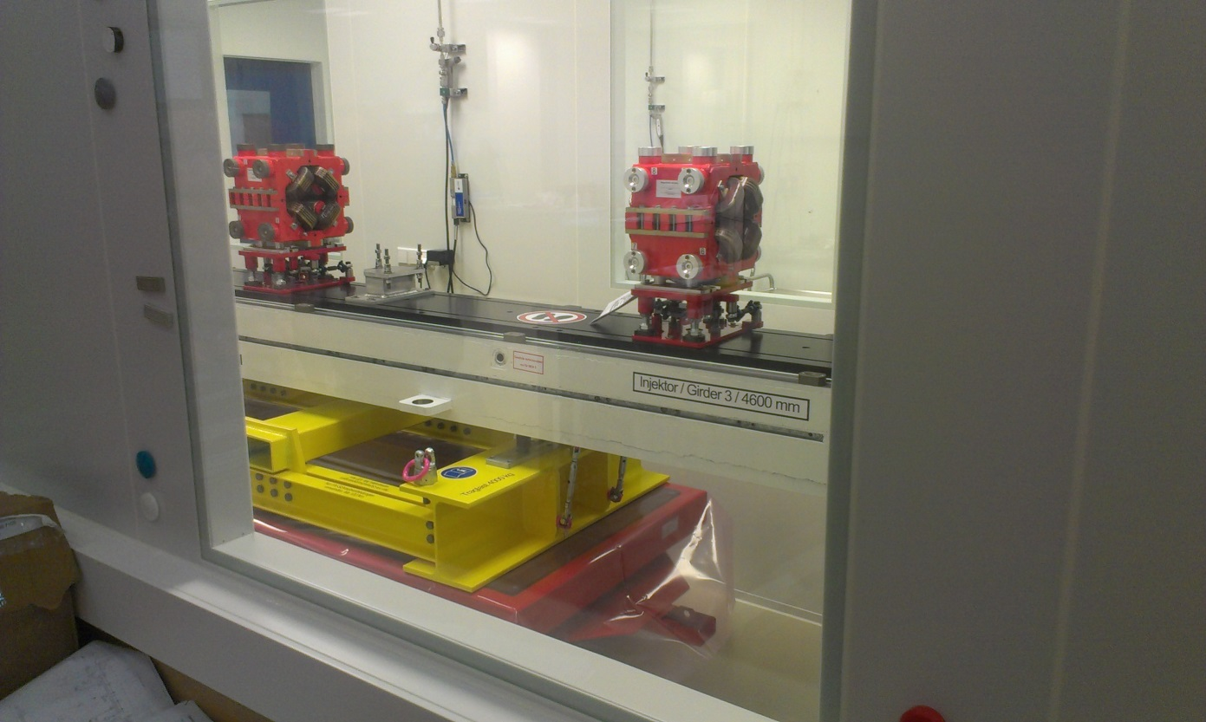
Girder installation - preparation
Handling test of a girder in the clean room
In general handling is quite good
Some minor improvements (steering) necessary

Slide 5
Pre-requirements for tunnel installation
Necessary infrastructure fully available
Electrical power for pump carts and mobile clean rooms
IT network
Pressurized air for pump carts and valves
Working platforms
Cooling water (ECOLs in chicanes)
No “dirty” works afterwards
All cables (signal and HV for SIP’s) in place

Slide 6
Installation sequence
Girders:
Transport of girders into tunnel (WP34)
Installation of girders onto concrete pillars (WP34)
Survey (WP33)
Installation of mobile clean rooms and pump cart(s) (WP19)
Connection of girders (WP19)
Leak check and RGA (WP19)
Start of SIP’s (WP19)

Slide 7
Installation sequence
Chicanes (rough sequence)
Survey of chicane supports (WP32)
Transport of chicane chambers into tunnel and placement on installation frame (WP33)
For the 4 BB chambers of each BC the chambers will be placed inside the magnets in advance of the tunnel installation.
Installation of chicane chambers (WP19) including leak check and RGA
Survey (WP32)
Connection of cooling water to the ECOLs (WP34)
During chicane installation no module transport possible!

Slide 8
Installation sequence
BC1 and BC2 dump lines (more detailed discussions needed)
Dump installation (WP20)
Installation of dump line (WP12, WP19, WP32, WP33)
Installation of outlet chamber
Pressure stages
Support frame installation (WP33)
Transport and placement (WP33)
Vacuum connections (WP19)
Including leak check
After installation of a complete section (also adjacent cryo string) commissioning of beam valves, fast shutters and collimators
Full control system has to be available

Slide 9
Organization
WPL
Sven Lederer
Lutz Lilje
Section responsibilities:
Dogleg, BC0: Vitalij Belokurov
BC1, BC2: Hanni Hügelmann
Main dumps: Jakob Hauser
Mechanical Installation supervision
Particle free:
Antonio de Zubiaurre Wagner
Non-particle free :
Ralph Böspflug, Torsten Wohlenberg
Electronics installation supervision
Dirk Keese
Installation teams from MVS and partially BINP

