Slide 1
FNAL beam test data analysis
A Hands-on session at CMS Upgrade School
Aiwu Zhang
Florida Institute of Technology
On behalf of the CMS GEM collaboration

Slide 2
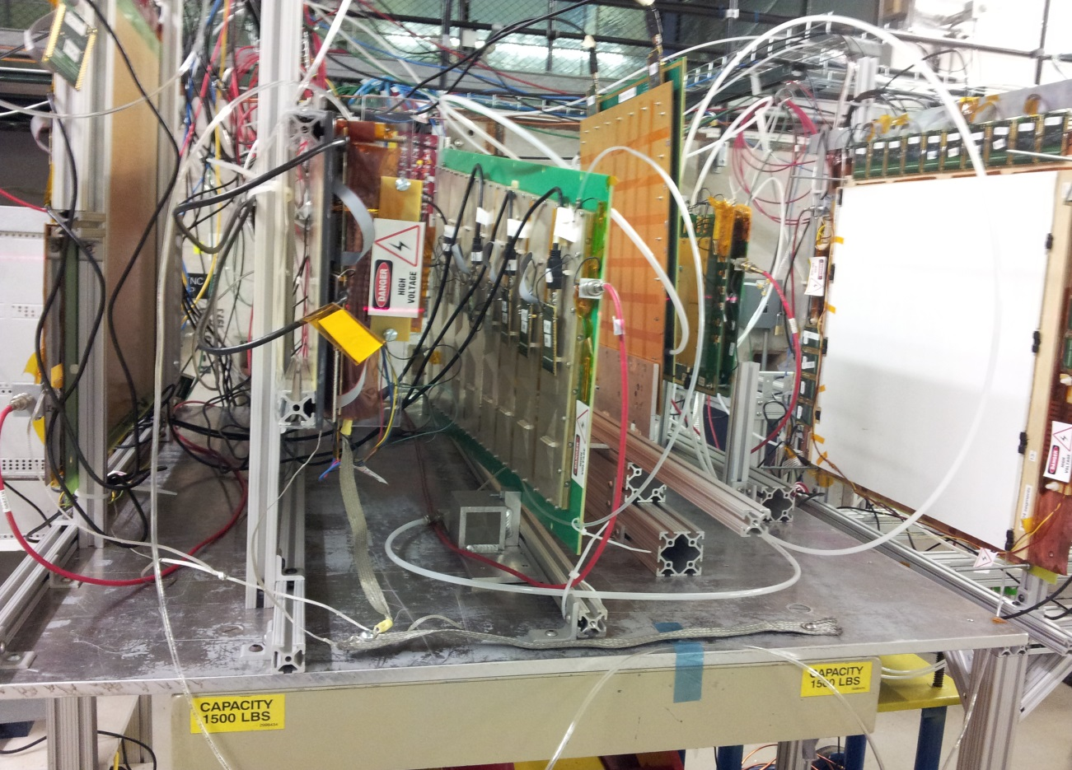
FNAL beam test information
FIT & U.Va operated 10 triple-GEM detectors in Oct. 2013 at Fermilab Test Beam Facility (FTBF), 4 of them worked as reference detectors (trackers). All detectors worked in Ar:CO₂(70/30) gas.
All data were taken with 32GeV/c mixed hadrons (p,π,K).
One CMS GE1/1-III GEM detector was tested in this beam test. 8 APVs were read out one time
(1APV/sector).
For the CMS GEM detector,
We did HV scan in the middle-
sector 5, and position scan for
the entire chamber (except
sector 1) (we scanned along
three lines: the lower, middle
and upper lines).
Notes:
1. Assume students know CMS GEM prototypes: one detector has 8 η-sectors and each sector is read out by 3 APVs. (also we have VFAT readout structure…)

Slide 3
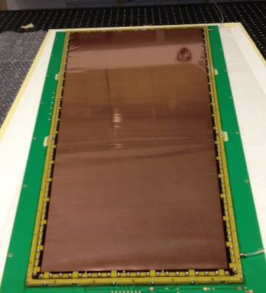
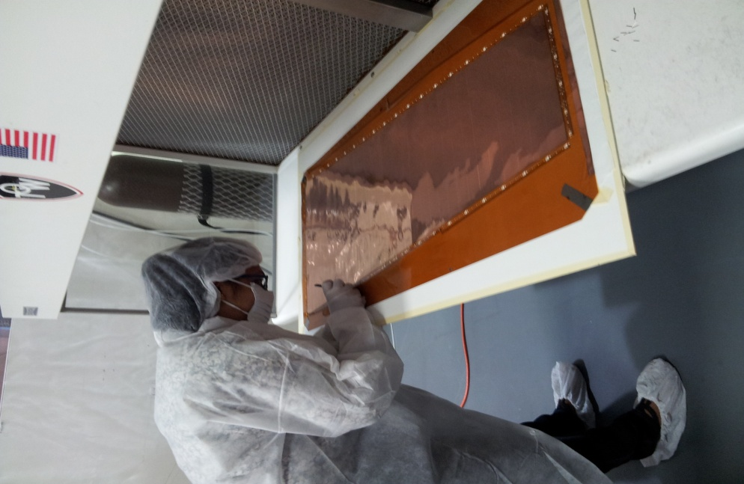
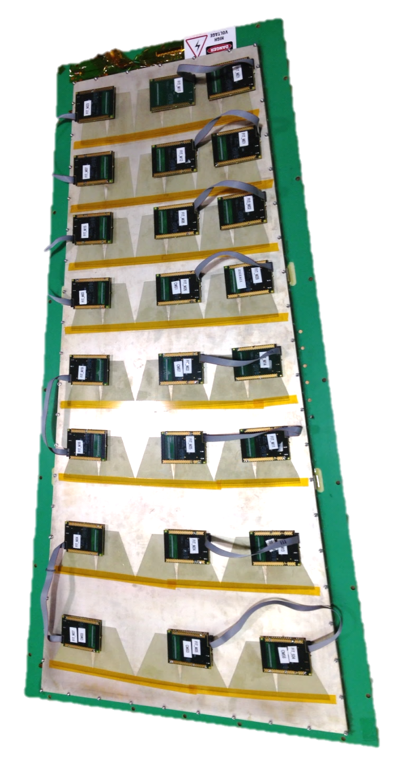
A quick look at the GEM foils & the chamber

Slide 4
Detector arrangement in the beam test
CMS GEM
REF2
REF3
UVA3
REF1
Beam
Z axis
Tracker1
Tracker2
Tracker3
Tracker4
1143.5
2011.5
Distance:
Unit in mm
2686.5
3169.5
One more thing to be in mind:
-> the CMS GEM detector has a trapezoidal shape, the (1 dimensional) readout strips run in radial direction and can measure polar phi-coordinate. We measure hit (we often say cluster) positions in polar coordinates, so we’ll transfer Cartesian to polar system for the trackers in some of the analysis, for instance, resolution studies.

Slide 5
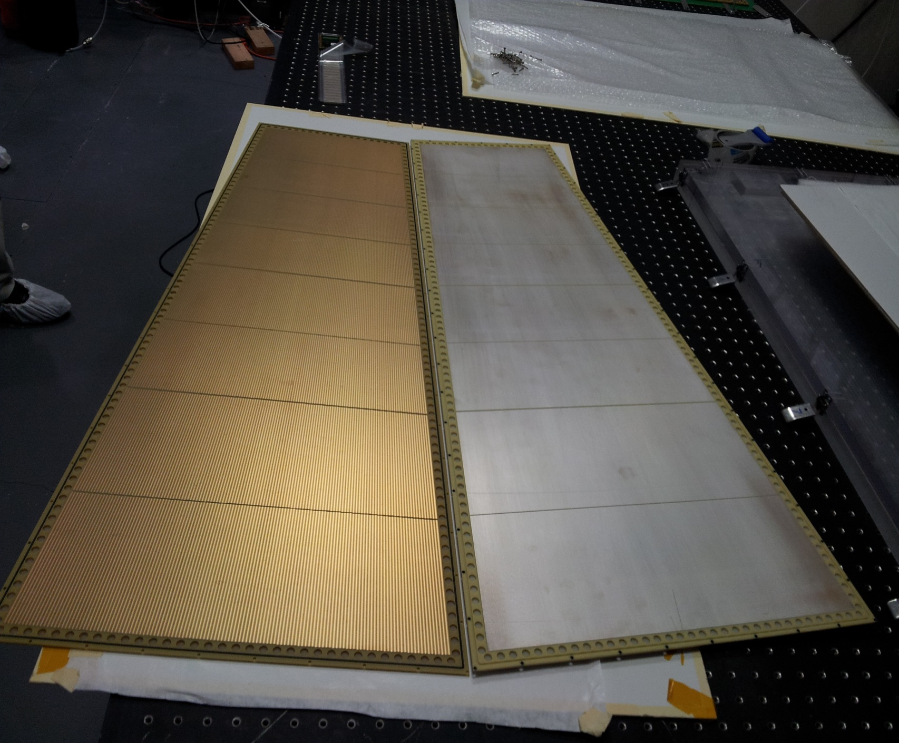
A quick look at readout strips
The readout board for the CMS GEM.

Slide 6
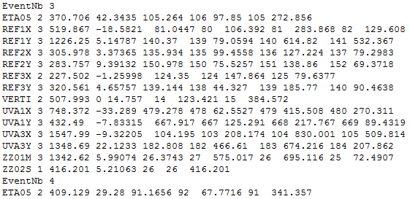
A quick look at the raw data
Event number
The contents in each line (except the event number line) are:
(1)detector plane name: “ETA05” means sector 5 in the CMS GEM;
(2)number of fired strips in this plane;
(3)cluster charge (in ADC counts);
(4)cluster position in mm;
(5)cluster position in strip number;
(6)Groups of strip number i and charge on it, i=1,2,…,n, n is the number in (2).
Notes: (a) in one event not all detectors have signal due to inefficiency (and some other reasons like fluctuation, noise, …); (b) please focus on these planes: REF1X(Y), REF2X(Y), REF3X(Y), UVA3X(Y) and “ETA0i”(i=0,1,…,7).

Slide 7
Select “valid” events
“Valid” event means an event that creates hits in both trackers and the CMS GEM detector.
The “Script_ValidEventSelection.C” script does this work.
-> This script reads in the raw data file, outputs a new text file which contains the “valid” events that can be studied in further analysis.
-> The cut is basically on the cluster sizes in the detector planes. Cluster size means number of strips that are fired in an event.
-> Total 9 columns in the new output text file, the first 8 columns are clusters positions in trackers (both X and Y planes), the last column is the cluster position in the CMS GEM detector in phi-coordinate (radian).
We’ll go through the script briefly …

Slide 8

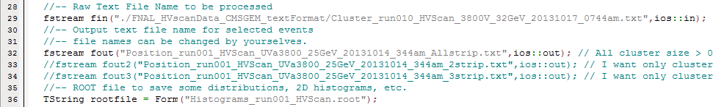
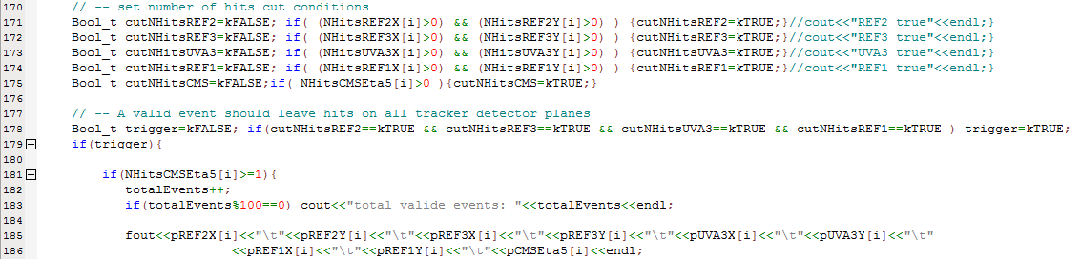
Script_ValidEventSelection.C
To run the script:
“root -l” in a terminal; -> open ROOT
“.L Script_ValidEventSelection.C”; -> load the script
“main()”. -> execute the function
Number of raw events in file
File names
Selection cuts on cluster sizes

Slide 9
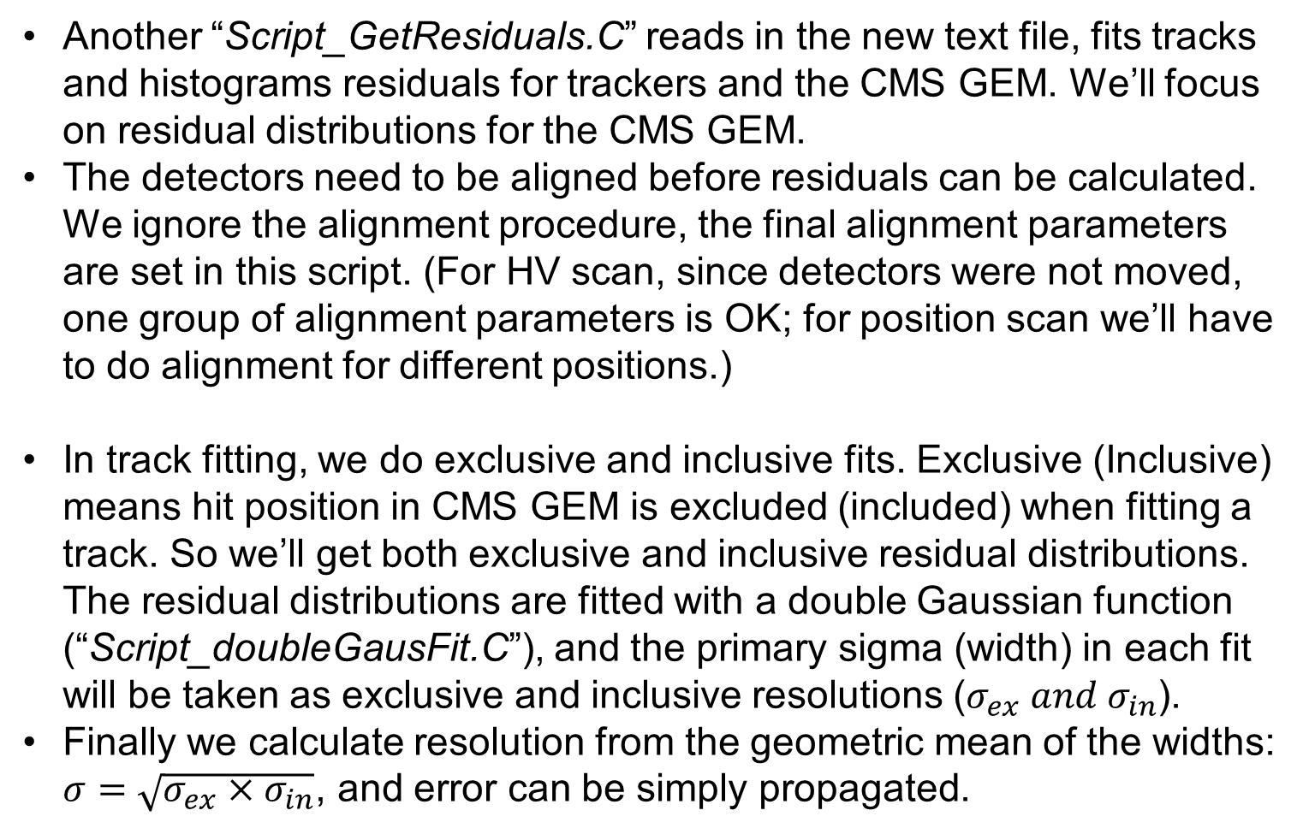
Spatial resolution study
Another “Script_GetResiduals.C” reads in the new text file, fits tracks and histograms residuals for trackers and the CMS GEM. We’ll focus on residual distributions for the CMS GEM.
The detectors need to be aligned before residuals can be calculated. We ignore the alignment procedure, the final alignment parameters are set in this script. (For HV scan, since detectors were not moved, one group of alignment parameters is OK; for position scan we’ll have to do alignment for different positions.)
In track fitting, we do exclusive and inclusive fits. Exclusive (Inclusive) means hit position in CMS GEM is excluded (included) when fitting a track. So we’ll get both exclusive and inclusive residual distributions. The residual distributions are fitted with a double Gaussian function (“Script_doubleGausFit.C”), and the primary sigma (width) in each fit will be taken as exclusive and inclusive resolutions ($σ_{ex} and σ_{in}$).
Finally we calculate resolution from the geometric mean of the widths: $σ=\sqrt{σ_{ex}×σ_{in}}$, and error can be simply propagated.

Slide 10
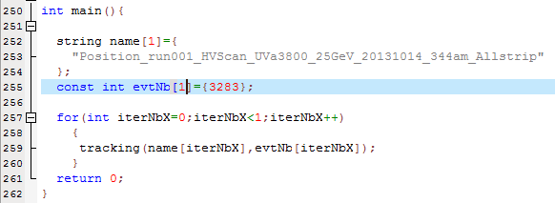
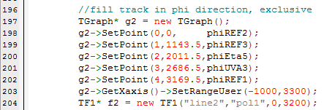
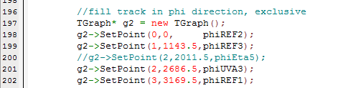
Script_GetResiduals.C
Same way to run this script!
Set file name(s), and event number(s).
Change “_Residuals_Inclusive.root” to “_Residuals_Exclusive.root” If calculate exclusive residual,
For Inclusive track fit, please make sure the lines 196—204 are the same as on the left, for exclusive track fit, please change those lines accordingly to the right.

Slide 11
Practice with the ValidEventSelection script
-> Within the HV scan data (10 files), use any one file;
-> Select events that has size >= 1 in all tracker planes, and also >=1 in the CMS GEM;
-> Note that we can also study the clusters that have a certain size, eg., 2-strip clusters.
-> Check the output text file;
-> Also a root file is output, some histograms are stored in it. It’ll also be interesting to check them.

Slide 12
Practice with the GetResiduals script
-> Use one newly output text files, run the script with “Exclusive” mode and “Inclusive” mode,
-> then read residual widths of both, and calculate geometric mean for the resolution
-> do the same thing for all HV points.
Let’s go ……

Slide 13
Summary
Resolutions at different HV points can be analyzed with the two scripts.
The first script is actually can be used to do some other analyses: (1) cluster charge distribution; (2) detection efficiencies; (3) cluster sizes characters; etc… please implement them if you are interested!
Thanks!

