Slide 1
Phase-2 Muon Performance Projections and Evaluation:
Example: GE-1/1 Case

Slide 2
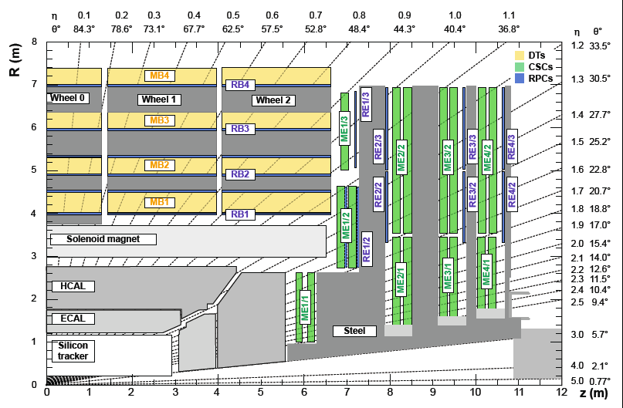
GE-1/1
A new muon detector station GE-1/1 covering 1.6<|η|<2.15 is planned to be installed in LS-2 as part of “early” Phase-2 upgrades. The new detector consists of pairs of triple GEM chambers arranged in rings and position next to the existing CSC chambers forming station ME-1/1. Each GEM chamber spans 10 degrees in φ and its readout is segmented in several partitions in pseudorapidity η, each readout using 128 radial strips

Slide 3
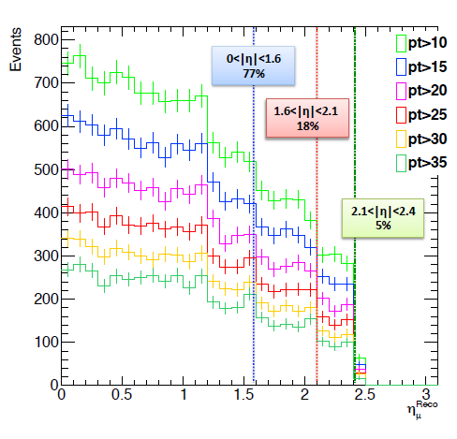
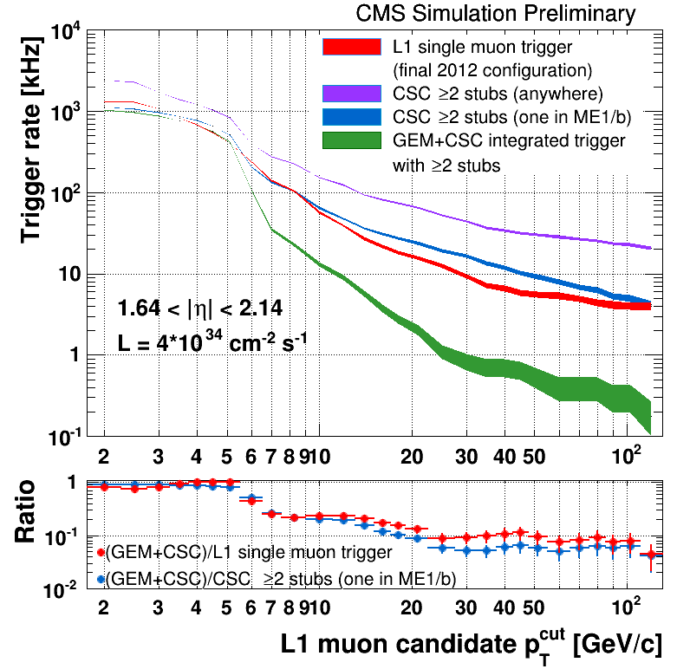
H2Tau
Studied channels H→τ(μνν) τ(had) and Η→τ(μνν) τ(μνν)
  Argument: Muons from tau-decay are soft <p_{T}>~15 GeV → Lowering trigger pT from ~35 GeV to ~15 GeV = doubling event yield

Slide 4
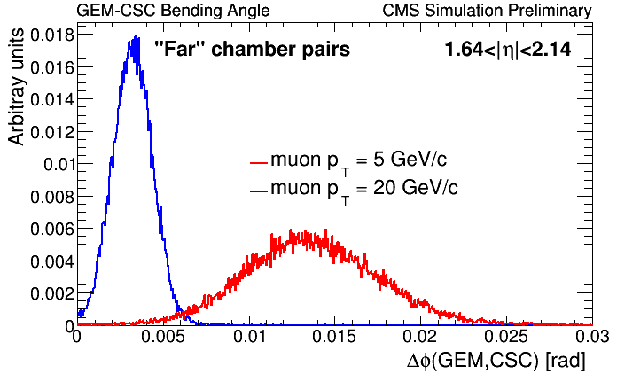
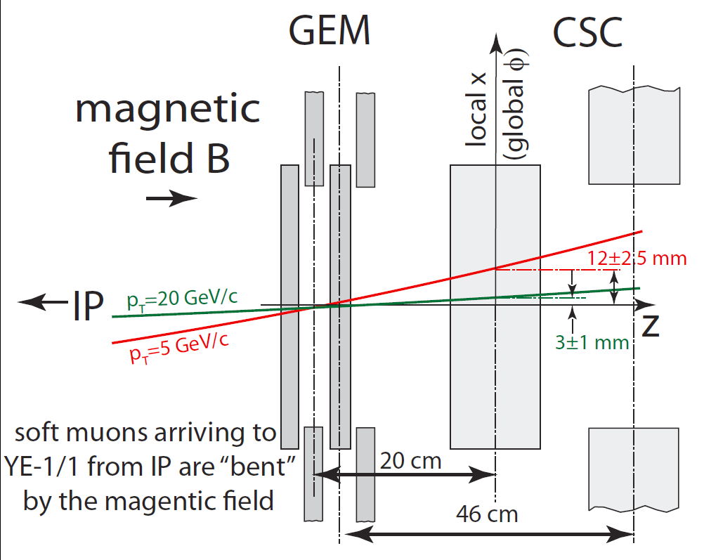
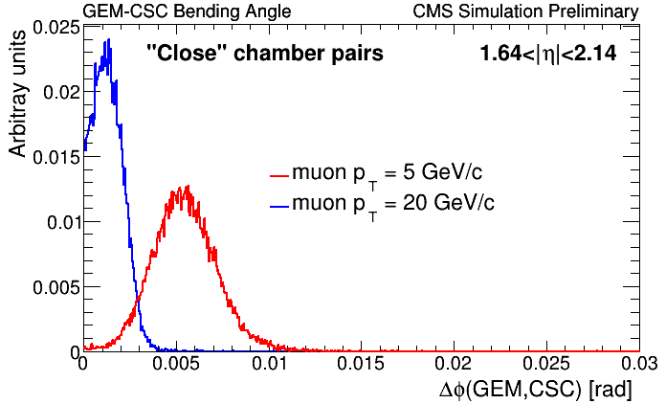
Bending Angle
View from the top of the CMS down
An increased lever arm of the combined CSC+GEM system compared to that measureable by CSC chambers alone allows a better accuracy measurement of the bending angle in the B-field. High momentum tracks point back towards the interaction point while lower momentum muons are angled due to the magnetic field. Because muon detectors are designed to have overlapping chambers, half of the CSC-GEM chamber pairs fall into the “close” category and the other half is in the “far” category.)
Bending angle Δφ is defined as the difference in global φ between the CSC Local Charged Track position at the CSC key layer and the center of the GEM Level-1 trigger pad. The plot shows that the bending angle measurement can be utilized in the trigger to discriminate high momentum muons from low p_{T} muons.

Slide 5
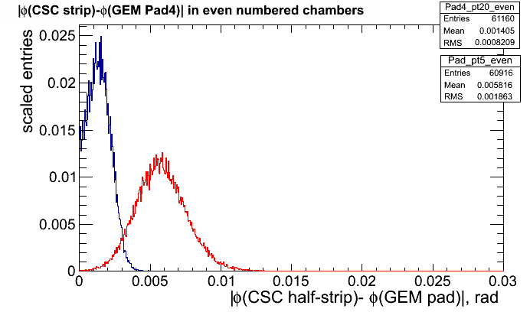
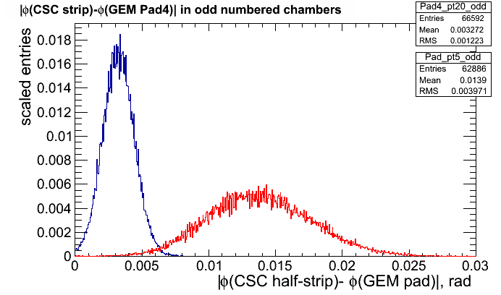
Bending angle at L1 Granularity
“Close” chamber pairs
“Far” chamber pairs
Δφ(CSC-GEM)~ 4 mrad
Δx ~8 mm
p_{T}=20 GeV
p_{T}=5 GeV
GEM-CSC bending angle measurement using full GEANT simulation:
  Muons with PT=5 and PT=20 GeV
  GEM L1 Trigger pads (4 strip OR)
  Good discrimination and a powerful new handle on p_{T} resolution
An “OR” of two GEM chambers within a super-chamber is ~100% efficient

Slide 6
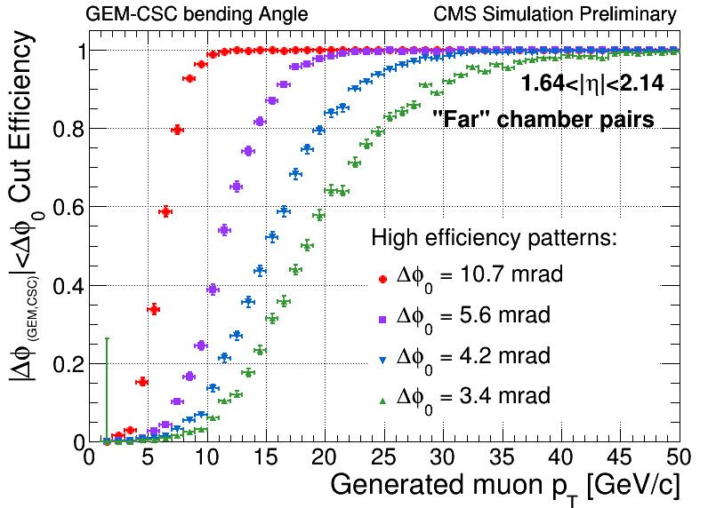
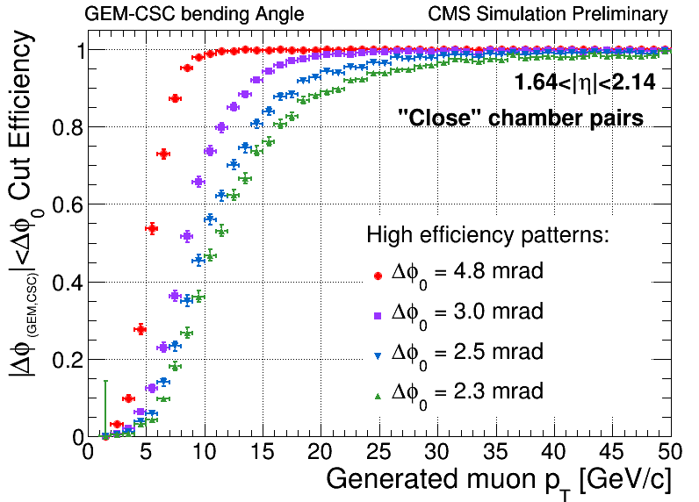
Bending Angle & p_{T} Measurement
Measured bending angle using the GEM and CSC chambers is strongly correlated with the muon momentum. A suitably chosen Δφ cut values allow fast selection of muons with momentum above a desired threshold. As an illustration, we define Δφ cut values which allow efficient selection of muons with p_{T} falling in one the following ranges: 10-20, 20-30, 30-40, and 40+ GeV/c. The values shown in the plots correspond to efficiency of at least 98% for muons with p_{T} from the target momentum range . Momentum measurement using the bending angle within YE-1 is not strongly correlated with (and is therefore complementary to) the momentum measurement based on bending between neighboring stations, which is the basis for measuring momentum in the current Level-1 trigger . The upgraded muon trigger is expected to deploy an algorithm that combines all available information including the new bending angle measurement.

Slide 7
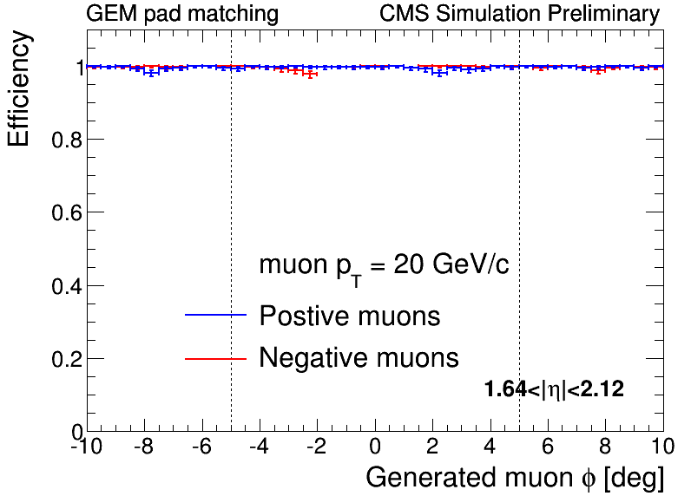
GE-1/1: Level-1 Trigger Stub Efficiency
In the future, the small dips in the efficiency are expected to disappear as those are primarily associated with the presence of spacers in the current GEM simulation geometry
New design of the GEM chambers allows spacer-less geometry
Efficiency of reconstructing GEM Level-1 trigger primitives, which are defined as an “OR” of the trigger pads of the two GEM chambers forming a super-chamber as a function of φ. GEM trigger pads are formed by dividing 128 radial strips in each GEM chamber partition into groups of 4 strips each. The signal is defined as an “OR” of digital signals in each of the 4 strips in the pad. Overlaps of the 10-degree GEM super-chambers (vertical lines show the span 10 degree span corresponding to the chamber in the center of the plot) ensure near 100% efficiency near chamber borders as a track in the overlap region can be found inside either of the two overlapping super-chambers.
  Matching of signal tracks and pads is done geometrically by comparing position of the simHit and the corresponding digi

Slide 8
GE1/1 and GE2/1 detectors
Residuals for various GE1/1, GE2/1 : pitch segmentation impact on resolution

Slide 9
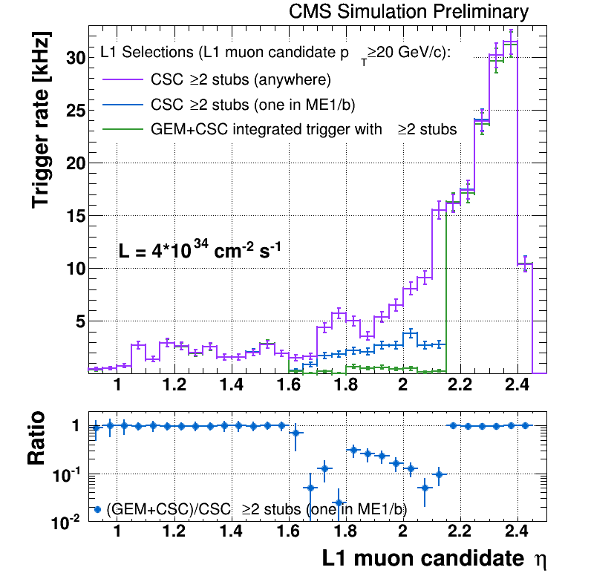
GE-1/1: Trigger Rate Reduction
The luminosity corresponds to N_{PU}=100 and 25 ns bunch crossing spacing
ME1/b is the upper half of the ME1/1 chamber and spans 1.55< |η|< 2.1
An illustration of the achievable trigger rate reduction in the region covered by the new station GE-1/1. The trigger rate reduction is primarily driven by better discrimination of high momentum muon candidates using the bending angle measured with pairs of GEM and CSC chambers. In this case, each Level-1 muon track of a given moment is required to have its measured bending angle to satisfy the working point Δφ cut corresponding to the momentum range, in which the track in question belongs to

Slide 10
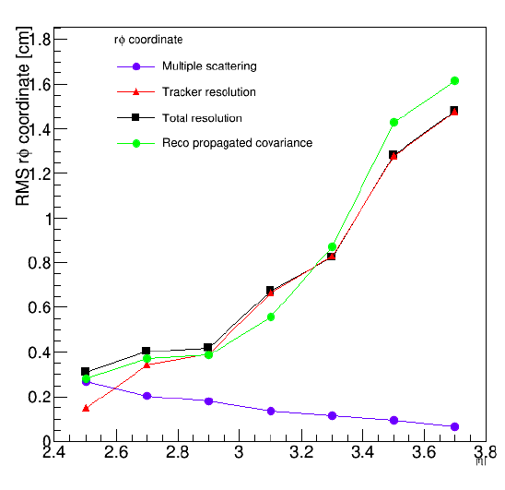
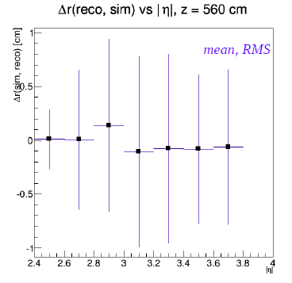
ME0: Offline Performance Summary
 | p_{T}~ 20 GeV | p_{T}~5 GeV*
Momentum range (GeV) | 100-400 | 20-100
Material scattering | 3-1 mm | 12-4 mm
Pixel track extrapolation accuracy in rφ (conservative projection) | 3-14 mm or better | 1-4 mm or better
Combined rφ pointing precision | ~14 mm or better | ~12 mm or better
Pointing precision along η | Less than ~8 mm
Muon gun
p_{T}>20 GeV
Despite difficult B-field configuration, measurable bend for |η|<3.2
  Muon system can contribute to the momentum measurement
Muon gun
p_{T}>20 GeV
* FastSim for p_{T}~20 GeV, simple scaling for p_{T}~5 GeV

Slide 11
Near Tagger: Physics Impact
PU=200 2.1<|η|<4.0 | p_{T}> 10 GeV | p_{T}>5 GeV
Number of pixel tracks per pp interaction | negligible | 0.25
Number of pixel tracks per BX (200 pp interactions) | 5 | 50
Number of muon hits | 100 | 100
Probability of a fake match per event (for a tagged vertex) | Negligible | <0.004
Probability of a fake match per event (unknown vertex) | <0.08 | <0.8
Muon gun sample
p_{T}>20 GeV
Separately, neither system provides low enough fake rate
  Except perhaps standalone tracking may work for some special cases
Combined system performance is clearly acceptable for a broad range of physics analyses
  Calculations use a matching window of ΔηxΔφ~0.05x0.04
    Over 95% efficient matching, based on results from the previous page

Slide 12
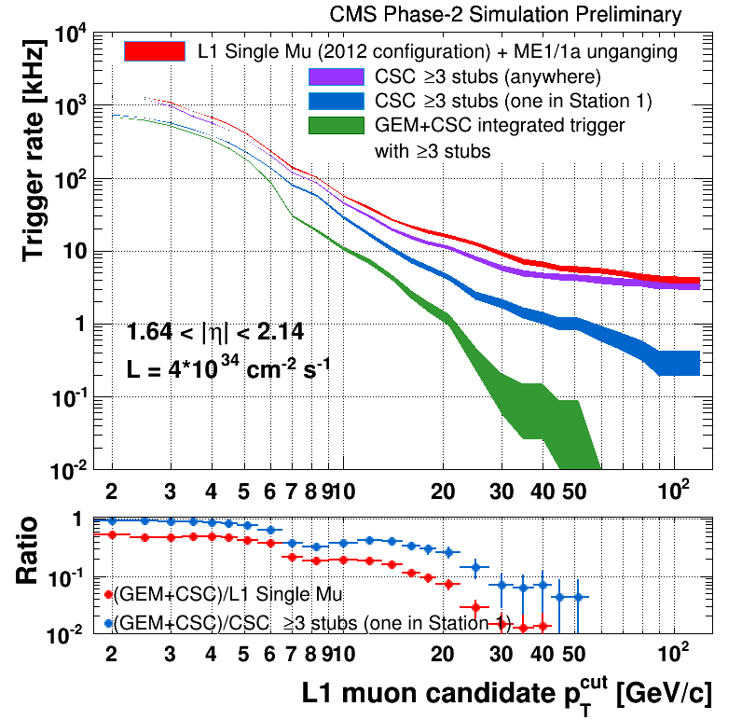
H2Tau
Studied channels H→τ(μνν) τ(had) and Η→τ(μνν) τ(μνν)
  Argument: Muons from tau-decay are soft <p_{T}>~15 GeV → Lowering trigger pT from ~35 GeV to ~15 GeV = doubling event yield

