Slide 1
WP-18 Special Diagnostics Installation Status
Presented by: Christopher Gerth
Notes:
How to edit the title slide
Fill in the text written in brown

Slide 2
Scope of WP-18 Devices
Distribution of fs-stable optical synchronization signals over entire facility (~ 3.5 km)
Monitoring of long. properties: beam energy, bunch profile/length and bunch arrival time.
Igor Zagorodnov, 2011
Energy | 130MeV | 600MeV | 2.5GeV | 17.5GeV
20pC | 4.53ps | 1.46ps | 185fs | 5.23fs
100pC | 4.80ps | 1.55ps | 197fs | 11.6fs
250pC | 5.27ps | 1.70ps | 223fs | 25.4fs
500pC | 6.00ps | 1.96ps | 259fs | 43.0fs
1000pC | 6.77ps | 2.23ps | 303fs | 84.0fs
Energy change (x 100) after accelerating sections: I0, L1, L2, L3
Bunch length change (x 1000) after bunch compressors: BC0, BC1, BC2
Bunch arrival time may change after dispersive sections: BC0, BC1, BC2
=> Longitudinale Diagnostik nach Beschleunigung und Bunch Kompression

Slide 3
Rückblick: Longitudinale Diagnostik bei FLASH / XFEL
FELs: Erzeugung ultra-kurzer X-Ray Pulse FEL einige 10 fs Bunchlänge ↔ Speicherring einige 10 ps Entwicklung von Messtechniken mit fs-Zeitauflösung
Entwicklung der longitudinalen Diagnostik für FLASH fand bei FLA statt (P. Schmüser, B. Schmidt)
Installation, Betrieb und Wartung beim XFEL => Bedarf an technischer Infrastruktur => Eingliederung der long. Diagnostik in den M-Bereich
Anfang 2010: WP-18 wurde in MSK integriert: M. Felber, Ch. Gerth, H. Schlarb (GL MSK) von MPY
MSK schlecht aufgestellt im Bereich Mechanik: Verstärkung durch Mechaniker Martin Schäfer und M-Verbundwerkstatt (es gibt aber keinen Mechanik-Ingenieur bei MSK)
MSK verfügte nur über ein Digital/Analog Labor: => Labor für Optikaufbauten eingerichtet (Büro-Container 28f) => Labor für Vormontage in XTIN UG1 R017 vorgesehen
Entwicklung für das optische Synchronisationssystem finden im Laser-Labor von FLA statt => eigenes Laserlabor wird benötigt
Weiteres technisches und wissenschaftliches Personal wurde eingestellt => ca. 8 FTE

Slide 4
Overview on WP-18 Devices
Beam energy
Bunch arrival
Laser-based
Synchronization
Bunch length/profile
TDS⁽¹⁾
Transverse
Deflecting
Structure
EOD
EO
Diagnostics
BCM
Bunch
Compression
Monitor
EBPM
Energy BPM
SRM
Synchrotron
Radiation
Monitors
Reference
Distribution XTIN UG5 R25
(MLO, FSD, Faser-Links)
Bunch profile
Slice emittance
Phase space
Bunch profile
Compression
Beam energy
(Bunch arrival)
Beam Energy
Energy profile
CRD
THz
Spectrometer
BAM
Bunch Arrival
Monitor
L2L
Laser
Synchronization
REFM
LLRF
Synchronization
Bunch profile
Bunch arrival
Beam energy
1)
High-Power RF system and TDS are part of contract between European XFEL GmbH and Inst. for Nuclear Research (INR).
High-Power RF system and TDS are made by INR, Moscow.
Vacuum parts for BAM and EBPM manufactured by WP-17
Yellow: involves lasers (=> laser lab space required => XTIN UG1 in Arbeit …)
Notes:
Before you start editing the slides of your talk change to the Master Slide view: Menu button “View”, Master, Slide Master:
Edit the following 2 items in the 1st slide: 1) 1st row in the violet header: Delete the existent text and write the title of the EoI for WPnumber 2) The row in the footer area: write the institute name
Close Master View

Slide 5
Overview on WP-18 Devices (2)
5
TL: Supports for CRD and BAM need to be designed
 | INJ | BC0 | BC1 | BC2 | TL | UND | Sum
BAM | 1 | - | 2 | 2 | 2 | - | 7
EOD | 1 | 1 | 1 | - | - | - | 3
BCM | - | 1 | 1 | 2 | - | - | 4
CRD | - | - | - | - | 1 | - | 1
SRM | - | - | 1 | 1 | - | - | 2
TDS | 1 | - | 1 | 1 | - | - | 3
EBPM | - | 1 | 1 | 1 | - | - | 3
Sum | 3 | 3 | 7 | 7 | 3 | - | 23
BC1 Girder Belegung
G2 : EOD, BCM, BAM
G3 : EOD, BCM, BAM
G4 : TDS
BC2 Girder Belegung
G2 : BCM, BAM
G3 : BCM, BAM
G4 : EOD
G5 : TDS
7 Completely different types of devices (≈ Einzelanfertigung)
All WP18 devices in XTL and INJ
Most in B1 and B2 section
Notes:
5
Before you start editing the slides of your talk change to the Master Slide view: Menu button “View”, Master, Slide Master:
Edit the following 2 items in the 1st slide: 1) 1st row in the violet header: Delete the existent text and write the title of your talk into this text field 2) The 2 rows in the footer area: Delete the text and write the information regarding your talk (same as on the Title Slide) into this text field.
If you want to use more partner logos position them left beside the DESY logo in the footer area Close Master View

Slide 6
Generic Layout
6
Zuerst Installation der Vakuumbauteile => WP-19 / MVS
Bedarf teilweise der Hilfe von Experten im Reinraum
Beamline Hardware: EOD, BCM, CRD, SRM => Installation am Girder in XTL
SRM: Nach Einbau der Bunchkompressor Schikanen
Rack equipment
Es gibt kein Installationsteam: Organisation der Installation durch Experten mit Unterstützung vom WP-18 Team
Rasante Entwicklung bei Optiken, THz Detektoren 1D Detektoren, Kameras, MTCA, … => richtigen Zeitpunkt treffen um Designs ein zu frieren: nit zu früh / nicht zu spät
19’’ Modules:
Operation of Hardware
Vacuum
setup
Beamline Hardware: Detektion und Signalwandlung
LLRF
MTCA:
Signal detection, computation, …
19’’ Module:
Conversion for signal detection
e-beam
Rack
Notes:
6
Before you start editing the slides of your talk change to the Master Slide view: Menu button “View”, Master, Slide Master:
Edit the following 2 items in the 1st slide: 1) 1st row in the violet header: Delete the existent text and write the title of your talk into this text field 2) The 2 rows in the footer area: Delete the text and write the information regarding your talk (same as on the Title Slide) into this text field.
If you want to use more partner logos position them left beside the DESY logo in the footer area Close Master View

Slide 7
WP-18 MTCA Crates
About 22 crates in 12 different configuration (12 in XTL)
About 200 MTCA boards of 20 different types
Pre-commissioning of crates before installation at final location (on demand and availability)

Slide 8
WP-18 Rack/Crate/Device test and installation
8
Rack installations:
Every rack configuration different (22 stations, shared, room reserved => TC rack inventory)
No pre-commissioning: Installation of MTCA and 19’’ modules at final location
Installation and cabling by experts plus others (depends on rack, depends on others)
MTCA Crate installation
Almost every crate configuration different (about 22 crates)
Integration tests: should be close to MTCA device storage and testers (tbd.)
Crate storage unclear (where to store 22 crates)
MTCA Devices
Device labeling and documentation in KDS (Matthias Felber, Maciek Kudla)
Device testing: as for LLRF boards, some boards during pre-commissioning
Too many side constraints for each rack => no standard installation procedure
Needs to be organized within WP-18 Team …
Notes:
8
Before you start editing the slides of your talk change to the Master Slide view: Menu button “View”, Master, Slide Master:
Edit the following 2 items in the 1st slide: 1) 1st row in the violet header: Delete the existent text and write the title of your talk into this text field 2) The 2 rows in the footer area: Delete the text and write the information regarding your talk (same as on the Title Slide) into this text field.
If you want to use more partner logos position them left beside the DESY logo in the footer area Close Master View

Slide 9
Installation schedule
Overall Schedule:
Injector Commissioning: BAM, EOD, TDS, 4 Links (complete systems)
Handover of all vacuum parts to WP-19 by end of 2014
Installation of all additional equipment (20 systems and 20 Links) until 06/16
Additional Equipment Installation schedule
No rigid schedule as for instance like LLRF (A01 – A26)
Needs to be planned by device responsible persons and coordinated in WP-18 team
Coordination will depend on
Availability of WP-18 hardware
Availability of sub-system experts for device testing
Availability of support for installation
Availability of support for firmware / server installation
Overall schedule (vacuum installation, infrastructure and rack installation, …)
=> Needs to be worked out
All hardware developments to be finished by end 2014
All hardware available beginning of 2015
Establish installation rules and routines …

Slide 10
Overview on WP-18 Team
Beam energy
Bunch arrival
Laser-based
Synchronization
Bunch length/profile
TDS⁽¹⁾
Transverse
Deflecting
Structure
EOD
EO
Diagnostics
BCM
Bunch
Compression
Monitor
EBPM
Energy BPM
SRM
Synchrotron
Radiation
Monitors
C. Sydlo, F. Zummack
Reference
Distribution
(MLO, FSD, LSU)
B. Steffen
P. Peier
U. Mavric
C Gerth
INR (MIN)
LLRF (MSK):
M . Hoffmann
Water: MKK
Vacuum: WP-19
Coord: WPL
Admin: WPL
CRD
THz
Spectrometer
BAM
Bunch Arrival
Monitor
L2L
Laser
Synchronization
REFM
LLRF
Synchronization
P. Peier
M. Czwalinna
J. Müller (FLA)
T. Lamb
PhD thesis
Red: Post-Docs auf Zeitverträgen! … Betrieb und Wartung?
MTCA Board Entwicklung: R. Wedel und polnische Kollaborationen
Software: 3 Doktoranden + 1 PostDoc (poln. Koll.) + 1/2 HVF
MTCA Test und Installation: U. Mavric, M. Felber
1 Mechaniker (2 Jahre) in M-Verbund, 1 Elektriker (1,5 Jahre)
Zeit zwischen Design und Installation muss kurz sein, da FTEs limitiert! Schwerpunkte setzen.
Generell: WP-02 LLRF Entwicklungen übernehmen wo möglich, um Entwicklungsaufwand zu minimieren
Notes:
Before you start editing the slides of your talk change to the Master Slide view: Menu button “View”, Master, Slide Master:
Edit the following 2 items in the 1st slide: 1) 1st row in the violet header: Delete the existent text and write the title of the EoI for WPnumber 2) The row in the footer area: write the institute name
Close Master View

Slide 11
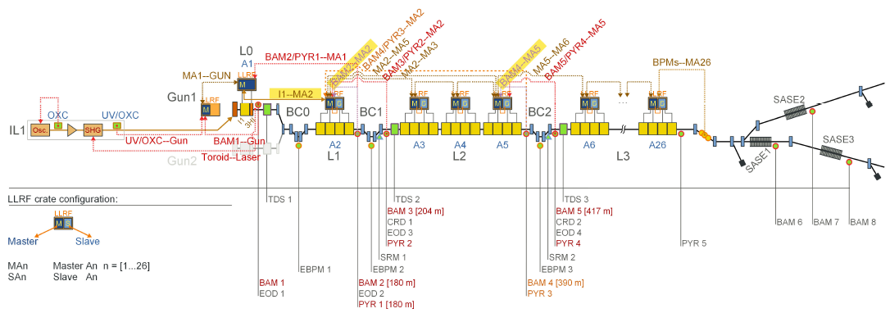
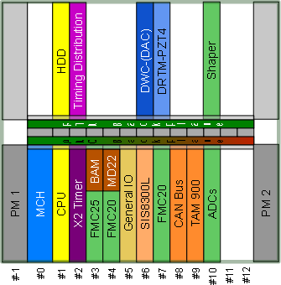
WP-18 Diagnostics and Beam-Based Feedback
Planning: M.K. Czwalinna, C. Gerth, C. Schmidt
BAM, EOD and BCM are combined in 1 MTCA crate
Planung abgeschlossen
Spezielle polarisationserhaltene LWL fuer BAM
Roehrchen fuer LWL in XTL sind verlegt
Combined Signals with EBPM are sent to upstream LLRF station

Slide 12
Thank you for
your attention

