Slide 1
Installation XFEL Tunnel WP 34
Hans-Jörg Eckoldt
For WP34

Slide 2
WP4
Responsibilities
Energy supply
Connection of the racks
UPS
Elektrants
Water supply
20 ° Water
30° water
Pressurized air
Air conditioning
No extra cooling in the tunnel
Power supplies

Slide 3
WP4
Responsibilities
Energy supply
Organization Markus Faesing
Work coordination Marko Krüger
Water supply
Organization Frank Reinhard Ullrich
Work coordination Felix Levenhagen
Power supplies
Injector Björn Näser
XS1 Axel Hauberg
Superconducting Magnets Martin Blöcher
Cabling Karo Amyan
Air conditioning
Organization Silke Feuker

Slide 4
Requirements
All requirements for the technical infrastructure is fixed in the room book
If all of a sudden additional requirements occur, these have to be introduced as change request and will be handled after acceptance when there is time
Most probably at a late stage of installation

Slide 5
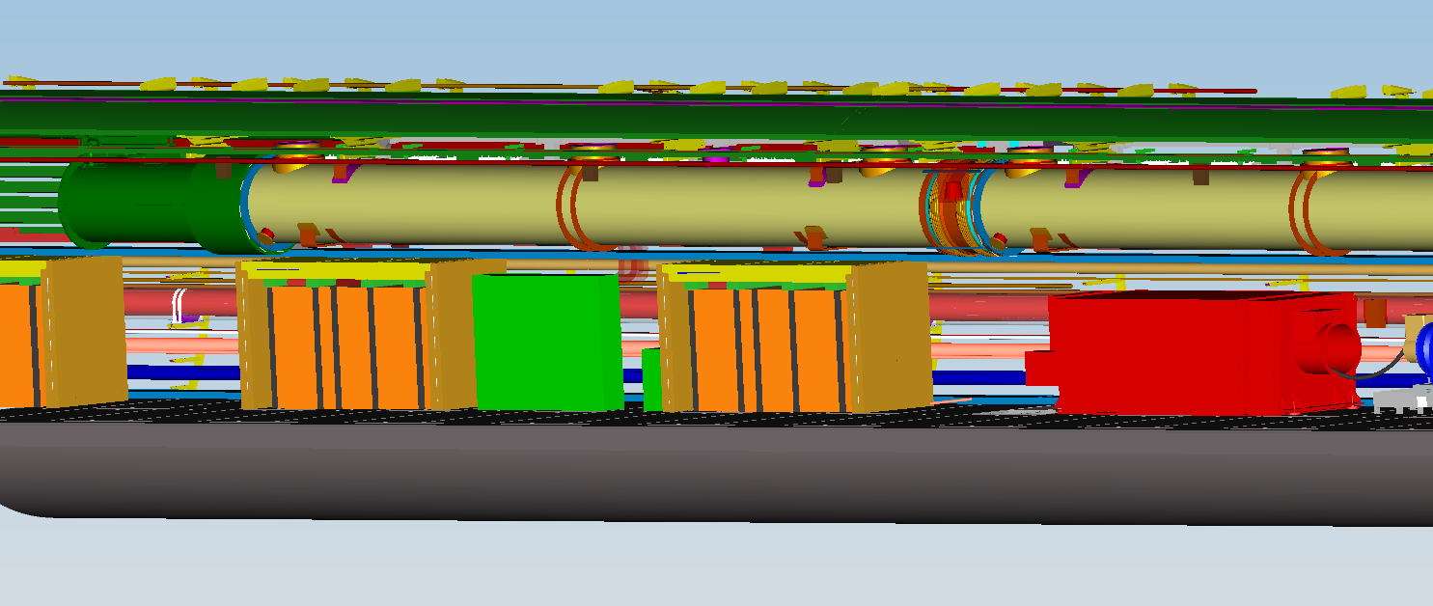
Work WP34 (1)
LV-distribution
electrant
Rack connection
400 V
Water 18°C
IT
Fire protection
Power supplies
Rack connection
400 V
Water 18°C
IT
Fire protection
Connection of pulse cables WP01

Slide 6
Work WP34 (2)
Water distribution
Klystron/ transformer
electrant
Rack connection
400 V
Water 18°C
IT
Fire protection
Power supplies
Rack connection
400 V
Water 18°C
IT
Fire protection

Slide 7
Energy supply
The installation is strongly related to the installation process of the machine.
The sub distributions and electrants can only be installed in combination with the installation of an RF-Section.
When the entire racks are of 1 - 3 sections will be installed the electrical distribution can be done. This has to be optimized
Energizing of the racks
This will be according to the installation of the distributions. This may cause delays. The connection of the electrants will be connected up and down-stream from the distribution.

Slide 8
Work WP34 (1)
LV-distribution
electrant
Rack connection
400 V
Water 18°C
IT
Fire protection
Power supplies
Rack connection
400 V
Water 18°C
IT
Fire protection

Slide 9
Electrant (just example)

Slide 10
Installation of cables Pulse / low voltage cables through floor slabs
Additionally slabs have to be lifted on the walk way. The low voltage voltage cables are generally on this side. The pulse cables from appr. 1000 m on.

Slide 11
Water connection 18°C
The racks are water cooled with 18 °C water
The distribution connection will be ready at that time.
The connection of the racks will be done according to the installation
The connection will only be done once per RF section.
There will not be an immediate connection as soon as the rack is positioned

Slide 12
Water connection 30°C
The klystron/transformer are water cooled with 30 °C water
The klystron water distribution connection will be installed in combination with the transformer
The connection will be done according to the installation and in coordination with WP01.

Slide 13
Water connection 30°C
The magnets are water cooled with 30 °C water
The magnets will be connected directly to the sub-distribution pipes.
The connection will be done according to the installation.

Slide 14
Water connection 30°C
Some special user like Dump or TDS are cooled by an own pump station. The task is to separate water loops (e.g. Dump) or to have a big water flow by controlled water temperature.
The pump stations will be installed as soon as possible.
The connection will be done according to the installation.

Slide 15
Pressurized air
The main installation (main distribution pipe and main valves) is finished
There are requirements for controlling units and for installation
The connections will be done according to the installation progress
These will be either sub-distribution pipes and small distribution racks or direct

Slide 16
Safety
The components for smoke detection and extinguishing system will be installed with the progress of rack installation.
It will be possible to commission parts of the ring cabling of the fire alarm system. This is dependent of the subsection structure.

Slide 17
IT
The general light links are installed below ground.
The racks will have to be connected to these central light links.
Additionally the interconnections between the different racks has to be installed.
This will only be done when a sufficiently high number of racks installed since an external enterprise will come to perform this work.
The number and starting dates will be discussed with TC

Slide 18
Power supplies
Cabling
The cables of the bunch compressors and dogleg will be installed beginning next year. The bid for tender is on the market
The cables for the superconducting magnets will be installed on the fly when the RF section is installed.
The cables at the XS1 side will be installed in 2015

Slide 19
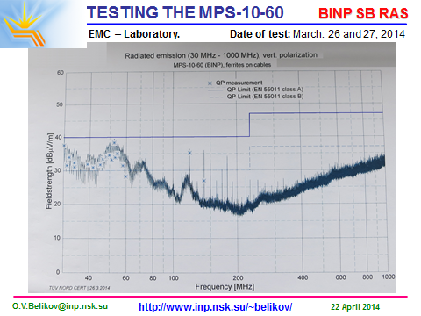
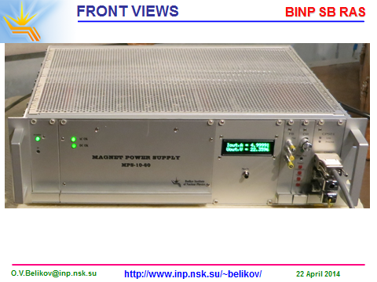
Inkind BINP power supply passed PRR

Slide 20
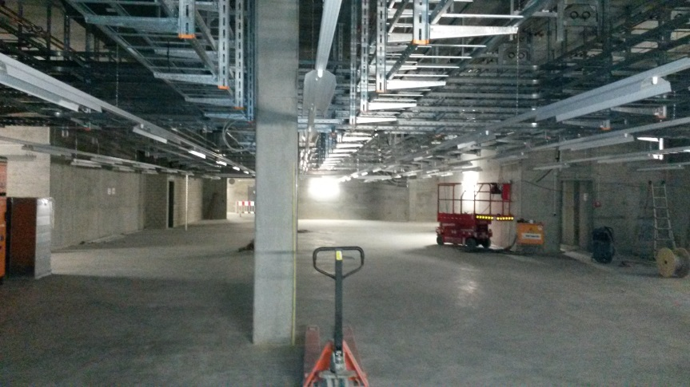
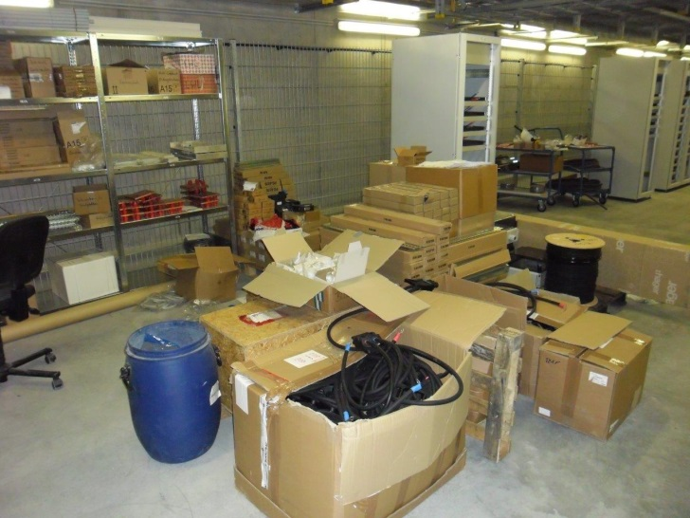
Installation of power supplies
Cable trays and water installation
for power supplies (XS1)
First power supply operated in the
Gun test, installation of power supplies
ongoing (XTIN)
Material transported to XTIN

Slide 21
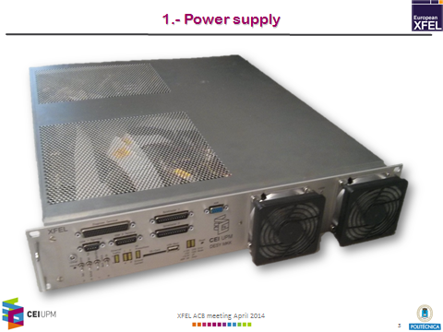
Inkind Spainish power supplies ready for PRR

Slide 22
Power supplies for the superconducting magnets
The power supplies of the superconducting magnets will be installed after the installation of the electronic racks by WP 34.
This is only dependent of the installation of the racks.

