Slide 1
Installation of the warm vacuum system
Main Linac Installation Meeting
20.05.2014
Lutz Lilje
Notes:
How to edit the title slide
Upper area: Title of your talk, max. 2 rows of the defined size (55 pt)
Lower area (subtitle): Conference/meeting/workshop, location, date, your name and affiliation, max. 4 rows of the defined size (32 pt)

Slide 2
Outline
Installation of cold beam vacuum
Particle free sections
Installation of Isolation vacuum

Slide 3
Beam vacuum: Module connection
Main installation task
Clean room placement
Space below the modules needs to be empty
In addition install pump cart
Installation of the Beamline Absorber (BLA or HOM absorber)
Connection of two modules
Leak check and residual gas analysis (RGA)
Opening the gate valves of the modules
Removal of the clean room
Total duration: 1.5 days
Still needs detailed discussion with cryogenics for optimisation
Will learn from first string in L1

Slide 4
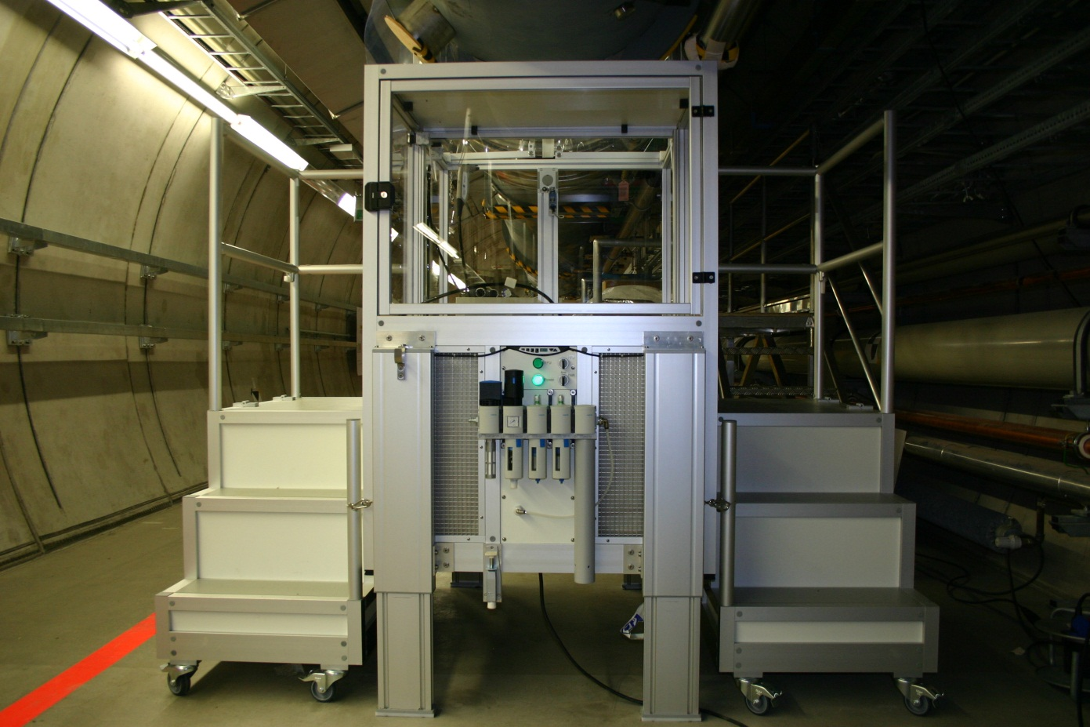
Modulmontage XFEL HOM-Absorber
Reinraum aufgebockt und in Höhe justiert mit den beiden demontierbaren Arbeitsplattformen
Courtesy of C. Buhr
Notes:
Before you start editing the slides of your talk change to the Master Slide view: Menu button “View”, Master, Slide Master:
Edit the following 2 items in the 1st slide: 1) 1st row in the violet header: Delete the existent text and write the title of your talk into this text field 2) The 2 rows in the footer area: Delete the text and write the information regarding your talk (same as on the Title Slide) into this text field.
If you want to use more partner logos position them left beside the DESY logo in the footer area Close Master View

Slide 5
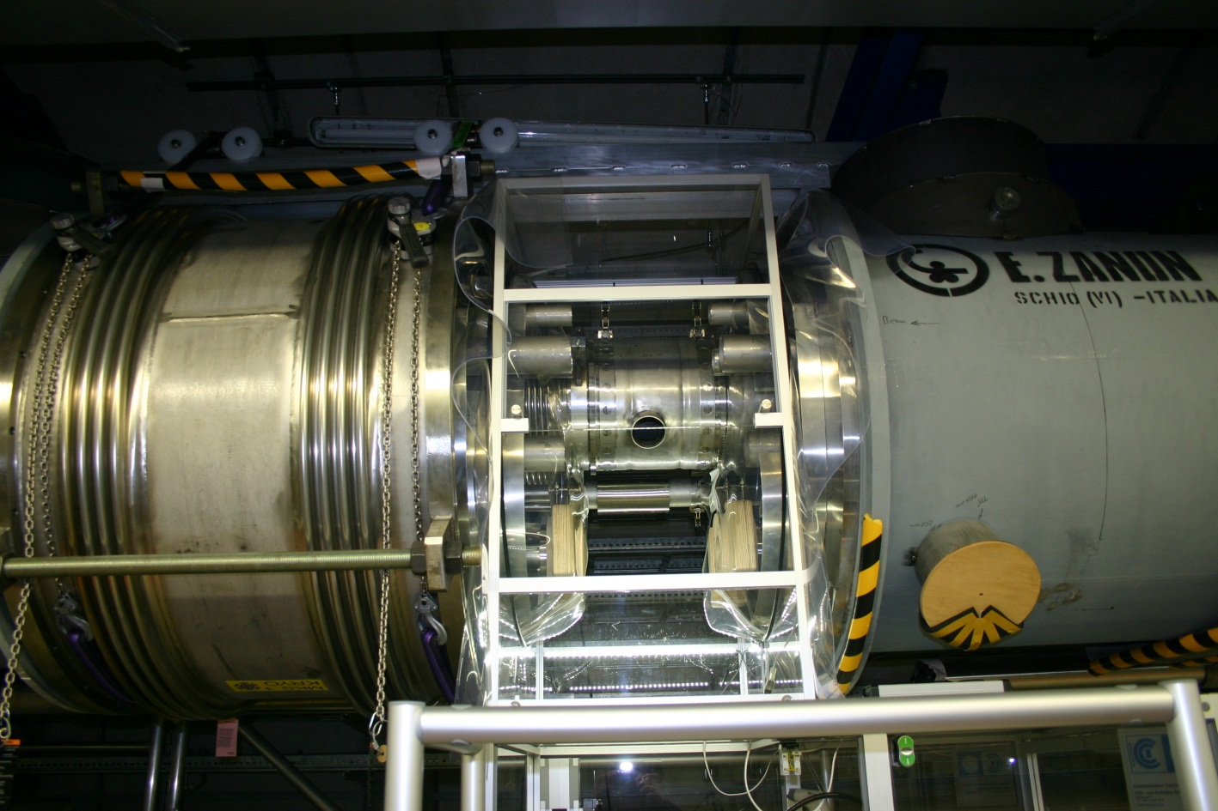
Modulmontage XFEL HOM-Absorber
Reinraum zwischen zwei Modulen aufgebaut. Durch die Öffnungen wird von beiden Seiten montiert.
Courtesy of C. Buhr

Slide 6
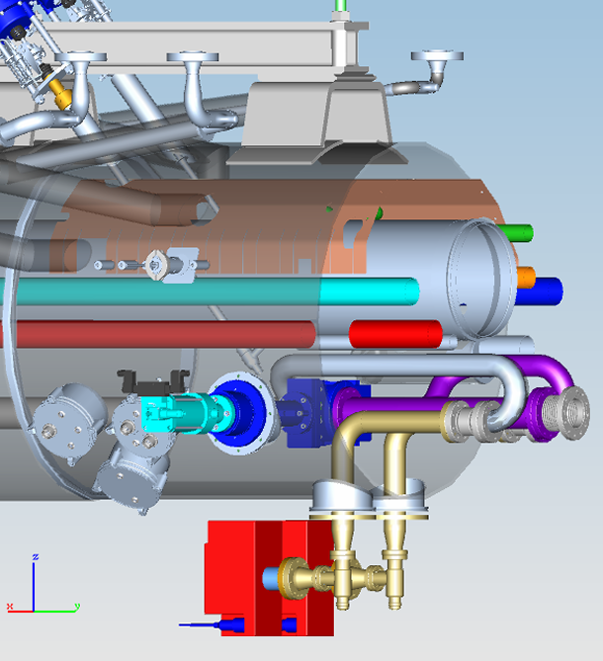
Installations for cryo boxes
Final connection similar to modules
Bellow connections
Currently the installation works on the beamtubes into the boxes should not take place in the tunnel but above ground
If not:
More time in tunnel needed
No estimate available yet
Need at least some time to practise above ground

Slide 7
Isolation vacuum
Installation of pump carts
Permanent carts
2 per cryostring
Temporary pump carts
Initially, at least 2 high volumetric flow pump carts
More details not yet finalised
Experience in L1 needed
Leak searches
Need good coordination with cryogenics group to achieve sufficiently low helium background
Tests on process piping will ‚flood‘ tunnel with helium

Slide 8
Pre-requirements for tunnel installation
Necessary infrastructure fully available
Electrical power for pump carts and mobile clean rooms
IT network
Pressurized air for pump carts and valves
Working platforms especially isolation vacuum works
(Reminder WP19: Cooling water (ECOLs in chicanes))
No “dirty” works afterwards
All cables (signal and HV for SIP’s) in place

Slide 9
Installation sequence
Will follow cryogenics to a large degree

Slide 10
Organization
WPL
Lutz Lilje
Sven Lederer
Section responsibilities:
Lutz Lilje,
Ralph Böspflug
Mechanical Installation supervision
Antonio de Zubiaurre Wagner
Ralph Böspflug
Electronics installation supervision
Dirk Keese
Installation teams from MVS

