Slide 1
Fermilab Test Beam Facility
Aria Soha
June 30, 2014
DESY Test Beam Workshop

Slide 2
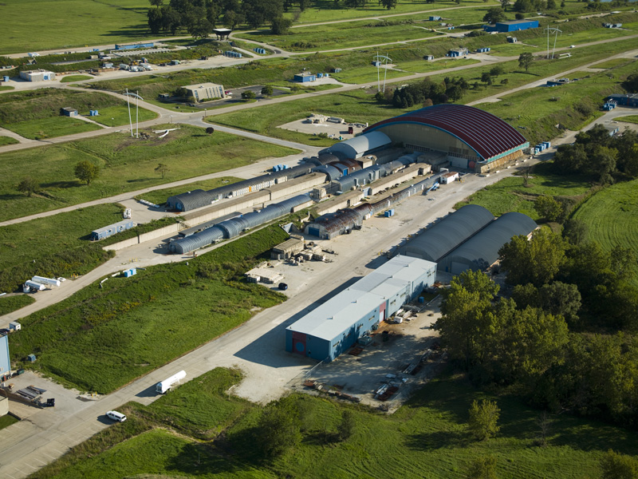
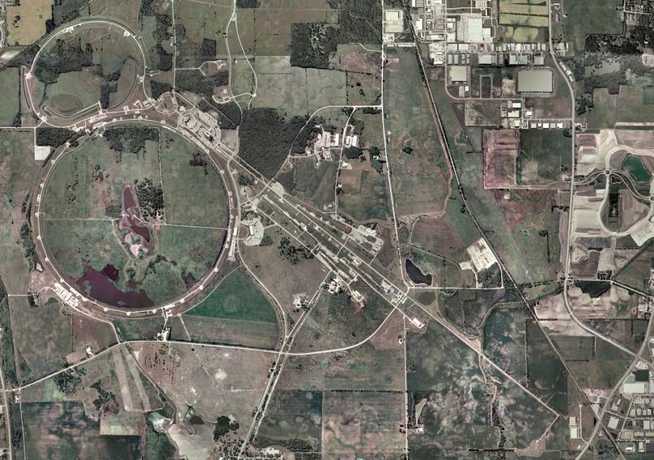
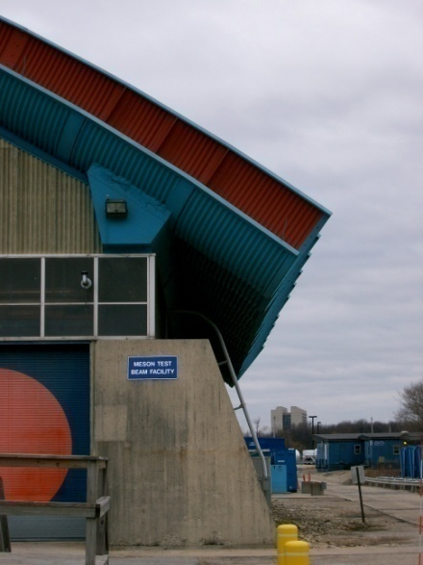
Location
Fermi National Accelerator Laboratory
Meson Detector Building – West
Notes:
Fermilab is located in Northern Illinois, USA, outside Chicago.

Slide 3
Layout and Rooms
Beam Areas
Work Areas
Control Rooms
Notes:
2 Beamlines
MTest for short-term (weeks) experiments
MCenter for make-up and long-term (months) experiments

Slide 4
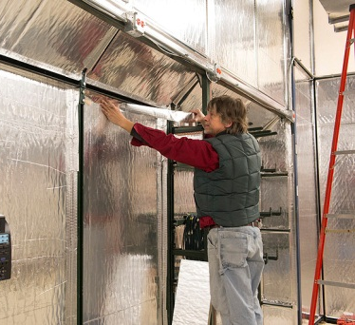
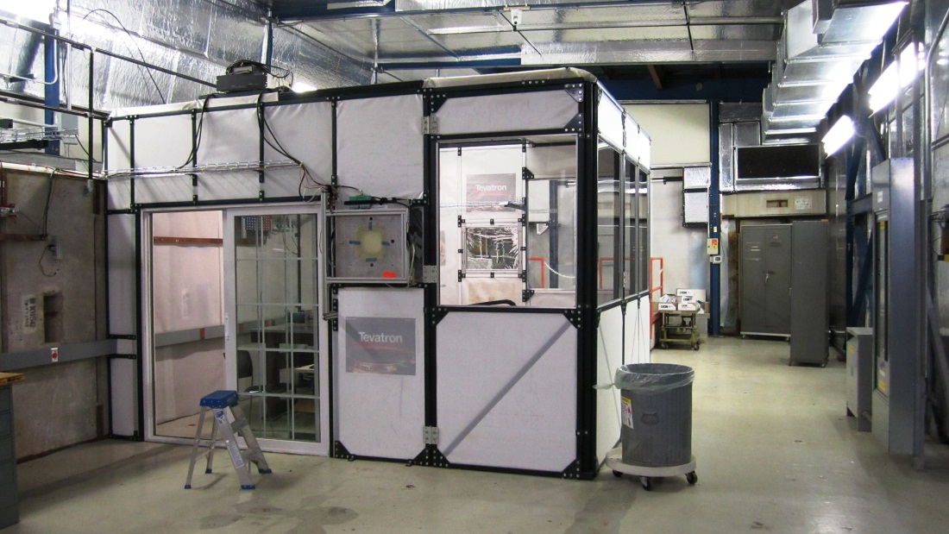
MTest Beam Areas
Section 2 Newly Insulated!
6 MT6 Experiment Areas
2B
2C
2D
1A
1B
2A
3 Climate Controlled areas
Notes:
New! MT6.2 has been insulated to control temperature within 5 degrees.
Additional Climate controlled areas allow to maintain temperatures within 2 degrees

Slide 5
MTest Beam Areas
6 MT6 Experiment Areas
2B
2C
2D
1A
1B
2A
2 areas with Crane access
(30 Tons)

Slide 6
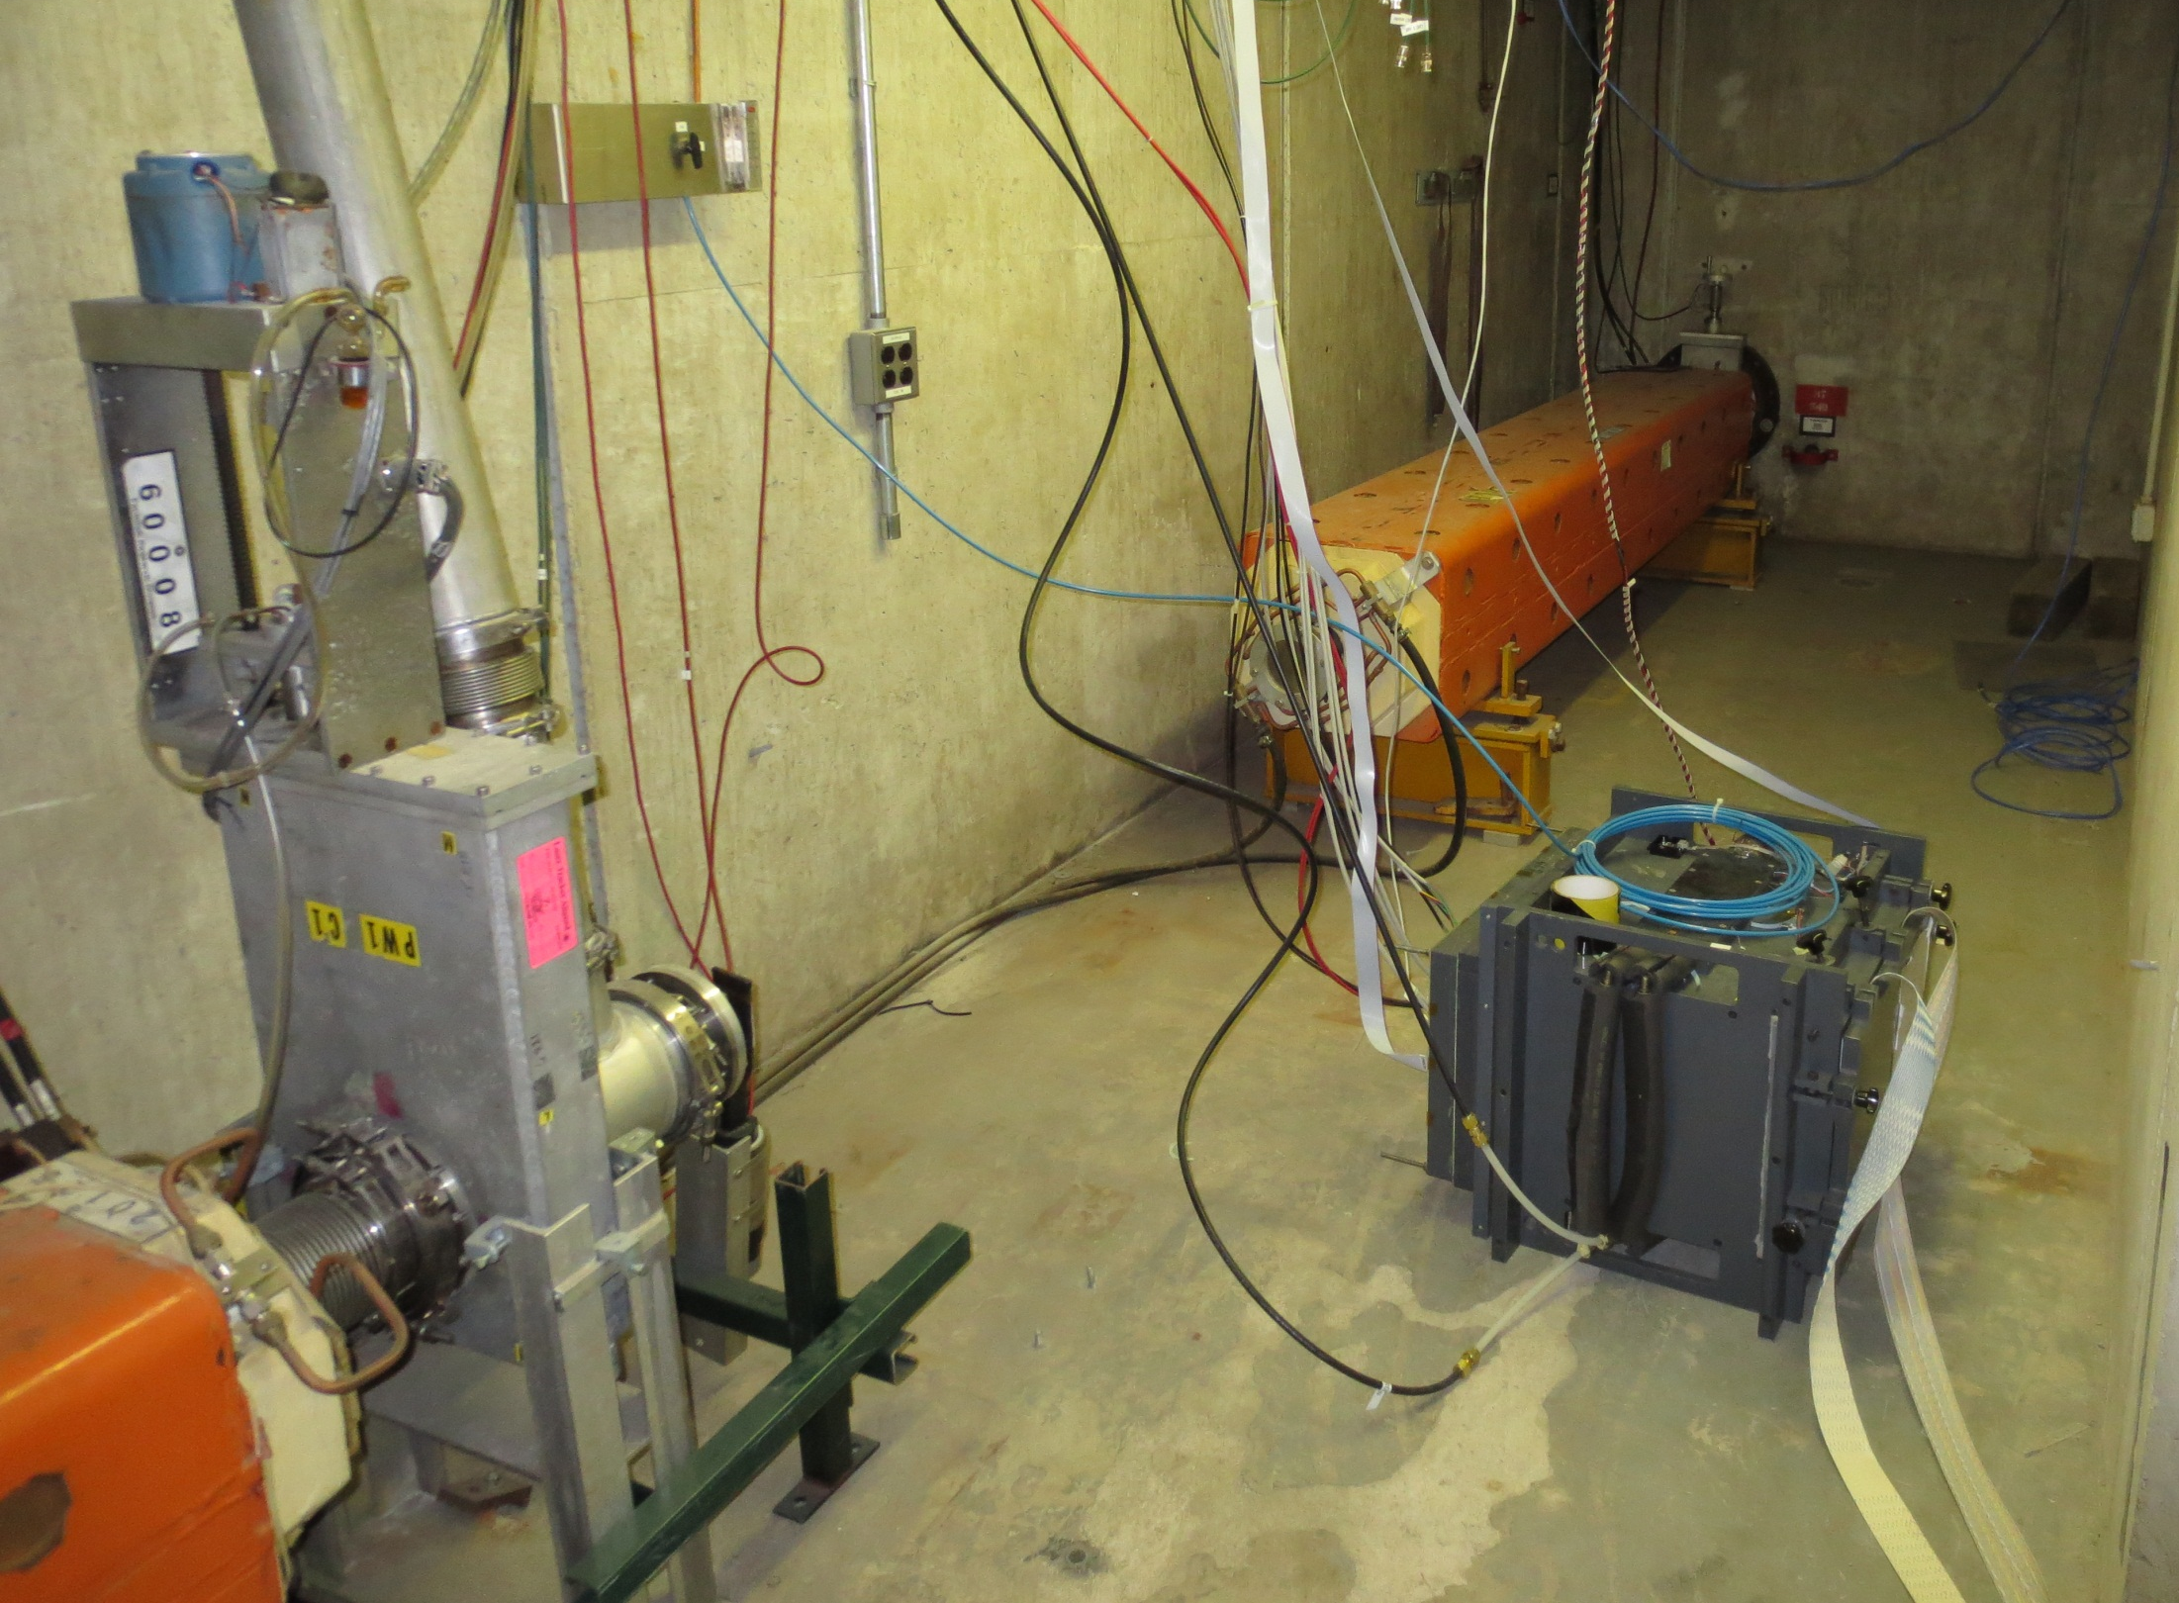
High Rate Tracking Area
Located in MTest beamline upstream of pinhole collimator (MT3 Alcove)
2.5 GHz/cm² Rates for protons
Patch panels for signal, HV, and network link the enclosure alcove area with the MS3 service Building
Acnet controlled table
Pions also available
Notes:
Detectors in this area must have Interaction Lengths of less than 3%

Slide 7
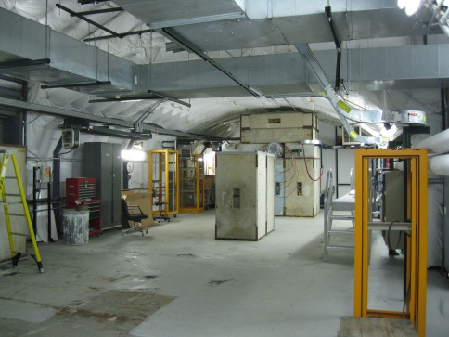
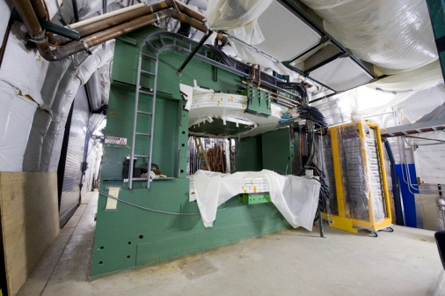
MCenter Beamline
Beamline Now Operational!
Similar beam to MTest
Long dwell time experiments
Overflow/make-up experiments
Supports Liquid Argon (Under development)
Tertiary beamline Option
Protons & Pions
200 MeV – 1 GeV range
Large Dipole Magnets
~ 1 Tesla
1 meter bore
Notes:
2 Areas under development

Slide 8
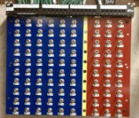
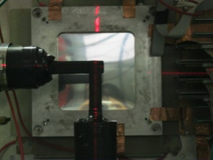
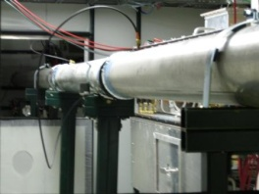
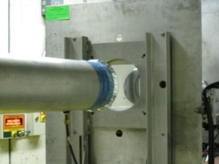
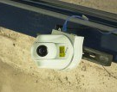
Facility Equipment
Patch Panels (Newly Upgraded!)
in enclosures and control rooms
Signal (lemo & BNC), SHV, Network (CAT5), Power, and other assorted cables are available to users in various lengths and quantities.
Including network controlled power strips
Lasers for Alignment (Newly Upgraded!)
Helium Tubes
Phone System (Newly Upgraded!)
Web-based Cameras (Now in MT6.1A & 1B!) (All of MT6.2)
Notes:
New Gigabit Ethernet throughout facility, including upgraded wireless
Web-based Cameras have 26x Optical zoom

Slide 9
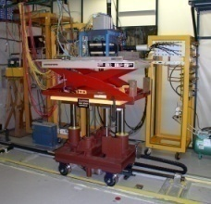
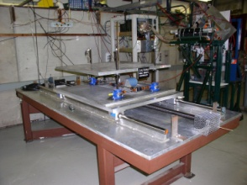
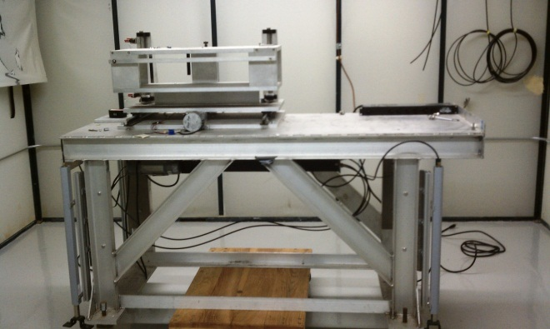
Motion Tables
ACNET Controlled to minimize accesses
1mm precision in X/Y
Rotation option now available!
Smaller stages with centimeters of travel available for small loads
Notes:
http://www-ppd.fnal.gov/FTBF/facility/tables.html

Slide 10
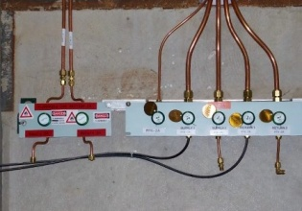
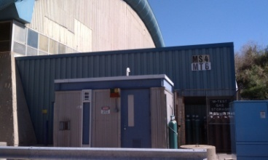
Gas
Gas Distribution system throughout facility
MT6.2 and MC7 have flammable capability
Some gasses provided
Notes:
http://www-ppd.fnal.gov/FTBF/facility/gas.html

Slide 11
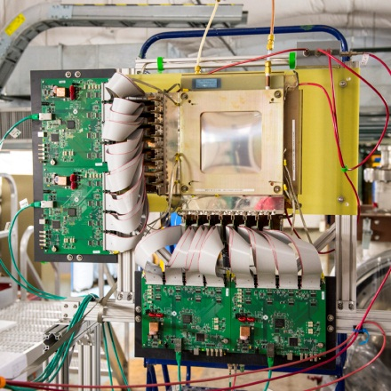
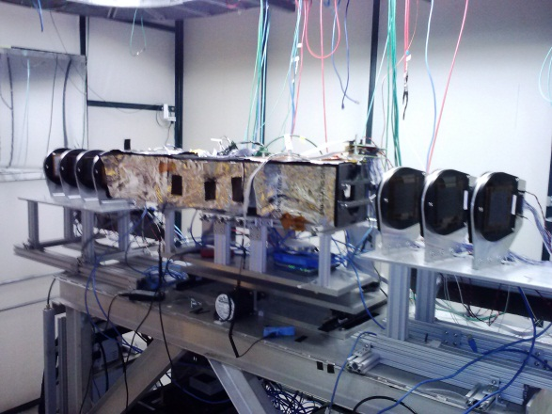
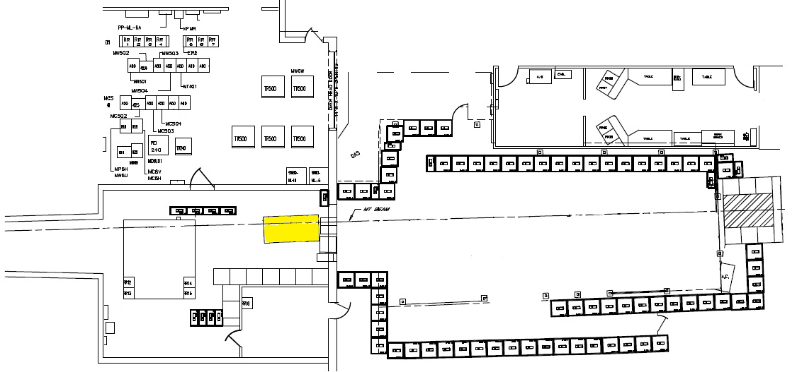
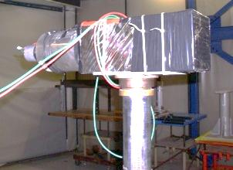
Instrumentation
MS4
Electronics Room
MTest Control Room
M05 &
Upstrm Ckov
Absorber
Lb-Glass
Calorimeter
MT6.2
Downstream Cerenkov
Inner/Outer
Alcove Control Room
MT6.1
can be moved anywhere.
Climate Controlled Area
Scintillator Counters
SWIC (AD)
MWPC (Fenker Chamber)
Time Of Flight
Lead-Glass
Calorimeter
Si strip
Telescope
(CAPTAN)
Remotely Controlled Table
Notes:
Scintillator Counters 2 & 3 now retractable
New Si Strip Telescope
Upgraded MWPC tracking – see poster 143
TOF System to be upgraded in the future
http://www-ppd.fnal.gov/FTBF/instrumentation/index.html

Slide 12
Beam Delivery
MTest
Linac
MCenter
8GeV Line
Booster
Main Injector
SY120
P3 Line
Neutrino Line
P2 Line
Booster captures protons into 84 bunches (1 batch) and accelerates them to 8GeV
Bunches are 19nsec long: 1 RF Bucket (53 MHz)
Booster batch = 1.6 microsecond in length
Up to 6 batches go into Main Injector
Main Injector = 11.2 microsecond
Beam is ramped from 8 to 120 Gev and held at the flattop value
Fraction of the beam resonantly extracted each rotation over 4.2 sec to Switchyard
In Switchyard electrostatic Septa split beam twice. First split beam to NM line (Sea Quest) and M line, the second splits the beam between MTest and MCenter.
P1 Line
Beam Available 24 hrs /day
6 sec event (4.2 sec spill) every 60 seconds
Control room manned during beam hours
If beam were smoothly extracted, 100 kHz or less would imply 1 particle per MI rotation would occur.
Beam extraction is not smooth resulting in up to 35% double occupancy per MI rotation (11μSec)
Notes:
All of these clock signals are available to users in NIM and TTL

Slide 13
Particles & Energies
P
120 Gev Proton Mode
Maximum intensity: 5E5 p/spill
High Energy Pion Mode
+ 60
+ 50
+ 40
Muon Mode:
Every LE or HE Pion Mode with additional absorbers in MT6-1.
Low Energy Pion Mode
+/- 32
+/- 30
+/- 25
+/- 20
+/- 16
+/- 15
+/- 12
+/- 10
+/- 8
+/- 6
+/- 5
+/- 4
+/- 3.5
+/- 3
+/- 2.5
+/- 2
+/- 1.5
+/- 1
π
Some kaons
k
μ
Mostly Electrons/
Positrons
New ‘Energy Script’ will be able to select particles at any discrete energy.
e

Slide 14
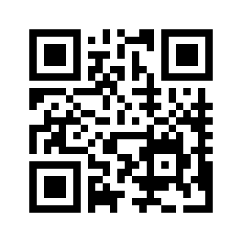
FTBF Summary
Fermilab Test Beam Facility is an High Energy Beam facility for world-wide Detector R&D
Extensive facility infrastructure & instrumentation
Flexible beam delivery
Protons, pions, muons, electrons, kaons
200 MeV – 120 GeV
1 – 300 kHz intensities
Beam time available!
http://www-ppd.fnal.gov/FTBF
Become a User

Slide 15
Additional Slides

Slide 16
Tertiary Beam Details
Rates: ~200 particles / 4 sec spill (~50 Hz)
60% pions, 40% protons,
very few electrons, kaons, and deuterons
Momentum Resolution: dp = 3%
multiple scattering limited for this momentum range
design momentum is 200MeV minimum

Slide 17
Slow Extraction to MTest - General Beam Delivery
Source Linac & Booster
Beam is produced from AD’s Proton source which includes three machines. The Source, Linac and the Booster Ring. Depending on the request intensity Booster over laps beam from Linac. Each revolution in Booster is called a Turn.
Booster then delivers 8 GeV proton beam to Main Injector in bunches at a maximum of ~84 bunches at a time. This term is called a Batch.
Previous runs were partial batching*
Main Injector

Slide 18
Slow Extraction to MTest - General Beam Delivery
Source Linac & Booster
Even though physically Main Injector can hold 7 Batches, the maximum number is 6. This is because of the abort gap needed for operations.
Main Injector

Slide 19
Slow Extraction to MTest - General Beam Delivery
Source Linac & Booster
Beam is ramped from 8 to 120 Gev and held at the flattop value and resonantly extracted 4 seconds.
Main Injector

Slide 20
Slow Extraction to MTest - General Beam Delivery
Field Free Region
Field Region
2 Electrostatic Septa
Not to scale*

Slide 21
Slow Extraction to MTest - General Beam Delivery
Source Linac & Booster
MTest
MCenter
Neutrino Muon
SeaQuest
P3
Beam is extracted from the MI52 area transported
through the P1 P2 and P3 (Main Ring remnant)
Beamlines to Switchyard. In Switchyard electrostatic
Septa split beam twice. First split beam to Neutrino Muon and Meson, the second splits the Meson beam between MTest and MCenter.
P2
Main Injector
P1

Slide 22
Slow Extraction to MTest – Running Modes
Key Requirements
120 Gev Proton Mode
M01 target in place for attenuation
MT3 Pinhole Collimator for attenuation
Quadrupole magnets off for larger spot size
Low Energy Pion Mode
MT4 target in place for production
MT3 Pinhole Collimator out for transmission
Quadrupole magnets specific settings
High Energy Pion Mode
M01 target in place for production
MT3 Pinhole Collimator out for transmission
Quadrupole magnets specific settings

Slide 23
The Fermilab Test Beam Facility
World Class Facility
The only U.S. HEP Test Beam
Detector R&D focus
In 2012:
11 experiments
229 collaborators
64 institutions
14 countries
*Number of Collaborators has been scaled to fit on plot
*Number of Institutuions has been scaled to fit on plot.
FY12 only consisted of 7 months of Beam

Slide 24
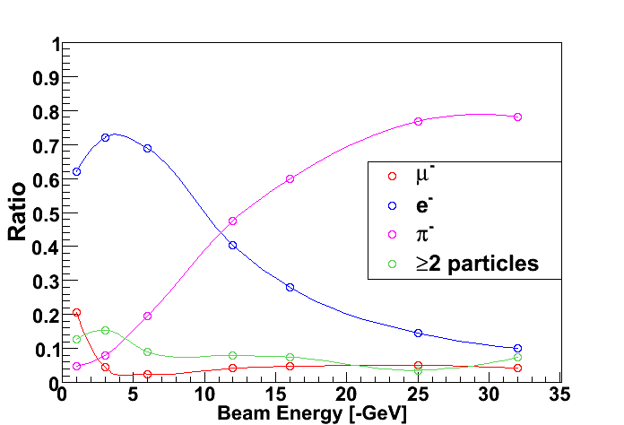
Particle Composition of Beam
120 Gev Protons
2 - 66 GeV Pions
0.5 – 32 GeV Electrons
Broadband Muons
If beam were smoothly extracted, 100 kHz or less would imply 1 particle per MI rotation would occur.
Beam extraction is not smooth resulting in up to 35% double occupancy per MI rotation
Beam Energy (GeV) | Rate at Entrance to Facility (per spill) | Rate at Exit of Facility (per spill) | % Pions, Muons | % Electrons
16 | 132,000 | 95,000 | 87% | 13%
8 | 89,000 | 65,000 | 55% | 45%
4 | 56,000 | 31,000 | 31% | 67%
2 | 68,000 | 28,000 | <30% | >70%
1 | 69,000 | 21,000 | <30% | >70%

Slide 25
Tertiary Beam Details
Rates: ~200 particles / 4 sec spill (~50 Hz)
60% pions, 40% protons,
very few electrons, kaons, and deuterons
Momentum Resolution: dp = 3%
multiple scattering limited for this momentum range
design momentum is 200MeV minimum

Slide 26
Weekly Usage
FY2012 only consisted of 7 months of beam
Facility use includes Beam studies, and educational support such as EDIT 2012.

Slide 27
Meson Area Beamlines

