Slide 1
TEWS TECHNOLOGIES GmbH
TAMC532
32 x
12 Bit ADC @ 75Msps

Slide 2
Company Background
TEWS TECHNOLOGIES is a
leading solutions provider of
embedded I/O and CPU products
based on open architecture standards
(i.e. IndustryPack, PMC, XMC, CompactPCI, standard PCI, PCIe, VME, AMC, and FMC).
Our modular hardware designs are coupled with extensive software drivers and support for major real-time and server operating systems (i.e. VxWorks, Windows, Linux, Integrity, QNX)

Slide 3
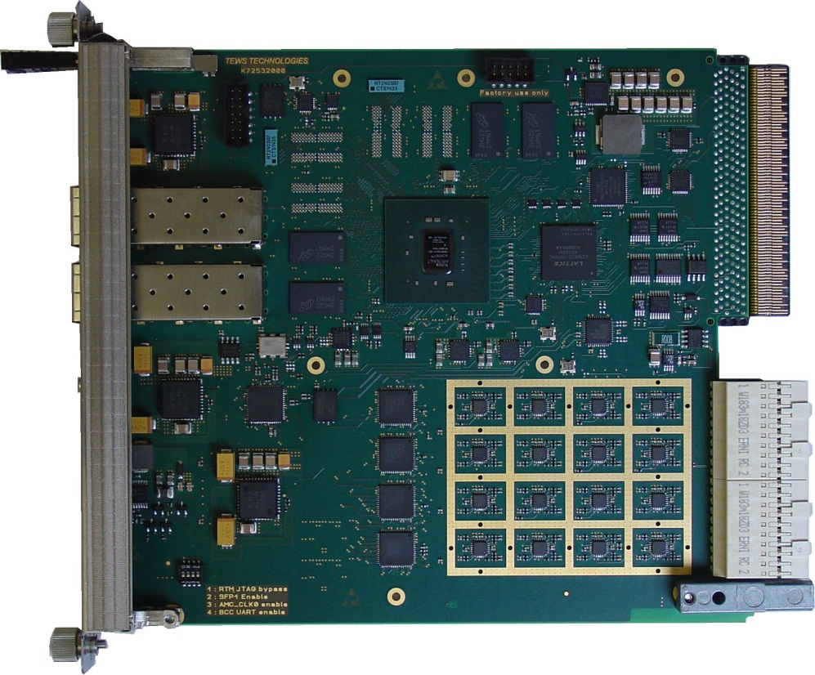
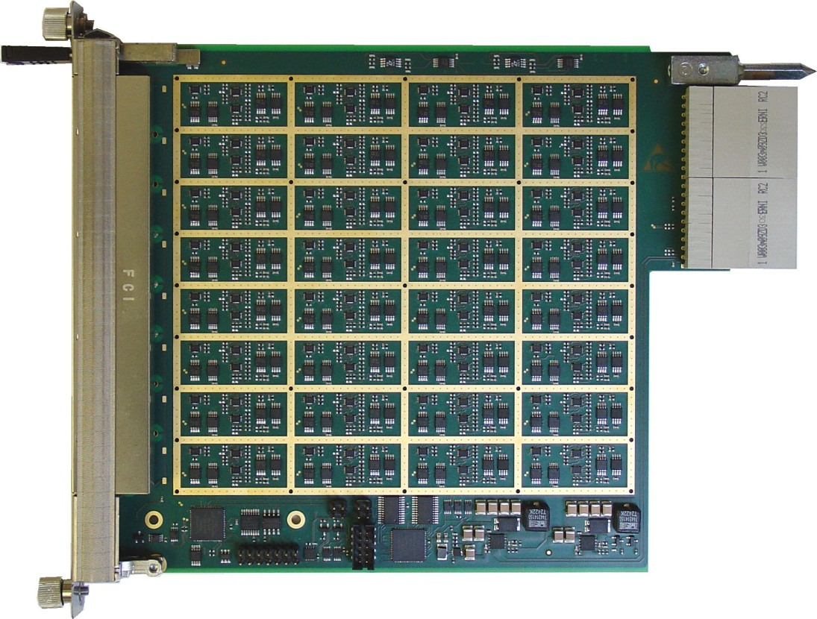
Product Photo
TAMC532
TAMC532-TM
(Developed within Helmholtz Validation Fund)

Slide 4
TAMC532 Block Diagram

Slide 5
FPGA
Kintex 7
8 Multi-Gigabit Transceiver
6.6Gb/s (optional up to 12.5Gb/s)
PCIe Gen 2 Interface
Endpoint or Root Port
70k (optional up to 410k Logic Cells)
Redundant Configuration Flash
2 x 128MBit SPI-Flash
Field Update via MMC
User Access

Slide 6
FPGA Fabric Interconnects
AMC Port 0
(e.g. Gigabit Ethernet)
AMC Port [7:4]
(e.g. x4 PCI-Express Gen 2)
AMC Port 12
SFP+ Cage in AMC Bezel
µRTM or 2nd SFP+ Cage (software controlled)

Slide 7
DDR3 Memory
Two independent banks
allow double buffering or doubling the data rate
32 Bit data bus width / bank (optional 64 Bit)
800Mb/s – 1600Mb/s line rate
256MByte – 2GByte / bank

Slide 8
4 x Octal ADC
Resolution:
12 or 14 Bit (assembly option)
max. Sample Rate
75 Msps @ 12 Bit
50 Msps @ 14 bit
Analog Inputs:
DC-coupled with on-board ADC-driver
Input voltage Range according to Class A2.1
±1V differential @ 0V common-mode voltage
Zone 3 pin assignment
According to Zone 3 Recommendation Class A2.1

Slide 9
ADC Clocking --- Block Diagram

Slide 10
ADC Clocking --- Facts
Clock Inputs:
TCLKA + B
µRTM CLK0
On-Board generated Clock
Input frequency range:
10kHz – 100MHz
Clock Up- and Downscaling
ADC Clock Phase Shift
522 steps of ½ PLL freq. (app. 200ps / step)
ADC Clock Delay
up to 475ps (25ps steps)
Zero-Delay operation
Bypass-Mode
Clock Outputs:
TCLKB
AMC_TCLK
AMC_CLK0

Slide 11
Trigger
8 Trigger from AMC-Backplane
AMC Port [20:17] via MLVDS-Transceivers
each Trigger can be Input or Output
additional NAND connection of Tx[19] and Rx[20] to Zone 3 OUT0 and OUT1
Up to 6 Trigger from RTM
Zone 3 D[8:3] have direct connection to FPGA
2.5V IO-Voltage

Slide 12
TAMC532-TM Block Diagram

Slide 13
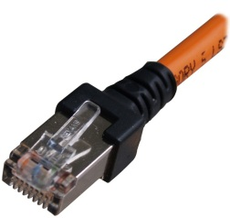
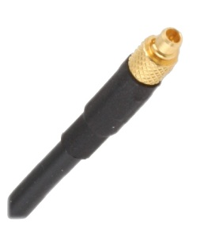
Inputs
32 x Analog Input
RJ45 Input Connectors
cheap cables
easy cable field tailoring
Differential
up to ±1V differential input voltage
up to ±3V common mode voltage
1 x Clock + 1 x Trigger Input
MMCX Connectors
single-ended

Slide 14
Filter Block (32x)
Gain selection
1, 2, 5 or 10
Adjustable Pole-Zero Cancellation
Gaussian Shaping Amplifier with selectable shaping time
10µs, 1µs, 100ns
Adjustable Baseline-Shift
Zone 3 pin assignment according to Class A2.1

Slide 15
Clock / Trigger + Control
single ended clock input
single-ended to differential conversion
connected to Zone 3 RTM_CLK0±
single ended trigger input
single-ended to differential conversion
connected to Zone 3 D[8]±
digital Control from the AMC
Gain, pole-zero cancellation, Shaper time and baseline shift are all controlled via one I²C interface
IO-Voltage selectable as 1.5V, 1.8V, 2.5V or 3.3V

Slide 16
Management
Zone 3 pin assignment according to Class A2.1
µRTM Management according to Class A2.1
Optional management implementation via microcontroller
allows adaption to nearly any MMC
IPMI-controlled D[8:3] IO-Voltage possible

Slide 17
TEWS TECHNOLOGIES GmbH
Am Bahnhof 7
25469 Halstenbek / Germany
Phone: +49-4101-4058-0
Fax: +49-4101-4058-19
E-mail: info@tews.com
http: www.tews.com

