Slide 1
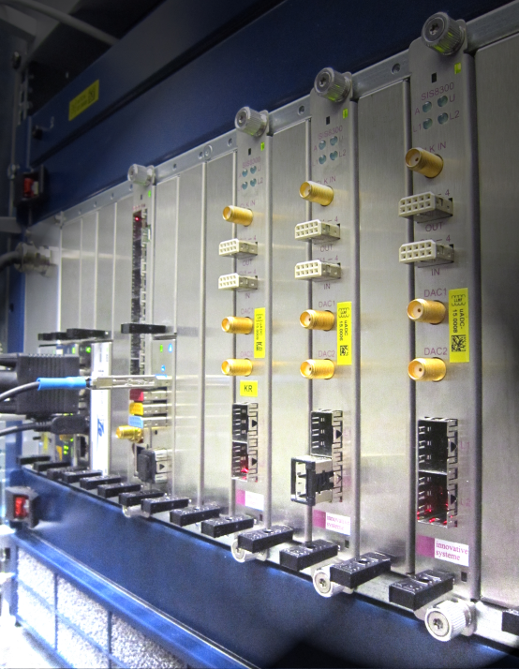
Helmholtz Validation Fund Results and Perspectives
''MTCA.4 for Industry"
and workshop organization
Dr. Holger Schlarb
MSK, DESY
DESY, 10.12.2014

Slide 2
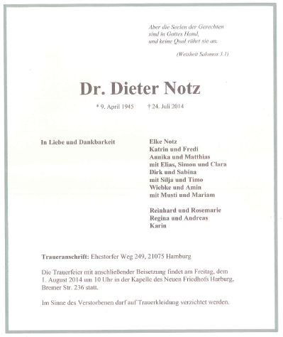
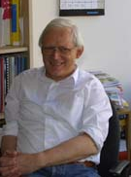
Co-chair of this event…
2
Dieter Notz, 69, passed away unexpectedly….
He provided us the main guidance and shaped this event …
and we sadly missed him in the course of the preparations for this year workshop.
Email from Elke Notz:
Best wish to you and your team for successful MTCA-workshop.
My husband would have deeply enjoyed to be present …
Notes:
Before you start editing the slides of your talk change to the Master Slide view:
Menu button “View”, Master, Slide Master:
Edit the following 2 items in the 1st slide:
1) 1st row in the violet header:
Delete the existent text and write the title of your talk into this text field
2) The 2 rows in the footer area: Delete the text and write the information
regarding your talk (same as on the Title Slide) into this text field.
If you want to use more partner logos position them left
beside the DESY logo in the footer area
Close Master View

Slide 3
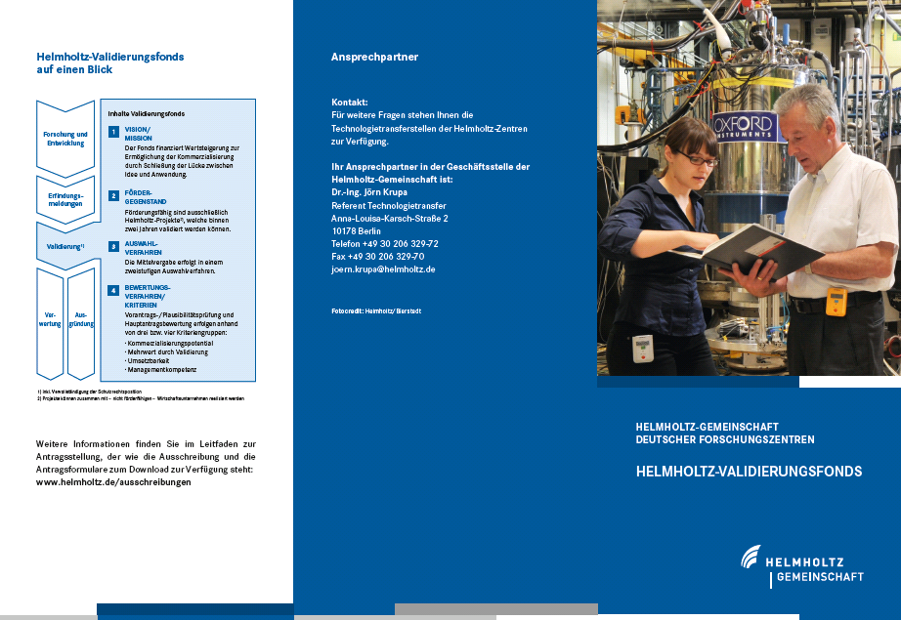
Helmholtz association (HGF) validation-fund (HVF)
3
What is the HGF validation fund?
Finance instrument to support the spin-off and technology transfer from scientific, technical inventions or developments from HGF centers to the industry and society
Validation: increase of value (material/immaterial) with direct application to society / industry
Ideally: generate commercial product
Boundaries:
Duration max. 2 years
Funding max. 2 M€/a (50% by HGF)
Not extendable!
Notes:
Before you start editing the slides of your talk change to the Master Slide view:
Menu button “View”, Master, Slide Master:
Edit the following 2 items in the 1st slide:
1) 1st row in the violet header:
Delete the existent text and write the title of your talk into this text field
2) The 2 rows in the footer area: Delete the text and write the information
regarding your talk (same as on the Title Slide) into this text field.
If you want to use more partner logos position them left
beside the DESY logo in the footer area
Close Master View

Slide 4
History of MicroTCA@DESY
4
Nov. 2005: Reliability Workshop in Grömitz, Germany
  Joint meeting with ILC (intern. linear collider, 33km, 500GeV)
Dec. 2007: XFEL Crate-Standard Workshop
  MicroTCA and ATCA was defined to be used
Mar. 2009: First PICMG Meeting “xTCA for Physics”
  Hardware group: rear I/O and timing
  Software group: standardization of interfaces for FPGAs…OPsys
Oct. 2011: Official announcement of PICMG Specification
  “MTCA.4 Enhancements for Rear I/O and Precision Timing“
Jul. 2012: Start of Helmholtz Validation Fund
  „MicroTCA.4 for Industry“
Jan. 2014: Significant activities with HW/SW PICMG working groups
➔ Talk from Ray Larsen, SLAC
Notes:
Before you start editing the slides of your talk change to the Master Slide view:
Menu button “View”, Master, Slide Master:
Edit the following 2 items in the 1st slide:
1) 1st row in the violet header:
Delete the existent text and write the title of your talk into this text field
2) The 2 rows in the footer area: Delete the text and write the information
regarding your talk (same as on the Title Slide) into this text field.
If you want to use more partner logos position them left
beside the DESY logo in the footer area
Close Master View

Slide 5
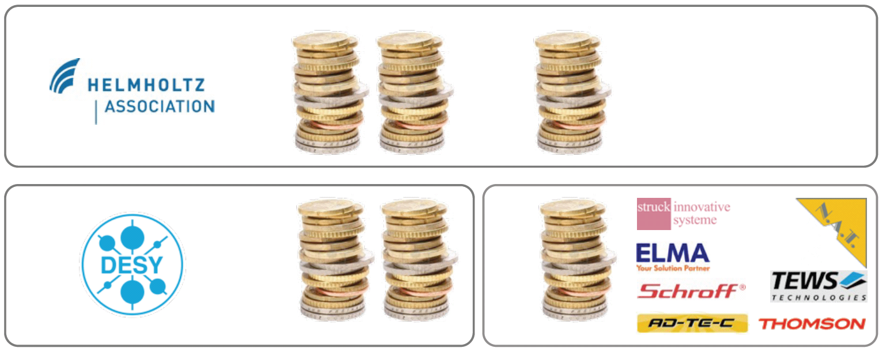

Helmholtz validation-fund (HVF) “MTCA for Industry”
5
Main objectives of project:
Establish MTCA.4 electron crate system
  In accelerator community
  Industrial branches
  Scientific community
by reducing the market entry barriers and foster MTCA.4 to industry
Business model:
  Marketing for the RF controls modules via Company using DESY License
Funding distribution:
4 Mio€
50%
30%
20%
Notes:
Before you start editing the slides of your talk change to the Master Slide view:
Menu button “View”, Master, Slide Master:
Edit the following 2 items in the 1st slide:
1) 1st row in the violet header:
Delete the existent text and write the title of your talk into this text field
2) The 2 rows in the footer area: Delete the text and write the information
regarding your talk (same as on the Title Slide) into this text field.
If you want to use more partner logos position them left
beside the DESY logo in the footer area
Close Master View

Slide 6



Work packages and program “MTCA.4 for Industry”
6
AP1: Industrialize modules of the RF control system
AP1.1 Revision of existing modules
    AP 1.1.1 Field Detection (uDWC)
    AP 1.1.2 Controller (uTC)
    AP 1.1.3 RF driver unit (uVM)
    AP 1.1.4 Local RF-Generation (uLOG)
AP1.2 Cost opt. for Single Cavities Applications
    AP 1.2.1 Field detector with RF driver (uDWC-VM)
    AP 1.2.2 High-end Digitizer (DAQ-LNC)
AP1.3 Extending Portfolio in Frequency
    AP 1.3.1 Field detector with RF driver (uVM, 0.35-6GHz)
    AP 1.3.2 Local RF-Generation (uLOG, 0.35-6GHz)
    AP 1.3.3 RTM with local clock circuit (uCLK-RTM, 10–350MHz)
    AP 1.3.4 Global clock generation (uCLK-eRTM, 10-350MHz)
AP1.4 Supplementary systems for RF control
    AP 1.4.1 Multi-channel Direct RF-sampling (uDS800)
    AP 1.4.2 AMC carrier with motor/RTM with Piezo driver (uFMC20)
AP1.5 Introduction of RTM-RF Backplane
AP 1.5.1 Development of RTM-RF Backplane concept
AP 1.5.2 Crate integrated RF source (uOSC_eRTM)
AP2: Completion of MTCA.4 for industry and institutions
AP2.1 Extension of product portfolio for MTCA.4
    AP2.1.1 Industrial production of timing module
    AP2.1.2 2 GSPS, 4 channel , 12bit ADCs on RTM & AMC
    AP2.1.3 32 ch., 40MSPS, AMC-RTM with analog shaping capability
    AP2.1.4 Management low noise power supplies
    AP2.2 EMI optimization and classification of MTCA.4 components
    AP2.2.1 EMI test board development
    AP2.2.2 EMI current distribution in MTCA.4 crate
    AP2.2.3 Optimization of crate-contact transitions
    AP2.2.4 Shields for AMC/RTM boards
    AP2.2.5 EMI Bypass-concept
    AP2.2.6 Vibration studies and vibration reduction
    AP2.2.7 EMI classification of AMC and RTM boards commercially available
    AP2.2.8 AMC Backplane/connector/board development towards 10Gbit/sec
    AP2.3 Application of MTCA.4 in industry
    AP2.3.1 Integrated klystron life-time and LLRF system
  AP2.4 Evaluation of MTCA.4 market
    AP2.4.1 Market evaluation for industry
    AP2.4.2 Market evaluation for institutes
    AP2.4.3 Optional industry order after evaluation
  AP2.5 Integral test of MTCA.4 in large facility, availability, failure analysis
    AP2.5.1 Inter-compatibility of boards/sub-systems, radiation, remote controllability
Almost 50 sub-projects to be
carried out and completed
> 40 hardware developments
> 30 new products on market
Demanding & challenging program
…also for DESY…
Industrial consortium essential
Collaborations:
AP3: Marketing & Support
AP3.1 Support and consultancy
    AP 3.1.1 Continues guidance and consultance
    AP 3.1.2 Tutorials
AP3.2 MicroTCA user guide
AP3.3 Marketing and exhibitions
AP3.4 MTCA.4 annual workshop
Notes:
Before you start editing the slides of your talk change to the Master Slide view:
Menu button “View”, Master, Slide Master:
Edit the following 2 items in the 1st slide:
1) 1st row in the violet header:
Delete the existent text and write the title of your talk into this text field
2) The 2 rows in the footer area: Delete the text and write the information
regarding your talk (same as on the Title Slide) into this text field.
If you want to use more partner logos position them left
beside the DESY logo in the footer area
Close Master View

Slide 7

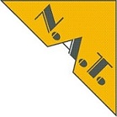

















HVF Consortium was steadily growing …
7
Status December 2014
  Industry cooperation partners:
Original HVF Consortium (7):
New Partners (6):
Not able to include due to budget & personnel & time constrains (6):

Slide 8
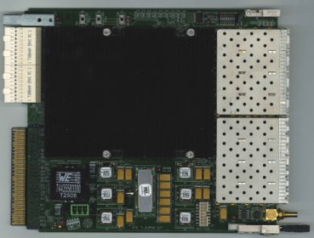
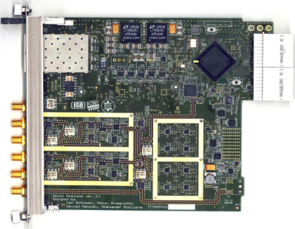
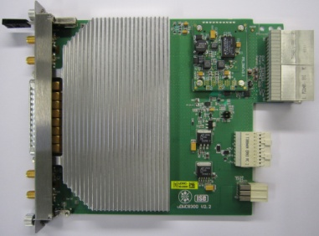
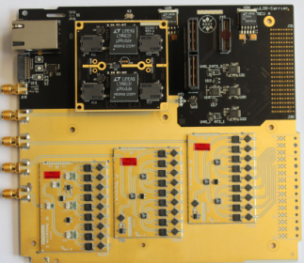
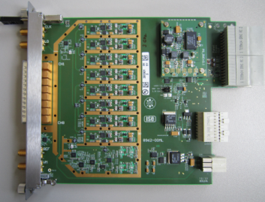
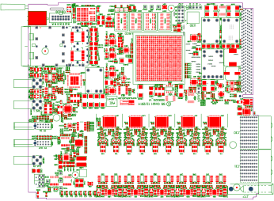
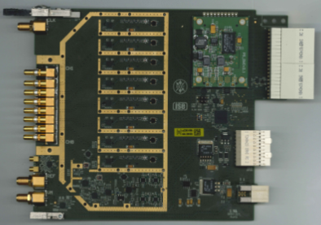
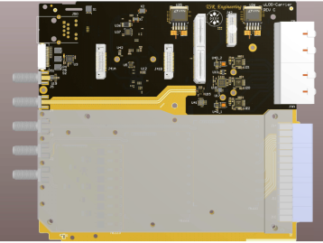
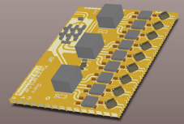
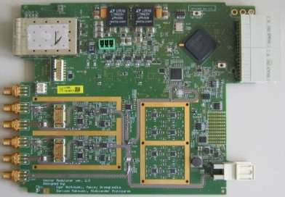
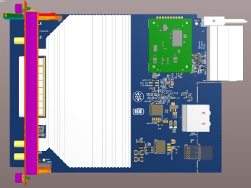
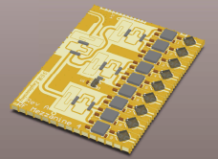
Status work package AP1: RF control systems
8
AP1.1 Revision of existing RF modules
AP1.2 Cost opt. for Single Cavities Applications
AP1.3 Extending Portfolio in Frequency
Struck GmbH
Vadatech
Dynamique Sarl
Ready for licence
DRTM-DWC10
DAMC-TCK7
DeRTM-LOG1300
DRTM-VM2LF
poster
poster
250 MSPS/ 16bit
Follow up of
SIS8300L2
Struck GmbH
Available Q1/15
DRTM-DWC8VM1
SIS8325
~ MHz
6 GHz
0.35-0.7GHz
Struck GmbH
Design ready
On demand
Ready for licence
Available Q1/15
3-6GHz
DRTM-DS8VM1
DeRTM-CLK
DRTM-VM2HF
DRTM-DWC8VM1HF
DeRTM-LOGLF/HF
poster
Notes:
Before you start editing the slides of your talk change to the Master Slide view:
Menu button “View”, Master, Slide Master:
Edit the following 2 items in the 1st slide:
1) 1st row in the violet header:
Delete the existent text and write the title of your talk into this text field
2) The 2 rows in the footer area: Delete the text and write the information
regarding your talk (same as on the Title Slide) into this text field.
If you want to use more partner logos position them left
beside the DESY logo in the footer area
Close Master View

Slide 9
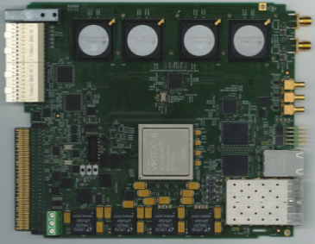
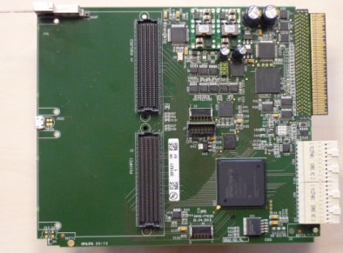
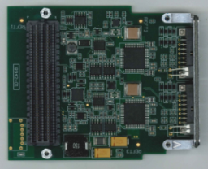
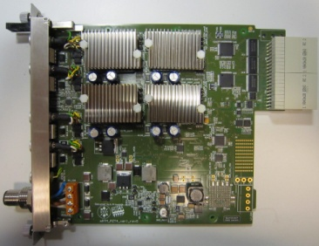
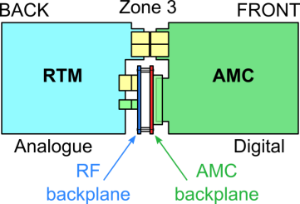

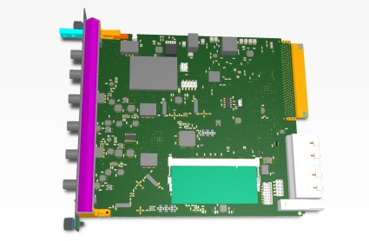

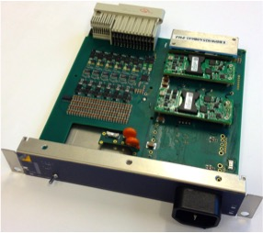

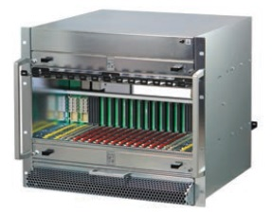

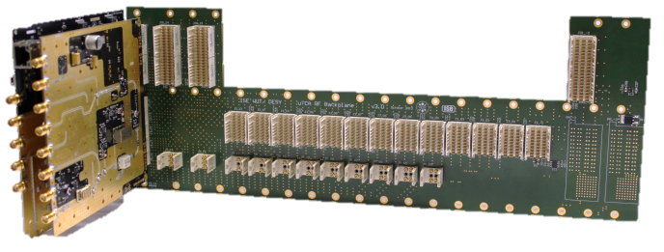
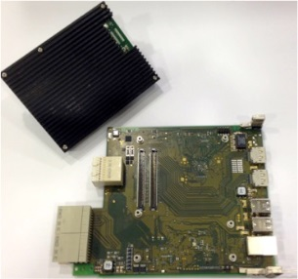
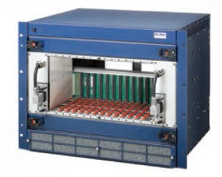
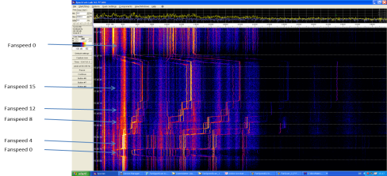
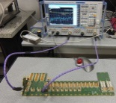
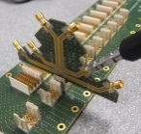
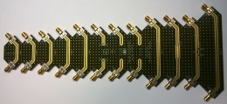
Status work package AP1: RF control systems
9
AP1.4 Supplementary systems for RF control
Multi-purpose feed
through RTM (Q1/15)
EicSys
EicSys
EicSys
Ready Q1/2015
High order mode
RTM (Q1/15)
Femtosecond
Synchr. RTM (Q3/15)
DAMC-FMC20
DFMC-MD22
DRTM-PZT4
DAMC-DS800
AP1.5 Introduction of RTM-RF Backplane
Performance improvement and extended to 6 GHz
Adaption of crate mechanics (two vendors)
Upgrade Radiall coaxpack2 connector
Specification will be part of PICMG MicroTCA.4 standard
Patent (DESY/ISE) released free of charge to PICMG
Management concept developed
Power supply carrier
AP1.5.3 AMC - RF Source
Radiall Coaxipack 2
upgrade
Available Q2/15
NAT-RPM-PSC
SAMC-DDS1400
poster
Vibration studies
Ready for licence
NAT-MCH-RTM-RF
Talk T. Lesniak, ISE/WUT
Notes:
Before you start editing the slides of your talk change to the Master Slide view:
Menu button “View”, Master, Slide Master:
Edit the following 2 items in the 1st slide:
1) 1st row in the violet header:
Delete the existent text and write the title of your talk into this text field
2) The 2 rows in the footer area: Delete the text and write the information
regarding your talk (same as on the Title Slide) into this text field.
If you want to use more partner logos position them left
beside the DESY logo in the footer area
Close Master View

Slide 10
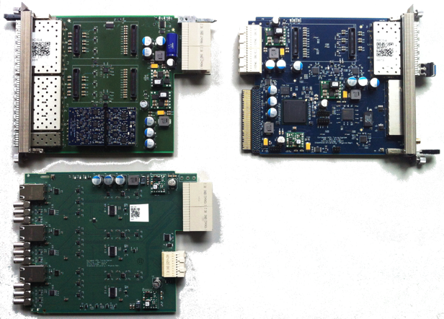
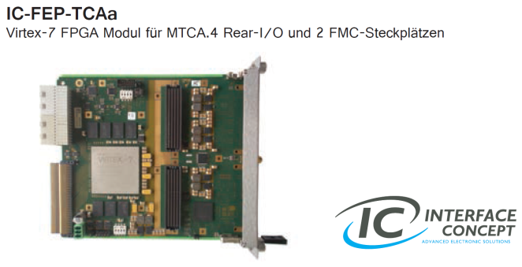
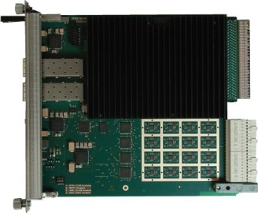
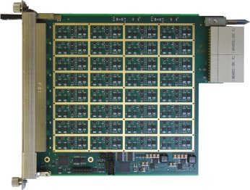
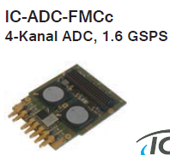

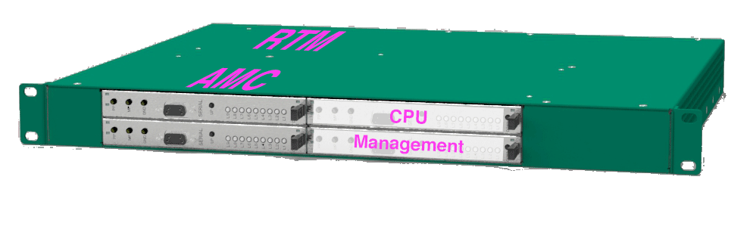
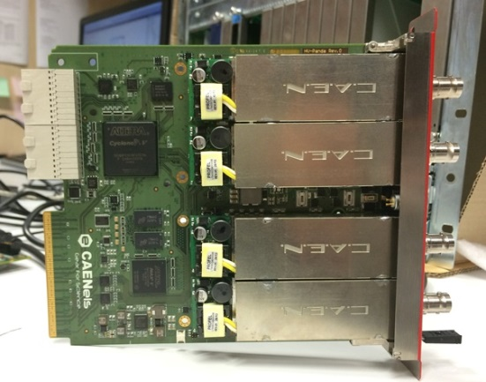


Status work package AP2:
Completion of the MTCA.4 for industry and institutes
10
  AP2.1 Extension of product portfolio for MTCA.4
ps-timing distribution
High end FMC-carrier / 4ch 1.6GSPS
RTM Shaper - AMC 32 ch ADC 12/14bit
TAMC532-TM
TAMC532
Available N.A.T.
X2TIMER
Available
Available Q1/15
RTM_TRIG1
  AP2.4 Evaluation of MTCA.4 market → Optional industry order after evaluation
Market entry starter kit (1HE)
High voltage AMC
Generic linux driver for MicroTCA
Open source !
Topics:
Linux kernel driver & libraries
Efficient DMA transfer
Hotplug capability
Set of test cases
Test suite for automated driver test
Redesign of API implementation
HV-Panda
Available Q1/15
Available Q1/15
Several talks scheduled
Petrosyan/Killenberg/Mehle
Notes:
Before you start editing the slides of your talk change to the Master Slide view:
Menu button “View”, Master, Slide Master:
Edit the following 2 items in the 1st slide:
1) 1st row in the violet header:
Delete the existent text and write the title of your talk into this text field
2) The 2 rows in the footer area: Delete the text and write the information
regarding your talk (same as on the Title Slide) into this text field.
If you want to use more partner logos position them left
beside the DESY logo in the footer area
Close Master View

Slide 11
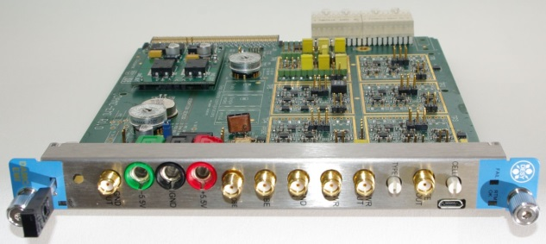

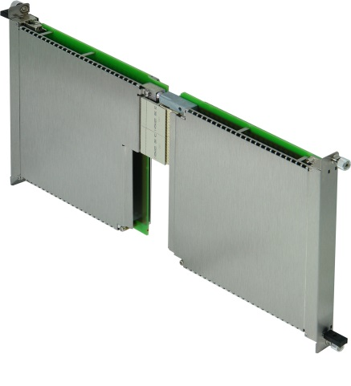
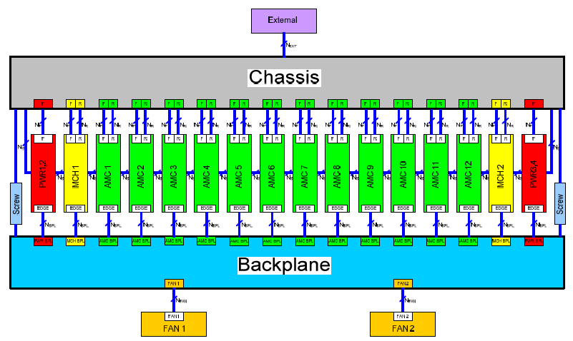
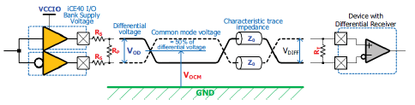
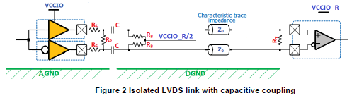
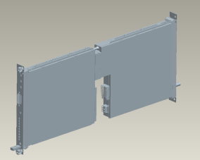
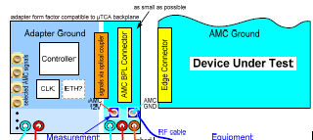

Status work package AP2:
Completion of the MTCA.4 for industry and institutes
11
  AP2.2 EMI optimization and classification of MTCA.4 components
    EMI test board development
    EMI current distribution in MTCA.4 crate
    Optimization of crate-contact transitions → complicated << mΩ
    Shields for AMC/RTM boards
    EMI Bypass-concept → less benefit ⇒ local Isolation
    Vibration studies and vibration reduction
    EMI classification of AMC and RTM boards commercially available
    AMC Backplane/connector/board development towards 10Gbit/sec

Talk T. Owczarek, ISE/WUT








DAMC-EMI
Shields
MicroTCA.4 ground modelling
Decoupling of digital/analog grounds by local isolation


Requires for quantitative
measurements & classification
specialized setup!
Project launched: Q2/15
Talk H-H. Ibowski
Notes:
Before you start editing the slides of your talk change to the Master Slide view:
Menu button “View”, Master, Slide Master:
Edit the following 2 items in the 1st slide:
1) 1st row in the violet header:
Delete the existent text and write the title of your talk into this text field
2) The 2 rows in the footer area: Delete the text and write the information
regarding your talk (same as on the Title Slide) into this text field.
If you want to use more partner logos position them left
beside the DESY logo in the footer area
Close Master View

Slide 12
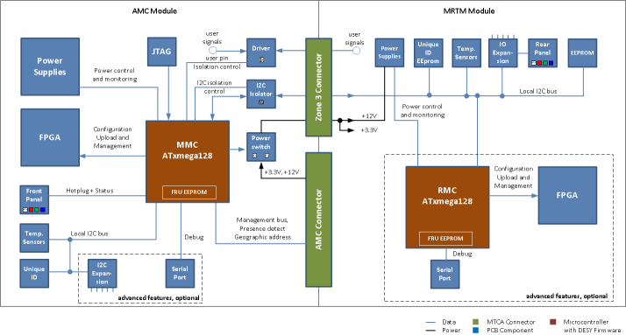
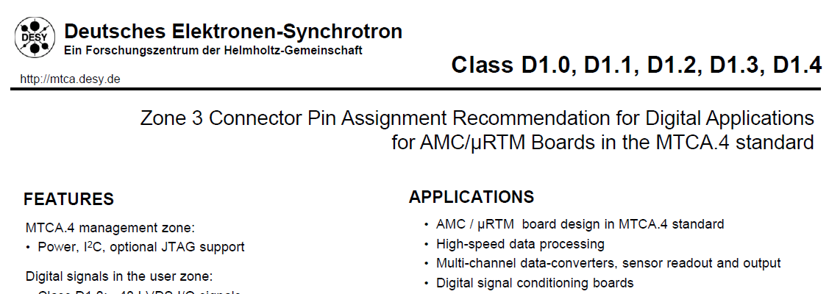
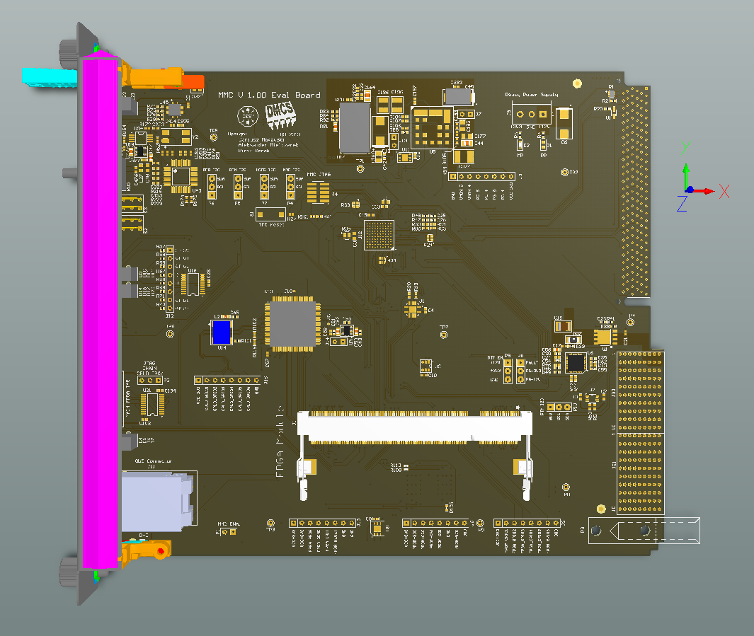



Status work package AP2:
Completion of the MTCA.4 for industry and institutes
12
AP2: missing standards / critical items / open issues / misc. barriers…
Zone 3 Recommendation
MMC Altium designer templates
MMC Template
Talk F. Ludwig
MTCA.4, open software framework
MMC Starter Kit (AMC/RTM) available
Talk M.Killenberg
MMC code development
Interlock integration….
Talk M.Fenner
Notes:
Before you start editing the slides of your talk change to the Master Slide view:
Menu button “View”, Master, Slide Master:
Edit the following 2 items in the 1st slide:
1) 1st row in the violet header:
Delete the existent text and write the title of your talk into this text field
2) The 2 rows in the footer area: Delete the text and write the information
regarding your talk (same as on the Title Slide) into this text field.
If you want to use more partner logos position them left
beside the DESY logo in the footer area
Close Master View

Slide 13









Review HVF Project “MTCA.4 for Industry” 2012 -2014
13
  MTCA.4 support and consulting
    FAQ/Hotline
    Direct support
    Tutorial, every 2 month “hands on”
    6 in 2013
    8 in 2014 (4 advanced)
  MicroTCA.4 Introductory guide
    Booklet published by DESY/NAT : Q1/15
  Products marketing & information
  3 MTCA.4 workshops (2012/2013/2014)
  Marketing on industrial exhibitions/ Face-to-face meetings
  28 (+11) in 2013
  16 (+16) in 2014
  Webpage
  Interoperability / Integration
    AIW24 Pentair, Straubenheim @ Nov 2013
    AIW25 DESY, Hamburg @ Apr 2014
    AIW26 Vadatech, Henderson @ Oct 2014
    Integration WS, DESY @ Dec 2014
MTCA Tutorials at DESY (05/2013)
& Shanghai (09/2014)
IPAC 2013 Shanghai
Embeddedworld 2013
Nürnberg
TWEPP 2013 Perugia
European Microwave
Week2013
Webpage URL http://mtca.desy.de/
Notes:
Before you start editing the slides of your talk change to the Master Slide view:
Menu button “View”, Master, Slide Master:
Edit the following 2 items in the 1st slide:
1) 1st row in the violet header:
Delete the existent text and write the title of your talk into this text field
2) The 2 rows in the footer area: Delete the text and write the information
regarding your talk (same as on the Title Slide) into this text field.
If you want to use more partner logos position them left
beside the DESY logo in the footer area
Close Master View

Slide 14
Perspectives MicroTCA@DESY 2015+
14
DESY Directorate recently approved founding of
“MicroTCA Innovation Laboratory” @ DESY
Activities:
  Future enlarge MicroTCA product portfolio through licensing
  Continuation PICMG efforts (HW/SW)
  Marketing / support / consultancy (somewhat reduced)
    Annual MTCA.4 Workshop
    Trainings & Tutorials ~ 4-6/a
    Marketing on industrial exhibitions/ science conferences
    Interoperability / Integration Workshop
  Further & forward developments (EMI/Analog/Digital)
  Contact point: Internally and external, e.g. MicroTCA cooperation Network!
Notes:
Before you start editing the slides of your talk change to the Master Slide view:
Menu button “View”, Master, Slide Master:
Edit the following 2 items in the 1st slide:
1) 1st row in the violet header:
Delete the existent text and write the title of your talk into this text field
2) The 2 rows in the footer area: Delete the text and write the information
regarding your talk (same as on the Title Slide) into this text field.
If you want to use more partner logos position them left
beside the DESY logo in the footer area
Close Master View

Slide 15




Perspectives MicroTCA@DESY 2015+
15
Clearly the most relevant contributions …
European X-Ray Free Electron Laser:
RF controls
2014 FLASH II ~ 20 crates
We are here!
2013 FLASH I ~ 10 crates
… which will serve the community as
Reference Implementation
BUT: which also will draw resources
2015/16 European XFEL ~ 200 crates
with ~4500 MicroTCA Components
3.5 km
Notes:
Before you start editing the slides of your talk change to the Master Slide view:
Menu button “View”, Master, Slide Master:
Edit the following 2 items in the 1st slide:
1) 1st row in the violet header:
Delete the existent text and write the title of your talk into this text field
2) The 2 rows in the footer area: Delete the text and write the information
regarding your talk (same as on the Title Slide) into this text field.
If you want to use more partner logos position them left
beside the DESY logo in the footer area
Close Master View

Slide 16

16
Workshop organization
Katharina Fein
Notes:
Before you start editing the slides of your talk change to the Master Slide view:
Menu button “View”, Master, Slide Master:
Edit the following 2 items in the 1st slide:
1) 1st row in the violet header:
Delete the existent text and write the title of your talk into this text field
2) The 2 rows in the footer area: Delete the text and write the information
regarding your talk (same as on the Title Slide) into this text field.
If you want to use more partner logos position them left
beside the DESY logo in the footer area
Close Master View

Slide 17

General information
Lunch
Lunch will be served in FLASH II hall
Workshop Dinner
Wednesday, November 10th
at 19:30
in building 9

Slide 18

General information
DESY tour
Meeting point ➔ in front of the registration desk
Takes about an hour
Guides you to FLASH facilities and AMTF hall

Slide 19

General information
WLAN
name ”MTCA-Workshop”
Password rkMwdT7n
Group photo
Wednesday, November 10th
at 12:00
Next Workshop:
9/10 of Dec. 2015!

Slide 20
20
Wish you an informative
and pleasant
3nd MTCA Workshop
Thanks for attention
Notes:
Before you start editing the slides of your talk change to the Master Slide view:
Menu button “View”, Master, Slide Master:
Edit the following 2 items in the 1st slide:
1) 1st row in the violet header:
Delete the existent text and write the title of your talk into this text field
2) The 2 rows in the footer area: Delete the text and write the information
regarding your talk (same as on the Title Slide) into this text field.
If you want to use more partner logos position them left
beside the DESY logo in the footer area
Close Master View

Slide 21

















Personal…/ faces … / HVF team…
21
Since spring/summer 2013
Management
Contracts
Software
Tech. Marketing
Thomas Walter
Ilka Mahns
Martin Killenberg
Annika Rosner
Old faces…
Event/Markt.
Development
.
Developers
Katharina Fein
Michael Fenner

