Slide 1
ATLAS CMOS strip sensor Test & Irradiation Programme
Craig Buttar
15th May 2014
craig.buttar@glasgow.ac.uk

Slide 2
Charge to meeting
● Discuss the testing of incoming CMOS sensors.
● Define the testing procedures including a irradiation and testbeam programme.
● Establish email list
It should identify who will do the work and and available infrastructures and provide detailed testing milestones for the next year.
Focus on devices in hand and pixel test structures

Slide 3
International CMOS programme: Year 1
Goals
Signal/Noise; S/threshold, radiation hardness, uniformity within pixels, charge collection efficiency should be measured using small devices in a small number of selected vendors.
Sensor & Readout
Relevant foundries selected
HR and HV CMOS processes evaluated with basic devices.
Bulk and Surface Radiation hardness evaluated
Hit efficiency evaluated with representative devices, within a pixel
Charge collection efficiency understood, or close to
S/N S/T measured to be acceptable
Boundary electronics architecture understood
Cut lines, stitching, multi-reticule possibilities evaluated.
Common read-out selected

Slide 4
Devices
Now or soon
TJ180 test structures
Mainly electronics: transistors, capacitors, resistors
H35 available early July
Based on proposed test structures (see backup)
Limited supply
Basic test structures (H35 & TJ180): available Oct/Nov
Sensors 3x3 pixels
Sensors 5x5 pixels with fast amplifier
Fast amplifier
“realistic” amplifier
Electronics test structures
Architectural test structures: available Jan/Feb
Parallel traces to periphery
Total length devices
Test structures
Some structures in H35 wafers

Slide 5
Timeline
TJ180 & H360 Available
From now
Basic submission
Pixel and readout test structures
Submit to TJ180 & H35 July/August
Devices read for testing: Oct/Nov
First results presented at November ATLAS week
Architectural submission
Architectural test structures
Submit to TJ180 & H35
Devices ready for testing: Jan/Feb
First results presented at February ITK week
Final report ready May 2015
Irradiations
CERN PS: Start Sept
Birmingham: from ~now
Ljubljana?
Testbeam
CERN SPS in October
Does architectural submission require input from testing of basic test structures?

Slide 6
Testing: Current devices: TJ180 test structures
This module contains CMOS devices with different sizes, and different gate and threshold voltage options. Other devices like resistors, FOXFETs, diodes and capacitors have been implemented. The list of devices integrated in the CMOS test structures is the following:
1.8 V thin oxide transistors, minimum L = 0.18 µm :
3.3 V thick oxide transistors, minimum L = 0.35 µm :
Polysilicon resistors (p+ unsilicided) with W = 1 µm and two lengths: 10 µm and 20 µm.
Field oxide transistors (FOXFETs) to measure radiation effects on inter-device isolation (STI).
p+ in n-well diodes (typically used in bandgaps)
Capacitors
More details in backup slides

Slide 7
Testing: Current devices: TJ180 test structures
Circuit components, no bulk test structures
Test on probe station
Or on carrier?
Are probe cards available?
Irradiate up to 600kGy
Interested groups?
Feedback required for next submission?

Slide 8
Testing current devices: H35
Similar to “basic test structures”

Slide 9
Testing: basic sensors
3x3 test structures
Diode structure?
I-V, C-V
signal development: evaluate pixel size/fill-factor, drift/diffusion
Irradiation: n and p
Upto 2x10¹⁵cm⁻² neq
Requires probe station for studies?
How to measure drift vs diffusion?

Slide 10
Testing: basic test structures
5x5 pixels with fast amplifiers
Source/Laser/X-ray
Mounted on readout board
Apply bias voltages for pixel and amplifier
Readout to scope and Alibava/or other readout
Pulse shape → signal development, CCE, fill-factor
TCT measurements
Testbeam measurements
Irradiation: n and p
Upto 2x10¹⁵cm⁻² neq

Slide 11
Testing: amplifiers
Fast and realistic amplifier test structures
Measure gain, timewalk
Irradiate up to 600kGy (also n and p?)
Test on probe station and/or readout board

Slide 12
Tasks
Definition of tests and procedures
TJ180 test structures in hand ← already defined?
H35 test structures (probably similar to other tests)
3x3 pixels
5x5 pixels
Amplifiers and electronics test structures
(Architectural structures) ← Sept?
Ensure tests can be compared across labs
Design and manufacture of readout boards
Common for H35 and basic test structures
Design by mid-June; boards ready mid-July for H35
Irradiation
Coordinate irradiations: collect samples and distribute to facilities, distribute to labs after irradiation
Testbeam
Coordinate with ITK TB coordinator to get time on telescope for characterising devices
Develop TB module
Next 2 weeks

Slide 13
Backup: Slides from May 6th CMOS meeting

Slide 14
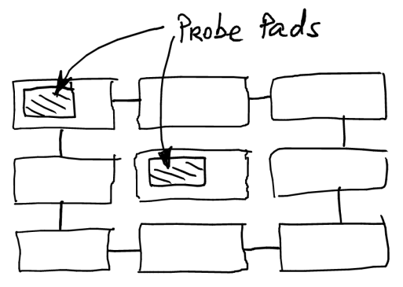
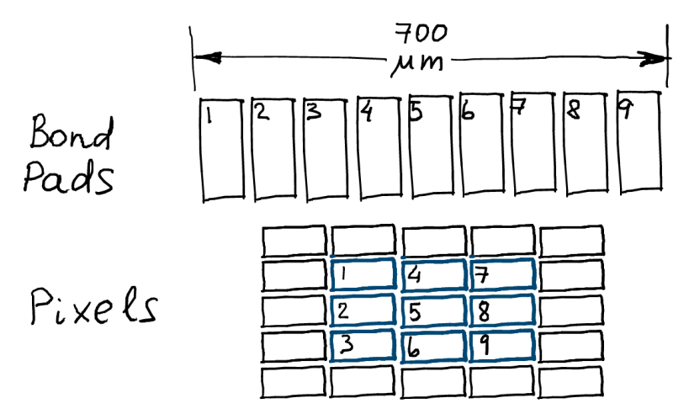
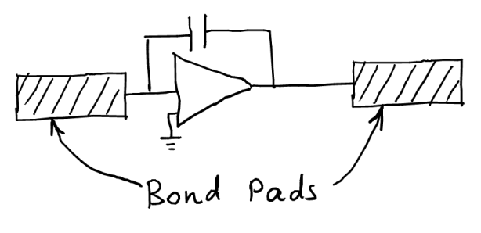
“Basic” Submission Test Devices
Proposed test circuits:
“Sensor” diodes, 3x3 pixels. Tests: signal development, depletion/capacitance, irradiation. Variation: pixel size, fill factor.
Integrated 5x5 pixels with amplifiers. Tests: depletion, CCE, irradiation. Variation: pixel size, fill factor.
Front-end amplifier without the “sensor” part, but with I/O test pads. Possibly different shaping time. Tests: gain, irradiation, timewalk (?), output matching.
Transistor test structures: gain, threshold matching. (E.g. see P. Pangaud’s GF talk.)

Slide 15
“Architectural” Submission
Partitioning the available area (assume 5x5 mm²) into 3 sub-sections to investigate the effect of different pixel size. Initially considered 3 sizes: x1, x2, x4.
Part 1: parallel traces to the periphery. Addresses the channel density, pixel size. Can use different timewalk design for different pixels. Can implement traces near pixels to inject external signals (noise susceptibility).

Slide 16
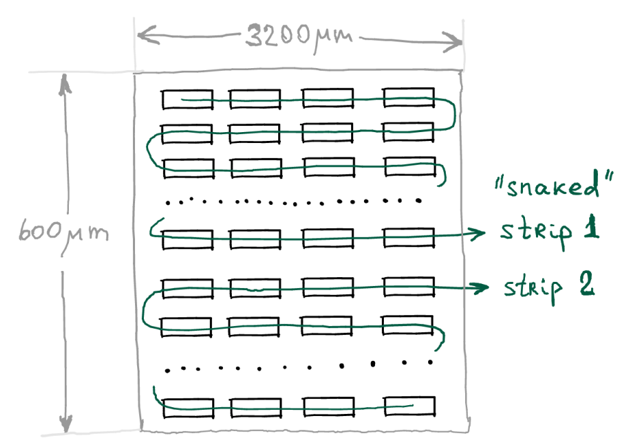
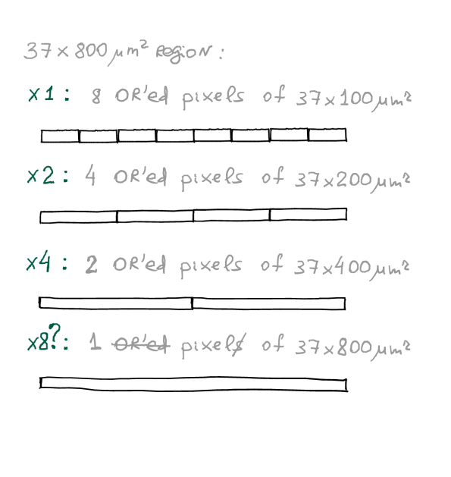
“Architectural” Submission (2)
Part 2: 2 complete channels with correct total length implemented in a “snaked” geometry. The idea is to test that OR’ing pixels does not cause problems.
Chip periphery should be close to final :
Timing and location information.
Tuning of shaping/thresholds, changing power.
Readout to an FPGA or equivalent.

Slide 17
Testing Sensors: What would we like to test?
Basic submission :
Amplifier speed and gain
Signal quality
Signal size (drift/diffusion fraction, depletion depth)
Charge collection Speed (drift/diffusion fraction)
Architectural submission: pixel readout along the strip:
Cross talk
Signal quality
General evaluation for both:
Noise
Signal Speed
Depletion Voltage
Power consumption and its interplay with noise and signal speed
Temperature dependence
Radiation hardness
Pixel size optimization
Pixel efficiency map?

Slide 18
What tools ?
Laser
1064 nm ..
Sources
⁵⁵Fe
⁹⁰Sr
Test beams
DESY/CERN/Focused X-rays at Diamond

Slide 19
Radiation damage studies
What
X-rays
Neutrons
Protons
Where
Ljubljana, Karlsruhe, Birmingham …
Main issues
Time for Irradiating & Re-Testing
SHE Issues

Slide 20
TJ180 current test structures
1.1. Device list
This module contains CMOS devices with different sizes, and different gate and threshold voltage options. Other devices like resistors, FOXFETs, diodes and capacitors have been implemented.
The list of devices integrated in the CMOS test structures is the following:
- 1.8 V thin oxide transistors, minimum L = 0.18 µm :
o W-array of both NMOS (SVt, HVt and Triple-Well SVt) and PMOS (SVt and LVt) of several gate width (to measure the radiation-induced narrow channel effect, and possible lateral leakage currents)
o L-array of both NMOS (SVt, HVt and Triple-Well SVt) and PMOS (SVt and LVt) of several gate length (to measure possible radiation effect dependencies on gate length)
o W/L-array of both NMOS (SVt) and PMOS (SVt) of several gate size with constant W/L=10
o W/L-array of Triple-Well NMOS only of several gate size with constant W/L=600 (for noise measurement).
o 4 edgeless NMOS with minimum size matching DRC (to measure the radiation effects on the gate oxide only).
- 3.3 V thick oxide transistors, minimum L = 0.35 µm :
o W-array of both NMOS (SVt, MVt and Triple-Well SVt) and PMOS (SVt) of several gate width (to measure the radiation-induced narrow channel effect, and possible lateral leakage currents)
o L-array of both NMOS (SVt, MVt and Triple-Well SVt) and PMOS (SVt) of several gate length (to measure possible radiation effect dependencies on gate length)
o W/L-array of both standard Vt NMOS and PMOS of several gate size with constant W/L=10
o 4 edgeless NMOS minimum size matching DRC (to measure the radiation effects on the gate oxide only).

Slide 21
TJ180 current test structures
- Polysilicon resistors (p+ unsilicided) with W = 1 µm and two lengths: 10 µm and 20 µm.
- Field oxide transistors (FOXFETs) to measure radiation effects on inter-device isolation (STI). In particular, 2 FOXFETs with n+ diffusion source and drain and Metal1 gate, 2 FOXFETs with n-well source and drain and polysilicon gate, 2 FOXFETs with n-well source and n+ diffusion drain with Metal1 gate.
- p+ in n-well diodes (typically used in bandgaps). In particular, 2 diodes with same area and very different perimeter very large and very small), to measure the radiation effect on forward-biased diodes and the influence of the STI periphery on the radiation-induced leakage current.
- Capacitors
o Metal Interface Metal (MIM) in single and stacked configuration. Both capacitors are made by a matrix 960 elements, each one with a size of 5 µm x 5 µm for a total area of 0.24 mm² (28.0 pF (single), 55.1 pF (double)).
o n-well accumulation capacitors with thin and thick oxide. Both capacitors are made by a matrix 126 elements, each one with a size of 5 µm x 5 µm for a total area of 0.35 mm² (28.9 pF (1.8 V), 16.0 pF (3.3 V)).
A voltage overdrive protection for the MOS gate is guarantee by a double diode. The n-well diode (405 µm perimeter and 124 µm² area) anode is connected to the substrate, the cathode is connected to the MOS gate. The p-well diode (607 µm perimeter and 186 µm² area) anode is connected to the MOS gate, the cathode to the voltage supply.

