Slide 1
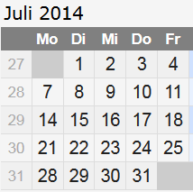
Inj. installation schedule July ’14 : Gun start July 21st
Interlock doors : 1.-3.7.
Finalizing pers. Interlock : 2.7.-14.7.
Interlock tests : 15.7. – 17.7.
Prepare RF for 3 bar : 1.7. – 11.7.
Installation injector dump : 8.7.-9.7.
Closing fire walls : 30.6.-3.7.
Cleaning UG7 : 4.7.-7.7.
Vacuum installation : 8.7.-16.7. = 7d ?
Electronics installation and test: 7.7. – 15.7.
MPS installation and test: 18.7.
Girder supports installation : ?
July 21st :
Start with test of RF, LLRF etc.

Slide 2
Installation phases, best guess
Phase 1 : ~ 2-3 weeks, late August – early September
Cryo installation warm pipes XSE shaft
Girder supports
Girder 1, 5, 4, 3
Phase 2 : ~ 2 weeks , late October
Laser beamlines XTIN shaft
Girder 2 (TDS), BB and steel girder
Phase 3 : ~ 1 week, November
Cryo transfer line XSE shaft
Phase 4 : ~ 12 weeks, March – May 2015
Installation of modules
Installation and testing of electronics ( if not done already )

