Slide 1
Inj. installation schedule : Gun start August 21st
Interlock doors : 1.-3.7.
Finalizing pers. Interlock : 2.7.-14.7. -> 2.7. – 1.8.
Interlock tests ( incl. TÜV ) : 15.7. – 17.7. -> 13.8. – 20.8.
Prepare RF for 3 bar : 1.7. – 11.7. -> 21.7. – 1.8.
Installation injector dump : 8.7.-9.7.
Closing fire walls : 30.6.-3.7.
Cleaning UG7 : 4.7.-7.7.
Vacuum installation : 8.7.-18.7.
Gun Electronics installation and test : 7.7. – 15.7. -> 21.7. – 1.8.
Machine protection installation and test: 18.7. -> ~13.8.
Girder supports installation : 16.7. – 25.7.
Installation of Girder 1 ( Dump Girder, BB ? ) : 28.7. – 15.8.
Start Cryo Installation warm beam pipes XSE shaft – 15.8. ?

Slide 2
Installation phases, update
Phase 1 : 3 weeks , October
Laser beamlines XTIN shaft
Cryo installation warm pipes XSE shaft
Girder 2, 3, 4 (TDS), BB and steel girder
Girder Rack Installation
Rack shielding installation
Phase 2 : ~ 1 week, November
Cryo transfer line XSE shaft
Phase 3 : ~ 14 weeks, March – June 2015
Installation of modules
Installation and testing of electronics ( if not done already )
Commissioning of cryogenics and modules

Slide 3
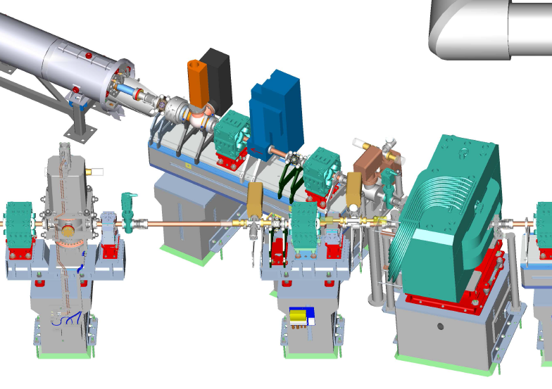
Offene Fragen :
Kann Dump Girder eingebaut werden ?
Kann BB eingebaut werden ?
Können die Stahlgirder eingebaut werden ?
Konkrete Installationspläne für Cryoleitungen im XSE-MS

