Slide 1
DLCL Energy – Current Status
LSDMA All Hands Meeting October 2014

Slide 2
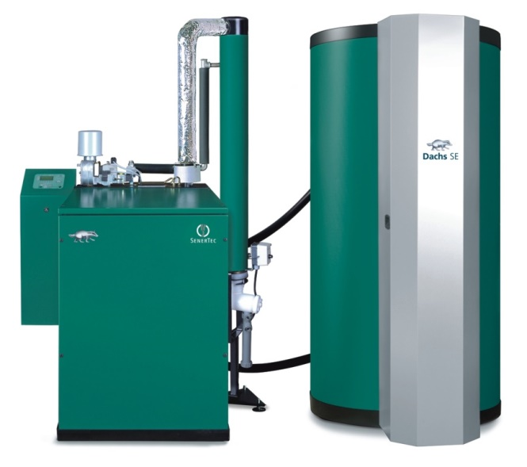
Hybrid Energy Grid Management (HEGRID)
Main goal:
Making multi-commodity energy management possible
Heat
Gas
Electricity
Other fuels (e.g. Power-to-gas)
Prototype implementation: µCHP with additional electrical heating
Source: www.senertec.de

Slide 3
HEGRID: Challenges
Data from different sources:
Appliances
Smart meters
µCHPs
Economic data
Different stakeholders:
Consumers
Gas/electricity retailers
Distribution grid operators
Balance responsible party
Combination of
Data life cycle analysis
European energy market role model

Slide 4
HEGRID: Results
Customer (C)
electricity/gas
Distribution System Operator (DSO)
electricity/gas
Retailer (R)
electricity/gas
Balance Responsible Party (BRP)
electricity only
Acquisition
Primary data 1. µCHP equipment data 2. Metering data (electricity) 3. Metering data (gas) 4. User preferences Derived data 5. Control signals/incentives
Derived data from Cs 1. Aggregated metering data
Derived data from DSO/Cs 1. Aggregated metering data 2. Flexibility profiles (electricity only) 3. Grid usage invoices Primary data 4. Contract data
Derived data from R 1. Aggregated metering data (electricity) 2. Flexibility profiles (electricity)
Transmission (from / to)
1. µCHP → EMS 2. Meter → EMS 3. Meter → EMS 4. Local UI → EMS 5. BRP → EMS
1. C‘s meter → Metering data management system
1. DSO → ERP 2. C → ERP 3. DSO → ERP 4. Back Office → ERP
1. R → Control System 2. R → Control System
Storage
(Local) EMS database
(Local) Metering database
ERP system
Control system
Analysis
Aggregation Analysis Optimization
Data validation Billing Forecasting
Data validation Billing Forecasting
Forecasting Calculation of control signals/incentives
Rigoll, Gitte, Schmeck:
“Data Life Cycles in Future Residential Multi-Commodity Energy Management Systems”,
IEEE PES Great Lakes Symposium 2014 (accepted)
Distribution (to)
R: Aggr. metering data DSO: Aggr. metering data R: Energy flexibility profiles (electricity only)
R: Aggr. metering data R: Grid usage invoice
BRP: Aggr. metering data BRP: Flexibility profiles BRP: Contract info Customer: Invoice
C: Control signals/Incentives (electricity)
Deletion
Deletion of data which is no longer necessary
Deletion of data which is no longer necessary
Deletion of data which is no longer necessary
Deletion of data which is no longer necessary

Slide 5
Data Custodian Service
Energy data is personal data
Standard anonymization and pseudonymization not sufficient
Basic ideas:
Allow for different views on data (spatial/temporal resolution, noise)
Reveal only the lowest quality possible
User decides which party gets to see which data in which quality

Slide 6
Data Custodian Service
Concept published, basic prototype
out
in
out
in
req.
Data Custodian Service
Request
Handler
DB 1
DB m
Output Module 1
…
Output Module n
…
Rigoll, Schmeck:
“Outline for an Energy Data Management System in Accordance with Data Protection and Privacy”,
VDE Kongress 2014 (accepted)
Database Connector
Data Custodian
Access Log
Rigoll, Hirsch, Kochanneck, Mauser, Schmeck:
“A Privacy-Aware Architecture for Energy Management Systems in Smart Grids”,
IEEE ATC 2014 (submitted)
Input
Handler
Input Module 1
…
Input Module l
in
in

Slide 7
Battery-Electric Storage System (BESS)
First prototype providing the whole data life cycle in one tool (ingest, search, retrieve).
Extended workflow during ingest including
Automatic metadata extraction
Indexing metadata
Search via elasticsearch implemented
Download client based on search results
Performance tests
Documentation
→ Please contact Volker Hartmann for more info

Slide 8
Publications
Rigoll, Gitte, Schmeck: “Data Life Cycles in Future Residential Multi-Commodity Energy Management Systems”, IEEE PES Great Lakes Symposium 2014 (accepted)
Rigoll, Schmeck: “Outline for an Energy Data Management System in Accordance with Data Protection and Privacy”, VDE Kongress 2014 (accepted)
Rigoll, Hirsch, Kochanneck, Mauser, Schmeck: “A Privacy-Aware Architecture for Energy Management Systems in Smart Grids”, IEEE ATC 2014 (submitted)

Slide 9
Summary
Current status
HEGRID
Data Custodian Service
BESS
Publications
Future plans
Thank you for your kind attention!

