Slide 1
DLCL Energy – Topical Meeting on Meta Data
LSDMA All Hands Meeting October 2014

Slide 2
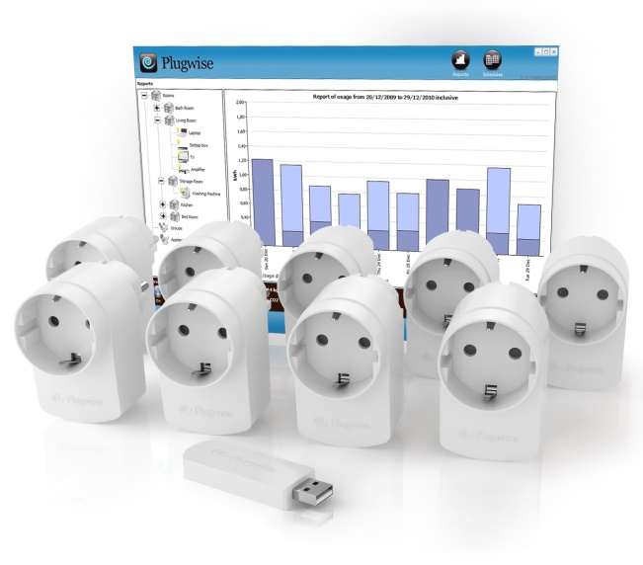
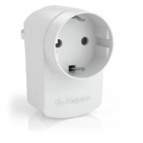
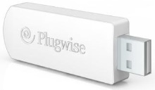
Motivation
Households are equipped with smart plugs (“circles”)
Energy consumption is measured and recorded
Data is collected by a Raspberry Pi and sent to an external, central storage (via SCP)
Images: Plugwise, Raspberry Pi Foundation

Slide 3
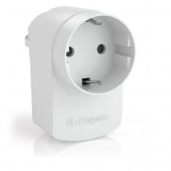
Meter Data Meta Data
Each household may use up to 9 circles
Each circle has a unique ID
IDs are mapped to devices

Slide 4
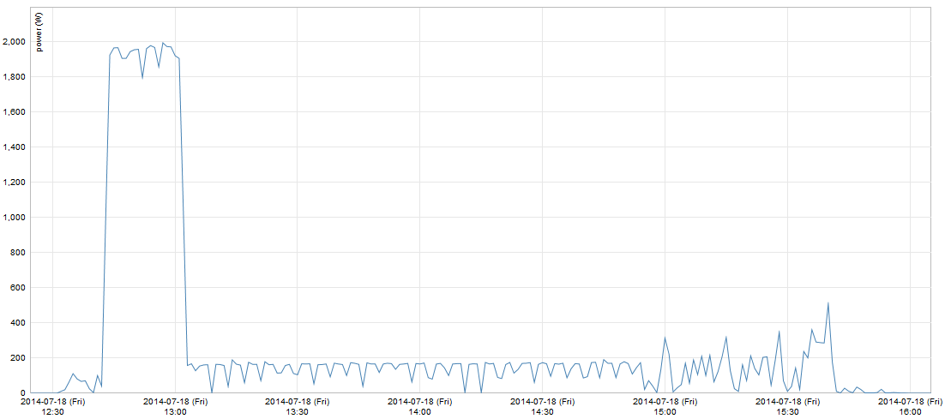
Meter Data – Washing Machine

Slide 5
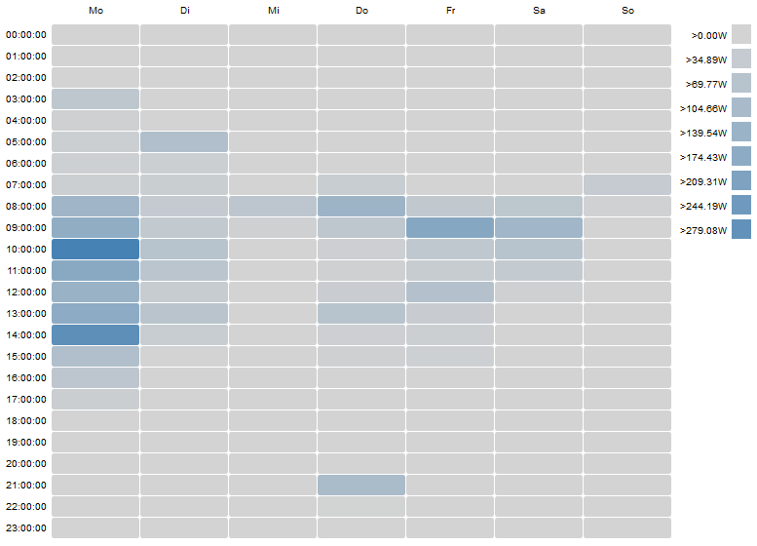
Meter Data – Derived Data (Washing Machine)
Derived data can be created
However, data must be mapped correctly

Slide 6
Meter Data Meta Data Mix-Up
People are curious → plugs are used to measure other devices
However, IDs are not (yet) remapped automatically (and most of the time not even manually)
→ Same ID, different device!
X

Slide 7
Meta Data and Energy Consumption Profiles
Still work in progress!
Find energy profiles (actual use vs. base load)
Extract properties of energy profiles
Duration
Power (min, max, average)
Energy consumed
…
→ Try to map them automatically

