Slide 1
AMS submission design
We are converging:
At the end of last week we had prototype passive cells and amplifier design.
The plan is to: a) place things in the design, b) integrate the two for the active pixels, c) place transistor structures, d) run DRC checks by Thursday this week.
(Just so that we have time to give the design to CERN for the submission on Monday.)
➔ Right now is very busy time.

Slide 2
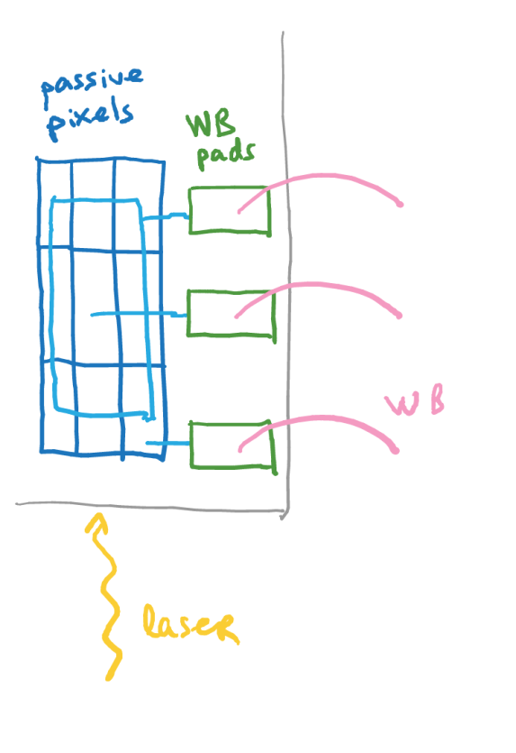
Latest design changes
We changed from 50V tolerances that Ivan had to 120 V tolerances. This changed some design rules. In particular:
the max active area fraction became less
Inadequate space (width) for the amplifier placement
➔ We relaxed the pitch from 40 um to 45 um
We are concerned that the performance of the device conforming to DRC rules is sub-optimal. Additional test structures are implemented to verify that:
Pixel array with narrower guard ring (violates DRC)
Pixel array without “internal” guard ring, only “external” one (violates DRC)
Pixel array with separate nets for “internal” and “external” GR.
As per I. Mandic’s request, there will be 2 additional passive structures near corners of the device for laser-TCT measurements.

