Slide 1
Piezo radiation resistance
N. Gandolfo
From an experiment* driven by the following team :
M. Fouaidy, G. Martinet, N. Hammoudi, F. Chatelet, A. Olivier, S. Blivet, F. Galet
IPN Orsay
*M. Fouaidy, G. Martinet, N. Hammoudi, F. Chatelet, A. Olivier, et al.. Radiation hardness tests of piezoelectric actuators with fast neutrons at liquid helium temperature. 2007, pp.20.<in2p3-00148346>

Slide 2
Piezo radiation resistance
Outline
Introduction
Experimental setup
Measurements of the neutrons fluence
Measurements of electrical parameters
Conclusion

Slide 3
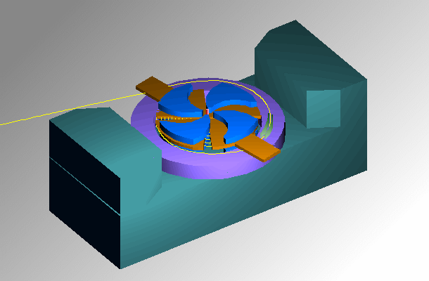
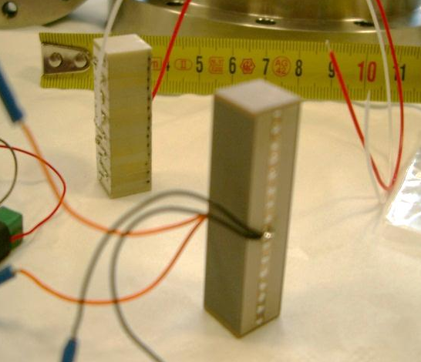
Piezo radiation resistance
Introduction
Idea : Irradiate piezos with fast neutrons and see what happens.
Tools : Neutrons irradiation facility at the CERI cyclotron (Orléans)
Deuterons beam : Energy ≤ 25 MeV, Current up to 35µA
Collision with a water cooled thick beryllium target
Production of a high neutrons flux with low γ dose (<20%)
Neutrons energy spectrum in the range of 1 to 20 MeV
The total dose of ~10¹⁵ n/cm² (10 Years LHC operation) is nearly achieved in 8 hours
Cryostat :
Main dimensions : Inner diameter: 270 mm, Height: 600 mm
Could be operated with Liquid Helium or Liquid Argon
Minimum distance between neutrons source and irradiated component : 80 mm
Piezo actuators (which are not very lucky) :
4 Noliac (from Noliac) : 36x10x10 multilayer low voltage stacks
4 PICMA (from Physik Instrument) : 36x10x10 multilayer low voltage stacks

Slide 4
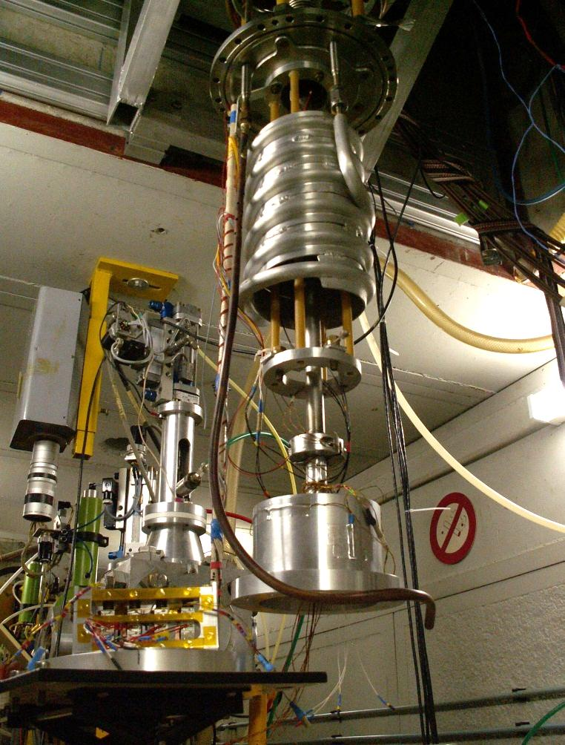
Piezo radiation resistance
Experimental setup
The experimental setup was inspired by a previous cryogenic sensors radiation resistance test for LHC*
To acquisition & control system
LHe Dewar
Piezos in Al vacuum chamber
Be target (3 mm thickness)
d
(20 to 25 cm)
Deutons beam
*Junquera, T., Thermeau, J. P., Amand, J. F., & Casas-Cubillos, J. (1997). Neutron Irradiation Tests of Calibrated Cryogenic Sensors at Low Temperatures. Adv. Cryog. Eng., A, 43(LHC-Project-Report-153), 765-772.

Slide 5
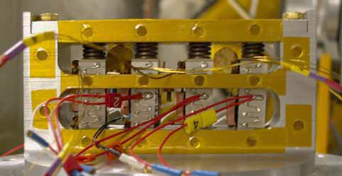
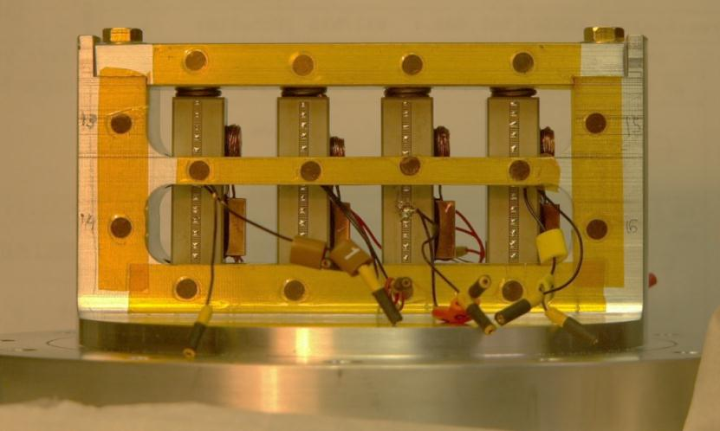
Piezo radiation resistance
Measurement of the neutron fluence
Neutron fluence value is obtained by measuring radioactivation of 16 high purity Nickel foils (O.D = 3 mm)
Radiation exposition mean values :
Noliac : 5.3 x10¹⁴ n/cm²
PICMA : 2.5 x10¹⁴ n/cm²
(Exposure time : 8 hours)
Noliac piezos assembly
Neutron dose map [for PICMA test] (x10¹⁴ n/cm²)
Nickel foils
PICMA piezos assembly
Notes:
The Activity of high purity Nickel foils is determined by γ rays spectrometry gamma ray of 58Co at 810 keV
LN2 cooled ORTEC Ge-Li detector

Slide 6
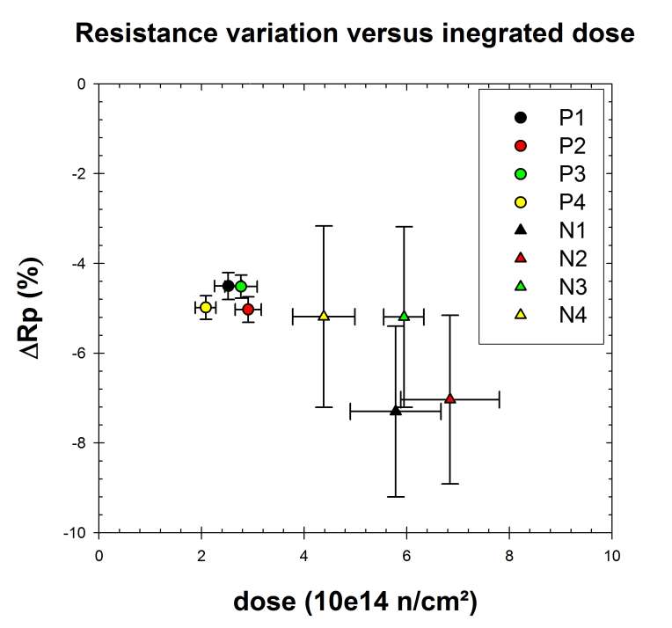
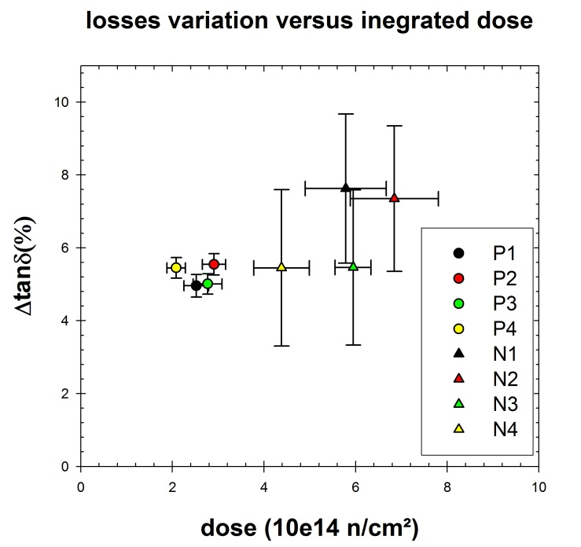
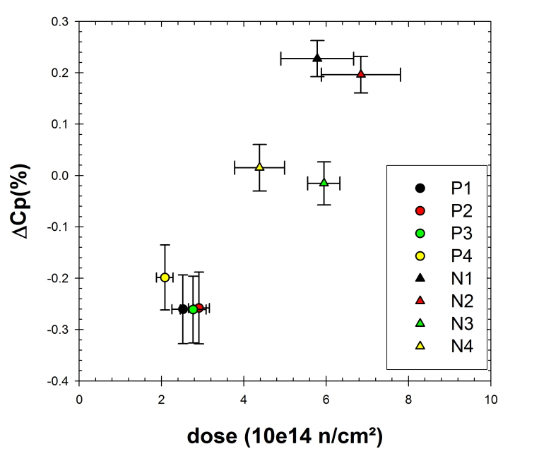
Piezo radiation resistance
Electric parameters measurement
Actuator nominal capacitance values from 300 K to 4 K
Noliac : 9 µF ➔ ~1.5 µF (83% drops)
PICMA : 12.5 µF ➔ ~2.7 µF (78% drops)
For temperature <100 K : Displacement is proportional to capacitance
Values of parameters prior to exposure to neutrons and after radiation are compared
Resistance variation Vs Integrated dose
Losses variation Vs Integrated dose
Capacitance variation Vs Integrated dose
PICMA
Noliac

Slide 7
Piezo radiation resistance
Conclusion
No significant modification of electromechanical performance of piezoelectric actuators after exposure to fast neutrons fluence up to 7x10¹⁴ n/cm² at LHe temperature.
No major damage was observed but negligible performance degradation may be due to aging effect is measured
Weak linear increase of loss factor by up to 10 %
no impact on cryogenic thermal budget
PICMA &NOLIAC piezoelectric actuators suited of use in radiation environment up to fluence ~ 10¹⁴ n/cm²

