Slide 1
RF Performance
in STF2 Cryomodule Tests
Eiji KAKO (KEK, Japan)
Questions to address:
“What about the measurement precision?”
frequency control
tuner stroke
piezo stroke
input coupling range
Q_{L}, Q_{input}, Q_{monitor}, Q_{HOM1}, Q_{HOM2}
Calibration of monitor coupler

Slide 2
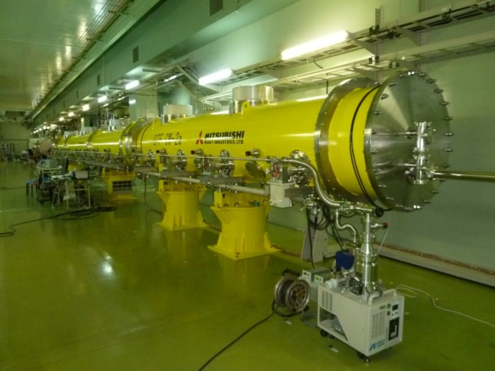
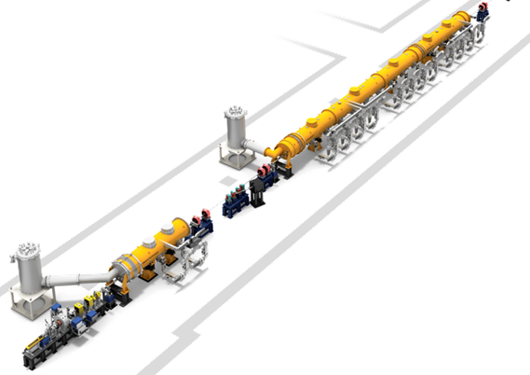
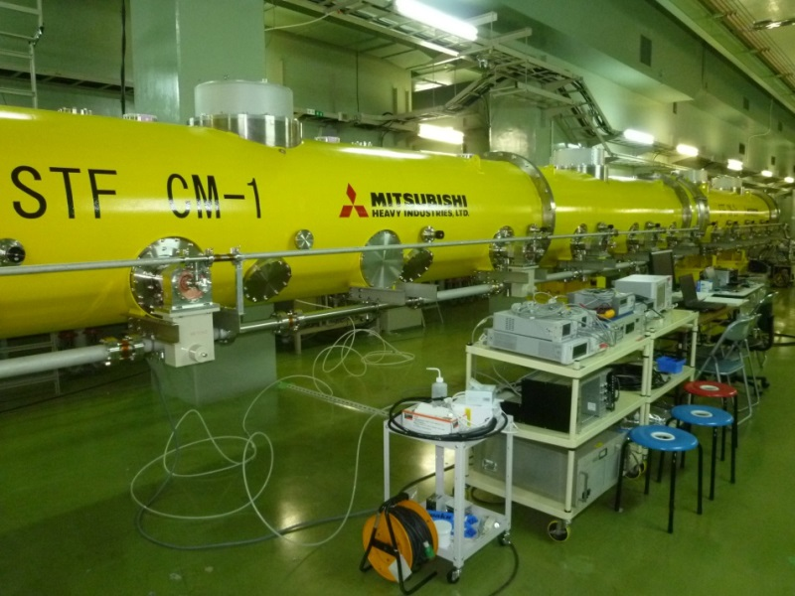
STF2 Cryomodule
CM2a Cryomodule
(four 9-cell cavities)
2014’ Oct.-Nov.
First cool-down tests
(Low RF power tests)
CM1 Cryomodule
(eight 9-cell cavities)
Cold Box -2
Total 14
9-cell cavities
Capture Cryomodule
(two 9-cell cavities)
Cold Box -1
Photocathode RF-Gun:
(1.3 GHz, 6 mA, 1 ms, 5 Hz)

Slide 3
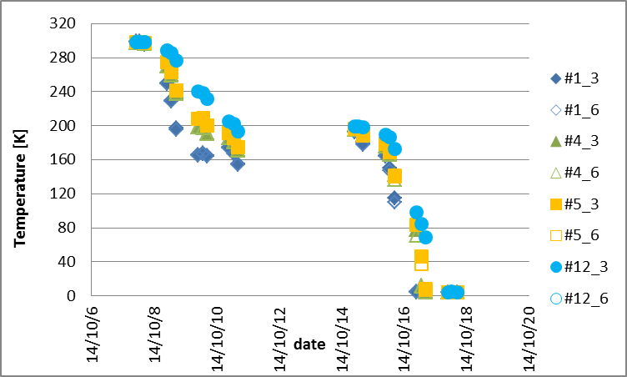
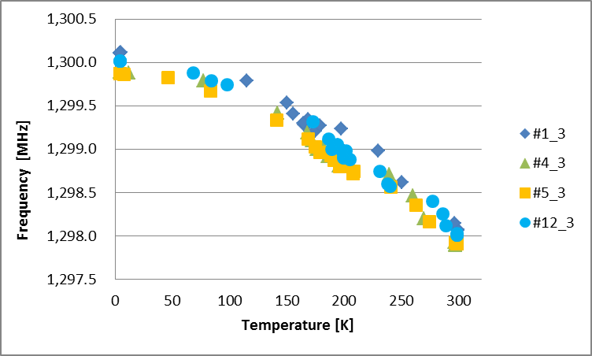
Resonant frequency control (1)
Cavity temperature during cool-down
4 days
300K
3 days
3 days
200K
160K
Cavity resonant frequency during cool-down
4.2K
4.2K
300K

Slide 4
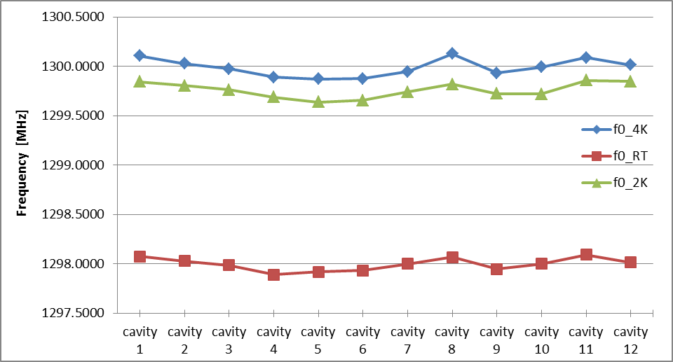
Resonant frequency control (2)
Under tuner-free condition
4.2 K
2.0 K
Δ f = - 250 kHz
by pump-down
Δ f = + 2.0 MHz
by cool-down
300 K before cool-down

Slide 5
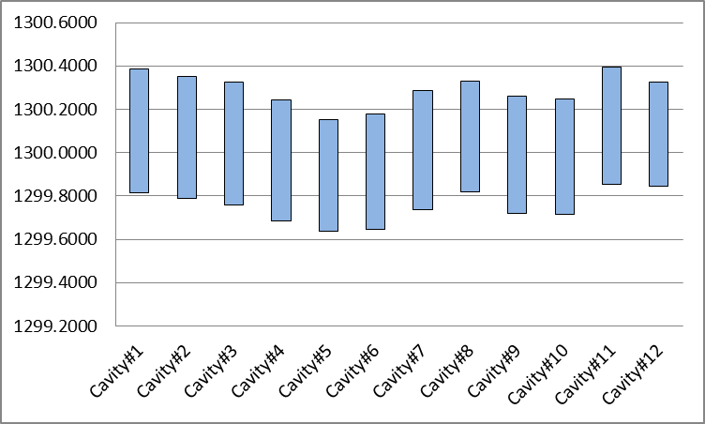
Tuner stroke of slide-jack tuner
[MHz]
at 2.0 K
Number of rotations = 40
Δ L = 2.22 mm , Δ f = 570 kHz
Δ f/Δ L = 260 kHz/mm
1300.000 MHz
Tuner free

Slide 6
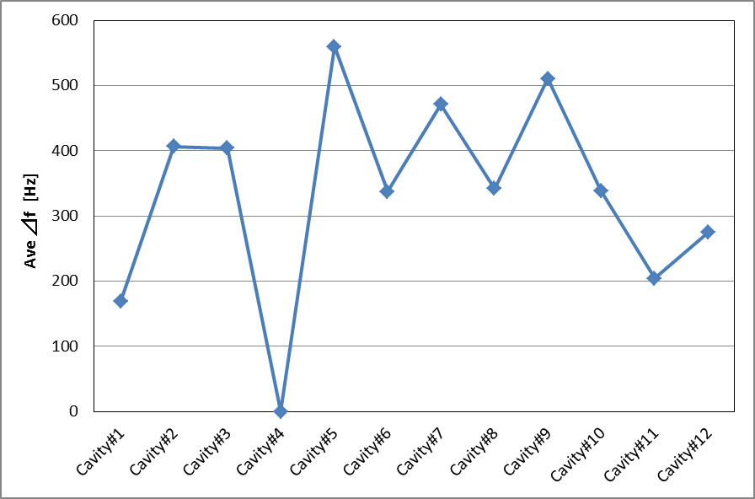
Piezo stroke of slide-jack tuner
Δ f [Hz]
fo = 1300.000 MHz, at 2.0 K
V_{DC} = + 500 V
(max. +1000 V)
Lorentz force detuning in STF cavities
Δ f < -200 Hz at 35 MV/m
Discharge at V_{DC} > + 100 V
(replace of piezo)

Slide 7
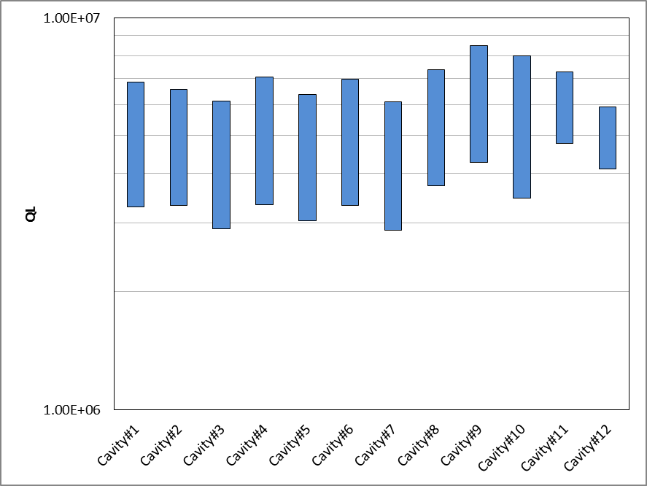
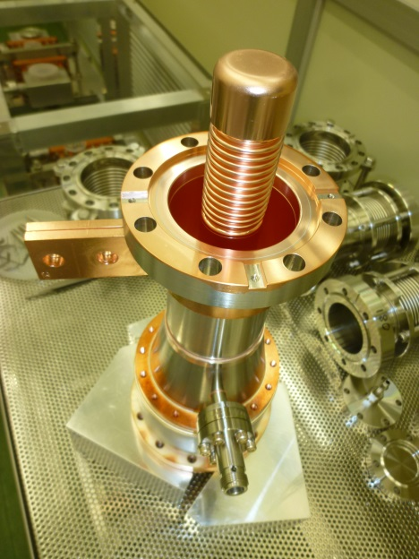
Coupling range of STF2 input coupler
(Δ L = +/- 2 mm)
Q_{in} = 5 x 10⁶
Q_{input}
Δ L = +/- 3 mm
Q _{input} = 3.5 ~ 7. x 10⁶

Slide 8
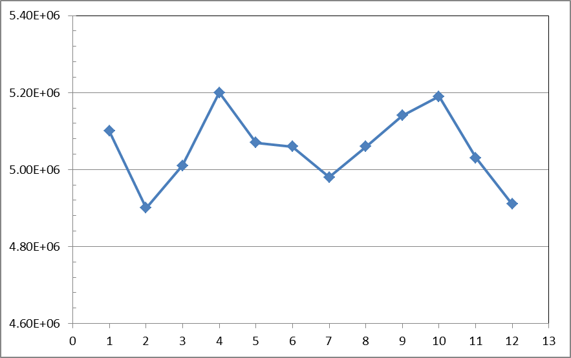
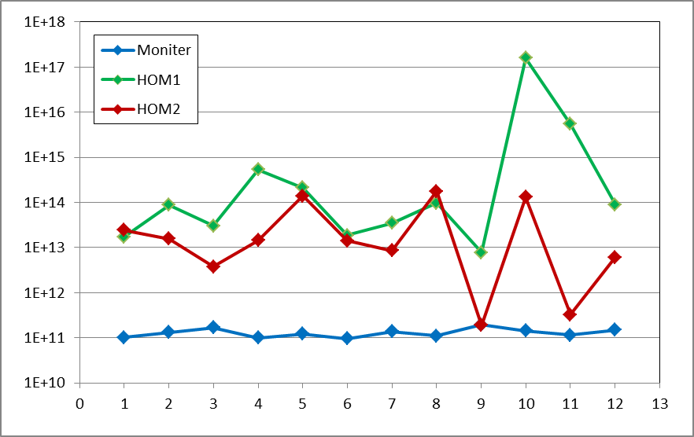
Q_{L}, Q_{input}, Q_{moniter}, Q_{HOM1}, Q_{HOM2}
Q_{L} = Q_{input}
Q_{in} = 5 x 10⁶
Q_{in} = 4.9 ~ 5.2 x 10⁶
Q_{HOM2} > 1. x 10¹²
Cavity
Q_{HOM1} > 1. x 10¹²
Q_{ext}
Q_{moniter} = ~ 1.1 x 10¹¹
Cavity

Slide 9
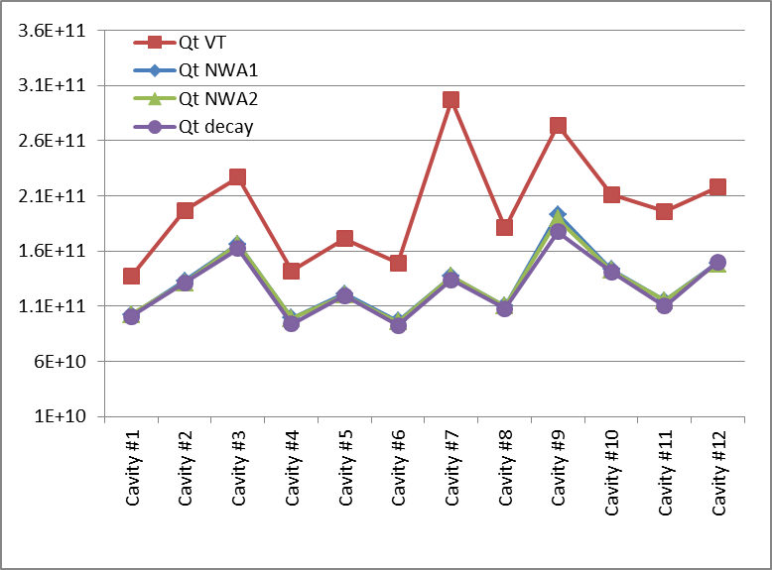
Calibration of monitor coupler (1)
Q_{moniter} in Vertical Test
CT
Eacc x 1.24
x 1.5
Q_{moniter} in Cryomodule Test

Slide 10
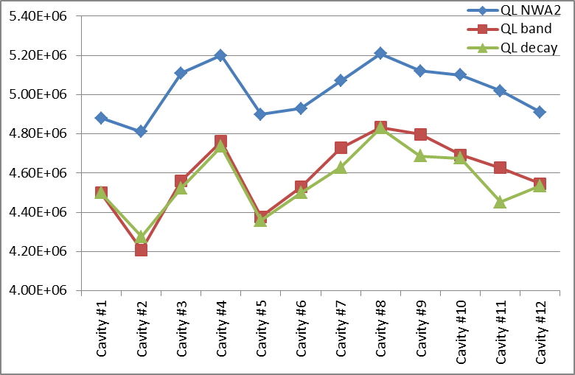
Calibration of monitor coupler (2)
Q_{L}
Cryomodule Test at 2K, fo = 1300.000 MHz
Network Analyser (bandwidth)
~10%
SG + Amp. + PM (bandwidth)
SG + Amp. + PM/Diode (decay time)

Slide 11
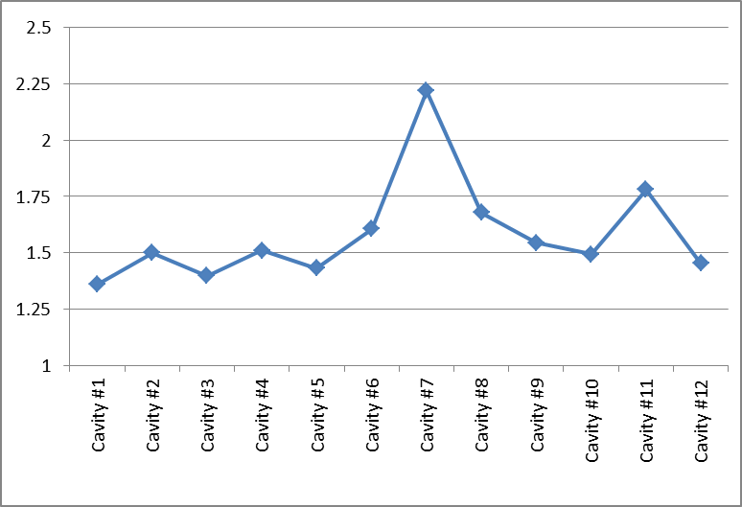
Calibration of monitor coupler (3)
Ratio of Q_{moniter}
VT / CT
VT : β = 1 (no P_{ref}), Q_{L} by decay time
CT : β = 2000 (total P_{ref}), Q_{L} by decay time & bandwidth
??
x 1.5

Slide 12
Discussions
Questions to address:
“What about the measurement precision?”
My conclusions;
Both Q_{moniter} in VT and CT might be correct.
Because observation of Quench field at Eacc,max is usually good agreement between VT and CT within 10% error,
if there is no severe degradation.
Beam energy measurements also supports this.

