Slide 1


Summary of HOMSC14 Workshop
J. Sekutowicz
TTC Meeting, KEK
December 5th, 2014

Slide 2

ICFA Workshop on High Order Modes in Superconducting Cavities
It was the 4th Workshop devoted to this topic
July 14-16, 2014
Chairs: Vyacheslav Yakovlev, Alexander Sukhanov
Higher Order Mode Measurements in Superconducting Accelerating Cavities
2007 at DESY, Chair Nicoleta Baboi
HOM Damping in SCRF Cavities
2010 at Cornell University, Chair Matthias Liepe
3. Higher Order Mode Diagnostics and Suppression in SC Cavities
2012 at The Cockcroft Institute, Chair Roger Jones

Slide 3
Plenary Session and Working Groups (Conveners)
Agenda Plenary Session (V. Yakovlev, R. Jones) WG1. HOM damping requirement (N. Solyak, J.S) WG2. HOM-based diagnostics (N. Baboi, R. Jones) WG3. RF simulation and beam dynamics (M. Liepe, O. Napoly) WG4. HOM damping couplers and loads (J. Delayen, T. Khabiboulline) WG5. LLRF, controls and system integration (B. Chase, L. Doolittle) 27 Presentations / 40 participants https://indico.fnal.gov/conferenceDisplay.py?ovw=True&confId=7942

Slide 4
Plenary Session (July 14th, 2014) Summary
Hasan Padamsee (FNAL) HOMs for the Future High Intensity and CW Superconducting Accelerators
Roger Jones (University of Manchester) Overview of HOMs and Wakefield Issues in SC Cavities and Systems
Matthias Liepe (Cornell University) HOM damping requirements and HOM beamline load for the Cornell ERL
HP and RJ gave introductory talks to HOM topics, discussing:
Present and future SRF facilities (FLASH, XFEL, LCLSII, ILC, ESS, LHeC, ERLs and ADS)
Recipes for what can be done to HOMs (LOMs and SOMs):
  Damping using HOM couplers or/and BLAs.
  Avoiding HOM excitation, by designing a proper cavity, which HOM spectrum does not overlap with the nominal beam spectrum.
  Using some of HOMs for beam diagnostics (BPMs).

Slide 5
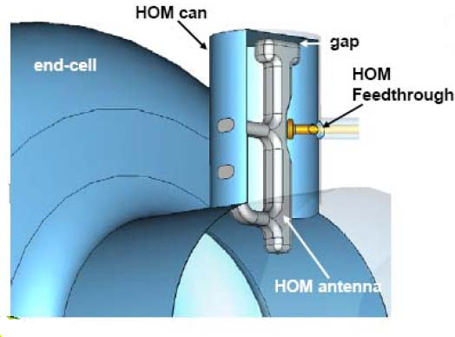
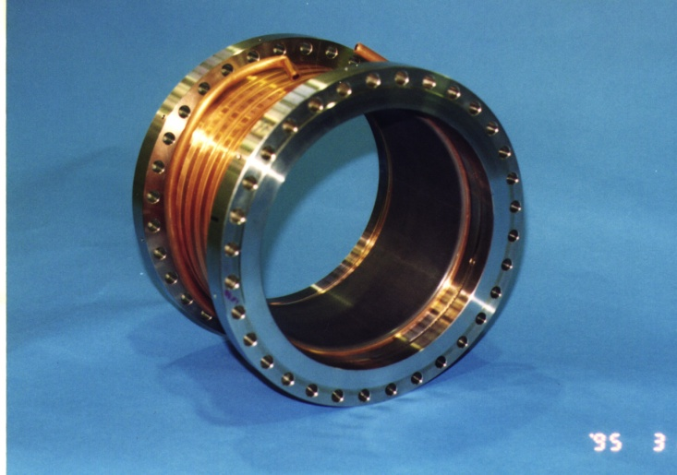
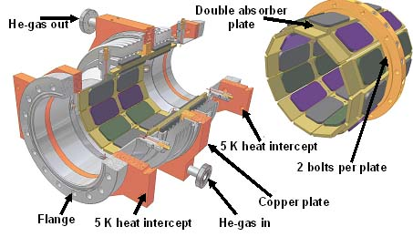
Plenary Session (July 14th, 2014) Summary, cont.
  Damping using HOM couplers or/and BLAs, example of devices discussed in both presentations.

Slide 6
Plenary Session (July 14th, 2014) Summary, cont.
  Using some of HOMs for beam diagnostics (BPMs).
  (RJ presentation)
  HOM-BPMs in TESLA Cavities using dipole mode at 1.7 GHz
  The mode is monitored in 5 accelerating modules (40 cavities) at FLASH
  Now routinely used in FLASH for the beam alignment in modules.
  Other studies at FLASH:
  Cavity alignment in modules
  Beam phase measurement with monopole modes at ~2.4GHz
x-resolution
9 µm
y-resolution
4 µm

Slide 7
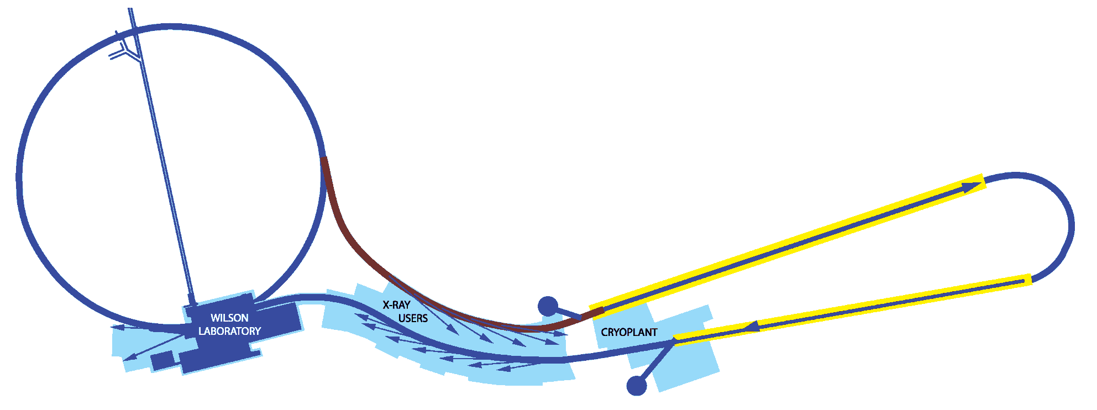
Plenary Session (July 14th, 2014) Summary, cont.
Matthias Liepe (Cornell University) HOM damping requirements and HOM beamline load for the Cornell ERL
ERL main linac: 5 GeV, 100 mA with energy recovery, 5 kW RF power per 7-cell cavity
CESR
ERL injector: 12 MeV, 100 mA without energy recovery, >100 kW RF power per cavity
Beam Stop
Beam Parameter | Injector Linac | Main Linac
CW beam current [mA] | 100 | 2 x 100
Bunch charge [pC] | 77 | 77
Bunch length [ps] | 2 (600 µm) | 2 (600 µm)
Bunch repetition rate | 1.3 GHz | 2.6 GHz
Average HOM power / cavity [W] | 40 | 200

Slide 8
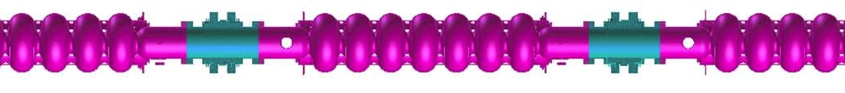
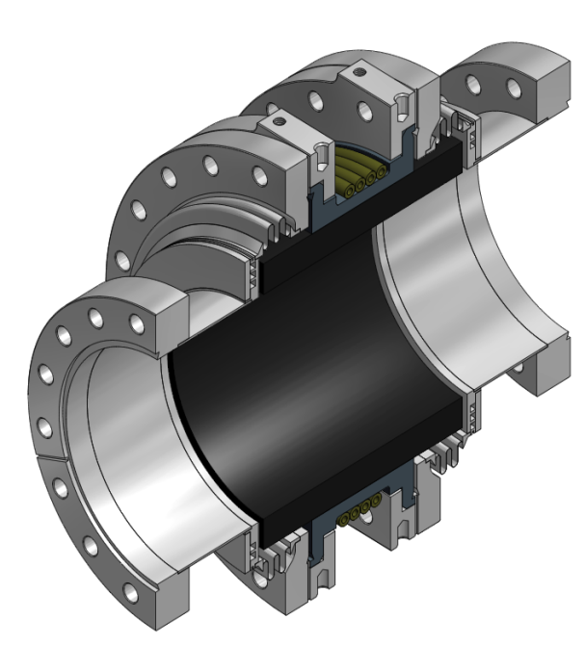
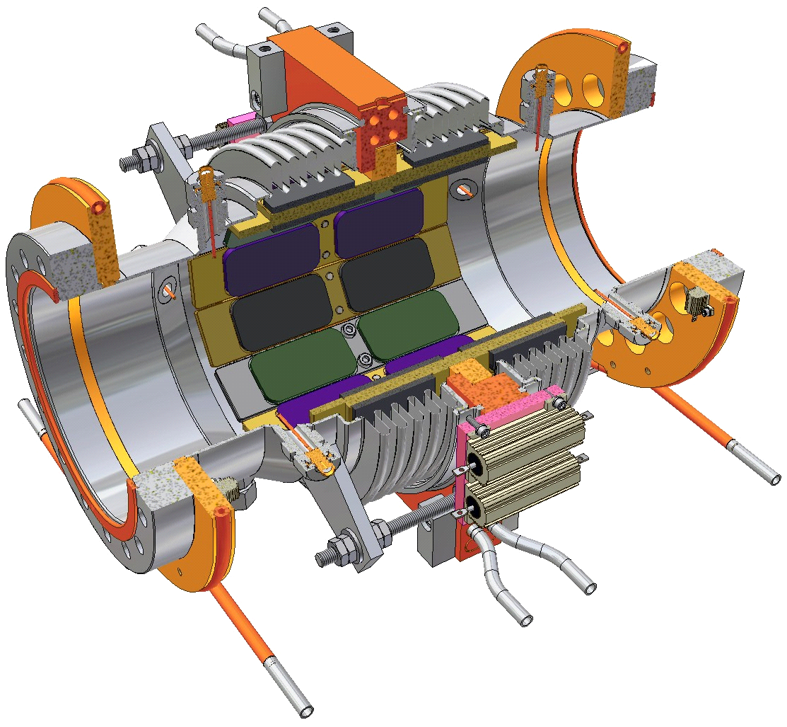
Plenary Session (July 14th, 2014) Summary, cont.
(ML) cont. Damping requirements:
For monopole modes limit is on HOM power/cavity < 400 W
(R/Q)Q < 2500 Ω for modes near beam harmonics
For all dipole modes limit is to stay below BBU threshold
(R/Q)Q/f < 10⁴ Ω/(cm²GHz)
80 K BLA
1.8 K
1st Version of BLA (tested with 75 mA)
Ferrites & Ceramic 137Zr10: no DC cond.
2nd Version of BLA(tested with 10 mA)
Tungsten jacket+Ceramic SiC: good DC cond.
Flange to Cavity
5K intercept
80K intercept
Flange to Cavity
RF Absorbing Tiles
80K Cooling Channel (GHe)
Shielded Bellows
SiC absorber ring brazed to Tungsten ring
Shielded bellows

Slide 9
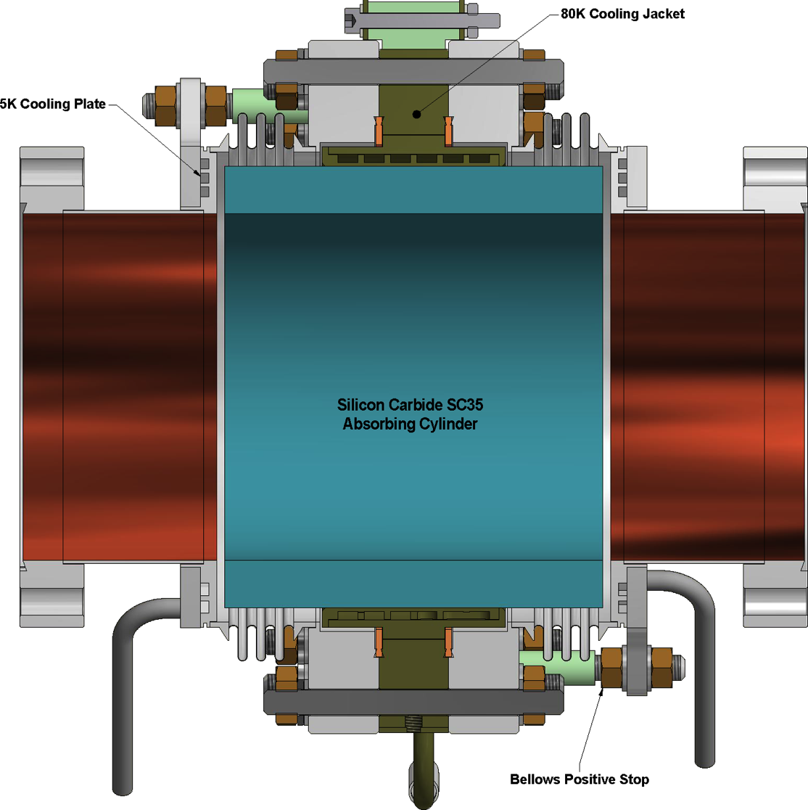
Plenary Session (July 14th, 2014) Summary, cont.
(ML) cont.
  In 2nd version Tungsten became porous after brazing causing leaks.
3rd Version of BLA Titanium jacket + Ceramic SiC: good DC cond.
5K cooling
80K cooling jacket

Slide 10
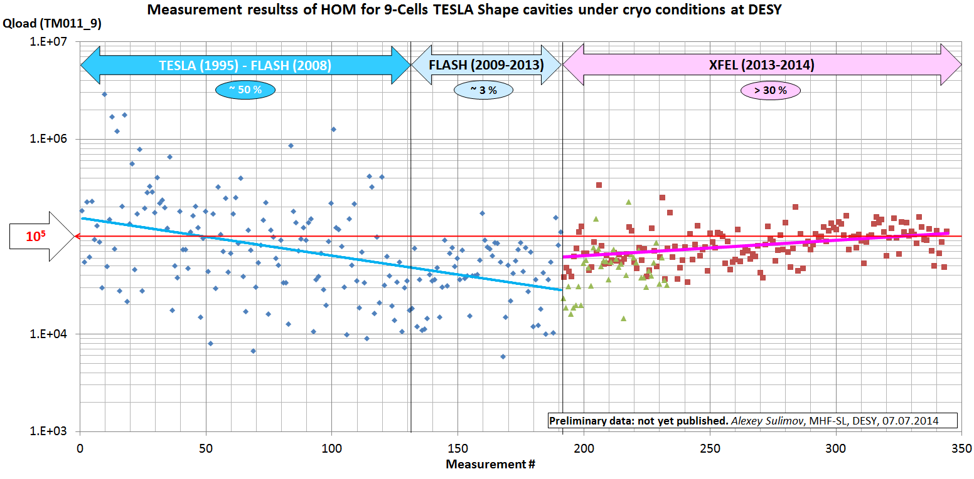
WG1. HOM damping requirement Based on the WG1 summary by N. Solyak
Alexey Sulimov: (DESY): XFEL HOM Specifications Karl Bane (SLAC): HOMs and wakes in LCLS-II Superconducting linac Binping Xiao (BNL): Overview of HOM damping in deflecting cavity Gennady Stupakov (SLAC): Physics of wake potentials of very short bunches Alexander Sukhanov (FNAL): Resonance HOM excitation in LCLS-II Timergali Khabiboulline (FNAL): HOM-free deflecting cavity.
XFEL HOM Specifications - Alexey Sulimov (DESY)
• HOM damping for dangerous TM011 mode of XFEL cavities shows degradation during production time. This can be attributed to relaxed tolerances on geometry.
• Often Qext ≥ 2·10⁵, which needs to be discussed with the vendor and beam dynamic group

Slide 11
WG1. HOM damping requirement Based on the WG1 summary by N. Solyak
The beam (Q = 300pC, frep = 1MHz, σ_{z} = 25μm: the most challenging case for HOM) loses: 7.7W/CM, 10.7W/CM, 13.8 W/CM in L1, L2, L3
Beam HOM spectrum in L3 reaches 4 THz (50% for f>100 GHz, 15% for f>2 THz ).
Beam pipe transitions (1 cm ↔ 3.9 cm) at ends of L3 generate 46W.
Two 3rd harmonic CMs generate 26W.
CSR at the last bend of B2 bunch compressors (with transient) is 110 W.
All stainless steel surfaces will be Cu – coated to reduce cryogenic losses (98% of the HOMs power will be dissipated in BLAs).
2. Karl Bane (SLAC): HOMs and wakes in LCLS-II Superconducting linac
5. Alexander Sukhanov (FNAL): Resonance HOM excitation in LCLS-II
• Mean heat load (HL) at 2K<1mW (HL>100mW has prob. <5·10⁻⁴)
• Mean P_{HOM} /cavity removed by couplers (2HOM+FPC)<5 W
• Mean power dissipated in bellows < 5W
Estimation was done for 1.3 GHz and 3.9 GHz structures.

Slide 12
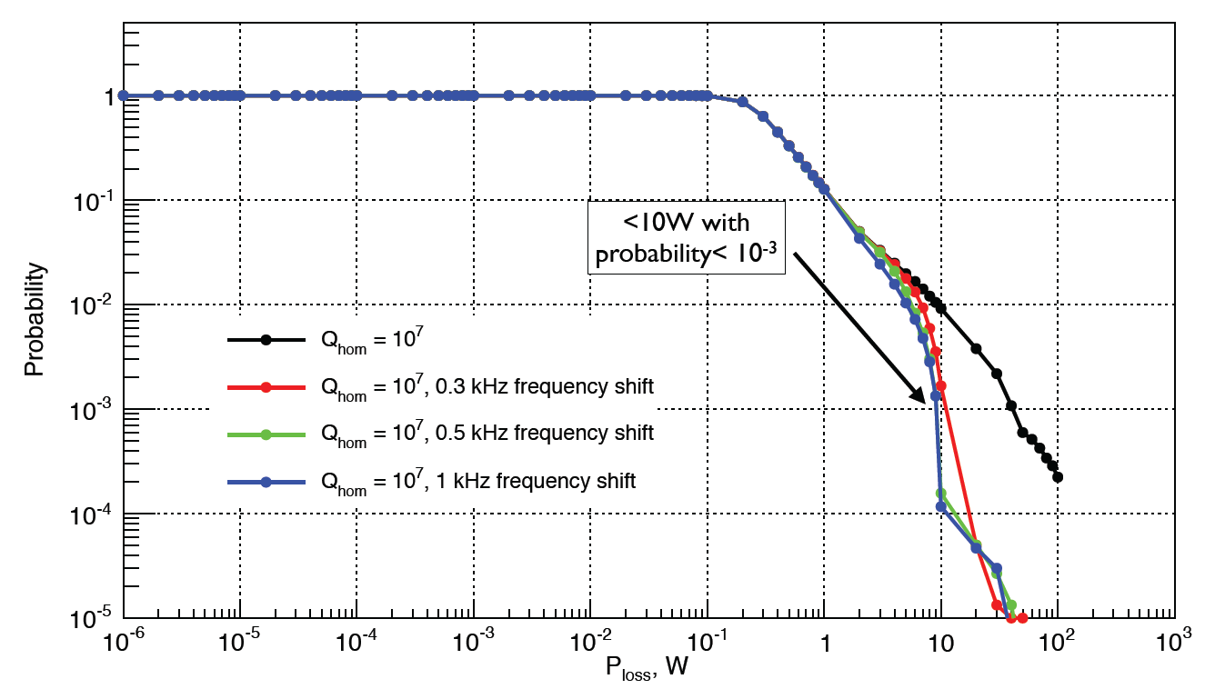
WG1. HOM damping requirement Based on the WG1 summary by N. Solyak
5. AS, cont.
Power removed by HOM couplers: HOM spectra manipulation
Higher P_{HOM} can be remedied by HOM spectrum manipulation
(detuning and tuning cavity back, which shifts HOM freq. by 100s of Hz)

Slide 13

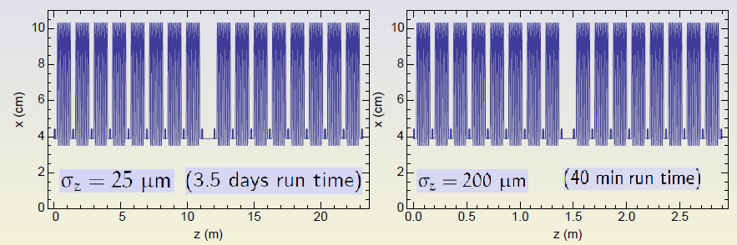
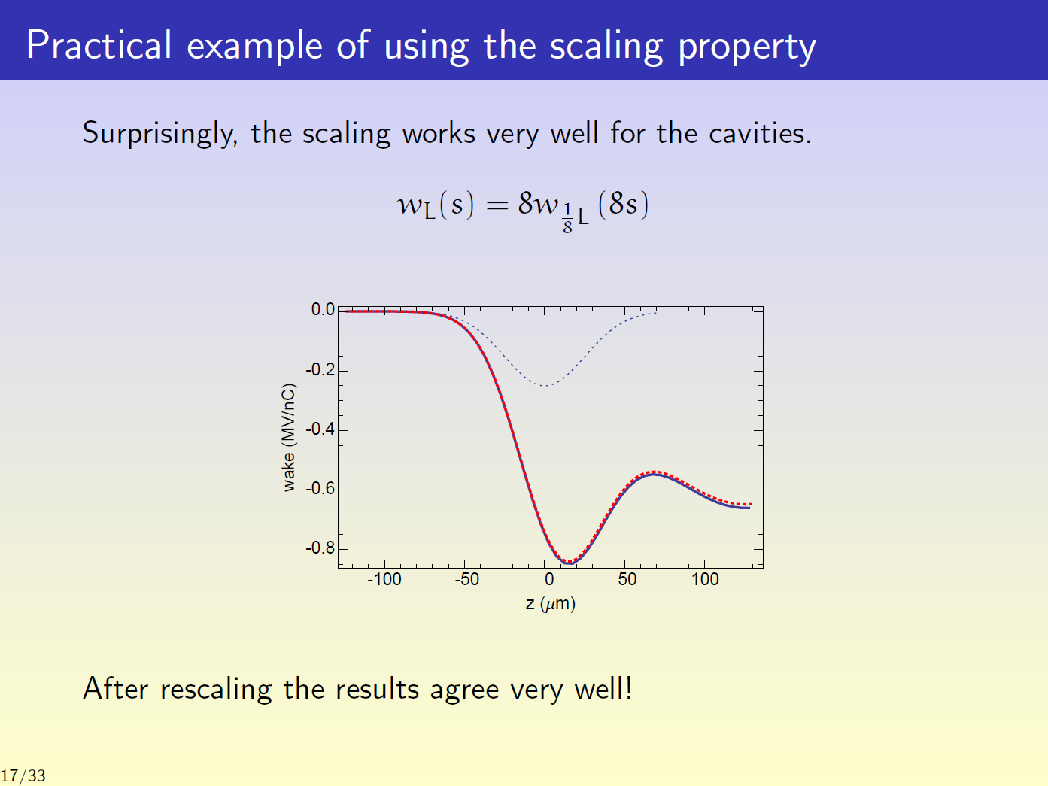
WG1. HOM damping requirement Based on the WG1 summary by N. Solyak
4. Gennady Stupakov (SLAC): Physics of wake potentials of very short bunches .
Scaling low:
Example of 2 CMs
Real geometry (left) and scaled geometry (right).
Calculated wake

Slide 14
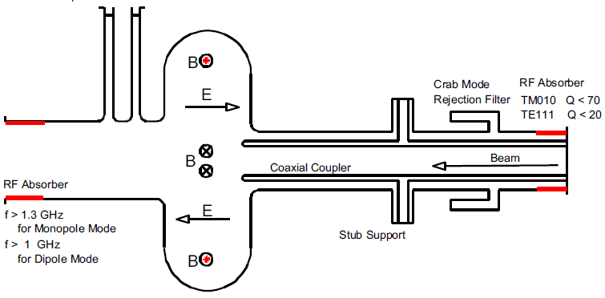
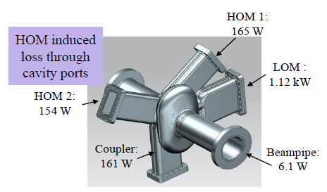
WG1. HOM damping requirement Based on the WG1 summary by N. Solyak
3. Binping Xiao (BNL): Overview of HOM damping in deflecting cavity.
Elliptical cavity for KEKB and SPX
SPX Crab Cavity at ANL
509 MHz squashed elliptical cavity
LOM picked up by coaxial coupler
Choke filter to reject crabbing mode
Low Qext for HOMs
HOM power 16 kW/cavity
2.8 GHz squashed ellip. cavity (8th harm.)
LOM damped by waveguide at equator
Y section: 2 ports for HOM, 1 for FPC

Slide 15
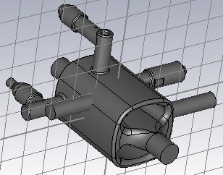
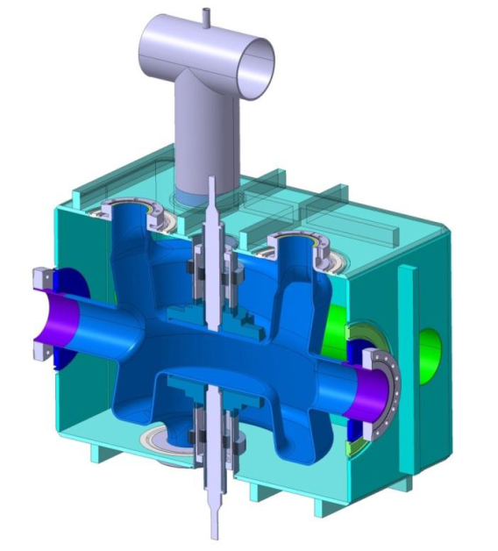
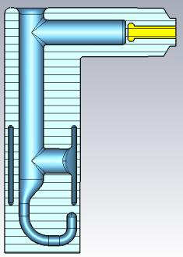
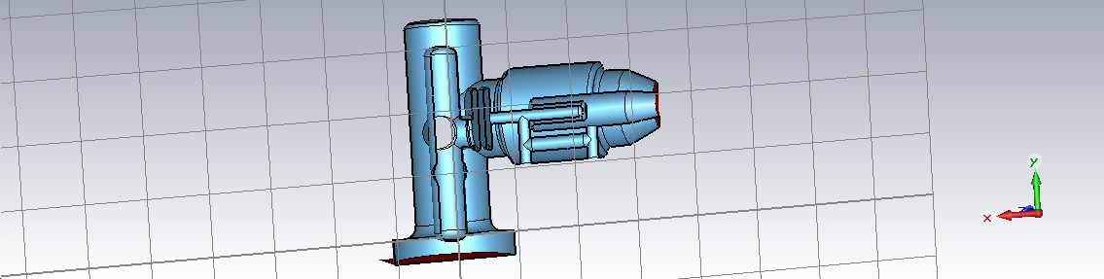
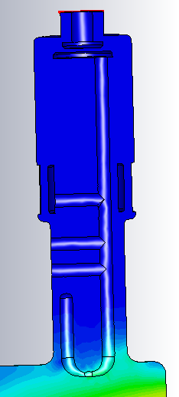
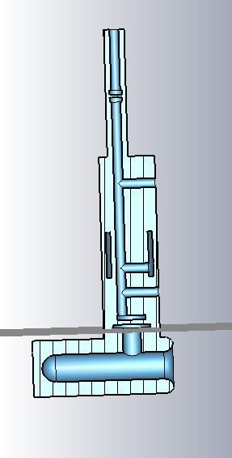
WG1. HOM damping requirement Based on the WG1 summary by N. Solyak
3. Binping Xiao cont.
HOM damp. in LHC crab 4-rod cavity
LHC Crab Cavity: DQW (PoP)
570 MHz
-2 dB
685 MHz
-20 dB
400±17 MHz
-128dB
LOM coup.
H-HOM coup.
Qext < 50000
V-HOM coup.
Qext < 1000000

Slide 16
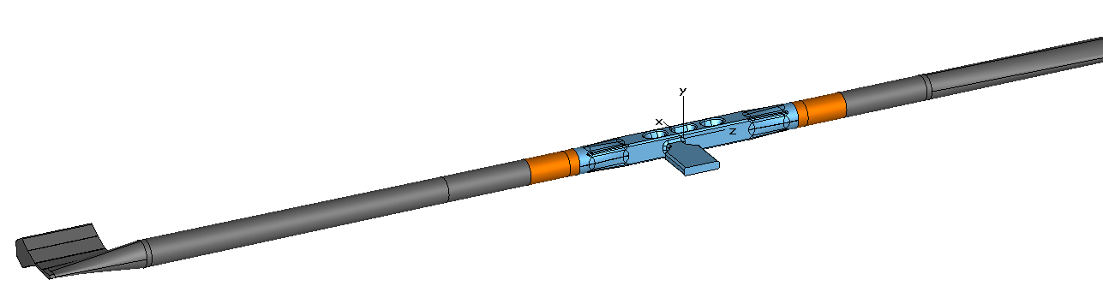
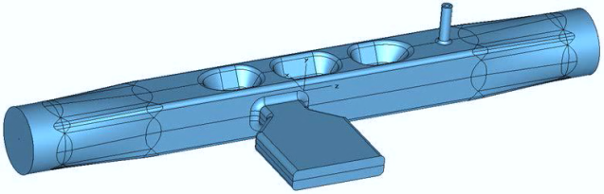
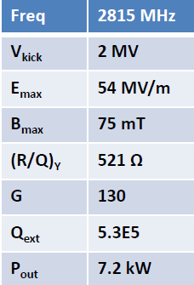
WG1. HOM damping requirement Based on the WG1 summary by N. Solyak
6. Timergali Khabiboulline (FNAL): HOM-free deflecting cavity.
New design of RF-dipole crab cavity for APC upgrade (ANL)
92% HOM power
8% HOM power
Monopole Qext < 1200 (140W)
Dipole Qext < 5000

Slide 17
WG2. HOM-based diagnostics Based on the WG2 summary by N.B. and R.J.
Beam characterization: alignment, position, phase:
Nicoleta Baboi (DESY): Overview of HOM-based diagnostics at FLASH and XFEL Nathan Eddy (FNAL): HOM-based diagnostics for 3.9 GHz cavities Nathan Eddy (FNAL): Plans at FNAL (for HOM-based diagnostics) Liangliang Shi (DESY): Stability of HOM BPMs in FLASH Thomas Flisgen (U. Rostok): Simulation results for diagnostics in 3.9GHz cavities Cavity characterization: Ayaka Kuramoto (KEK): HOM studies on cavity alignment at KEK and DESY Daniel Hall (Cornell Uni.): Measuring HOM parameters with beam for Cornell's ERL cavities
Beam characterization, presentations 1-5:
At FLASH for the beam alignment, position monitoring and phase detection following modes are presently used/studied:
For 1.3GHz cavity mode 6 of the 1st DP, (~1.7GHz)
For 3.9GHz cavity modes in the 2nd and 5th DPs, (5.4GHz and 9GHz respectively)
For beam phase detection a monopole mode at 2.4GHz (TM011 in 1.3GHz cavity)

Slide 18
WG2. HOM-based diagnostics Based on the WG2 summary by N.B. and R.J.
Beam characterization, presentations 1-5, cont.:
The processed signals of 40 cavities at FLASH are an operator tool for the beam and cavity alignment.
The best demonstrated BPM resolution was <10µm rms for 1.3GHz cavities, but stability calibration is an issue.
Also for 3.9 GHz calibration stability is an issue.
Study on the calibration stability is continued (not very easy task!, Liangliang Shi). It seems that tuning of cavities during operation cause calibration problems
Plans at FNAL for HOM-Based Diagnostics (Nathan Eddy)
Advanced Superconducting Test Accelerator (ASTA) facility, will be ready in 2015(!)
ASTA consists of 2 booster cavities and one 8-cavity cryomodule.
ASTA is not an user facility, it will be used for accelerator R&D studies only:
  HOMBPM calibration stability
  Beam phase measurement with the monopole mode.

Slide 19
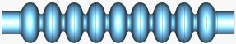


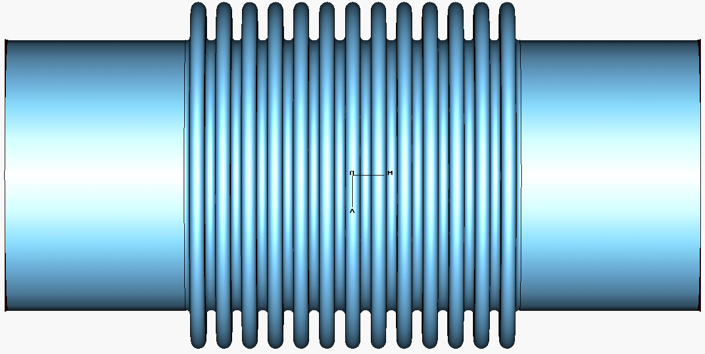
WG2. HOM-based diagnostics Based on the WG2 summary by N.B. and R.J.
Beam characterization, presentations 1-5, cont.:
Simulation results for diagnostics in 3.9GHz cavities (Thomas Flisgen )
**
Topology Information
Eigenmode based
Model Order Reduction
Compact models
of individual segments
SSC
Advantages of State-Space Concatenations (SSC):
Modeling of the individual sections needs significant less CPU time
identical sections need to be treated only once
f and Qext errors < 10⁻⁴ , 10⁻² respectively
For 2x9-cell structure + bellows + pipe CPU time 33 min vs. 29h with CST
Up to now method was demonstrated on 2D objects with no dissipation
Work in progress.
Compact model of full structure

Slide 20
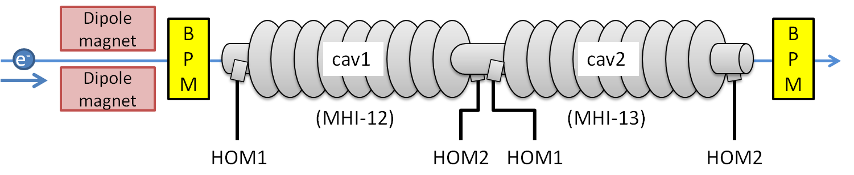
WG2. HOM-based diagnostics Based on the WG2 summary by N.B. and R.J.
Cavity characterization, presentation 6-7:
Ayaka Kuramoto (KEK): HOM studies on cavity alignment at KEK and DESY
Goal is the cavity alignment detection (offset, bending and tilt) using:
TE111 mode for the cavity body
Beam pipe modes for end groups
Experiments are going at STA (KEK) and at FLASH
<Electrical center of TE111-1 and 6 >
<Electrical center of beam pipe mode>
 | TE111-1 (HOM1) | TE111-1 (HOM2) | TE111-6 (HOM2)
x [μm] | 1179±725 | 1189±363 | 1313±37
y [μm] | -706±186 | -682±83 | -804±32
 | HOM1 (upstream) | HOM2 (downstream)
x [μm] | 1054±138 | -534±60
y [μm] | 311±126 | -583±53
Conclusion from that test was that cav. 1 is probably bended

Slide 21
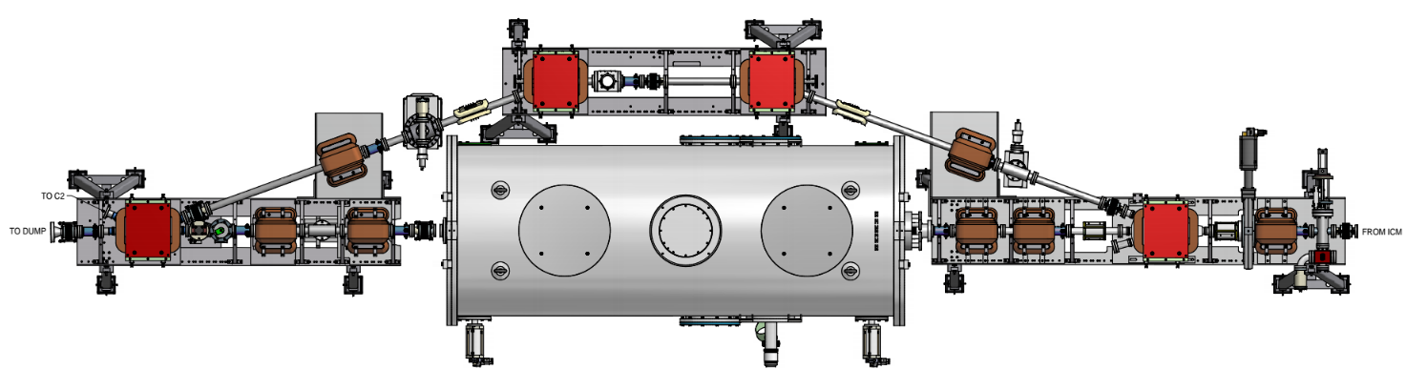
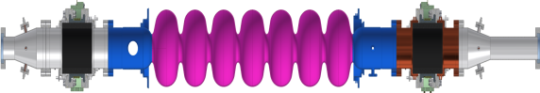
WG2. HOM-based diagnostics Based on the WG2 summary by N.B. and R.J.
Cavity characterization, presentation 6-7:
Daniel Hall (Cornell Uni.): Measuring HOM param. with beam for Cornell's ERL cavities
HTC with a 7-cell fully equipped cavity was installed in the ERL injector
Dump 1° dipole magnet
Beam direction
BPM2
BPM1
BPM used to look for kicks
With charge-modulated 5MeV beam up to 40 mA and unpowered cavity, following was measured:
Heat produced by monopole modes. Result scaled to 100 mA is 90W, expected 200W. Difference due to high frequency content for shorter bunches.
Mainly high Q quadrupoles were found in the range 2.2-2.5GHz. For proper interpretation of the test result more 3D modeling is needed.

Slide 22
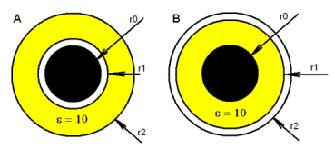
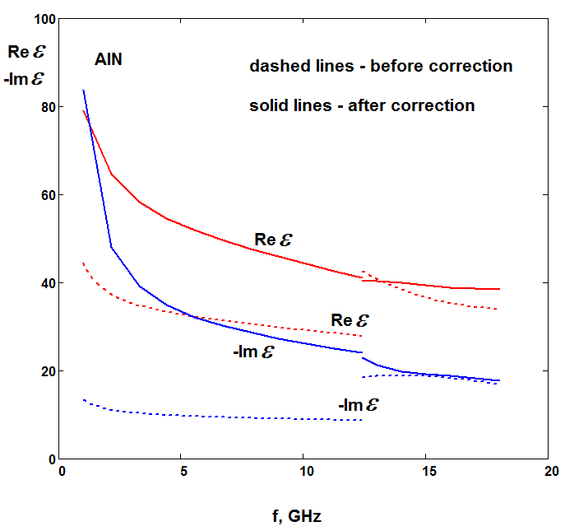
WG3. RF simulation and beam dynamics Based on the WG3 summary by M.L. and O.N.
RF-simulations Valery Shemelin (Cornell University): RF simulation for accurate measurements of HOM-material properties Christopher Hopper (ODU): HOMs in velocity-of-light spoke cavities Subashini De Silva (JLab): HOMs and HOM damping in RF-dipole cavities Beam dynamics Aaron Farricker (University of Manchester): Beam dynamics in the ESS linac under the influence of monopole and dipole modes
RF-simulations, presentations 1-3
Valery Shemelin: Significant errors in ε and µ measurement result from gaps between inner and/or outer conductor of the transmission line and tested sample. This can be corrected:

Slide 23
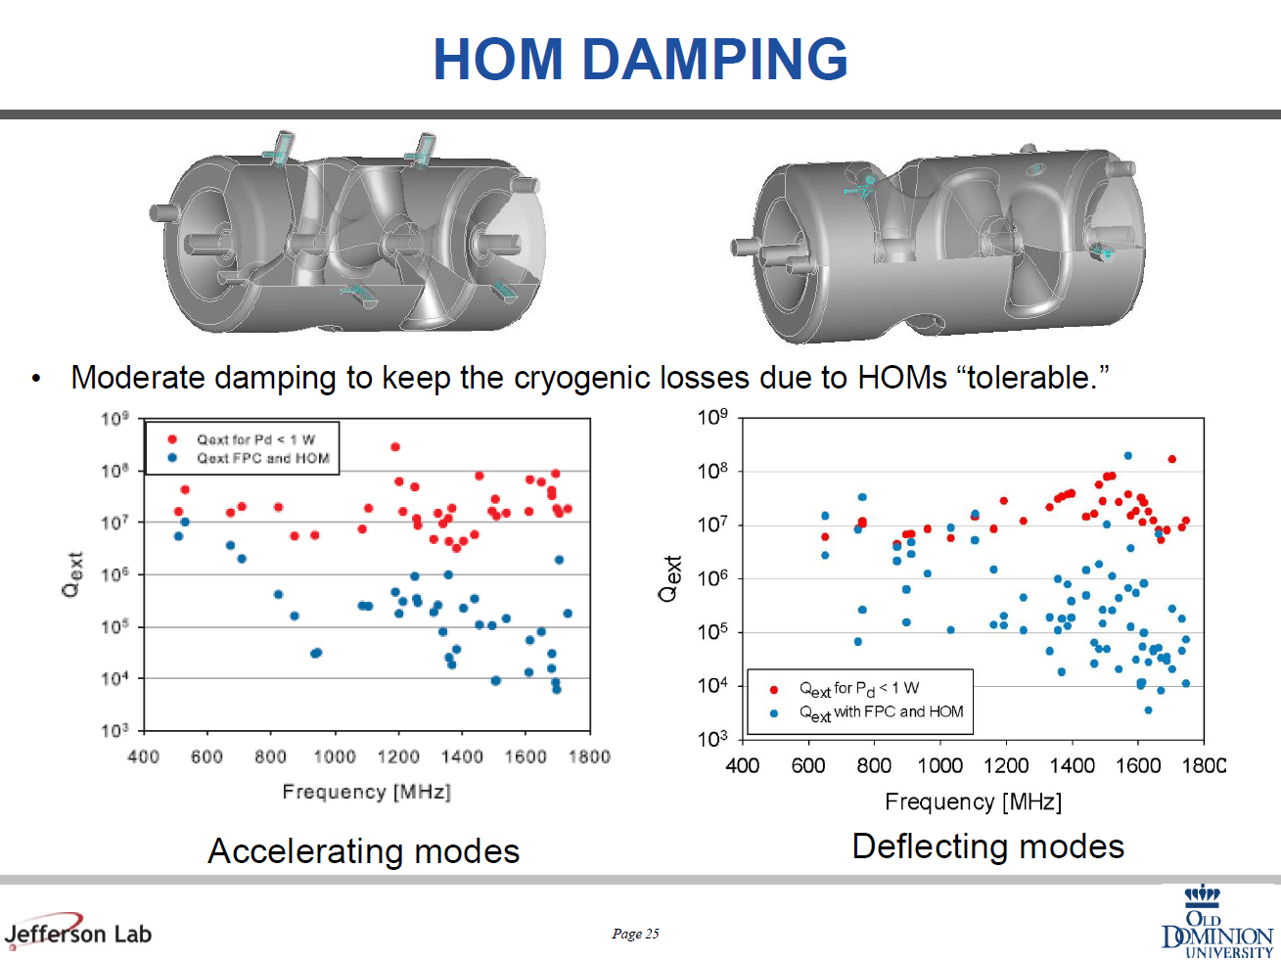
WG3. RF simulation and beam dynamics Based on the WG3 summary by M.L. and O.N.
RF-simulations, cont. Christopher Hopper: HOMs in velocity-of-light spoke cavities Two spokes were discussed 352MHz (ß=0.92) and 500MHz (ß=1). Moderate damping is required Q_{ext}<10⁷, which can be achieved with FPC and additional coaxial-technique HOM couplers.
500 MHz

Slide 24
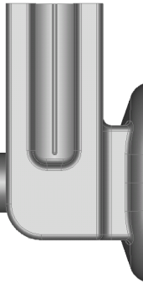
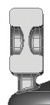
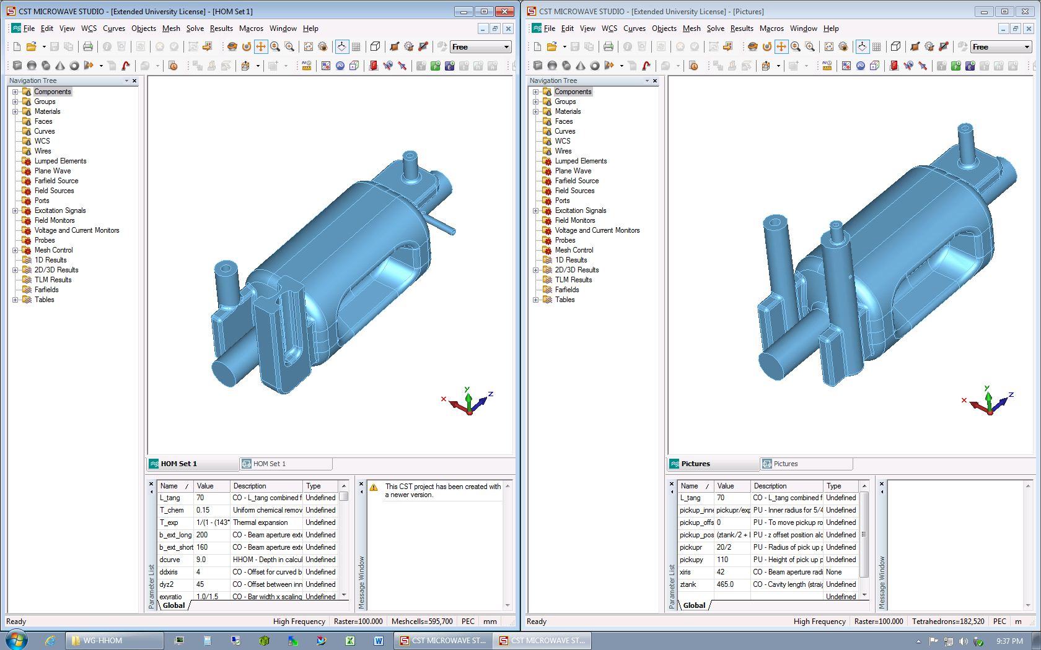
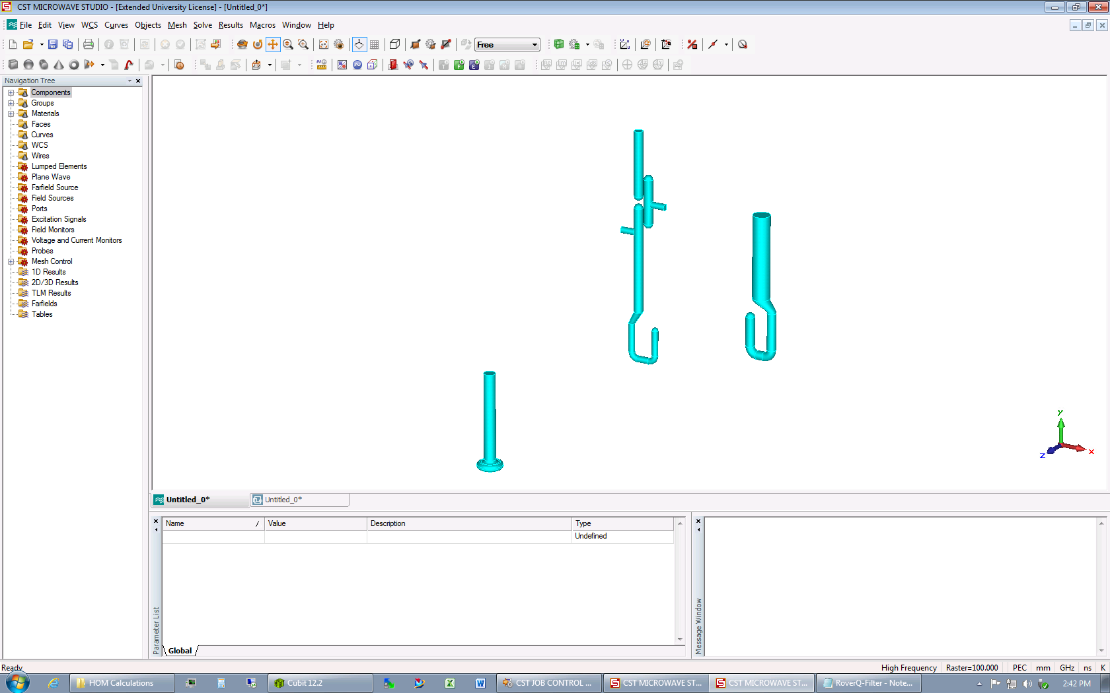
WG3. RF simulation and beam dynamics Based on the WG3 summary by M.L. and O.N.
RF-simulations, cont. Subashini De Silva (JLab): HOMs and HOM damping in RF-dipole cavities
High pass filter
Ridged waveguide
Frequency | 499 | 400 | 750 | MHz
LOM | None |  |  | MHz
Nearest HOM | 777.0 | 589.5 | 1062.5 | MHz
  HOM Damping
Two HOM (vertical and horizontal) couplers in each option
Both options damp adequately and meet impedance requirements
Horizontal HOM possible two options: Waveguide or high pass filter
Vertical HOM doesn’t couple to fundamental mode: No filter needed
HOM ports are in low-field locations
Multipacting free

Slide 25
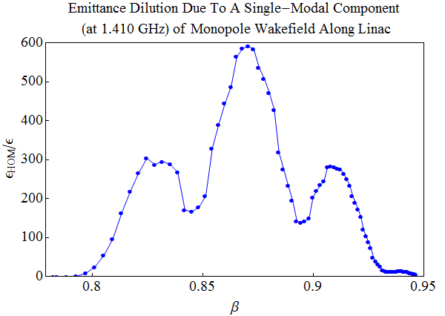
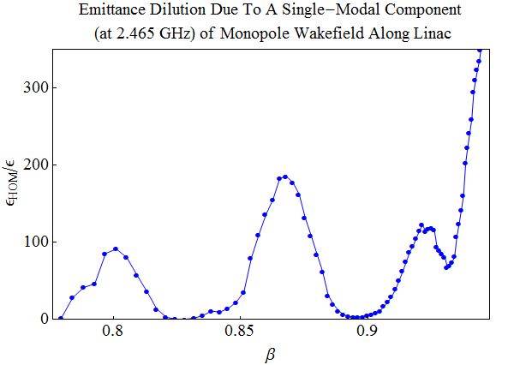
WG3. RF simulation and beam dynamics Based on the WG3 summary by M.L. and O.N.
Beam dynamics
Aaron Farricker: Beam dynamics in the ESS linac under the influence of monopole and dipole modes
High beta elliptic cavity has two modes with frequency close to the machine lines (Δf~2MHz). When frequencies of these modes of one cavity in the linac are on machine lines (Nx352.2MHz), emittance dilution can grow to 600%, for Q= 10⁸ (marginal damping by FPC).
Q=10⁸
Q=10⁸
The elliptic cavities in ESS will not have HOM couplers, but with tighter tolerances on shape
HOMs are of little concern, both monopoles and dipoles.

Slide 26
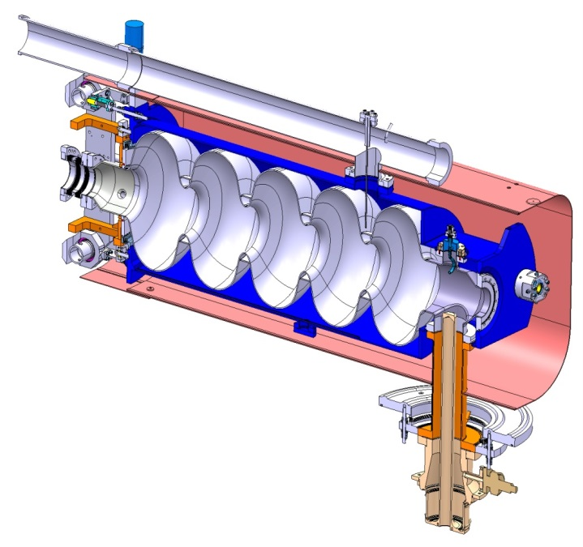
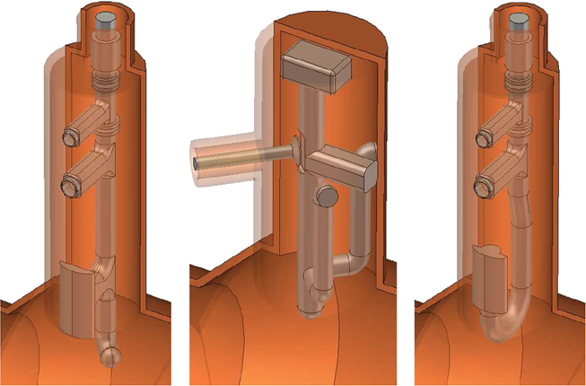
WG4. HOM damping couplers and loads Based on the WG4 summary by J. D and T. K.
Kai Papke (CERN): HOM coupler for SPL project Wencan Xu (BNL): HOM measurements at R&D ERL and developing new HOM couplers for eRHIC Jiquan Guo (JLab): HOM survey results from JLab upgrade cryomodule production run Sergey Belomestnykh (BNL): First experience with an HOM coupler for the 56 MHz quarter wave SRF cavity Nikolay Solyak (FNAL): HOM coupler heating in CW operation
Kai Papke (CERN): HOM coupler for SPL project
Three types of HOM coupler are under investigation:
Hook TESLA Probe
As a first for the Cu cavity model the probe coupler was chosen. R&D in progress

Slide 27
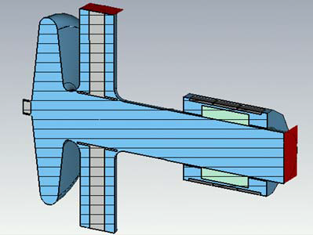
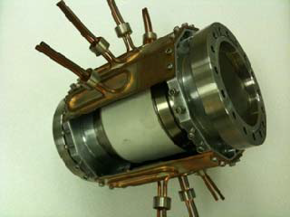
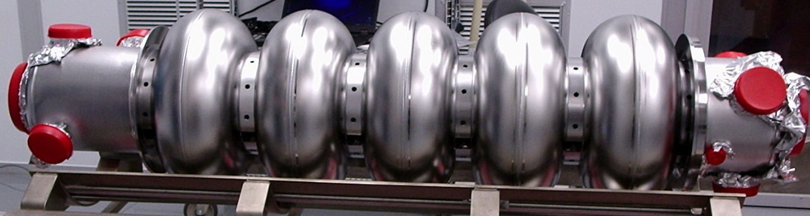
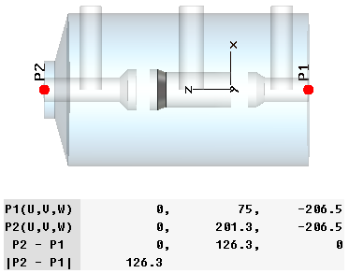
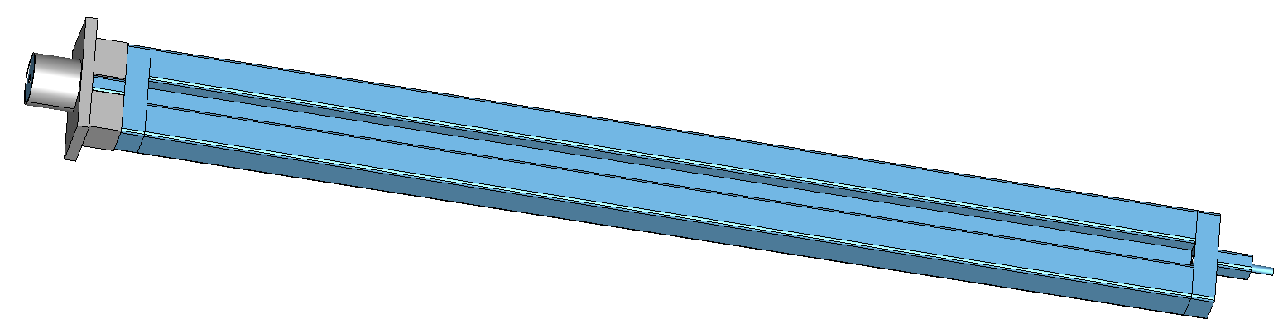
WG4. HOM damping couplers and loads Based on the WG4 summary by J. D and T. K.
Wencan Xu: HOM measurements at R&D ERL and developing new HOM coup. for eRHIC
Valve
# | F (GHz) | Q _{load} | Mode
1 | 1.00827 | 47600 | Dipol.
2 | 1.47795 | 800000 | Mon.
3 | 2.1459 | 76000 | Dipol.
HOM damping scheme for 704 MHz SRF gun
Sufficient suppression (W.X)
HOMs are damped by FPCs and Ferrite
HOM damping of BNL3 cavity for eRHIC
2-stage HOM coupler
Transfer curves were measured for each option
Next step: measurements on Cu-model
Dual-Ridge Waveguide HOM coupler

Slide 28
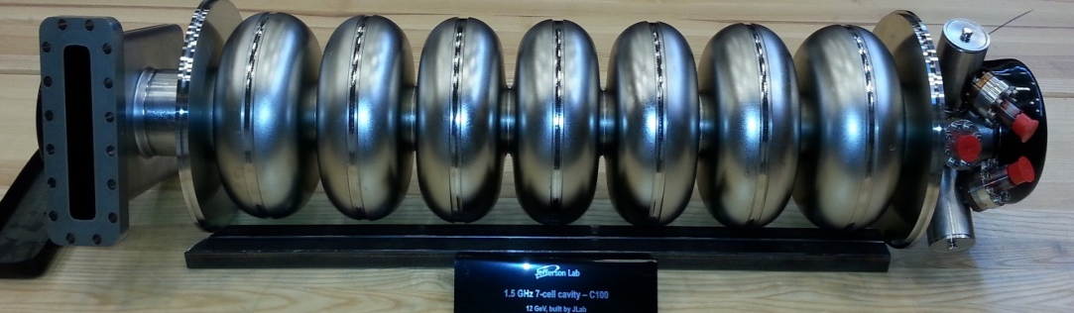
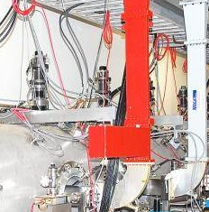
WG4. HOM damping couplers and loads Based on the WG4 summary by J. D and T. K.
Jiquan Guo (JLab): HOM survey results from JLab upgrade cryomodule production run
HOM-B
80 new LL cavities are installed in CEBAF for 12 GeV-upgrade and 8 in injector..
2 coaxial HOM couplers/cavity.
Input coupler
HOM-A
7 out of spec modes were found in 5 cavities during CMTF survey, all are TM111 π/7 modes
  5 can be brought back to spec with additional filter attached to the FPC waveguide.
Red one in the table has Q and impedance above the baseline spec , Z_{max} = 2.4·10¹⁰
Blue one is below baseline but above stretched goal Z_{max} = 2.4·10¹⁰
Cavity ID | Mode | f (MHz) | Q CEBAF | Z (Ω/m)
C100-4-3 | TM111 π/7 V | 2887.5 | 9.21×10⁵ | 5.95×10⁹
C100-4-3 | TM111 π/7 H | 2887.8 | 1.62×10⁶ | 1.06×10¹⁰
C100-6-2 | TM111 π/7 V | 2890.8 | 1.15×10⁶ | 7.49 ×10⁹
C100-9-3 | TM111 π/7 H | 2881.9 | 7.03×10⁵ | 4.58×10⁹
C100-9-6 | TM111 π/7 V | 2884.0 | 5.83×10⁶ | 3.76×10¹⁰
C100-9-6 | TM111 π/7 H | 2884.2 | 2.05×10⁶ | 1.34×10¹⁰
C100-10-2 | TM111 π/7 V | 2881.4 | 9.08×10⁵ | 5.86×10⁹

Slide 29
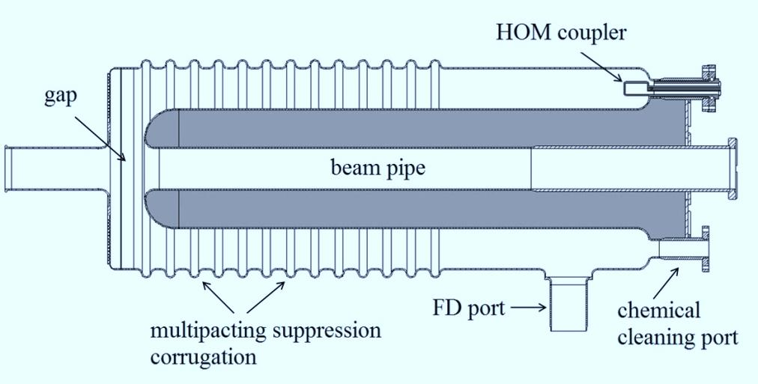
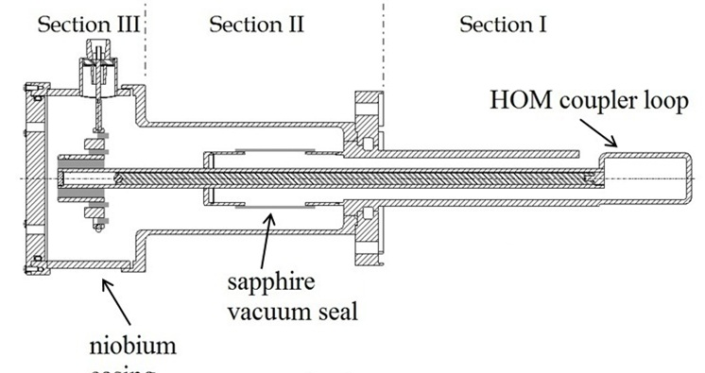
WG4. HOM damping couplers and loads Based on the WG4 summary by J. D and T. K.
Sergey Belomestnykh (BNL): First experience with an HOM coupler for the 56MHz quarter wave SRF cavity
Cavity for making ion RIHC bunches short
4 HOM couplers use to suppress HOMs up to 900 MHz
The high-pass filter has a coaxial layout with niobium and sapphire rings.
Very low loss dielectric, sapphire was chosen to minimize the size of the filter
A cylindrical sapphire window separates the cavity vacuum from the insulation vacuum
Extremely uniform transfer function up to ~1GHz with very good filtering of the fundamental mode.
Power dissipation | 42 | W
Q_{0 /} Q_{L} | 1.4E9 /4E7
R/Q | 80.5 | Ohm
Max. surf .E / B | 42 / 112 | MV/m / mT
Coarse tuner reso. | 17 | kHz/mm
Fine tuner reso. | 0.06 | Hz/Volt

Slide 30
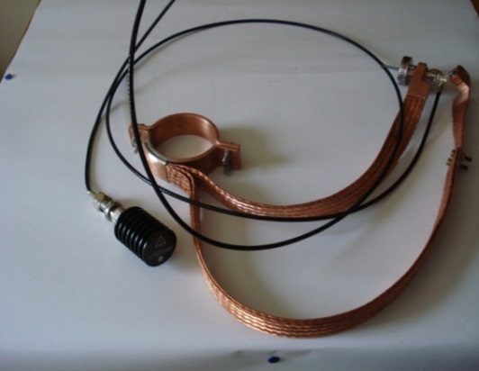
WG4. HOM damping couplers and loads Based on the WG4 summary by J. D and T. K.
Nikolay Solyak (FNAL): HOM coupler heating in CW operation R&D program towards cw/lp operation of the TESLA/XFEL technology. Results have direct impact on the LCLS II project and the XFEL DF-upgrade. First stage of the R&D is to find out what is the gradient limit for the XFEL-like HOM-couplers output lines.
+
High thermal conduction HOM
feedthroughs with sapphire windows
HOM feedthrough with cable,
thermal connection and load
Two XFEL feedthroughs were assembled on ILC cavity and tested in HTS in CW mode.
Temperature rise ~0.5K was measured at E_{acc}=22.6MV/m in end-cells.
RF power from HOM-couplers ~0.5W was measured outside the cryostat.
Further test are coming.

Slide 31
WG5. LLRF, controls and system integration Based on the WG5 summary by B. Ch. and L. D.
Brian Chase (FNAL): LLRF theory and vector control interaction with HOM signals Larry Doolittle (LBNL): HOM transfer function measurements and other topics
Topics discussed
Active control of Pass-band Modes
LLRF systems today have the bandwidth to measure and control many if not all pass‐band modes
  125MHz ADC sample rate is common and 250MHz or higher is available
  Current FPGAs have the gate density available to put control loops around each mode.
HOM Transfer Function Measurements
With modulated time between bunches having constant charge
  Photo-injectors don't have to be operated only at their nominal repet. rate
  Pulse-on-demand feature can be used as a programmable frequency.
  It seems to be a good way to excite (or avoid) HOMs at any frequency.
Thank you for your attention

