Slide 1

New data on pressure tested Nb cavities
G. Ciovati, P. Dhakal, J. Matalevich, G. Myneni
Jefferson Lab
TTC Meeting, Tsukuba, Dec. 2-5, 2014

Slide 2
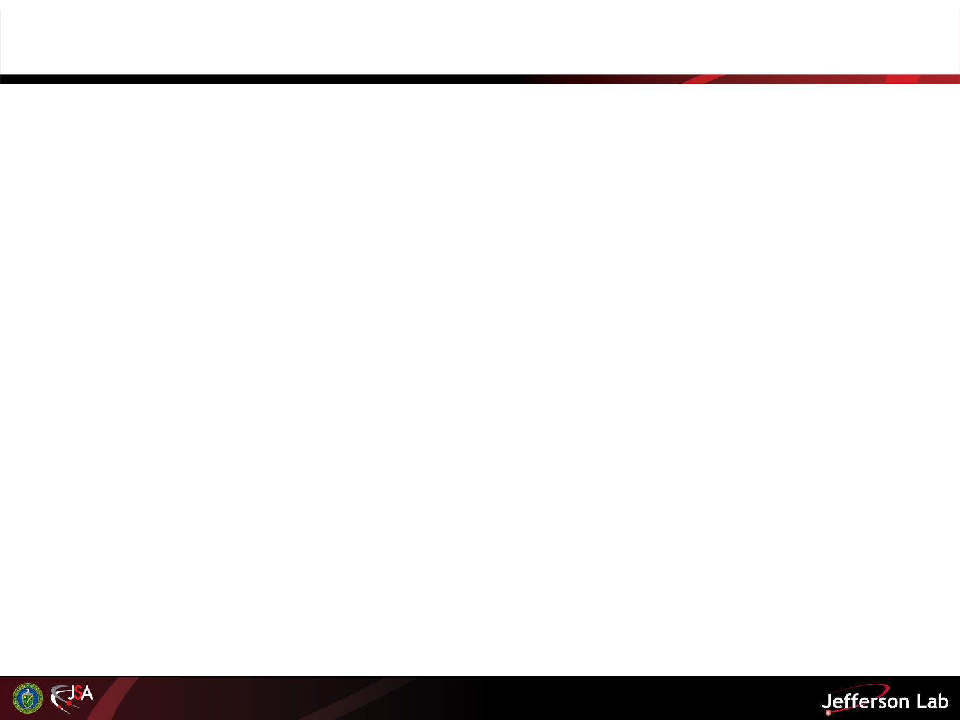
Motivation
Validate Nb material parameters (E, ν) used in FEA of cavities after different treatments
Are ingot Nb cavities “softer” than fine-grain ones?

Slide 3
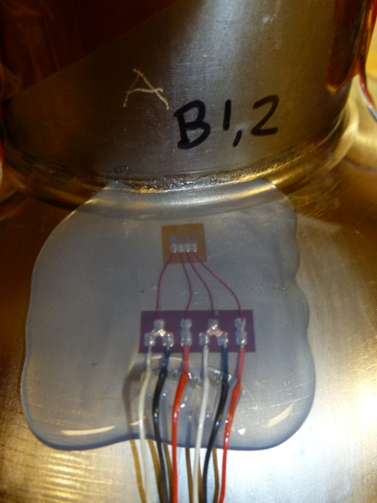
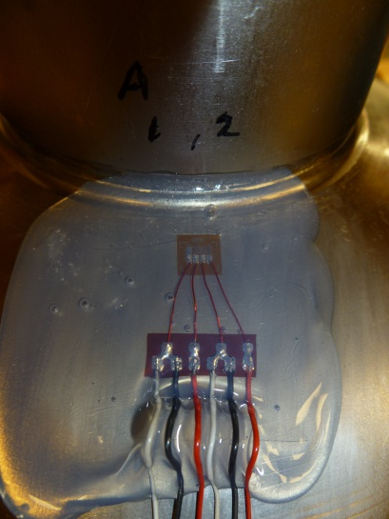
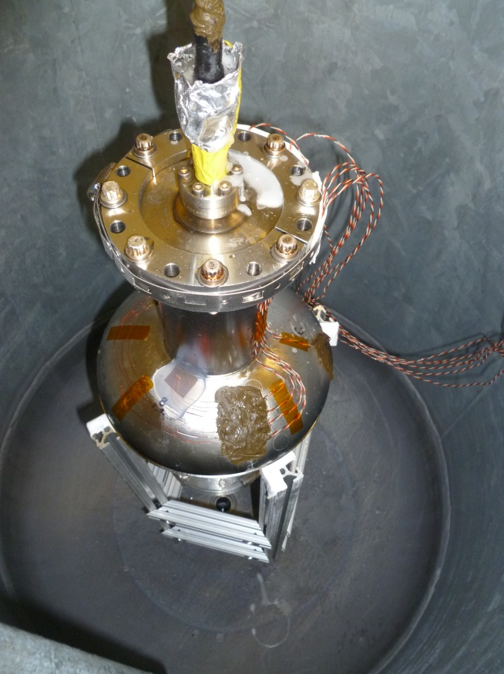
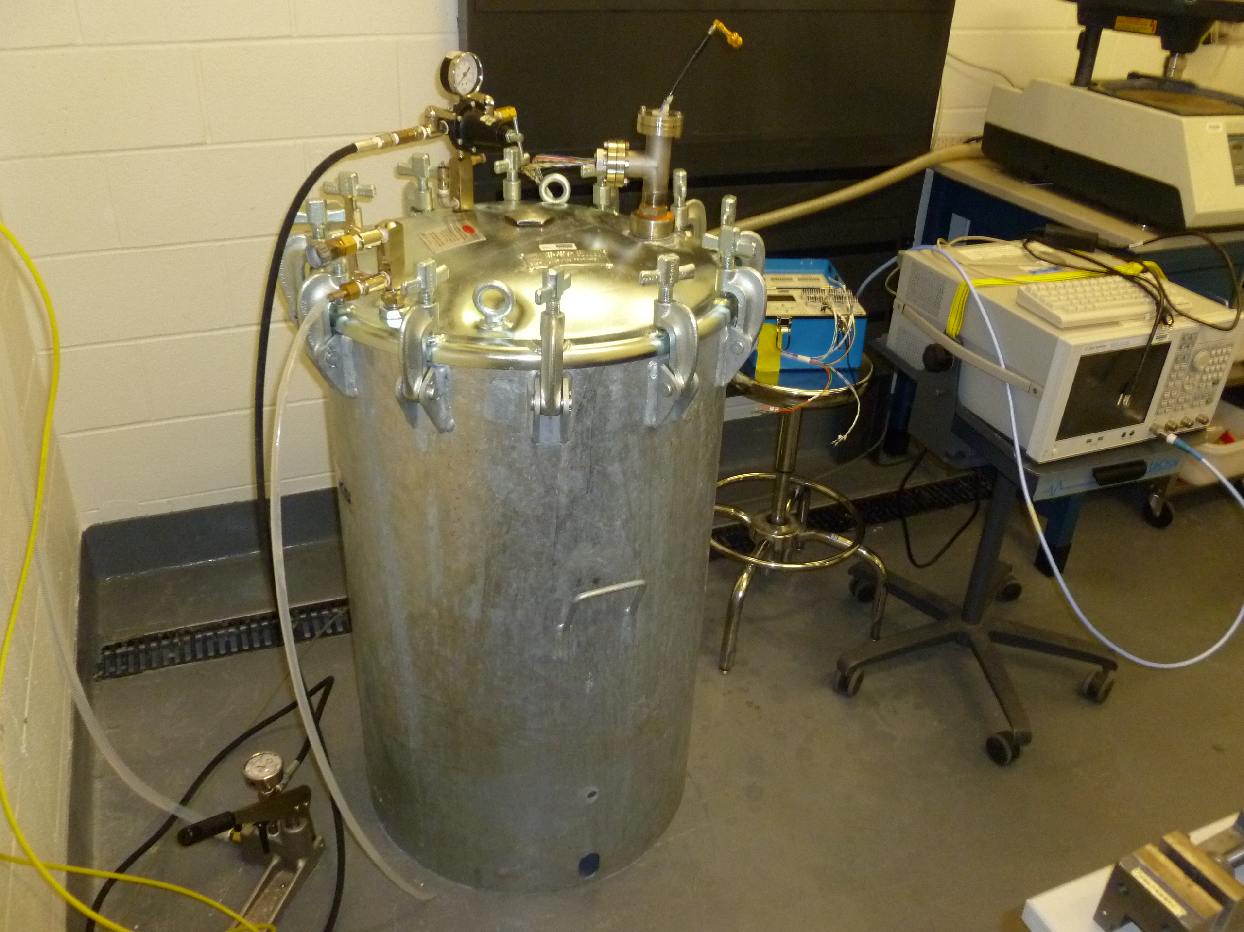
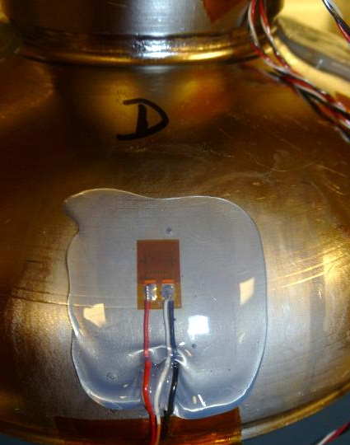
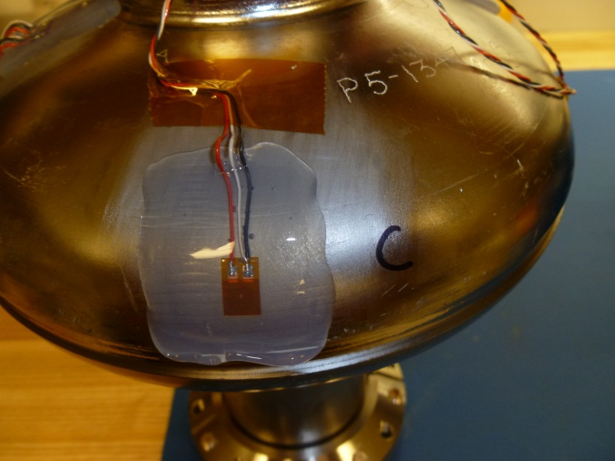
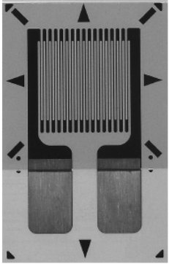
Experimental
Gages 1, 2
Gages 3, 4
1.5 GHz cavity inside pressure tank
Gage 6
Gage 5

Slide 4
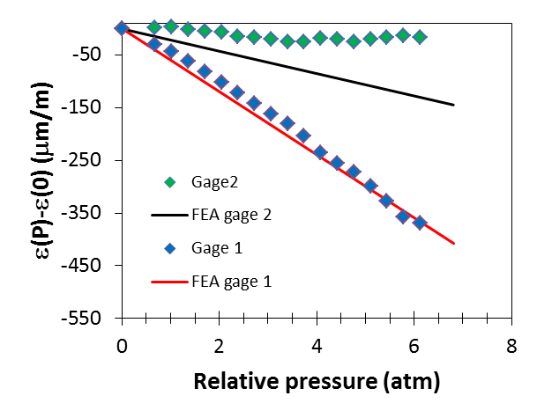
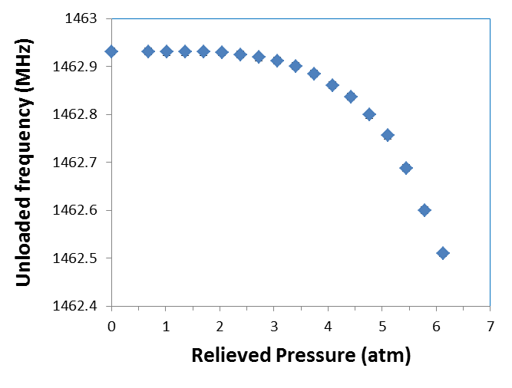
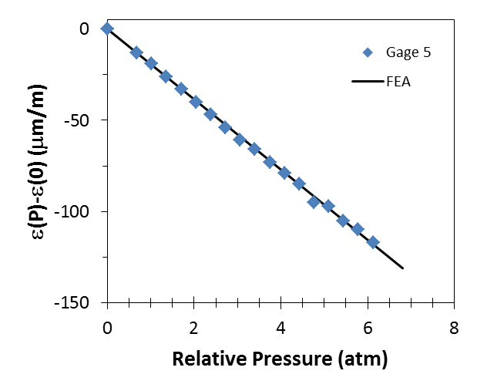
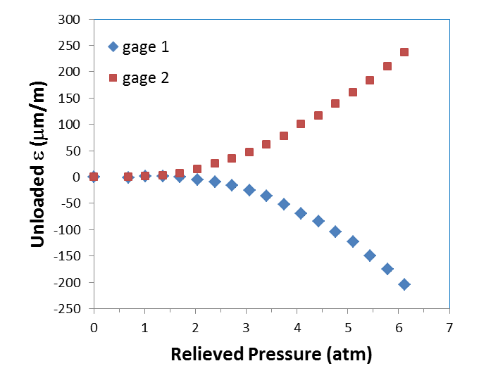
FG cavity HT up to 800 °C/2 h
Strain at iris
Evidence of yielding
Strain at equator

Slide 5
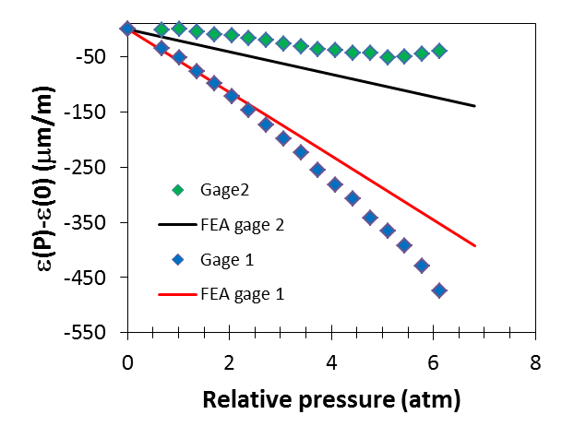
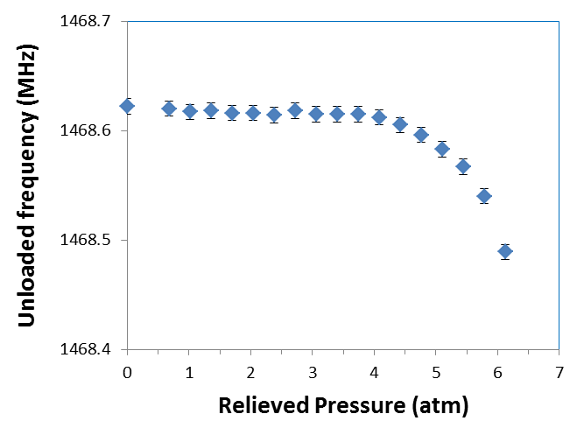
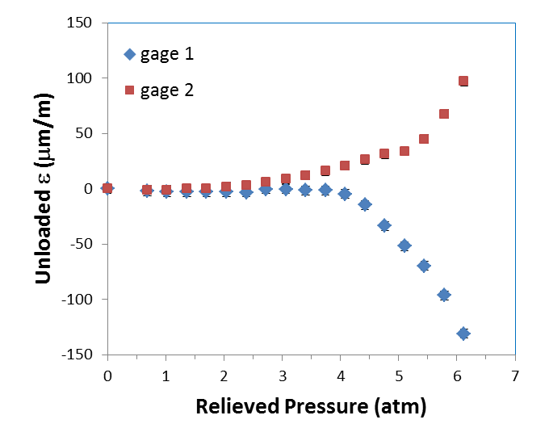
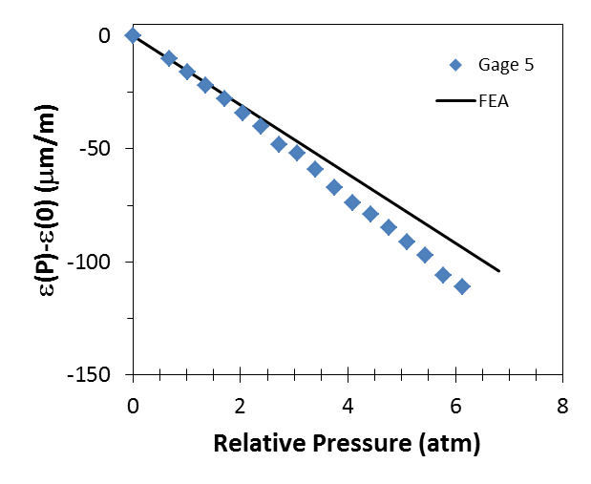
Ingot Nb HT up to 1400 °C/9 h
Strain at iris
Evidence of yielding
Strain at equator

Slide 6
Summary table
Cavity Material | Highest HT temperature/time | Yield Pressure (atm) | Δf/ΔP (kHz/atm) | Δf/ΔP from FEA (kHz/atm) E=88.5 GPa, ν=0.4
CBMM Ingot F, RRR~200 | None | - | -67 ± 2 | -68
CBMM Ingot F, RRR~200 | 800 °C/2 h | - | -73 ± 2 | -71
Fine-grain, RRR>250 | 600 °C/10 h | - | -71 ± 1 | -73
Fine-grain, RRR>250 | 800 °C/2 h | 3.4 | -76 ± 4 | -73
CBMM Ingot G, RRR~200 | 1400 °C/9 h | 4.4 | -73 ± 1 | -68
CBMM Ingot H, RRR~200 | 1400 °C/6 h | 4.4 | -69 ± 1 | -71
Tantalum content:
~1300 wt.ppm for ingot F and G
~700 wt.ppm for ingot H
<500 wt.ppm for fine-grain Nb

Slide 7
Conclusion
Good agreement between FEA analysis and strain vs. pressure data for E=88.5 GPa, ν=0.4.
Compared to high-purity fine-grain Nb, medium-purity ingot Nb cavities of showed:
  No significant difference in the elastic properties
  Higher yield strength

Slide 8
Acnowledgments
J. Mammosser and S. Yang for procuring the pressure tank
J. Henry and B. Carpenter for CMM and 3D model of cavity
S. Dutton for helping with wiring of strain-gages
G. Cheng for helping with FEA analysis

