Slide 1
SLAC Electron Beam Test Facilities
5 MeV to 20 GeV
FACET ● ESTB ● NLCTA ● ASTA
Focus on ESTB
Carsten Hast, SLAC
Telescope Workshop, DESY January 19, 2015

Slide 2
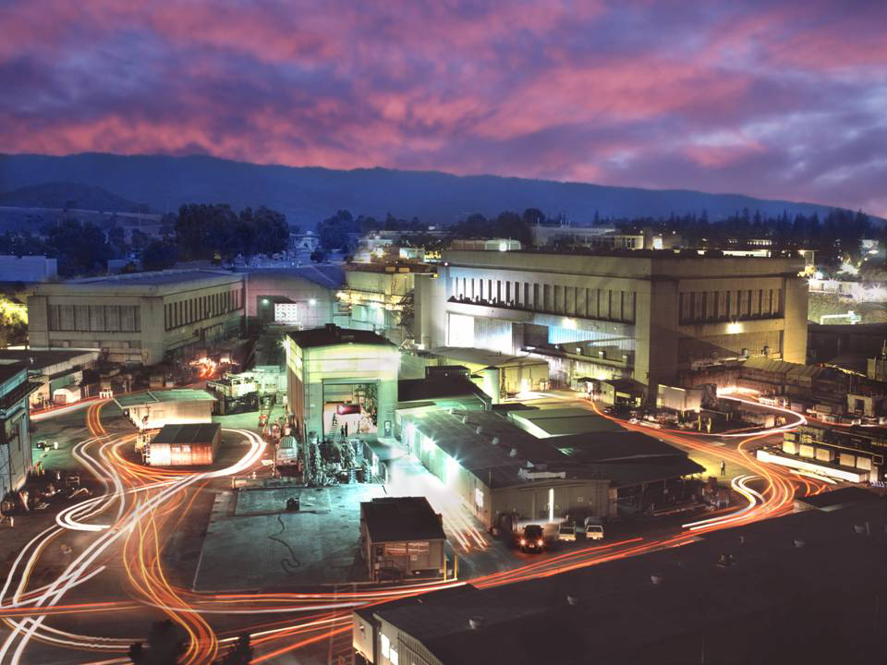
20 GeV
5 MeV
2-15 GeV
& single e⁻
FACET
ASTA
NLCTA
ESTB
60-160 MeV

Slide 3
SLAC Beam Test Facilities Overview
Facility | Purpose | Parameters
FACET | Accelerator R&D, Material Science, THz | Very focused and short bunches at 20GeV e+/-
ESTB | Detector R&D, LC MDI, Radiation Tests | 2-15GeV primary LCLS beam or single e-
NLCTA | Accelerator R&D, Medical, Radiation Tests | 60 to 160 MeV, small emittance, very versatile infrastructure
ASTA | Gun and RF Testing, RF processing, new Ultrafast Electron Diffraction Beam Line | <50MeV, X- and S-Band RF power
All supported by SLAC’s Test Facilities Department
http://facet.slac.stanford.edu and http://estb.slac.stanford.edu
e-mail: hast@slac.stanford.edu
Google: SLAC FACET or SLAC ESTB
Carsten Hast, SLAC, SLAC Electron Beam Test Facilities

Slide 4
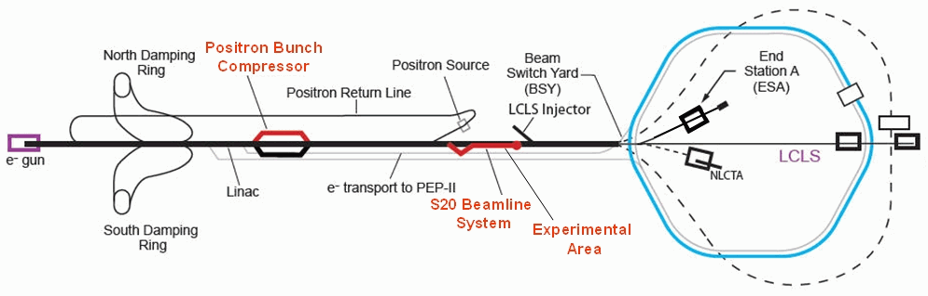
SLAC Accelerator Layout
ASTA
Carsten Hast, SLAC, SLAC Electron Beam Test Facilities

Slide 5
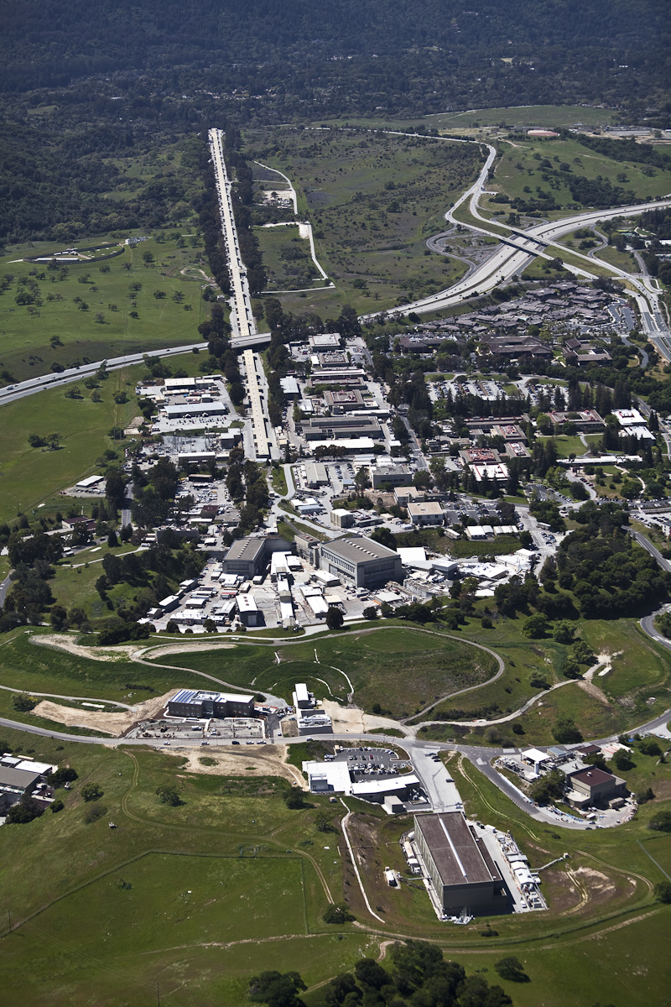
FACET uses 2/3 of SLAC LINAC
LCLS uses 1/3 of SLAC LINAC
ASTA
SSRL
NLCTA
ESTB at
End Station A
LCLS
Carsten Hast, SLAC, SLAC Electron Beam Test Facilities
5

Slide 6
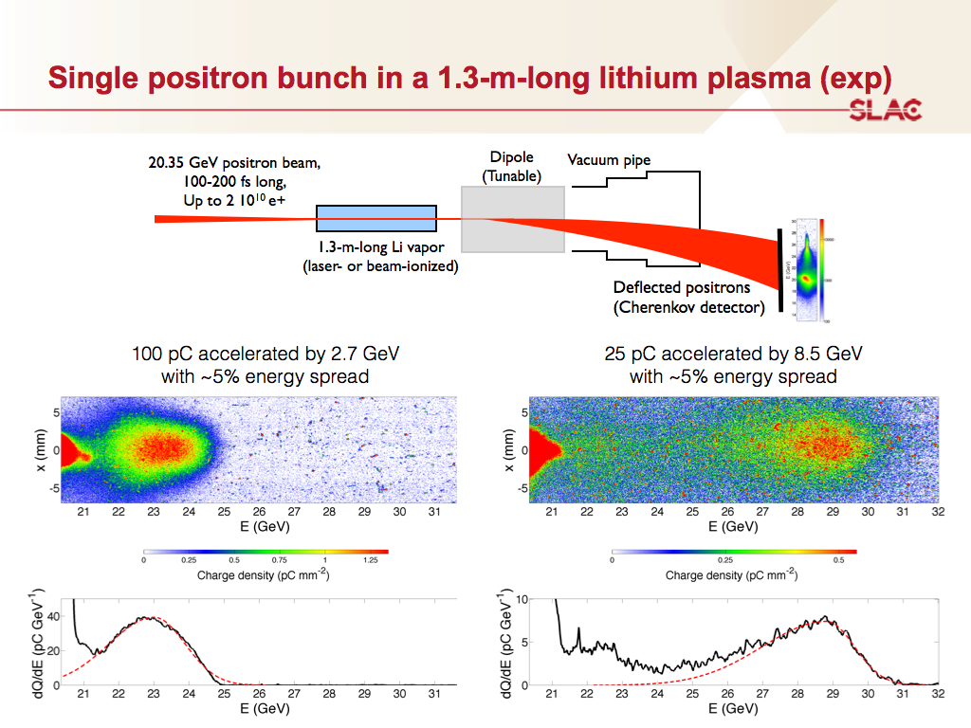
FACET
Carsten Hast, SLAC, SLAC Electron Beam Test Facilities

Slide 7
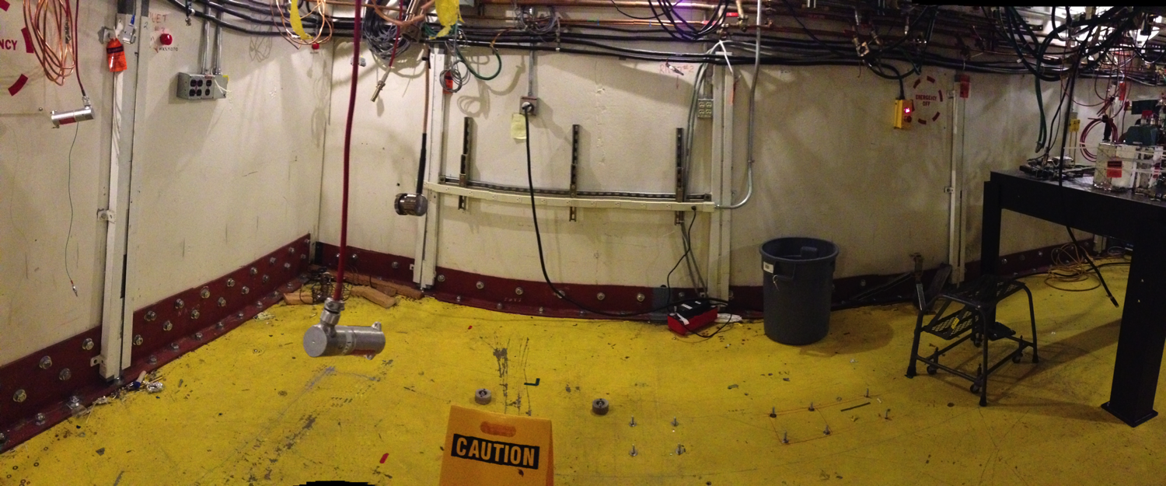
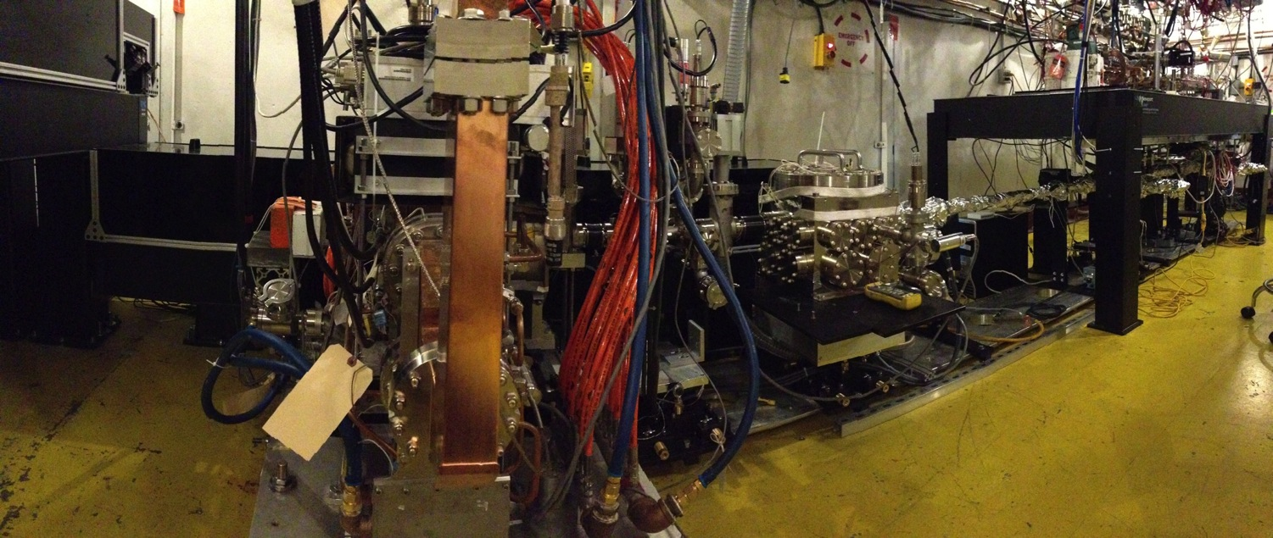
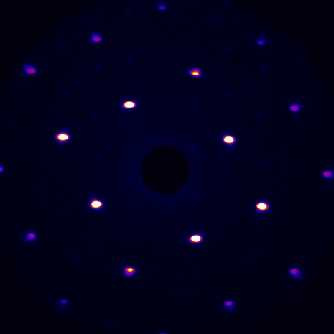
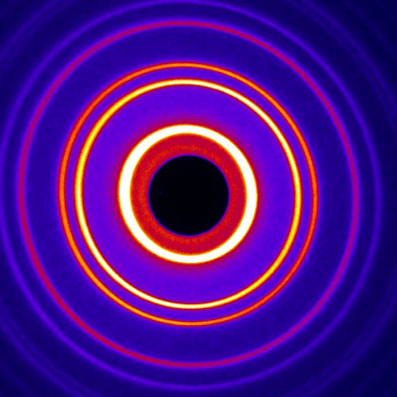
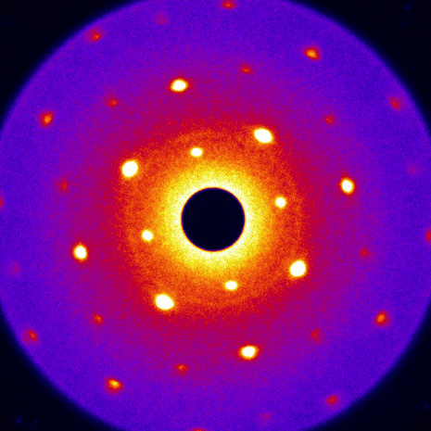
Ultrafast Electron Diffraction (UED at ASTA)
  June 2014 August 2014
Samples tested: Au, Bismuth, FePt, MoS₂, Zr-Cu-Al Metal Glass
Au
Bi
FePt
  Just a fantastic machine, with an incredible stability, plenty to come
Carsten Hast, SLAC, SLAC Electron Beam Test Facilities

Slide 8
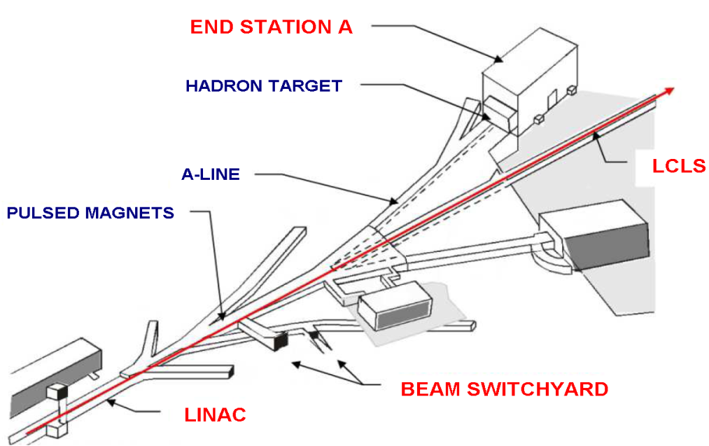
End Station Test Beam (ESTB)
  LCLS beam is deflected to ESTB at 5Hz
  2 kicker magnets in Beam Switch Yard
    Primary beam up to 10GeV
    Need 2 additional kickers for 16GeV (funding)
  Secondary particle production target in BSY
    Just kick beam onto 5mm of Cu
    Secondary electrons up to 15GeV
  Beam is bend by 24.5^{O} into ESA
  Multi stage collimation system for energy selection and rate adjustment
  Wide user acceptance of ESTB
  within a short time
Carsten Hast, SLAC, SLAC Electron Beam Test Facilities

Slide 9
LCLS and ESTB Electron Beams
LCLS beam
  Energy: 2.2 –16.6 GeV (typically 3-6GeV or 12-14GeV)
  Repetition rate: 120Hz
  Beam charge: 20 to 250 pC (typically 150pC ~ 10⁹ e⁻/pulse)
  Beam availability > 95%
  User are scheduled in 2 shifts 9am to 9pm and 9pm to 9am
    User beam is typically Thursday 9am to Tuesday 9am following week
    Machine development and maintenance Tuesday and Wednesday
    Typically beam energy changes at shift change (~1h)
ESTB beam
  Kick the LCLS beam towards ESA @ 5Hz
    Potential for higher rates when LCLS doesn’t need full rate
  Primary beam 2.2 -10.0 GeV (need more kickers for 16.6GeV)
    Beam energy determined by LCLS
    Typically 150pC ~ 10⁹ e⁻/pulse
  Clean secondary electrons
    2 GeV to 15 GeV (always lower than primary beam)
    1, or a few, up to 100 e⁻/pulse (Poisson distributed)
Carsten Hast, SLAC, SLAC Electron Beam Test Facilities

Slide 10
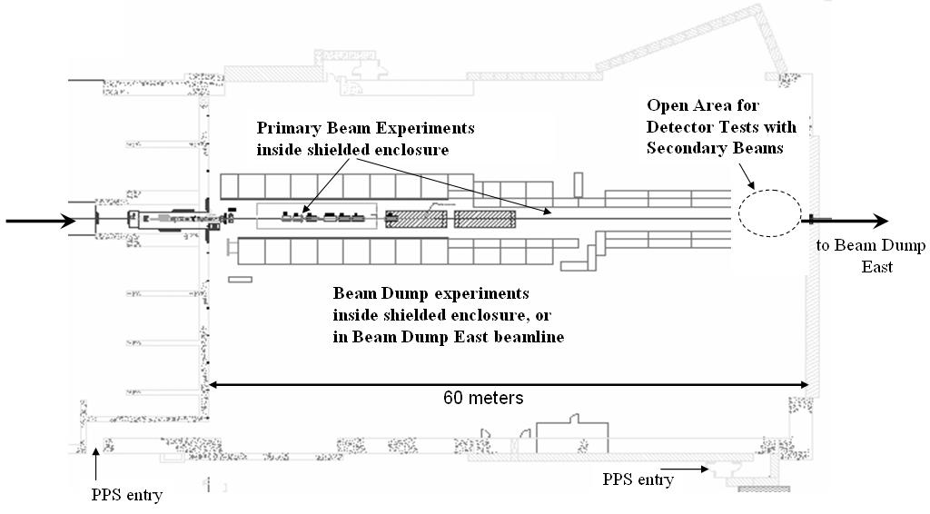
Building 61: ESA
Beam
Carsten Hast, SLAC, SLAC Electron Beam Test Facilities

Slide 11
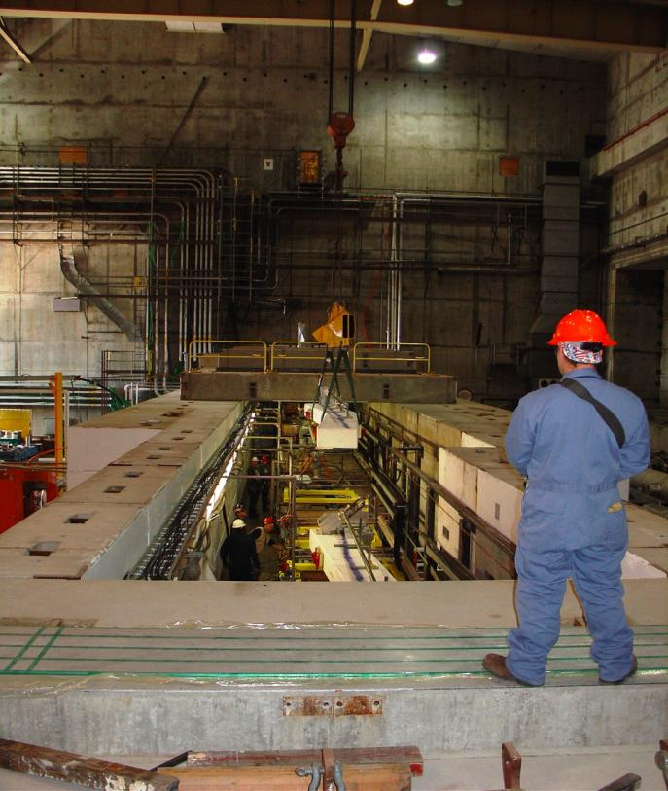
ESA
ESA has massive shielding
  Pretty good temperature stability
Beam line is at 6’10”=208cm height
Crane coverage
Vacuum up to your experiment
Beam path is straight for about 150m after the last bend magnet
Protection collimators limit spot size to about 20mm diameter max
Primary beam can be focused to 50-100 microns
Secondary beam can be focused to about 1mm
Energy resolution is in the per mill range
Divergence is < 0.1mrad
Carsten Hast, SLAC, SLAC Electron Beam Test Facilities

Slide 12
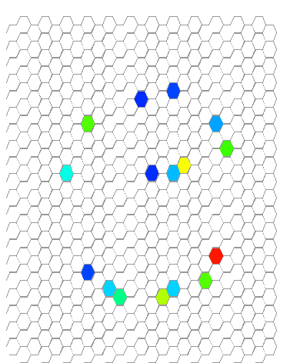
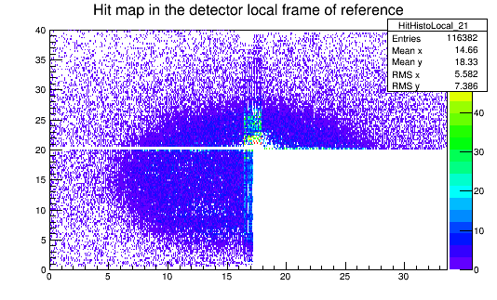
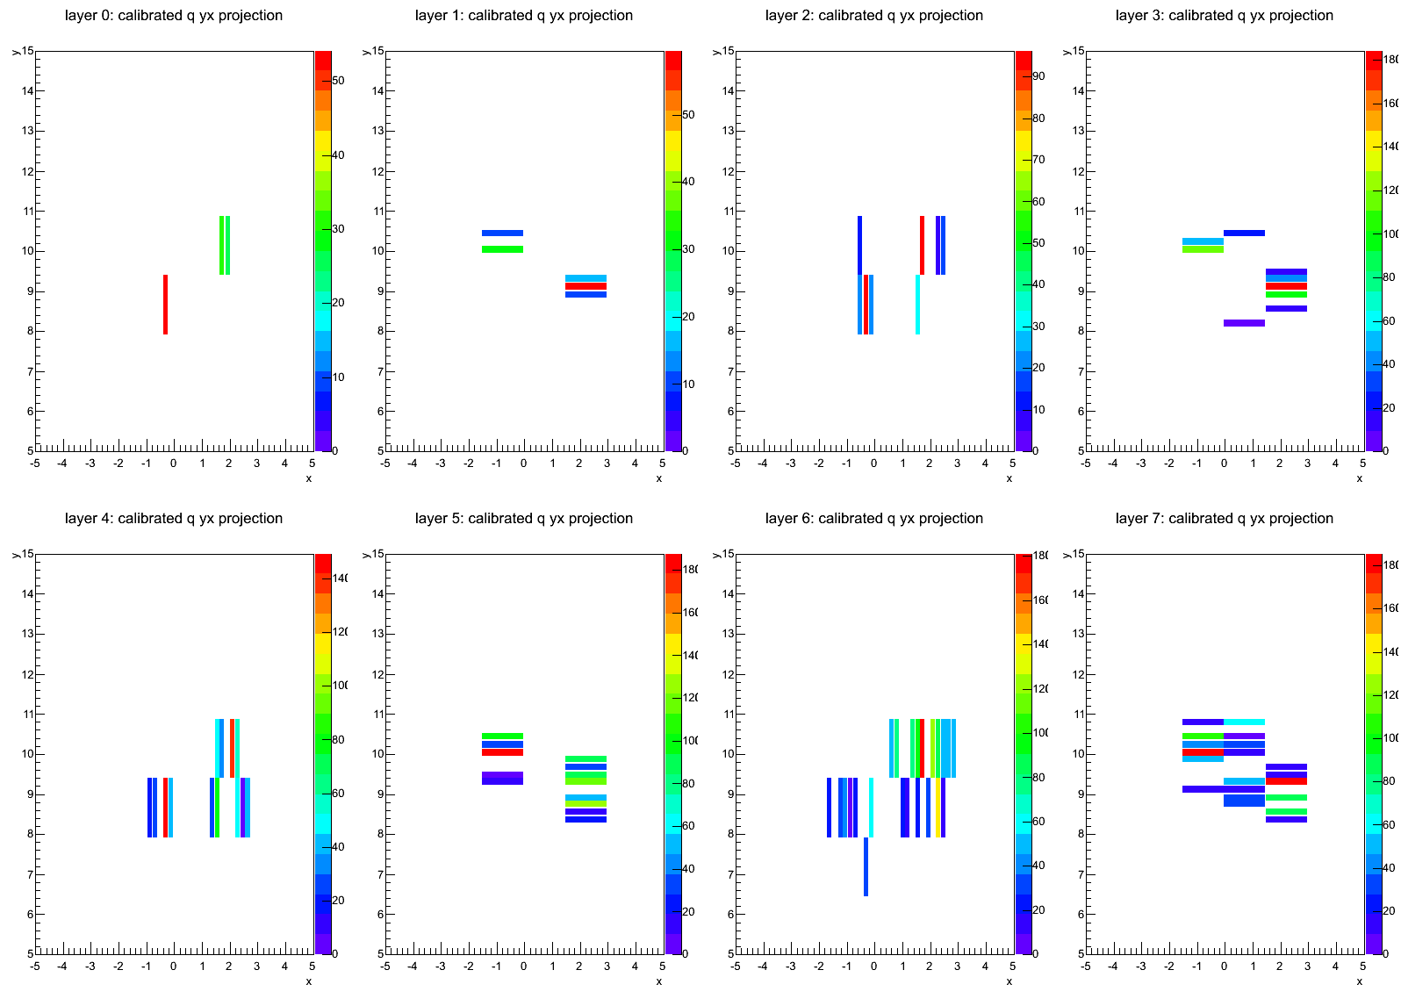
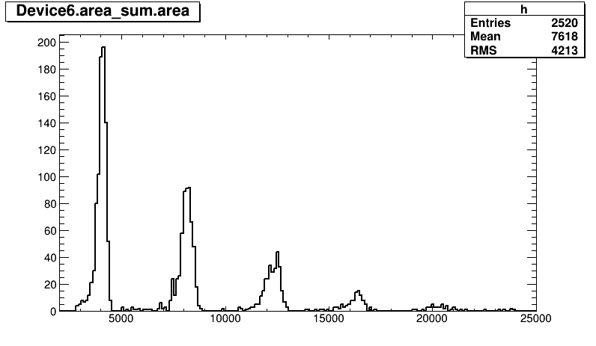
Different Beam Configurations for 1 to 100 Electrons
Single electron per event
Multiple, well separated
electrons per event
10th to hundreds
electrons per event
1 e⁻
2 e⁻
3 e⁻
4 e⁻
5 e⁻
6 e⁻
Carsten Hast, SLAC, SLAC Electron Beam Test Facilities

Slide 13
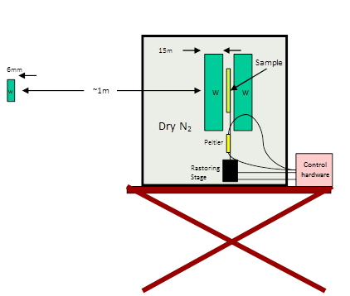
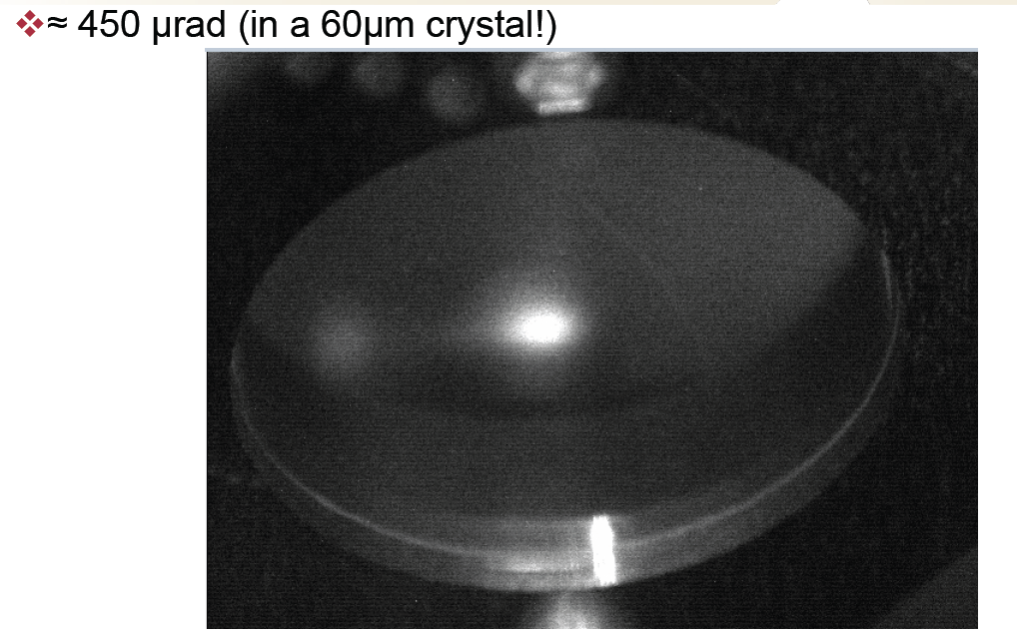
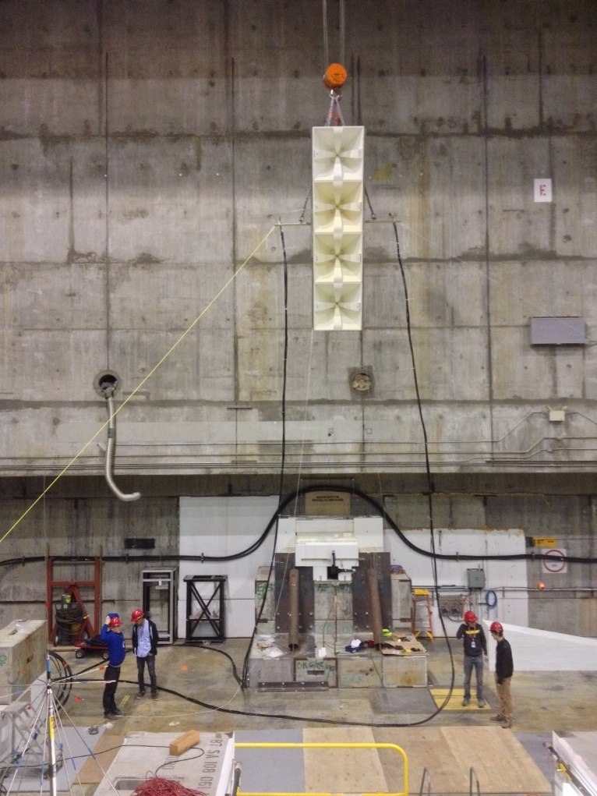
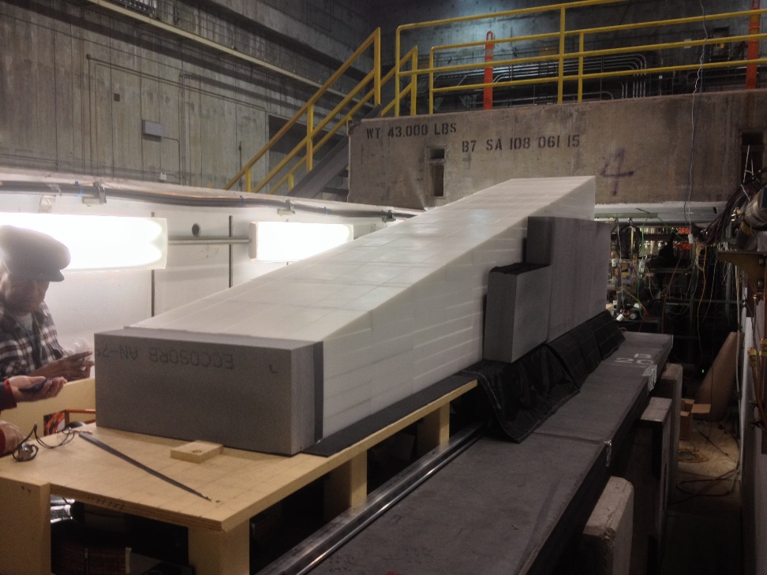
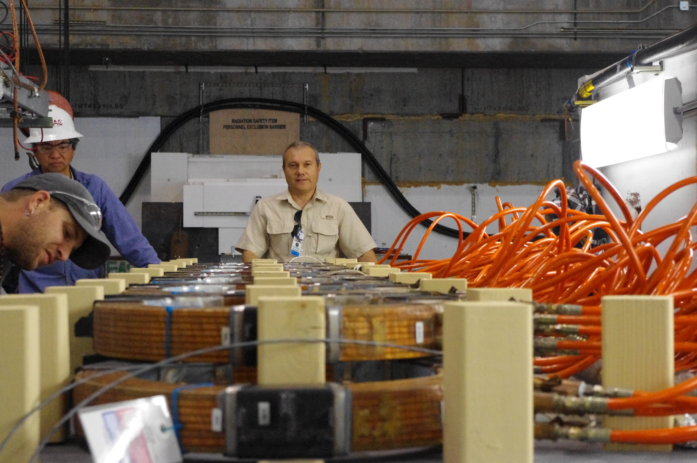
Primary Beam for Irradiation, Beam Physics and Fun
Carsten Hast, SLAC, SLAC Electron Beam Test Facilities

Slide 14
ESTB User Experiments FY2013 and FY2014
FY 2013
  T-505: Tests of 3D silicon pixel sensors for ATLAS, P. Grenier, SLAC
  T-506: EM Shower Damage to Si Diode Sensors, Bruce Schumm, UCSC
  T-507:Test of a RICH-Prototype Based on CsI-GEMs for an Electron-Ion Collider, T. Hemmick, Stony Brook University
  T-508: HERA-B ECal modules beam test for G_{Ep}(5) at Jefferson Lab, E. J. Brash, Christopher Newport University
  T-511: Test of a Silicon-Tungsten Electromagnetic Calorimeter for the ILC SiD, R. Fry, Univ. of Oregon
FY 2014
  T-505: Tests of 3D silicon pixel sensors for ATLAS, P. Grenier, SLAC
  T-512: Calibration of the g-2 calorimeter, D. Hertzog, Univ. of Washington
  T-513: Channeling and Volume-Reflection Studies of High-Energy Electrons in Crystals, U.Wienands, SLAC
  T-510: Geosynchrotron radio emission from extensive air showers to detect ultra-high energetic neutrinos at Antarctica, K. Belov, UCLA
  T-513: Channeling and Volume-Reflection Studies of High-Energy Electrons in Crystals, U.Wienands, SLAC
  T-509: Develop a Neutron Beam Line for Calibration of Dark Matter Detectors, J. Va’Vra, SLAC
  T-506: EM Shower Damage to Si Diode Sensors, Bruce Schumm, UCSC
  T-516: ATLAS Inner Tracker (ITK) Upgrade, Test of several pixel sensor technologies, M. Bomben (Paris), P. Grenier (SLAC), S. Grinstein (Barcelona), D. Muenstermann (Geneva) and J. Weingarten (Gottingen), on behalf of the ATLAS-ITK Pixel Group
  T-520: Radiation Test of Epoxy for LCLS Delta Magnet, C. Field, SLAC
  T-517: PHENIX MPX-EX Calorimeter, T. Hemmick, Stony Brook University
  T-516: ATLAS Inner Tracker (ITK) Upgrade, Test of several pixel sensor technologies, ATLAS-ITK Pixel Group
  T-519: Calibration of the g-2 calorimeter, D. Hertzog, Univ. of Washington
FY2015 approved
  T-518: Belle II Cherenkov: G.Varner Univ. of Hawaii
  T-523: Channeling of Electrons in Crystals, U. Wienand, SLAC
  T-524: STAR Forward Calorimeter: H. Crawford, UC Spaces Science Laboratory
  T-525: Atlas IBL Pixel, A. Pranko, LBNL
Carsten Hast, SLAC, SLAC Electron Beam Test Facilities

Slide 15
Problems: No Experiments since October 2014
LCLS demands to not be disturbed by ESTB
  Rebuild our kicker magnets from metal supports to G10
  Installed this fall, but still have a slight remnant kick
  1e-7 rad ~ 5 um at LCLS experiments
  5 x 10^-4 kG/m
  (hopefully) will install corrector next week
Carsten Hast, SLAC, SLAC Electron Beam Test Facilities

Slide 16
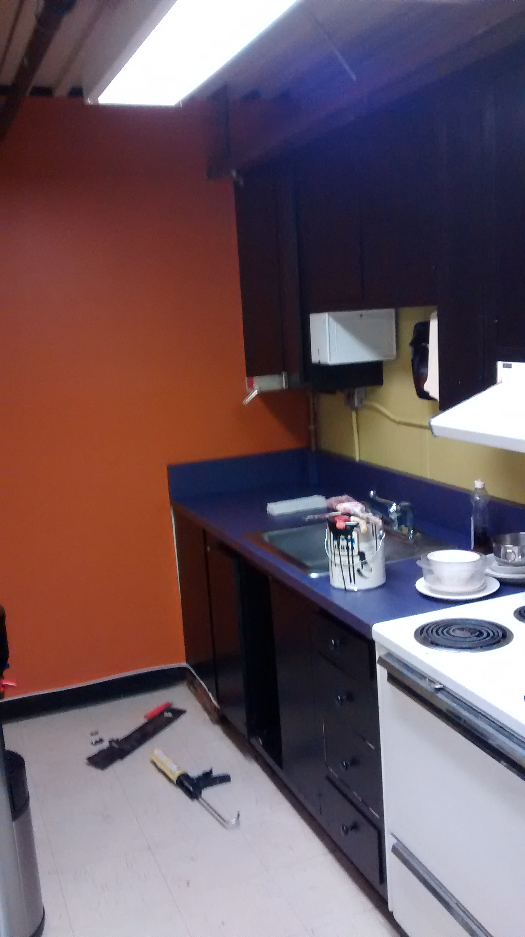
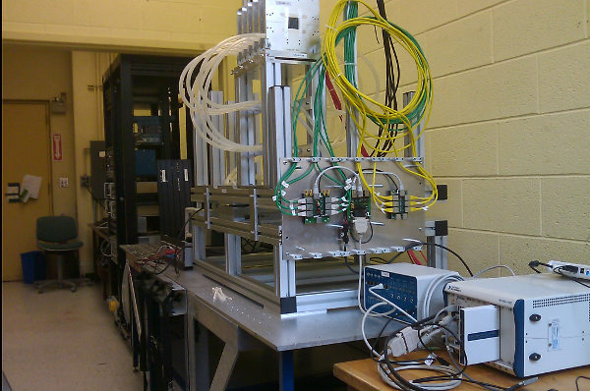
Good News
About to sign an agreement with Carleton University to loan their UDET Pixel Telescope to SLAC for 2 years
Functional in March (I hope)
We are remodeling the kitchen
So bring
you tracker
studies
to a more
reasonable
climate…
Carsten Hast, SLAC, SLAC Electron Beam Test Facilities

Slide 17
Summary
ASTA-NLCTA-ESTB-FACET span a broad spectrum
    e⁻ energy between a few MeV to 20 GeV
Together they cover broad research themes
    Novel and better acceleration techniques
      RF, X-Band, WFA, DLA, GTL, FEL Seeding
    BDL/MDI for Linear Colliders
    Detector R&D
    Ultrafast Electron Diffraction
User and technical support is via Test Facilities Department
Formal proposal review processes for FACET and ESTB
  Please submit your proposals
  http://facet.slac.stanford.edu and http://estb.slac.stanford.edu
Need Electrons? Come to SLAC !
Carsten Hast, SLAC, SLAC Electron Beam Test Facilities

Slide 18
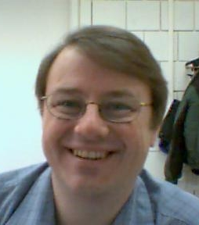

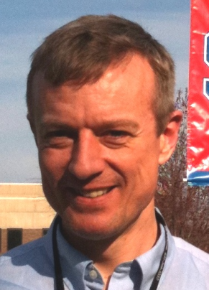
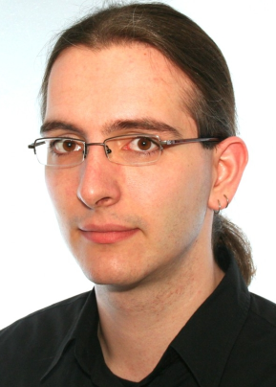
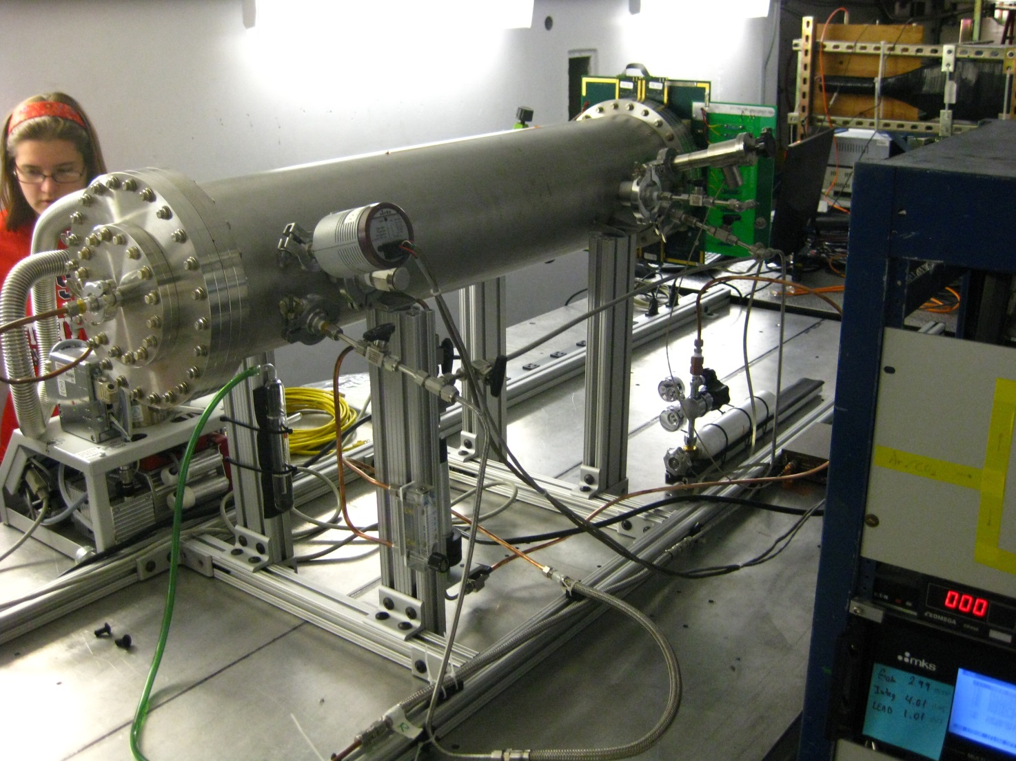
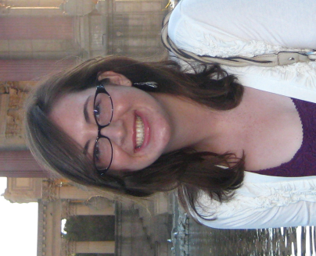
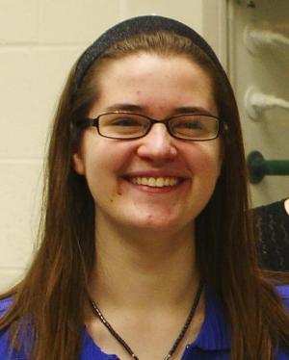
T-507: Test of a RICH-Prototype Based on CsI-GEMs for an Electron-Ion Collider
  T. Hemmick, Stony Brook Uni.
  Single electrons @ 5 Hz, 9 GeV
  4 24h days from 5/31 to 6/03 2013
Recorded 1.4 million triggers
Ran for 84% of wall clock time
Tom
Hemmick
Abhay
Deshpande
Klaus
Dehmelt
Nils
Feege
Stephanie
Zajac
Marie
Blatnik
ESTB can deliver single electrons per event
Carsten Hast, SLAC, SLAC Electron Beam Test Facilities

Slide 19
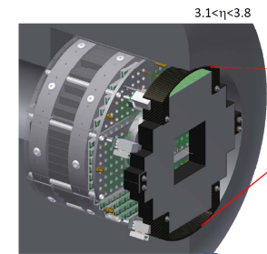

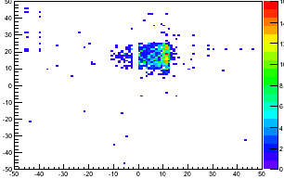
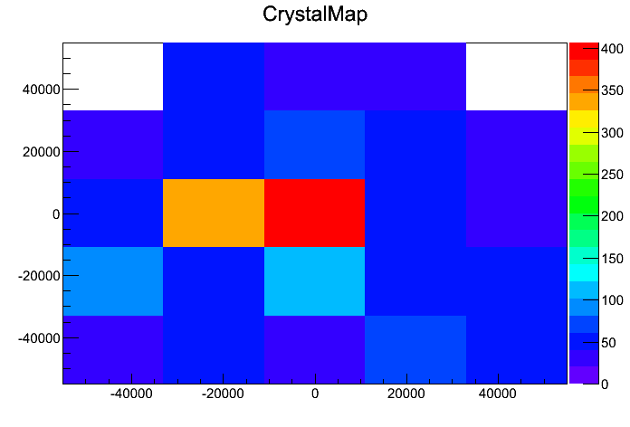
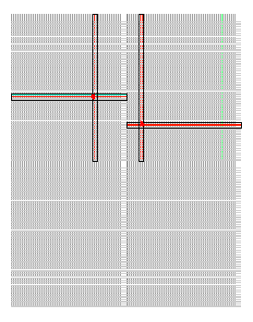
T-517: PHENIX MPX-EX Calorimeter Upgrade (at RHIC)
W/Si-pixel
Sandwich
Not Merged
Merged
Standard PbWO₄ Cal
ESTB can deliver multiple clean well separated electrons per event
Carsten Hast, SLAC, SLAC Electron Beam Test Facilities

Slide 20
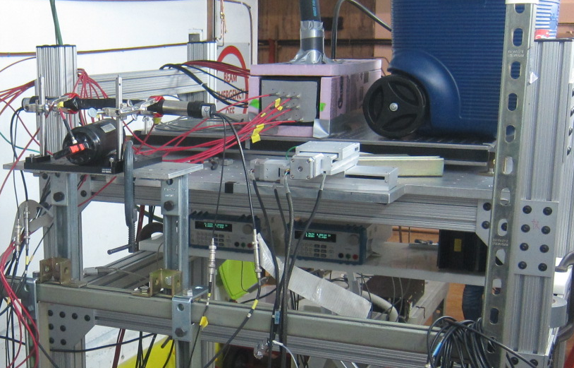
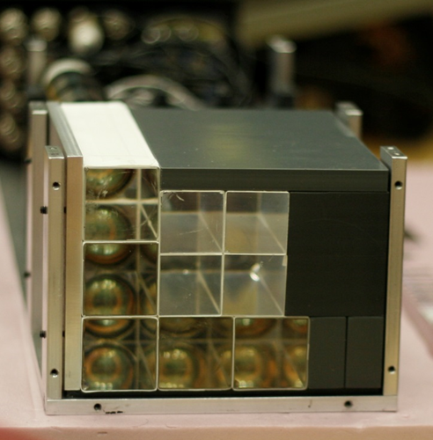
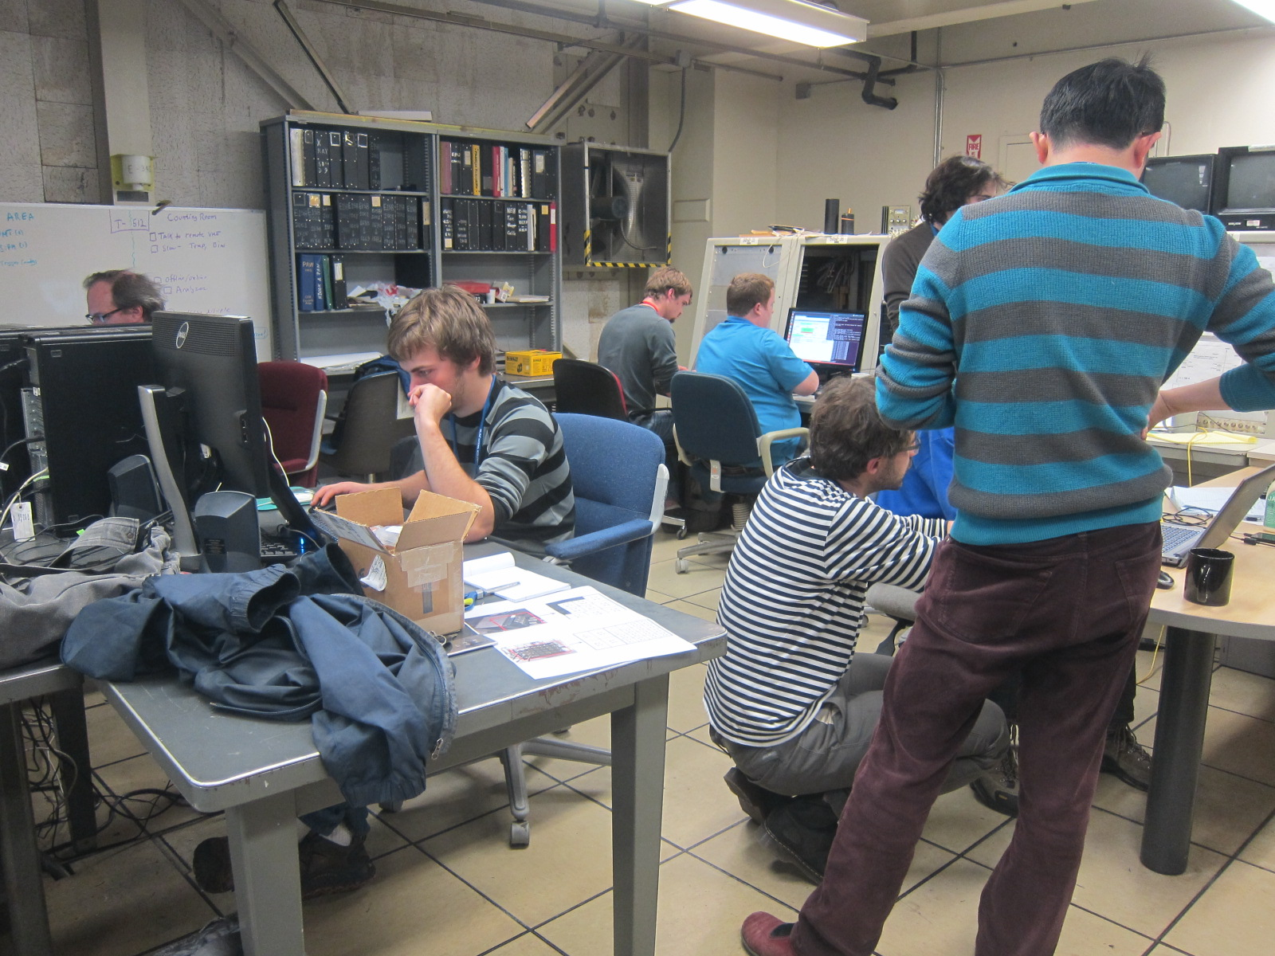
T-512: Test of FNAL g-2 Calorimeter
  D.Hertzog, Univ. of Washington
  8 collaborating institutions
  Single electrons @ 5 Hz, 2-6 GeV
3 GeV electron
1 e⁻
2 e⁻
3 e⁻
4 e⁻
5 e⁻
6 e⁻
g-2 back at ESTB for 2 weeks in July and 2 in October for calorimeter calibration
Carsten Hast, SLAC, SLAC Electron Beam Test Facilities

Slide 21
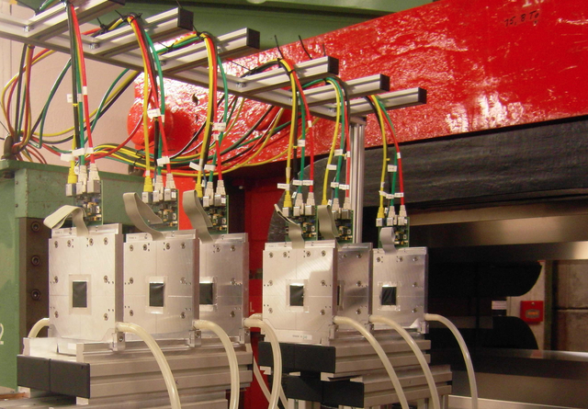
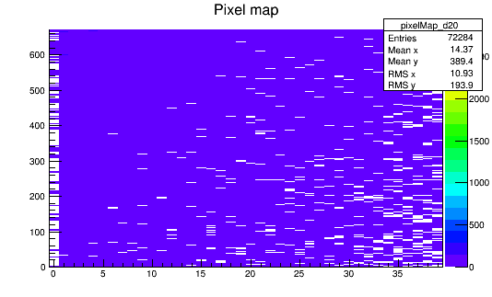
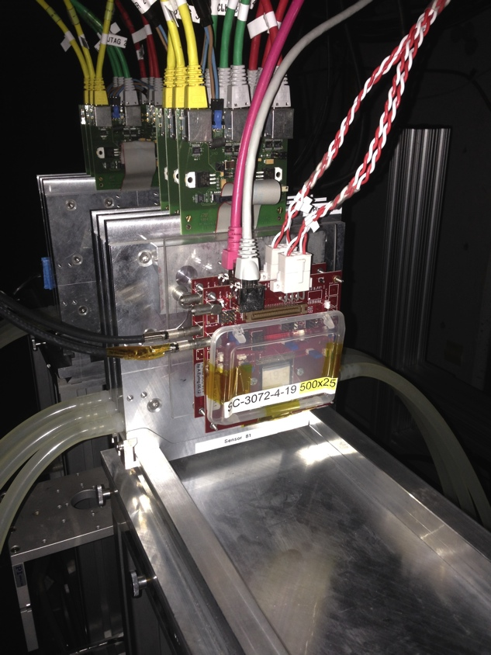
T-516 Atlas Si Tracker Upgrade work at ESTB
Andrew Blue, Glasgow
Tested 8 devices
  At various biases, thresholds and positions
  3 Irradiated with 1x10¹⁵ 1MeV neutrons
  1 quad (2x2 chips)
SLAC’s 13.5GeV allowed us to
  Reduce multiple scattering
  Test multiple devices
  Beam trigger has also increased stats
    Instead of using smaller scintillator
Full coverage of sensor with 50-100 tracks/pulse
ESTB can deliver 10th to 100 of clean well separated electrons per event

Slide 22
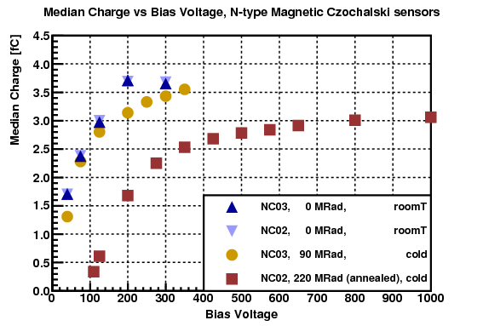
T-506: Electromagnetic Shower Damage to Silicon Diode Sensors
  PI: Bruce A. Schumm, UC Santa Cruz
  Physics Goals: Test of radiation tolerance of various silicon sensor technologies in realistic shower spectra for ILC forward detectors
Beam Cal
100MRad/y
Carsten Hast, SLAC, SLAC Electron Beam Test Facilities

Slide 23
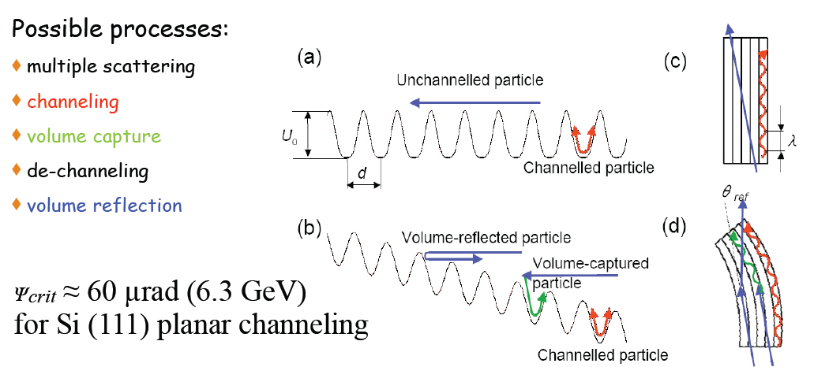
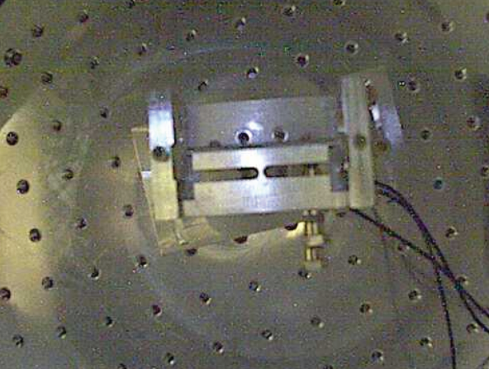
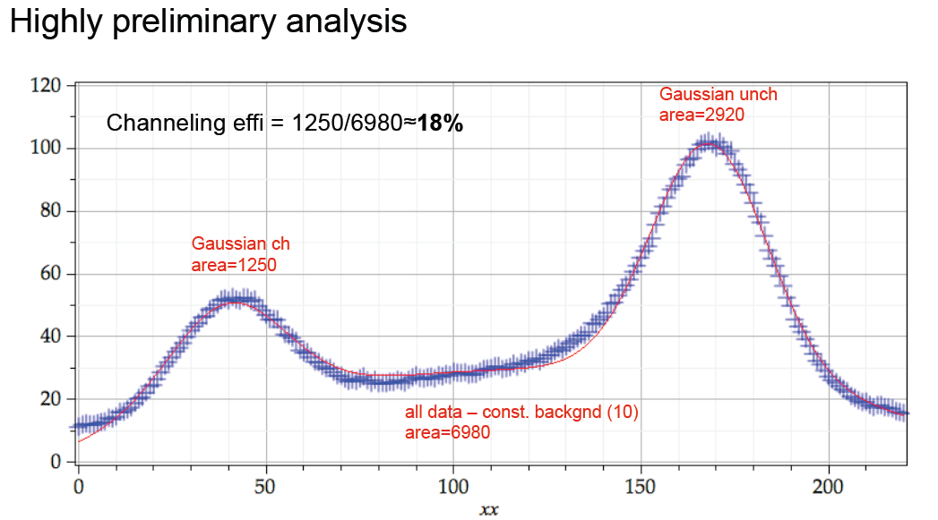
T-513: Channeling and Volume-Refection in Crystals
Uli Wienands, SLAC
Beam Collimation
Multi MeV gamma ray generation
Corresponds to a 150T magnet
18% channeling efficiency
Carsten Hast, SLAC, SLAC Electron Beam Test Facilities

