Slide 1
EUDAQ 2.0
3rd Beam Telescopes and Testbeam Workshop 2015
Ulf Behrens, Alan Campbell, Francesco Crescioli, David Cussans, Hendrik Jansen, Moritz Kiehn, Hanno Perrey, Richard Peschke, Igor Rubinskiy, Simon Spannagel

Slide 2
EUDAQ
Software Layout
Distributed DAQ system
Consists of completely independent parts / programs such as:
Run Control
Data Collector
Producers
Synchronous read out
All devices get a common trigger
Every device raises a busy signal
DAQ for MIMOSA telescope
RunControl
TLU Producer
TCP/IP
Data flow
Data Collector
Producer 1
Producer 2
Read Out
Device 1
Device 2
Trigger/Busy
Trigger / Busy Handshake
Trigger
Hardware Layout
TLU

Slide 3
Goals
More flexibility in the data format
Possibility to store multiple readout frames in one “packet”
Increasing of the track rate by more than 2 orders of magnitude
Easier combination of different kind of devices
FE-I4 / Mimosa / Timepix(3) / Slow Control
Resolved scalability issues
Decentralized data taking
Data can be stored locally without network overhead
Stay backward compatible to old EUDAQ 1.x Producer and analyze readout chain (EUTelescope)
Only recompiling is needed
Changes are only need to benefit from some new features
Cross platform

Slide 4
Motivation
MIMOSA
MIMOSA
Tracks
DUT
1
2
3
Information Needed:
Space and time information at the position of the DUT
Space resolution < 3 µs
Separation time* < 30 ns
Time Resolution < 4 ns
*Tracks can only be separated if their time difference is larger than the separation time

Slide 5
Motivation
MIMOSA
MIMOSA
Tracks
DUT
1
2
3
+ Intrinsic resolution of ~3.5 µm precession
- Very poor time resolution (115.2 µs)

Slide 6
Motivation
MIMOSA
MIMOSA
Tracks
DUT
FEI4
1
2
3
+ Intrinsic resolution of ~3.5 µm precession
- Very poor time resolution (115.2 µs)
Solution adding faster device for time stamping the tracks
+ time resolution 25 ns
- Intrinsic resolution 14 x 70 µm
Asynchronous data streams

Slide 7
Combining of two types of sensors
By adding the FE-I4 Detector the time resolution is increased by more than 3 orders of magnitude
Gives the possibility to timestamp the individual Tracks
Combined Resolution

Slide 8
From Trigger to Timestamps
Particles
TLU
DAQ 1
DAQ 2
One trigger per read out frame
Prevents the issuing of triggers for the whole time of the read out
All but the first particle are ignored
Online event building
Slowest device limits the Event rate
Time
Readout Frame
Contains:
Trigger No.
Hits
…
Trigger No.
Hits
Readout Frame
Contains:
…
Marked for write to Disk
Not Marked

Slide 9
From Trigger to Timestamps
Time
Particles
TLU
DAQ 1
DAQ 2
Using all particles
Possible rate increase of two orders of magnitude
No online event building
Offline merging
Readout Frame
Contains:
Timestamp 1
Timestamp 2
Hits
…
Timestamp 1
Hits
Timestamp 2
Hits
Readout Frame
Contains:
…
Marked for write to Disk
Not Marked

Slide 10
Hardware Layout
Classical Trigger Handshake:
Device receives trigger and clocks out event number from TLU
Device replies with a “busy” signal
Slowest device limits trigger rate for all devices
Synchronous Trigger interface:
TLU shares internal clock with DUT
Device counts clock cycles
On Trigger clock count is stored as timestamp
No clock cycles used for transmitting timestamps
Trigger rate can be in the same order of magnitude as internal clock
Device can rises busy signal to veto issuing of new trigger

Slide 11
Software Layout with Multiple Data Collector
Run Control:
Central authority
Starts, stops and configures runs
Assigns Data Collectors to Producers
Main user interface
Producer:
Interface with user’s readout system
Receives command from Run Control
Sends its data to the Data Collector
Data Collector:
Receives data from multiple producers
Producer can have their own Data Collector on local machine
Log Collector:
Stores and displays log information
Start time, stop time
Errors and warnings

Slide 12
Online Monitor
In the new layout the data gets stored at different locations
Data rate too high to process all events
Receives all meta information
Meta information contains timestamps and/or trigger number
Uses meta information to synchronize events from different Producers
Request a small subset of the data from the Data Collectors
Correlates the data from different device

Slide 13
Merging
Every Data Stream is stored separately
The TLU is the central authority for merging
Every event gets compared to the TLU events to find the corresponding TLU event
The Compare algorithm can easily be modified by the users. It is part of the converter plugin
Adding the TLU timestamp to the Event
Processing events from different producers Individually until the tracks are extracted
Merging happens on the level of tracks and not events

Slide 14
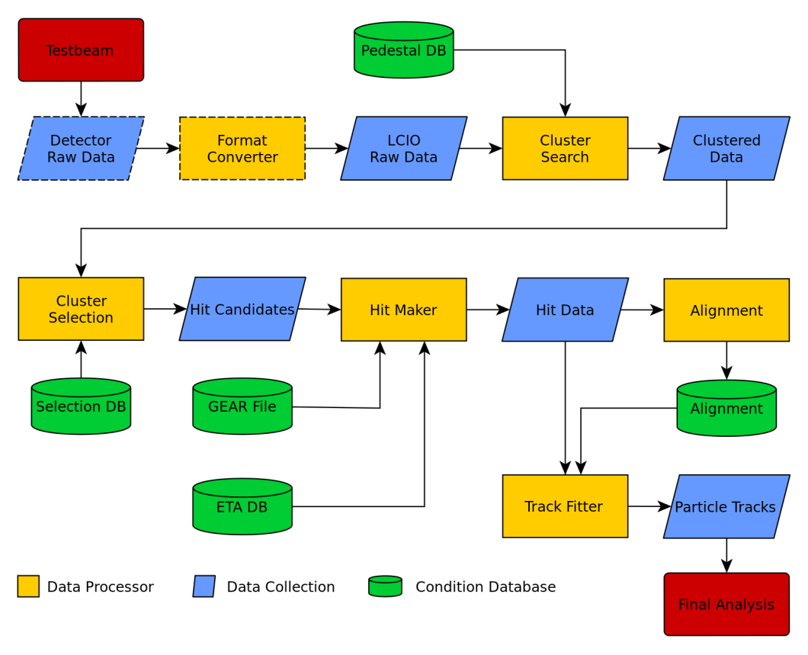
Merging
Current workflow
The merging of the tracks with the DUT hits goes at the end.
Reprocessing of alignment step after merging
DUT hits

Slide 15
Merging
EUDAQ 2.0 workflow
The merging of the tracks with the DUT hits goes at the end.
Reprocessing of alignment step after merging
DUT hits

Slide 16
Definition: Read Out Frame (ROF)
Read Out Frame is the finest granularity one gets from a device
It does not mean the granularity with which one reads out the Device.
As an Example: With every read out from the TLU one gets the information from multiple triggers. Since one can disentangle the information from the individual trigger the Read Out Frame is the individual Trigger!
For the FE-I4 one ROF is one LHC bunch crossing which covers a time of 25 ns
For the Mimosa one ROF is one frame which covers a time of 115 µs

Slide 17
Packets
EUDAQ 1.x
EUDAQ 2.0
Every Producer sends one Event per readout frame
For some devices this leads to a lot of overhead
With low rate (~4 kHz) the overhead is not limiting the data rate
Desired rates: 100 kHz -1 MHz
The overhead from packing every ROF into one Event can Limit the data rate
Allowing the use of Packet
Packets can contain multiple ROFs.
No overhead for the individual ROFs
ROFs are extracted Offline

Slide 18
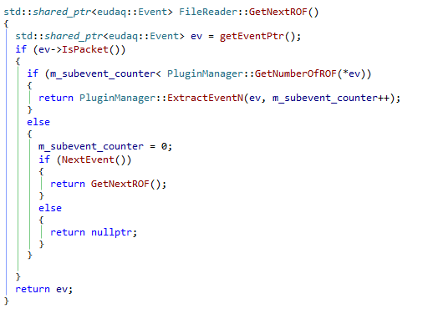
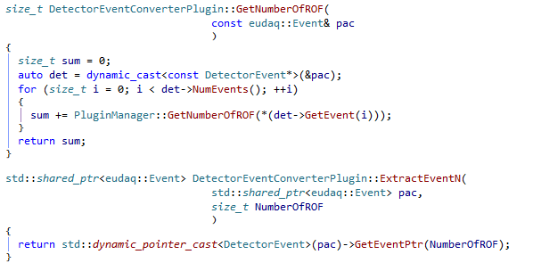
How to extract Events from Packets
Packet
Event
Header
Header
Meta Data
Uses the well known mechanism of data converter plugins
Complete flexibility how the users store their data
Meta Data
ROF
ROF
ROF
Data Converter plugin
ROF
ROF
Example Code:

Slide 19
Extra: Two TLU Setup
PMT
TLU 1
Fast Device (FE-I4)
PMT
Trigger In
Trigger Out
PMT
TLU 2
Slow Device (Telescope)
Trigger In
Trigger Out
TLU 1 is triggering TLU 2
If the TLU 2 issues a trigger to the telescope it also triggers TLU 1 (TLU handshake)

Slide 20
Combination to events
Time
Trigger
TLU 1
TLU 2
Telescope
Particle Trigger
TLU 2 Trigger
Discarded Trigger
TLU 1 sees all particles
TLU 2 only triggers when Telescope is not busy
TLU 1 has a trigger from TLU 2 for the offline reconstruction
Trigger which where issued after a certain time after the primary trigger will be discarded completely

Slide 21
Test in the Laboratory
Input trigger from pulse generator
The main TLU is not limited anymore by the Telescope
The second TLU is synchronous with the Telescope
Resynchronization of the two data streams via timestamps
Default approach for EUDAQ 2.0
Not tested with beam yet

Slide 22
Summary
Accomplished
Open Task
New Data Format for Multiple Readout frames
Possibility to Store Data locally to reduce the network overhead
Merging for Online Monitor
Track merging in EUTelescope
Extensive beam tests
Users need to update their producer converter to take full advantage from EUDAQ 2

Slide 24
Backup

Slide 25
Mimosa Readout
Rolling shutter readout
Readout row by row
The readout takes 115 µs
Hits that that appear at the exact same time can be in two different readout frames
It is needed two associate two readout frames two one trigger

Slide 26
Telescope Type devices
Trigger
Telescope
Time
The information for one Trigger is split up on two ROF
Limitation in the analyze framework prevents the use of references to previous events
Instead of associating only the trigger that happened during the ROF we also Associate the one from the previous ROF to this Event
Trigger get associated to multiple ROF
Read out
Time
Row

