Slide 1


WP02 PRR:
Master Oscillator and
RF Reference Distribution
RF Distribution Layout
Notes:
How to edit the title slide
Upper area: Title of your talk, max. 2 rows of the defined size (55 pt)
Lower area (subtitle): Conference/meeting/workshop, location, date,
your name and affiliation,
max. 4 rows of the defined size (32 pt)
Change the partner logos or add others in the last row.

Slide 2
Synchronization Requirements Overview
LO, precise clocks and other locally generated and distributed signals not included here but also of concern for the RF distribution
Together more than 220 tap points
Main reference signal frequency is 1300 MHz
Required high availability (best would be no breaks in operation over the XFEL life time)

Slide 3
General Synchronization System Layout
Three complementary systems (performance and cost compromise)
  Optical synchronization: sub-10fs performance, 10 links
  RF Coaxial distribution: sub-100fs performance, interferometers, local distribution
  Timing system
Notes:
All systems phase synchronized to the the RF Master Oscillator
RF signal phase adjusted to the MO with 10 fs accuracy at each of 10 optical system outputs
In case of optical system failure, the coax distribution should still deliver signals but with limited performance
Main drive line as a cascade of IMx interferometers
IMx interferometers are redundant

Slide 4
Layout (Conceptual): Injector, L1, BC1

Slide 5
Layout (Conceptual): L2, BC2

Slide 6
Layout (Conceptual): L3 (One Section)
REFM descriptions (e.g. TP REFM-L3.3) are REFM types, not physical box numbers.
There are 4 sections
Last section right local interferometer was foreseen for future upgrade (A27 to A29)

Slide 7
Layout (Physical) Example: Injector

Slide 8
System Components
MO: Talks by Ł. Zembala and B. Gąsowski
REFM-OPT: Talk by E. Janas
Interferometer Links and REFMs: Talks by D. Sikora

Slide 9

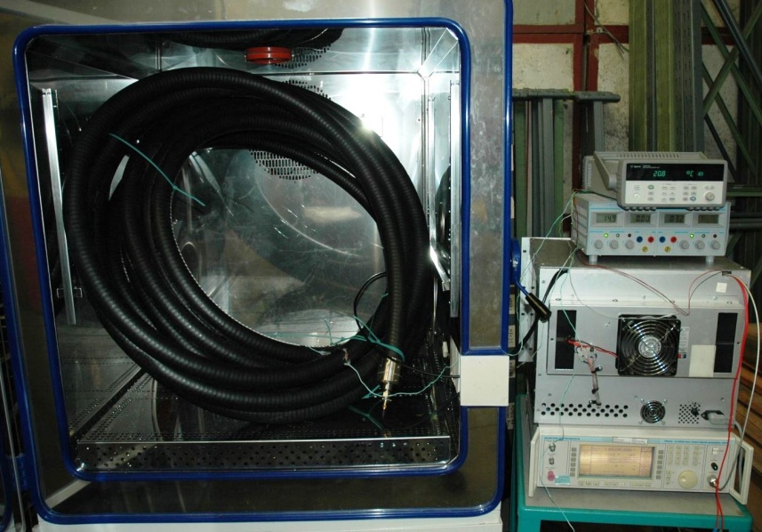
System Components: Coax Cable Selection
Low-loss foam dielectric coaxial cables for long distance distribution
Phase Master for inner rack cabling
Measured phase drifts vs. temperature for all cables
Simulated phase drifts between MO and end of L3 in range of 70 ps without stabilization
Cable Type | LCF158-50JATC | LCF78-50JATC | LCF12-50JFN | LCF38-50J | Phase master 190
Diameter | 1 5/8" | 7/8" | 1/2" | 3/8" | 0.19" (inside rack)
attenuation @ 216MHz [dB/100m] | 1 | 1,7 | 3,2 | 5,1 | ~13
attenuation @ 1300MHz [dB/100m] | 2,62 | 4,55 | 8,3 | 13,07 | ~30
phase drift @ 20ºC [fs/ºC/m] |  | 30 | 18 | 10 | -60÷15
phase drift @ 25ºC [fs/ºC/m] | 100 | 25 | 15 | ~0 | 12
phase drift @ 30ºC [fs/ºC/m] | 100 | 21 | 11 | -10 | 5
phase drift @ 35ºC [fs/ºC/m] |  | 23 | 8 |  | 30

Slide 10
Link Power Budget Calculation Example
Similar spreadsheets are done for all links in the machine
Design prepared to have the same power level values at all outputs
 |  |  |  |  |  | xx dBm | - loss/coupling value
LCF38-50J: 13.1 dB/100m |  |  |  |  |  | ← xx dBm | - power of forward wave
LCF12-50J: 8.3 dB/100m |  |  |  |  |  | xx dBm → | - power of reverse wave
LCF78-50JA: 4.6 dB/100m |  |  |  |  |  | xx dBm | - output power
LCF158-50JA: 2.6 dB/100m |  |  |  |  |  | xx dBm | - value to set
Phase Master 190: 30.0 dB/100m |  |  |  |  |  | ← xx dBm | - value calculated based on value above

Slide 11
Diagnostics

Slide 12
Summary
General system layout is frozen
Modular design: unified links and link components reused in many places
More details on subsystems (REFM, Links) will be given in following talks
Thank you for attention!

Slide 13
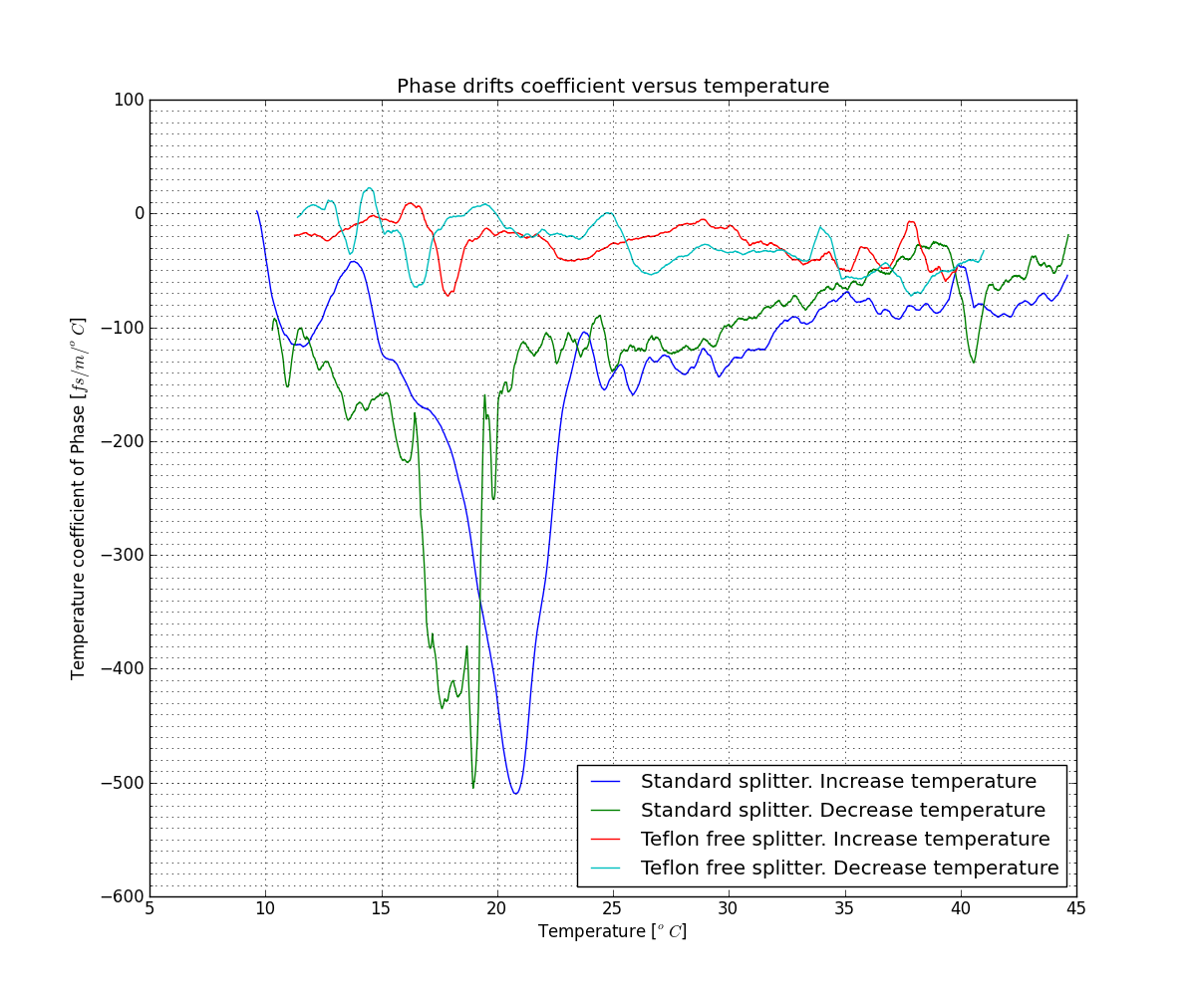
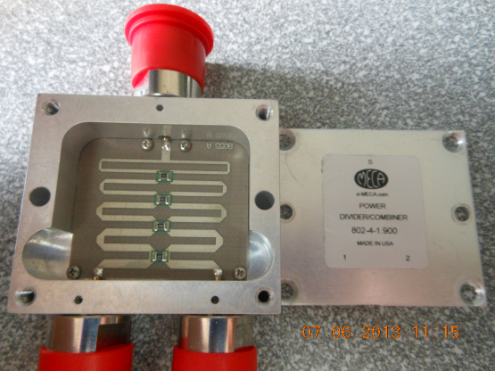
Power Splitters
One of the most critical distribution system components
Meca developed a special low-drift (Teflon-free) spliiters for us

