Slide 1
WP02 PRR: Master Oscillator and RF Reference Distribution
Infrastructure
Notes:
How to edit the title slide
Upper area: Title of your talk, max. 2 rows of the defined size (55 pt)
Lower area (subtitle): Conference/meeting/workshop, location, date, your name and affiliation, max. 4 rows of the defined size (32 pt)
Change the partner logos or add others in the last row.

Slide 2
MO and RF Reference Infrastructure overview
Master Oscillator racks
MO grounding
RF Reference Injector cabling
RF Reference L1, L2 and L3 cabling
Status of RF Reference Infrastructure

Slide 3
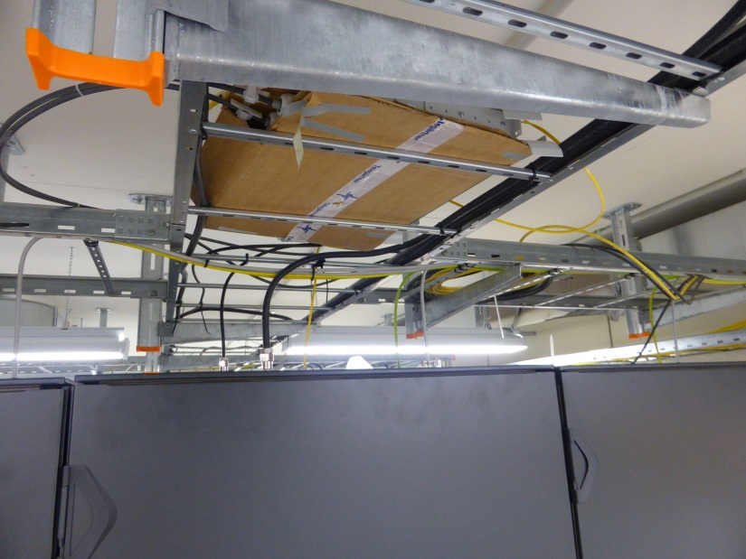
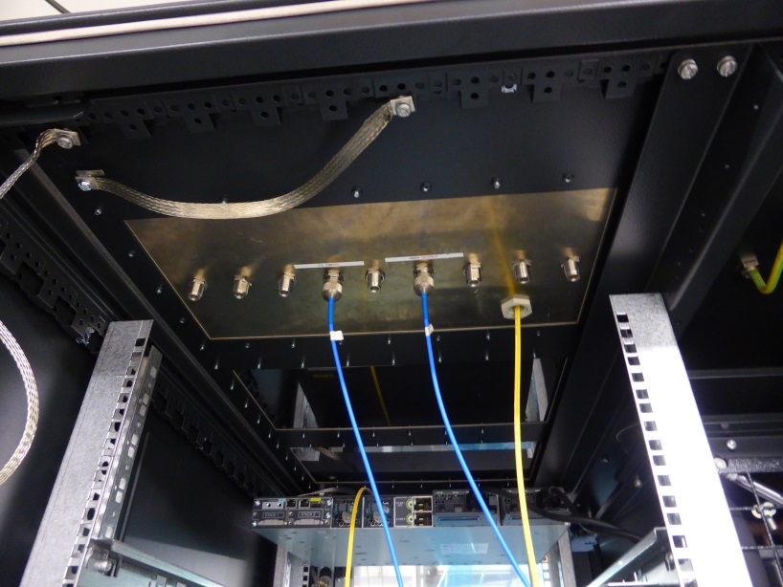
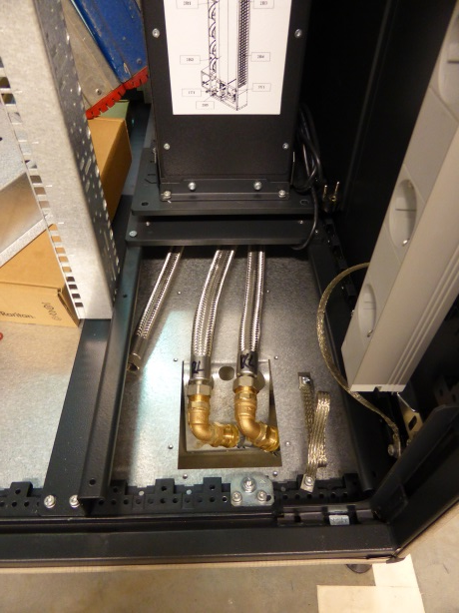
MO Racks
The Schroff MO racks (special vibration free) with LHX20 (20kW cooling unit) are installed on UG05/011.
The AC power UPS is connected.
The cooling water is connected, the cooling units are tested, still need a tests of temperature stability.
The Ethernet switch is installed in rack #2, will be installed in all racks very soon.
The temporary patch panels are installed, the final PP’s are ready, will be exchanged very soon.

Slide 4
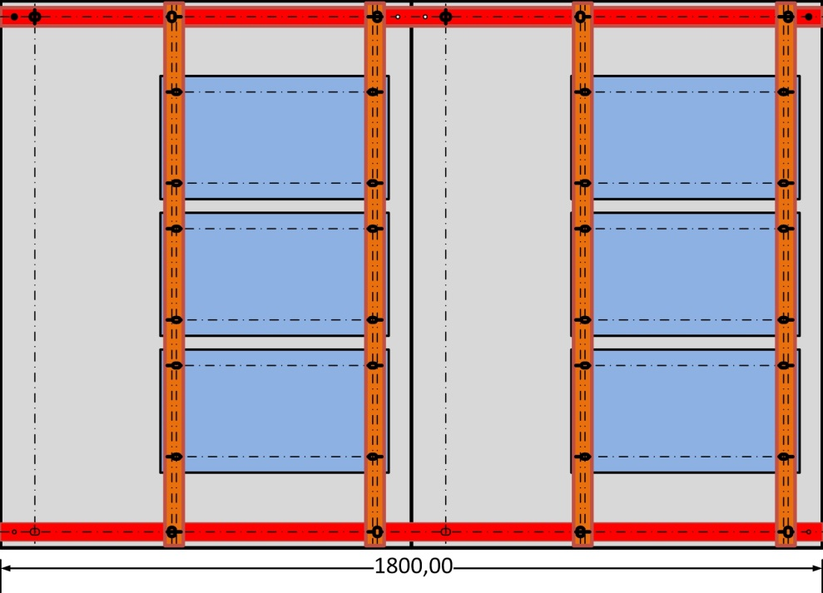
MO Racks grounding
Requirements:
Very low grounding impedance between MO cabinets top patch panels,
Adjustable fixing to the PP – MO racks are in a row and not screwed together,
Ability to disassembly PP without dismounting grounding,
Foresee on top PP some grounding points to feed low impedance paths to the inner 19”rack and MO boxes,
Possibility to improve grounding scheme after measurements.
Designed after discussion with H. Kapitza
Two main copper bars screwed to cabinets frames using M12 steel screws with hammer head.
Two copper bars on the top of PP’s.
The each PP is connected to grounding bars using four M8 brass screws.
There are cable ear under each screw from the PP bottom for flexible connection to the 19”rack frame.
All screws have special washers with ‘teeth’ to improve electrical connection to metal frames.
The grounding ‘net’ on the top of MO cabinets are connected to ‘wall’ grounding point using 4 cooper cables of 50 mm².
More details can be found: N: \4all\public\MSK_Projekte\XFEL\Installation\Injector\Master oscillator\Grounding scheme for MO 18.06.14.pdf
Patch Panel
Patch Panel
Patch Panel
Top View
Patch Panel
Copper bar 40 mm x 5 mm (200 mm²)
Patch Panel
Patch Panel
Copper bar 40 mm x10 mm (400 mm²)

Slide 5
RF Reference distribution for Injector
GUN Laser (UG05/025)
Laser Synchro (UG05/026)
MO (UG05/011)
XTIN media bay
XTIN media bay
XSE media bay
RF Reference signals from MO for Laser Synchro and Laser Gun – all on one level UG05 neighboring rooms.
RF Reference signals from UG05/011 to Klystron Life Management on UG03 via XTIN media bay (Medienschacht).
RF Reference signals from UG05/011 to Injector racks UG07/008 via XSIN media bay.
RF Reference signals from UG05/011 to XTL via XSE media bay.

Slide 6
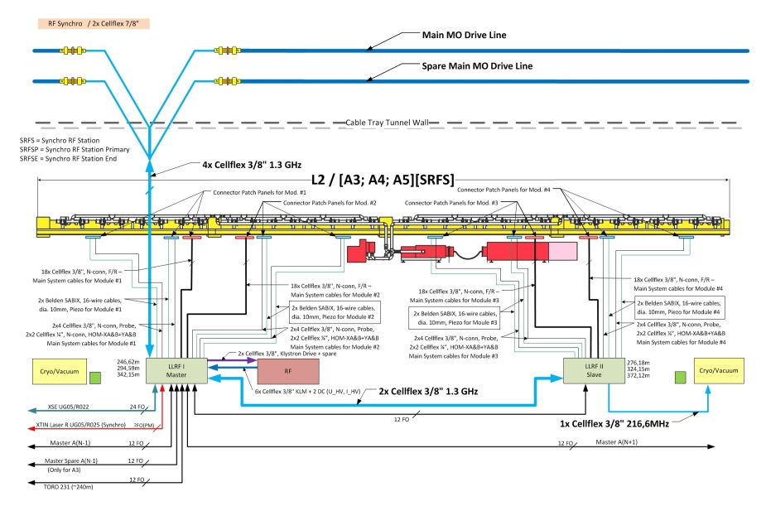
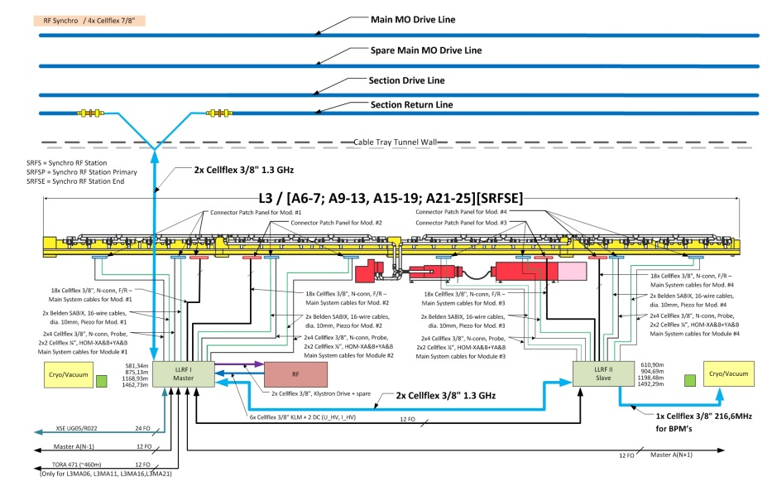
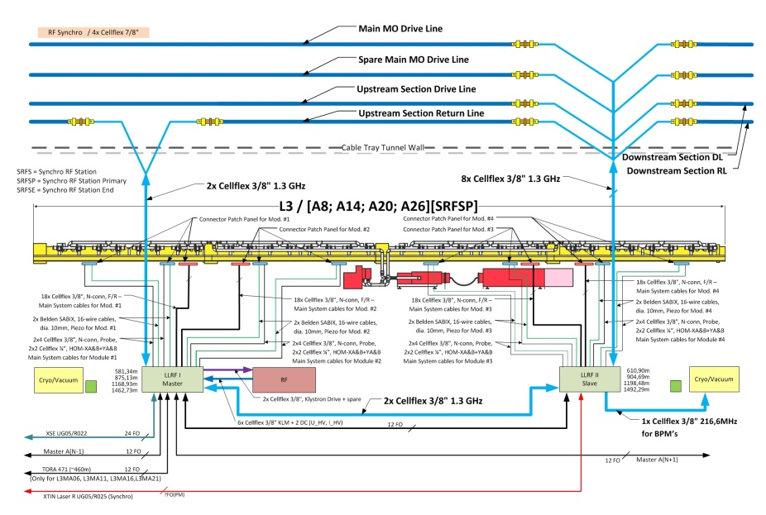
RF Reference cabling for RF Station’s in XTL

Slide 7
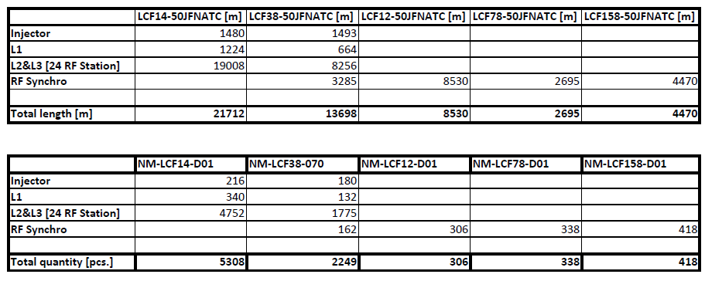
RF Reference cabling for XFEL
All cabling is already planned
All cables have been ordered
KDS entries for L1 done (95%)
KDS entries for RF Reference for Injector (70%), L2 and L3 will be finished soon
Cables
Connectors

Slide 8
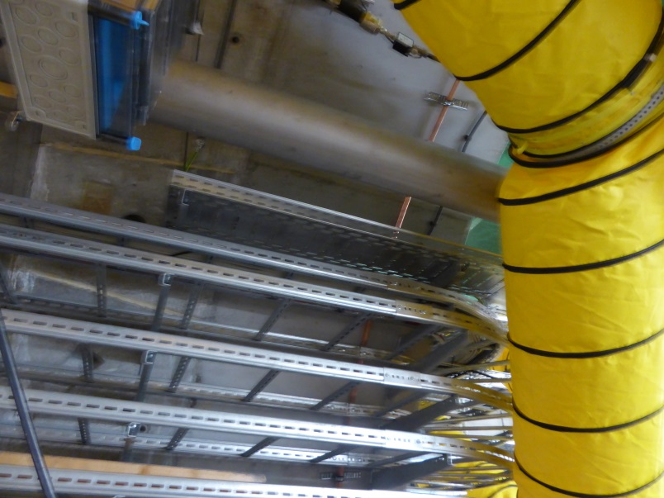
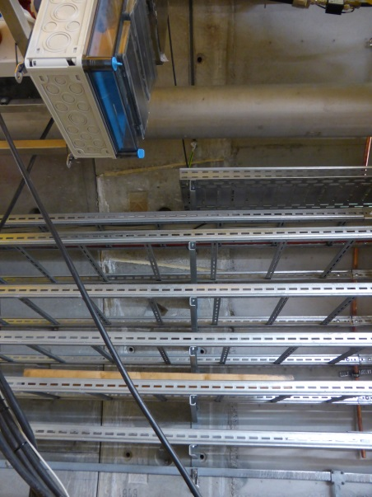
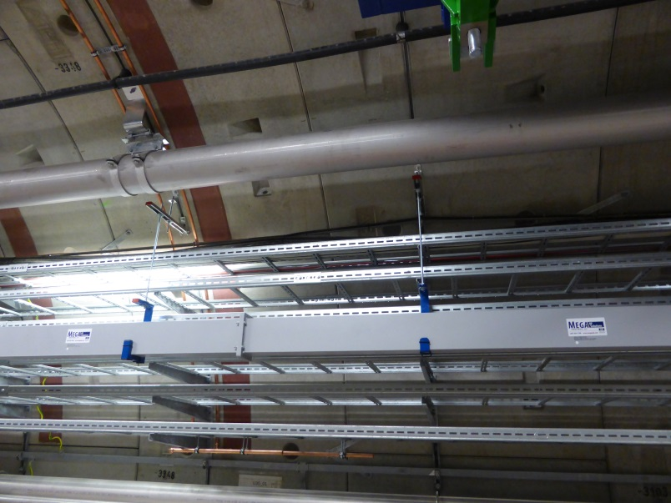
XTL RF Reference cabling
It is necessary to change the RF Synchro cable type from ½” to 1.5” at the entrance of XTL, there will be a ‘dummy’ PP (simply N-feedthrough/barrel).
The RF Synchro cables in XTL will be fixed to the wall with special brackets, there will be no cable tray for those cables.
The cable tray under Cryo Modules (on concrete Radiation Shielding) will be used for RF Synchro cables between Master and Slave

Slide 9
Status of infrastructure for MO & RF Reference
MO racks are installed on UG05/011 - AC power, Ethernet and cooling water connected, grounding installed.
Final PP’s for MO ready (will be installed in ~1-2 weeks, now temporary PP’s installed).
Final PP’s for L1 ready and installed.
Design of PP’s for Injector ready, will be ordered first week of September (manufacturing takes ~1 month).
Design of PP’s for L2 and L3 ready, needs approval.
Cabling for L1 ordered.
The cooling units are tested, connected to Ethernet for remote control, still need a tests of temperature stability.
Implementation of RF Reference cables in KDS in progress (L1 95% ready, Injector RF Reference 70% ready, L2 & L3 will be ready in ~2 months) – main problem is creation of PP’s for other WP’s, lack of information.

