Slide 1
WP02 PRR: Master Oscillator and RF Reference Distribution
REFM-OPT
Notes:
How to edit the title slide
Upper area: Title of your talk, max. 2 rows of the defined size (55 pt)
Lower area (subtitle): Conference/meeting/workshop, location, date, your name and affiliation, max. 4 rows of the defined size (32 pt)
Change the partner logos or add others in the last row.

Slide 2
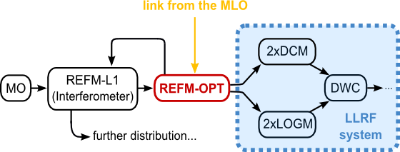
REFM-OPT: application & location
REFM-OPT connection scheme for the first linac station (L1) of the European XFEL.
Master Oscillator (MO)
REFerence Module (REFM)
Drift Calibration Module (DCM)
LO Generation Module (LOGM)
Down Converter (DWC)
The REFM-OPT is a 19” module, which is responsible for resynchronizing the 1.3 GHz reference signal for the LLRF, distributed by coaxial cables, to a phase-stable signal from the optical synchronization system.
The module provides 1.3 GHz output signals with low phase noise and high long-term stability.

Slide 3
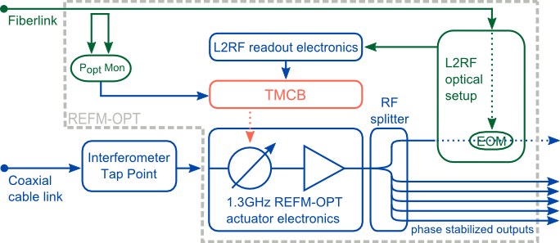
REFM-OPT scheme
REFM-OPT consists of:
L2RF phase detector:
L2RF optics
L2RF electronics
Control board (TMCB)
REACT PCB – actuator electronics
MPS PCB – electronics to provide MPS signal
6-way RF power splitter
Temperature controller
Amplitude Monitor PCB
Power supply board (FRED)
Heat sink
Inputs:
optical signal from the optical link
1.3 GHz electrical signal from the RF distribution
Outputs:
6x 1.3GHz reference (~21dBm each)
Machine Protection System (MPS) signal

Slide 4
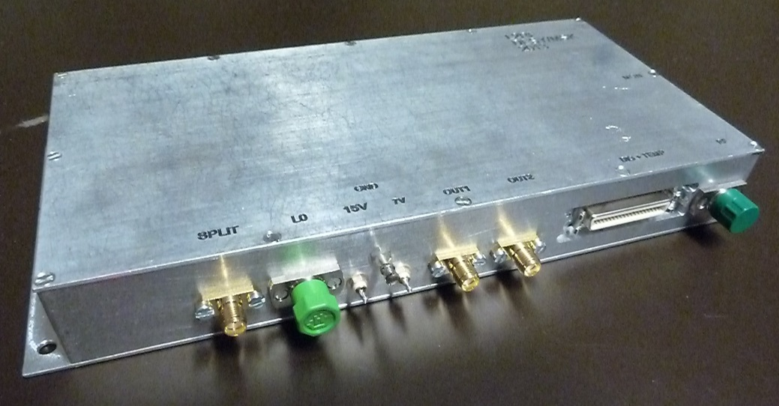
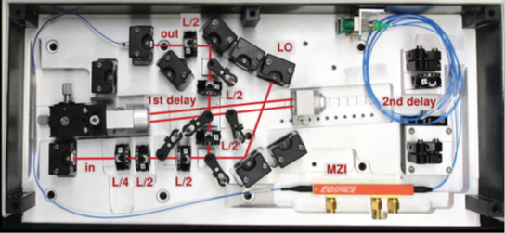
L2RF phase detector
main part of an opto-electrical phase locked loop
The PLL reference input: optical pulse train
The phase comparison done in the optical domain
The phase difference extracted in the electrical domain and given as an electrical signal (RF detector)
low noise: ~1fs timing jitter within 1Hz-10MHz
both parts are ready and fully tested

Slide 5
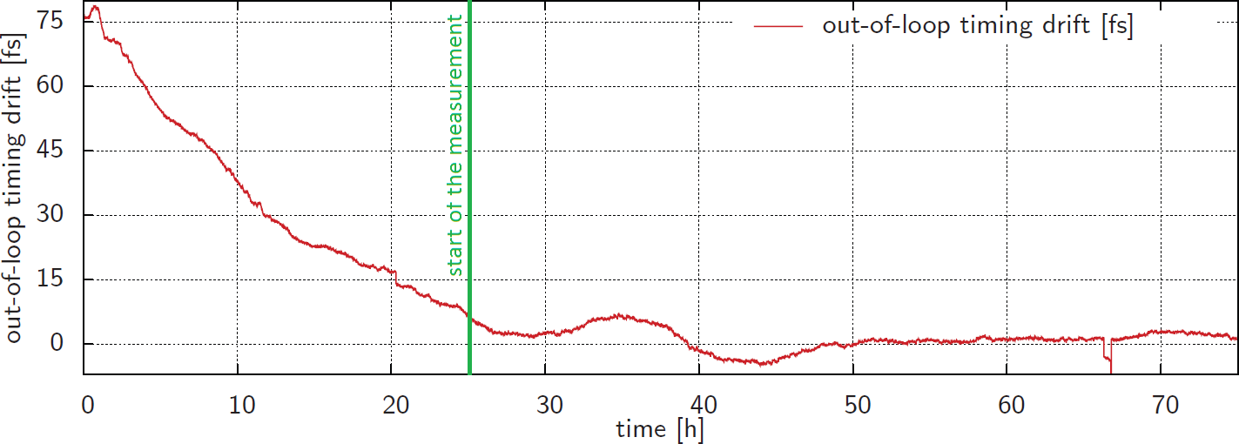
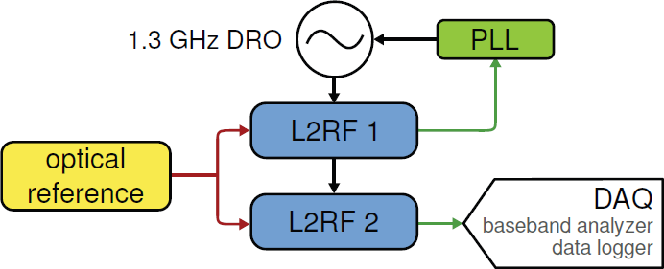
L2RF phase detector: test results
Out-of-loop timing of the L2RF drift measurement
The peak-to-peak stability amounts to only 12 fs for the last 48 h while the last 24 h show 3.6 fs peak-to-peak stability

Slide 6
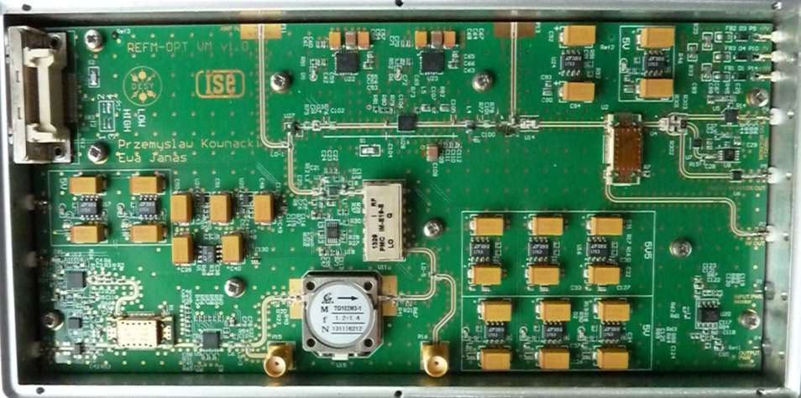
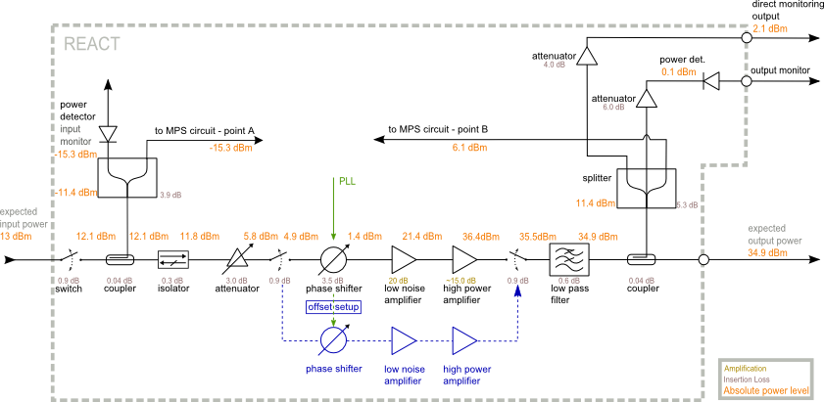
REACT – REFM-OPT actuator electronics
input from the 1.3 GHz RF distribution (REFM)
RF signal phase resynchronized based on the signal from the PLL (L2RF)
high output power, adjustable gain to compensate for lower input power
redundancy path in case of power or phase drop
PCB ready, MPS circuit in the design process

Slide 7
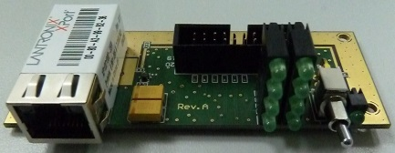
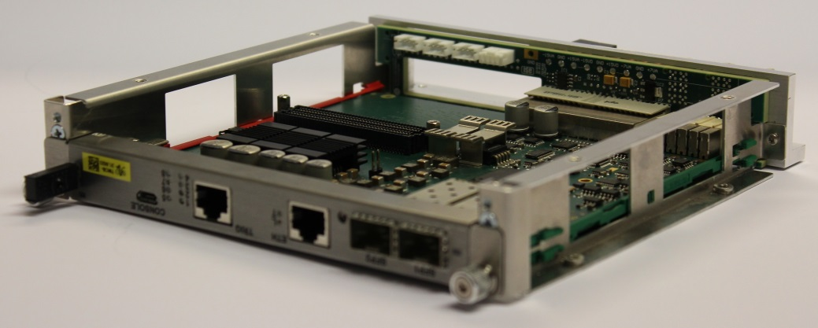
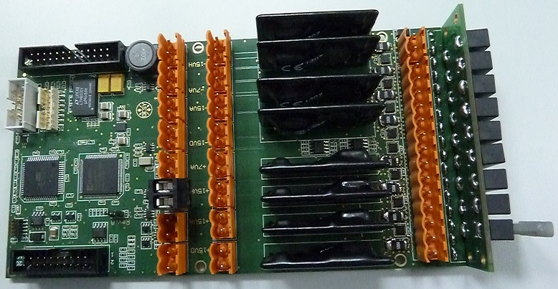
TMCB & FRED
TMCB - Temperature Monitoring & Control Board
Used as a platform for the PLL controller
Provides online monitoring of humidity and temperature sensors, power detectors etc.
current modules built with version1
second version available, but new (rewritten) firmware necessary
FRED – Fuse-Relay board
provides all the necessary power supplies, fused
channels monitored in terms of current consumption
panel with a switch and LED indicators
current modules built with version1
second version available and tested

Slide 8
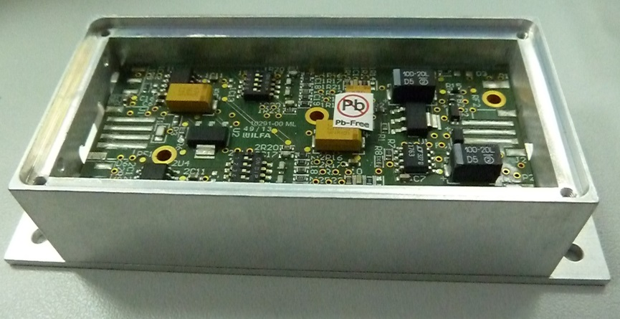
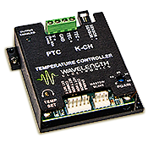
Temperature controller & amplitude monitor
TEMPERATURE CONTROLLER
a part commercially available
set point , and current sensor reading controled via ethernet
necessary to stabilize the temperature of a plate for the optical setup
the measurement done within the completely assembled module shows below 5 mK peak-to-peak temperature stability close to the critical optical component
AMPLITUDE MONITOR
measures the optical power
necessary for setting the proper working point of the L2RF optics
PCB ready and tested
http://www.teamwavelength.com/

Slide 9
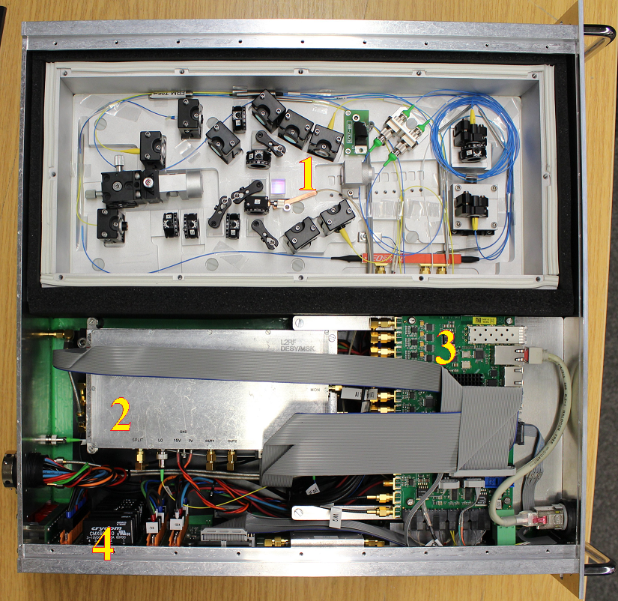
FLASH prototype & XFEL upgrade
FLASH prototype ready
XFEL version:
TMCBv2 (+mechanics, FLASH prototype has reserved space)
FRED2 – PCB ready, tested
REACT2 – PCB ready, needs tests with MPS and redundancy
6-way power splitter instead of 4-way
inner cabling planned, including few special drift-free cables (ready, waiting for installation)

Slide 10
Summary
Most of the hardware is fully ready for installation, which means it is designed and tested: L2RF electronics and optics, REACT PCB, Amplitude Monitor, FRED, TMCB, temperature controller...
What still has to be done:
MPS PCB has to be finished and tested (design ongoing)
Redundancy on a REACT PCB to be tested. Second PCB version has been designed, waits for being manufactured
Firmware must be rewritten for the TMCB2 and tested, waits for another project to be finished
Server for the module has to be written – final step, needs running setup and finished firmware
Mechanics has to be slightly changed, place for the upgraded components already foreseen

