Slide 1
WP02 PRR: Master Oscillator and RF Reference Distribution
REFMs

Slide 2
REFMs
REFerence Modules provide reference signals to:
LLRF (1.3 GHz)
DCM
LOGM/uLOG
REFM-OPT
Special Diagnostic systems (1.3 GHz)
EOD
eBPM
TDS
BPM system (216 MHz)
10 MHz signal for diagnostics

Slide 3
REFMs
18 different REFMs for distribution system (total 85)
All REFMs are based on limited number of blocks (assembly variants):
Interferometer control board (INCON)
Interferometer tap point
Link power amplifier
Stabilized power amplifier
Power splitter
Frequency divider
TMCB
FRED
PLL 3.9GHz

Slide 4
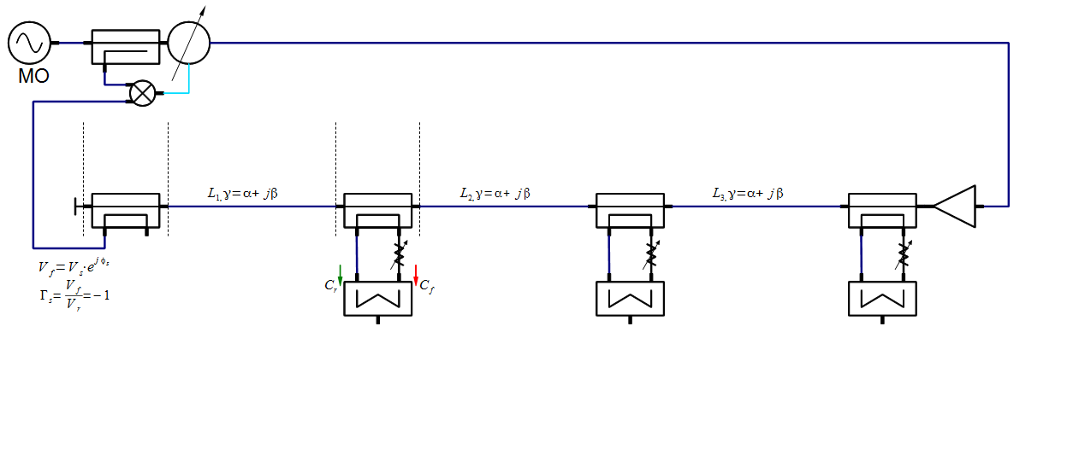
RF Interferometer Components
Interferometer controller (INCON)
Tap Point
Link power amplifier
Cables

Slide 5
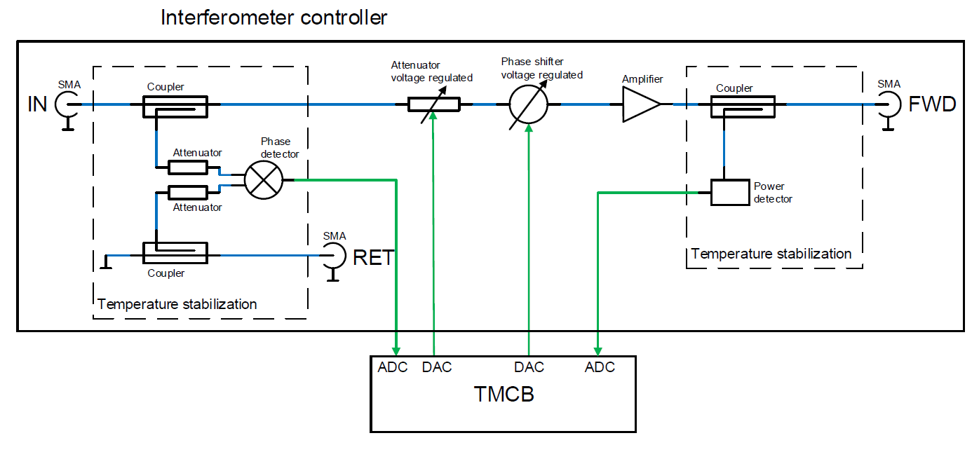
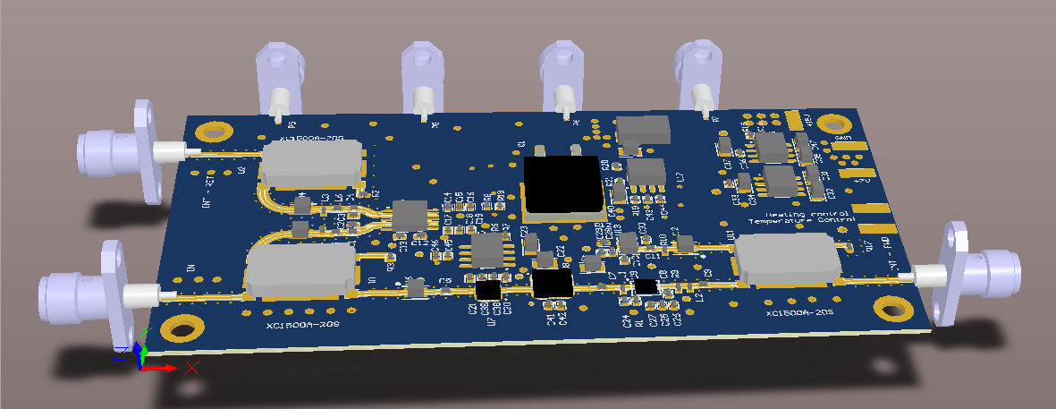
INterferometer CONtrol board (INCON)
Analog part of interferometer phase-locked loop – beginning of the interferometer
Amplitude stabilization
Temperature stabilization
In production

Slide 6
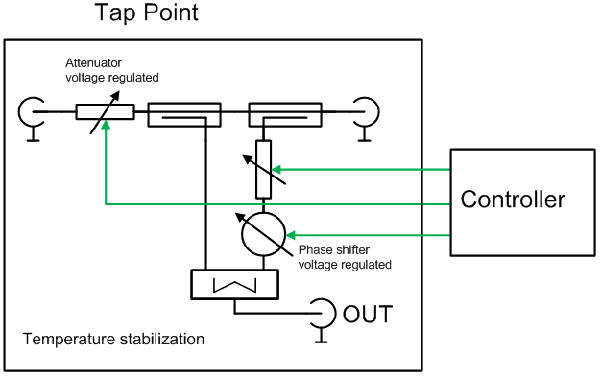
Interferometer Tap Point
Limited access to manual tunning in the tunnel (attenuator and phase shifter adjustments)
Electronic, automatic tuning under development
Temperature stabilization
In design stage

Slide 7
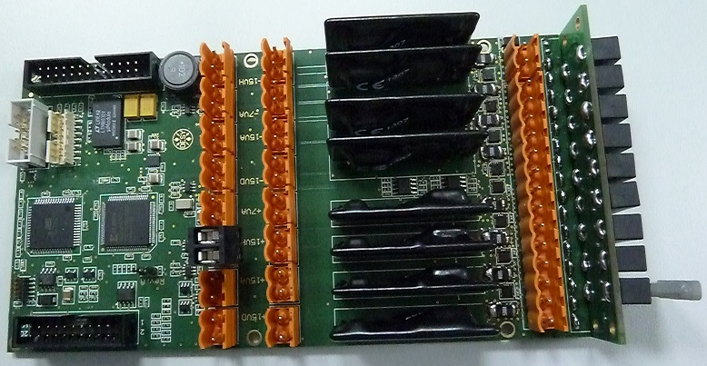
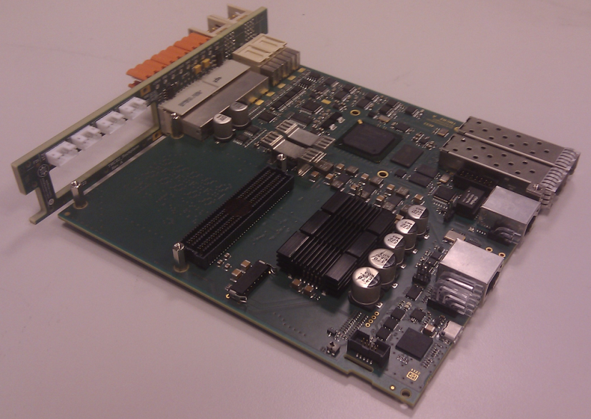
TMCB and FRED
TMCB – Temperature Monitoring and Control Board
Used as a controller for:
interferometer phase-locked loop
amplitude stabilization
temperature stabilization
Communicate with the interferometer tap point controller
FRED – Fuse RElay boarD
Provides all necessary power supplies, fused
Current consumption monitoring

Slide 8
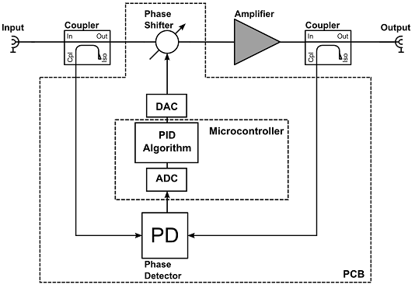
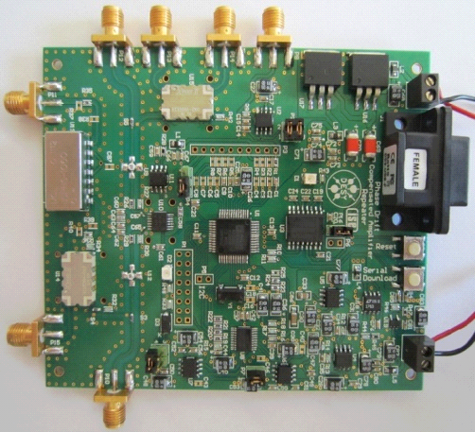
Stabilized Amplifier
Phase and amplitude drifts compensation between amplifier input and output
First version developed for phase drift compensation (see figures)
Second version under development

Slide 9
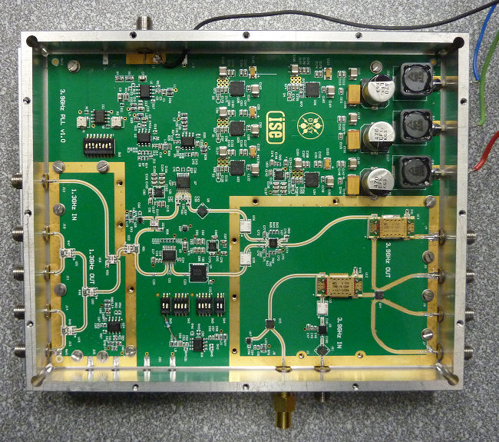
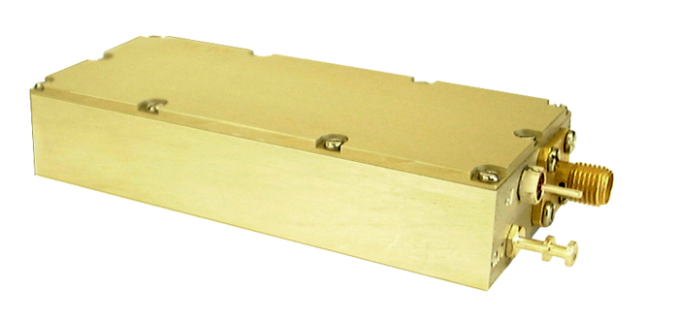
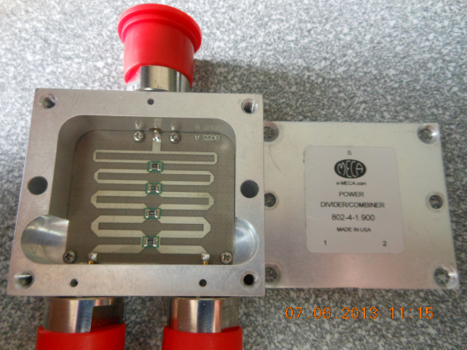
Remaining Components
PLL 3.9 GHz tested in FLASH
Remaining components available:
Power amplifier (COTS)
Power splitter (custom Teflon free version of commercial component)
Frequency divider (DESY design)

Slide 10
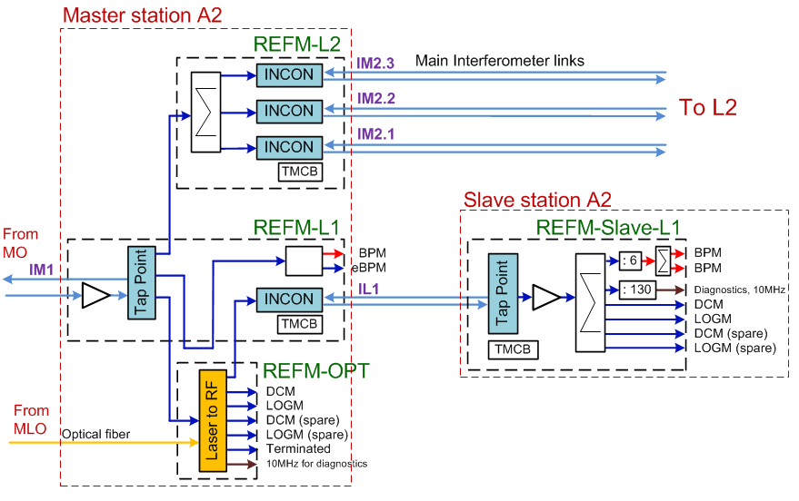
REFM Example (L1)
Limited number of components (assembly variants)

Slide 11
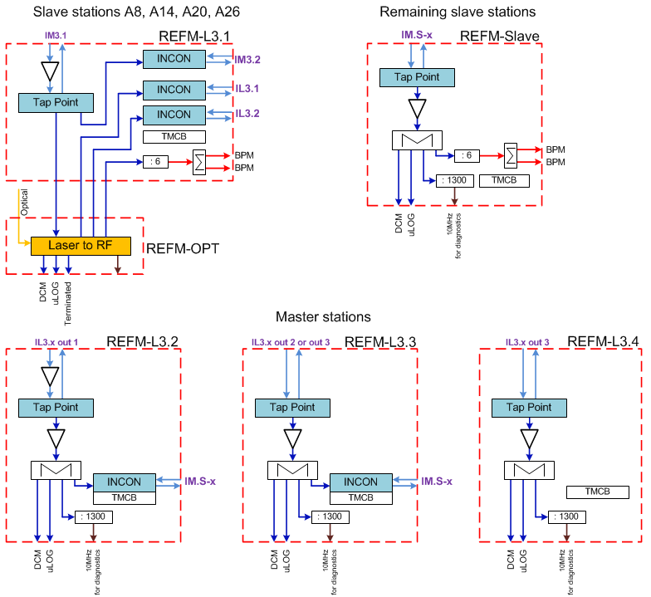
REFM Example (L3)

Slide 12
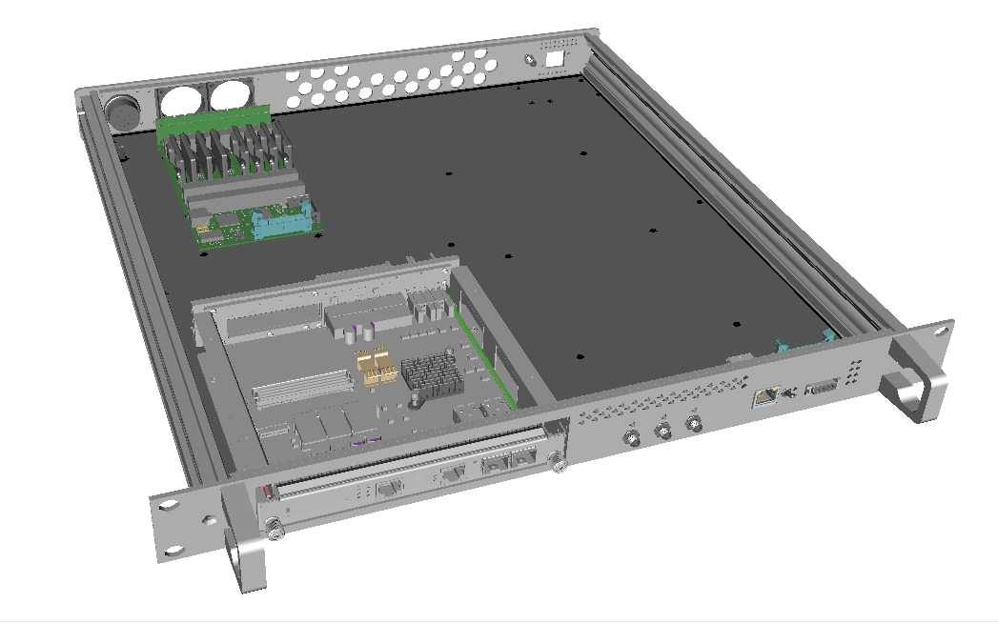
Mechanical Base for REFM Module

Slide 13
Thank you for your attention

Slide 14
Component cost
Interferometer control board (INCON)
Interferometer tap point
Link power amplifier - 1100€
Stabilized power amplifier
Power splitter
Frequency divider
TMCB – 600€
FRED
PLL 3.9GHz

