Slide 1
The
Ultrashort
Pulse
Whisperer:
How to create well-behaved light on the attosecond scale

Slide 2
Overview
Introduction
My Project
Generation of ultrashort broadband pulses
Further Work
Improvements
Applications
Conclusion

Slide 3
Introduction

Slide 4
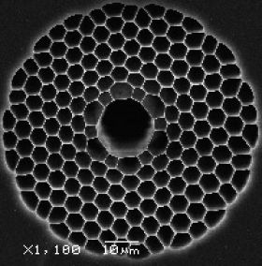
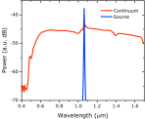
Introduction
Lasers Lasers Lasers Lasers Lasers Lasers Lasers
ULTRASHORT PULSE
FRAN KIRSCHNER
100% lasers yo
Wikipedia, phys.org, bath.ac.uk

Slide 5
Introduction
“I'll say things that are serious and put them in a joke form so people can enjoy them. We laugh to keep from crying.”

Slide 6
Introduction
“I'll say things that are serious and put them in a joke form so people can enjoy them. We laugh to keep from crying.”
-Kanye West

Slide 7
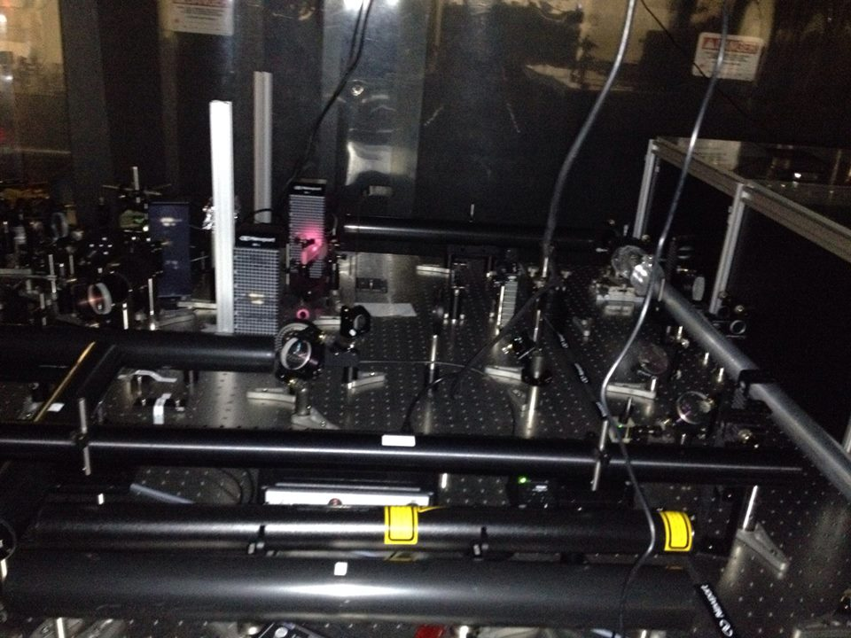
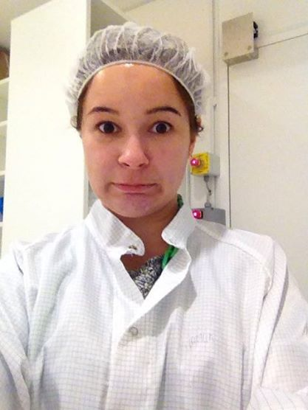
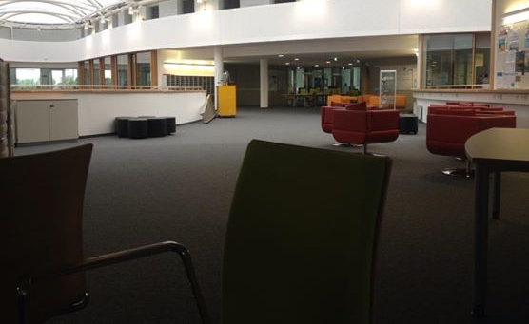
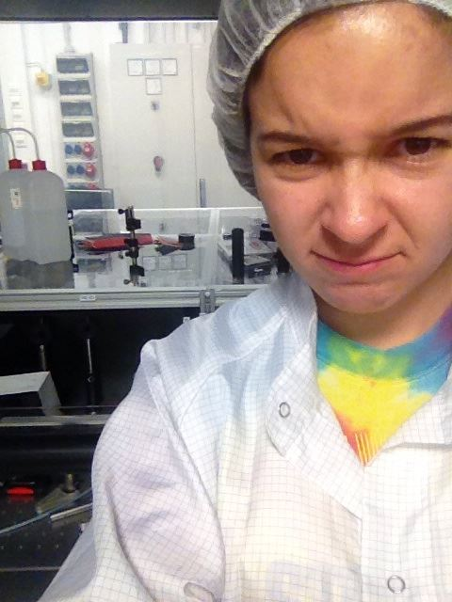
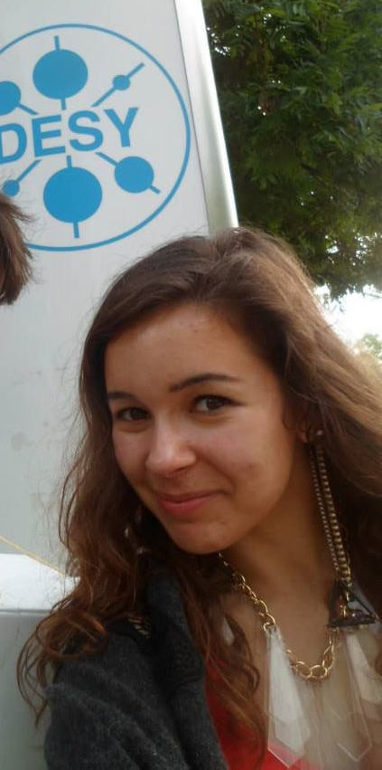
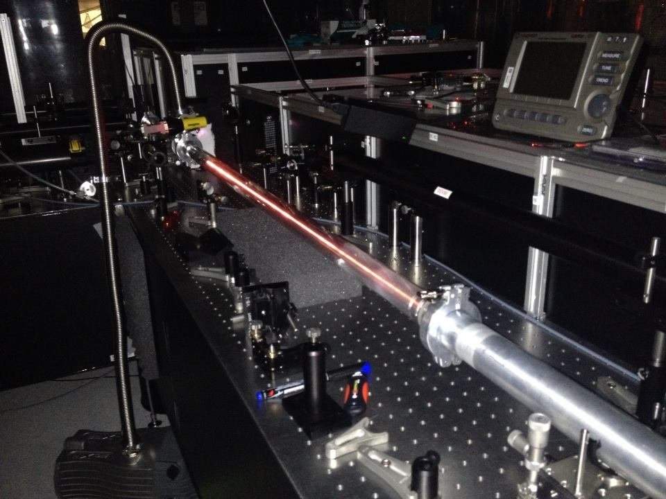
My Project
Notes:
Talk about transverse and longitudinal kerr (only longitundinal here) and SPM
Transverse = introduces chirp, SPM
Longitudinal = self focussing, incr in intensity

Slide 8
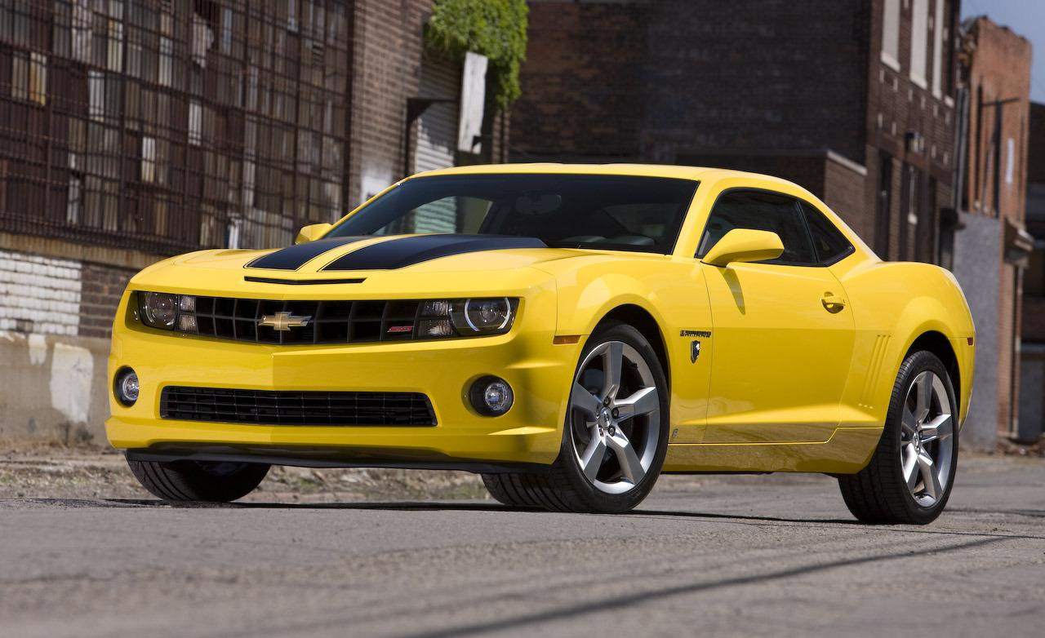
My Project
Generation of ultrashort broadband pulses
Uncertainty
$$A$$
$$f$$
$$A$$
$$f$$

Slide 9
My Project
Generation of ultrashort broadband pulses
Uncertainty
$$A$$
$$t$$
$$f$$
$$A$$
$$f$$
$$t$$

Slide 10
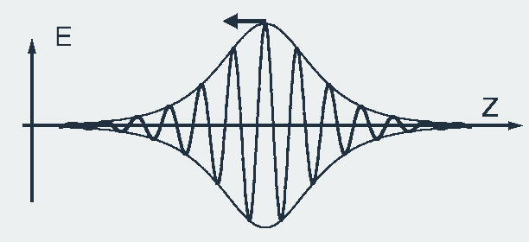
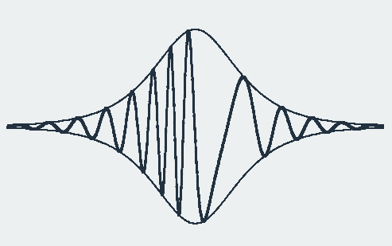
My Project
Generation of ultrashort broadband pulses
SPM
Kerr effect
$$n\left(t,\overset{⃑}{x}\right)=n_{0}+n_{2}I(t,\overset{⃑}{x})$$
G. Steinmeyer et. al., Science, 286, 5444 (1999)
Notes:
Talk about transverse and longitudinal kerr (only longitundinal here) and SPM
Transverse = introduces chirp, SPM
Longitudinal = self focussing, incr in intensity

Slide 11
My Project
Generation of ultrashort broadband pulses
Dispersion control
G. Steinmeyer et. al., Science, 286, 5444 (1999)
Notes:
Talk about transverse and longitudinal kerr (only longitundinal here)

Slide 12
My Project
Generation of ultrashort broadband pulses
2.0mm
0.4mm
Notes:
Talk about photonic band gap guidance thing (PBG effect)

Slide 13
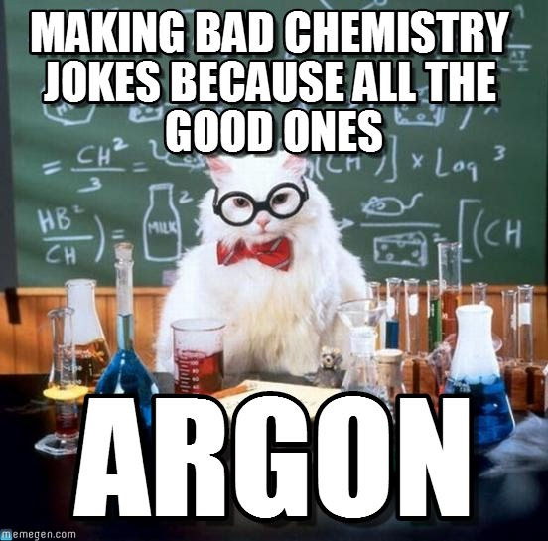
My Project
Generation of ultrashort broadband pulses
Notes:
Self-focussing => plasma formation, more broadening
Also other effects (list) – GVD, self-steepening, DVG, etc

Slide 14
My Project
Generation of ultrashort broadband pulses

Slide 15
My Project
Generation of ultrashort broadband pulses
SUPERCONTINUUM

Slide 16
My Project
Half-wave plate
Ti:Sapphire CPA System
Thin film polarizer
Gas in
HCF
Flip mirror
Chirped mirrors
f = 1.5m
Gas out
Spectrometer
Experiment chamber
Notes:
One of my jobs was to improve setup, incl:
Changing lens (smaller focal point)
Thinner windows (less dispersion, fewer unwanted nonlinearities)
Initially swapped Ne for Ar (lower IE, broader band)

Slide 17
My Project
Notes:
Various improvements:

Slide 18
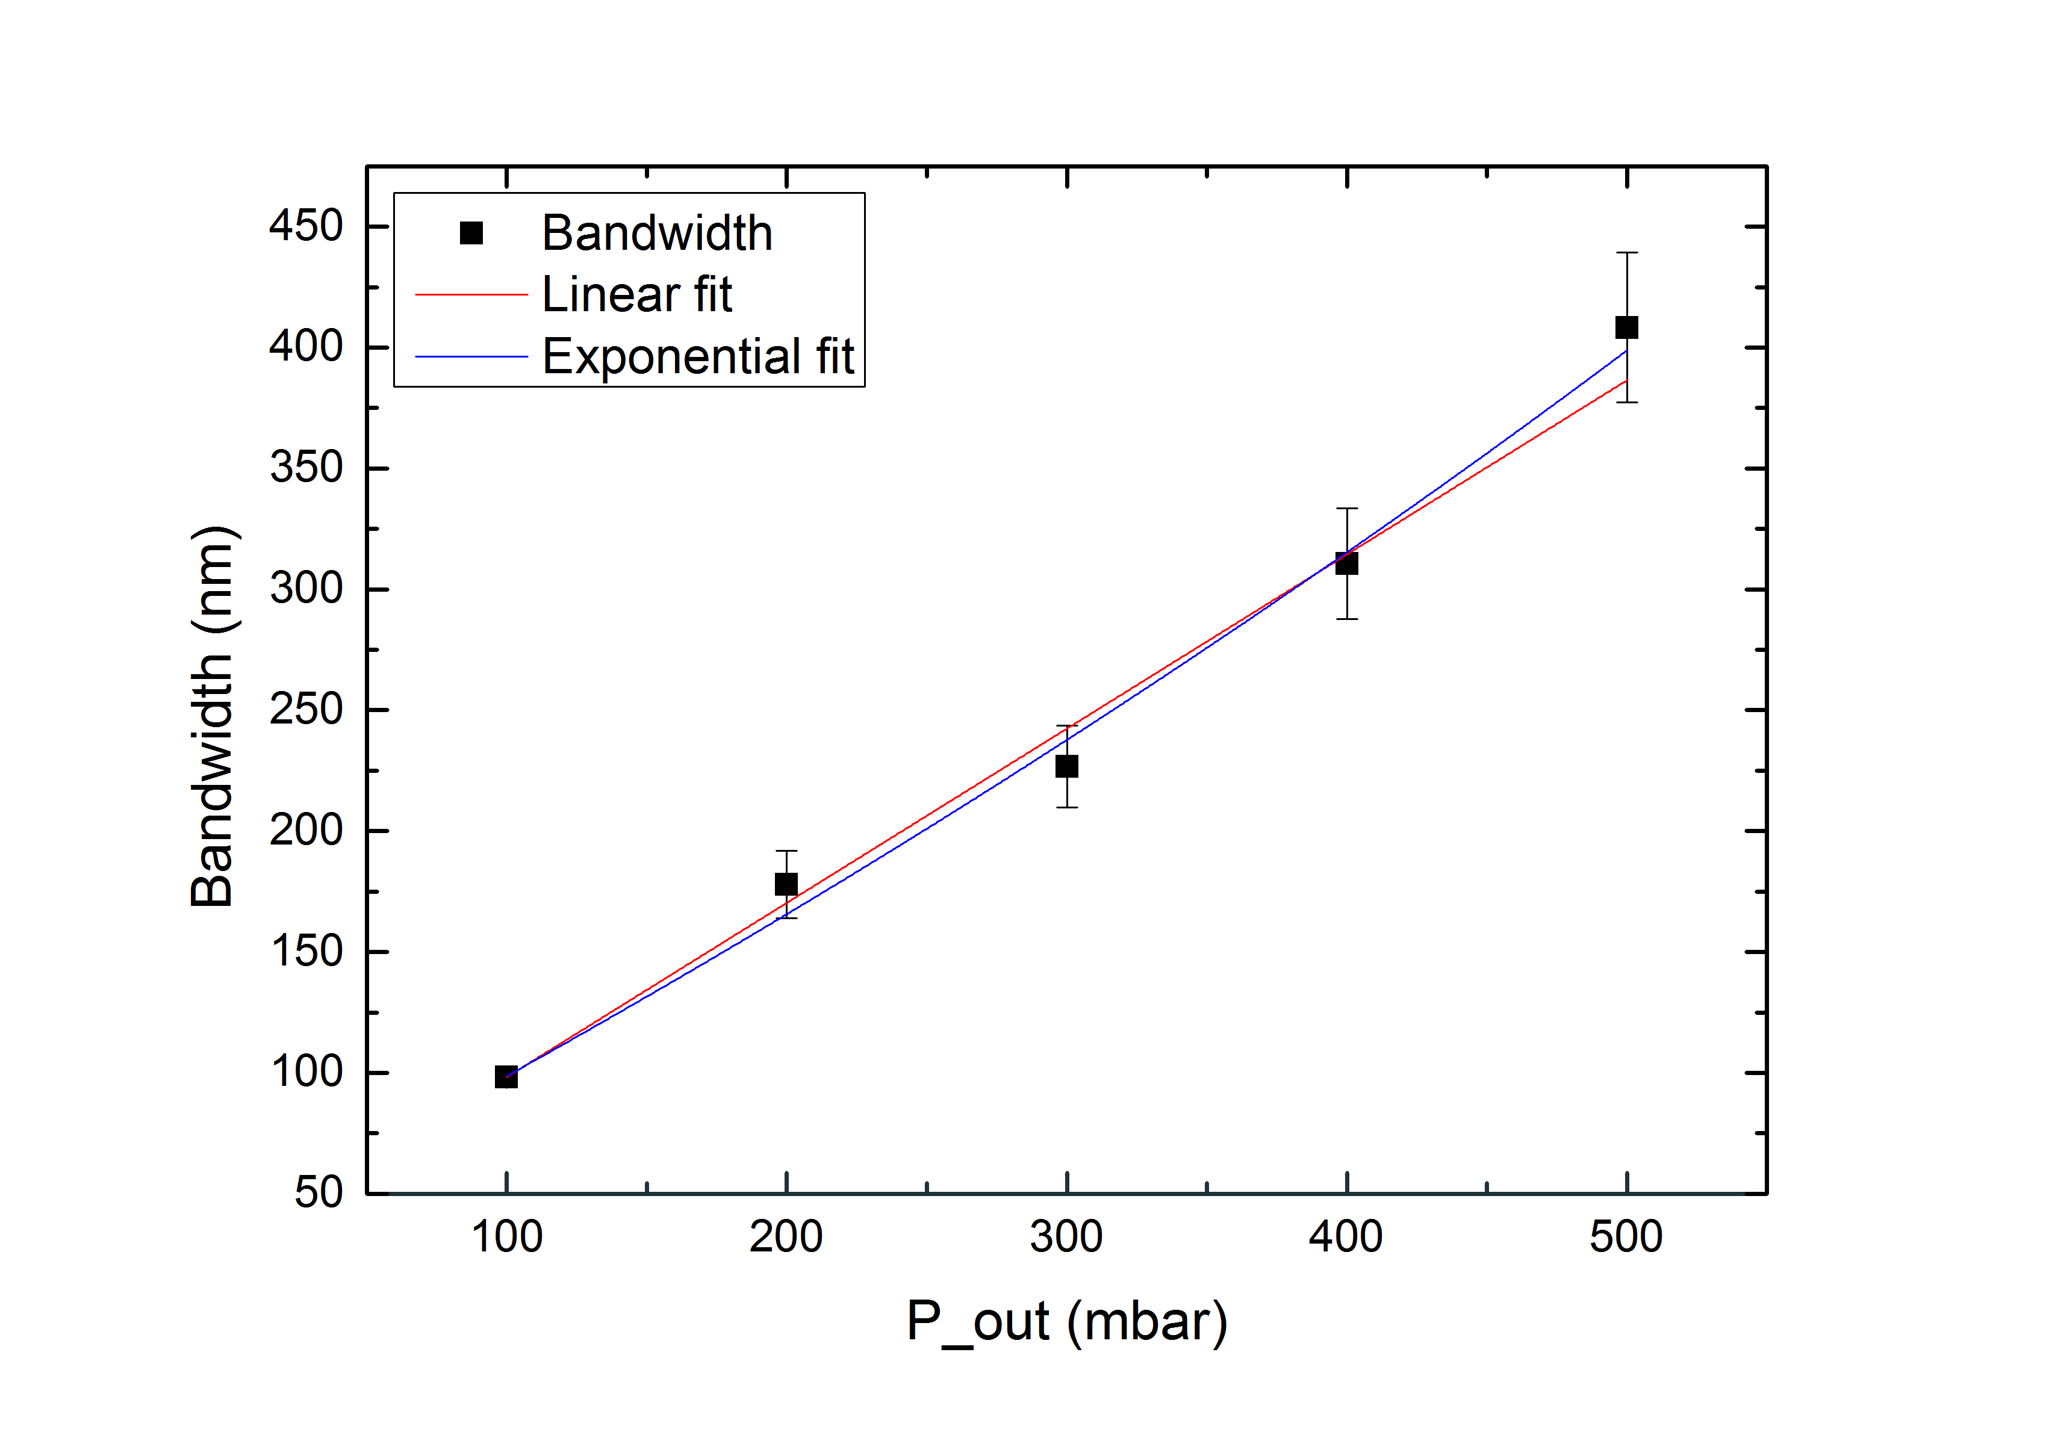
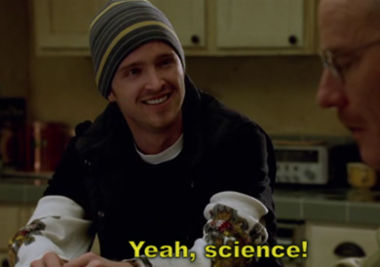
My Project
Generation of ultrashort broadband pulses E_{in}=1300µJ
E_{out}=960µJ
P_{in}=0bar
Notes:
Results from broadband spec w/ pressure

Slide 19
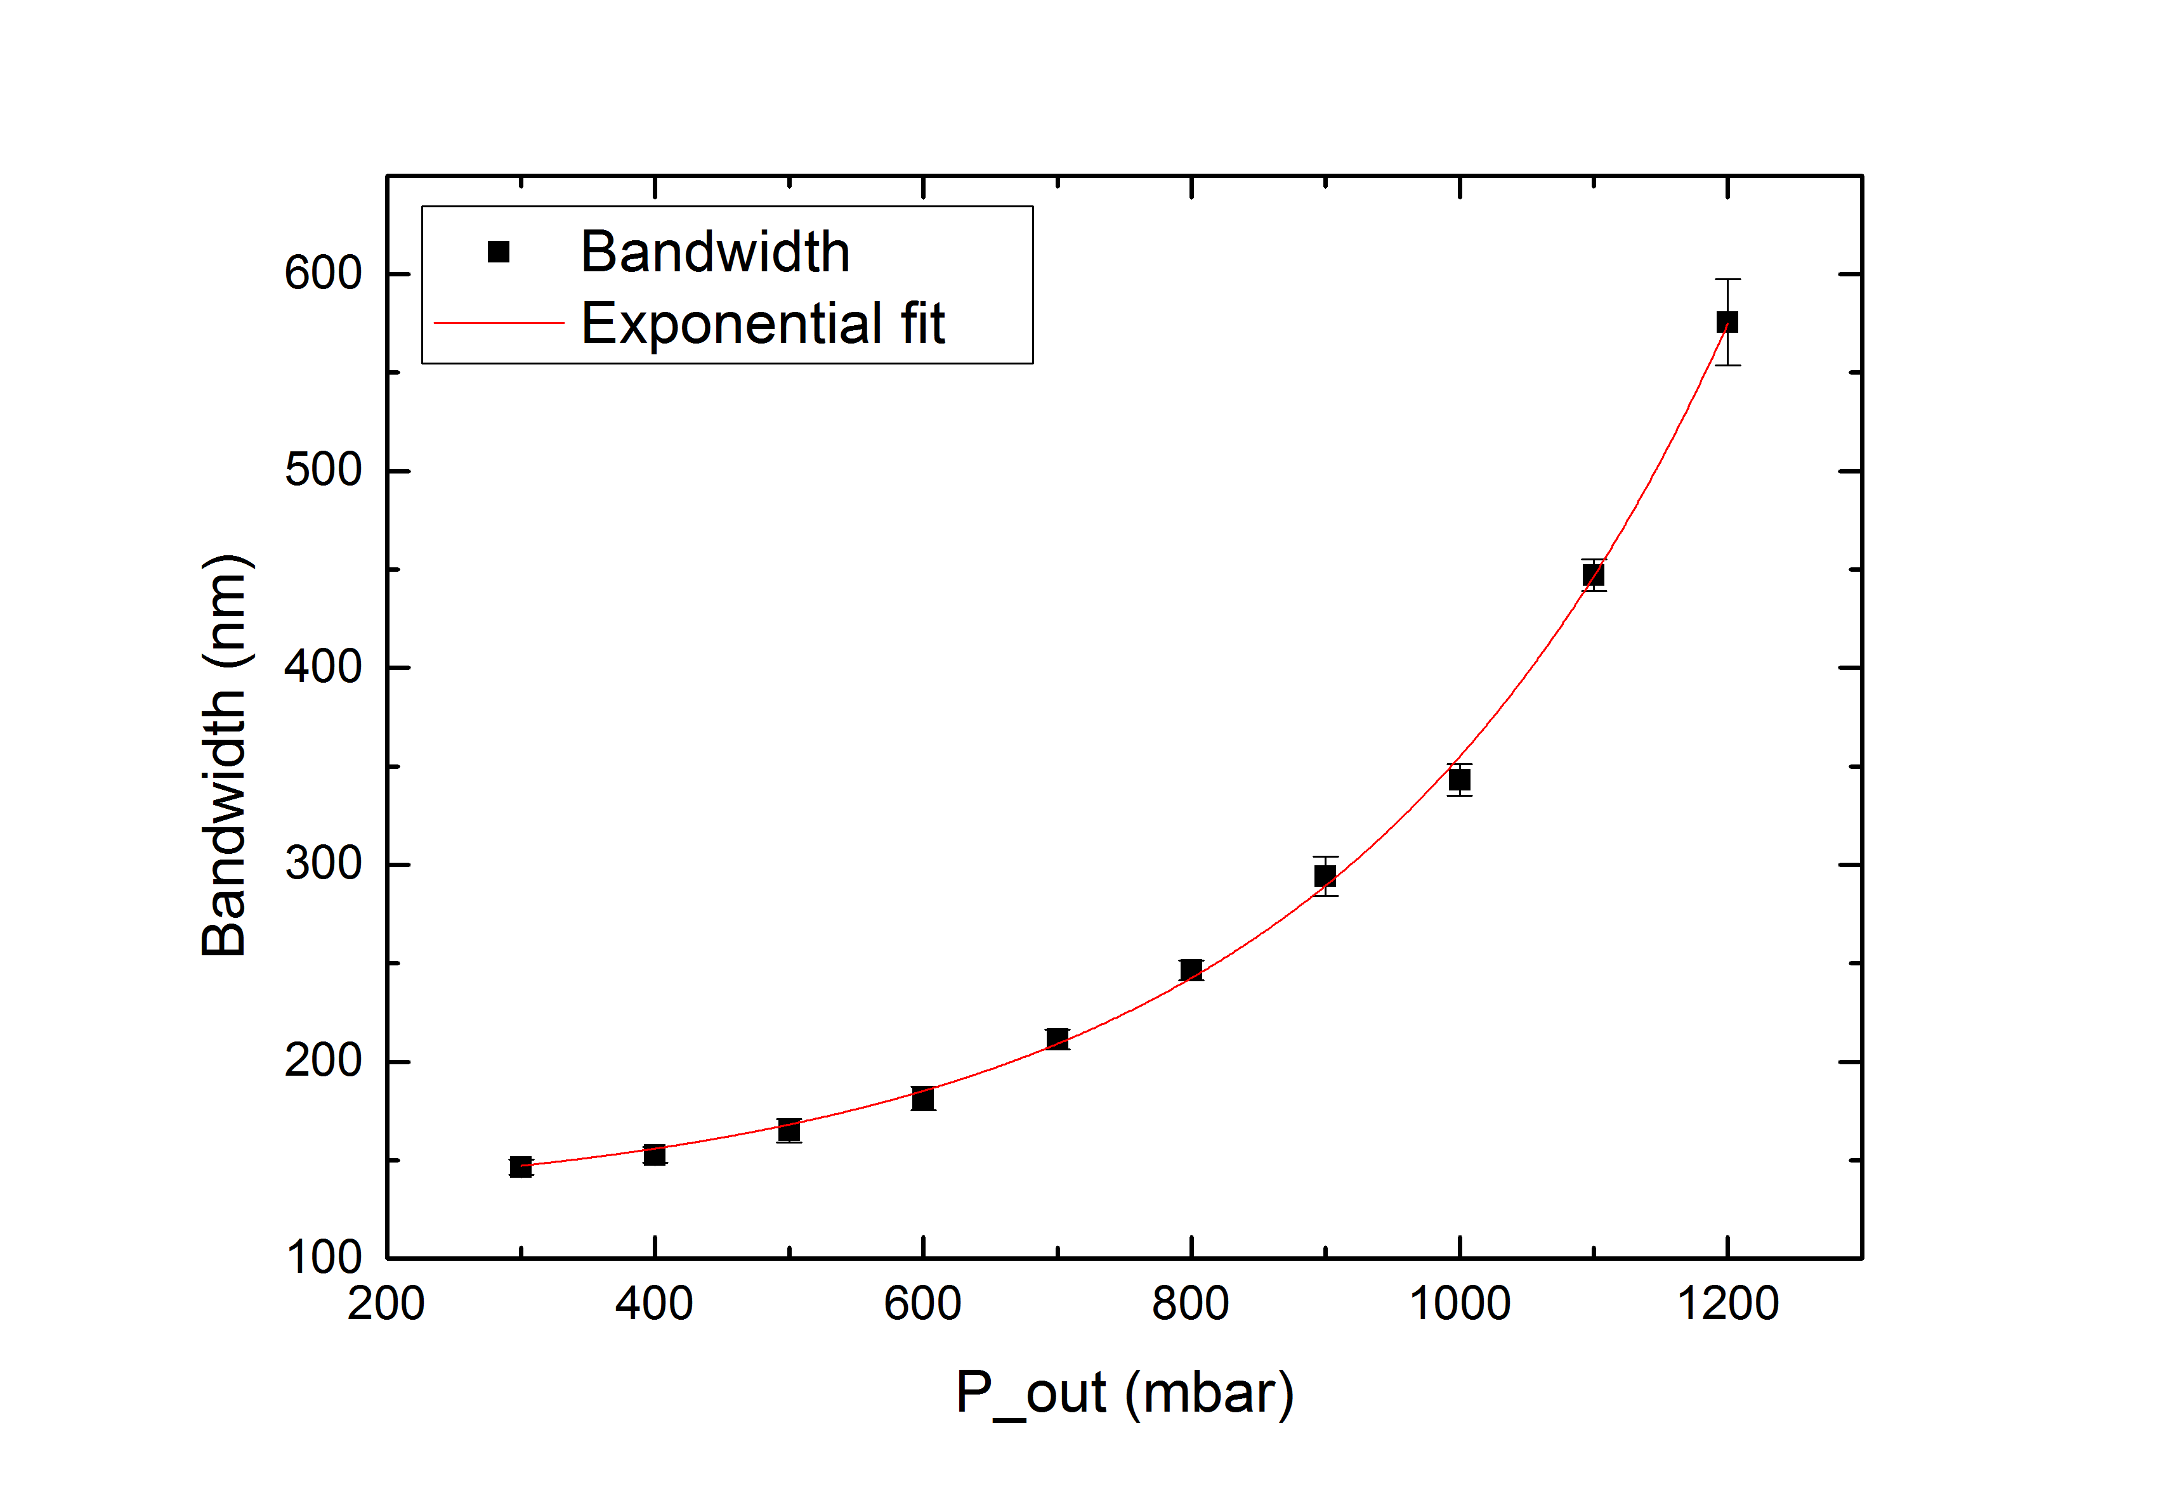
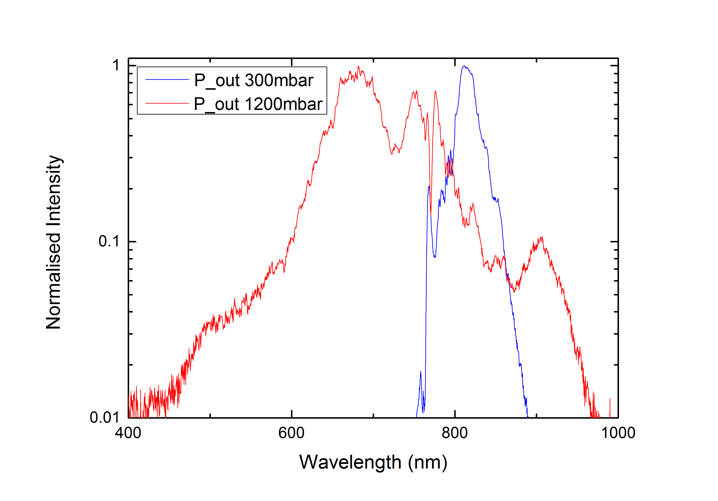
My Project
Generation of ultrashort broadband pulses E_{in}=600µJ
E_{out}=450µJ
P_{in}=0bar
Notes:
Results from broadband spec w/ pressure

Slide 20
My Project
Generation of ultrashort broadband pulses E_{in}=600µJ
E_{out}=450µJ
P_{in}=“0”bar
Notes:
Results from broadband spec w/ pressure

Slide 21
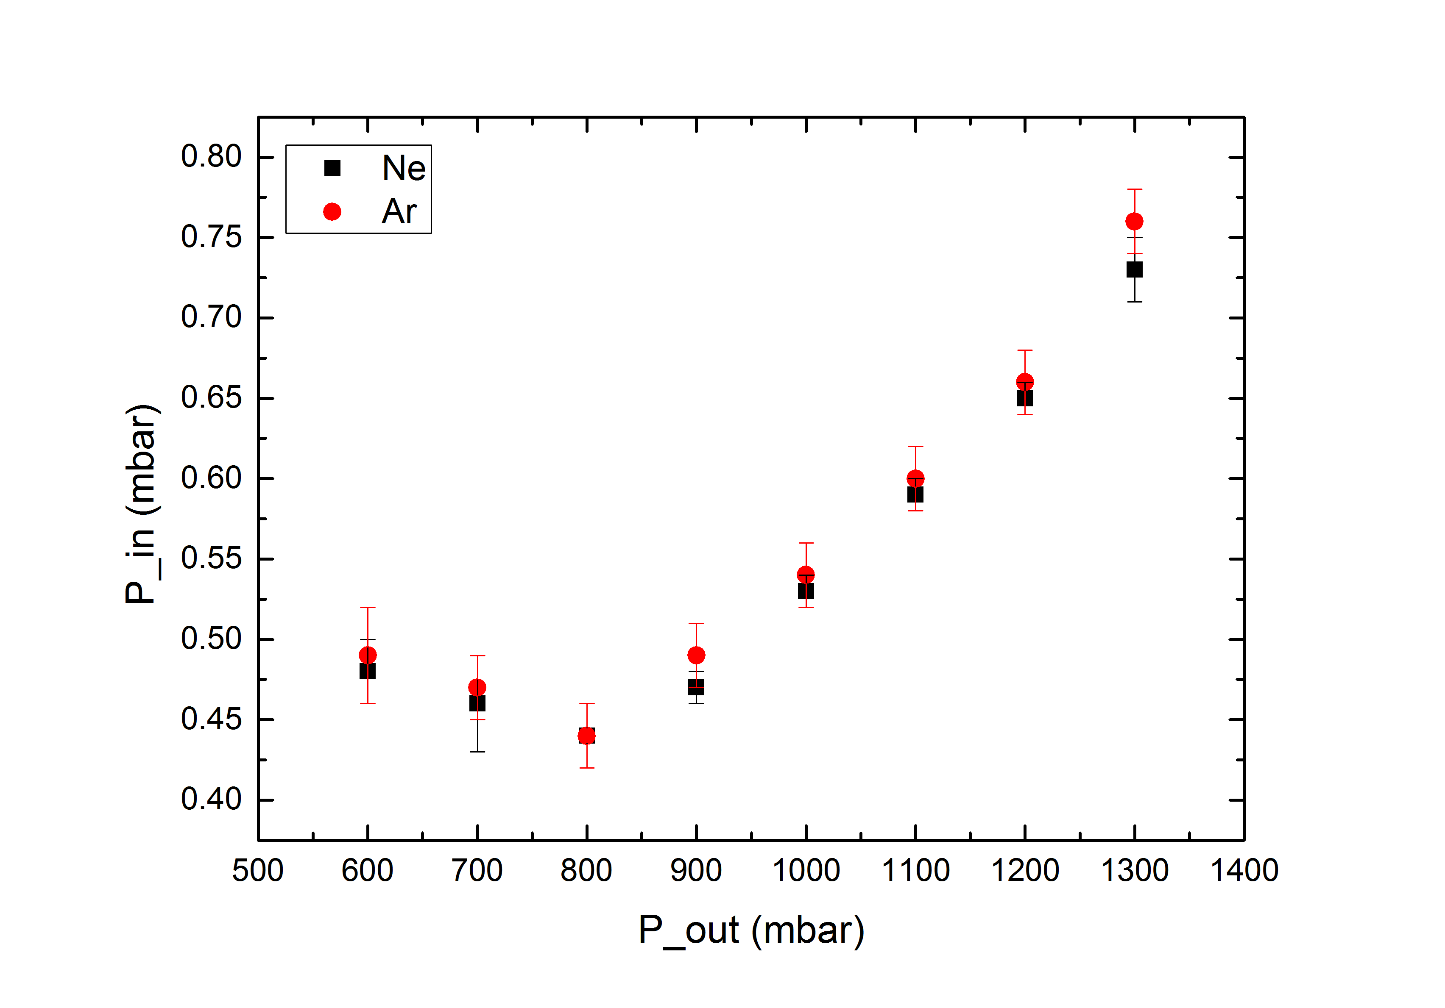
My Project
Generation of ultrashort broadband pulses
Notes:
Results from broadband spec w/ pressure

Slide 22
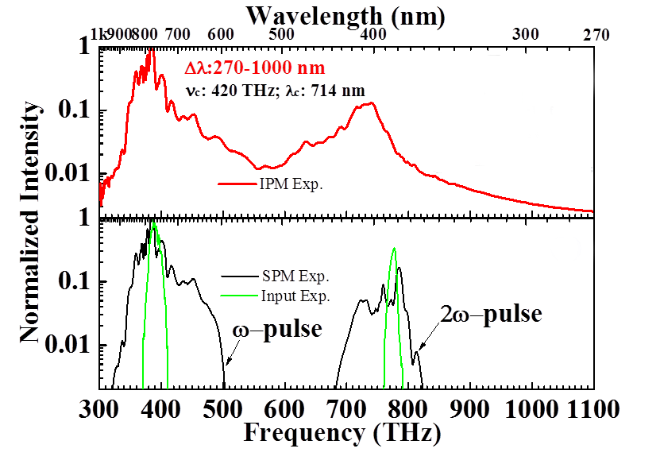
Further Work
Improvements
Higher energies
Broader bandwidths
Shorter pulses
IPM?
Shaobo Fang
Notes:
Incr stability by using Ne (also cheaper)
Talk a lil bit about IPM (using freq & double freq), absolute madness
Can achieve more stability w/ larger pressure grad and lower E

Slide 23
Further Work
Improvements
Higher energies
Broader bandwidths
Shorter pulses
IPM?
“Never say never”
-Justin Bieber
Shaobo Fang
Notes:
Incr stability by using Ne (also cheaper)
Talk a lil bit about IPM (using freq & double freq), absolute madness
Can achieve more stability w/ larger pressure grad and lower E

Slide 24
Further Work
Applications
Attoscience
High harmonic generation
Meteorology
Spectroscopy
Biological processes
Optical coherence tomography
Clocks
Notes:
Anywhere that needs control over intensity, phase,

Slide 25
Conclusion
Can’t use sun for white light
Generate it using SPM in a HCF
Use in attoscience, meteorology, spectroscopy…
Notes:
Anywhere that needs control over intensity, phase,

Slide 26
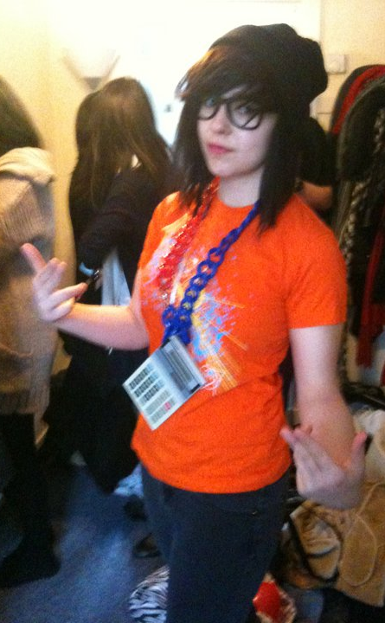
Conclusion
Thank you!
Special thanks to:
Shaobo Fang for putting the ‘super’ in ‘supervisor’,
the Ultrafast Optics and X-rays group,
OriginLab,
Lidl, and finally
the DESY Summer School (10/10, would do again).

