Slide 1
Protein expression and purification of the C-terminal domain of Parvovirus H-1 NS1 protein
Pongpawan Sethanant
Junior Research Group SIAS
DESY Summer Student 2014

Slide 2
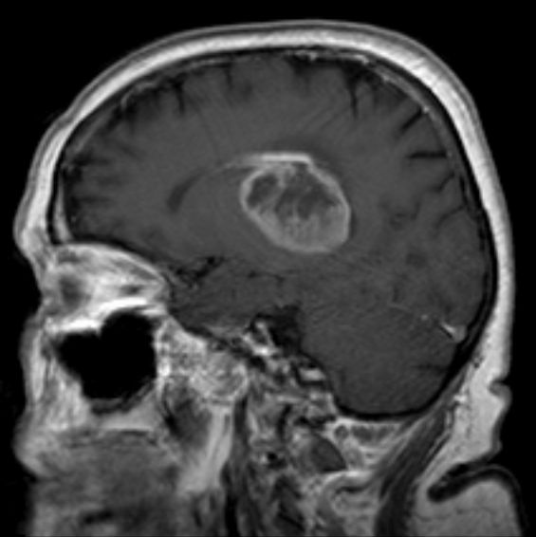
Glioblastoma
Most common and most aggressive
Replicates rapidly
Reoccuring

Slide 3
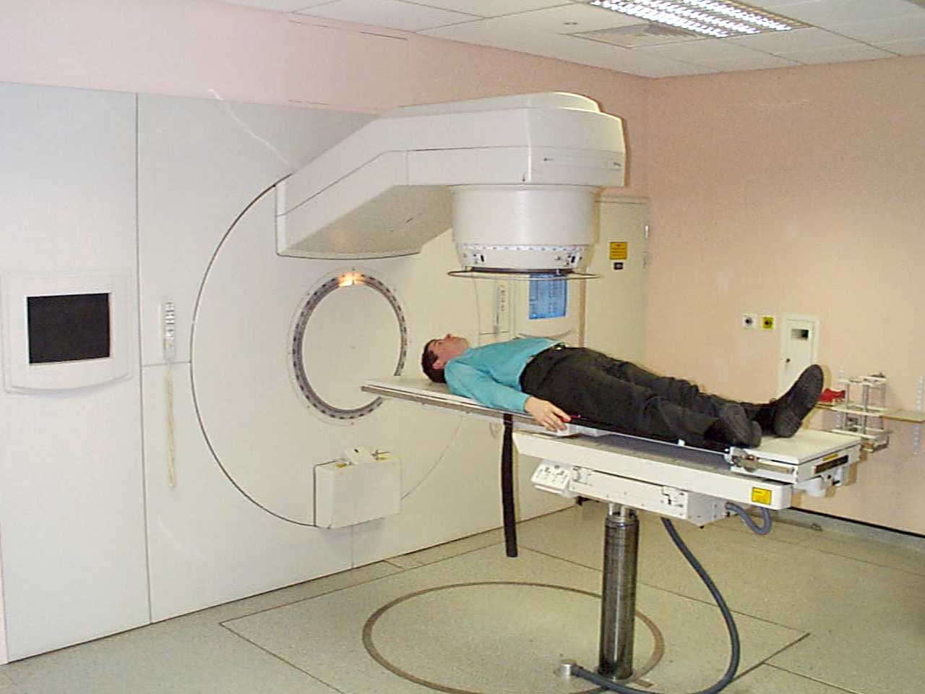
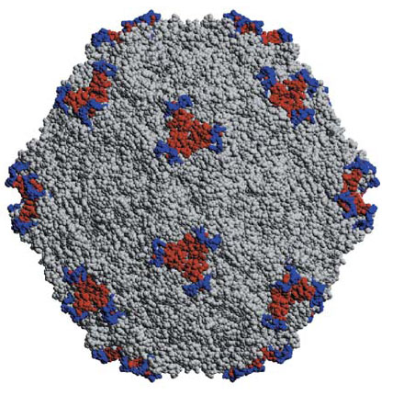
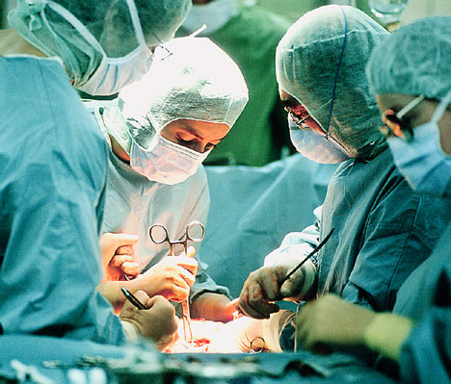
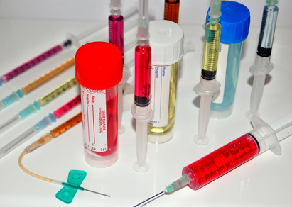
Cancer therapy

Slide 4
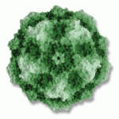
Oncolytic viruses
Specific to cancer cells
Examples
Adenoviruses
Herpes Simplex Virus-1
Parvoviruses

Slide 5
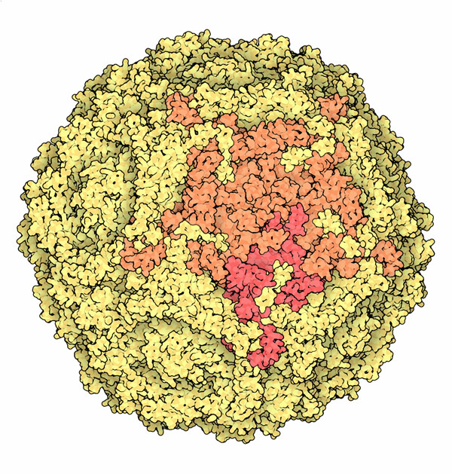
Parvovirus H-1
One of the smallest virus
~ 5,000 bp genome
Encodes only 7 proteins
2 structural: VP1 and VP2
5 nonstructural: NS1, 3 spliced NS2 forms and SAT

Slide 6
NS1 protein
672 amino acid residues
Multifunctional protein
NS1 protein is comprised of 3 domains
N-terminal
Helicase
C-terminal

Slide 7
Objectives
Express and purify the C-terminal domain of Parvovirus H-1 NS1 protein
Construction of pFastBac-NS1-C-terminal domain (aa 543-672)

Slide 8
Protein expression and purification
Expression trial
Large-scale protein expression (4 L)
Protein purification

Slide 9
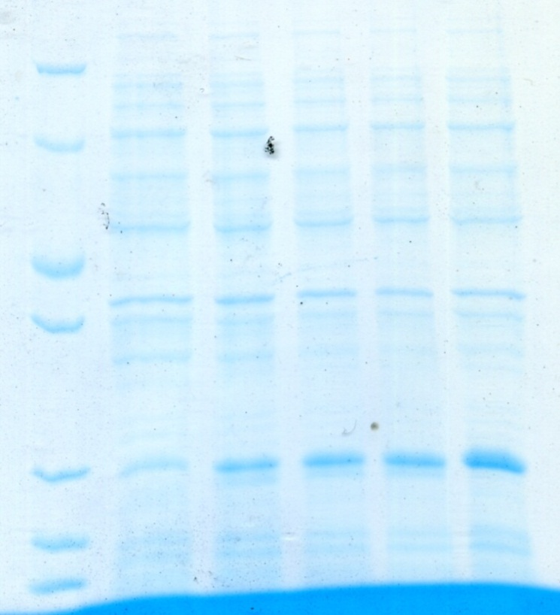
Expression trial
Protein induction of E. coli BL21 DE3 with 1 mM IPTG
at OD₆₀₀ of 0.6 at 37ºC
Induction time (hrs)
kDa
0
1
2
3
4
35.0
25.0
18.4

Slide 10
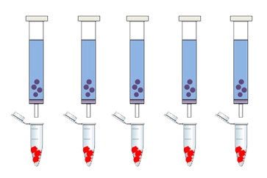
Protein purification
Centrifuge
Sup
Lyse cells
Ni-NTA
Sup
After induce
protein production
in bacterial cells
Wash
Cell debris
Gradient elution
Flow-through
(FT)

Slide 11
Test purification and solubility test
Sup1
Sup2
Pellet
Wash
Elution
kDa
Sup1 = supernatant before incubation with Ni-NTA beads
Sup2 = supernatant after incubation with Ni-NTA beads
25.0
18.4
14.4

Slide 12
Large-scale protein expression (4 L)
Sup
FT
Elution
1 2 3 4 5 6
Sup = Supernatant
FT = Flow-through
Elution
1= 50 mM imidazole
2= 100 mM imidazole
3= 150 mM imidazole
4 = 200 mM imidazole
5 = 500 mM imidazole
6 = 500 mM imidazole

Slide 13
Size exclusion chromatography
C2-C11
B11-B2

Slide 14
Size exclusion chromatography
B
C
Marker 11 10 9 8 7 6 3 2
2 3 4 5 8 9 10 11 12 Marker
kDa
25.0
18.4

Slide 15
Construction of pFastBac-NS1- C-terminal domain (aa 543-672)

Slide 16
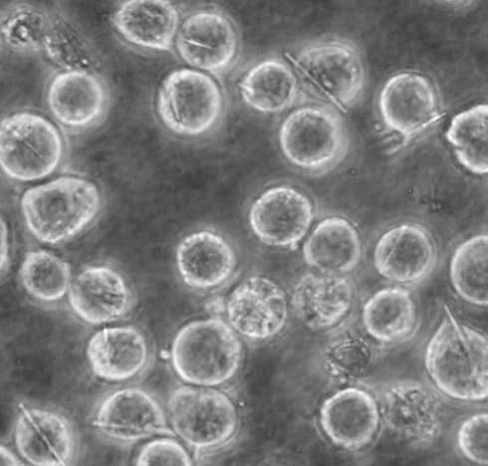
In vivo crystallization of cathepsin B
Pre-pro-cathepsin B of the parasite Trypanosoma brucei (TbCatB)
Recombinant expression in baculovirus-infected Sf9 insect cells
Crystals are membrane surrounded, indicating crystallization within a cellular compartment, e.g. the endoplasmatic reticulum
Koopmann*, Kupelli*, Redecke* et al., Nat. Methods 9, 259-262 (2012)

Slide 17
pFastBac constructs | Localization
pFastBac
pFastBac-ER | Endoplasmic reticulum
pFastBac-ER-SKL | Endoplasmic reticulum and Peroxisomes
pFastBac-ER-KDEL | Endoplasmic reticulum and retention signal
pFastBac-SKL | Peroxisomes

Slide 18
pFastBac vector construction for in vivo crystallography tests
pFastBac
A
A
NS1 C-terminal gene
T
T
pFastBac
pFastBac
Add T-tail
Digest with
SfoI

Slide 19
NS1 C-terminal gene amplification
bp
A
A
NS1 C-terminal gene
400

Slide 20
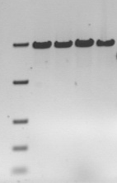
pFastBac linearization
pFastBac
(A)
(B)
bp
1 2 3 4
5,000
pFastBac
1.pFastBac-SKL
2.pFastBac-ER
3.pFastBac-ER-KDEL 4.pFastBac-ER-SKL
bp
5,000
2,000
2,000

Slide 21
T-tailing reaction
Linearized pFastBac plasmid
PCR reaction
- Linearized pFastBac plasmid
- Taq polymerase
- dTTP***
T-tail addition
T
T

Slide 22
Discussions
Protein expression and purification
The purified protein from size exclusion chromatography must be re-purified prior to structural characterizations such as
DLS measurement
CD spectroscopy
Protein crystallization

Slide 23
Discussions
Low efficiency of pFastBac T-tailing by Taq polymerase
Change to
Terminal transferase and ddTTP

Slide 24
Vielen Dank!

Slide 25
C-terminal transactivation domain

