Slide 1
Coherent diffraction imaging of colloidal crystal grain in the divergent beam
Summer student:
Ilia Grigoriev
Supervisors:
Prof. Dr. Ivan Vartaniants
Anatoly Shabalin
Ruslan Kurta
Dmitry Dzhigaev
Hamburg, 10.09.2014

Slide 2
Outline
Motivation
Experiment setup
Theoretical background
Properties of the sample in the CXDI experiment and simulation of the experiment
CXDI simulation - results
CXDI – Coherent X-RAY Diffraction Imaging

Slide 3
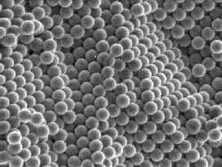
Motivation
Self-organized colloidal crystals have potential applications as functional materials.

Slide 4
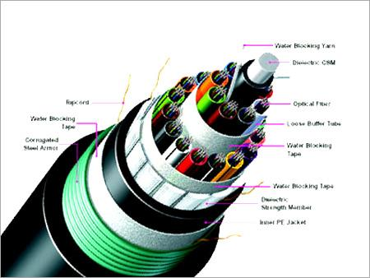
Motivation
Self-organized colloidal crystals have potential applications as functional materials.
Optical computing - research projects focus on replacing current computer components with optical equivalents, resulting in an optical digital computer system processing binary data (Wikipedia).

Slide 5
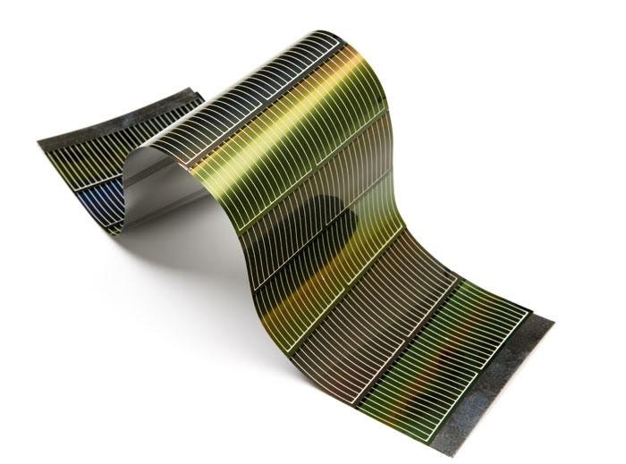
Motivation
Self-organized colloidal crystals have potential applications as functional materials.
Optical computing - research projects focus on replacing current computer components with optical equivalents, resulting in an optical digital computer system processing binary data (Wikipedia).
Future solar cells

Slide 6
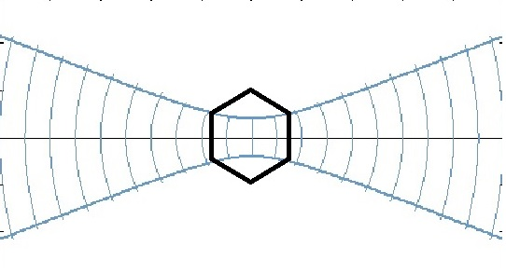
Experimental problem
The sample is in the focus. Plain wave front.
In focus

Slide 7
Experimental problem
The sample is in the focus. Plain wave front.
Problem: if the size of the sample (the largest distance between the edges of the crystal) is larger than the size of the beam in the focus.
In focus

Slide 8
Experimental problem
The sample is in the focus. Plain wave front.
Problem: if the size of the sample (the largest distance between the edges of the crystal) is larger than the size of the beam in the focus.
Solution: move the sample out of the focus.
In focus

Slide 9
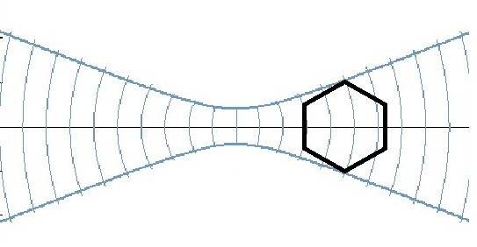
Experimental problem
The sample is in the focus. Plain wave front.
Problem: if the size of the sample (the largest distance between the edges of the crystal) is larger than the size of the beam in the focus.
Solution: move the sample out of the focus.
Problem: Curved wave front.
In focus
Out of the focus

Slide 10
Experimental problem
The sample is in the focus. Plain wave front.
Problem: if the size of the sample (the largest distance between the edges of the crystal) is larger than the size of the beam in the focus.
Solution: move the sample out of the focus.
Problem: Curved wave front.
Issues: Investigate the influence of the curved front on the reconstruction quality.
In focus
Out of the focus

Slide 11
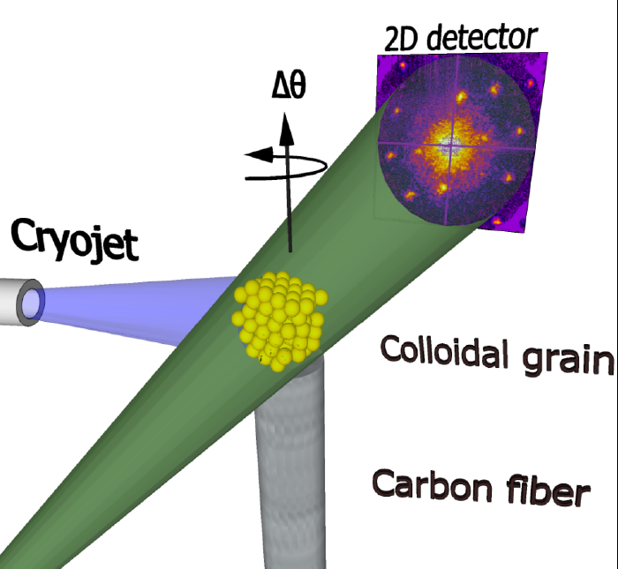
Experiment setup
CXDI – Coherent X-ray Diffraction Imaging experiment
Monochromatic coherent X-ray beam, 7.9 keV
Photon-counting pixel detector positioned in transmission geometry.
Sample detector distance: 5.1 [m]
Detector size: 28x28 [mm],
516x516[pixel], pixel size: 55 [um]
Gaussian beam size:
$σ$z= 2.0806 [um], $σ$y = 1.3588 [um]
Sample positioning: 11 [mm] downstream the focal plane (size of the focal spot 0.64x0.41 [um^2])
Wave front curvature:
Rz = 16.15 [mm], Ry = 15.4 [mm]
$$I(q)$$
x
y
z

Slide 12
Theoretical background
Finite Size Crystal, $ρ(\vec{r})$ – electron density distribution in 3D (real space)
$A(\vec{q})= \int{ρ(\vec{r})e^{−i\vec{q}\vec{r}}}d\vec{r}$ – complex scattered amplitudes in 3D (reciprocal space, kinematical approximation)

Slide 13
Theoretical background
Finite Size Crystal, $ρ(\vec{r})$ – electron density distribution in 3D (real space)
$A(\vec{q})= \int{ρ(\vec{r})e^{−i\vec{q}\vec{r}}}d\vec{r}$ – complex scattered amplitudes in 3D (reciprocal space, kinematical approximation)
$\vec{q}$ – momentum transfer
$\vec{q}$ = $\vec{k}$f – $\vec{k}$i
$\vec{k}$f – scattered wave vector
$\vec{k}$i – incident wave vector
$\vec{k}$f
$\vec{k}$i
$$\vec{q}$$
Detector
Sample

Slide 14
Theoretical background
$I\left(q_{x},q_{y}\right)={\left|A\left(q_{x},q_{y}\right)\right|}^{2}$– measured intensities on the detector

Slide 15
Theoretical background
$I\left(q_{x},q_{y}\right)={\left|A\left(q_{x},q_{y}\right)\right|}^{2}$– measured intensities on the detector
$φ \left(q_{x},q_{y}\right) \text{– }\text{phases}$ of the wave in the far-field (from the phase retrivial procedure, simulation)

Slide 16
Theoretical background
$I\left(q_{x},q_{y}\right)={\left|A\left(q_{x},q_{y}\right)\right|}^{2}$– measured intensities on the detector
$φ \left(q_{x},q_{y}\right) \text{– }\text{phases}$ of the wave in the far-field (from the phase retrivial procedure, simulation)
$w\left(q_{x},q_{y}\right)= \left|A\left(q_{x},q_{y}\right)\right|e^{−i∗φ \left(q_{x},q_{y}\right)}$ – complex function of the wave in the far-field (2D, reciprocal)

Slide 17
Theoretical background
$I\left(q_{x},q_{y}\right)={\left|A\left(q_{x},q_{y}\right)\right|}^{2}$– measured intensities on the detector
$φ \left(q_{x},q_{y}\right) \text{– }\text{phases}$ of the wave in the far-field (from the phase retrivial procedure, simulation)
$w\left(q_{x},q_{y}\right)= \left|A\left(q_{x},q_{y}\right)\right|e^{−i∗φ \left(q_{x},q_{y}\right)}$ – complex function of the wave in the far-field (2D, reciprocal)
$p\left(x, y\right)=ℱ_{2D}\left(\left|A\left(q_{x},q_{y}\right)\right|e^{−i∗φ \left(q_{x},q_{y}\right)}\right)$ – projection of the electron density in the beam direction (2D, real space)

Slide 18
Theoretical background
Merge all 2D complex scattered amplitudes from the sample 3D (reciprocal space):
$$Merge[\left|A\left(q_{x},q_{y}\right)\right|e^{−i∗φ \left(q_{x},q_{y}\right)}] =\left|A\left(\vec{q}\right)\right|e^{−i∗φ \left(\vec{q}\right)}$$

Slide 19
Theoretical background
Merge all 2D complex scattered amplitudes from the sample 3D (reciprocal space):
$$Merge[\left|A\left(q_{x},q_{y}\right)\right|e^{−i∗φ \left(q_{x},q_{y}\right)}] =\left|A\left(\vec{q}\right)\right|e^{−i∗φ \left(\vec{q}\right)}$$
Distribution of the electron density (3D, real space):
$$ρ(\vec{r})=ℱ_{3D}(\left|A\left(\vec{q}\right)\right|e^{−i∗φ \left(\vec{q}\right)})$$

Slide 20
Theoretical background
$\tilde{p}\left(x, y\right)=\left|\tilde{A}\left(q_{x},q_{y}\right)\right|e^{−i∗φ \left(q_{x},q_{y}\right)}→$ projection of the electron density in the beam direction (2D, real space, curved wave front)
$p\left(x, y\right)=\left|A\left(q_{x},q_{y}\right)\right|e^{−i∗0}→$projection of the electron density in the beam direction (2D, real space, plain wave front)
$g(x,y)−$ Gaussian beam function (real space)

Slide 21
Theoretical background
$\tilde{p}\left(x, y\right)=\left|\tilde{A}\left(q_{x},q_{y}\right)\right|e^{−i∗φ \left(q_{x},q_{y}\right)}→$ projection of the electron density in the beam direction (2D, real space, curved wave front)
$p\left(x, y\right)=\left|A\left(q_{x},q_{y}\right)\right|e^{−i∗0}→$projection of the electron density in the beam direction (2D, real space, plain wave front)
$g(x,y)−$ Gaussian beam function (real space)
$ℱ_{2D}\{\tilde{p}\left(x, y\right)\}=ℱ_{2D}\{g\left(x,y\right)\}⊗ℱ_{2D}\{p\left(x,y\right)\}−$ Convolution (Blur on the detector, reciprocal space)
$\left|ℱ_{2D}\{\tilde{p}\left(x, y\right)\}\right|=\tilde{A}\left(q_{x},q_{y}\right)$ – distribution of the amplitudes on the detector (curved wave front, reciprocal space)

Slide 22
Theoretical background
$\tilde{p}\left(x, y\right)=\left|\tilde{A}\left(q_{x},q_{y}\right)\right|e^{−i∗φ \left(q_{x},q_{y}\right)}→$ projection of the electron density in the beam direction (2D, real space, curved wave front)
$p\left(x, y\right)=\left|A\left(q_{x},q_{y}\right)\right|e^{−i∗0}→$projection of the electron density in the beam direction (2D, real space, plain wave front)
$g(x,y)−$ Gaussian beam function (real space)
$ℱ_{2D}\{\tilde{p}\left(x, y\right)\}=ℱ_{2D}\{g\left(x,y\right)\}⊗ℱ_{2D}\{p\left(x,y\right)\}−$ Convolution (Blur on the detector, reciprocal space)
$\left|ℱ_{2D}\{\tilde{p}\left(x, y\right)\}\right|=\tilde{A}\left(q_{x},q_{y}\right)$ – distribution of the amplitudes on the detector (curved wave front, reciprocal space)
${A\left(q_{x},q_{y}\right)}_{deconv} = |ℱ_{2D}\left(\frac{\tilde{p}\left(x, y\right)}{g\left(x, y\right)}\right)|$ $−$ approximation of the result of the scattered amplitudes on the detector form the plain wave front (Deconvolution, reciprocal space)
${φ\left(q_{x},q_{y}\right)}_{deconv} =angle(ℱ_{2D}\left(\frac{\tilde{p}\left(x, y\right)}{g\left(x, y\right)}\right))$

Slide 23
Theoretical background
Merge all 2D complex scattered amplitudes from the sample 3D (reciprocal space):
$$Merge\left[A_{deconv} e^{−i∗{φ\left(q_{x},q_{y}\right)}_{deconv}}\right]=\left|A_{deconv}\left(\vec{q}\right)\right|e^{−i∗{φ \left(\vec{q}\right)}_{deconv}}$$
Distribution of the electron density (3D, real space, deconvolution):
$$ρ=ℱ_{3D}\{\left|A_{deconv}\left(\vec{q}\right)\right|e^{−i∗{φ \left(\vec{q}\right)}_{deconv}}\}$$

Slide 24
Properties of the sample in the CXDI experiment and simulation of the experiment
Sample: Colloidal crystal made of polysterene spheres 220 nm in diameter. Grain size = 3 [um]
Shape: Icosahedron

Slide 25
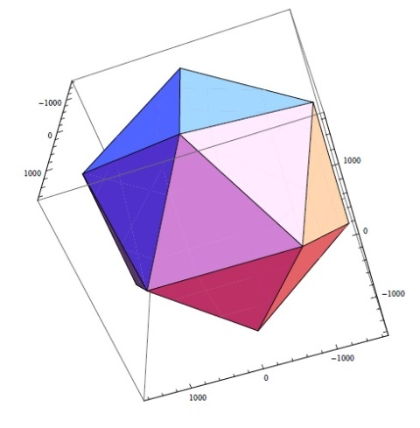
Properties of the sample in the CXDI experiment and simulation of the experiment
Sample: Colloidal crystal made of polysterene spheres 220 nm in diameter. Grain size = 3 [um]
Shape: Icosahedron

Slide 26
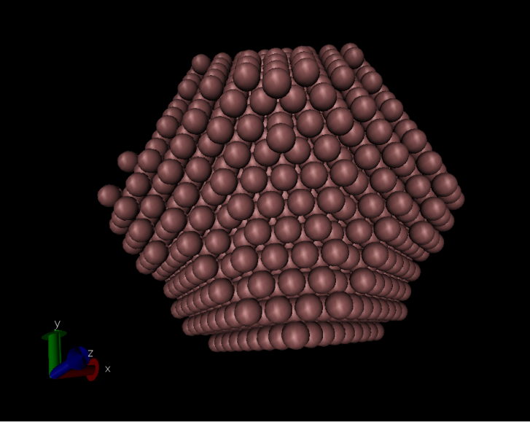
Properties of the sample in the CXDI experiment and simulation of the experiment
Sample: Colloidal crystal made of polysterene spheres 220 nm in diameter. Grain size = 3 [um]
Shape: Icosahedron

Slide 27
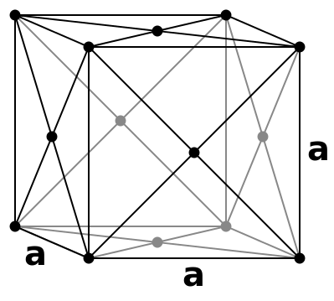
Properties of the sample in the CXDI experiment and simulation of the experiment
Sample: Colloidal crystal made of polysterene spheres 220 nm in diameter. Grain size = 3 [um]
Shape: Icosahedron
Structure: FCC – face centered cubic structure (layer sequence ABC).

Slide 28
CXDI simulation - results
The complex diffraction image (amplitudes and phases) that resulted from the curved wave front was obtained.
Then a deconvolution of the complex scattered amplitudes with the Gaussian beam function (in reciprocal space) was performed.
The results were compared with the case of the plain wave front.

Slide 29
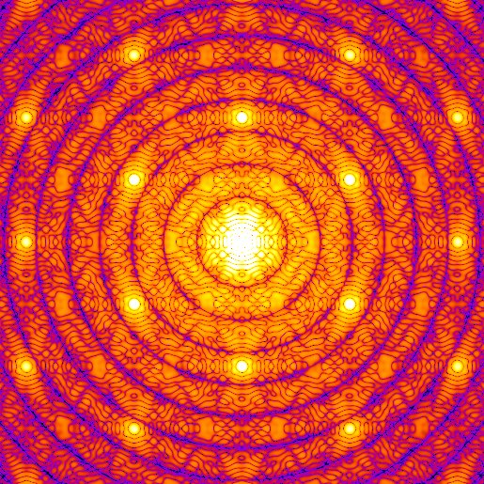
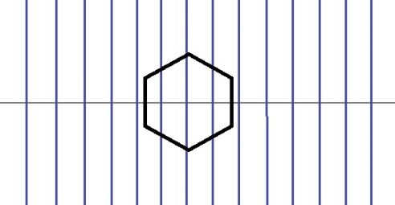
CXDI simulation - results (reciprocal space)
Plain wave front
$$A\left(q_{x},q_{y}\right)$$
$I\left(q_{x},q_{y}\right)={\left|A\left(q_{x},q_{y}\right)\right|}^{2}$, Logarithmic scale

Slide 30
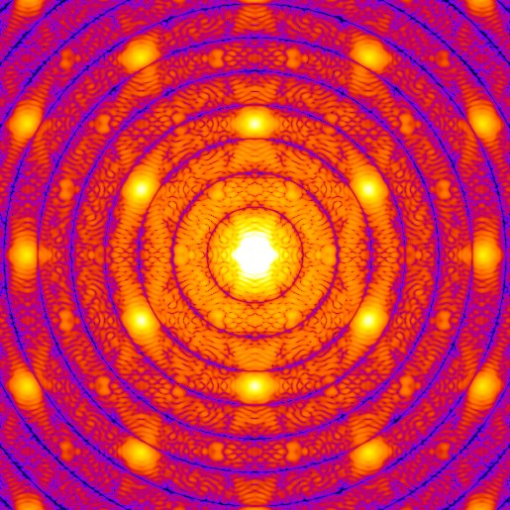
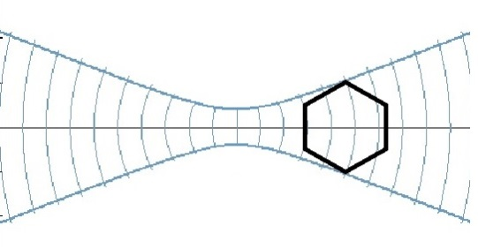
CXDI simulation - results (reciprocal space)
Plain wave front
Curved wave front
$$A\left(q_{x},q_{y}\right)$$
$$\tilde{A}\left(q_{x},q_{y}\right)$$
$I\left(q_{x},q_{y}\right)={\left|A\left(q_{x},q_{y}\right)\right|}^{2}$, Logarithmic scale

Slide 31
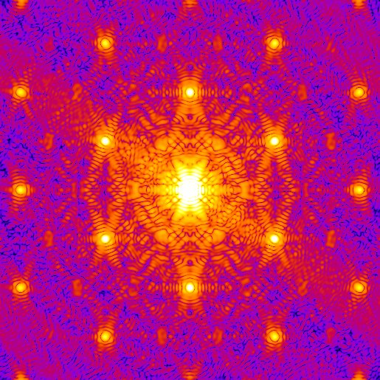
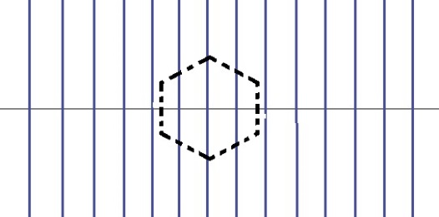
CXDI simulation - results (reciprocal space)
Plain wave front
Curved wave front
Deconvolution curved wave front
$$A\left(q_{x},q_{y}\right)$$
$$\tilde{A}\left(q_{x},q_{y}\right)$$
$\left|FT(\frac{\tilde{p}(x,y)}{g(x,y)})\right|$
$I\left(q_{x},q_{y}\right)={\left|A\left(q_{x},q_{y}\right)\right|}^{2}$, Logarithmic scale

Slide 32
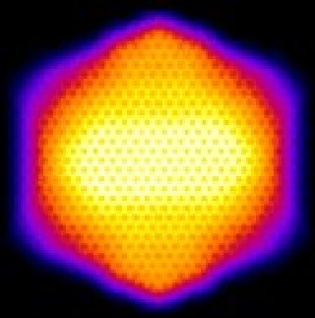
CXDI simulation - results (real space)
Plain wave front
$$p\left(x, y\right)=\left|A\left(q_{x},q_{y}\right)\right|e^{−i∗0}$$
Electron density distribution

Slide 33
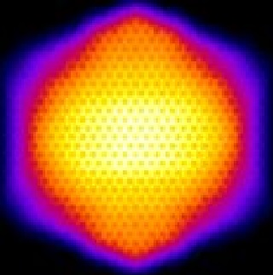
CXDI simulation - results (real space)
Plain wave front
Curved wave front
$$p\left(x, y\right)=\left|A\left(q_{x},q_{y}\right)\right|e^{−i∗0}$$
$$\tilde{p}\left(x, y\right)=\left|\tilde{A}\left(q_{x},q_{y}\right)\right|e^{−i∗φ \left(q_{x},q_{y}\right)}$$
Electron density distribution

Slide 34
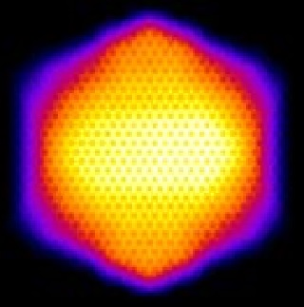
CXDI simulation - results (real space)
Plain wave front
Curved wave front
Deconvolution
$$p\left(x, y\right)=\left|A\left(q_{x},q_{y}\right)\right|e^{−i∗0}$$
$$\tilde{p}\left(x, y\right)=\left|\tilde{A}\left(q_{x},q_{y}\right)\right|e^{−i∗φ \left(q_{x},q_{y}\right)}$$
$\left|(\frac{\tilde{p}(x,y)}{g(x,y)})\right|$
Electron density distribution

Slide 35
CXDI simulation - results (real space)
Curved wave front
$$angle(ℱ_{2D}\left\{\tilde{p}\left(x, y\right)\right\})$$
Phase curvature

Slide 36
CXDI simulation - results (real space)
Curved wave front
Plain wave front
$$angle(ℱ_{2D}\left\{\tilde{p}\left(x, y\right)\right\})$$
$$angle(ℱ_{2D}\left\{p\left(x,y\right)\right\})$$
Phase curvature

Slide 37
CXDI simulation - results (real space)
Curved wave front
Plain wave front
Deconvolution
$$angle(ℱ_{2D}\left(\frac{\tilde{p}\left(x,y\right)}{g\left(x,y\right)}\right))$$
$$angle(ℱ_{2D}\left\{\tilde{p}\left(x, y\right)\right\})$$
$$angle(ℱ_{2D}\left\{p\left(x,y\right)\right\})$$
Phase curvature

Slide 38
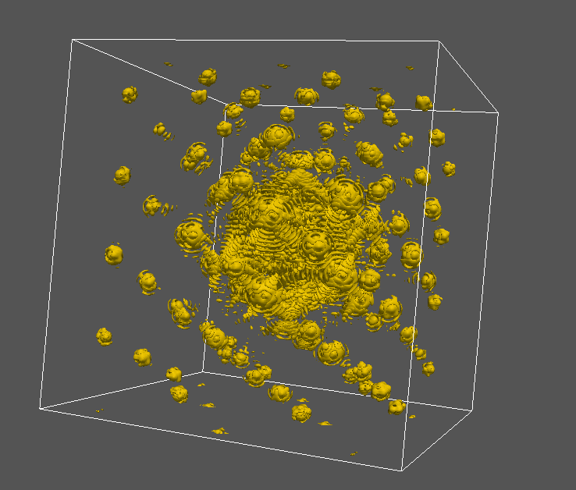
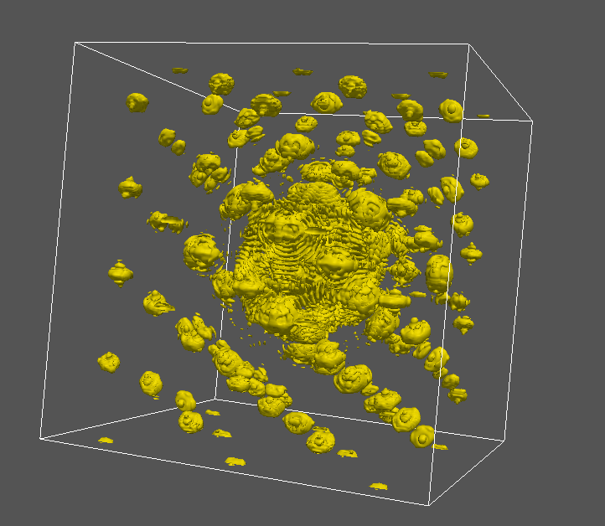
CXDI simulation – results (reciprocal space)
3D reciprocal space
Plain wave front
Deconvolution
$$Merge[\left|A\left(q_{x},q_{y}\right)\right|e^{−i∗φ \left(q_{x},q_{y}\right)}] =\left|A\left(\vec{q}\right)\right|e^{−i∗φ \left(\vec{q}\right)}$$
$$Merge[\left|\tilde{A}\left(q_{x},q_{y}\right)\right|e^{−i∗φ \left(q_{x},q_{y}\right)}] =\left|\tilde{A}\left(\vec{q}\right)\right|e^{−i∗φ \left(\vec{q}\right)}$$

Slide 39
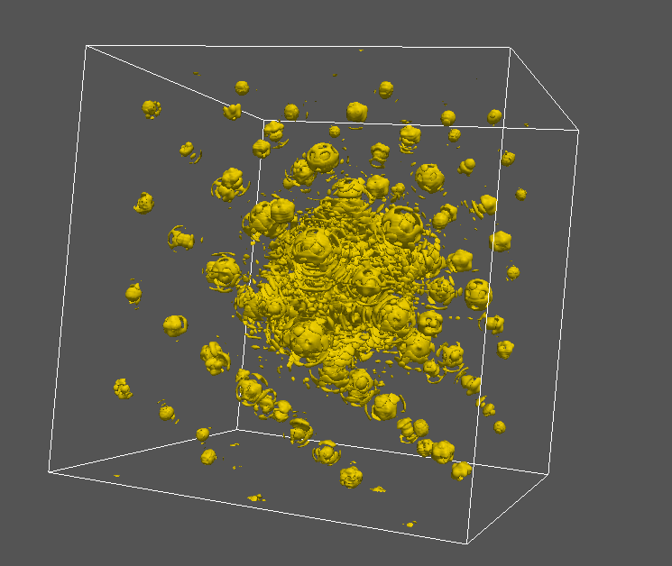
CXDI simulation – results (reciprocal space)
3D reciprocal space
Plain wave front
Deconvolution
$$Merge[\left|A\left(q_{x},q_{y}\right)\right|e^{−i∗φ \left(q_{x},q_{y}\right)}] =\left|A\left(\vec{q}\right)\right|e^{−i∗φ \left(\vec{q}\right)}$$
$$Merge\left[A_{deconv} e^{−i∗{φ\left(q_{x},q_{y}\right)}_{deconv}}\right]=\left|A_{deconv}\left(\vec{q}\right)\right|e^{−i∗{φ \left(\vec{q}\right)}_{deconv}}$$

Slide 40
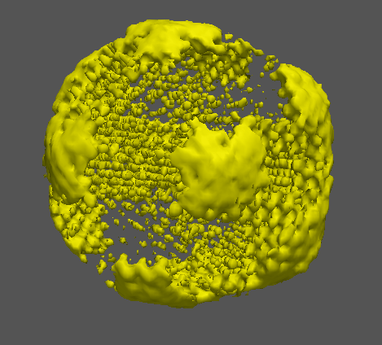
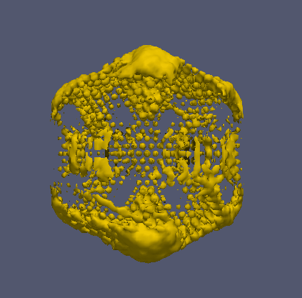
CXDI simulation – results (real space)
Reconstruction of the shape of the colloidal crystal
Plain wave front
Curved wave front
$$ρ(\vec{r})=ℱ_{3D}\{\left|A\left(\vec{q}\right)\right|e^{−i∗φ \left(\vec{q}\right)}\}$$
$$ρ(\vec{r})=ℱ_{3D}\{\left|\tilde{A}\left(\vec{q}\right)\right|e^{−i∗φ \left(\vec{q}\right)}\}$$

Slide 41
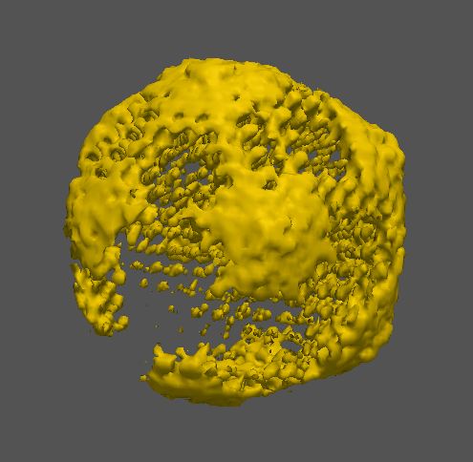
CXDI simulation – results (real space)
Reconstruction of the shape of the colloidal crystal
Plain wave front
Deconvolution
$$ρ(\vec{r})=ℱ_{3D}\{\left|A\left(\vec{q}\right)\right|e^{−i∗φ \left(\vec{q}\right)}\}$$
$$ρ(\vec{r})=ℱ_{3D}\{\left|A_{deconv}\left(\vec{q}\right)\right|e^{−i∗{φ \left(\vec{q}\right)}_{deconv}}\}$$

Slide 42
Conclusion and Outlook
Conclusion:
Problem with the focus improved by means of the deconvolution
Outlook:
Phase retrieval on simulated data
Phase retrieval on the experimental data

Slide 43
Acknowledgements
Prof. Dr. Edgar Weckert
Prof. Dr. Ivan Vartaniants
Anatoly Shabalin
Ruslan Kurta
Dmitry Dzhigaev
Sergey Lazarev
Max Rose

Slide 44
Thank you for your attention!

