Slide 1


Simulation of Ultra-short Optical Pulse Propagation with SPM & IPM
Ultrafast Optics and X-ray group
Fuyue Wang

Slide 2
Contents
Theory of pulses propagation in fibers
Simulation method
Simulation results
Summary

Slide 3
Maxwell equations
Electromagnetic field

Slide 4
Maxwell equations
Solving the equation ……
Loss Dispersion SPM Self-steeping Raman
IPM

Slide 5
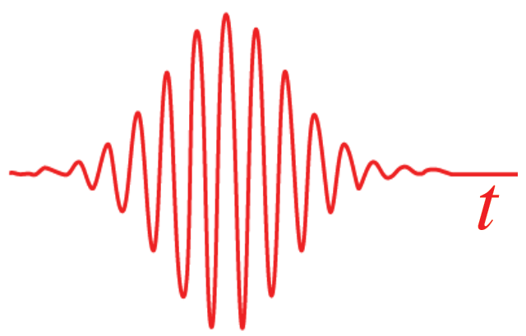
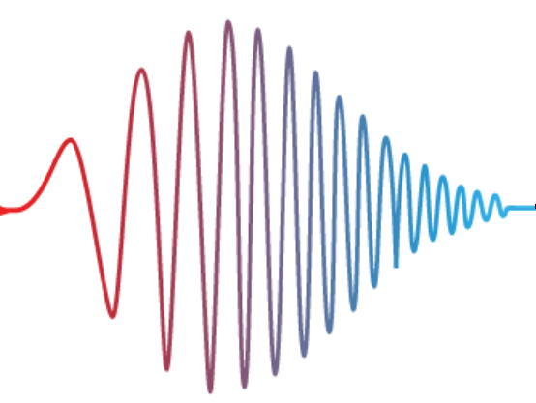
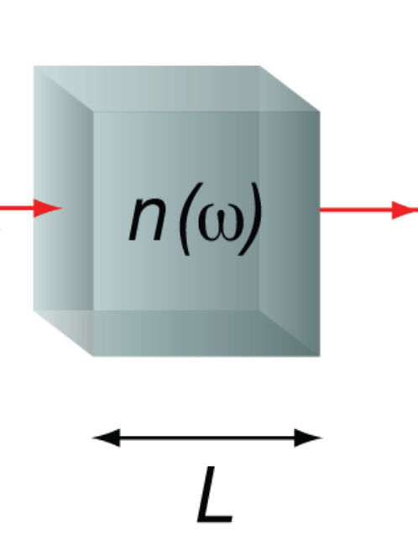
Dispersion effect
Group velocity difference
Second and third order
Pulses broadened
Spectrum unaffected

Slide 6
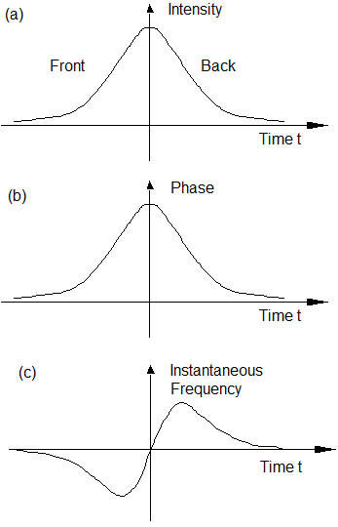
SPM & IPM
Nonlinear effects
Time dependent E
Changes of refractive index
Changes of phase
New frequency

Slide 7
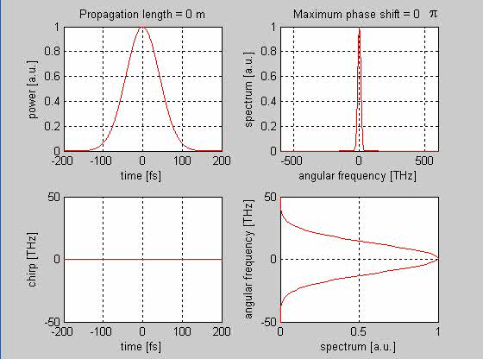
SPM

Slide 8
SPM & IPM
Nonlinear effects
Time dependent E
Changes of refractive index
Changes of phase
New frequency

Slide 9
Simulation methods
Split-step Fourier method

Slide 10
Simulation methods
Pressure gradient
ω
Gas In
ω
Gas-filled hollow fiber
p_{out}
2ω
2ω
ω
p_{in}
n₂
Pressure Gradient
Gas Out
Critical power
Compress
p_{in}
p_{out}

Slide 11
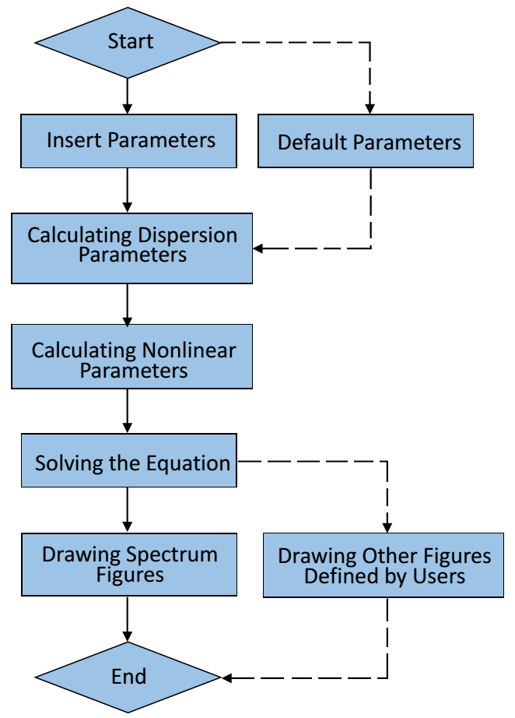
Simulation methods
Improvement
Faster
Parameters
GUI

Slide 12
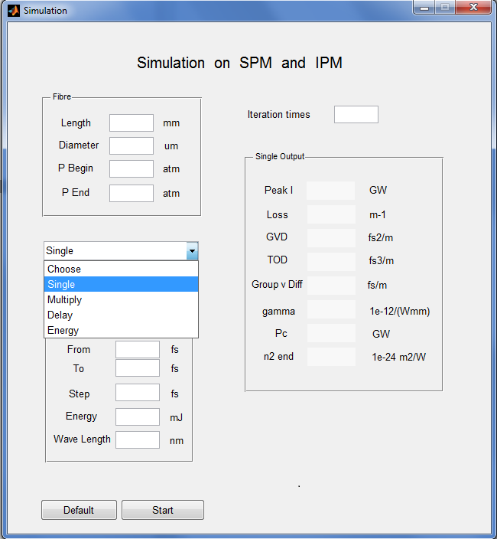
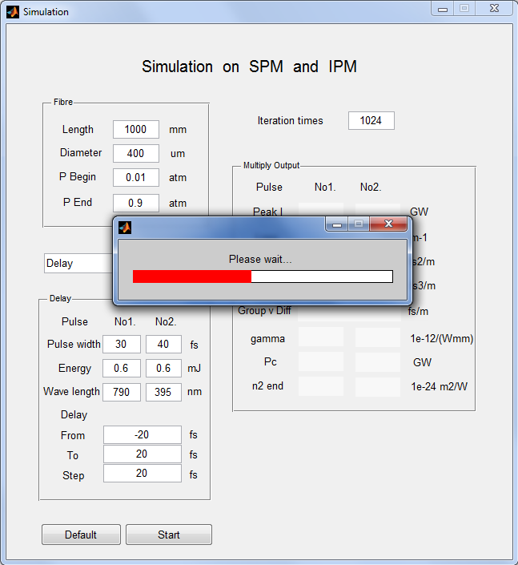
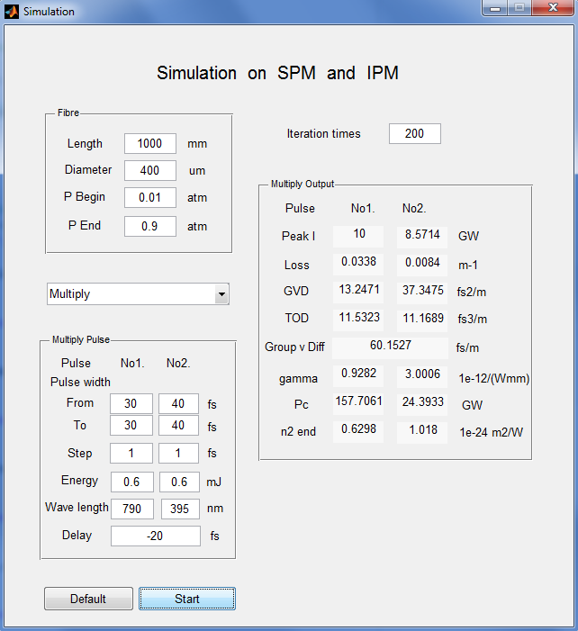
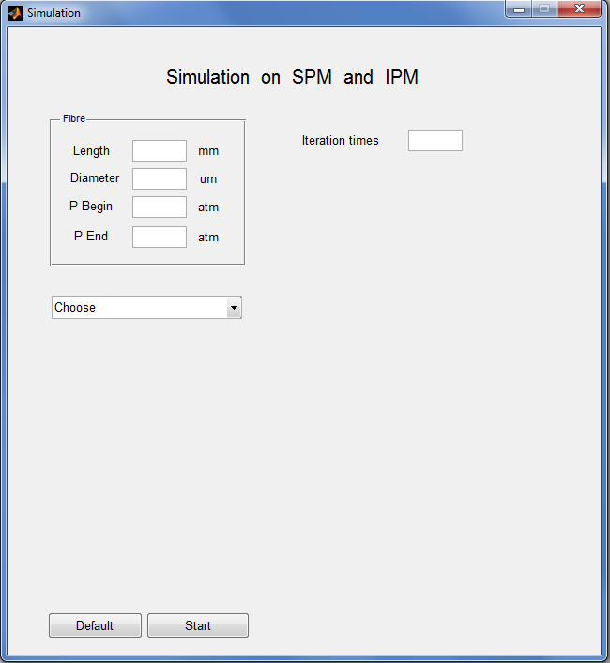
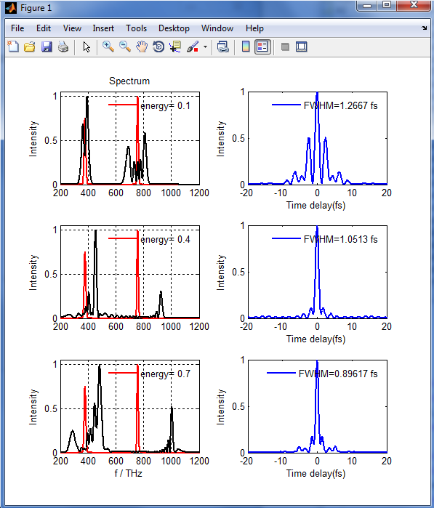
Simulation methods
Graphical User Interface (GUI)

Slide 13
Simulation results
 | Single pulse | Two pulses
Wavelength / nm | 800 | 790 | 395
Frequency / THz | 374.7 | 379.5 | 759.0
Pulse energy / mJ | 0.6 | 0.6 | 0.6
Input pulse width / fs | 30 | 30 | 40
Initial delay / fs | ----- | -20
Length/m | Diameter/mm | Input pressure/atm | Ending pressure/atm | Gas type
1 | 400 | 0.01 | 0.9 | Argon

Slide 14
Simulation results
Energy
dependence

Slide 15
Simulation results
End pressure
dependence

Slide 16
Simulation results
Pulse width
dependence

Slide 17
Simulation results
Initial delay time
dependence

Slide 18
Summary
Numerical methods
Proper set of parameters
A lot of thanks

Slide 19
Thank You !

