Slide 1
Design of Aperiodic Multilayers for Broadband Reflectivity Response in the Soft X-ray Regime
DESY Summer Student Program 2014
Jirawit Ratanapreechachai (Joe)
Under supervision of Dr. Mauro Prasciolu
Group: Multilayer X-ray Optics of Dr. Saša Bajt
Date: 10th September 2014

Slide 2
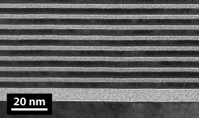
Introduction: What is a multilayer?
Alternating layers of two materials: spacer and absorber
In the soft X-ray regime, most materials have refractive indices close to unity.
Reflectivity from pure materials is usually very low
Much higher reflectivity obtained by using “multilayer structures”
Figure: TEM images showing typical periodic multilayer structures

Slide 3
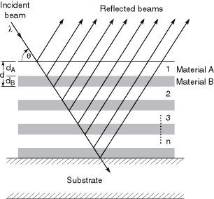
Introduction: How does a multilayer work?
Reflection from each interface interferes constructively resulting in high reflectivity
Figure: Diagram of a multilayer structure showing the reflections and transmissions at each interface

Slide 4
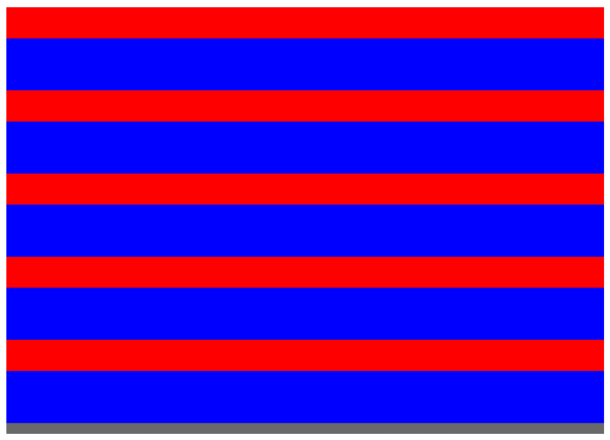
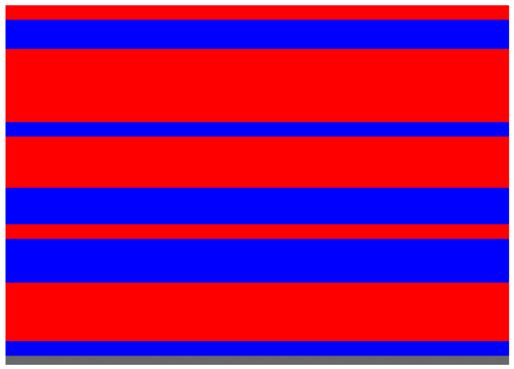
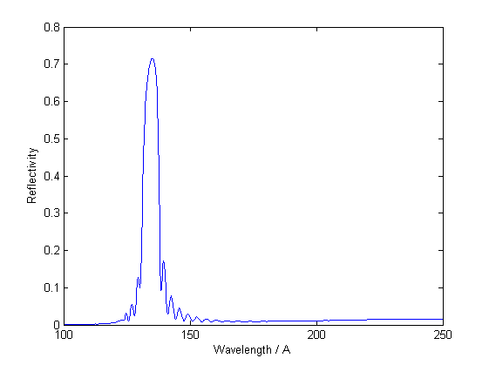
Introduction: Periodic VS Aperiodic ?
Periodic
Aperiodic
For periodic multilayers, usually peak bandwidths are small
Figure: Reflectivity simulation for an ideal periodic Mo/Si multilayer (40 bilayers, period = 7.0 nm, ratio = 0.5)

Slide 5
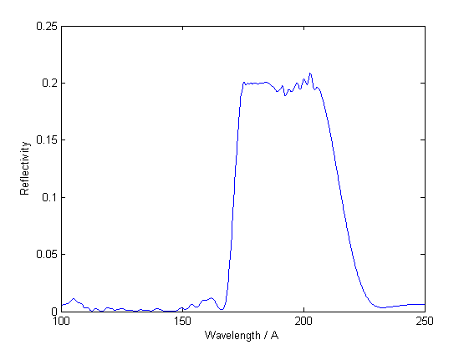
Introduction: Aperiodic Multilayers
Larger bandwidths are desirable in some applications such as attosecond pulses, x-rays telescopes and focusing optical components
This is achieved by aperiodic multilayers
Figure: Reflectivity simulation for an aperiodic Mo/Si multilayer (20 bilayers, 5-degree incidence angle)

Slide 6
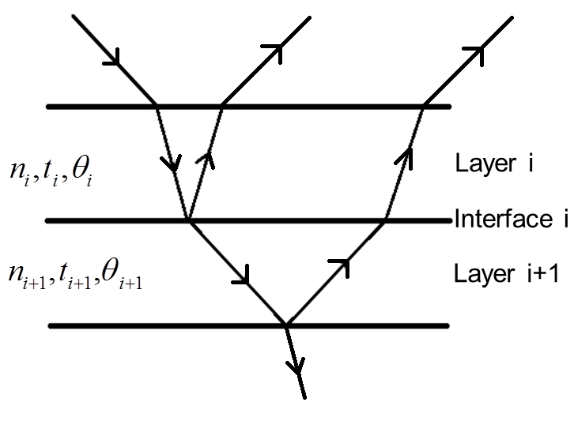
Methods for Calculation
Fresnel Reflection Coefficient
Recursive calculation

Slide 7
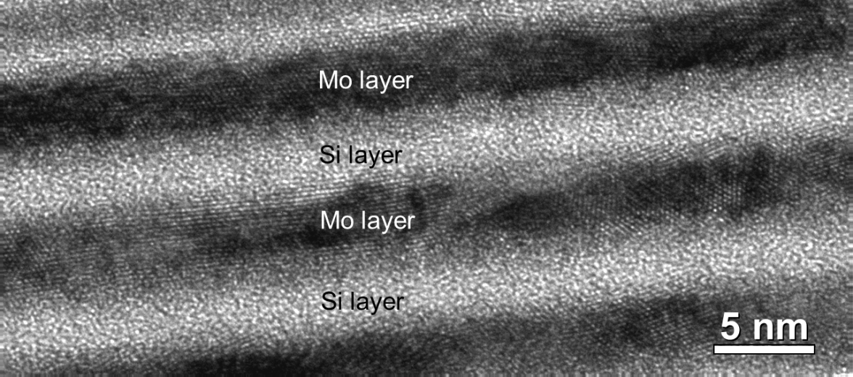
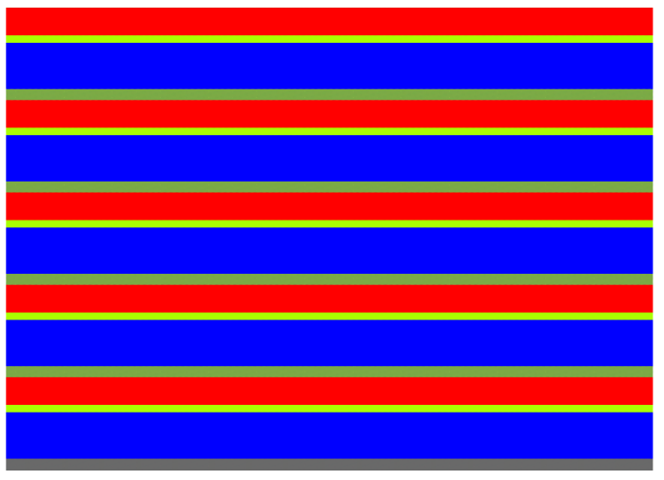
Interface Imperfections
Interface Diffusion
Taken into account by inserting an interfacial layer between each pair of materials
Figure: TEM image of a Mo/Si multilayer illustrating the forming of MoSi₂ interfacial layers

Slide 8
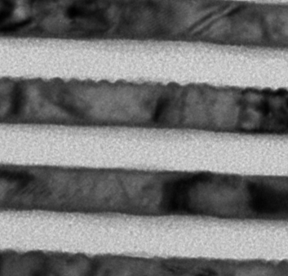
Interface Imperfections
Interface Roughness
Taken into account by multiplying the Fresnel reflection coefficient by
Figure: TEM image of a multilayer structure showing the presence of rough interfaces

Slide 9
Inverse Problem
Given all the layer thicknesses, calculating the reflectivity as a function of wavelength or incidence angle is easy!
The inverse problem of finding the layer thicknesses from a given reflectance response
No analytic solutions!
Numerical optimization methods
GOAL
Develop MATLAB code to solve the inverse problem.

Slide 10
Method of Optimization
Figure of merit (FOM) is defined as
Idea is to find the multilayer structure with the smallest possible figure of merit

Slide 11
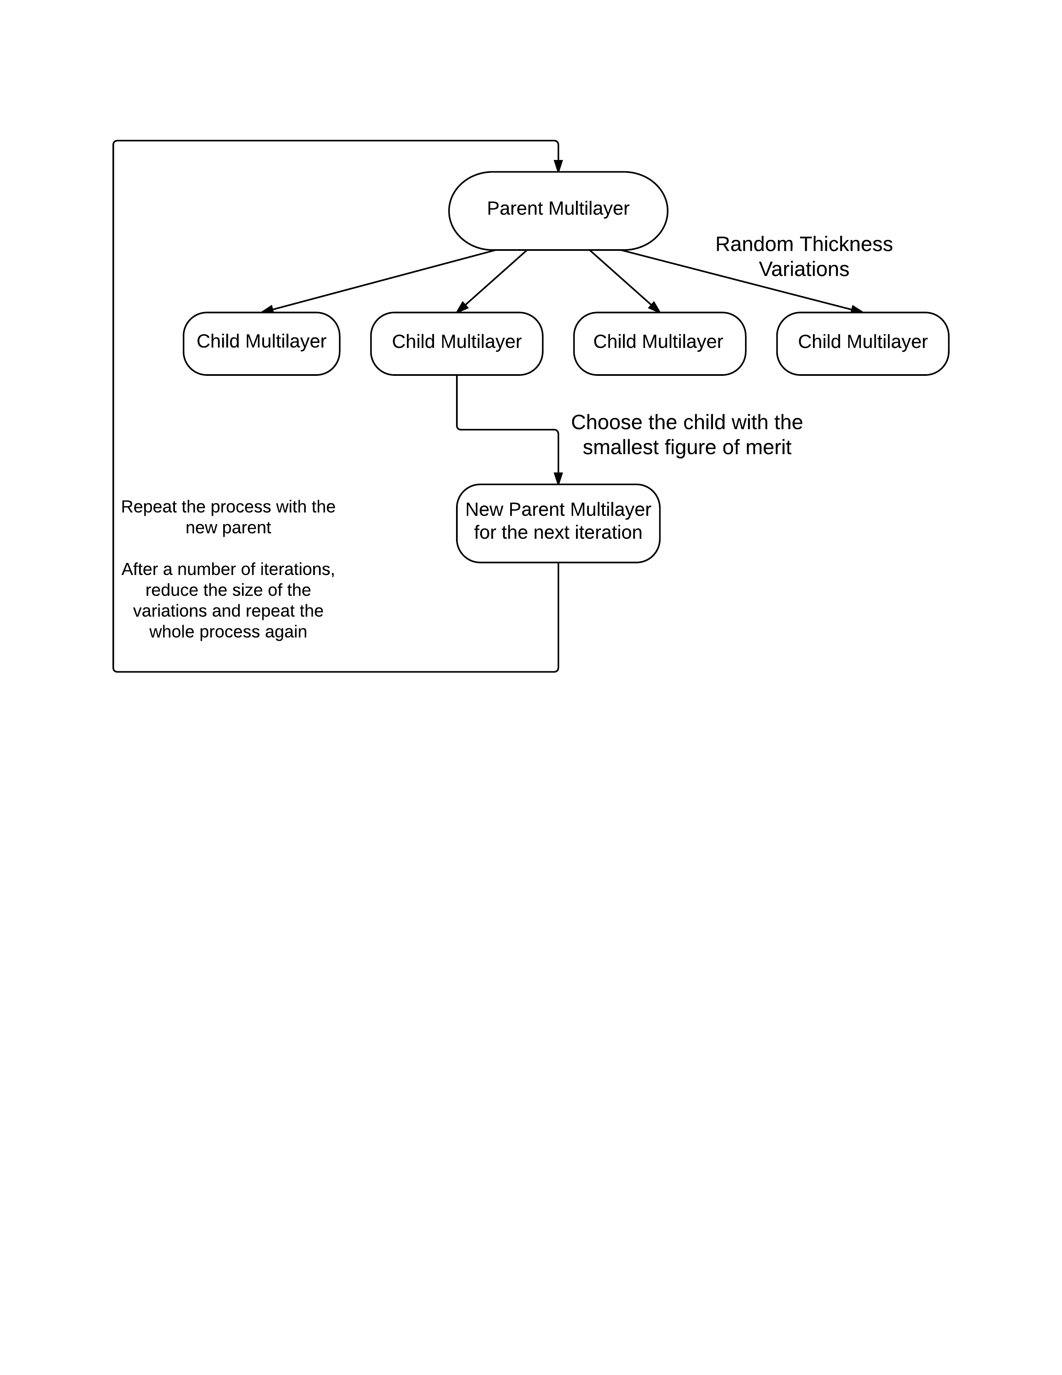
Luus-Jaakola Optimization Method
Usually periodic

Slide 12
Results
Consider only the two extremes
Mo/Si where only interface diffusion is important
Sc/Cr where only interface roughness is important
Mo/Si System
Sc/Cr System

Slide 13
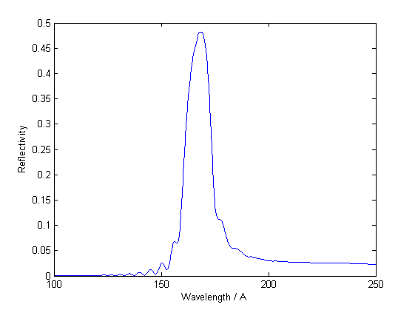
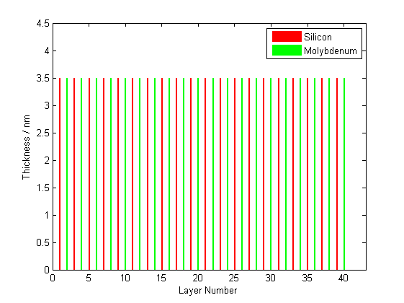
Results: Diffusion
Mo/Si multilayer
20 bilayers, 5-degree incidence angle
broadband response between 17-22 nm (R = 20%)
Initial: Periodic

Slide 14
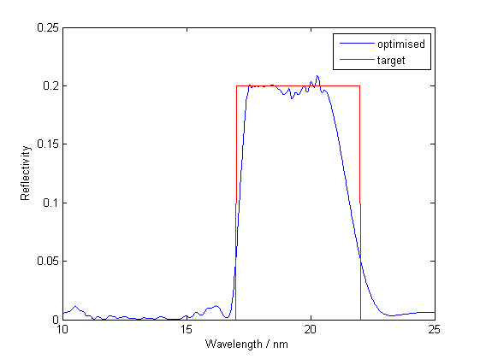
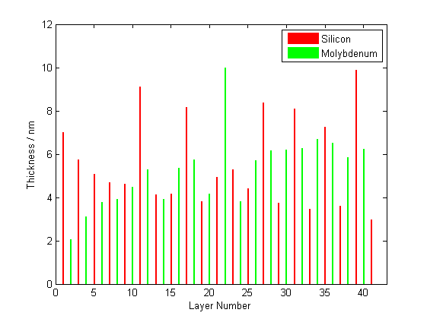
Results: Diffusion
Mo/Si multilayer
20 bilayers, 5-degree incidence angle
broadband response between 17-22 nm (R = 20%)
Optimized: Aperiodic

Slide 15
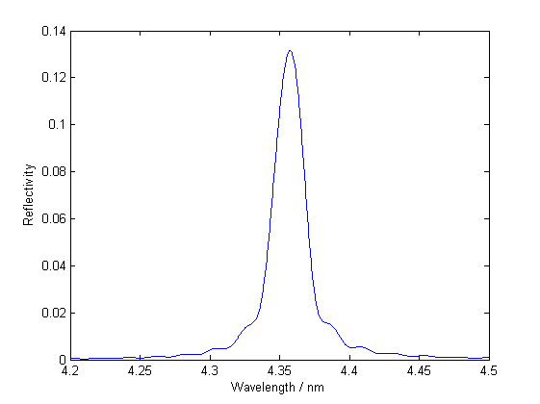
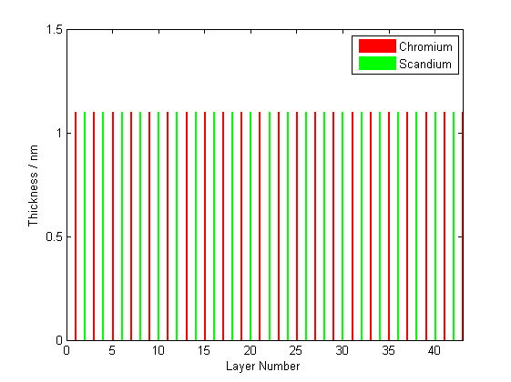
Results: Roughness
Sc/Cr multilayer
200 bilayers, 5-degree incidence angle, 0.3-nm roughness
broadband response between 4.30-4.42 nm (R = 1.0%)
Initial: Periodic

Slide 16
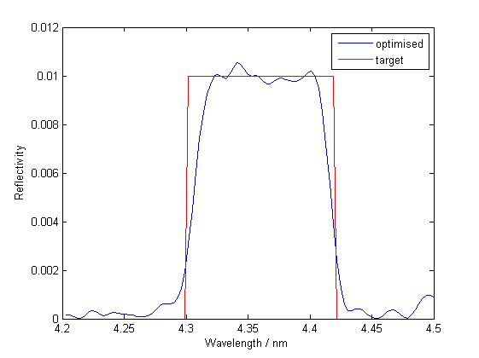
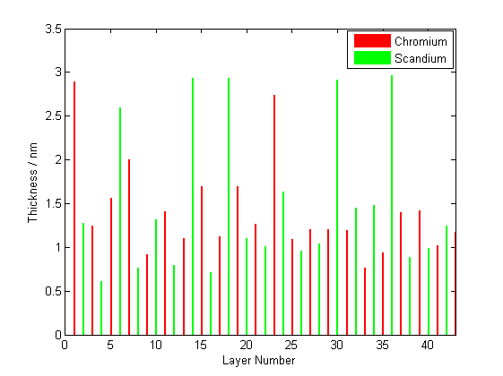
Results: Roughness
Sc/Cr multilayer
200 bilayers, 5-degree incidence angle, 0.3-nm roughness
broadband response between 4.30-4.42 nm (R = 1.0%)
Optimized: Aperiodic

Slide 17
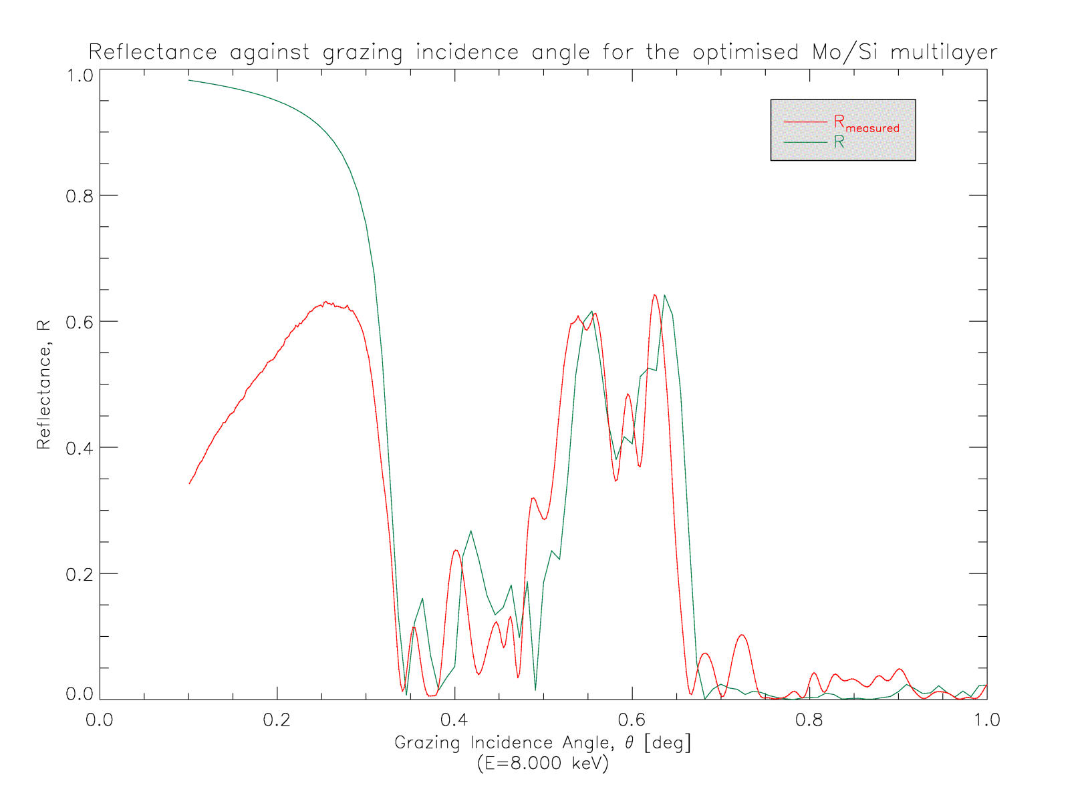
Comparison with X-ray Diffraction Measurements

Slide 18
Thank you for your attention

Slide 19
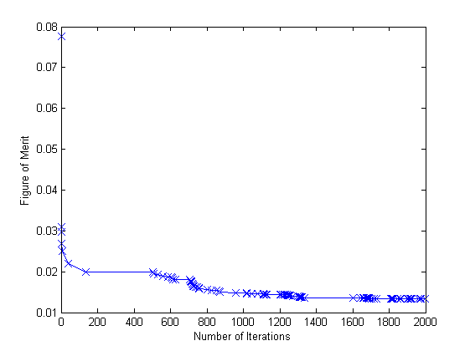
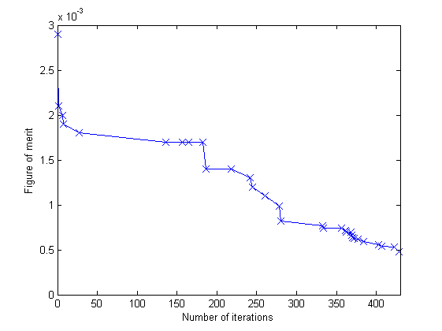
Figure of Merit
Mo/Si
Sc/Cr

Slide 20
Improvements
Calculation time strongly dependent on the number of layers
Optimized initial structure
Other numerical optimization methods
No means to find optimized number of bilayers and peak reflectance
Take into account the case when interfaces are both rough and diffuse

Slide 21
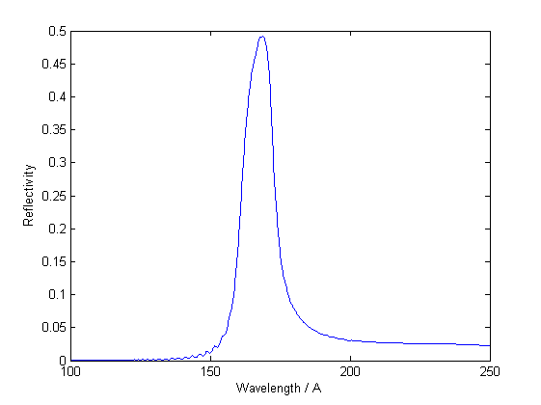
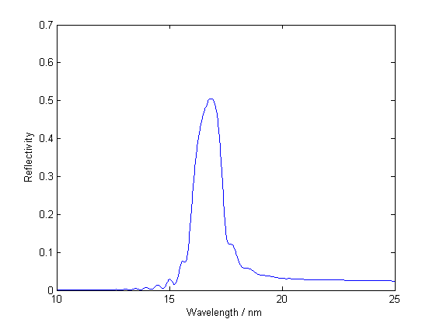
Interface Imperfections: Interdiffusion

Slide 22
Luus-Jaakola Optimization Method
Start with an initial ‘parent’ design (periodic)
Generate a number of ‘child’ multilayers from random variations of the parent layer thicknesses
The design with the smallest figure of merit becomes the parent for the next iteration
Repeat the process
Reduce the size of the random variations
Obtain a ‘locally’ optimized design

Slide 23
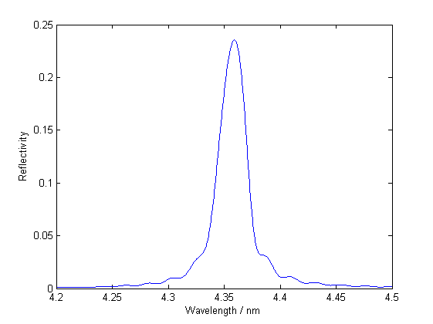
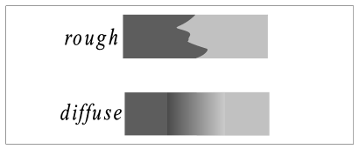
Interface Imperfections: Roughness
Perfect Interfaces
With Interfacial Roughness
Figure 7: Effects of roughness (Top) and representation of the two types of interface imperfections (Bottom)

Slide 24
Method of Optimization
Figure of merit (FOM) is defined as
Idea is to find the multilayer structure with the smallest possible figure of merit
Aim to reach the global minimum or at least a sufficiently deep local minimum

Slide 25
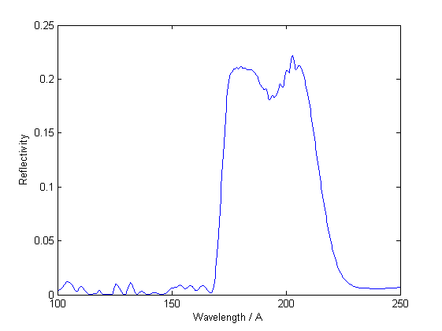
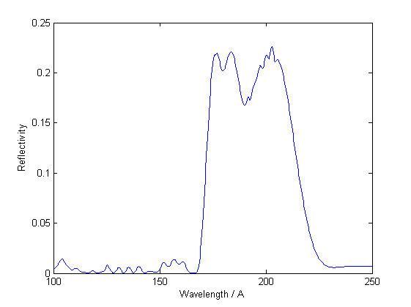
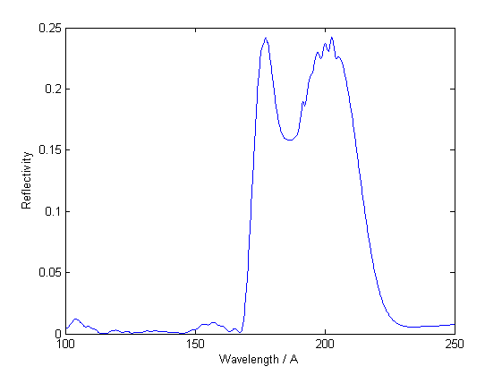
Increasing the peak reflectance
20%
21%
22%
24%

Slide 26
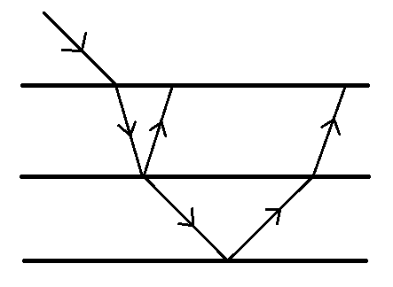
Methods for Calculation
Fresnel Reflection Coefficient (s-polarization)
Similarly for p-polarization
Recursive calculation
Layer i
Interface i
Layer i+1

