Slide 1
Nitrogen doping of SRF Nb cavities: The diffusion profile
Mario Hilbig
Presentation of summer school project
Supervisor: Alena Prudnikava
Hamburg, 9.10.2014

Slide 2
Content
Introduction
Diffusionprocesses: 1st and 2nd Fick‘s law
Nb-N: Binary phase system
Phase growth due to diffusion
Diffusion profiles for a α-ε-phase system
Summary

Slide 3
Introduction I
Quality factor
${\begin{aligned} \\ Q\end{aligned}}_{0}=\frac{ω_{0}U}{P_{diss}}$
$P_{diss}∝$ $n_{n}ω^{2}H^{2}$
$R_{S}{∝n}_{n}ω^{2}$
$R_{S}= \frac{1}{2} σ_{n}ω^{2}{μ_{0}^{}}_{}^{2}{λ_{L}^{}}_{}^{3}$, ${ R}_{S}$ $∝$ $le$ for $T<0,5T_{C}$
Energy losses
Normal conductivity
The higher the normal conductivity the lower Q₀!
(6)Padamsee, Hasan ; Knobloch, Jens ; Hays, Tomas: RF Superconductivity for Accelerators. 2. Auflage. New York: Wiley, 2008.

Slide 4
Introduction II
Investigation
Diffusion of Nitrogen into Niobium and subsequent removal of skin layer
Direct after the nitrogen diffusion: Q₀ = 1·10⁷ (normal treatment: Q₀ = 2·10¹⁰)
After layer removal Q₀ became larger (up to 3 times) than achieved with normal treatment
(1)Nitrogen and argon doping of niobium for superconducting radio frequency cavities: a pathway to highly efficient accelerating structures; A Grassellino¹, A Romanenko¹, D Sergatskov¹, O Melnychuk¹, Y Trenikhina², A Crawford¹, A Rowe¹, M Wong¹, T Khabiboulline¹ and F Barkov¹ (1: Fermi National Accelerator Laboratory, Batavia, IL 60510, USA. 2: Illinois Institute of Technology, 3300 S Federal St, Chicago, IL 60616, USA.)

Slide 5
Introduction III
Q depends on layer removal
Physical phenomenon unknown!
What are the phases within the skin layer?
What is the Nitrogen concentration?
(1) Nitrogen and argon doping of niobium for superconducting radio frequency cavities: a pathway to highly efficient accelerating structures; A Grassellino¹, A Romanenko¹, D Sergatskov¹, O Melnychuk¹, Y Trenikhina², A Crawford¹, A Rowe¹, M Wong¹, T Khabiboulline¹ and F Barkov¹ (1: Fermi National Accelerator Laboratory, Batavia, IL 60510, USA. 2: Illinois Institute of Technology, 3300 S Federal St, Chicago, IL 60616, USA.)
Cavity 1
Cavity 2
Cavity 3

Slide 6
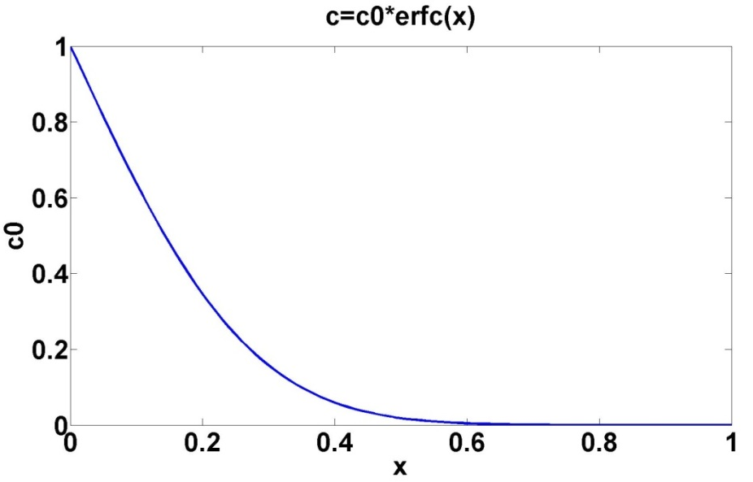
Diffusion from N₂ atmosphere into solid Nb
1st and 2nd Ficks law (one-dimensional)
${\vec{j}}_{Diff}=−D\frac{dc}{dx}{\vec{e}}_{x}$
$\frac{dc}{dt}=D\frac{d^{2}c}{dx^{2}}$
Assumptions:
gas atmosphere is an infinite source
incident flux is larger than diffusion flux
solid-halfroom is large against diffusion length
Solution:
Complementary errorfunction
Parameters:
diffusion coefficient D
boundary concentration c₀ (dependent on Nb-N phase!)
(3) Reactions of niobium and tantalum with gases at high temperatures and low pressures; E. Fromm and H.Jehn, Max-Planck-Institut für Metallforschung , Institut für Sondermetalle, Stuttgart, West Germany

Slide 7
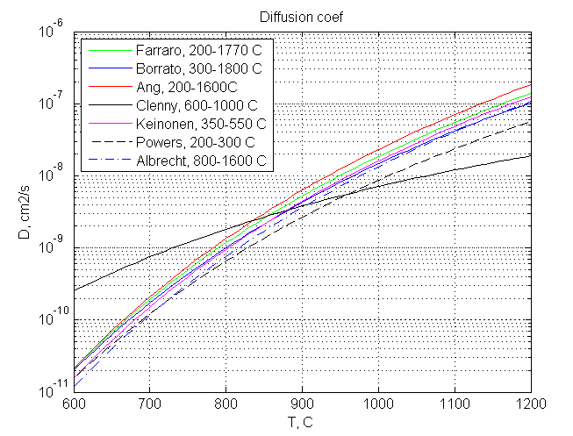
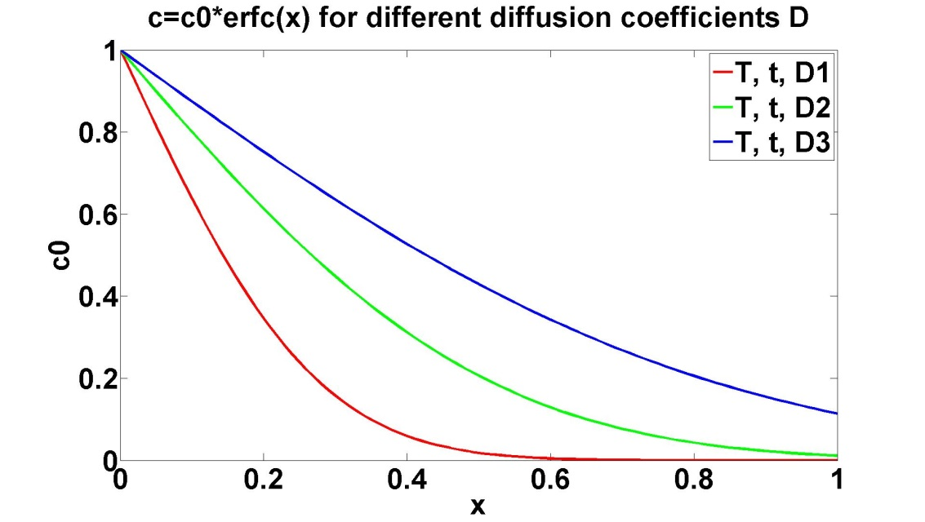
Diffusion from N₂ atmosphere into solid Nb
Diffusion coefficients and diffusion profiles
D3
D2
D1
Diffusion coefficients are different by different authors!

Slide 8
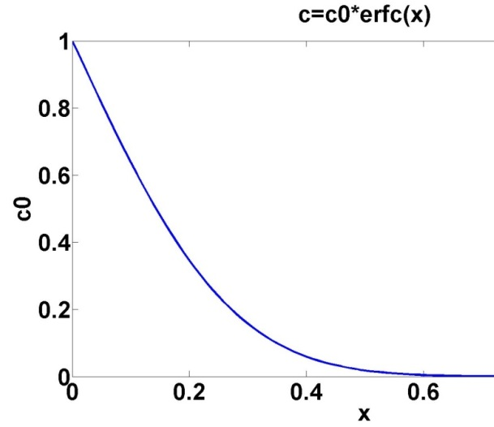
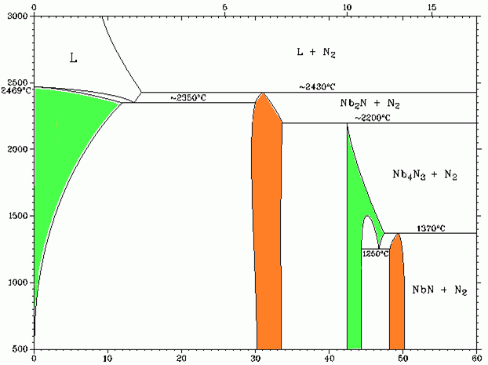
Phases of the Nb-N binary system
Binary phase diagrams
Weight Percent Nitrogen
L
L+N₂
Nb₂N+N₂
ε
δ
γ
β
α
α-Nb
β-Nb
Temperature °C
Nb₄N₃+N₂
γ-Nb
α+β
NbN+N₂
β+γ
Superconductive
ε-Nb
Not Superconductive
δ-Nb
Nb
Atomic Percent Nitrogen

Slide 9
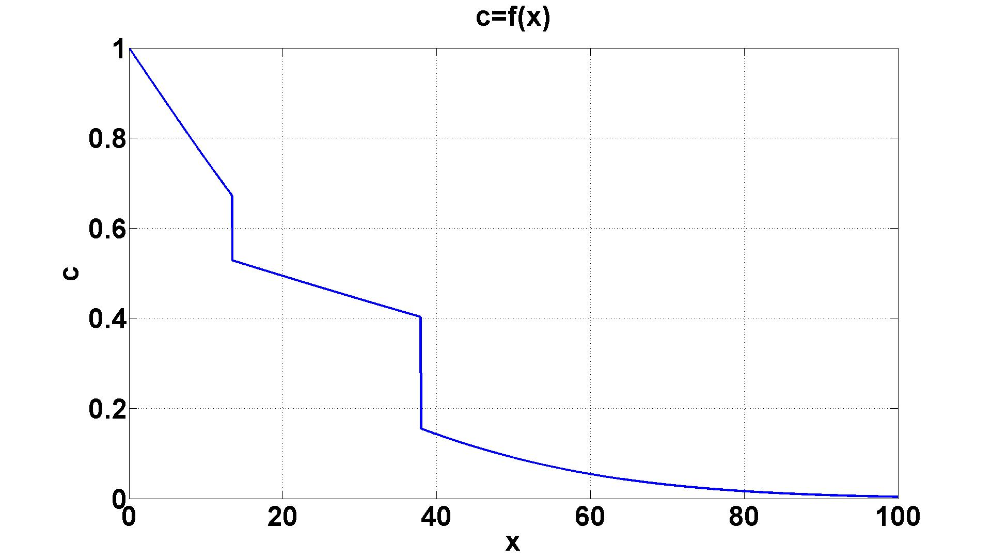
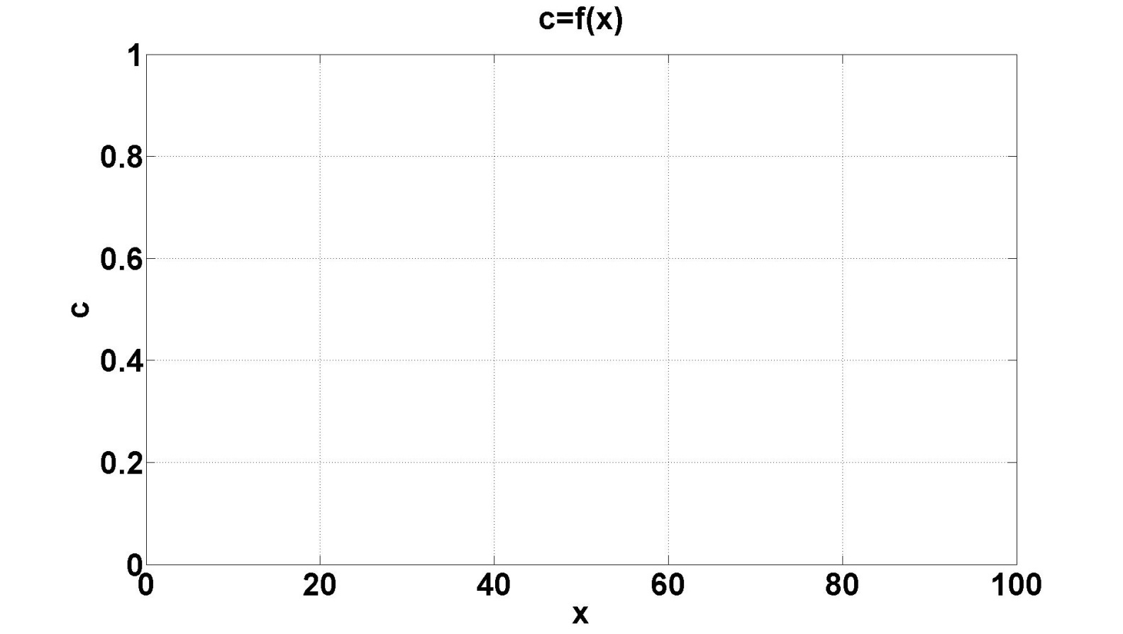
Growth of nitride phases due to diffusion
According to Wagner the movement of a phase boundary can be determined by
$ξ_{n}=γ_{n}∙x_{{diff}_{n}}=γ_{n}∙2\sqrt{D_{n}t}$
For every phase is now calculated a single error function where the boundaries in x are determined by the movement $ξ_{n}$
(2) Nitridation Kinetics of Niobium in the Temperature Range of 873 K to 1273 K; James T. Clenny and Casimir J. Rosa
Homogeneity range of γ-Nb
$$ξ_{1}(t)$$
$$ξ_{2}(t)$$
γ-Nb
β-Nb
α-Nb

Slide 10
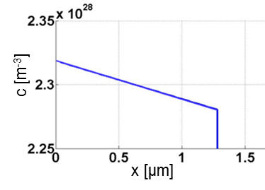
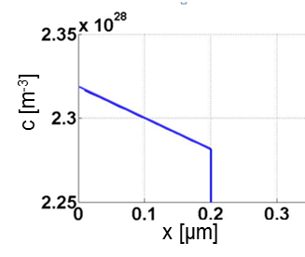
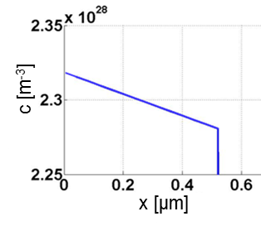
Calculated profile of ε-α-system
Cavity 1
Cavity 2
Cavity 3
T=1000°C, t=60min
T=800°C, t=10min
T=1000°C, t=10min
c [m⁻³]
c [m⁻³]
c [m⁻³]
x [µm]
x [µm]
x [µm]

Slide 11
Summary
Results
Approximate nitrogen concentration in skin layer 0,05-0,15%_{atomic}
α-Nb in skin layer: interstitial N cause improvent of Q₀
Calculation of a diffusion profile with all phases?
Lack of data: Diffusion coefficients for other phases are not available for temperatures of interest
Layer removal has high uncertainty and peak of Q₀ might not be observed
Experiments with real samples to investigate:
Explore diffusion of nitrogen in niobium in the temperature range 300 - 1000°C
Investigate formed phases
Estimate diffusion coefficients for formed phases
Optimize nitrogen doping treatment providing best Q₀-factor

Slide 12
References
Books and papers
Nitrogen and argon doping of niobium for superconducting radio frequency cavities: a pathway to highly efficient accelerating structures; A Grassellino¹, A Romanenko¹, D Sergatskov¹, O Melnychuk¹, Y Trenikhina², A Crawford¹, A Rowe¹, M Wong¹, T Khabiboulline¹ and F Barkov¹ (1: Fermi National Accelerator Laboratory, Batavia, IL 60510, USA. 2: Illinois Institute of Technology, 3300 S Federal St, Chicago, IL 60616, USA.)
Nitridation Kinetics of Niobium in the Temperature Range of 873 K to 1273 K; James T. Clenny and Casimir J. Rosa
Reactions of niobium and tantalum with gases at high temperatures and low pressures; E. Fromm and H.Jehn, Max-Planck-Institut für Metallforschung , Institut für Sondermetalle, Stuttgart, West Germany
Combined Refinement of Diffusion Coefficients Applied on the Nb-C and Nb-N Systems; David Rafaja, Walter Lengauer, Herbert Weisenberger and Manech Joguet
Hoppe, Bernhard: Mikroelektronik. 2. Herstellungsprozesse für integrierte Schaltungen. Würzburg: Vogel, 1998.
Padamsee, Hasan ; Knobloch, Jens ; Hays, Tomas: RF Superconductivity for Accelerators. 2. Auflage. New York: Wiley, 2008.

Slide 13
Thank you for your attention!
Questions?

Slide 14
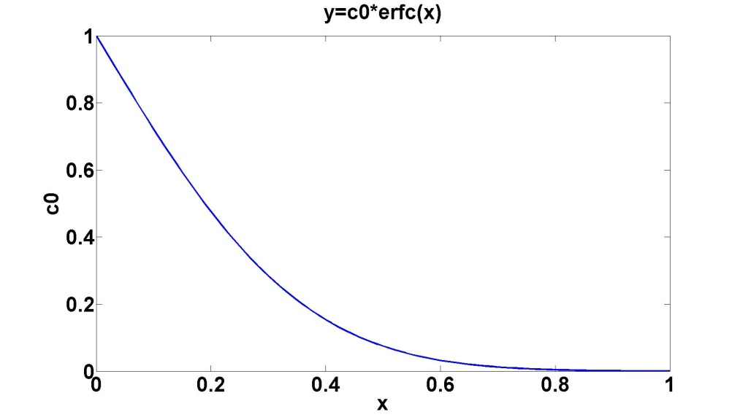
Addition: Boundary condition of diffusion flux
Error function: $c=c_{0}∙erfc⁡(\frac{x}{2∙\sqrt{D∙t}})$
At t=0 the slope is infinite at x=0
Since ${\vec{j}}_{Diff}=−D\frac{dc}{dx}{\vec{e}}_{x}$ this leads to a infinite flux
Since the gas pressure provides only a finite flux,
this assumption is not satisfied
At which time t is $j_{Diff} \left(x=0\right)<j_{Inc} \left(p\right)$ satiesfied?
$j_{Inc}=\frac{c_{gas}}{4}∙\sqrt{\frac{8RT}{πM}}$ ; $j_{Diff} \left(x=0\right)≈D∙\frac{c_{0}}{x_{diff}}$
p=1.33 Pa, T=1273 K, M=0,014 kg/mol, D_{α}, c_{0ε} gives t=1,5 s

Slide 15
Addition: Quality factor
${\begin{aligned} \\ Q\end{aligned}}_{0}=\frac{ω_{0}U}{P_{diss}}$
the ac electric field $E_{int}$in the skin layer:
$E_{int}∝\frac{dH}{dt}∝ωH$.
$$j_{int}∝n_{normal}E_{int}$$
$$P_{diss}∝j_{int}E_{int}∝n_{n}ω^{2}H^{2}$$
$$n_{n} ∝e^{−\frac{∆}{k_{B}T}}$$
In terms of surface resistance:
$P_{diss}=\frac{1}{2}R_{s}\int_{S}{{|H|}^{2}ds}$
RF surface resistance
$R_{S}= {A_{S}ω}^{2}e^{−\frac{∆(0)}{k_{B}T}},$ $T<0,5T_{C}$
$A_{S}$ is a const, depends on material parameters:
- penetration depth, $λL(0)$;
coherence length, $ξ0$ ;
Fermi velocity, $vF$;
the mean free path, $le$
$R_{S}= \frac{1}{2} σ_{n}ω^{2}{μ_{0}^{}}_{}^{2}{λ_{L}^{}}_{}^{3}$, ${ R}_{S}$ $∝$ $le$
=> The higher the purity of Nb the lower Q₀!

