Slide 1
THz Beamline at FLASH by Ekaterina Zapolnova & Markus Pötzlberger

Slide 2
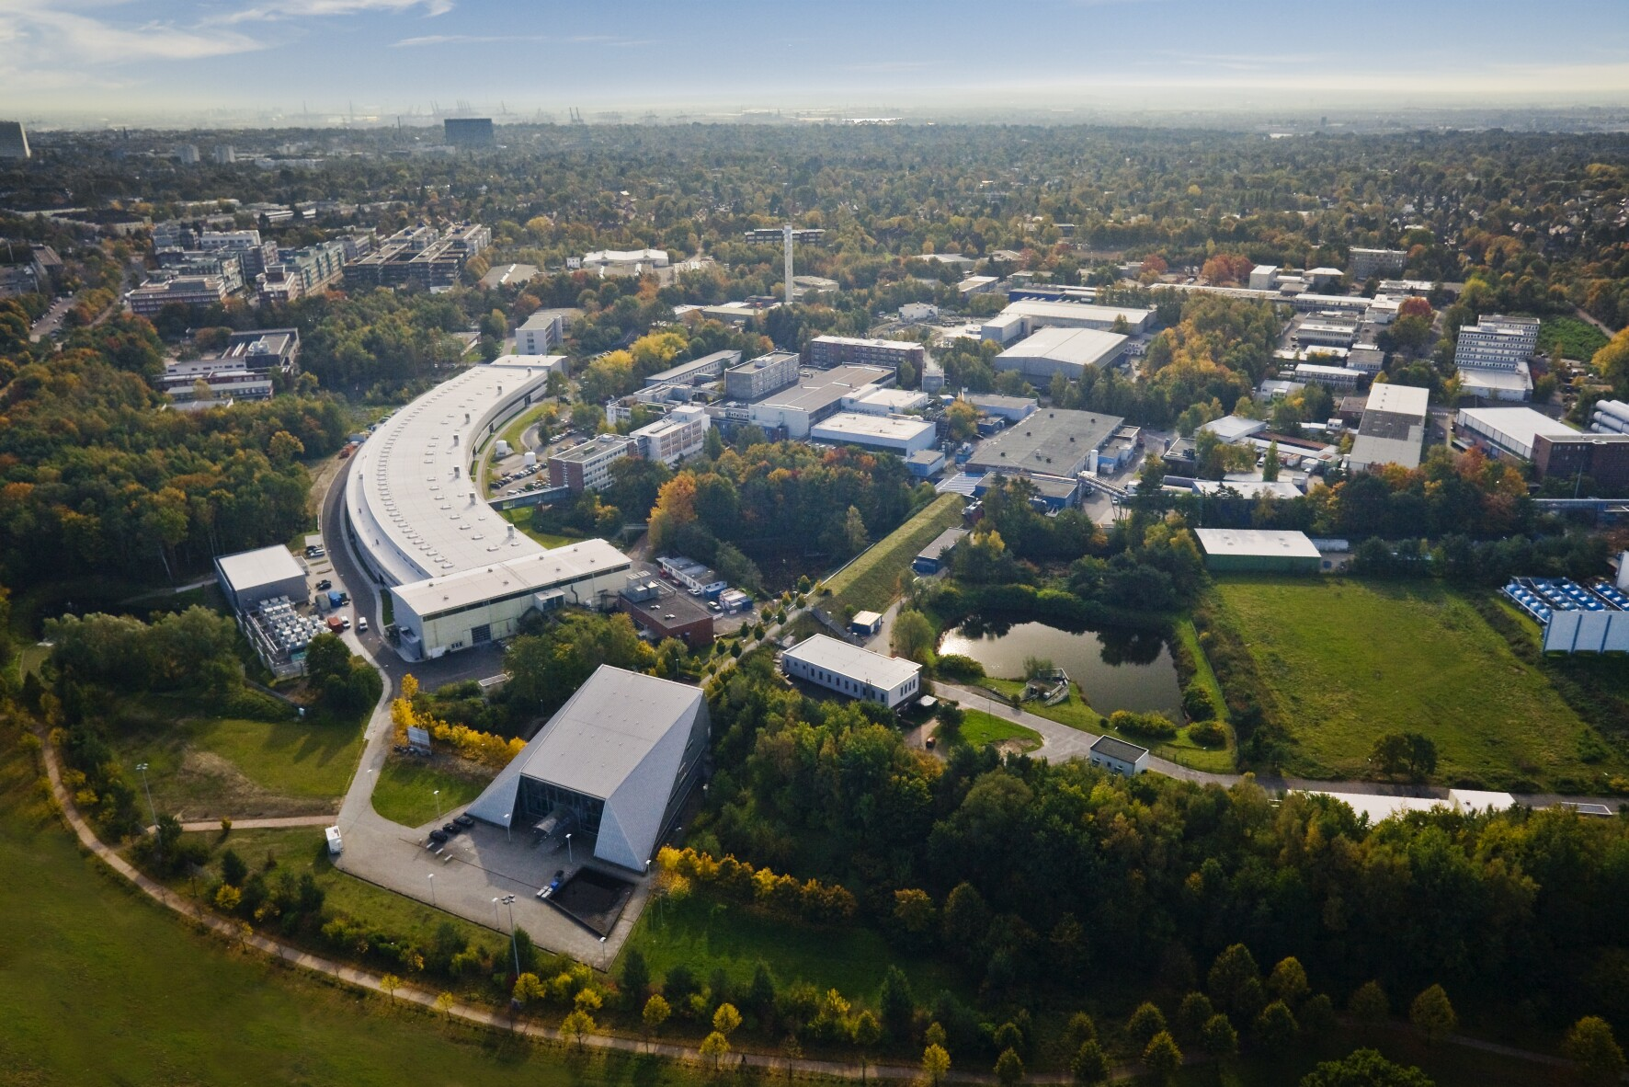
FLASH

Slide 3
FLASH - Scheme

Slide 4
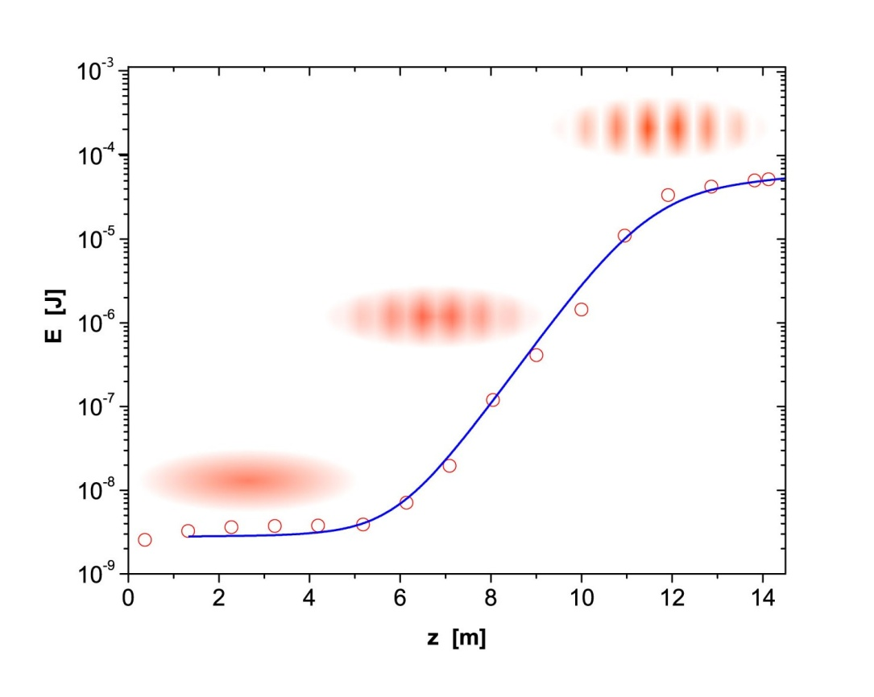
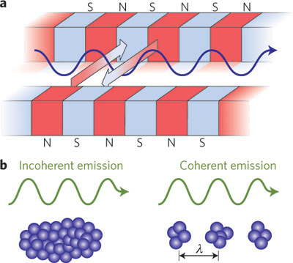
SASE – Self Amplified Spontaneous Emission
S. Jamison, Nature Photonics 4, 589 - 591 (2010)
Notes:
FLASH operates in SASE regime
Interaction of radiation generated in electrons enhances output.
However, this places extreme requirements on electron bunch properties.
1C = 6.24150965(16)×10¹⁸

Slide 5
FLASH - Scheme
X-ray undulator
THz undulator
Dump magnet
e⁻
radiation
e⁻

Slide 6
FLASH Hall

Slide 7
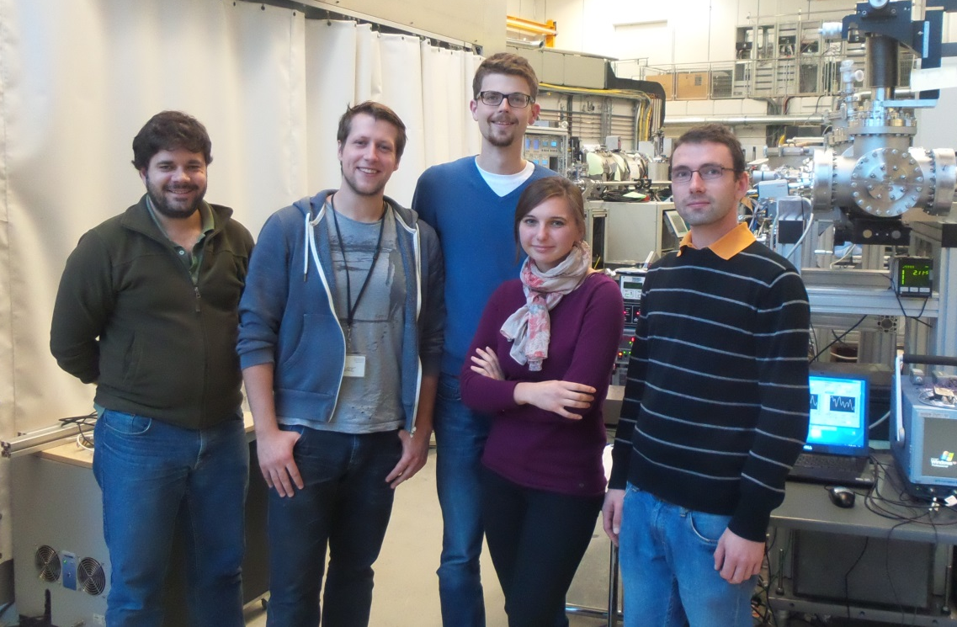
THz Beamline
THz Team

Slide 8
THz Beamline
THz Team
Maintain existing machinery
Continuous improvement of THz Beamline
Support external researches: designing, setting up and measuring

Slide 9
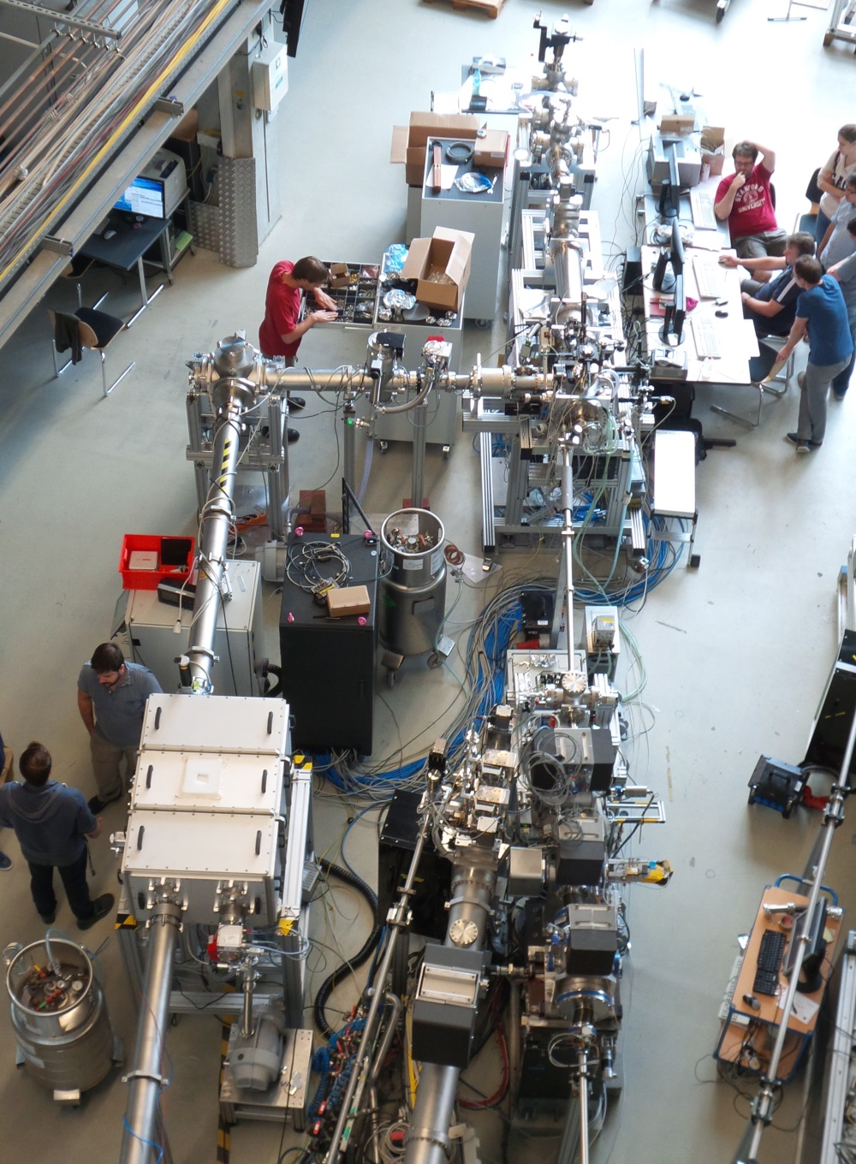
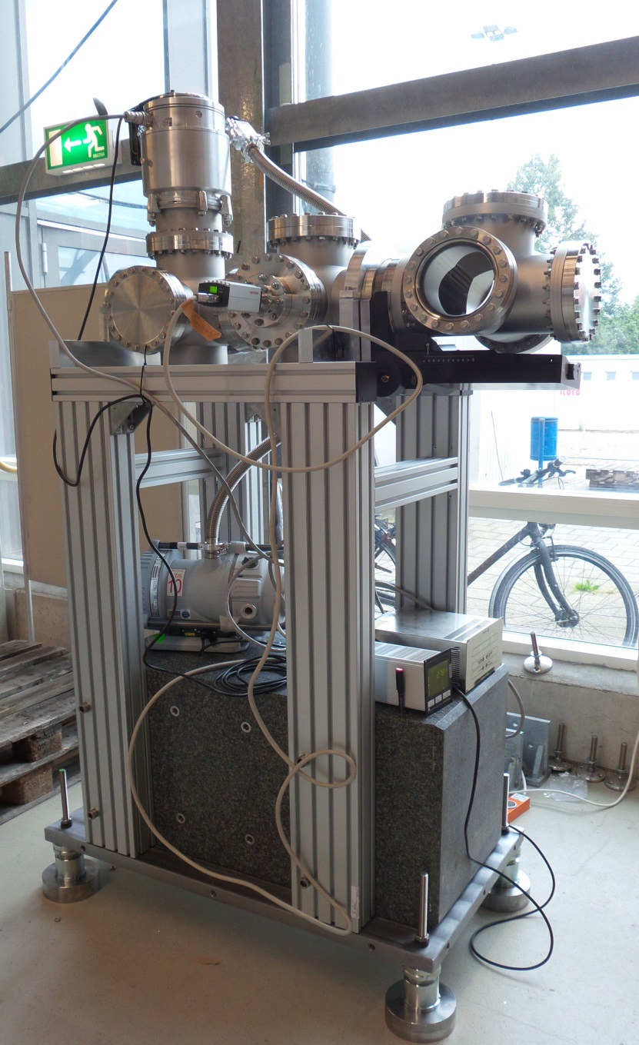
Experiment

Slide 10
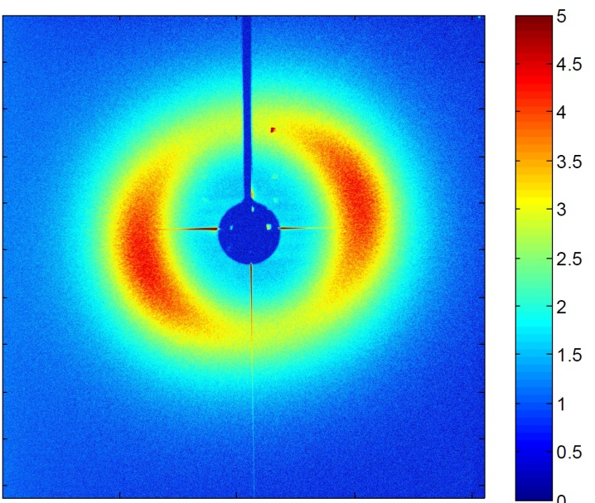
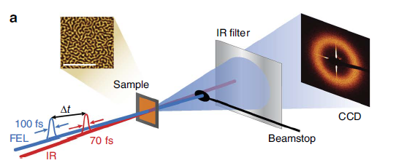
Experiment
The aim:
investigate the magnetization behavior of a cobalt platinum multilayer system

Slide 11
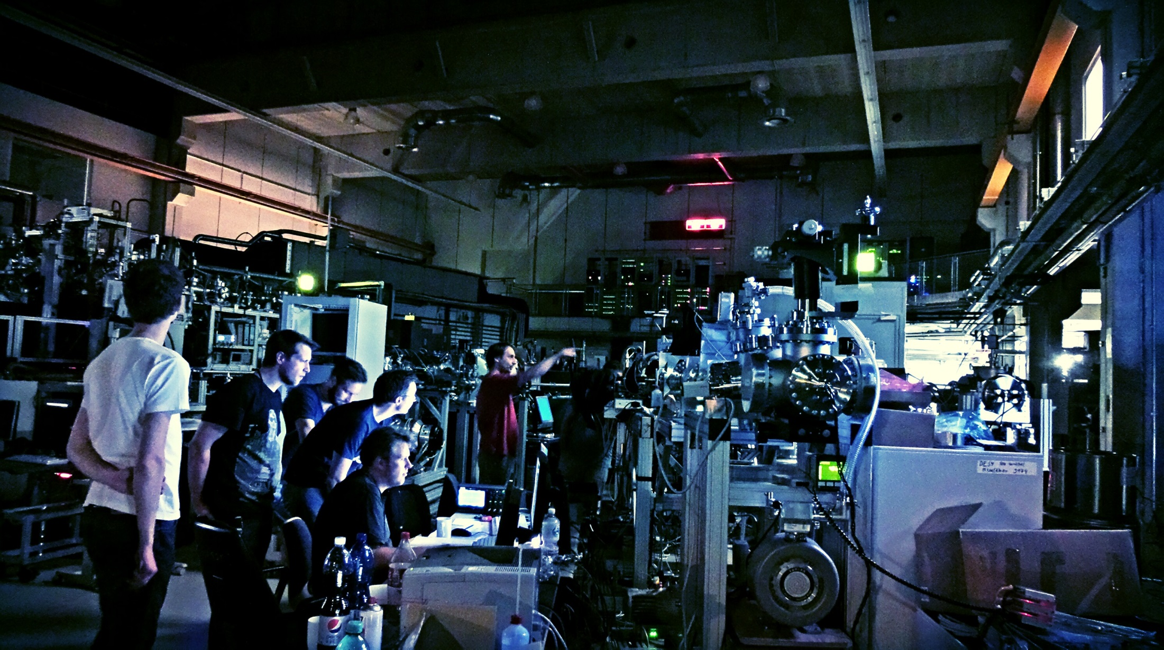
Experiment

Slide 12
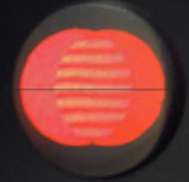
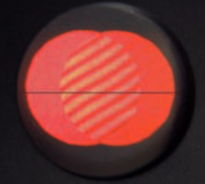
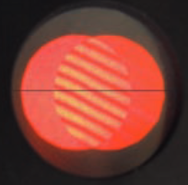
Shearing Interferometer

Slide 13
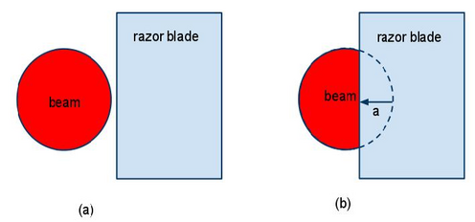
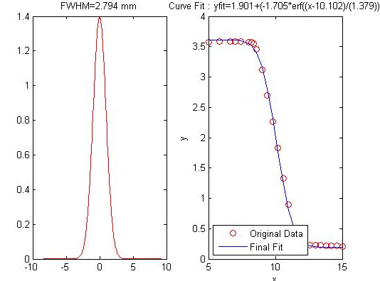
Shearing Interferometer

Slide 14
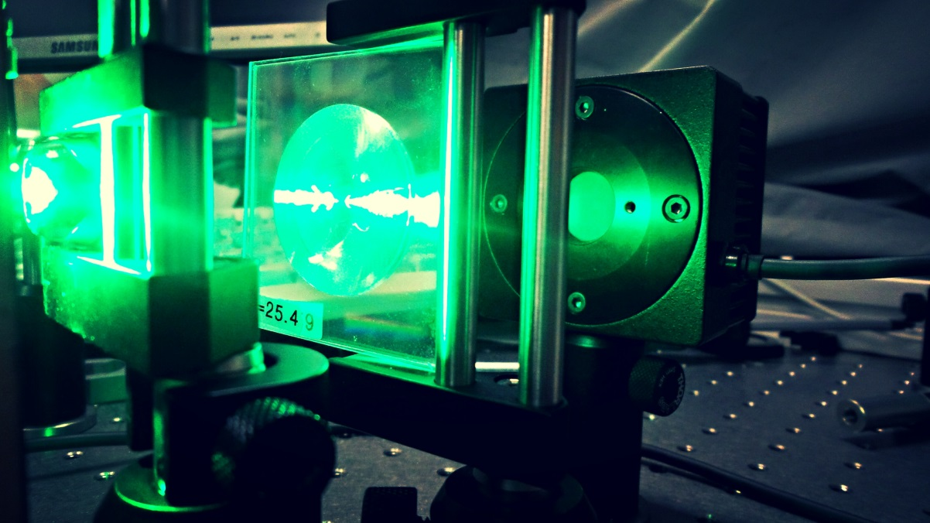
LED
The aim:
200 W/cm²
Lower limit for spot diameter 200 µm
Result: ~ 30 W/cm²

Slide 15
Thank you!

