Slide 1
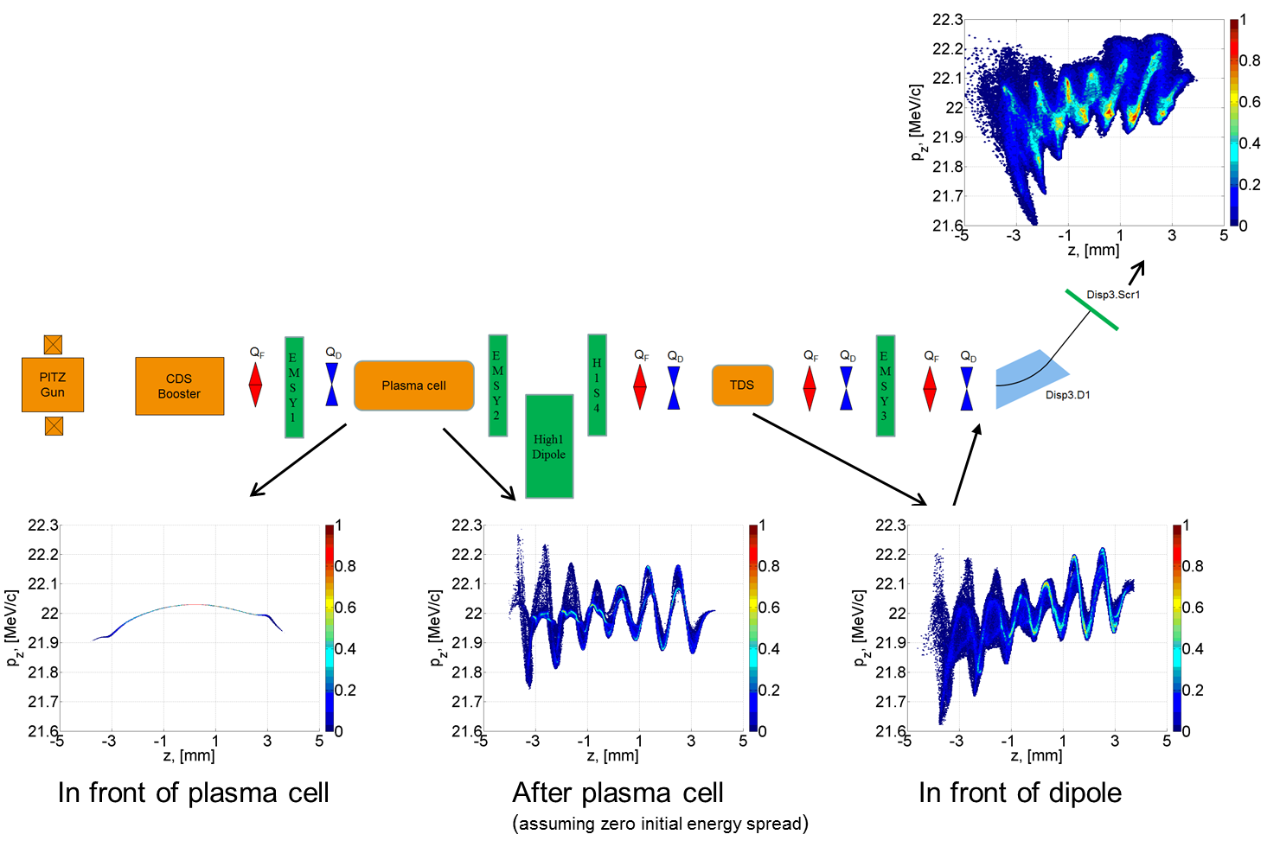
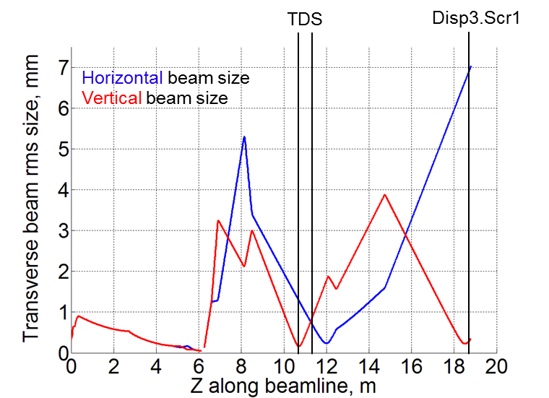
Optimization and transport of electron beam for self-modulation experiments at PITZ
PITZ setup for self-modulation studies
Martin Khojoyan
LAOLA workshop
October 6-7, 2014
Expected longitudinal phase space
Beam matching with different steps for LPS measurements.

