Slide 1
Research Group Prof. Hidding
Elevator speeches
Thomas Heinemannn¹, Georg Wittig¹ , Alexander Knetsch¹
¹ University of Hamburg & CFEL
Virtual Institute 503,
PWFA@FLASH
Brian Foster et al.

Slide 2
Beam quality transformation and stabilzation in a
hybrid all-optical plasma accelerator
Use LWFA-generated electron bunches as drivers for PWFA (Hidding, PRL 104, 195002 2010)
Inherently synchronized electron bunch and photocathode laser (both from the same laser)
Even large energy spreads from LWFA-generated bunches are not prohibitive
How sensitive is all-optical Trojan Horse towards variations of LWFA output, i.e.
driver energy, energy spread, charge?
Indeed PWFA stage produces similar output throughout various LWFA parameters!
e.g. if
driver beam energy deviation: +/- 50 % witness beam energy deviation: down to 3.2 %
Dramatic stabilization in energy & energy spread & current of witness w/ even huge variation of drive beam parameters!
+
generation of high-quality, ultra-low emittance and high brigtness witness bunches
T. Heinemann | October 6th 2014 | LAOLA Meeting Wismar 2014

Slide 3
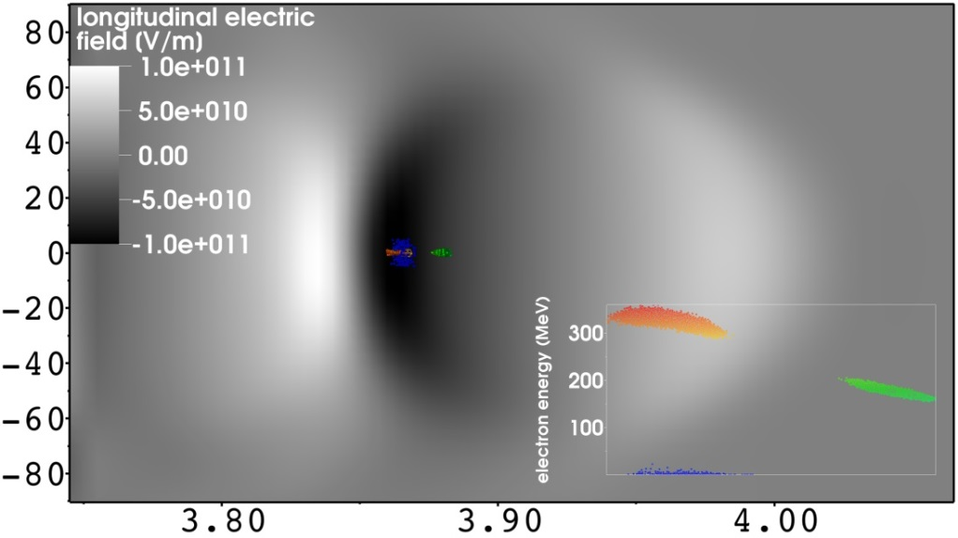
Multi-bunch production with underdense photocathode*
functional sketch in lab frame
Simulation with spatial overlapping bunches:
independent tunability of each bunch
three injection lasers with different foci:
l = 0.8 µm
a₀ = 0.14
w₀ = 5 µm
t_{FWHM} = 25 fs
driver: FACET like electron bunch
s_{z} = 20 µm
s_{r} = 15 µm
E = 23 GeV
Q = 3 nC
@ 4 mm acceleration
Generation of 3rd witness bunch
@ 5 mm acceleration
y [µm]
parmeter | bunch 1 | bunch 2 | bunch 3
energy [MeV] | 390 | 211 | 48.5
e [mm mrad] | 0.27 | 0.15 | 0.23
energy spread | 0.03 | 0.05 | 0.14
charge [pC] | 24.3 | 8.5 | 24.3
1
2
3
z [mm]
*to be published (http://de.arxiv.org/pdf/1403.1109v1)
G. Wittig | October 6th 2014 | LAOLA Meeting Wismar 2014

Slide 4
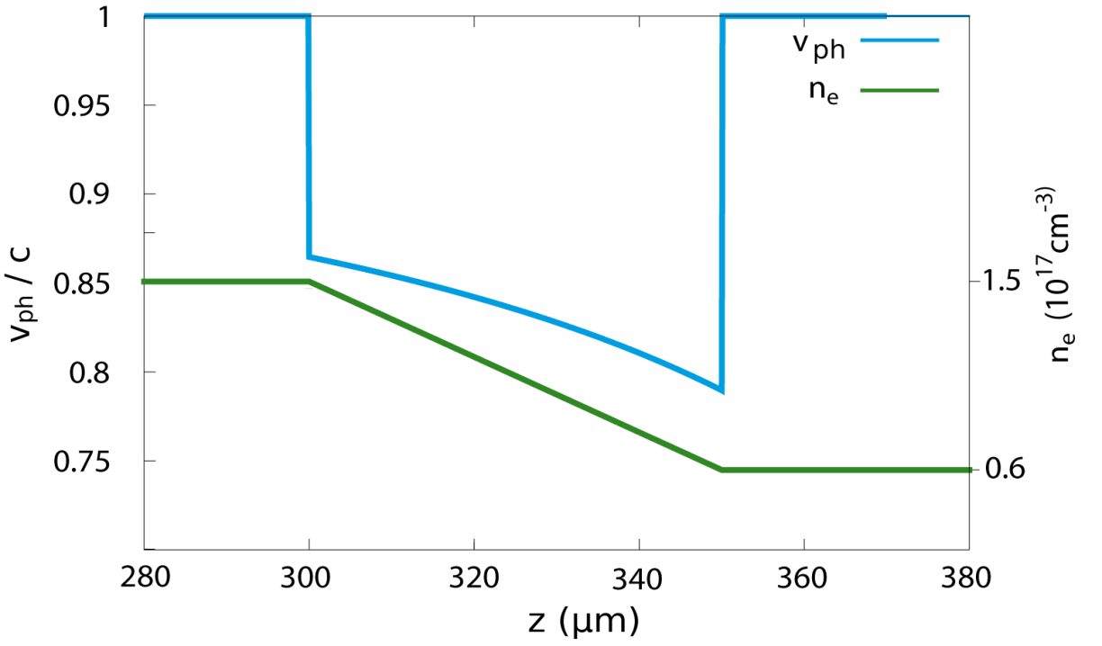
Downramp assisted underdense photocathode PWFA
Target:
Facilitate trapping for Trojan Horse PWFA
Open Up PWFA for low current e-beam facilites
Pave the way for an all-optical PWFA
Electron driver:
strong enough to drive a blowout
= 2.13
Too weak to trap electrons
Φ = -0.61 > -1
Peak current | 3 kA
rms width | 7 μm
rms length | 6 μm
Charge | 150 pC
Phase velocity
decreased on downramp
Trapping condition
depends on phase velocity
A. Knetsch et al. To be submitted
A. Knetsch | October 6th 2014 | LAOLA Meeting Wismar 2014

Slide 5
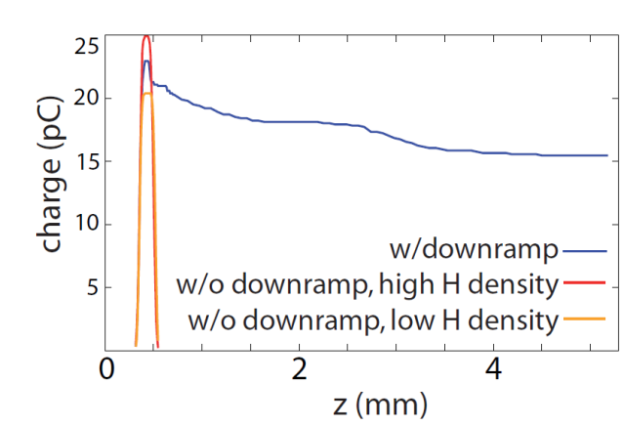
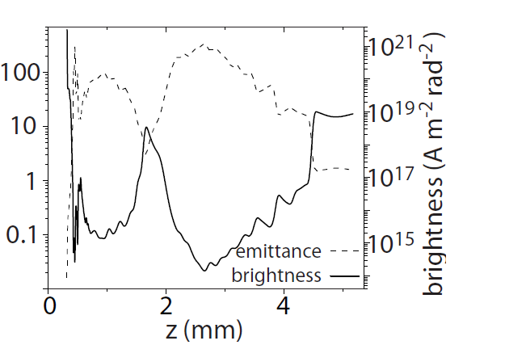
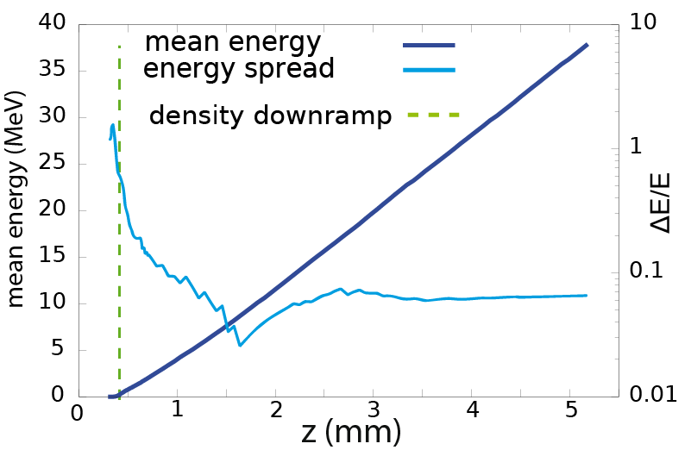
Downramp assisted underdense photocathode PWFA
No trapping possible before… …and after the downramp…
… but on the downramp
Wittness bunch properties
Low emittance
High brightness
Low energy spread
supressed dark current
Feasible with weak, low current driver beams

